Slide 1
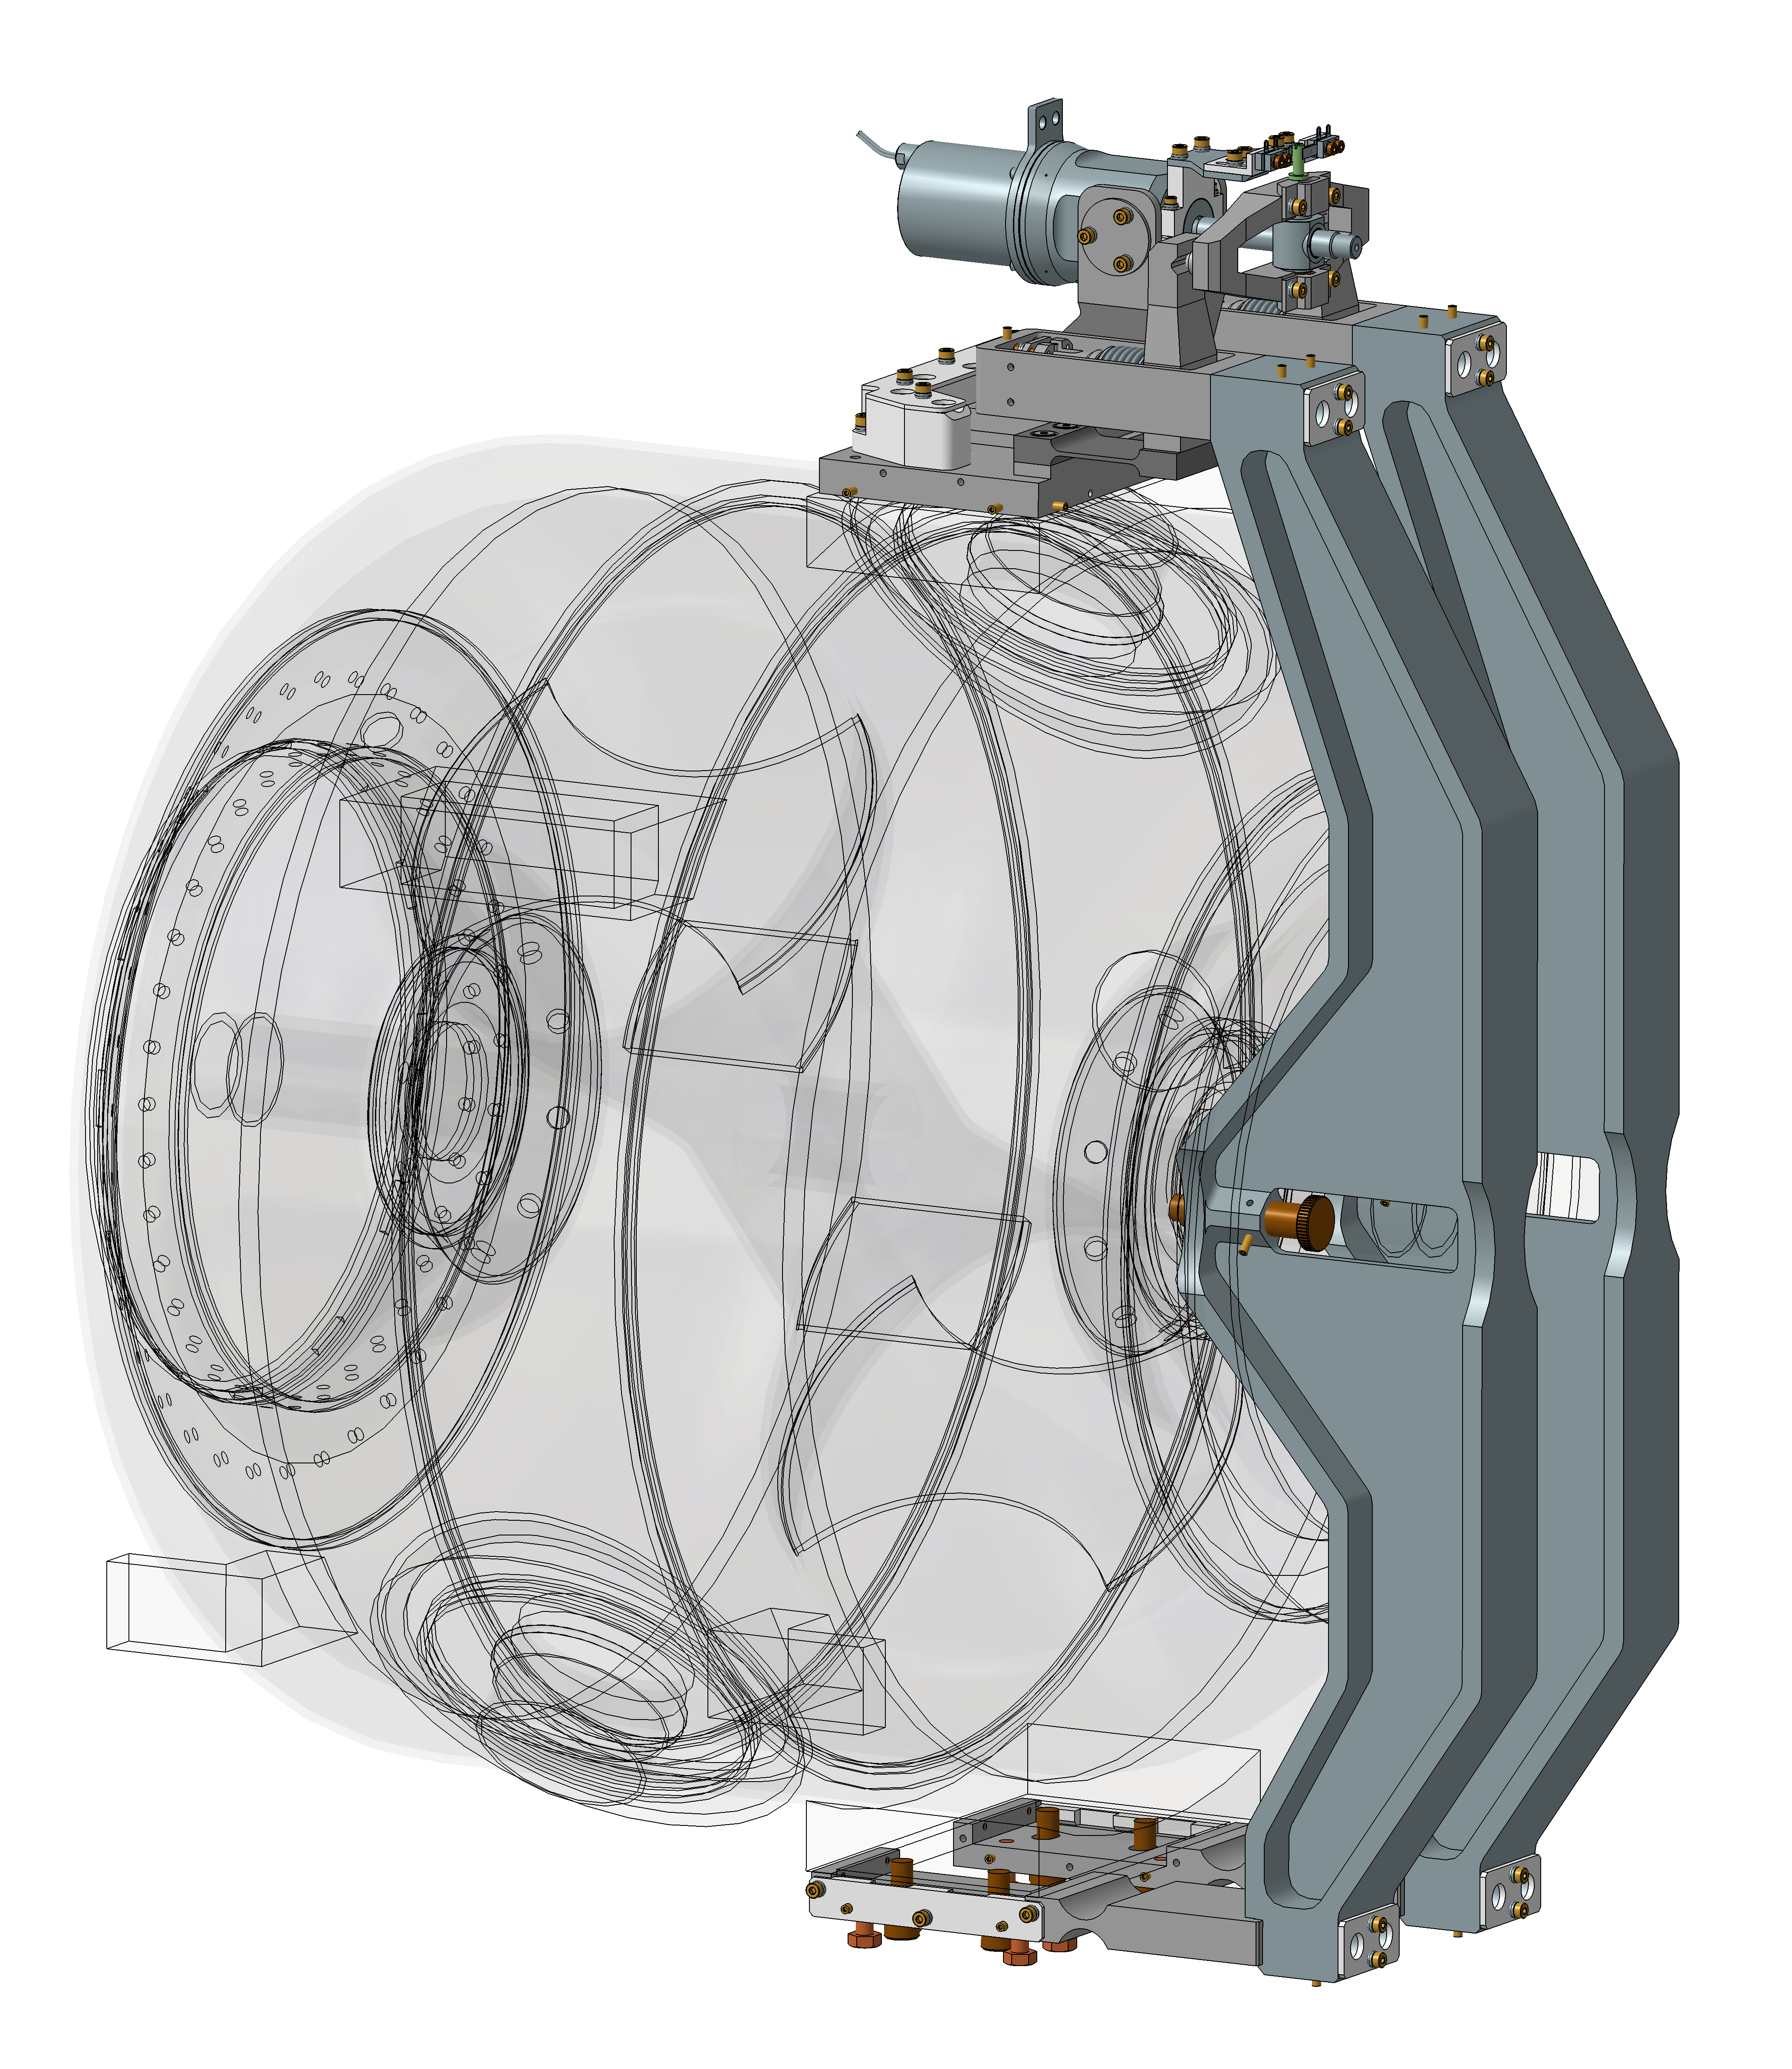
Motor cartridge tests plan
Motor cartridge tests plan
N. Gandolfo (IJCLab)
25th march 2020

Slide 2
Motor cartridge tests plan
Outline
Objectives
Available material
Focus on requirements
Measurements tools
Run structure

Slide 3
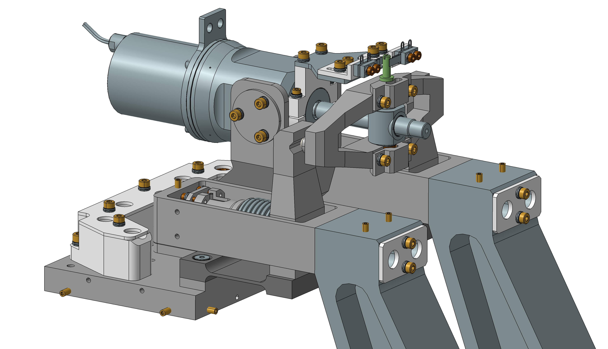
Objectives
Whole system accelerated lifetime test
  While main components such as piezo actuator and motor have been already extensively tested, the whole cartridge assembled, including bearings, flexible joints, mechanical structure, screws and spherical joints, is also subject to wear.
Long term operation (up to 12 months)
  The goal of the test is to reveal potential risks of failures of the motor cartridge, but also to give some predictions in order to improve the maintenance plan.
Main purpose of this presentation is to present the methodology used to define the lifetime test procedure.

Slide 4
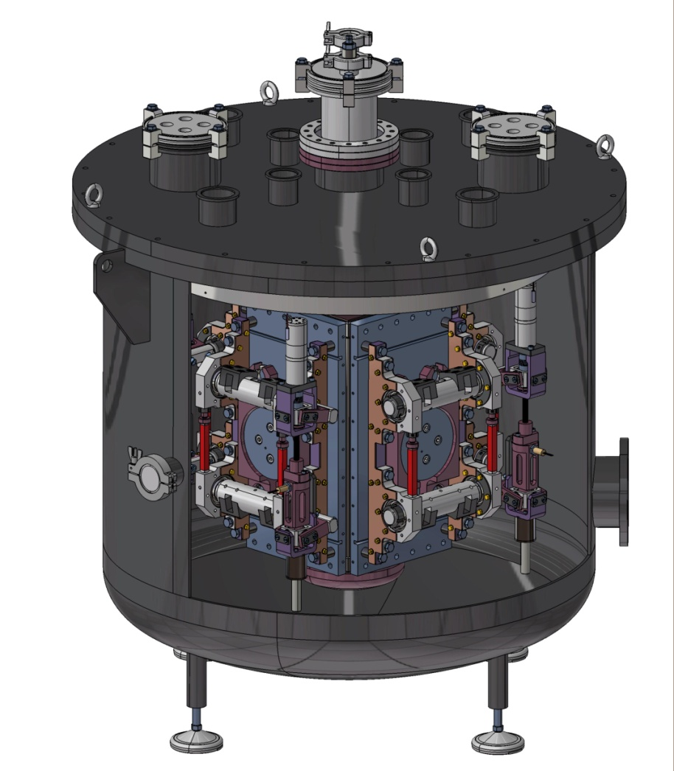
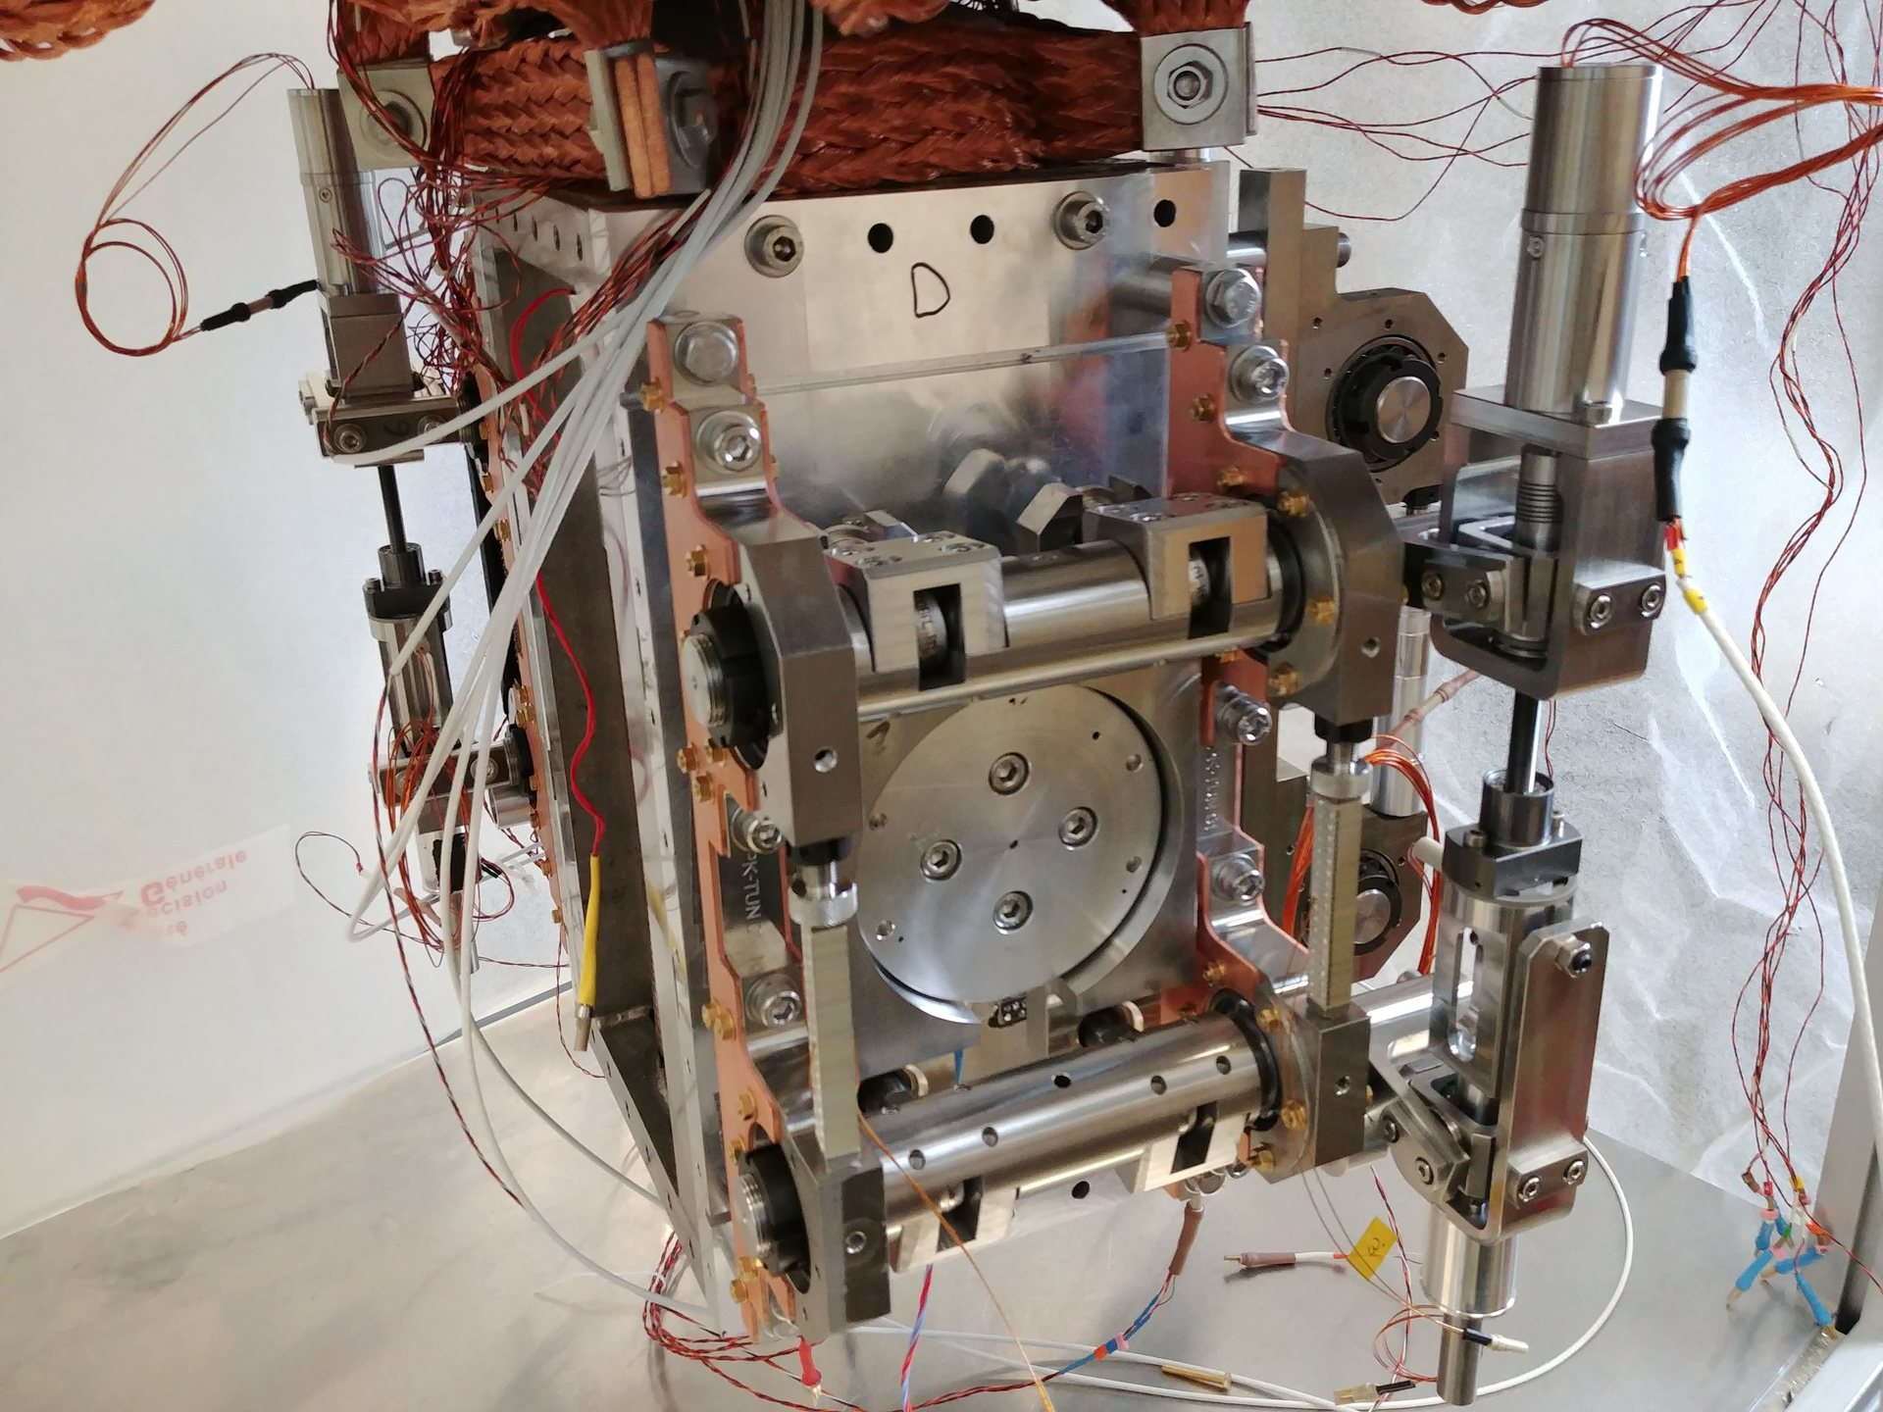
Available material
LN2 filling
LN2 Cryostat
  Built and used for tuner qualification and test for ESS and MYRRHA projects at IJCLab.
Up to 4 tuner systems
1 m
Insulation vacuum
ESS tuner during QC

Slide 5
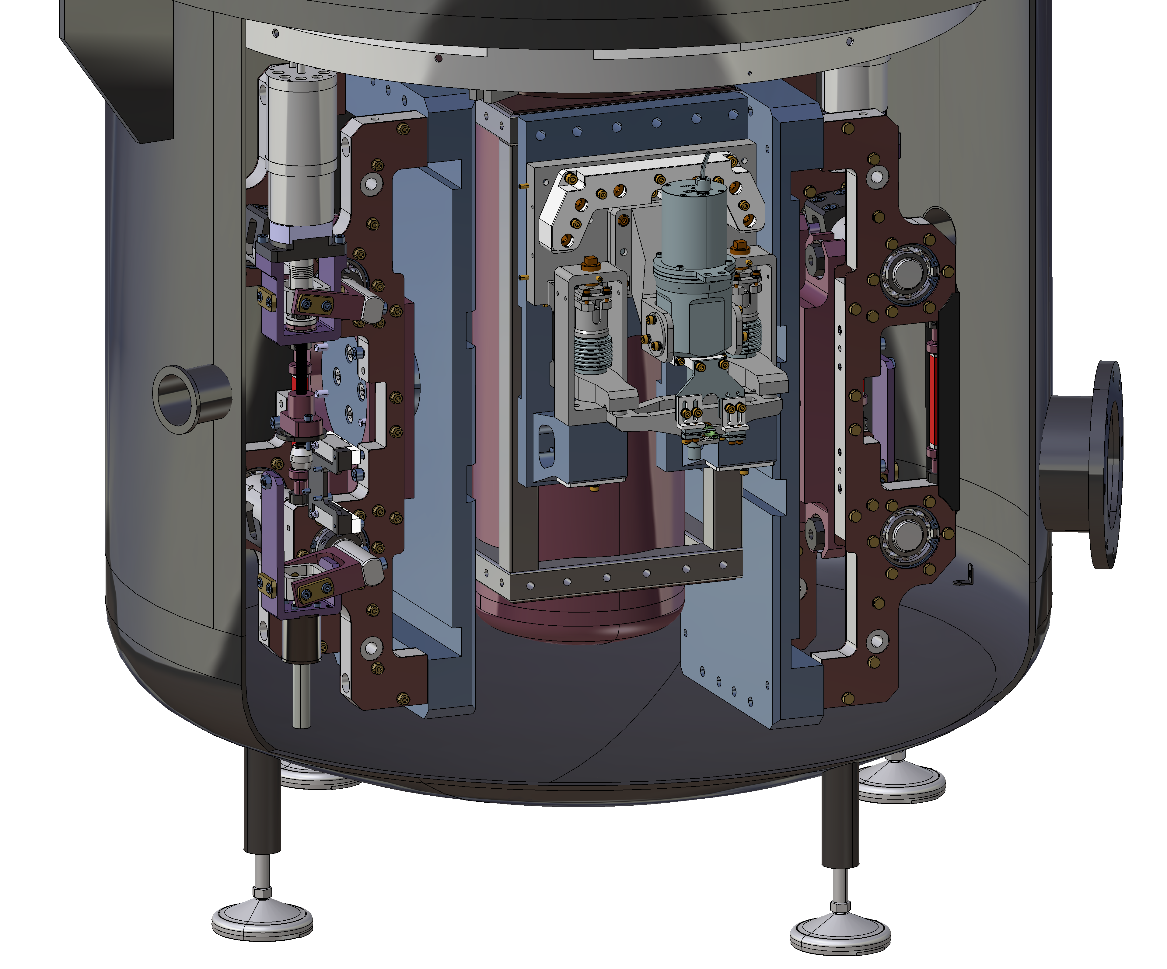
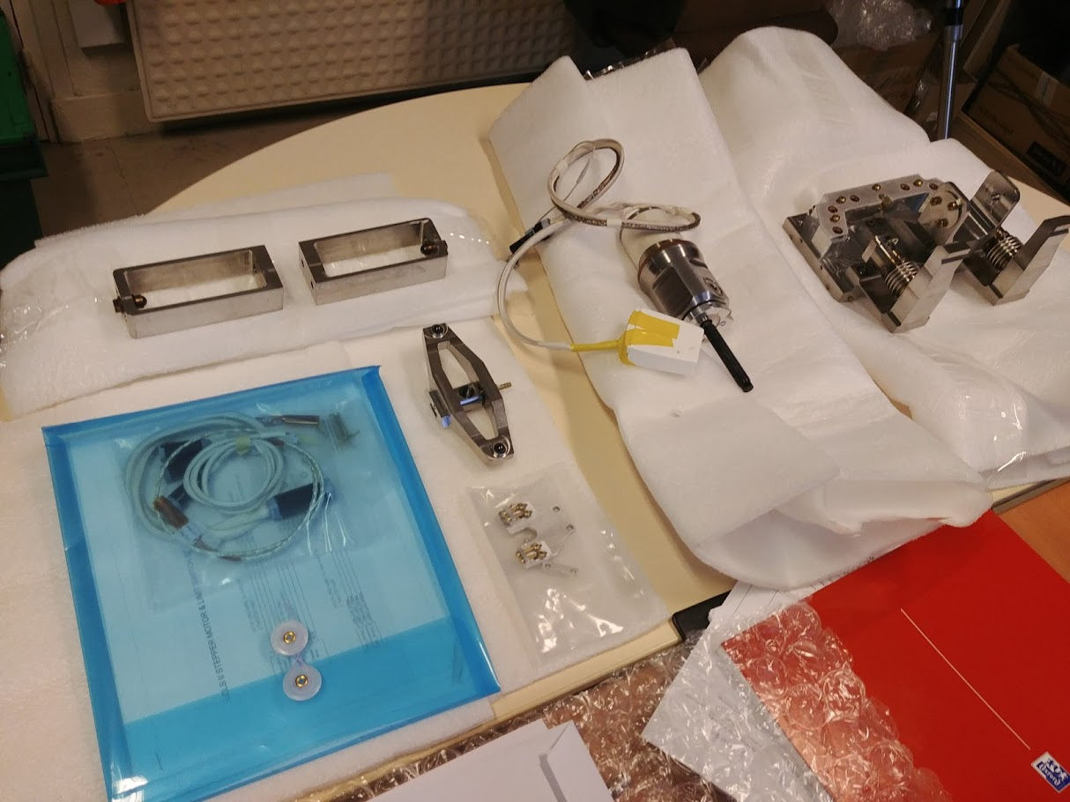
Available material
Motor Cartridge
LN2 Cryostat fit with Motor Cartridge
  Long term tests will be performed with two MYRRHA tuners.
  Motor cartridge is common for SSR1 and SSR2 tuner.
MYRRHA tuners (x2)
Motor cartridge package delivered at IJCLab

Slide 6
Tuner requirement (SSR2)
Mechanical parameters | Value
Tuner passive stiffness, kN/mm | ≥ 30
Tuner operating temperature (insulating vacuum), K | 10 - 60
Slow Tuner parameters | Value
Slow tuner frequency range, kHz | ≥ 130
Stepper motor resolution, Hz/step | < 9.5
Maximum force on the spindle system, N | 1300
Stepper motor maximum operation current, A | 1.2
Fast Tuner parameters | Value
Piezo tuner frequency range, Hz | ≥ 700
Piezo tuner frequency resolution, Hz | ≤ 0.5
Maximum operating force (each piezo capsule), N | 2000
Piezo actuator maximum operating voltage, V | 120
Lifetime parameters | Value
Tuner operation lifetime, year | 25
Maximum number of electromechanical actuator spindle rotations | 1250
Maximum number of piezo-electrical actuator control pulses | 8·10⁶
Maximum allowable radiation doze, Rad | 5·10⁹
Partially applicable (motor cartridge only)
Partially applicable (LN2 cryostat)
Indirectly applicable (no cavity)
Indirectly applicable (no cavity)
Applicable
Applicable
Indirectly applicable (no cavity)
Indirectly applicable (no cavity)
Applicable
Applicable
Applicable
Applicable
Applicable
Not applicable
Optionally, motor cartridge stiffness may be evaluated
Overall cartridge temperature should stabilize in the range of 90 ~ 120 K
Strain measurement (System assumption is required for Hertz conversion)
Force measurement
Driver is capable, not monitored
Strain measurement (System assumption is required for Hertz conversion)
Force measurement
Driver is capable, monitored
Accelerated lifetime test
Accelerated lifetime test
Require irradiations facility, nevertheless, every components were already radiation qualified.
1
2
1
3
Strain measurements to deploy + +
1
2
3

Slide 7
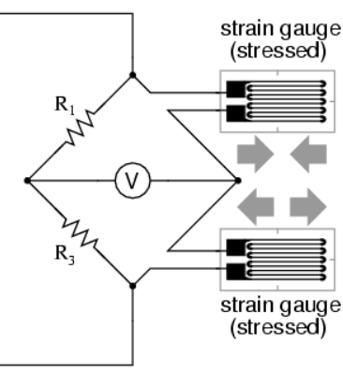
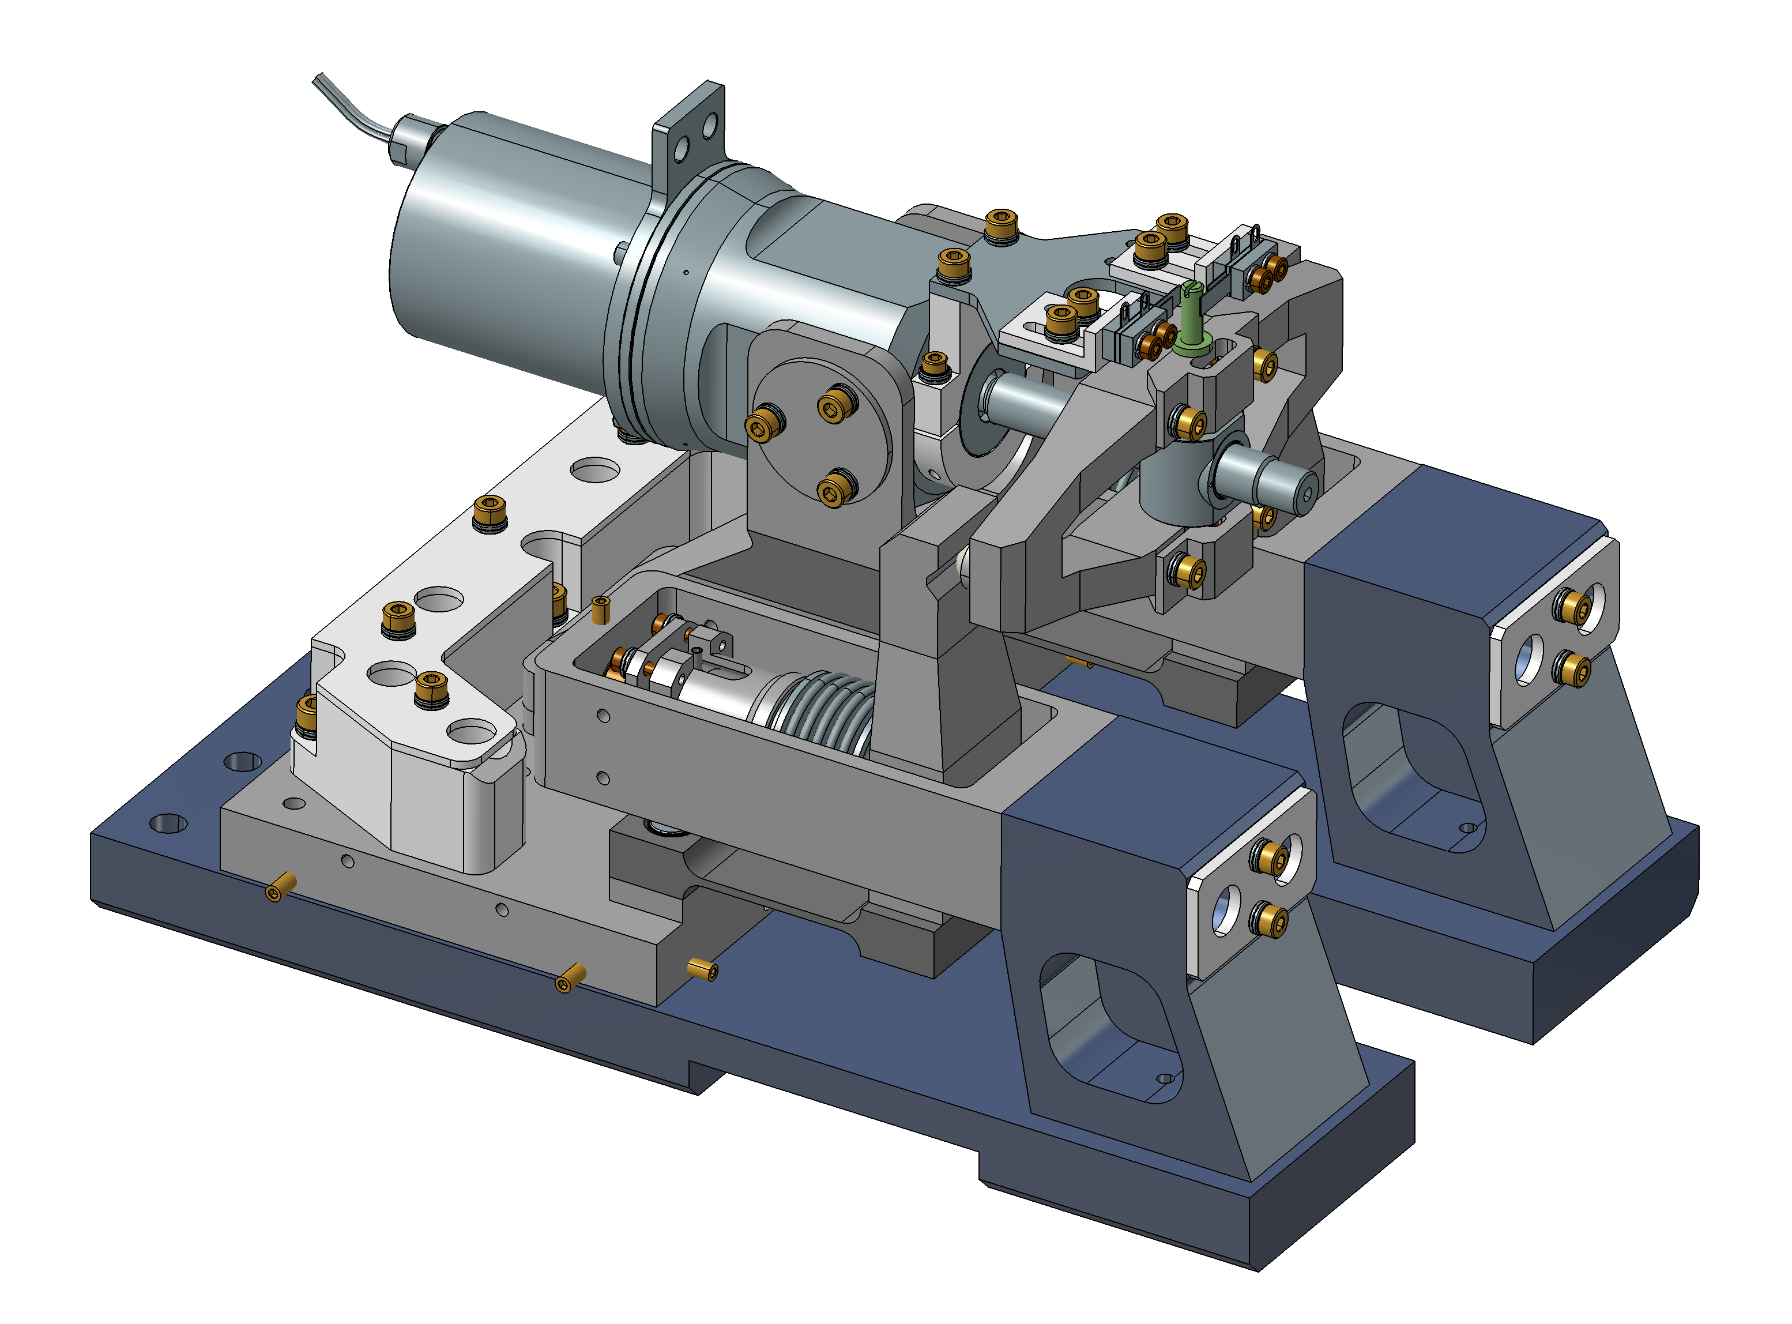
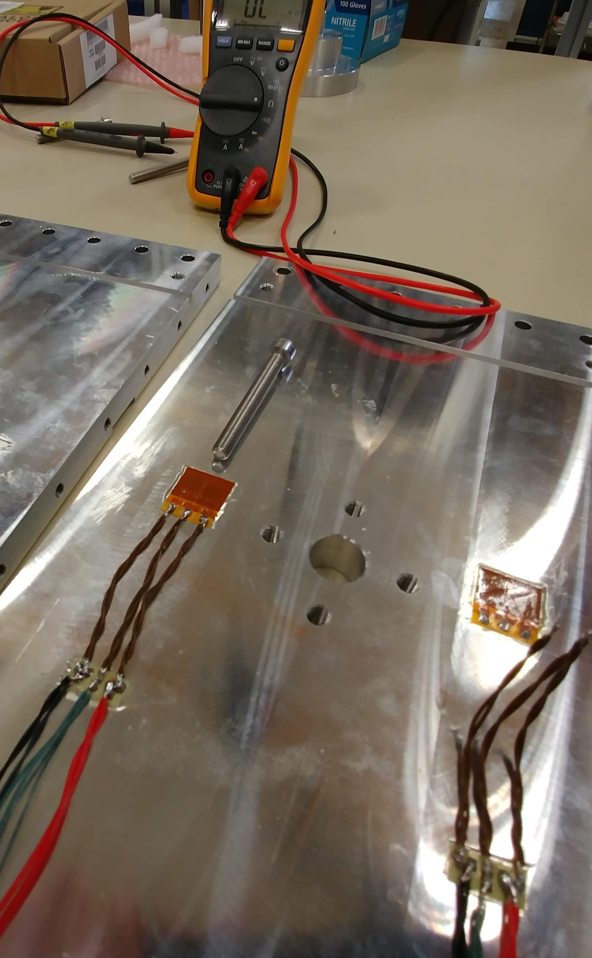
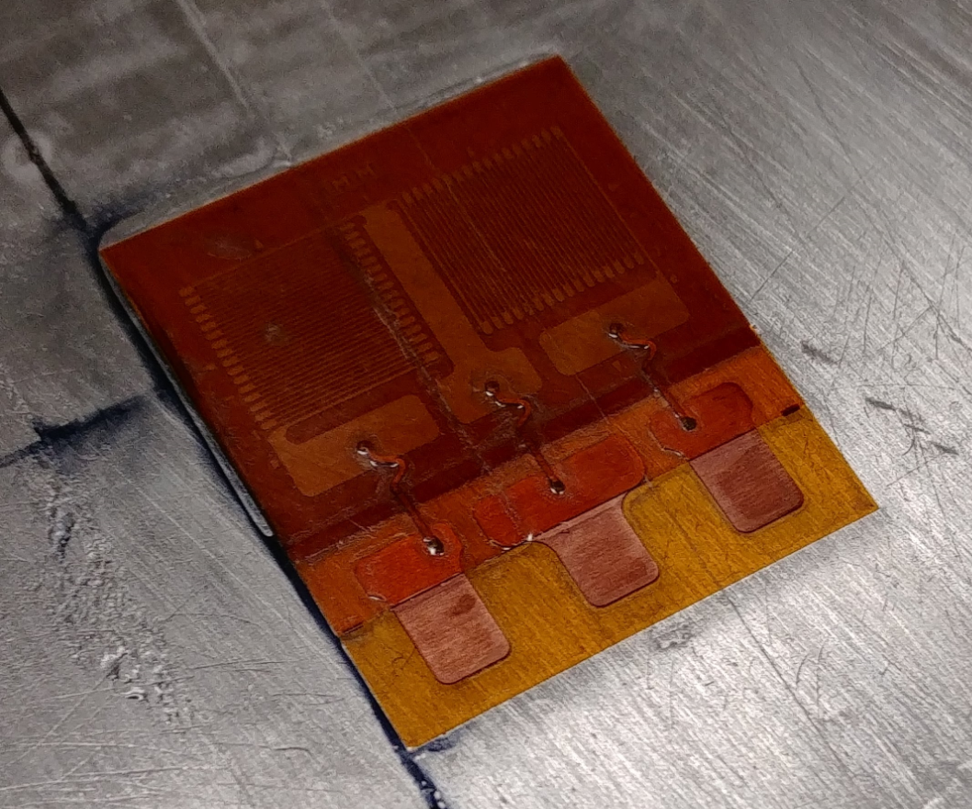
Strain measurements
Strain measurement to deploy
  Deformation sensor of the aluminum frame
  Deformation sensor on the spindle support (called “Pivoting lever”)
  Deformation sensor on the piezo frame (called “Connector”)
1
2
3
2
3
1
Dimensions : ~ 4 cm²
(down to mm²)
Strain gage example

Slide 8
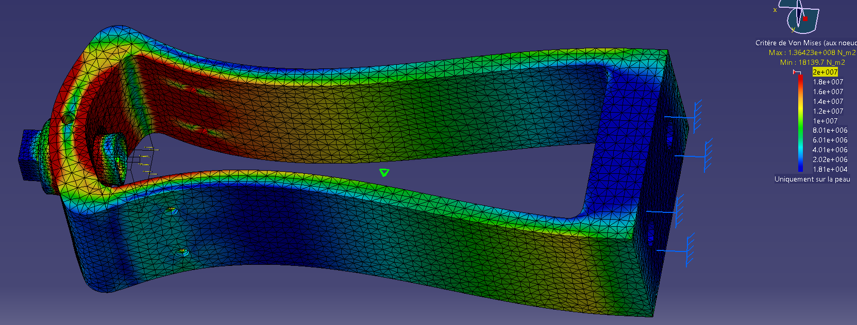
Strain measurements
Measurement grouping summary
  Deformation sensor of the aluminum frame
  Deformation sensor on the spindle support (called “Pivoting lever”)
  Deformation sensor on the piezo frame (called “Connector”)
1
2
3
Stress on the strain gage area : ~150 Mpa
2
1
Stress on the strain gage area : ~10 Mpa
Resulting strain : 5.2e-5
3
1
3
2

Slide 9
Other measurements not related to requirements
Non exhaustive list
  Temperatures
    Motor, piezo, structure…
  Motor start current
    Inform on the friction torque, linked to the mechanical wear
  Piezo electrical parameters
    Capacitance informs on the health of the actuators
  Vibration
    Mechanical resonance modes impact the control strategy during normal operation, they may evolve over time

Slide 10
Run structure
Accelerated lifetime test (ALT)
  Goal is to demonstrate the motor cartridge reliability by enduring the total amount of cycles expected for the machine lifetime.
  Bottom table summarize an example of working scenario divided into several phases that fits within one month period.
ALT Phases | Unit | Value | Main mode of failure expected | Comments
Phase 1 - Cooling | days | 4 |  | Include installation
Phase 2 - Endurance mode | days | 9 | Wearing / Fatigue | Long an fast back and forth on piezo and motor
Phase 3 - Regulation mode | days | 9 | Grinding/abrasion | Micro motion of piezo and motor that emulate regulation control
Phase 4 - Idle mode | days | 5 | Galling | Cartridge remains at max position (heavy static load) for long time
Phase 5 - Warming | days | 1
Phase 6 - Inspection | days | 2 |  | Visual inspection, screw torque control, maintenance..
Total : | days | 30

Slide 11
Run structure
Highly Accelerated lifetime test (HALT)
  Goal is to reveal potential weakness of the system by going far over the defined lifetime.
  A simple idea consist to duplicate the ALT (1 month) over the next 11 months, while continuously observing parameters evolution.
  By this way also, an opportunity appears to easily test the robustness to thermal shock of the system.
ALT #1
ALT #2
ALT #3
ALT #12
…
1 month
HALT 12 months

Slide 12
End.
Thanks, questions ?

