Slide 1
Update on SSR solenoid design
and upcoming FDR
Cristian Boffo, Stoyan Stoynev
Coordination meeting
25 March 2020

Slide 2
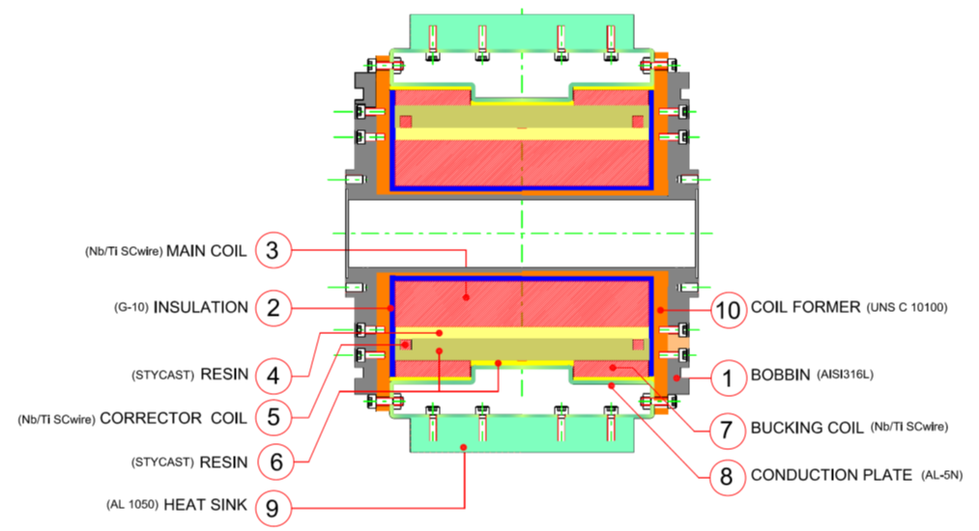
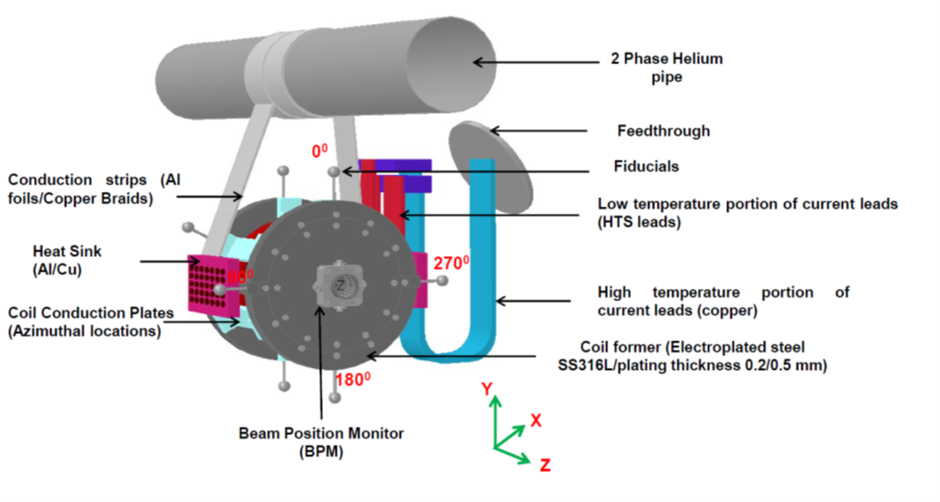
Design document draft
Sent by BARC more than a month ago
Discussed in meetings, feedback sent
Good quality work
Well advanced
There are open questions being addressed
Design concept and cross-section of conduction cooled SSR lens
(from the document)
Before sending an updated draft they asked a signed letter supporting the change of
delivery dates (see later; the letter is with Lia for the last ~10 days)

Slide 3
Interaction with BARC
BARC magnet 3D model received by FNAL
We made appropriate corrections (including some interface related) and sent the model back to BARC
Weekly meetings in addition to mail exchanges
They sent info by mail but we can only use Teamcenter for relevant data communication
The main input BARC need is interfaces and while documents are in the works we did exchange some information in meetings

Slide 4
Preparations for review
Indico page available (and populated:)
https://indico.fnal.gov/event/23501/
Preparation steps (some completed):
Finalize TRS. Awaiting inputs from Eduard [Stoyan, Cristian]
Write Charge, review agenda, reviewer list [Donato]
Approve charge, agenda, reviewers [Cristian/Genfa]
Update Indico page to reflect the agenda [Donato]
Generate TC# for the review [Donato]
Issue a zoom link and add it to Indico page [Stoyan]
Invite reviewers [Donato]
Send invitation to presenters and attendees [Donato]
Interface document [Vincent/Mattia]
QC plan for solenoids and e-travelers [Donato]
Testing plan [Stoyan?]
Acceptance criteria [Stoyan, Cristian]
Facilitate the integration of the 3D model in the string assembly/CM [Aravind]
At BARC [Stoyan to coordinate/facilitate the communication]
Finalize design
Design report (mechanical and electromagnetic design)
Fabrication plan and intermediate controls
Final tests before shipping
Shipping plan

Slide 5
Projected delays
The world situation (in USA and India included) will bring delays
There is work that can still be done while Labs a closed (most FNAL people can work from home) but a lot of the work, especially at BARC, requires physical presence
So far we were aiming at April 2020 for “warm” magnets delivery
April 2021 for the “cold” magnets delivery coupled with April 2020 FDR
Each day delay from now on adds the same delay to the schedules

