Slide 1
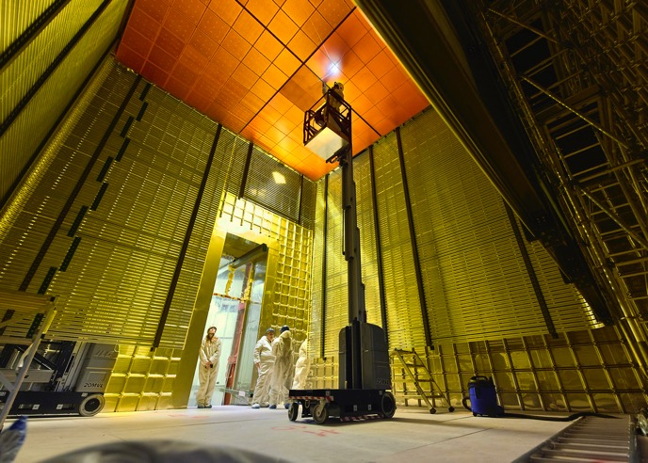
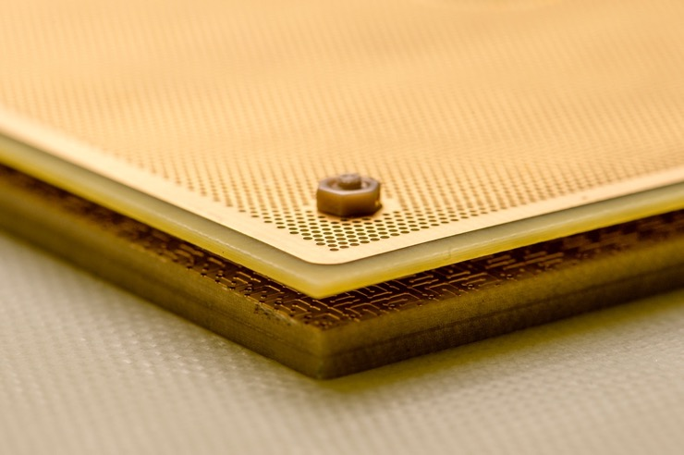
R&D on LEM improvements
for phase II of ProtoDUNE-DP
E. Mazzucato, A. Delbart, G. Eurin, P. Granger, M. Karolak
(CEA/Irfu, Université Paris-Saclay)
R. De Oliveira (CERN/EP-DT-EF (MPT lab.))
Alain Delbart, R&D on LEM for phase II of ProtoDUNE-DP, LEM, Workshop on the LEM/Thick GEM cryogenic utilization in pure Argon over large detection surfaces, 6-7th april, 2020

Slide 2
outline
Where we are with LEM performances in ProtoDUNE-DP
R&D on improvements of the LEM manufacturing & design
Improved CERN RIM etching process
Covering copper-FR4 LEM borders with an insulating layer
Full size single-sided DLC resistive LEM
Covering RIM edges with an insulating ring ?
Discussion on other ways of improvements for ProtoDUNE Phase II
Alain Delbart, R&D on LEM for phase II of ProtoDUNE-DP, LEM, Workshop on the LEM/Thick GEM cryogenic utilization in pure Argon over large detection surfaces, 6-7th april, 2020
2

Slide 3
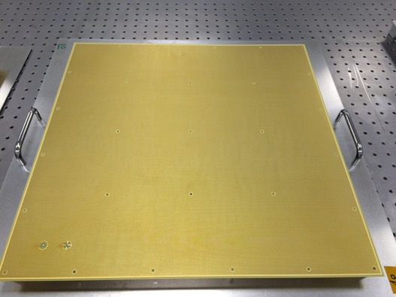
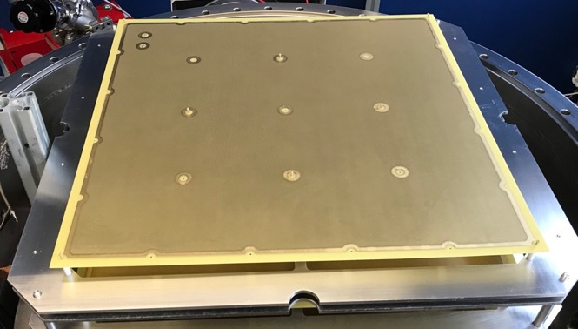
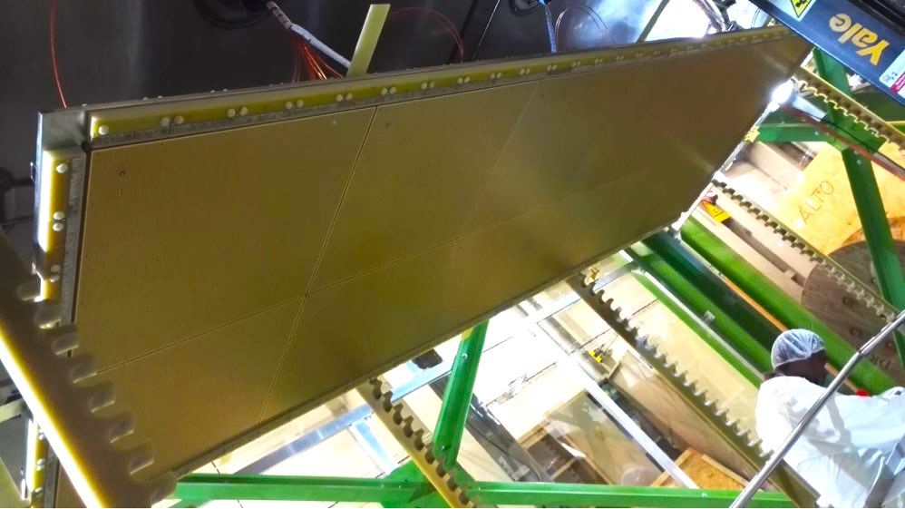
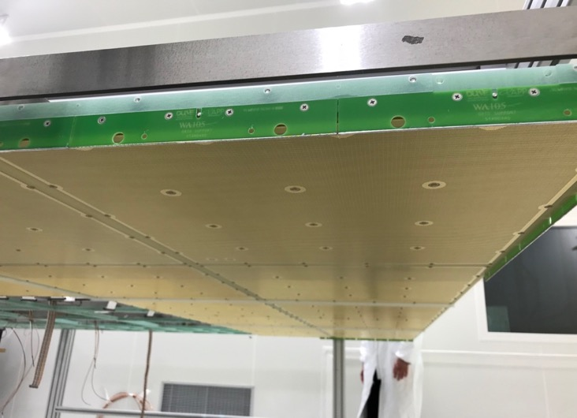
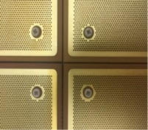
Reminder : where we are
CFR-34 – 3x1x1 m³
CFR-35 – NP02
3 m
LEM CFR-34
(96% active area)
3 m
50 cm
LEM CFR-35
(85% active area)
3 m
50 cm
2 mm FR4 + 2 mm coper
Alain Delbart, R&D on LEM for phase II of ProtoDUNE-DP, LEM, Workshop on the LEM/Thick GEM cryogenic utilization in pure Argon over large detection surfaces, 6-7th april, 2020
3

Slide 4
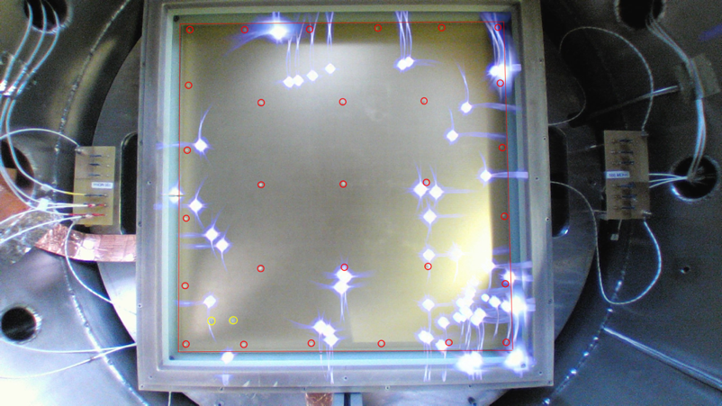
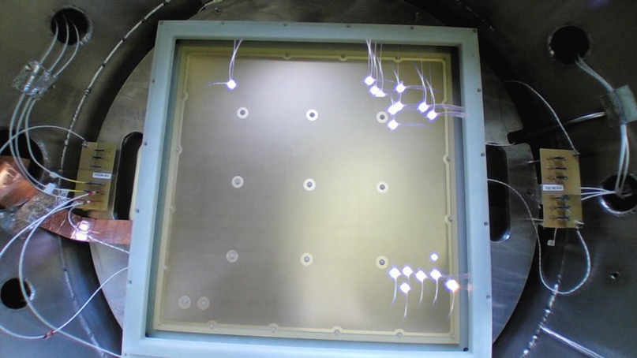
LEM performances
CFR-34 – 3x1x1 m³
CFR-35 – NP02
ΔV_{LEM} = 3.3-3.5 kV in Ar @ 3.3 bar
ΔV_{LEM} = 3.5 kV in Ar @ 3.3 bar
multiple
sparks
- 31 kV/cm max amplification field in 3x1x1
32 kV/cm for single LEM in 3,3 bar Ar
- Max gain ~20 before charging up
- spark rate: ∼20/h @ 34-35 kV/cm (3,3 bar Ar)
> 45% sparks on edges or corners
- 95% active area
- 34 kV/cm max amplification field in NP02
35 kV/cm for single LEM in 3,3 bar Ar
- max gain ~ 100 in DLAr before charging up
- spark rate: ∼3/h @ 35 kV/cm(3,3 bar Ar)
- sparks are no more stimulated on borders
- 86% active area
Alain Delbart, R&D on LEM for phase II of ProtoDUNE-DP, LEM, Workshop on the LEM/Thick GEM cryogenic utilization in pure Argon over large detection surfaces, 6-7th april, 2020
4

Slide 5
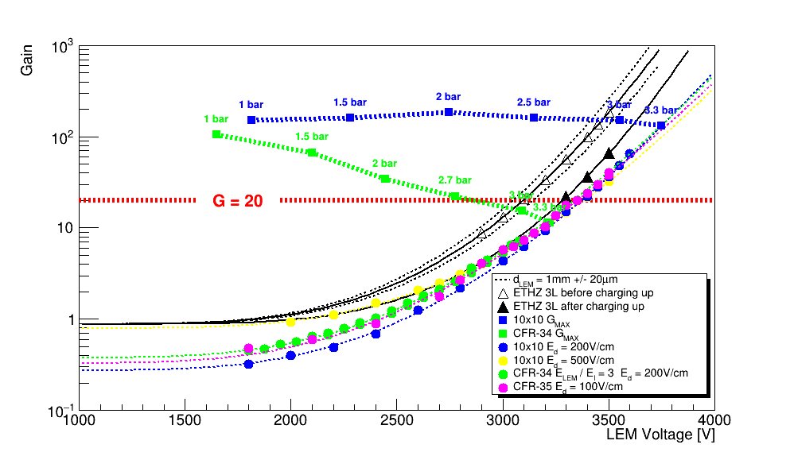
LEM for ProtoDUNE-DP challenge
G_{eff}=20 with <5% dead zone out of the 9 m² CRP area (~3,1 kV before charging-up)
With a long term stability <1 spark / h / CRP (=1/36 per LEM)
Max 34kV/cm
NP02 (CFR-35)
Max 32kV/cm
3x1x1 m³ (CFR-34)
G_{eff} = ε_{extraction} x G_{LEM} x ε_{coll}
~3,3 bar Ar
(same gas density
as DLAr)
ΔV
Alain Delbart, R&D on LEM for phase II of ProtoDUNE-DP, LEM, Workshop on the LEM/Thick GEM cryogenic utilization in pure Argon over large detection surfaces, 6-7th april, 2020
5

Slide 6
Ways of improvements of the LEM
LEM paremeters : increase thickness, decrease number of holes ? Other parameters to optimize ? Different RIM size on the 2 sides ? (see P. Correia’s talk)
Global quality of holes’ drilling & RIM etching locally affecting electric field
With a 40 μm RIM, can an even more smooth RIM edge help ?
Improve RIM etching (etching defects for holes on borders and corners)
Other improvement in the manufacturing procedure ?
Covering of the RIM copper edges with an insulating layer
How to set-up the burn-in procedure to remove residual copper asperities ?
Electric field increase on LEM borders & in the holes close to the borders/corners
Larger holes on the first few rows of holes from the border ?
LEM active area segmentation ?
Optimize the FR4 & copper guard rings dimensions on borders/corners
Covering of the copper edges with an insulator layer
Other ideas ? Resistive LEM, multi-LEMs, …
→ The R&D requires testing long term operation stability & ageing, both with individual LEMs in laboratory (3,3 bar argon) and with large area (> 4 LEMs) in DLAr conditions (« cold box »)
Alain Delbart, R&D on LEM for phase II of ProtoDUNE-DP, LEM, Workshop on the LEM/Thick GEM cryogenic utilization in pure Argon over large detection surfaces, 6-7th april, 2020
6

Slide 7
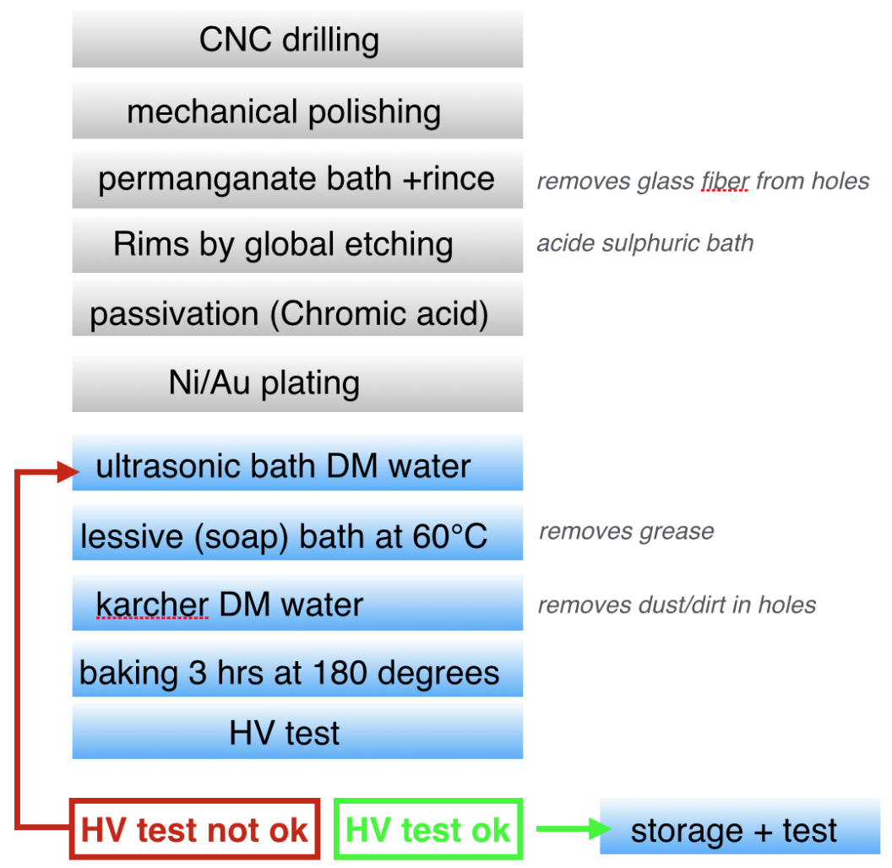
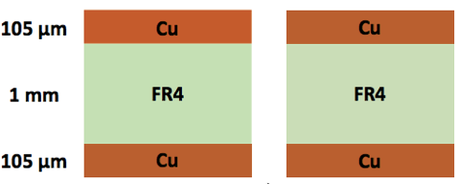
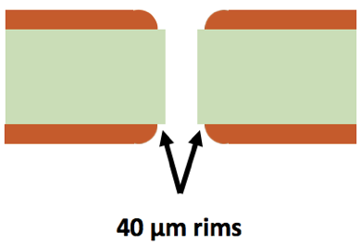
LEM manufacturing & QA/QC
« standard »
global RIM micro-etching (CERN-ELTOS)
Change drills every 1000 holes
Drilling of stack of PCBs is forbidden
with pumice powder
4 steps (+/- 90°, top/bottom)
Φ500 μm hole
By LEM manufacturer
3 mn Ultrasonic bath in 65°C NGL 17.40 ALU
By WA105
Karcher Normal + DM water
65 μm
3h Baking @ 80°C
+ final 160 °C polymerization
1 mm
HV test synth. Air & 3,3 bar Ar
65 μm
Alain Delbart, R&D on LEM for phase II of ProtoDUNE-DP, LEM, Workshop on the LEM/Thick GEM cryogenic utilization in pure Argon over large detection surfaces, 6-7th april, 2020
7

Slide 8
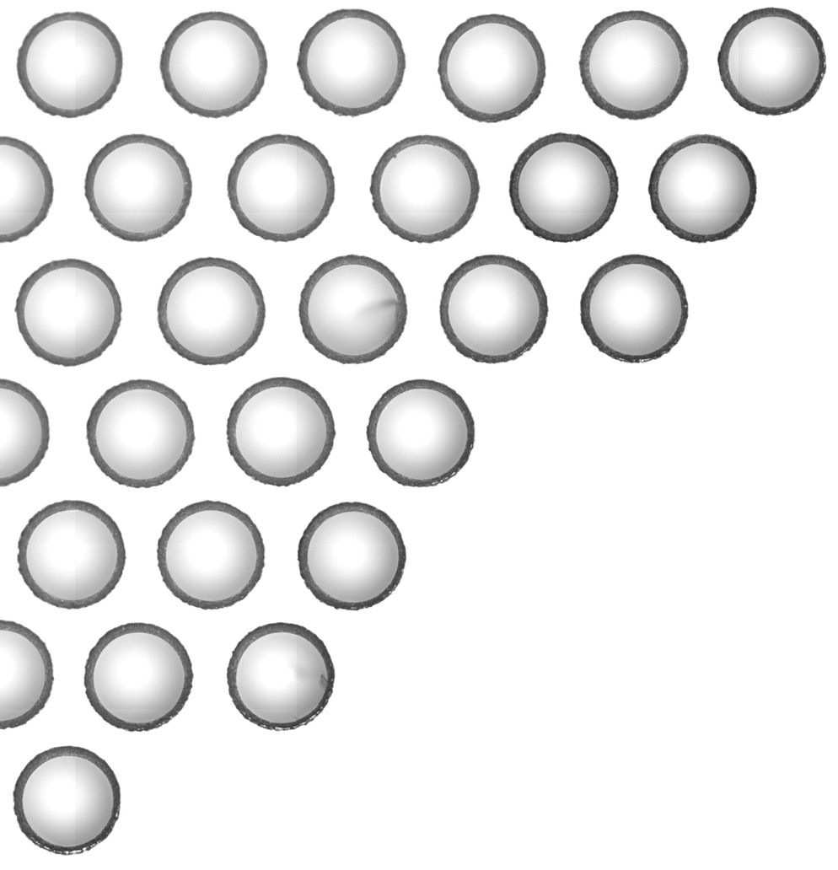
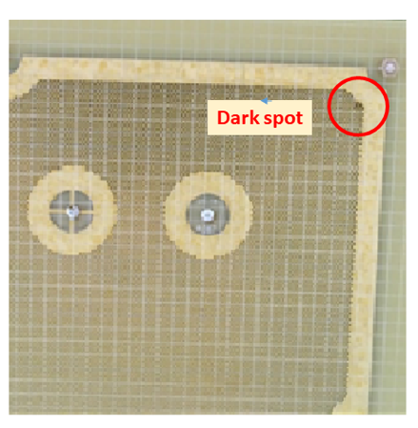
Global etching defects on borders
LEM corner
Decentered RIM
with
copper residues
→ New RIM etching process developped by CERN
Alain Delbart, R&D on LEM for phase II of ProtoDUNE-DP, LEM, Workshop on the LEM/Thick GEM cryogenic utilization in pure Argon over large detection surfaces, 6-7th april, 2020
8

Slide 9
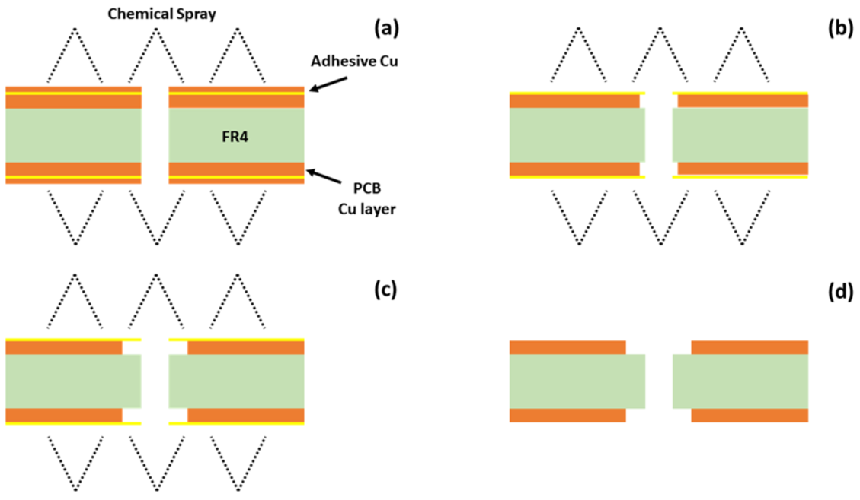
New RIM etching process
CERN/EP-DT-EF (MPT lab.)
LEM copper surfaces protected with thin adhesive copper foils before drilling.
Micro-etching only around holes, visible through transparent glue to control RIM
Copper thickness is not etched
4 x CFR-35 prototypes produced : CERN LEM #1 to #5 made with 0,92-0,93 mm thick FR4
~15 μm
35 μm
35 μm
1 mm
1 mm
35 μm
35 μm
35 μm
35 μm
Measured
0,92-0,93 mm
1 mm
1 mm
35 μm
35 μm
Alain Delbart, R&D on LEM for phase II of ProtoDUNE-DP, LEM, Workshop on the LEM/Thick GEM cryogenic utilization in pure Argon over large detection surfaces, 6-7th april, 2020
9

Slide 10
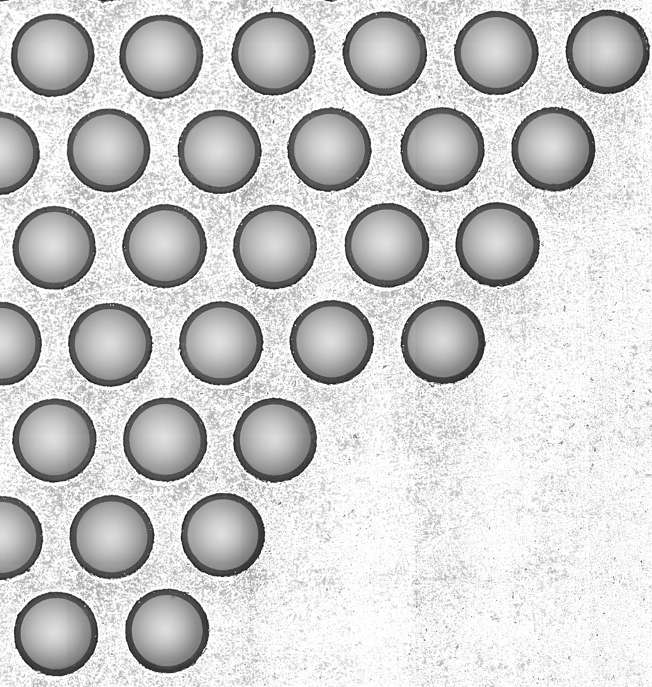
New RIM etching process Improved RIM quality
LEM corner
CERN LEM #5
New RIM etching process to be used for future productions
Can and have to be transfered to industrials
Alain Delbart, R&D on LEM for phase II of ProtoDUNE-DP, LEM, Workshop on the LEM/Thick GEM cryogenic utilization in pure Argon over large detection surfaces, 6-7th april, 2020
10

Slide 11
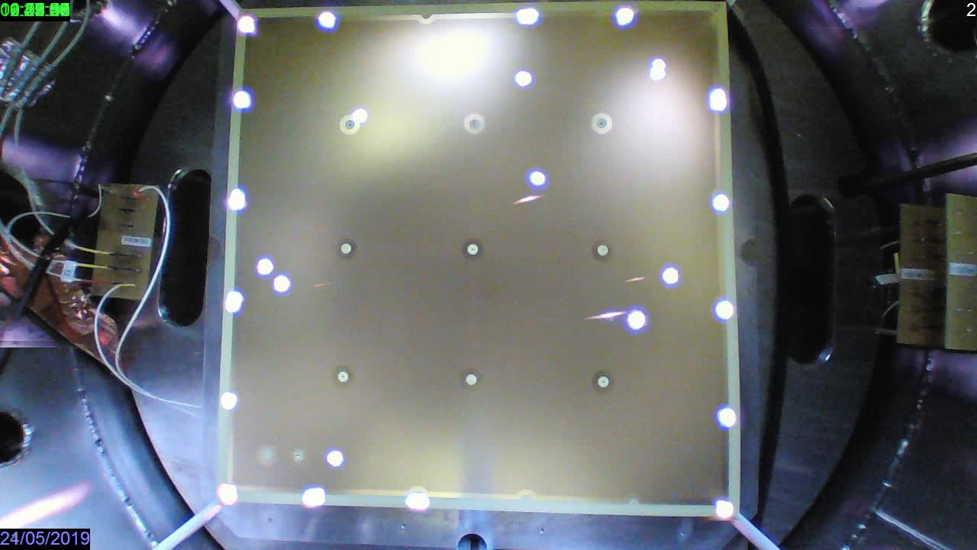
CFR-35 CERN LEM #5
New sparks located in vicinity of screw holes
Possible explanation : the RIM global etching process naturally smoothed copper edges
whereas the new CERN RIM etching process left sharp the edges of copper guard ring.
Alain Delbart, R&D on LEM for phase II of ProtoDUNE-DP, LEM, Workshop on the LEM/Thick GEM cryogenic utilization in pure Argon over large detection surfaces, 6-7th april, 2020
11

Slide 12
CFR-35 CERN LEM #5
New sparks located in vicinity of screw holes
Original CFR-35 & CERN LEM with new rim etching
Sparks
Modified CFR-35 copper edges
Modified CFR-35 copper edges + 64 μm pyralux PC1025 to cover LEM boders
Alain Delbart, R&D on LEM for phase II of ProtoDUNE-DP, LEM, Workshop on the LEM/Thick GEM cryogenic utilization in pure Argon over large detection surfaces, 6-7th april, 2020
12

Slide 13
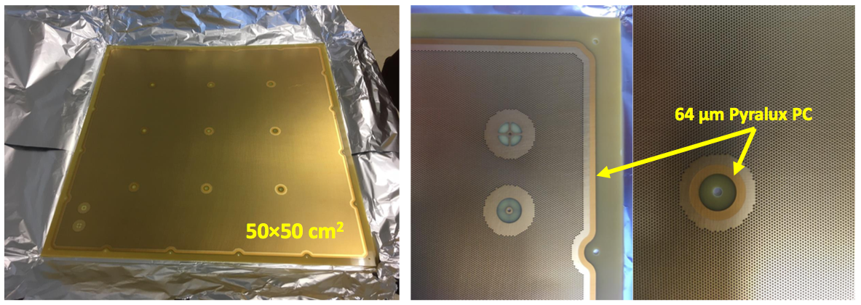
CERN CFR-35 + pyralux
This should improve HV stability by insulating areas where E-field is high (edges, corners, boundary regions).
Use CERN improved RIM micro-etching process → 35 μm copper thick
2 prototypes produced @ CERN : CERN CFR-35 + pyralux #1 & 2
Alain Delbart, R&D on LEM for phase II of ProtoDUNE-DP, LEM, Workshop on the LEM/Thick GEM cryogenic utilization in pure Argon over large detection surfaces, 6-7th april, 2020
13

Slide 14
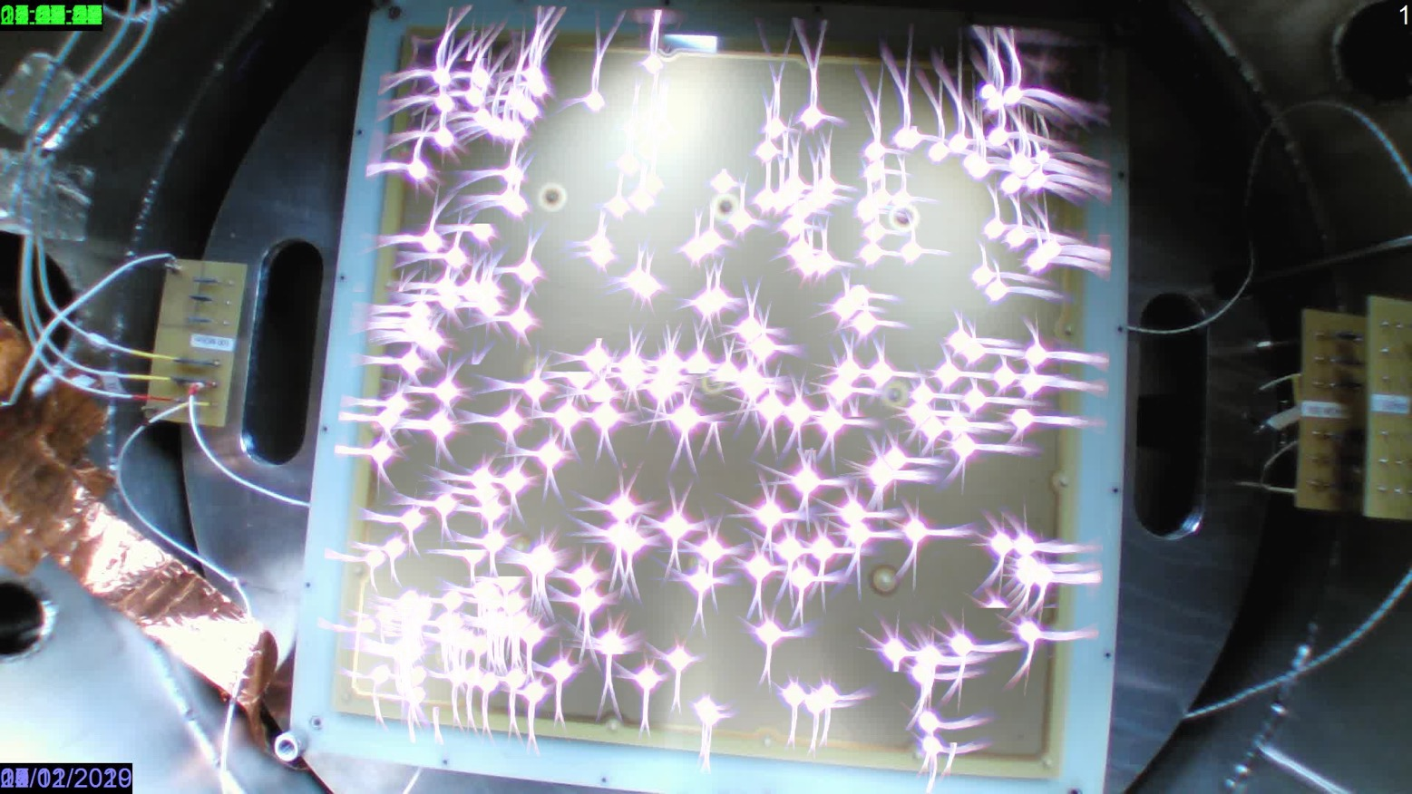
First new CFR-35 + pyralux #1
Localization of sparks
Several weeks of operation & spark recording : no more sparks on insulated areas & border holes
Ar 3,3 bar
LEM HV
2,8-3,2 kV
Alain Delbart, R&D on LEM for phase II of ProtoDUNE-DP, LEM, Workshop on the LEM/Thick GEM cryogenic utilization in pure Argon over large detection surfaces, 6-7th april, 2020
14

Slide 15
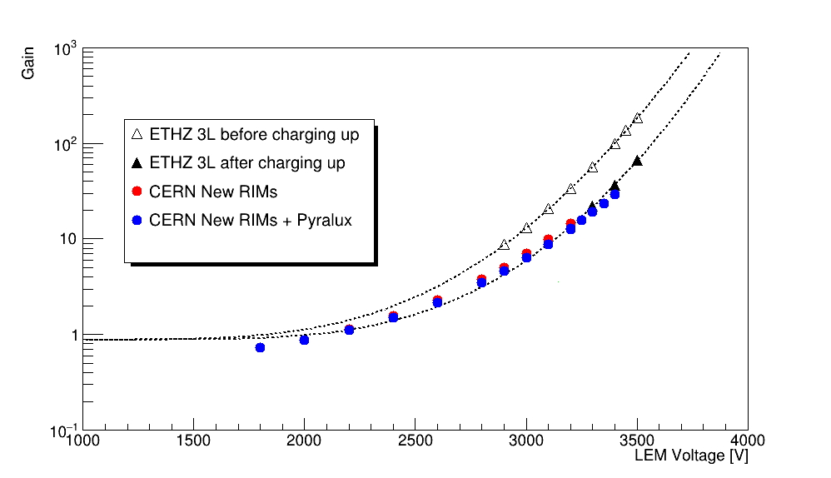
New CERN LEMs Gain measurements
In 3,3 bar Argon, with E_{d}=500 V/cm for CERN New RIMs prototypes
With same measurement protocol in HP chamber as for CFR-35 gain measurements
Ar 3,3 bar
LEM HV
2,8-3,2 kV
20
#1
ΔV
Alain Delbart, R&D on LEM for phase II of ProtoDUNE-DP, LEM, Workshop on the LEM/Thick GEM cryogenic utilization in pure Argon over large detection surfaces, 6-7th april, 2020
15

Slide 16
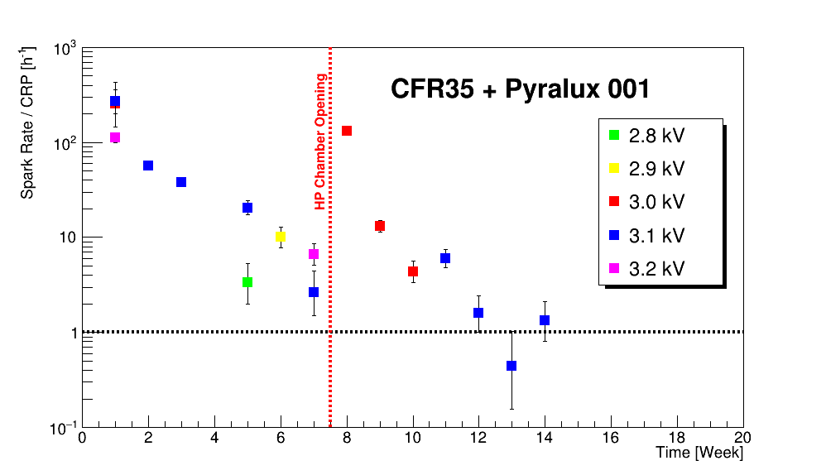
First LEM CFR-35 + pyralux borders
Spark rate over 14 weeks of operation in 3,3 bar
Spark monitoring with cathode mesh + LEM + grounded anode in NP02 Electric Field configuration
LEM ΔV
1 sp/h/CRP goal at 3,1 kV
Burn-in/ageing ?
Alain Delbart, R&D on LEM for phase II of ProtoDUNE-DP, LEM, Workshop on the LEM/Thick GEM cryogenic utilization in pure Argon over large detection surfaces, 6-7th april, 2020
16

Slide 17
First try of single-sided DLC-resistive LEM
Raw materials
50 μm APICAL + “standard” DLC
~250 MΩ/sq.
1 mm (measured : 0,92-0,93 mm)
PCB
35 μm copper
Glue the 2 parts with prepreg
150 μm glue
DLC-resistive LEM
Drilling like a THGEM
NO RIM etching
no RIM on copper side, no Ni/Au plating
Alain Delbart, R&D on LEM for phase II of ProtoDUNE-DP, LEM, Workshop on the LEM/Thick GEM cryogenic utilization in pure Argon over large detection surfaces, 6-7th april, 2020
17

Slide 18
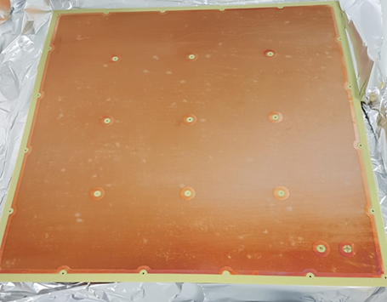
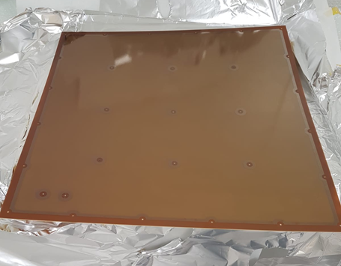
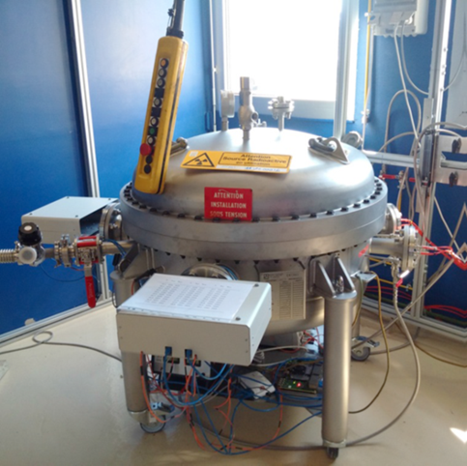
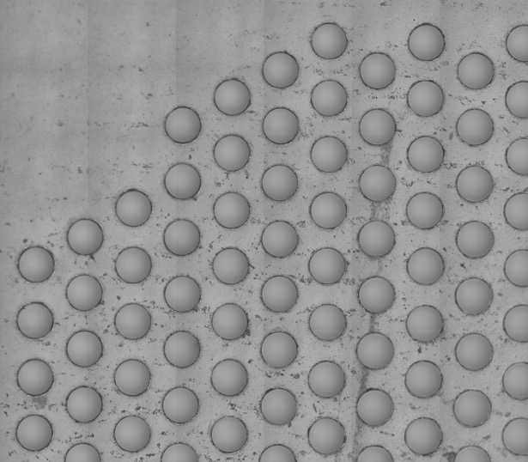
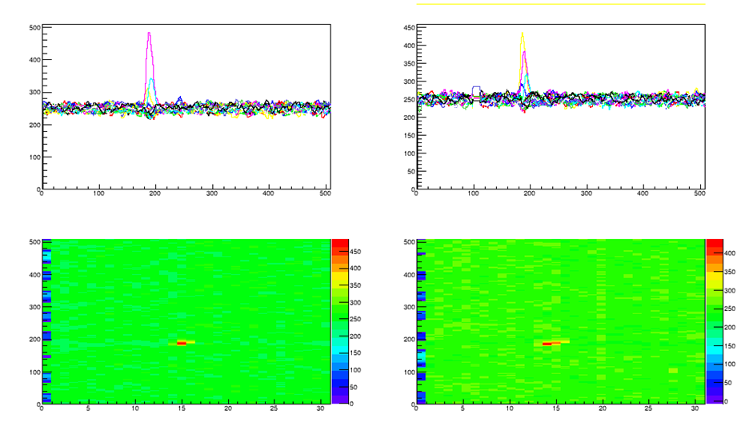
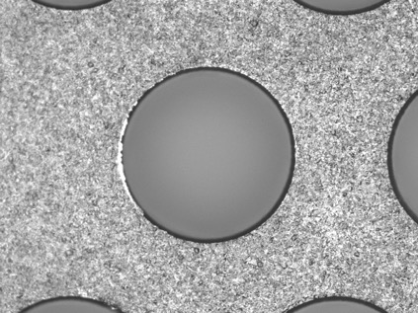
Single-sided DLC Resistive LEM CFR-35 full size prototype
HP chamber
Copper face
DLC face
DLC side
Tests with ²⁴¹Am source in Ar @ 3.3 bar
CU side
Signal from 5.5 MeV alpha
Alain Delbart, R&D on LEM for phase II of ProtoDUNE-DP, LEM, Workshop on the LEM/Thick GEM cryogenic utilization in pure Argon over large detection surfaces, 6-7th april, 2020
18

Slide 19
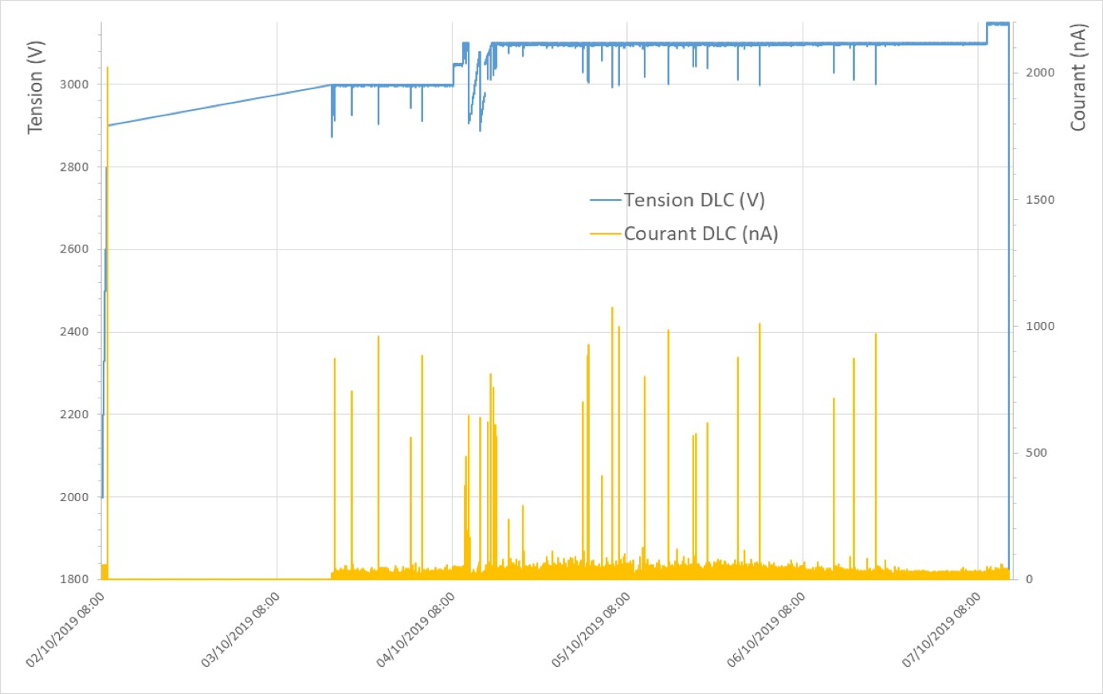
Single-sided DLC-Resistive LEM first week of operation in 3,3 bar Ar
DLC PS supply
current limit
LEM ΔV
Sparks ? with no OVC
<100 nA current
Alain Delbart, R&D on LEM for phase II of ProtoDUNE-DP, LEM, Workshop on the LEM/Thick GEM cryogenic utilization in pure Argon over large detection surfaces, 6-7th april, 2020
19

Slide 20
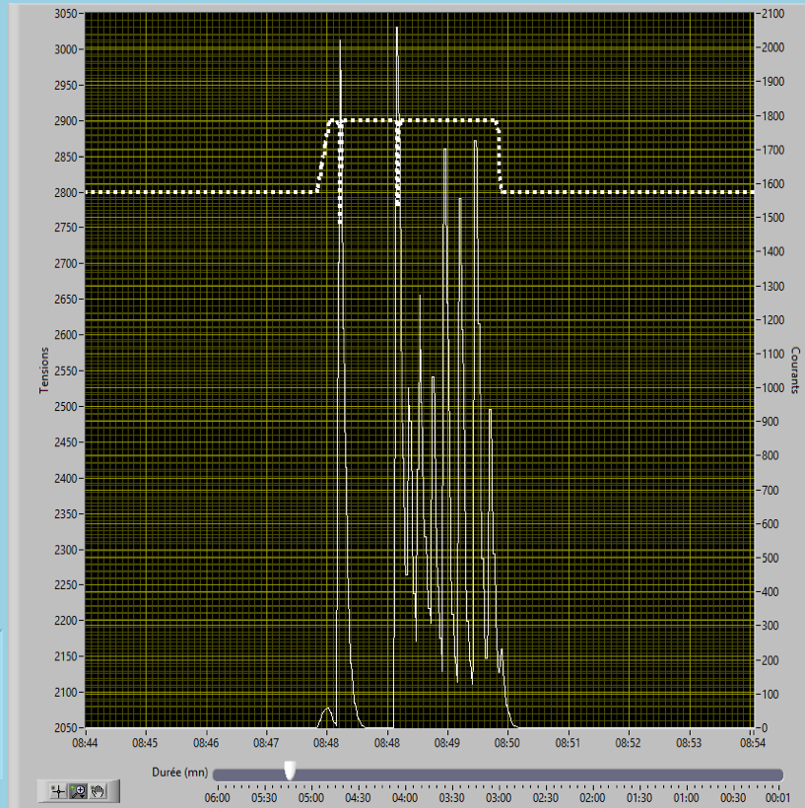
Single sided-DLC Resistive LEM
Camera recording
Setup : LEM mounted alone on a support frame, copper side at GND
DLC side facing camera.
Corresponding Camera recording (2’20s)
50 s
Ar 3,3 bar
LEM HV
2,8-3,2 kV
DLC PS supply
current limit
DLC HV
3,3 bar Ar
DLC PS
current
- Sparks are heard but not seen on camera
- Still under investigations (some sparks
are seen in other recordings)
- LEM was then mounted on anode & a gain curve was done
8/10/2019
Alain Delbart, R&D on LEM for phase II of ProtoDUNE-DP, LEM, Workshop on the LEM/Thick GEM cryogenic utilization in pure Argon over large detection surfaces, 6-7th april, 2020
20

Slide 21
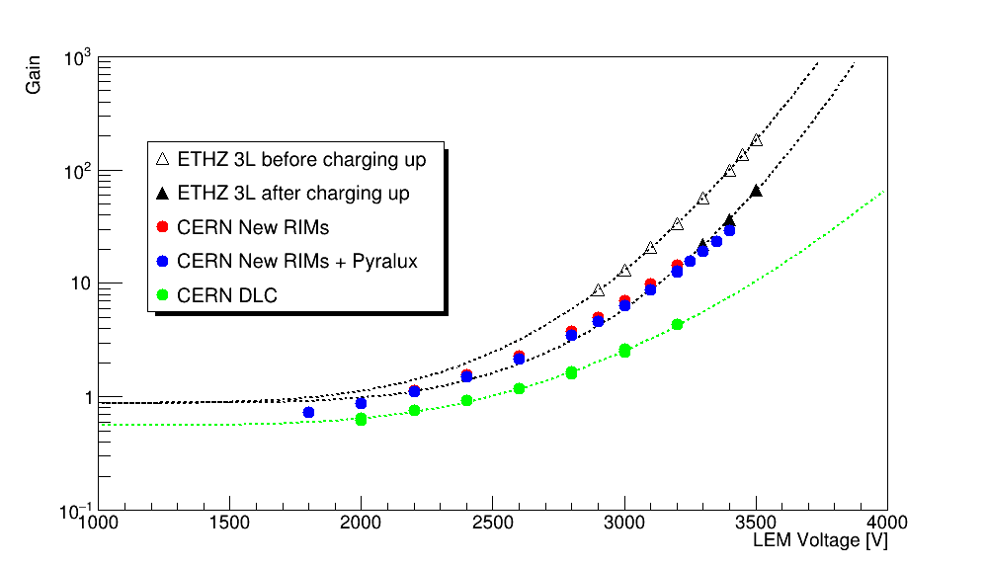
Single-sided DLC-Resistive LEM
Gain measurement in 3,3 bar Ar
In 3,3 bar Argon, with E_{d}=500 V/cm for CERN New RIMs & DLC prototypes
With same measurement protocol in HP chamber as for CFR-35 gain measurements
Ar 3,3 bar
LEM HV
2,8-3,2 kV
20
#1
Cu side facing anode.
Alain Delbart, R&D on LEM for phase II of ProtoDUNE-DP, LEM, Workshop on the LEM/Thick GEM cryogenic utilization in pure Argon over large detection surfaces, 6-7th april, 2020
21

Slide 22
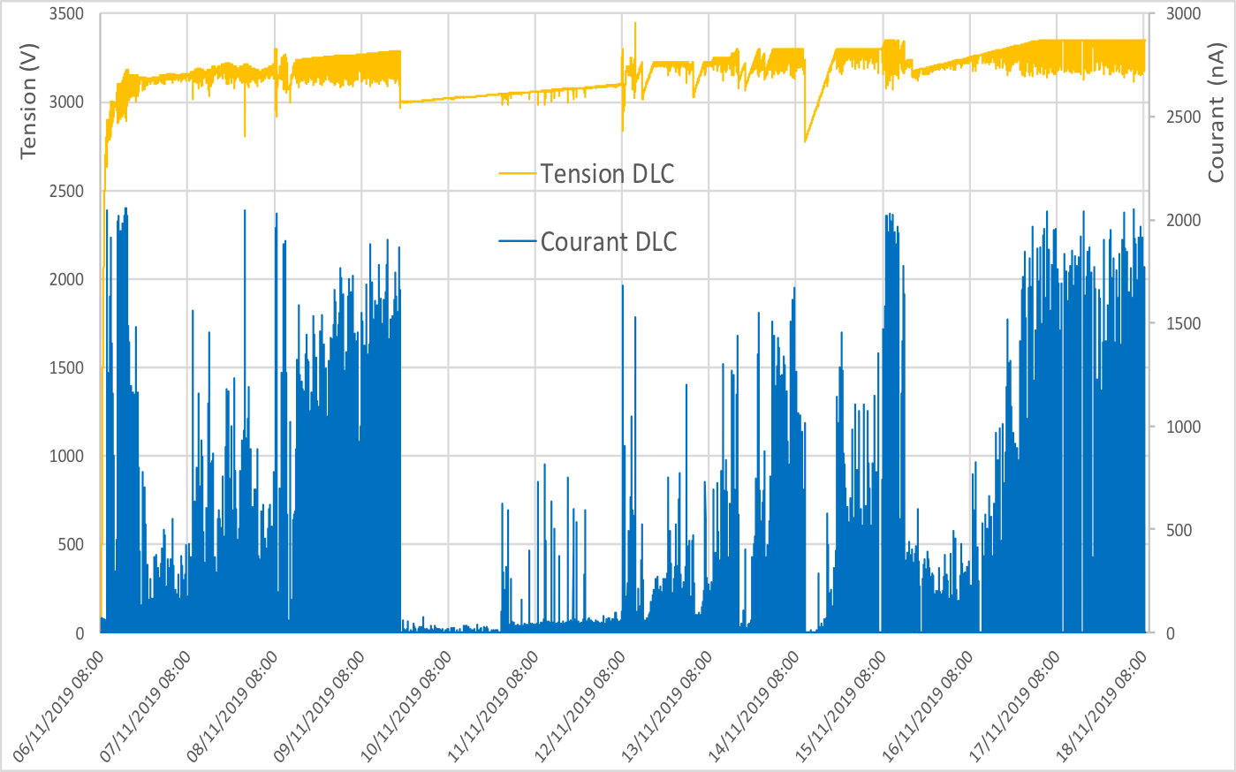
Single-sided DLC-Resistive LEM appearance of unstable operation after one month
DLC PS supply
current limit
LEM ΔV
No eye-visible damages on the LEM : still need further inspection
Alain Delbart, R&D on LEM for phase II of ProtoDUNE-DP, LEM, Workshop on the LEM/Thick GEM cryogenic utilization in pure Argon over large detection surfaces, 6-7th april, 2020
22

Slide 23
Adding insulating rings over RIM edges
CERN/EP-DT-EF (MPT lab.)
Soldermask
spray
a)
~30 μm
b)
35 μm
40 μm RIM
LEM
35 μm
1 mm
1 mm
35 μm
35 μm
~30 μm
UV exposure
After soldermask development
mask
c)
d)
80μm
80μm
140 μm
The process is applied on a LEM once finished. Requires precise mask alignment
Process to be tested : mask alignment on LEM holes, insulator uniformity, efficient covering ?
How will this affect LEM charging-up and performances ?
Alain Delbart, R&D on LEM for phase II of ProtoDUNE-DP, LEM, Workshop on the LEM/Thick GEM cryogenic utilization in pure Argon over large detection surfaces, 6-7th april, 2020
23

Slide 24
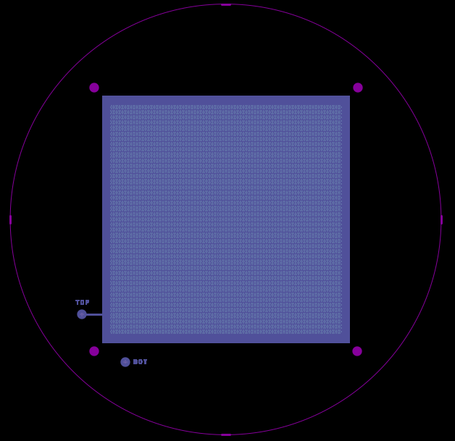
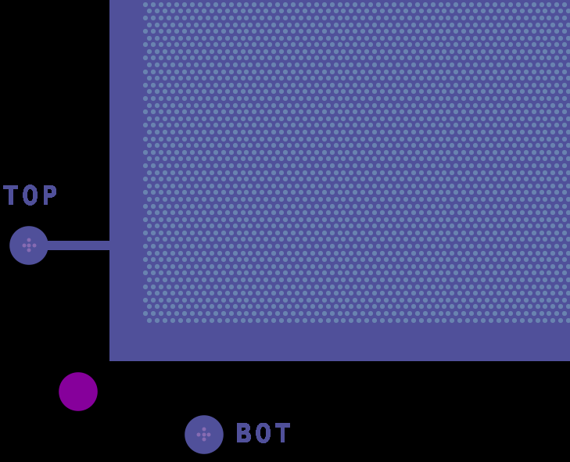
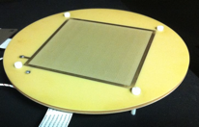
10x10 cm2 LEM prototypes
with insulating rings
Production of 10x10 cm2 prototypes, with improved CERN RIM etching :
2 x standard LEMs with 40 μm & 2 x standard LEMs with 80 μm RIM. Just produced @ CERN
2 x LEMs with with 40 μm & 80 μm large soldermask rings → under production @ CERN
Next steps :
Test these prototypes : compare gain, spark rate & spark localization, for RIM 40 μm, RIM 80 μm & RIM 40 μm + 80 μm soldermask rings
include all modifications in a full size LEM for protoDUNE-DP : increased active area from 86% in CFR-35 up to ~95% (back to $\sim$CFR-34 border design), insulated LEM borders, improved RIM etching & (if successfull prototype tests) add soldermask rings
Alain Delbart, R&D on LEM for phase II of ProtoDUNE-DP, LEM, Workshop on the LEM/Thick GEM cryogenic utilization in pure Argon over large detection surfaces, 6-7th april, 2020
24

Slide 25
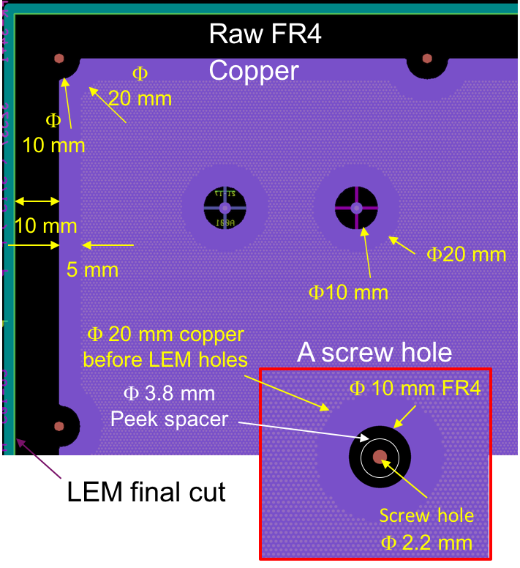
Towards ProtoDUNE-DP phase II
LEM design
CFR-35 – NP02
NP02 phase II ?
from modified CFR-35 + pyralux design
« secured design » (dvpt time / production)
FR4 border decrease : 10 ↘ ~2 mm
Copper border : 5 ↘ ~2 mm
Pyralux covering of copper borders
Φ0,5 ↑ Φ0,6 mm LEM holes on borders ?
Segmentation ?
+ LEM-Grid HV distribution modification
+ adding a guard ring on anode PCB
Longer time scale developments (>2022)
Resistive LEM (DLC or else)
Soldermask rings on RIMs
New ideas for charge readout in DLAr
Alain Delbart, R&D on LEM for phase II of ProtoDUNE-DP, LEM, Workshop on the LEM/Thick GEM cryogenic utilization in pure Argon over large detection surfaces, 6-7th april, 2020
25

Slide 26
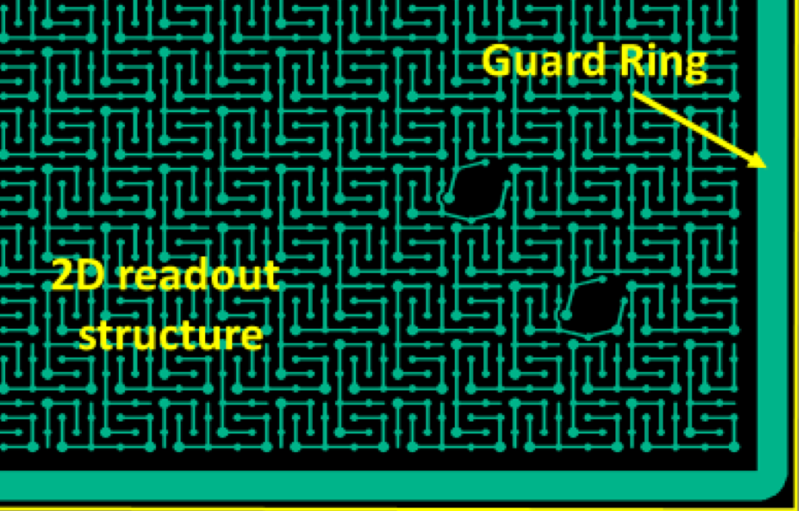
Anode guard ring
New design with a guard ring on both faces of the PCB (3 mm < LEM dead zone)
to mitigate risks associated with sparks causing damages to the FE electronics
2 prototypes will be ordered to PCB industrial partners ELTOS (it.) and ELVIA (Fr.).
Alain Delbart, R&D on LEM for phase II of ProtoDUNE-DP, LEM, Workshop on the LEM/Thick GEM cryogenic utilization in pure Argon over large detection surfaces, 6-7th april, 2020
26

