Slide 1
THGEM
CERN MPT Workshop
06/04/2020

Slide 2
OUTLINE
STD THGEM Production processes
COMSOL Simulation
Improved Rim uniformity process
Resistive Electrodes
Embedded electrodes

Slide 3
  Base material
  Drilling
  De-smearing
  Brushing
  Micro etching
  Curing
  De-smearing
  Cleaning
  Testing
Any base material can be used
The thickness uniformity have a large impact on gain
  Must be Lower than 1%
The technical reasons for a particular matrix choice are not yet clear
  But anti-CAF materials should be better (Cathodic Anodic Filaments)
At CERN we use halogen free materials for security reasons
The copper thickness should be at least 2 times larger than the RIM
Possible Base material :
  Glass epoxy
  Glass Polyimide
  Glass Teflon
  Pure polyimide
  Ceramic Teflon
  Polyaramid epoxy
  Polycarbonate

Slide 4
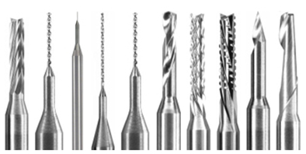
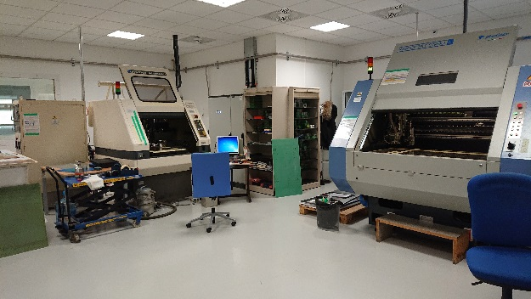
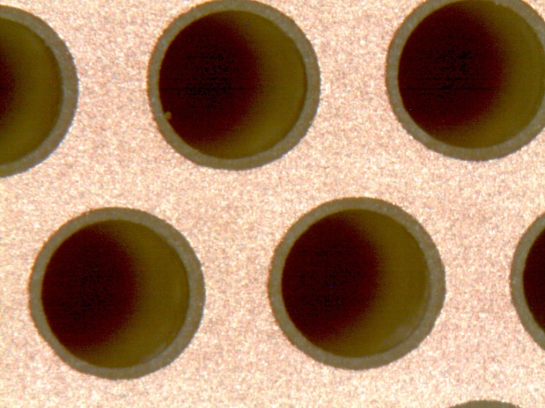
  Base material
  Drilling
  De-smearing
  Brushing
  Micro etching
  Curing
  De-smearing
  Cleaning
  Testing
PCB
All the parameters from drill bit supplier should be respected:
  Spindle speed
  Z axis speed
  Max hole count per drill bit divided by 2
Correct entry and output foils/boards should be selected
Avoid stack drilling

Slide 5
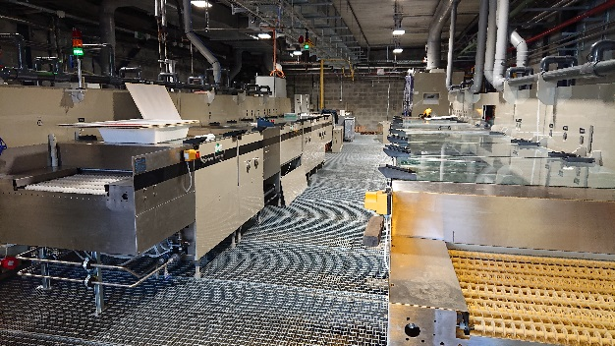
  Base material
  Drilling
  De-smearing
  Brushing
  Micro etching
  Curing
  De-smearing
  Cleaning
  Testing
This step is needed to remove thin layers of epoxy deposited
on copper edges during drill bit escape
-Horizontal line:
Ethylene Glycol
DI water rinse
Potassium Permanganate
DI water rinse
Acid Neutralizer
DI water rinse

Slide 6
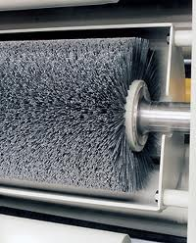
  Base material
  Drilling
  De-smearing
  Brushing
  Micro etching
  Curing
  De-smearing
  Cleaning
  Testing
This step is needed to round the metal edges
-At CERN we use a horizontal jet scrubbing machine
-we scrub the pieces in the 4 directions
-many times till we see the rounding effect
- The abrasive agent is neutral pumice

Slide 7
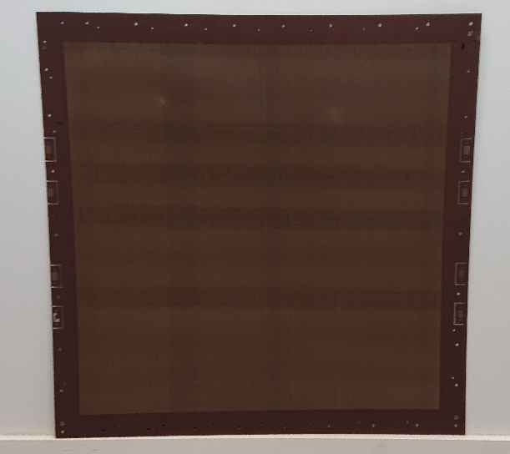
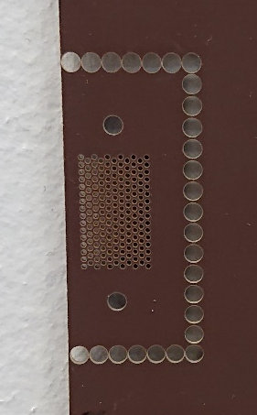
  Base material
  Drilling
  De-smearing
  Brushing
  Micro etching
  Curing
  De-smearing
  Cleaning
  Testing
This step is needed to reduce the copper thickness to create the RIM
-Different chemistries can be used
In Bath
-Chromic Acid (Rim up to 10um)
With Horizontal machines
-Ammonium persulfate (Rim up to 50um)
-Ferric per-chloride (Rim up to 100um)
Test patterns should be first etched to define the parameters

Slide 8
  Base material
  Drilling
  De-smearing
  Brushing
  Micro etching
  Curing
  De-smearing
  Cleaning
  Testing
A lot of thin base material are not fully polymerized
  Material producers think that they will be anyway cure
  during the multilayer PCB production gluing step.
-To complete this curing :
180 deg in air during 3 hours
curing horizontally or vertically

Slide 9
  Base material
  Drilling
  De-smearing
  Brushing
  Micro etching
  Curing
  De-smearing
  Cleaning
  Testing
This step is needed to remove the thin Epoxy layer
polluted by all the previous chemical baths
-Horizontal Line:
Ethylene Glycol
DI water rinse
Potassium Permanganate
DI water rinse
Neutralizer
DI water rinse

Slide 10

  Base material
  Drilling
  De-smearing
  Brushing
  Micro etching
  Curing
  De-smearing
  Cleaning
  Testing
This cleaning is needed to passivate the copper
-3 steps are needed:
High pressure DI water rinse
Chromic acid dip (30sec)
High pressure DI water rinse
-Drying @ 100deg during 1h
-If an oxide grows during drying , repeat the above steps
-A Ni/Au layer can also be deposited at this stage

Slide 11
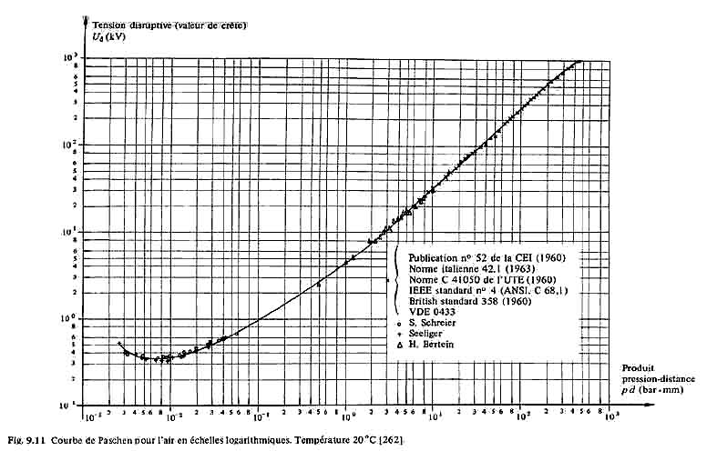
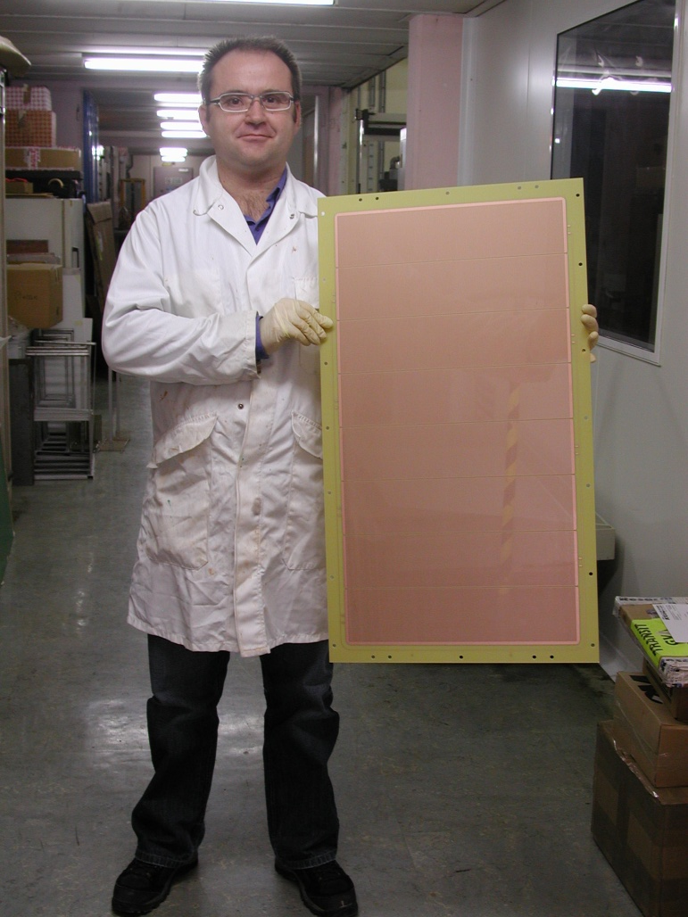
  Base material
  Drilling
  De-smearing
  Brushing
  Micro etching
  Curing
  De-smearing
  Cleaning
  Testing
We measure 2 parameters:
1/Sparking voltage, it should follow Paschen curves.
2/leakage current @ 90% of the sparking voltage,
it should be smaller than 10nA in air @ 10% RH

Slide 12
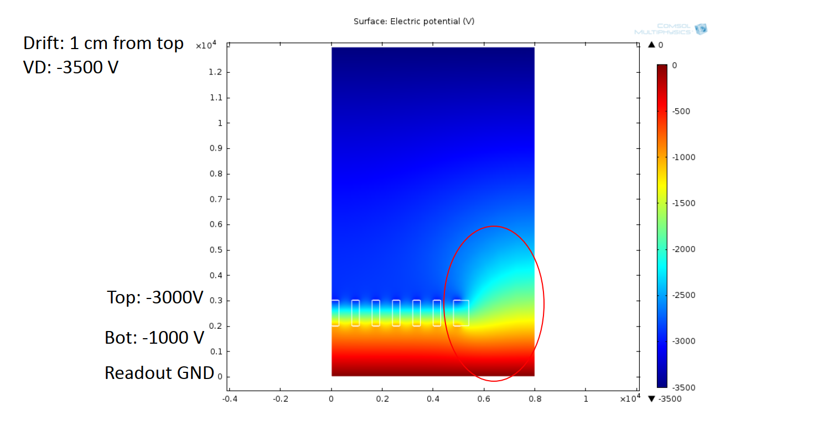
COMSOL Simulation
Voltage plot
-3500V
10mm
-3000V
1mm
-1000V
2mm
0V
THGEM: 1mm thick
0.8mm hole pitch
0.5mm hole diameter
40um RIM

Slide 13
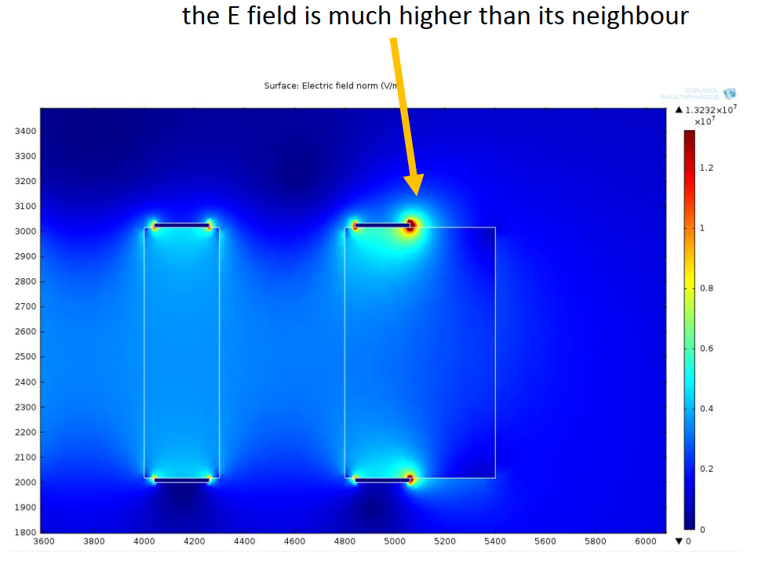
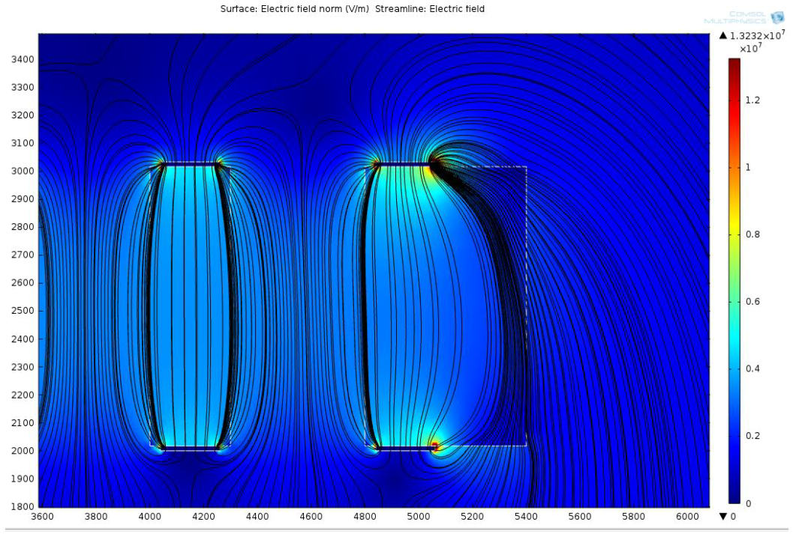
Field simulation
Field lines
The Fields are really high at the edges

Slide 14
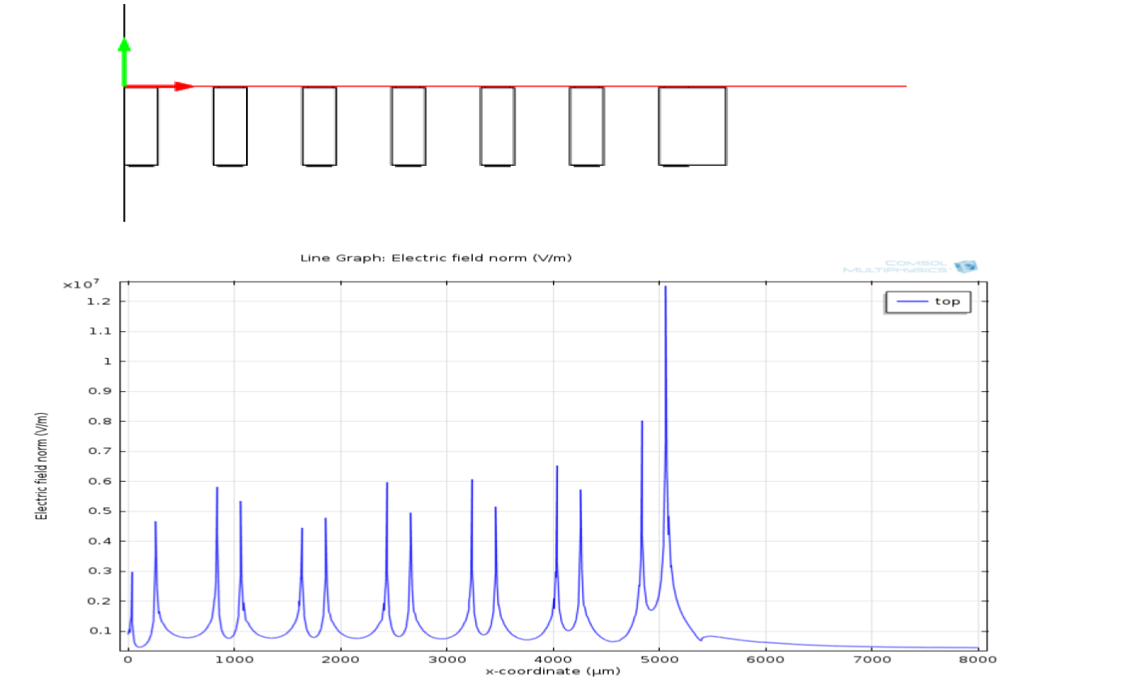
The Fields are also high at the copper RIM edge

Slide 15
Advanced Passivation to hide the high fields ?
With coverlay for thick layers
-outer copper edges
-mechanical holes
With liquid soldermask for complex thin layers:
-Copper edges in active area
THGEM
THGEM
+solerdask
Soldermask
Coverlay ?

Slide 16
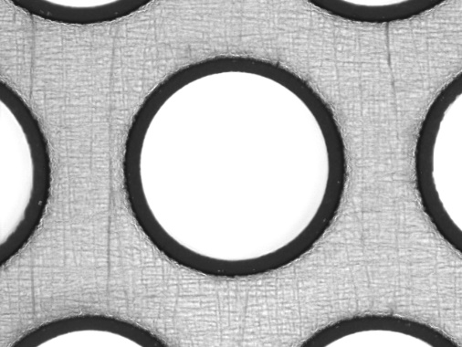
Precise RIMs production option
Base material
Drilling
PCB 1mm
Cu
17um
Cast Glue
25um
Cu
17um
Produced on a regular basis
Cast glue stripping
STD Cu spray etch

Slide 17
RIM production methods comparison
Conventional process to create large RIM
Copper remains in THGEM corners
Produced
Base material
Scrub
Soft etching
Sharp edges
Should be hidden with solder-mask
Large precise RIM in thin copper layer
Produced
Stripping
Base material
STD Copper spray etching

Slide 18
Resistive layers
Option 1
Option 2
Option 3
Option 4
DLC
?
?
?
Produced
Cu
-No RIM
-Simplest version
-HV limitation
-Rough DLC edges
-Spark protected
-RIM in Copper
-No RIM on DLC
-Rough DLC edges
-Still HV limitation ?
-Spark protected
-RIM in Copper
-RIM on DLC
-good DLC edges
-higher HV ?
-Spark protected
-No Copper
-RIM on DLC
-good DLC edges
-Higher HV ?
-Spark protected

Slide 19
Combining Resistive layers and Advanced passivation ?
?
?
Option 3
Option 3.1
?
?
Option 4
Option 4.1
-RIM in Copper
-RIM on DLC
-good DLC edges
-Higher HV ?
-Spark protected
-Edge passivation
-Maximum possible HV ?
-Spark protected

Slide 20
Option 4.1 : Fully resistive but simple to produce
Base material
Drilling
DLC
PCB 1mm
OK
DLC
No Copper → Easier/faster drilling ?
OK
OK
?
Option 4.1
Resist stripping
Easier passivation
Flat object
Resist + jet Scrub

Slide 21
Multi electrodes ?
?
Produced
?
?
-RIMs everywhere
-4 electrodes
-regular productions
- Useful ?
- COMSOL needed
- Useful ?
- COMSOL needed

Slide 22
Conclusion
-There is still several options to improve the
THGEM performances
-No result yet with passivation but it seems
to be a good option
-Resistive layer could also bring flexibility
and production process simplification

