Slide 1
Near Detector Motion System
Victor Guarino -- ANL

Slide 2
Introduction
Looking at three systems:
  Air pads with hydraulic pushing system (designed system for Atlas/CERN)
  Hilman rollers with hydraulic pushing system
  Hydraulic driven wheels
What are requirements for speed/frequency/positioning/cost/???
Spectrometer requirement was only that the detector had to be moved out of beam

Slide 3
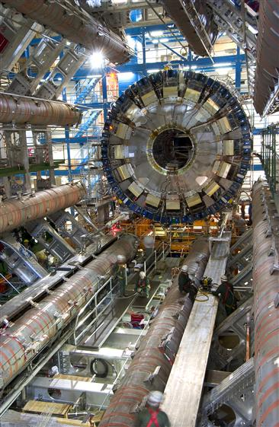
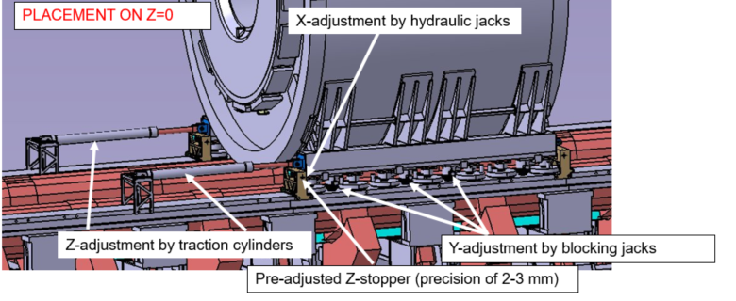
Airpads
Designed a system for moving the 1800 ton Atlas Tilecal at CERN
Height during move had to be maintained to 3mm because beam pipe was not removed
Pushed into along rails with hydraulic cylinders – positioned to 2mm
~$40k

Slide 4
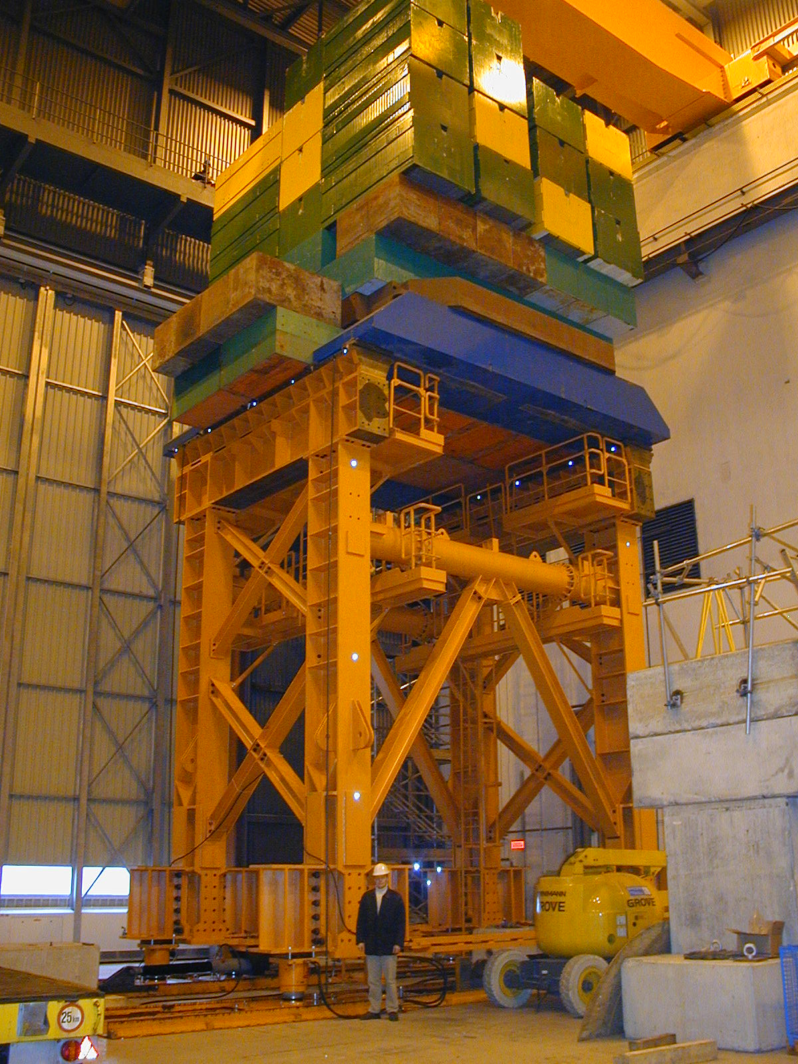
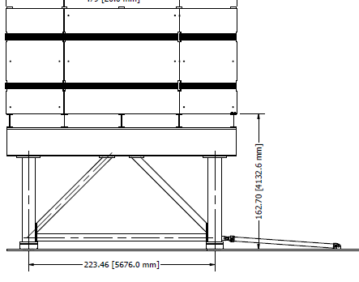
Airpads
Atlas test setup of airpad system looks a lot like spectrometer

Slide 5
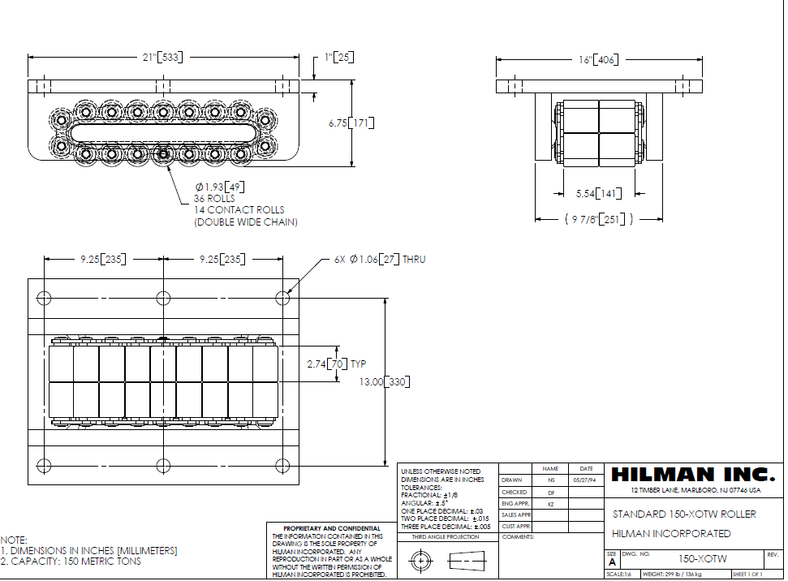
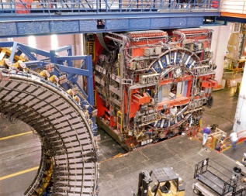
Hilman Rollers
Similar concept to airpads just larger cylinder for pushing
125 ton guided rollers ~$2500 each
Bosch Rexroth 8” double acting cylinder ~ $3500
Need hardened rail and guide rollers
CDF was installed using this method

Slide 6
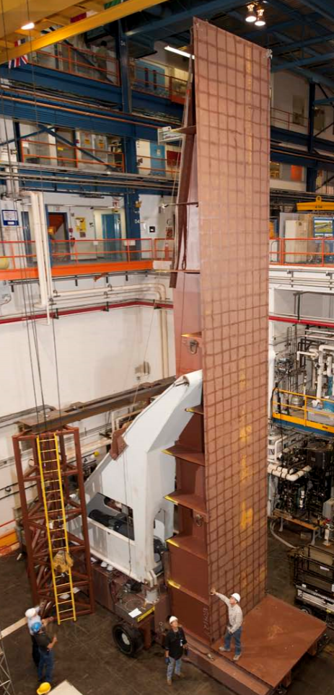
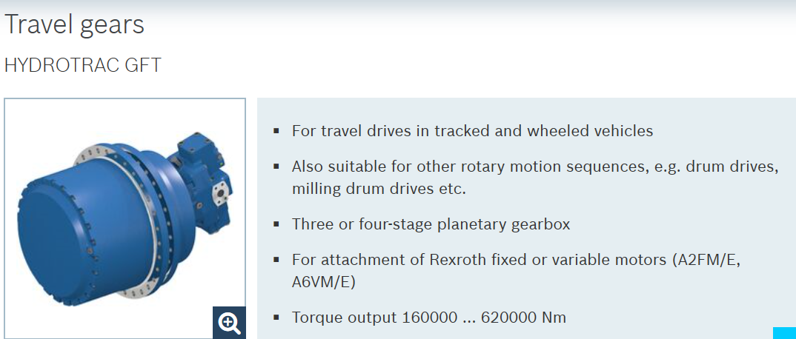
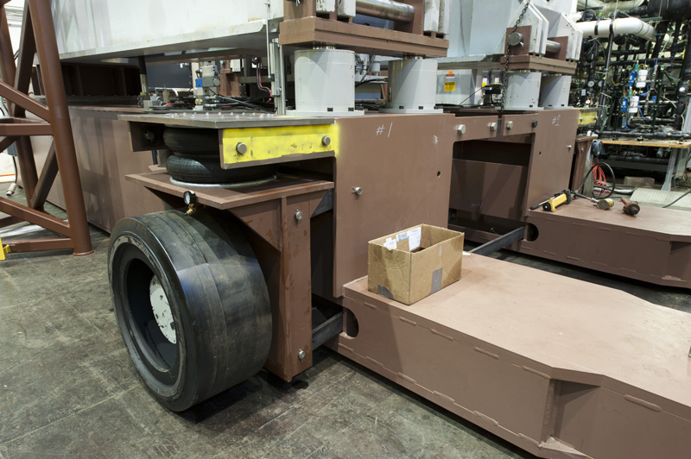
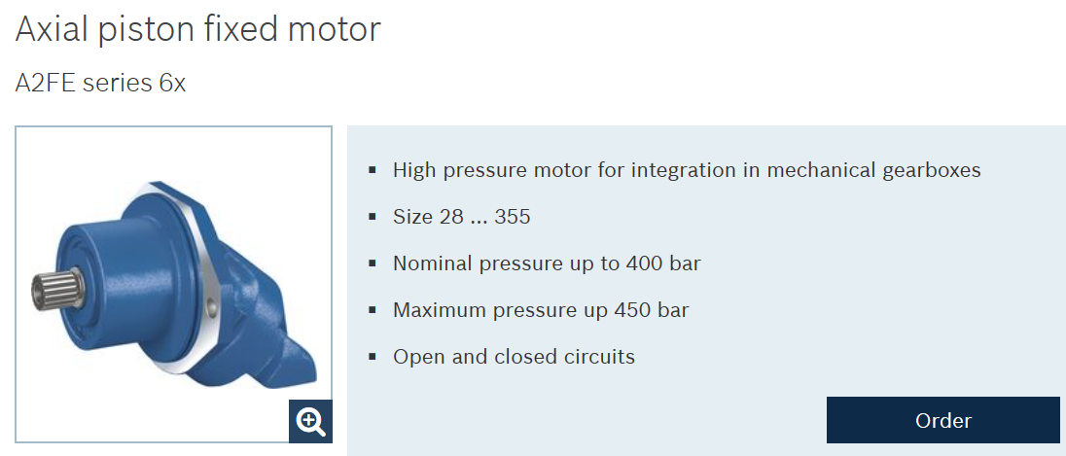
Hydraulic Drive Wheels
Bosch Rexroth hydraulic motor and gear box drive system
Guide rollers on rails
Common industrial method of moving large loads (NOvA Block raiser and ATLAS module mover)
~Budget quote $60k

Slide 7
Conclusion
Conceptual designs for three systems have been developed – each is proven industrial concepts
Each concept has pros/cons on simplicity, cost, accuracy.
Need well defined requirements in order to flesh out final design

