Slide 1
IOTA/FAST Run Report
Darren Crawford

Slide 2
This week
IOTA Run 2 extended to March 29th
FUR studies
AMPUR studies
NIO studies
Anti-damper studies
IBS studies

Slide 3
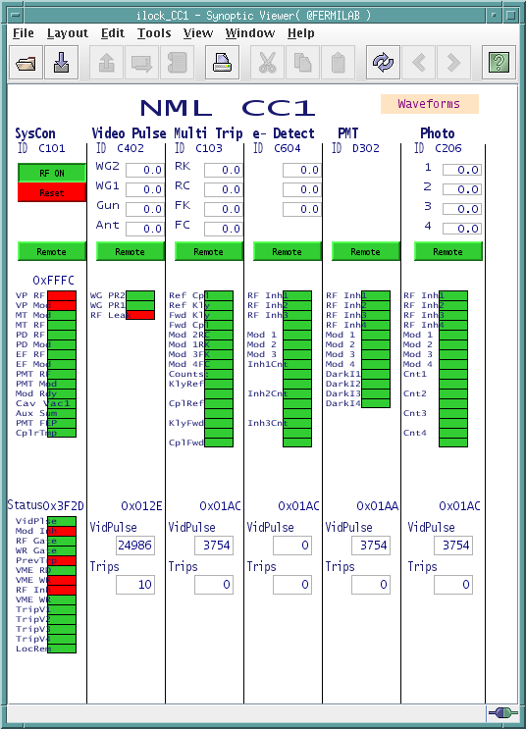
Downtime: 1.0 hours out of 80 hours (10 shifts)
CC1 RF Leak detected
CC1 Solenoid Current Fault trip

Slide 4
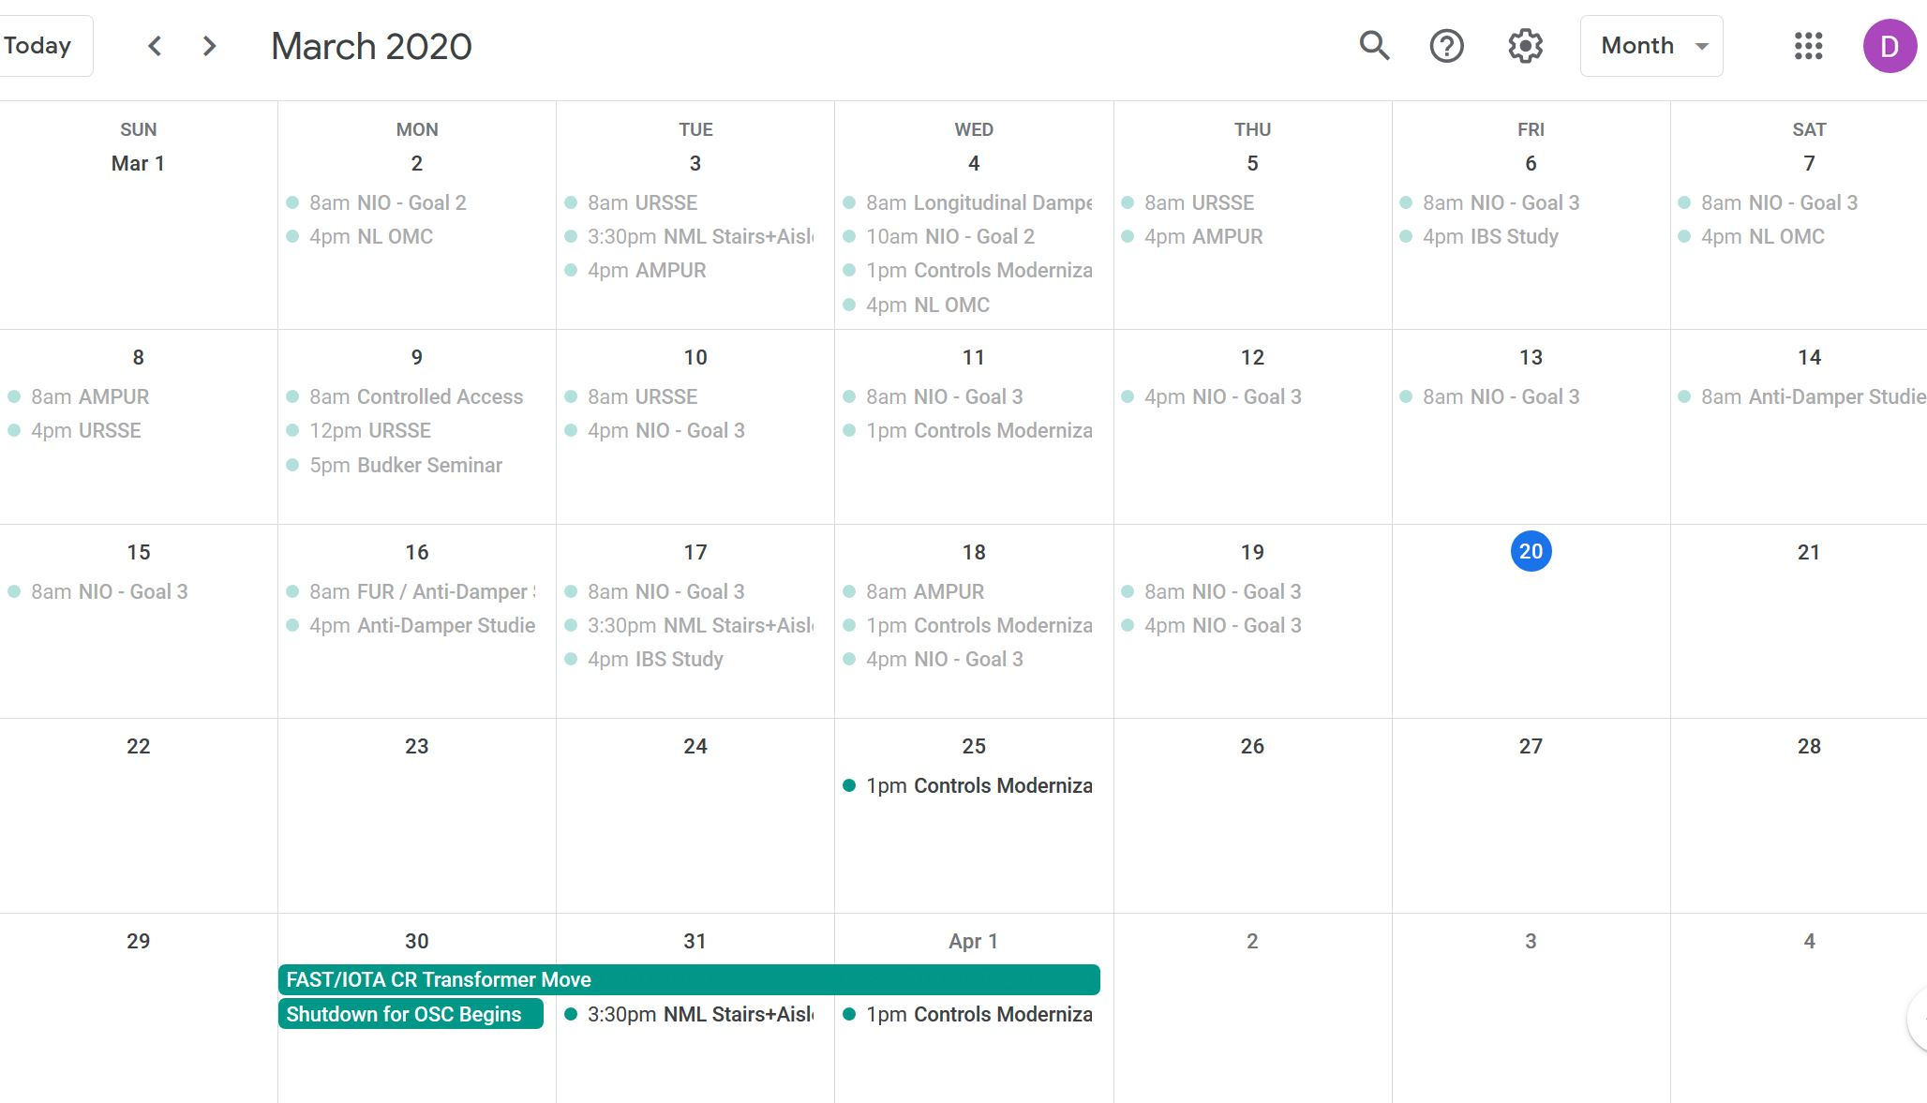
March schedule

Slide 5
Current Status
FAST Linac and IOTA Ring turned on
Cannot inject into IOTA
Horizontal kicker on, turned off
Vertical kicker left at 0.1 kV, set to 4.15 kV
Injection position is substantially off
Normal knobs adjusted with no results
Lattice program is not up on CNS67

