Slide 1
Snowmass All Frontier Conveners Meeting
Monday, August 24

Slide 2
Guidelines for the workshop times
Snowmass process from now to next summer
Community-wide meetings / workshops
Frontier workshops
Topical group workshops
The meeting times chosen to accommodate all of the US scientists and not to disenfranchise (mostly early career) researchers with families who need childcare
Suggested time (virtual meeting)
12:00 – 17:00 ET
11:00 – 16:00 CT
10:00 – 15:00 MT
09:00 – 14:00 PT

Slide 3
Funding Requests for in-person Workshops
We need to collect all and inform DOE/NSF
Workshop costs
Registration fees
Support by the local institutions
Requests to DOE/NSF
Traveling expenses / registration fees
Requests to DOE/NSF (who and why)
In-person Workshops
Instrumentation (w/ CPAD) mid March
Theory: March 17-19
Neutrino: Spring
Rare Processes and Precision Measurements Frontier Workshop (late Spring 2021)
Community Summer Study (July 2021)
Information sheet

Slide 4
CPM (Oct. 5-8, 2020)
Registration is now open
https://indico.fnal.gov/event/44870/

Slide 5
Goals of CPM
Inspire the community about the field (particle, accelerator, and related research areas), and encourage them to engage broadly in the Snowmass process
Inform the community
Plans from other regions and from related fields
Snowmass activities and plans broadly (e.g., members of one frontier may not know activities in other frontiers)
Listen to the community
Grassroot activities
Provide space for members across the field to talk to each other
Provide space to discuss, promote and develop new ideas
Organized activities (your own sessions & joint sessions)
Establish cross working-group connections
Identify gaps
Develop plans for your Frontier
Make a “work” plan between CPM 2020 and CSS 2021. This work plan can be finalized within a couple of weeks after CPM (by end of October 2020).

Slide 7
Day 2 and Day 3
Joint sessions
Agreed:
Topics proposed by frontier groups and agreed by relevant frontiers (some will be consolidated)
https://docs.google.com/spreadsheets/d/1kZtox3foIKtr_GP5hgNUrVYpwRdEsYFy2CvBLYPhQLk/edit#gid=0
Work in Progress:
Topics proposed by frontier groups; require further discussions
https://docs.google.com/spreadsheets/d/19H_FuoaXoT26p-jJxe6kcTlPkaq7statcUTbp2c0R40/edit#gid=0
To be added:
New ideas / suggestions by LOIs (to be submitted between now and Aug. 31)
Finalized ~mid September
Creating a breakout session schedule (continue to evolve)
https://docs.google.com/spreadsheets/d/1WebQNffS6KLxAPAzQITeMNh1cx2DjzYVtZQdl9vdCbw/edit#gid=0
3 30' sessions for each Frontier own meeting (2 on Tues + 1 on Wed) – no joint meetings during this time
Plus, topical group meetings as they are needed: in parallel with other joint meetings
4 "break/chat" sessions (2 on Tuesday and 2 on Wed)
Chat rooms will be available all the time

Slide 8
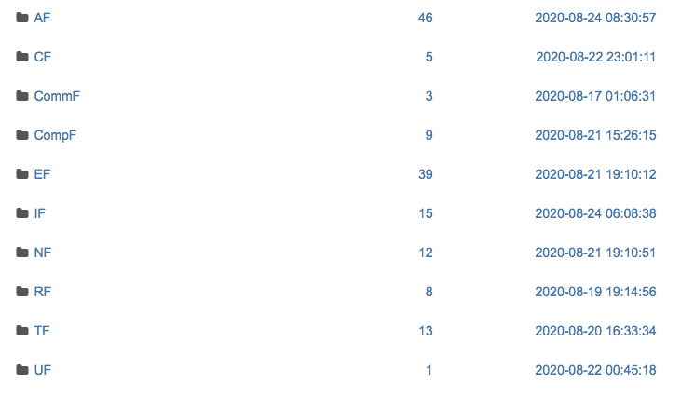
Letters of Interest
LOIs submitted so far (112 in total)
Sergei C.: Tools – sorting, …
Conveners:
What are new (not included in the current / planned activities)?
How shall we make authors feel that their LOIs are properly included in the process?
E.g. listening to them (presentations) or communicating with them in September → make a short list of topics to be discussed during CPM

