Slide 1
Snowmass Community Planning Meeting Snowmass Timeline
Young-Kee Kim
October 5, 2020
On behalf of the Snowmass Organization Team

Slide 2
U.S. Strategic Planning Process for Particle Physics
~year-long process
Community-Wide Science Study
(a.k.a. “Snowmass”)
Organized by
Division of Particles and Fields (DPF)
of American Physical Society (APS)
Together with APS DAP, DGRAV, DNP, DPB
~year-long process
Particle Physics Project Prioritization
(“P5”)
formulate a 10-year execution plan (20 year vision)
within funding constraints Subpanel of High Energy Physics Advisory Panel
for DOE/NSF funding agencies
Input to P5
Particle Physics is not isolated:
Long-Range Plan for Nuclear Science, Decadal Survey on Astronomy and Astrophysics, …
Snowmass organization: together with related fields (Accelerator Nuclear, Astro, Gravitational, AMO, …)
Particle Physics is global:
Strategies and Plans in other regions
Snowmass organization and participation: together with the international community

Slide 3
Snowmass
Goals
To define the most important questions for the field of particle physics
To identify promising opportunities to address them
Do & Do-Not
Do: Address the questions the particle physics community wishes to answer over the next two decades and how we plan to answer them
Do-Not: Prioritize activities (this is the task of the P5)
The Snowmass process could include
Develop a framework of scientific questions that can form the basis of a future program
Survey experiments, facilities, and capabilities that would address these questions

Slide 4
Frontiers and Topical Groups
30 Frontier conveners + ~250 Topical Group conveners + ~40 inter-frontier liaisons + xxx early career rep.s
Frontier | Topical Groups
Energy Frontier | Higgs Boson properties and couplings, Higgs Boson as a portal to new physics, Heavy flavor and top quark physics, EW Precision Phys. & constraining new phys., Precision QCD, Hadronic structure and forward QCD, Heavy Ions, Model specific explorations, More general explorations, Dark Matter at colliders
Frontiers in Neutrino Physics | Neutrino Oscillations, Sterile Neutrinos, Beyond the SM, Neutrinos from Natural Sources, Neutrino Properties, Neutrino Cross Sections, Nuclear Safeguards and Other Applications, Theory of Neutrino Physics, Artificial Neutrino Sources, Neutrino Detectors
Frontiers in Rare Processes & Precision Measurements | Weak Decays of b and c, Strange and Light Quarks, Fundamental Physics and Small Experiments. Baryon and Lepton Number Violation, Charged Lepton Flavor Violation, Dark Sector at Low Energies, Hadron spectroscopy
Cosmic Frontier | Dark Matter: Particle-like, Dark Matter: Wave-like, Dark Matter: Cosmic Probes, Dark Energy & Cosmic Acceleration: The Modern Universe, Dark Energy & Cosmic Acceleration: Cosmic Dawn & Before, Dark Energy & Cosmic Acceleration: Complementarity of Probes and New Facilities
Theory Frontier | String theory, quantum gravity, black holes, Effective field theory techniques, CFT and formal QFT, Scattering amplitudes, Lattice gauge theory, Theory techniques for precision physics, Collider phenomenology, BSM model building, Astro-particle physics and cosmology, Quantum information science, Theory of Neutrino Physics
Accelerator Frontier | Beam Physics and Accelerator Education, Accelerators for Neutrinos, Accelerators for Electroweak and Higgs Physics, Multi-TeV Colliders, Accelerators for Physics Beyond Colliders & Rare Processes, Advanced Accelerator Concepts, Accelerator Technology R&D: RF, Magnets, Targets/Sources
Instrumentation Frontier | Quantum Sensors, Photon Detectors, Solid State Detectors & Tracking, Trigger and DAQ, Micro Pattern Gas Detectors, Calorimetry, Electronics/ASICS, Noble Elements, Cross Cutting and System Integration, Radio Detection
Computational Frontier | Experimental Algorithm Parallelization, Theoretical Calculations and Simulation, Machine Learning, Storage and processing resource access (Facility and Infrastructure R&D), End user analysis
Underground Facilities and Infrastructure Frontier | Underground Facilities for Neutrinos, Underground Facilities for Cosmic Frontier, Underground Detectors
Community Engagement Frontier | Applications & Industry, Career Pipeline & Development, Diversity & Inclusion, Physics Education, Public Education & Outreach, Public Policy & Government Engagement
30 Frontier conveners and ~250 Topical Group conveners:
Thank you, community, for your nominations!!
Significant efforts being made:
Frontier conveners (since January 2020)
TG conveners (since April 2020)
Early Careers (since June 2020)

Slide 5
Snowmass Advisory Group
DPF Executive Committee
Chair: Young-Kee Kim
Chair-Elect: Tao Han
Vice Chair: Joel Butler
Past Chair: Prisca Cushman
Secretary/Treasurer: Mirjam Cvetic
Councilor: Elizabeth Simmons
Member-at-Large: Rick Van Kooten
Member-at-Large: Elizabeth Worcester
Member-at-Large: Natalia Toro
Member-at-Large: Andre de Gouvea
Member-at-Large: Mary Bishai
Member-at-Large: Lauren Tompkins
Early Career Member-at-Large: Sara Simon
Editor and Communication
Editor – Michael Peskin
Communication – Bob Bernstein
Representatives from other Divisions
DPB (accelerator): Sergei Nagaitsev
DNP (nuclear): Yury Kolomensky
DAP (astro): Glennys Farrar
DGRAV (gravitational): Gabriela Gonzales
Representatives from the Int. Community
Africa / Middle East
Azwinndini Muronga, Nelson Mandela Metropolitan Univ, South Africa
Asia / Pacific
Atsuko Ichikawa, Kyoto University, Japan
Xinchou Lou, IHEP, China
Canada
Heather Logan, Carleton University, Canada
Europe
Val Gibson, Cavendish Laboratory, UK
Berrie Giebels, CNRS, France
Latin America
Claudio Dib, Universidad Tecnica Federico Santa Maria, Chile
Steering Group
Special thanks to
Steering group meets weekly; Advisory group meets once every 4 weeks;
All Frontier conveners + Advisory group + CPM/CSS LOC co-chairs meet once every 4 weeks
Monitoring the progress to make sure that all is moving forward smoothly to achieve the goals of the planning exercise

Slide 6
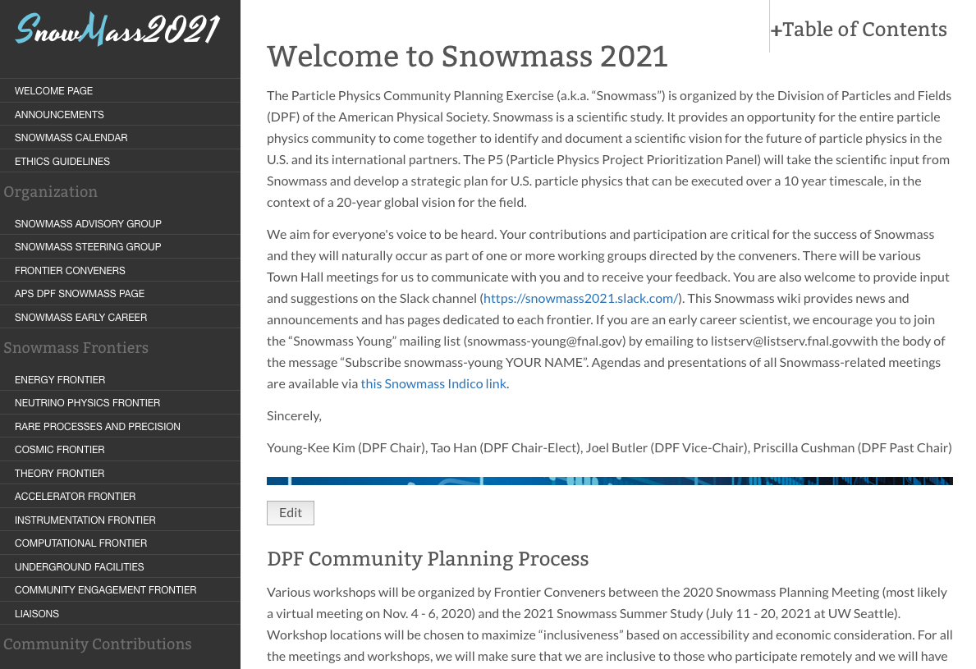
Snowmass Preparation
Wiki (https://snowmass21.org/) – one-stop shop
Slack channels, Monthly Newsletter, Snowmass History , …
Snowmass Early Career (SEC)
To represent early career members and promote their engagement in the Snowmass 2021 process
To build a long-term particle-physics early career community that persists after the Snowmass process.
Core Principles and Community Guidelines (CP&CG)
The Snowmass process is a dynamic exchange of ideas across a large swath of the community, taking place in a variety of formats (e.g., slack channels, meetings, workshops). All community members should feel safe and supported in engaging in all exchanges.
DPF Ethics Task Force / CP&CG Response Team formed (DPF Ethics Committee being formed)
If you notice any violations or have any concerns, please report to Snowmass conveners / advisory members (available at the Snowmass wiki), or write to the #code-of-conduct Slack channel.

Slide 7
Snowmass Timeline
Community
Planning
Meeting
(CPM)
Oct. 5-8
Virtual Kick-off
Town Hall
APS April Meeting
European Strategy Update
11/19 | 12/19 | 1/20 | 2/20 | 3/20 | 4/20 | 5/20 | 6/20 | 7/20 | 8/20 | 9/20 | 10/20
Preparation
Letters of Interest
Contributed (“white”) Papers
10 Frontier & 80 Topical Groups: Meetings & Workshops
Community Summer Study (CSS)
July 11-20, 2021
+ DPF 2021
(UW Seattle)
2021
APS April
Meeting
Snowmass
Report
11/20 | 12/20 | 1/21 | 2/21 | 3/21 | 4/21 | 5/21 | 6/21 | 7/21 | 8/21 | 9/21 | 10/21
Contributed (“white”) Papers
10 Frontier & 80 Topical Groups: Meetings & Workshops

Slide 8
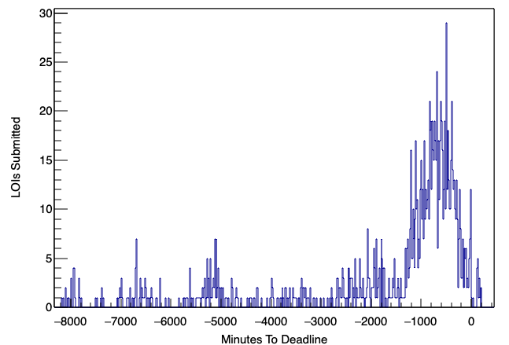
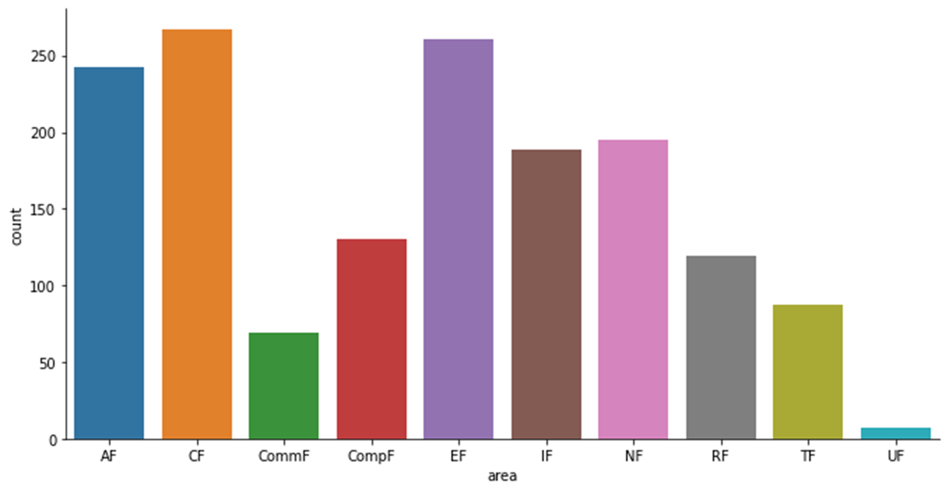
Letters of Interests
1,574 in total: submitted before August 31, 2020
Many LOIs – multiple frontiers
Frontier + TG conveners: tireless efforts to prepare the CPM using this information (Sept.)
# of LOIs vs time
Thank you, community, for your contributions!!
Primary Frontiers
20 hours

Slide 9
CPM: Goals and Agenda
Develop plans and steps to take between October 2020 and the Snowmass Community meeting in July 2021, leading to a final report in October 2021.
Day 1 (October 5): plenary
Inspire the community about the field
Inform the community about strategies and plans from other regions and from related fields
Listen to voices of the community, messages from funding agencies
Day 2 (October 6) and Day 3 (October 7): breakout
Establish cross working-group connections, identify gaps, areas to focus, and areas for further studies
Provide space for the community across the field to talk to each other and to discuss, promote, and develop new ideas
Discuss plans and steps to take between October 2020 and the Snowmass Community meeting in July 2021
Day 4 (October 8): plenary
Future global accelerator facilities for particle physics
Messages from early careers
Key scientific questions + plans and steps to take of frontiers
Importance of community’s engagement in the Snowmass process

Slide 10
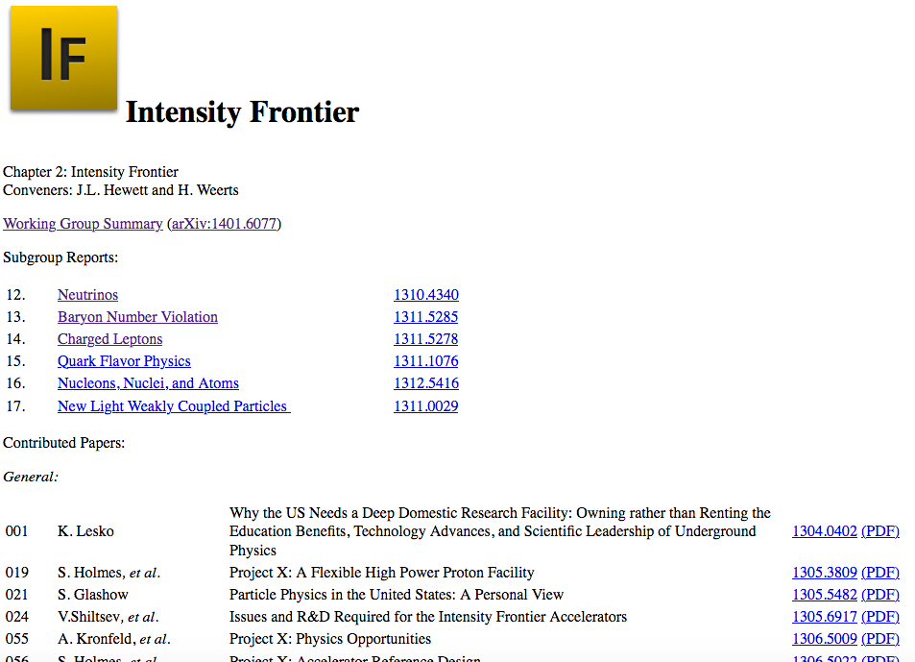
“Straw-person” Snowmass Report Structure
Discussion topic during the CPM:
Based on the community’s feedback, we will finalize this by October 31, 2020
Example: Snowmass 2013
Snowmass 2021 Report Structure:
Executive Summary
Introduction
A few page summary from each Frontier
Frontier Report
Frontier Summary
Topical Group Reports
Contributed Papers as References

Slide 11
“Straw-person” Snowmass Timeline (1/2)
Discussion topic during the CPM:
Based on the community’s feedback, we will finalize this by October 31, 2020
Note: this is only about “writing”
(there will be various Frontier workshops in 2021 that are not included in this timeline)
Stage 1: Now - October 31, 2020
Primary topical groups (TGs) acknowledge LOIs (email to primary contacts)
Frontiers and TGs use the CPM to identify gaps and to strengthen connections to other frontiers and between TGs within their frontier, and update inter-frontier working groups
Stage 2: November 1 - December 20, 2020
Each TG writes a ~2 paragraphs on community input (e.g., Letters of Interest and interests expressed via other formats) → Each Frontier reviews and polishes the “community input” document, releases it to the community, and invites comments from the community.
TGs initiate Contributed Paper consolidation and coordination, and solicit Contributed Papers (e.g., Contributed Paper kickoff workshops)
Each TG drafts “Focus Questions” & Physics Landscape.

Slide 12
“Straw-person” Snowmass Timeline (2/2)
Stage 3: January 3 - February 10, 2021
TG groups receive a “Preview Summary” (~2 paragraphs) for ALL planned and submitted Contributed Papers. This will be used as the base information for the TG report and allow TG conveners to coordinate the content of their report with other Frontiers.
Each TG writes an “Outline” of their report.
Stage 4: February 11 - APS April Meeting, April 17-20, 2021
Community comment period on the Outline
Each TG writes an “Extended Outline” of their report
Community comment period on the Extended Outline
Stage 5: April 21 - July 2021 CSS Meeting at Seattle
Frontier / TG conveners write the “DRAFT Frontier Report”.
Steering Group / Frontier Conveners write the “DRAFT Executive Summary”
Community comment period on the DRAFT Frontier Report and DRAFT Executive Summary
Stage 6: July CSS Meeting - October 2021
(July 31) Deadline for “Contributed Papers”
Input from the CSS meeting will be implemented
(October 31) The final report will be produced.

Slide 13
CPM Program Committee
Steering Group
DPF: Young-Kee Kim (Chair), Tao Han (Chair-Elect), Joel Butler (Vice-Chair), Priscilla Cushman (Past Chair)
Glennys Farrar (DAP), Gabriela Gonzales (DGRAV), Yury Kolomensky (DNP), Sergei Nagaitsev (DPB)
Frontier Representatives
Frontier Conveners
2 Early Careers
Vishvas Pandey (postdoc), Joshua Barrow (graduate student)
Co-chairs of LOC
Bo Jayatilaka, Brendan Kiburg
Energy | Laura Reina | Florida State U.
Neutrinos | Patrick Huber | Virginia Tech.
Rare Processes and Precision Measurements | Marina Artuso | Syracuse U.
Cosmic | Aaron Chou | Fermilab
Theory | Aida El-Khadra | UIUC
Accelerator | Tor Raubenheimer | SLAC
Instumentation | Jinlong Zhang | Argonne
Computational | Oliver Gutsche | Fermilab
Underground Facilities and Infrastructure | John Orrell | PNNL
Community Engagement | Breese Quinn | U. Mississippi
All Frontier Conveners
All Topical Group Conveners
Special thanks to

Slide 14
CPM Local Organizing Committee
Bo Javatilaka Brendan Kiburg
(co-chairs)
To Be Improved
Name | Institution
Jonathan Asaadi | University of Texas, Arlington
Sapta Bhattacharya | Northwestern University
Zoltan Gecse | Fermilab
Shih-Chieh Hsu (co-chair, CSS 2021) | University of Washington, Seattle
Erica Snider | Fermilab
Tiziana Spina | Fermilab
Gordon Watts (co-chair, CSS 2021) | University of Washington, Seattle
Yuanyuan Zhang | Fermilab

