Slide 1
Snowmass All Frontier Conveners Meeting
Young-Kee Kim
November 16, 2020

Slide 2
Announcements / Discussion Topics
Monthly Snowmass Newsletter (November)
Please complete your frontier section by TONIGHT
CSS (2021 Community Summer Study)
Dates
Assuming that the P5 schedule remains the same and the CSS will be a ~10-day workshop at UW
We looked into other options (Aug. 2021, Dec. 2021, Jan. 2022, Spring Break 2022)
None are good for the community (accommodating both semester- and quarter-system universities)
Dorms of UW (quarter-system) are not available during any of these periods
Current plan: the original dates July 11-20, 2021
But, we want to hear from Frontier conveners today.
We will give the final words to UW by end of this year.
Program Committee
Steering Group
10 frontier representatives
2 Early Career Representatives
Co-chairs of CSS’s LOC
Tao is forming the Committee

Slide 3
Announcements / Discussion Topics
Snowmass Frontier-Level Workshops
Table below: Google spreadsheet (continue to be updated with more information)

Slide 4
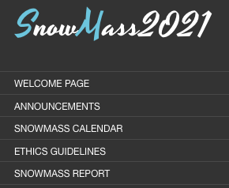
Announcements / Discussion Topics
DPF Ethics Advisory Committee
Structure of Snowmass 2021 Report
Feedback by Early Careers on Contributed Papers and Communication
Sara Simon
Feedback on Report Structure, Dates of CSS, Workshop Plan before CSS, and Contributed Papers
Frontier Conveners

Slide 5
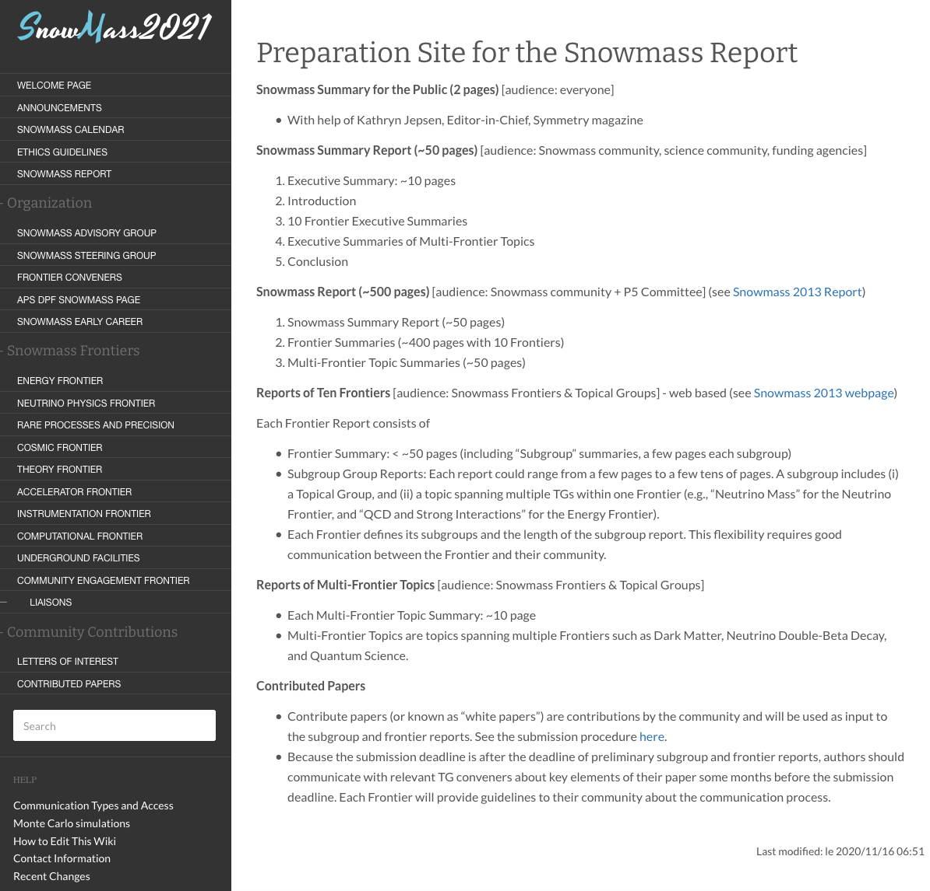

Slide 6
Preliminary Snowmass Timeline / Process
Meetings & Workshops (10 Frontiers & 80 Topical Groups) + Contributed Papers
Nov.
2020
Dec.
2020
Jan.
2021
Feb.
2021
Mar.
2021
Apr.
2021
May
2021
Jun.
2021
Jul.
2021
Aug.
2021
Sep.
2021
Oct.
2021
Community Meeting
(APS April Meeting)
Community Summer Study (CSS)
July 11-20, 2021 + DPF 2021 (UW Seattle)
Snowmass
Report
TGs: effort on consolidation, coordination & solicitation, leading to studies & Contributed Papers
TGs develop their key questions and opportunities
TGs produce outlines of their reports
(TGs: communication with authors of Contributed Papers)
Frontiers/TGs produce Preliminary Frontier Reports
Community feedback on Preliminary Frontier Reports
CSS
Build consensus on key questions / opportunities of particle physics,
enabling technologies, and community engagement;
Formulate the content of the Snowmass Executive Summary
Frontiers/TGs produce Final Frontier Reports
Steering Group produces Preliminary Executive Summary
Community feedback on Prelim. Exec. Summary
Snowmass Draft Report and Critical Commentary
Snowmass Final Report

