Slide 1
SBN Program Status
Peter Wilson – SBN Program Coordinator
Oversight Board
12 June 2020

Slide 2
Outline
COVID 19 closure and reopening
ICARUS technical progress
SBND technical progress
SBND Feb 2020 Director’s Review

Slide 3
COVID 19: Fermilab closure
Fermilab went to Safe State of operations at end of the day on March 20
  Many people already working from home for at least a week
  About 120-150 essential personnel on-site workdays from March 23 to May 20
    Limited list of personnel (employees and users) allowed access to site
    Others must request “Day Pass” at least one day in advance through division management.
  Essentially all on-site experiment work suspended (e.g. no beams)
  Only on-site SBN operation: filling of ICARUS (see later slides)
  Most SBN engineering activities continued remotely
  Long term residents accommodated in Village (~ 80 people) but no new people
COVID 19 Safety
  Must maintain social distancing of >6 ft (2m)
  Must wear a mask when indoors (except alone in an office)
  If can’t maintain >6ft, additional PPE and Hazard Analysis are required
  Occupancy rules on elevators, conference rooms
In May added screening process for entry onsite including questions and temperature scan

Slide 4
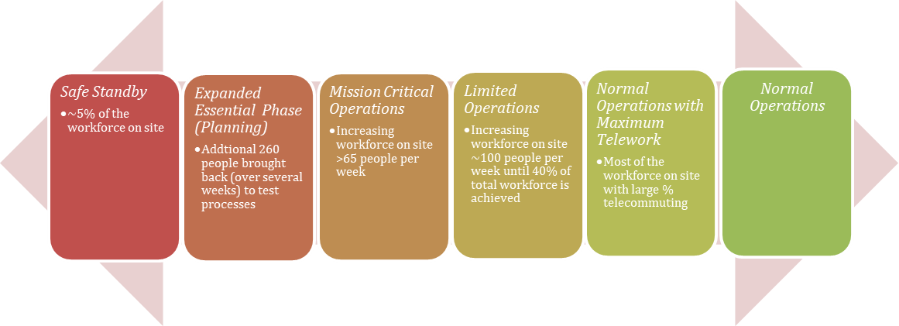
COVID 19: Fermilab re-opening
Planning process
  Coordinated plan across Fermilab organizations
    Synched with State of Illinois rules
    Synched with Argonne National Lab
    Approved by DOE
  Peter Wilson is Neutrino Division representative to planning process
Re-opening plan: slowly add personnel to Essential Personnel list
  Initially no more than 65 people add per round, rounds at least 1 week apart
  Evaluate how systems are working between each round
  Prepare to halt and possibly go back if epidemic in area gets worse

Slide 5
COVID 19: reopening and coordination of work
Gradual reopening started May 21
  Added about 65 people / week across the lab to the list of essential personnel
  Completed 4th round this week
  Pausing to evaluate before next round
Work must be carefully planned to ensure additional safety rules are followed
  Avoid conflicts of too many jobs at one time
  Each facility has point of contact with responsibility for the daily/weekly plan in the facility
    Authority to say work can proceed based on safety plans, scheduling etc
    SBN FD (ICARUS): Carrie McGivern
    SBN ND (SBND): Roberto Acciarri
    Dzero (SBND Assembly): Pete Simon (Joseph Zennamo)
  Weekly planning meetings set priorities for the upcoming week

Slide 6
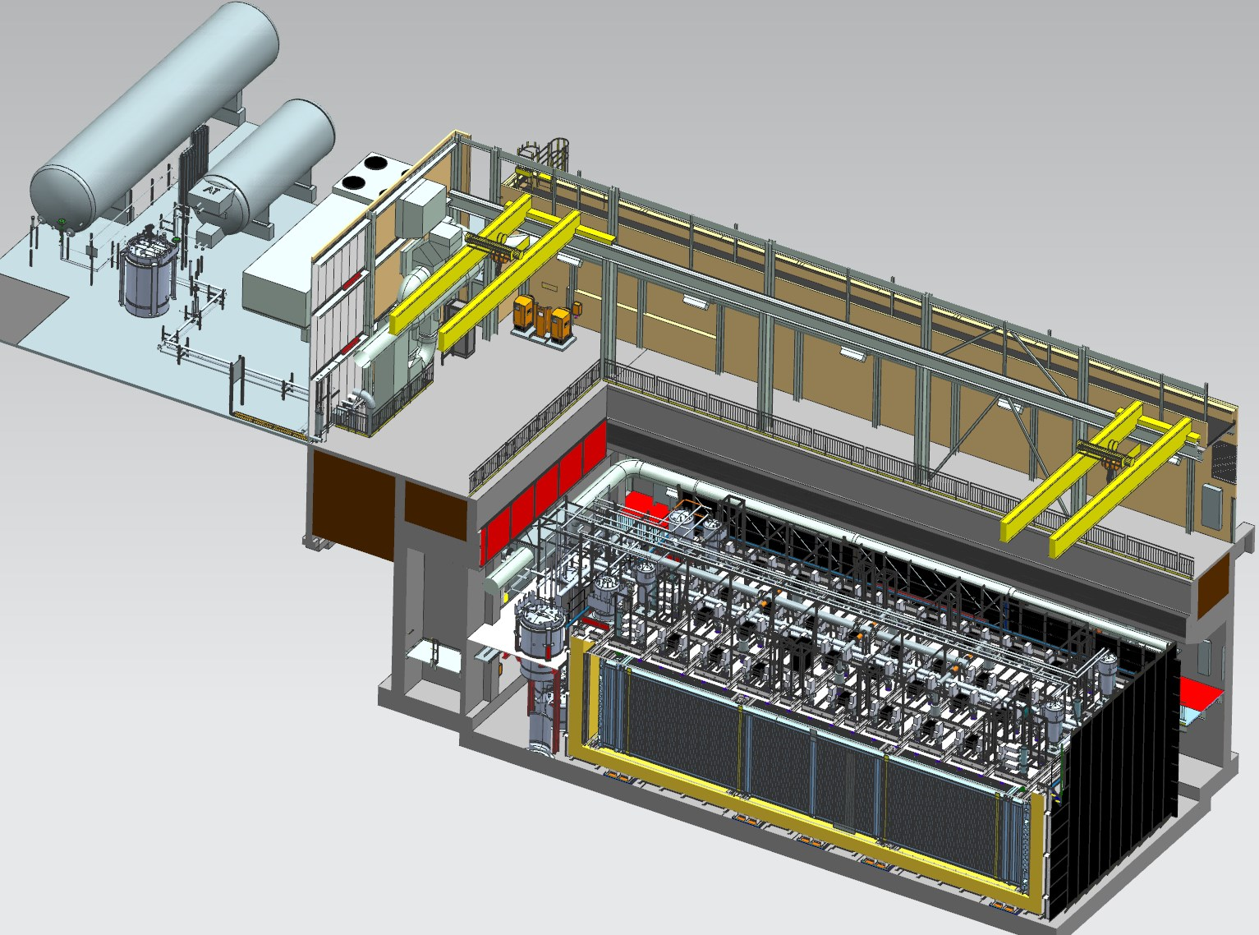
Far Detector - ICARUS
Cryogenic Dewars
TPC Electronics
Top CRT and Overburden
(not shown)
Exterior LAr Filters
Two 33 ton cranes
Proximity Cryogenics
Not shown in alcoves (mezzanine and pit):
DAQ racks
Controls racks
Cold Vessels (TPCs and PMTs inside)
Bottom CRT
Side CRT

Slide 7
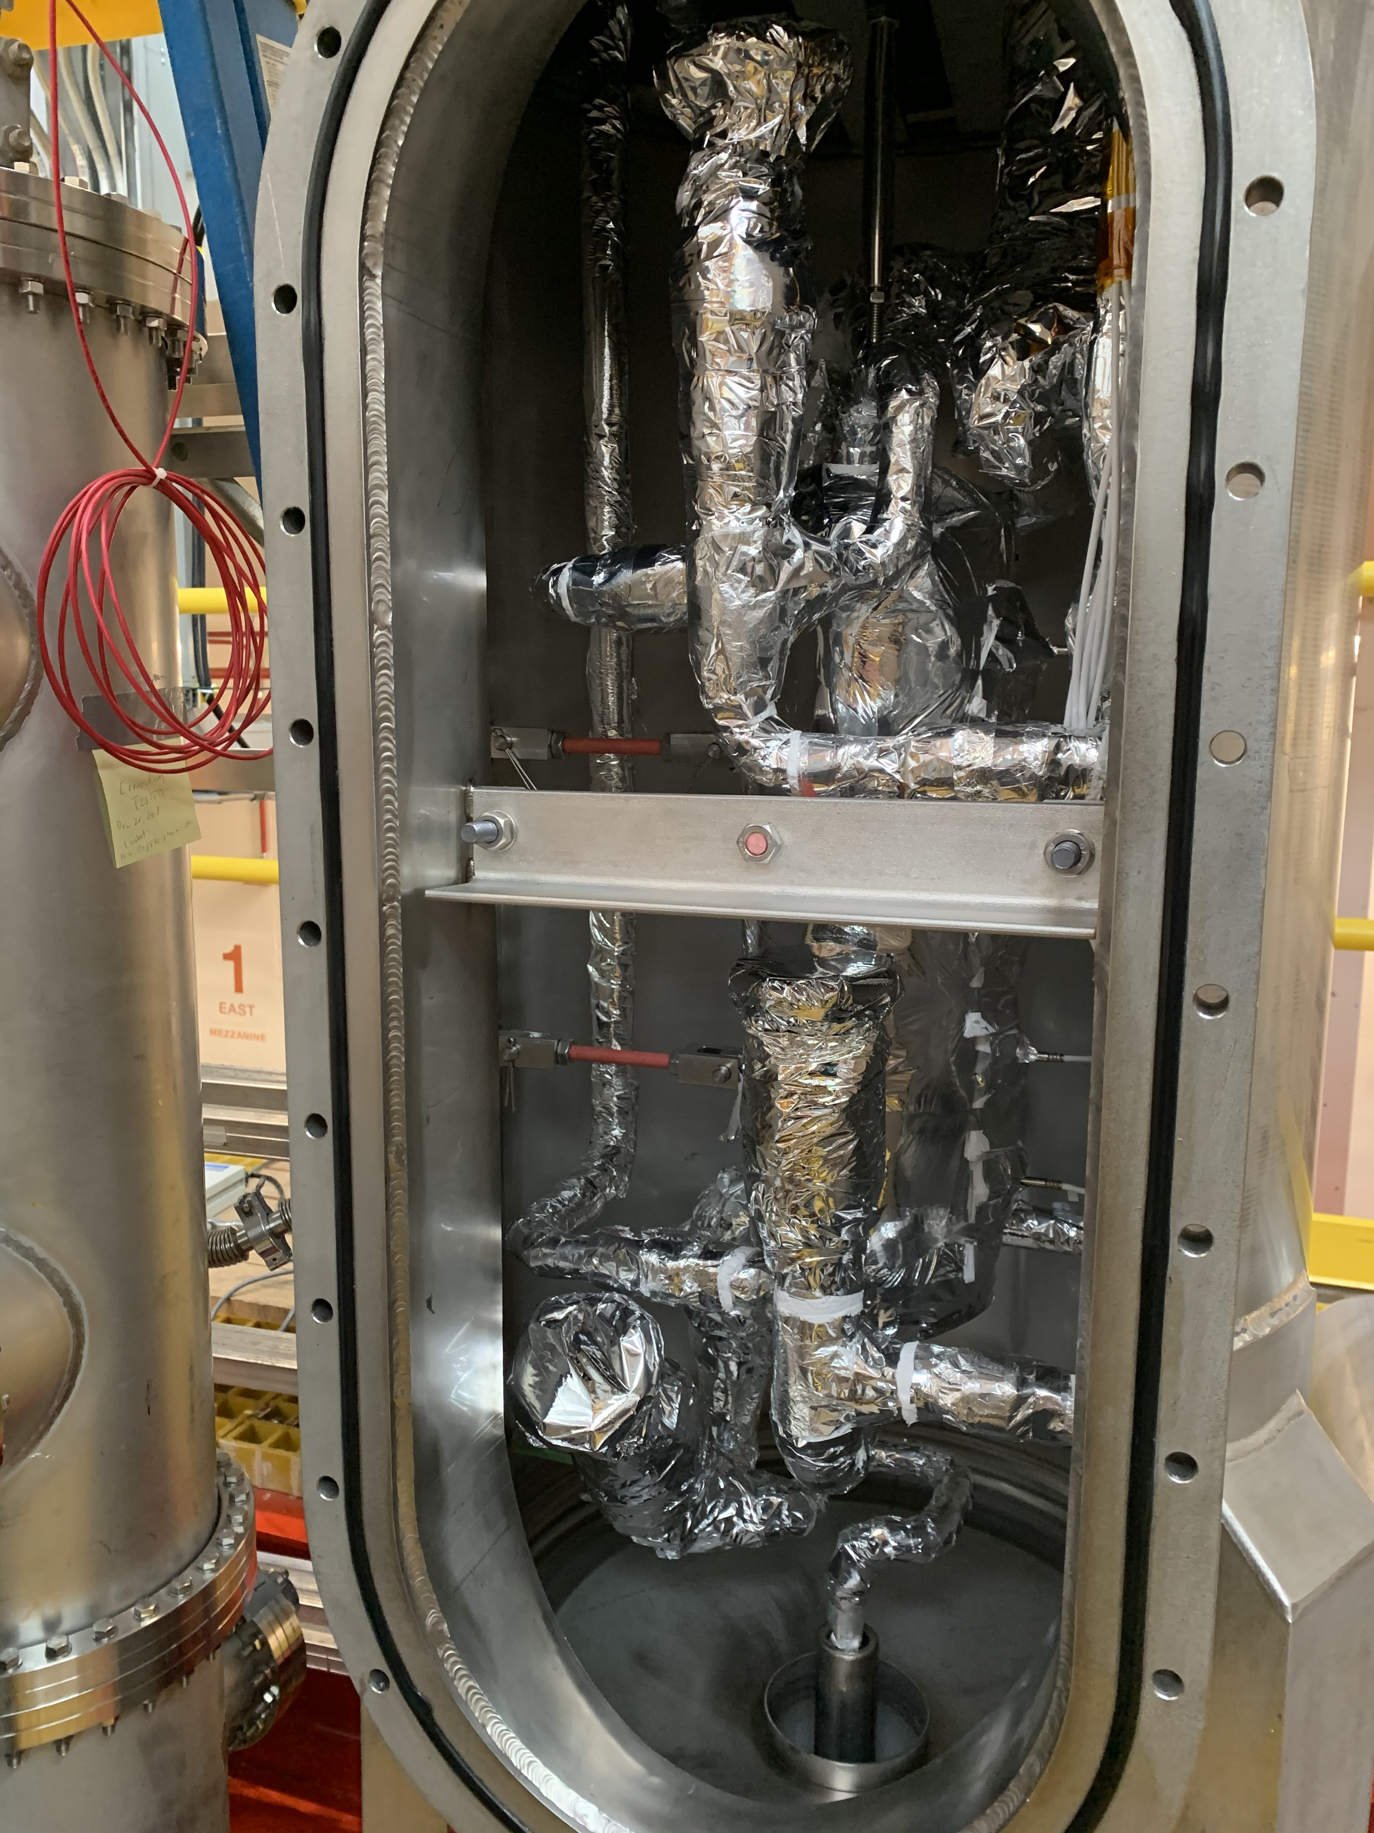
ICARUS Cryogenics Commissioning
Met schedule defined in December despite COVID 19
  Thank you to Steve Brice for making LA filling a priority with laboratory management
  CERN and INFN participation daily via Zoom
Completed fill in April
Completed ullage pressurization test in April
Turned on LAr circulation pumps in April
Turning on gas re-condensers (2/vessel)
  SW 4/22
  NE 4/25
  NW 5/1
  SE condenser still a work in progress
    Have operated for as long as 4 consecutive days (last week)
    Gaining experience – very sensitive to details of startup process
    Designing a modification to address vapor lock in gooseneck between heat exchanger and filter
Topped off vessels with LAr on May 20
Heat Exchanger
LAr Gooseneck
LN2 line
LAr vent line
Filter
LN2 line

Slide 8
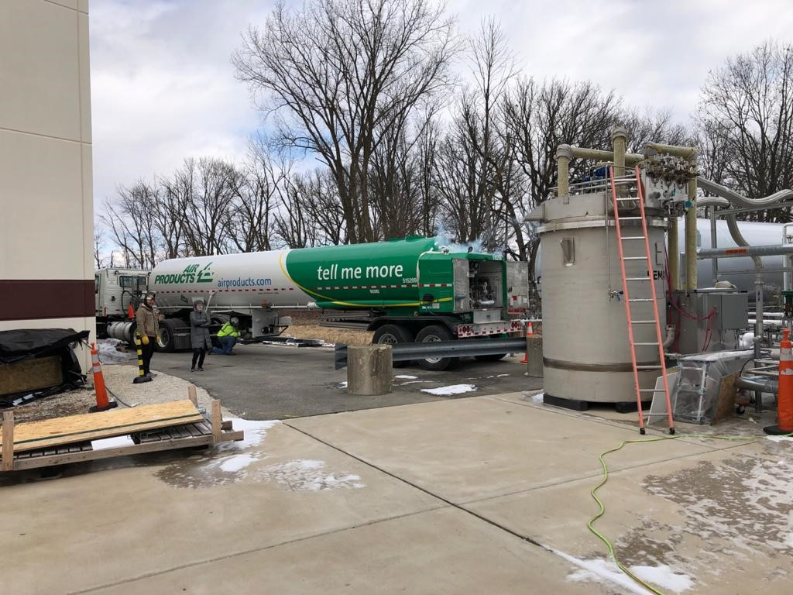
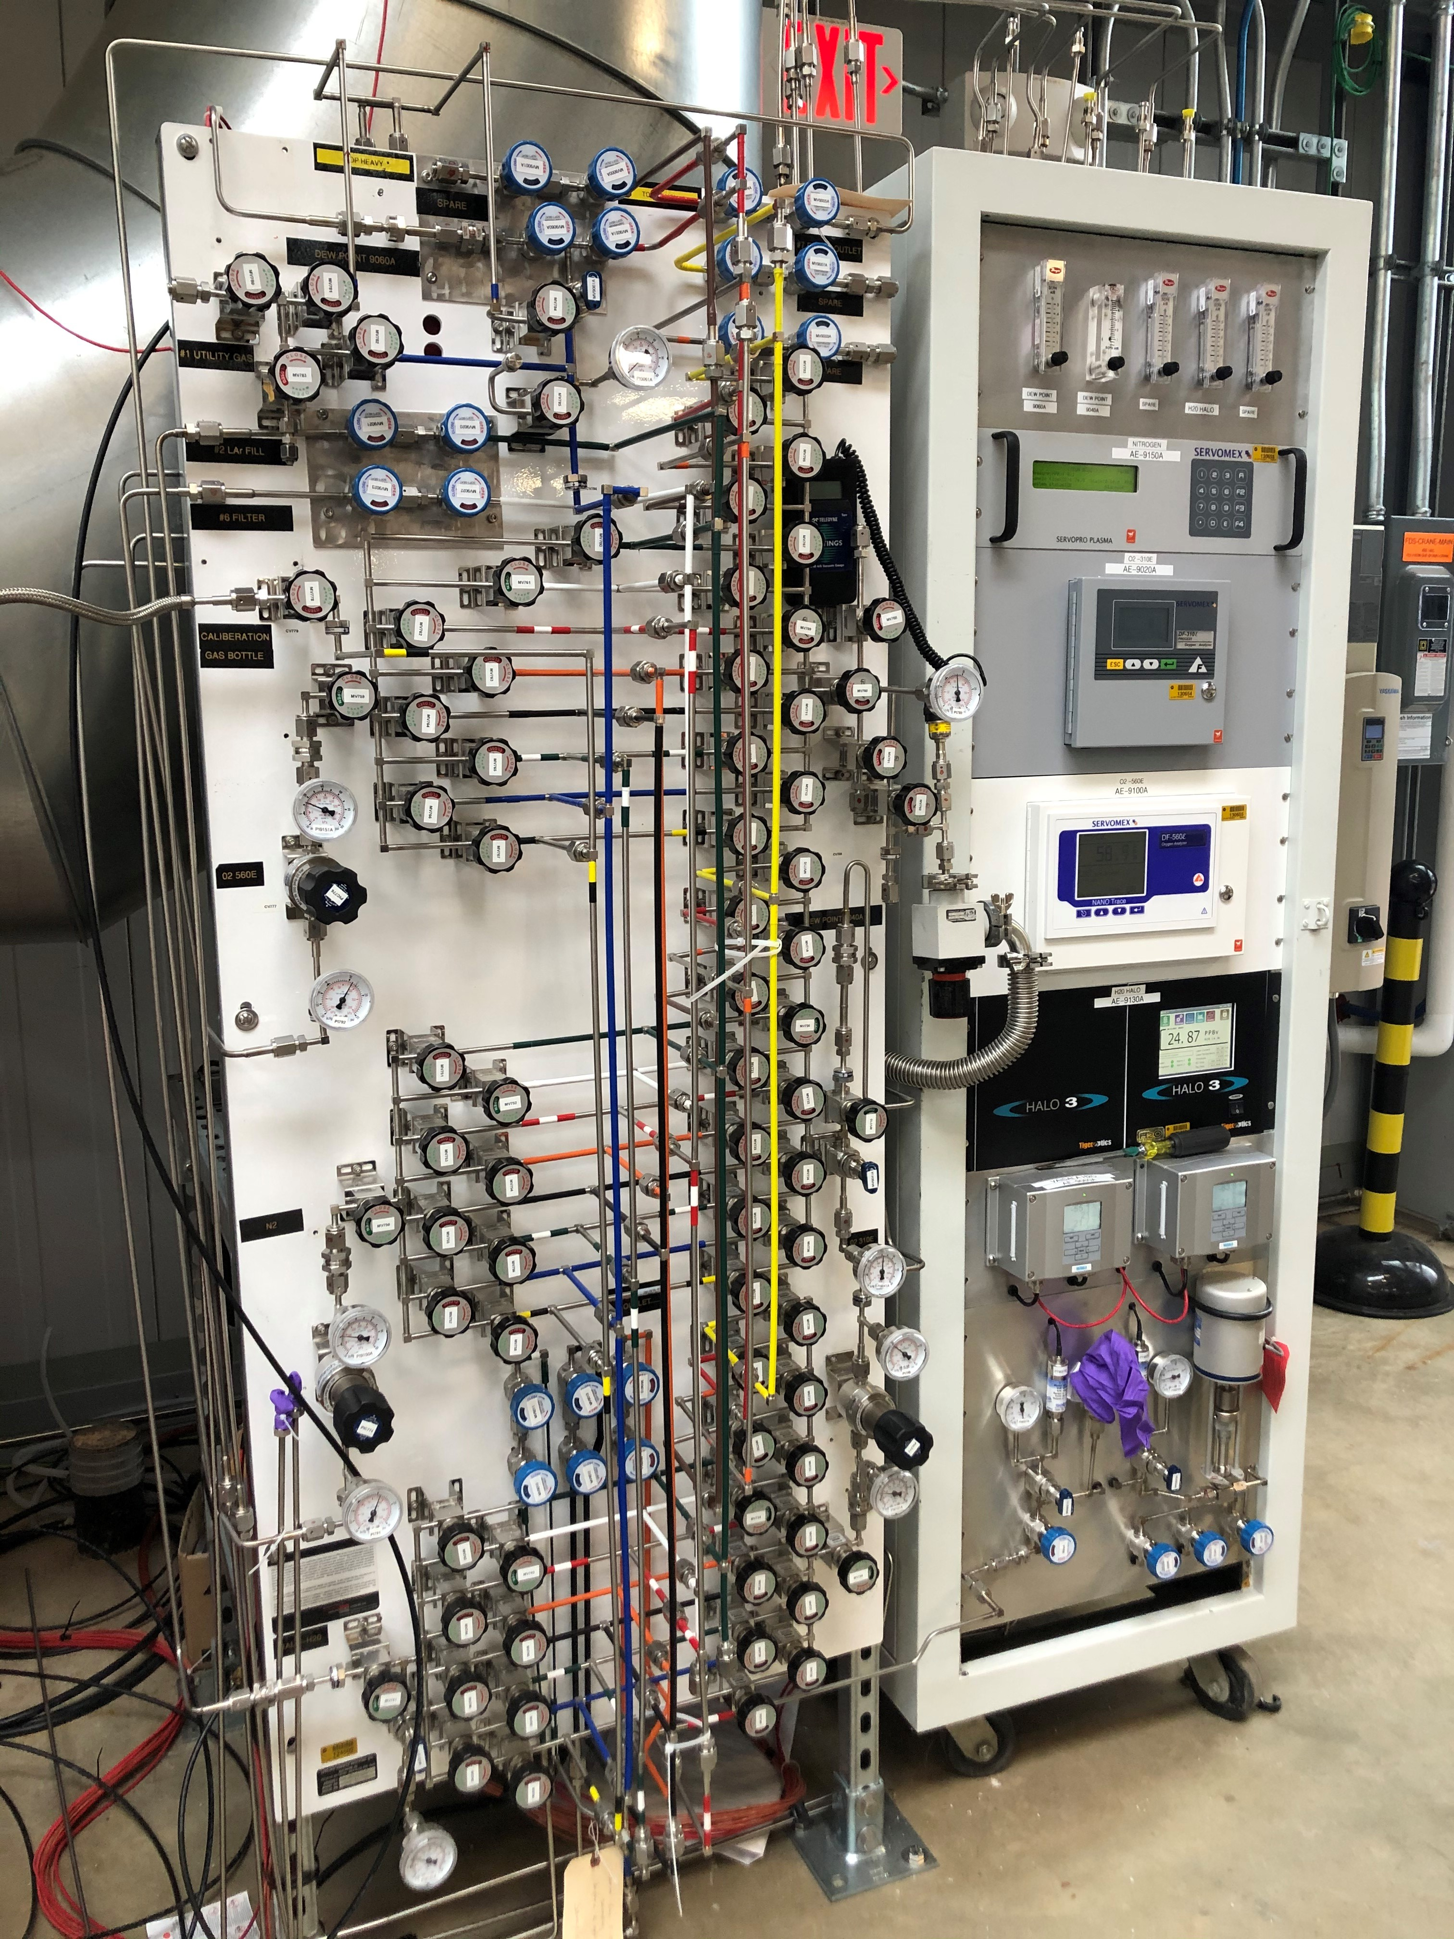
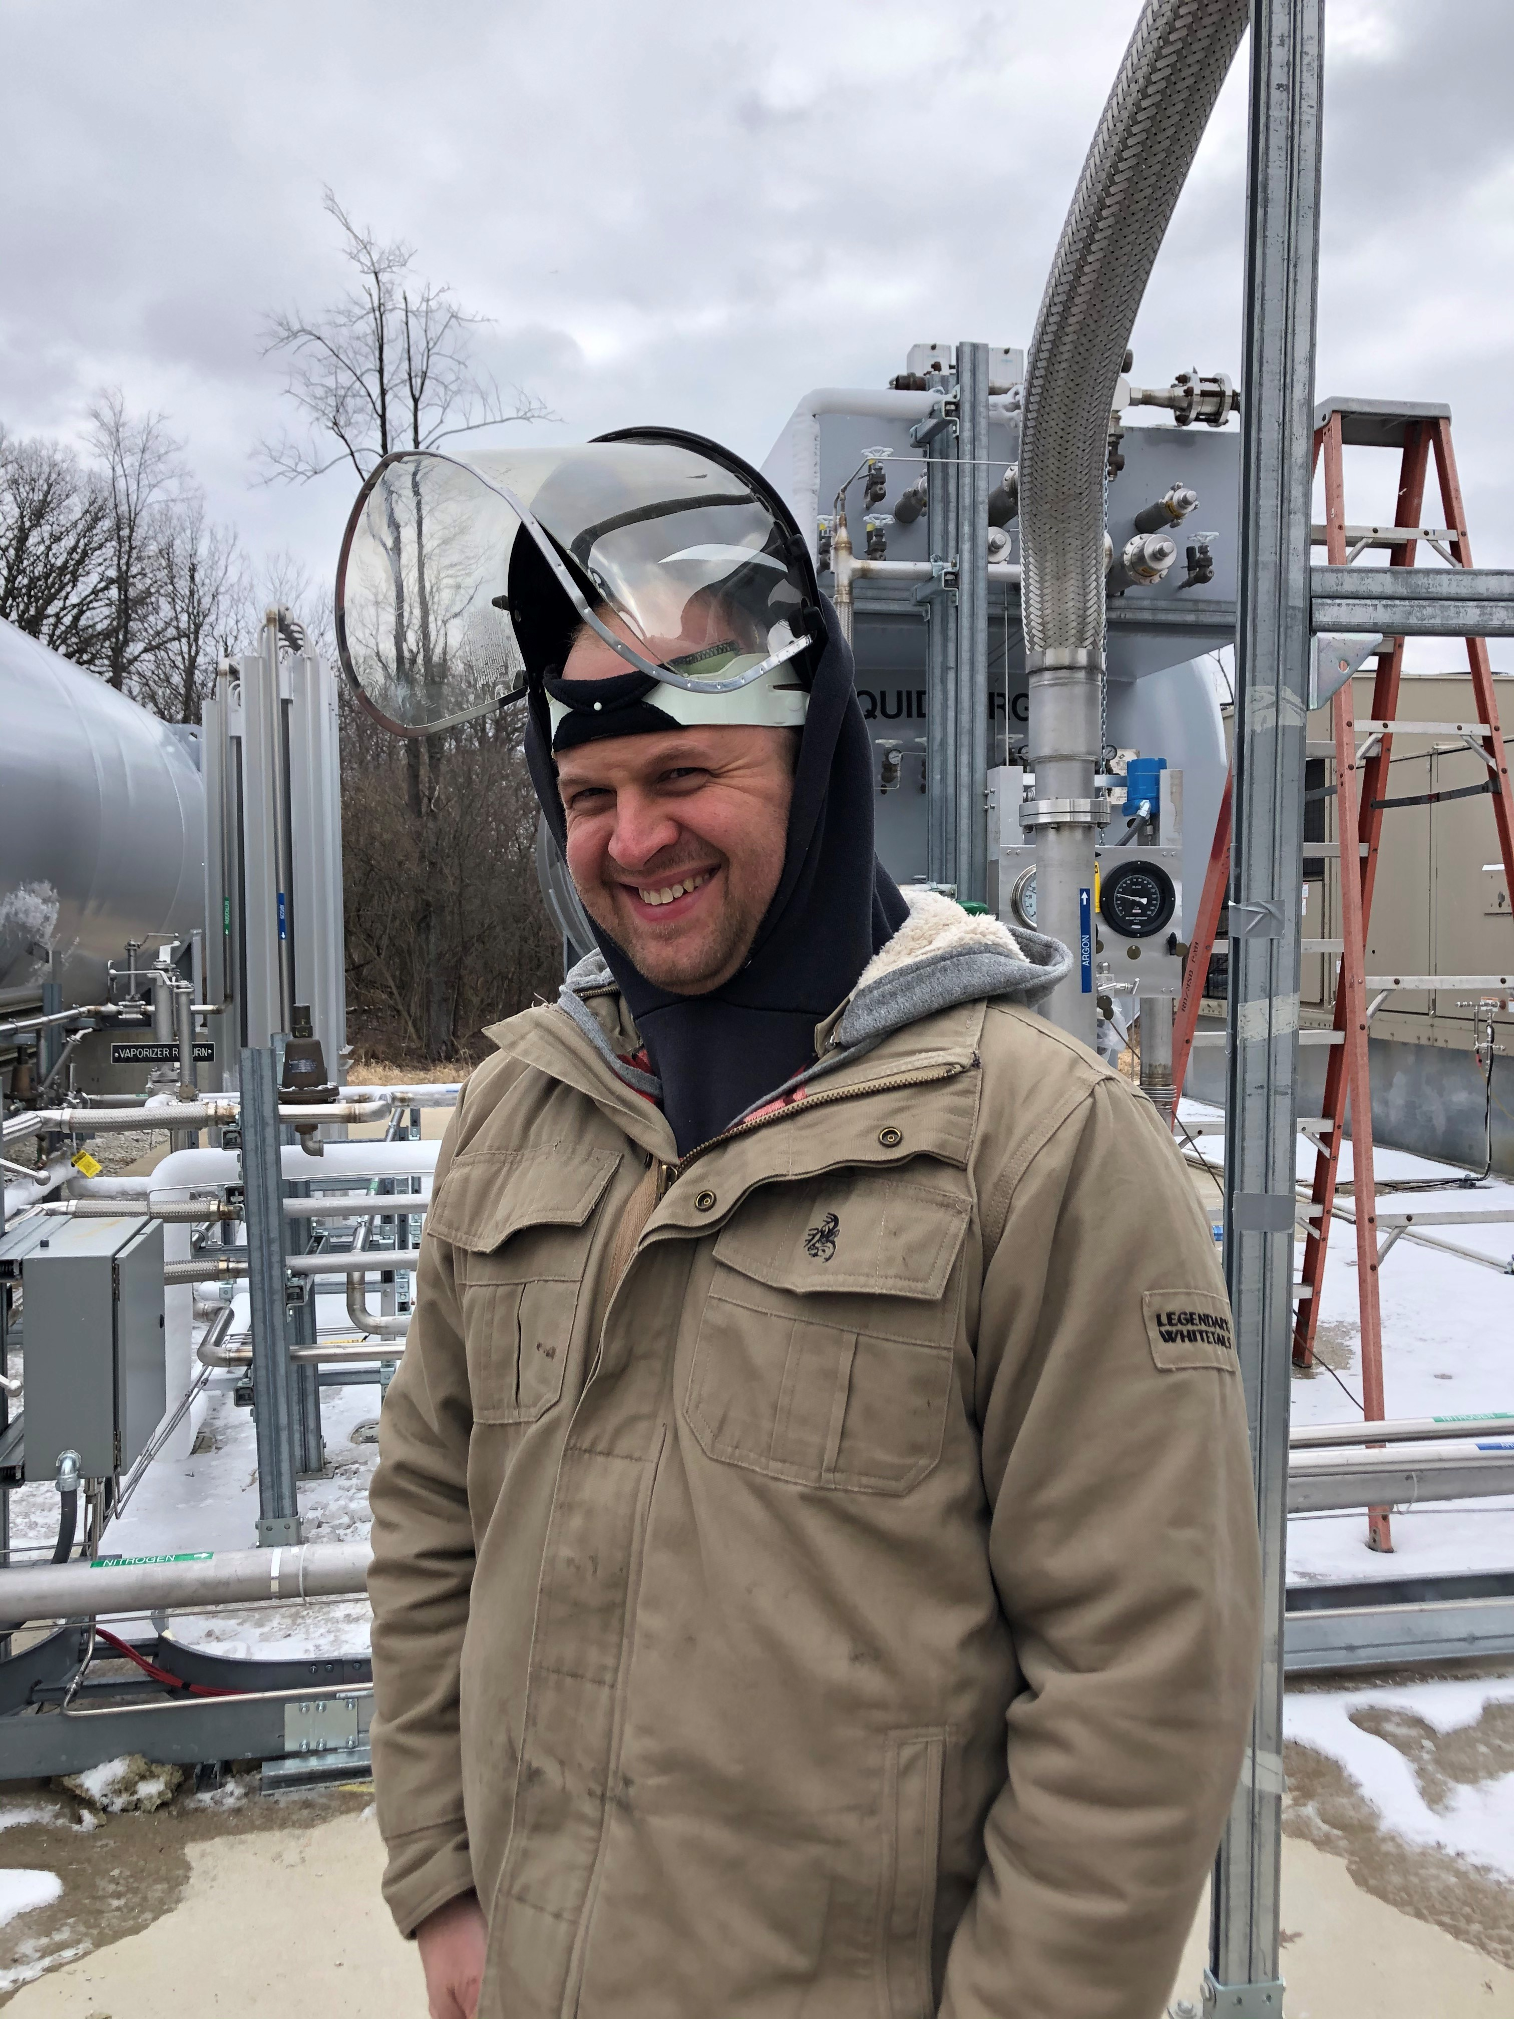
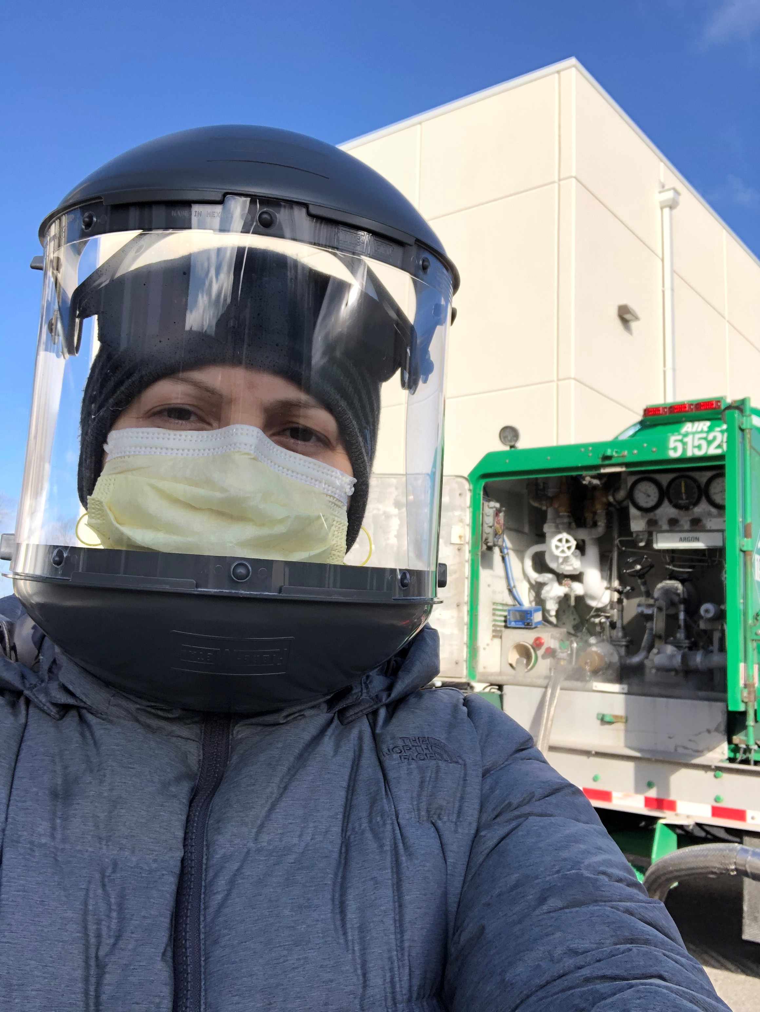
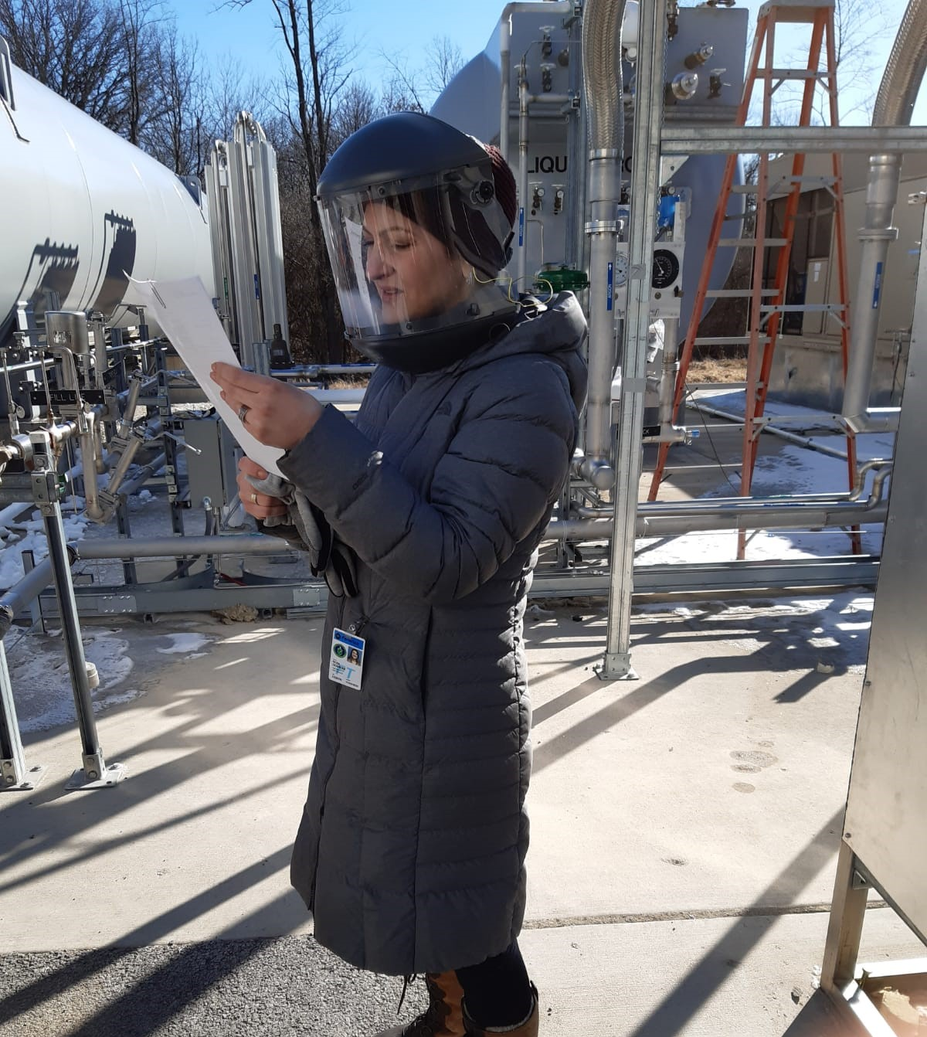
LAr Deliveries
Gas analyzer system
Fritz Schwartz – Weekdays
(Standard face shield for cryogens)
Roza Doubnik - Weekends
7 days/week receive LAr from Air Products
Truck from plant in Granite City, Illinois arrives about 8-10am every morning
Neutrino Division engineer
  Samples Argon before offload for O₂, N₂, H₂O
  Supervises offload (1-3 hours)
Daily Feb 24 – Apr 10 with 3 day pause in mid-March for filter regeneration
  Continues under COVID 19 with social distancing and additional facial coverings; 2nd person monitors over Zoom and Facetime
Thanks to ND engineers and procurement!
Caroline Fabre
Roza Doubnik – with addition of face mask

Slide 9
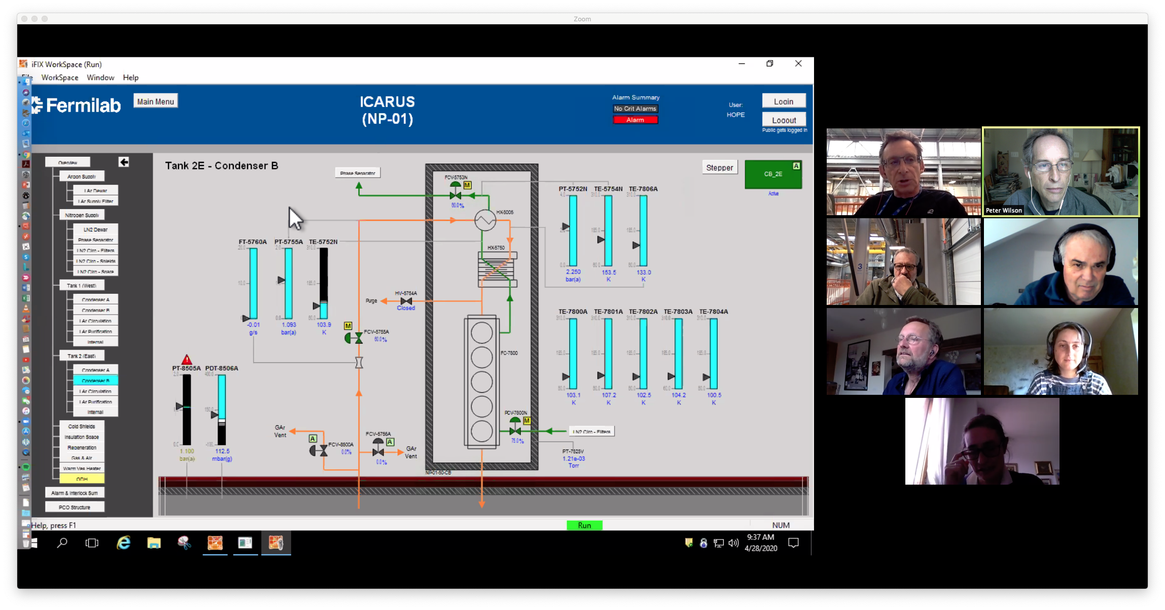
Cryogenics Commissioning during COVID-19
Cryogenics commissioning team in action
Michael Geynisman
Claudio Montanari
Michel Chalifour
Johan Bremer
Caroline Fabre
Chiara Vignoli
CERN (@ home in France)
Johan Bremer
Michel Chalifour
Caroline Fabre
Fermilab
Roza Doubnik (not shown)
Michael Geynisman (@ SBN FD)
Chris James (not shown)
Fritz Schwartz (not shown)
INFN
Claudio Montanari (@ SBN FD)
Chiari Vignoli (@ home in Italy)

Slide 10
ICARUS Detector Commissioning – COVID 19 Plan
Work expanded in last week of May with return of several Fermilab technicians and several key Fermilab personnel: Linda Bagby, Geoff Savage, Donatella Torretta
Weekly planning meeting (previously organized by the Installation Coordinator, Aria Soha) resumed by the ICARUS Experiment Liaison Officer (ELO), Carrie McGivern, in very close coordination with Claudio Montanari
  Work plans reviewed and scheduled
  Work is coordinated to ensure social distancing
  Ensure that necessary site access permissions are in place

Slide 11
ICARUS Detector Commissioning – COVID 19 Plan
Initial task list:
  Transition cryogenics from commissioning to operations – in progress
  Diagnosis of short between detector and building ground – significant progress - still in process
  Partial turn-on of PMT system – last week 8 PMTs/vessel
  Complete TPC drift HV installation - in progress
  Complete TPC bias voltage connections - in progress
  Complete TPC DAQ connections
  Turn-on Drift HV at up to 40kV (75kV nominal operating voltage)
Next tasks (likely to start in July)
  CRT wall installation
Have not yet made a schedule projection for completion of commissioning tasks. Goal is to be ready for beam when it returns in the fall

Slide 12
ICARUS Milestones to I-2 Detector Filled
Intermediate Milestone | Owner | Baseline Date | Forecast Date |  | Actual Date
Cold shield cooldown complete | C. Montanari | 7-Aug-2019 |  | ✓ | 18-Feb-2020
Vessels filled & ullage pressurization completed | M. Geynisman | 30-Sept-2019 |  | ✓ | 22-Apr-2020
Drift HV operational | Z. Williams | 15-Oct-2019 | 18-May-2020
PMTs operational | G. Raselli | 30-Oct-2019 | 25-May-2020
Cryogenics commissioning complete | M. Geynisman | 30-Nov-2019 | 29-May-2020
Cosmic tracks are observed in the TPC | A. Fava | 30-Nov-2019 | 08-Jun-2020
I2: detector is filled with liquid argon and ready for physics commissioning (LAr purity adequate for physics has been achieved) | P. Wilson | 30-Nov-2019 | 08-Jun-2020
COVID 19 impact on detector commissioning not yet included

Slide 13
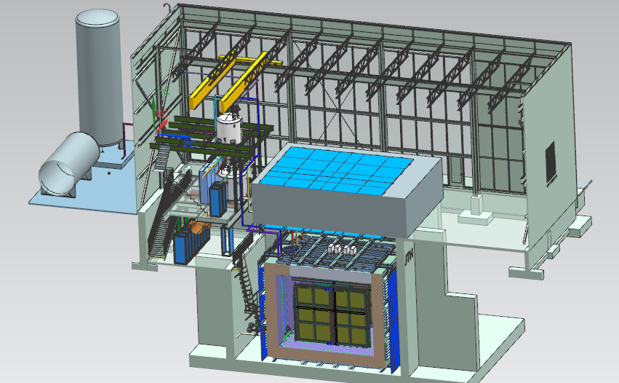
Near Detector - SBND
20 ton crane
Top CRT and Overburden
Cryogenic Dewars
Proximity Cryogenics
Readout racks
Top CRT
TPC
Cryostat
Side CRT

Slide 14
SBND Assembly at DZero
Work has continued by collaborators and engineers TPC on designs and assembly plans
  Contract has been placed for fabrication of the CPA support beam
    Delivery in early July
  Design of connections between APA and support beam finalizing
  Completed first iteration of all procedures for assembling the detector
Work restarted at Dzero in end of May
  Completing atf, completed final welding
  Assembled atf clean tent frames
  Work by collaborators expected to start at the end of June
atf with clean tent frames on each side

Slide 15
SBND Installation
Activities which took place during the last month:
  Cryostat decking and stair design completed and approved. Procurement in progress.
  Cryostat railing design completed and approved
  Pit False Floor design completed. Engineering Note in preparation.
  Contract for the 3D scan of the warm vessel interior walls placed with the same company who performed the task for FD (Exact Metrology).
Tasks paused or not started until the end of the Safe State mode:
  3D scan of the warm vessel interior walls
  Commissioning of the Sump Pump monitor panel
  Cryostat leak check
  Production and installation of stair and first stage of cryostat decking
  Planning to restart installation work in July

Slide 16
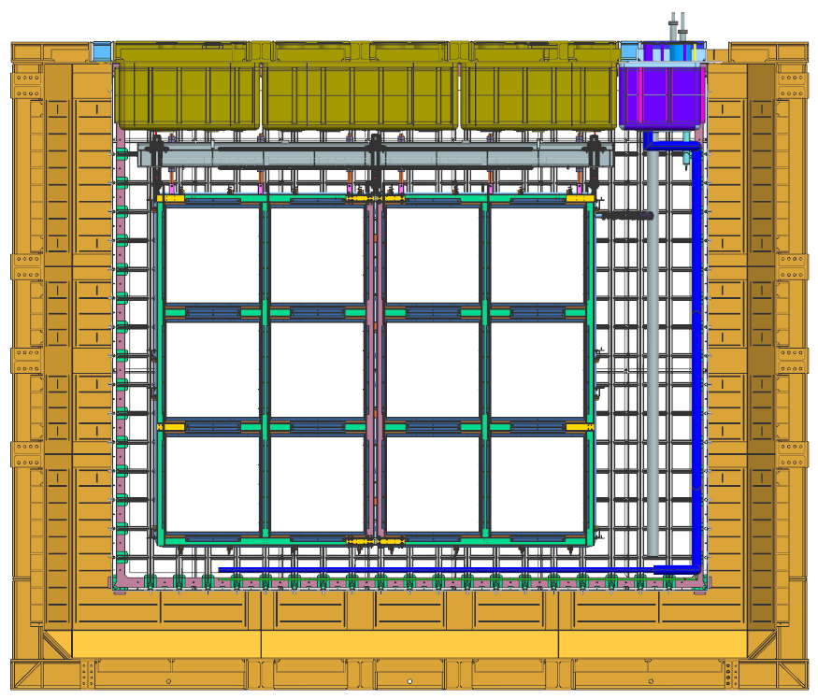
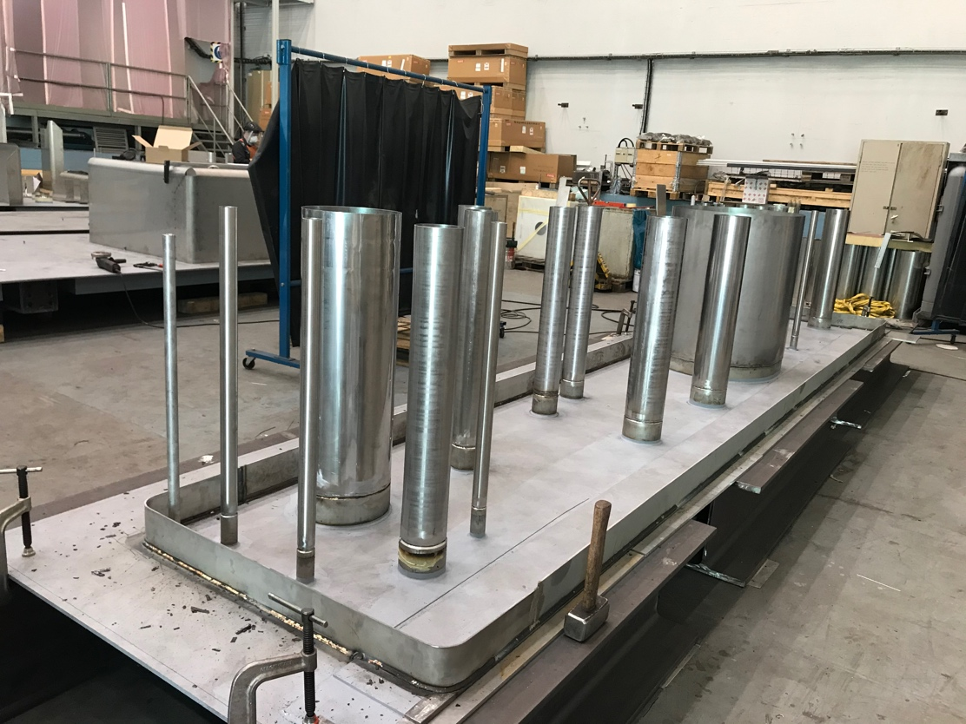
SBND Cryostat
Detector top cap
Cryogenics top cap
Membrane materials order placed by CERN at end of March
  Delivery to Fermilab from vendor in South Korea at end of November
Cryostat Top caps
  Flanges ordered by CERN
  Fabrication paused @ CERN
    Do not expect to restart until late summer – need technicians to return from outside France/Switzerland
    Delivery to Fermilab delayed 4-6 months
The cryostat is on the critical path
Cryogenics top cap fabrication

Slide 17
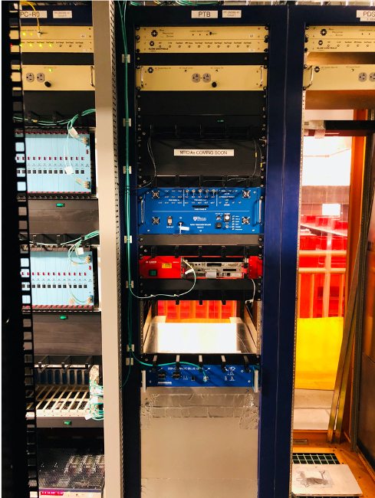
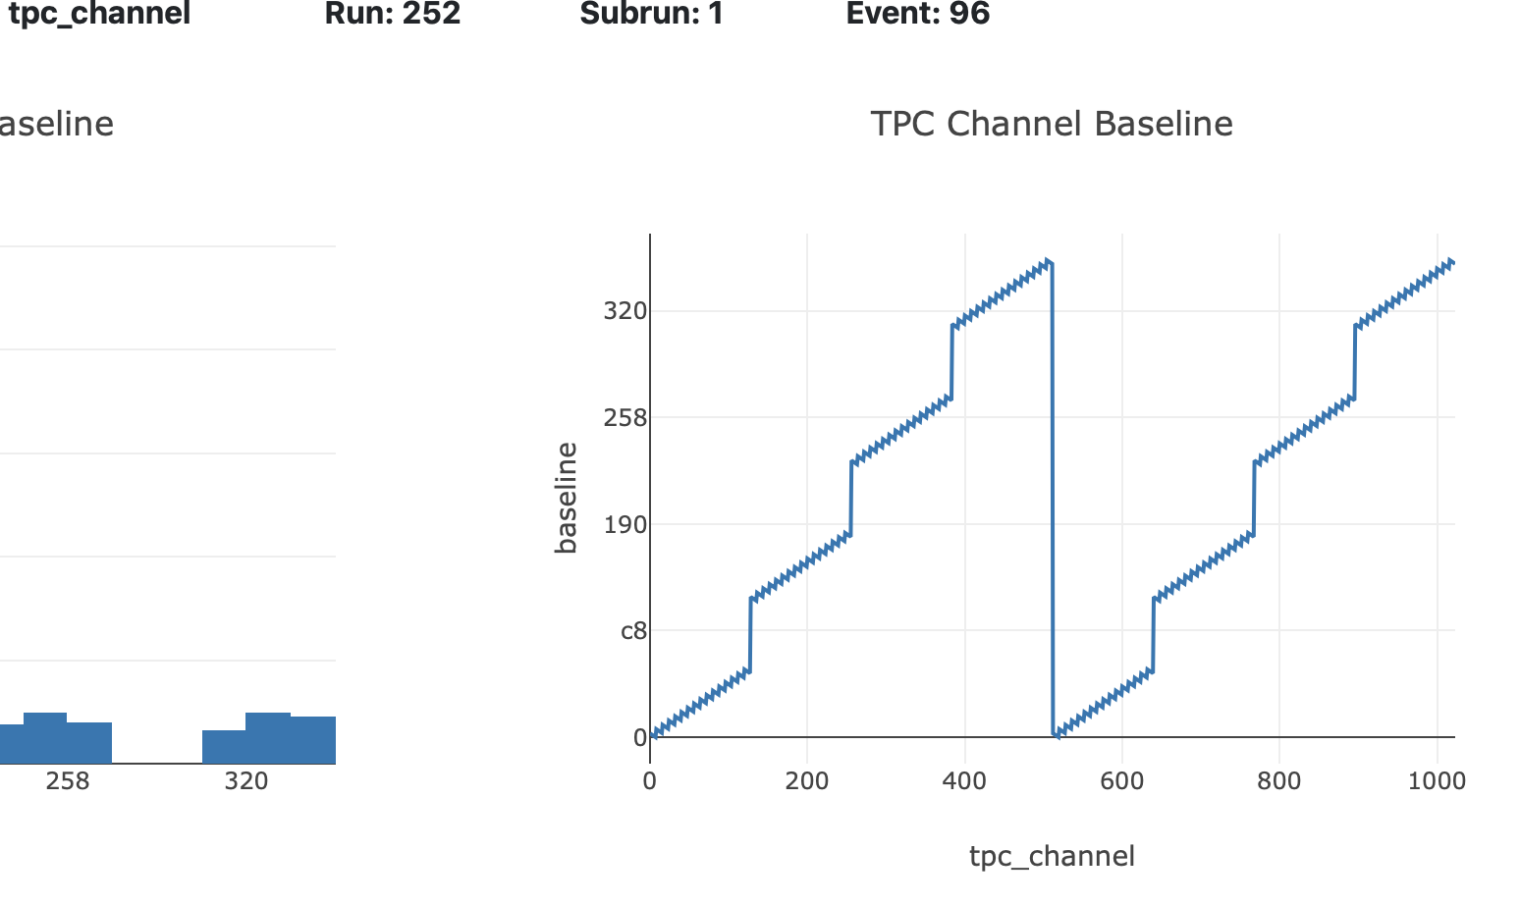
SBND DAQ
Just time for the COVID 19 shutdown:
  Installation of the Photon Trigger Board (PTB ) rack at SBN-ND, including safety review
  Installation of hardware and software for slow controls in the five populated electronics racks
  Started acceptance tests of TPC electronics
  Started integration tests of TPC readout and PTB
  Setup system to maximize remote control capabilities
Significant readout testing progress as remote activity
  In May, first (mostly) successful run of the WOW "WIB on Wheels".
  First attempts at running with multiple TPC readout crates and multiple DAQ servers
Continue implementing a WIB Board Reader for configuration of WIB/PTC/FEMBs

Slide 18

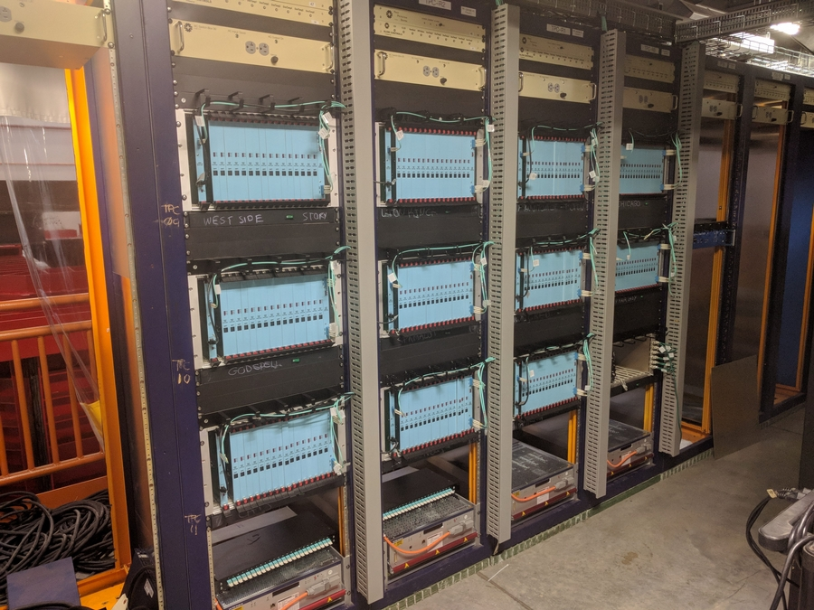
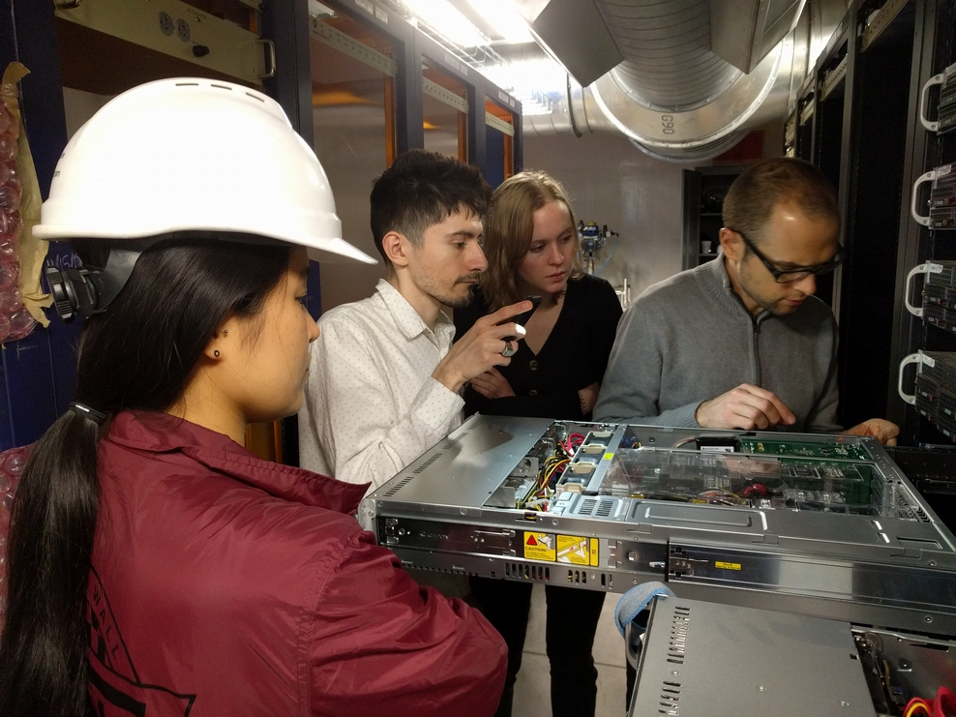
SBND Electronics Installation
Mezzanine racks installation:
  All racks in position
  AC Switch and Rack Protection Units production and assembly completed
Racks equipment (Rack protection, power distribution, slow control units installed
TPC readout installation – readout crates, all the fans, PCIe cards, readout fibers and clock cables, power supplies – installed by the NEVIS Columbia team with FNAL support
  Passed Operation Readiness Clearance (ORC)
Ground monitor in place and passed ORC

Slide 19
SBND Schedule re-plan - completed
Before February Director’s Review
  Updated TPC assembly plan based on Sept 2019 CRR recommendations
  Updated cryogenics resources based on FD lessons and cryostat schedule
  Updated labor resource needs based on past experience at DAB (SBND) and SBN-FD (ICARUS)
  Updated membrane cryostat procurement schedule to projection as of January
After Director’s Review (completed in April)
  Advanced cryogenics engineering based on additional funds this year
  More detailed cryogenics control plan
  Addressed review recommendations on reviewing assembly and installation plans
  Advanced completion of SBND by about 4.5 months
Unfortunately shutdowns at Fermilab, CERN and Universities will result in delay relative to that plan

Slide 20
SBND Milestones to S-1 SBND ready to move
Intermediate Milestone | Owner | Baseline Date | Forecast Date (Schedule) |  | Actual Date
First set of APAs shipped to Fermilab | K. Mavrokoridis | 24-Sept 2018 |  | ✓ | 4-Mar-2019
PO for COTS ADCs placed | H. Chen | 10-Oct-2018 |  | ✓ | 30-Oct-2018
All TPC Components at Fermilab | K. Mavrokoridis | 1-Mar-2019 |  | ✓ | 27-Mar-2019
Complete atf assembly at DAB | J. Zennamo | 1-May-2019 |  | ✓ | 27-Nov-2019
50% of motherboards delivered to Fermilab | H. Chen | 15-May-2019 |  | ✓ | 22-May-19
APAs and CPAs installed in atf | N. McConkey/ J. Zennamo | 15-Jun-2019 | 26-Oct-2020
Field cage assembly complete | N. McConkey/ J. Zennamo | 15-Jul-2019 | 25-Nov-2020
Cold electronics installed and tested | H. Chen | 23-Aug-2019 | 7-Jan-2021
S1: TPC ready to move to SBN ND | A. Schukraft | 30-Aug-2019 | 7-Jan-2021
These forecasts reflect the updated schedule at end of April but will need to be updated to reflect reality of COVID 19 delays

Slide 21
Upcoming Events
Operational Readiness Review for SBN FD (ICARUS) – date under discussion
Director’s mini-review of SBND schedule – September/October 2020

Slide 22
Backup

