Slide 1
Ionization Laser Update
Jan Boissevain
Laser WG Meeting
March 26, 2020

Slide 2
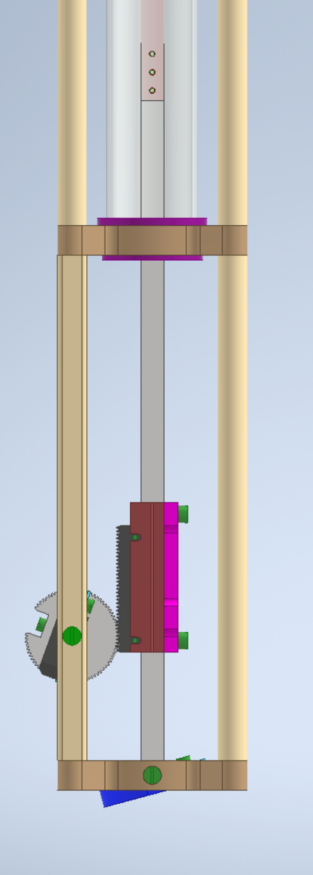
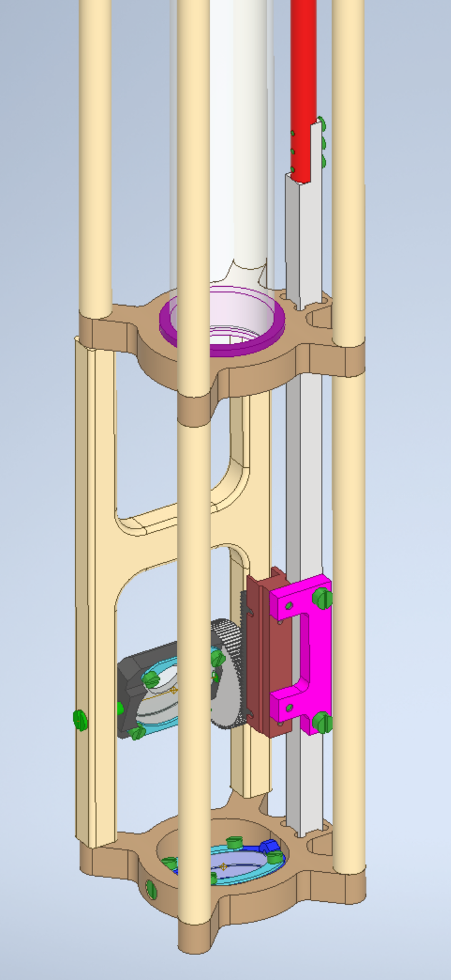
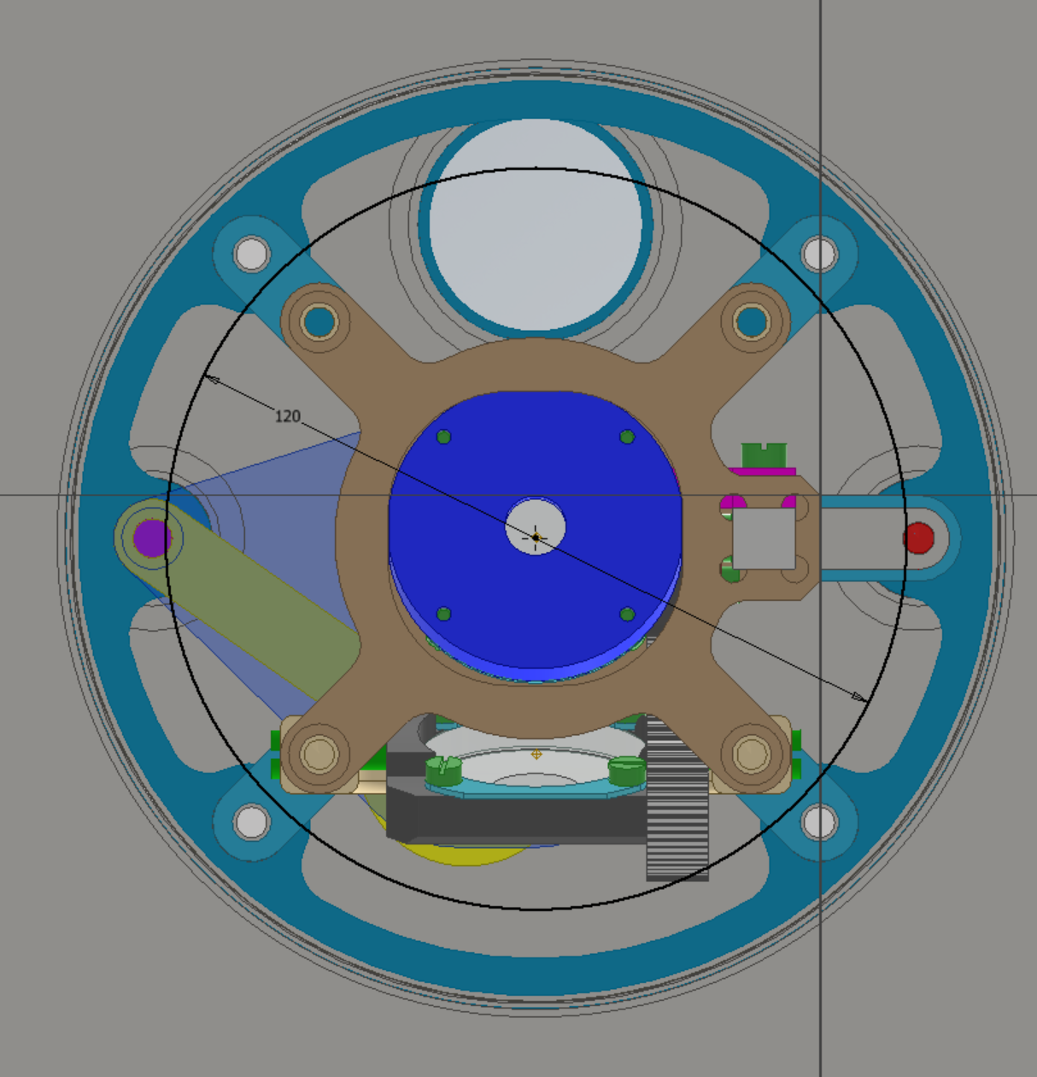
Design Study to check viability of increasing the mirror size from 25.4mm diameter to 38.1mm diameter
View of bottom – looking up
38mm mirrors

Slide 3
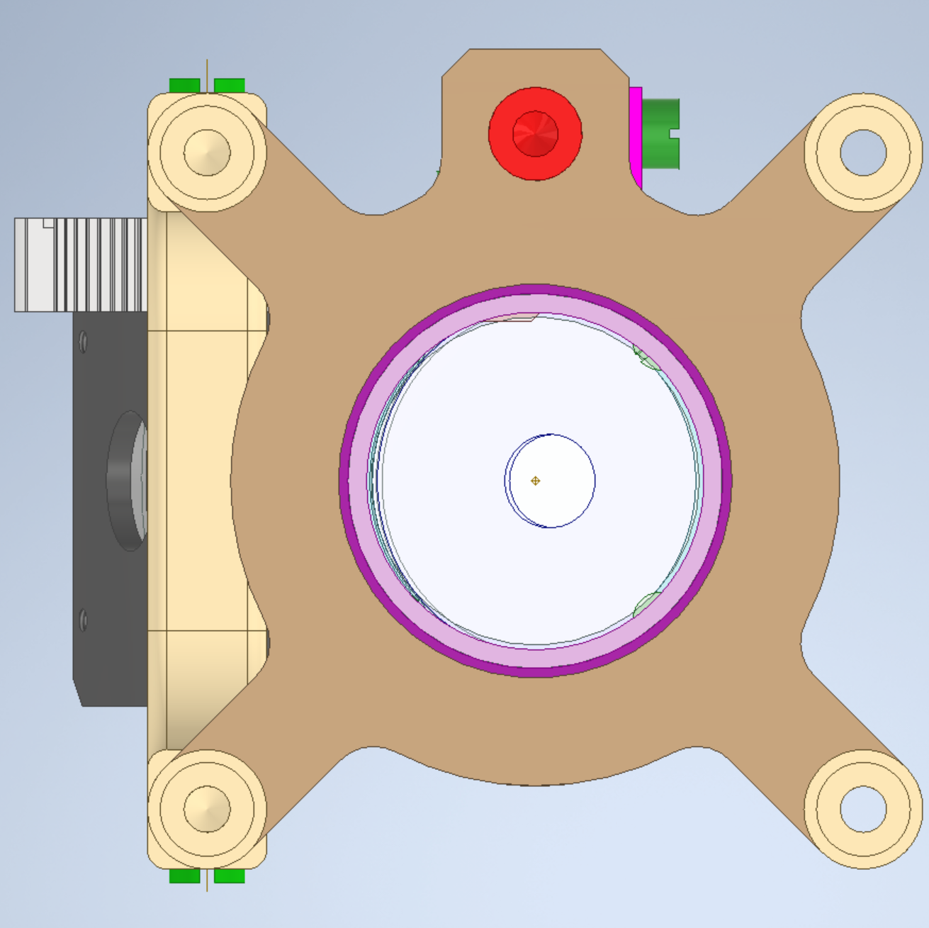
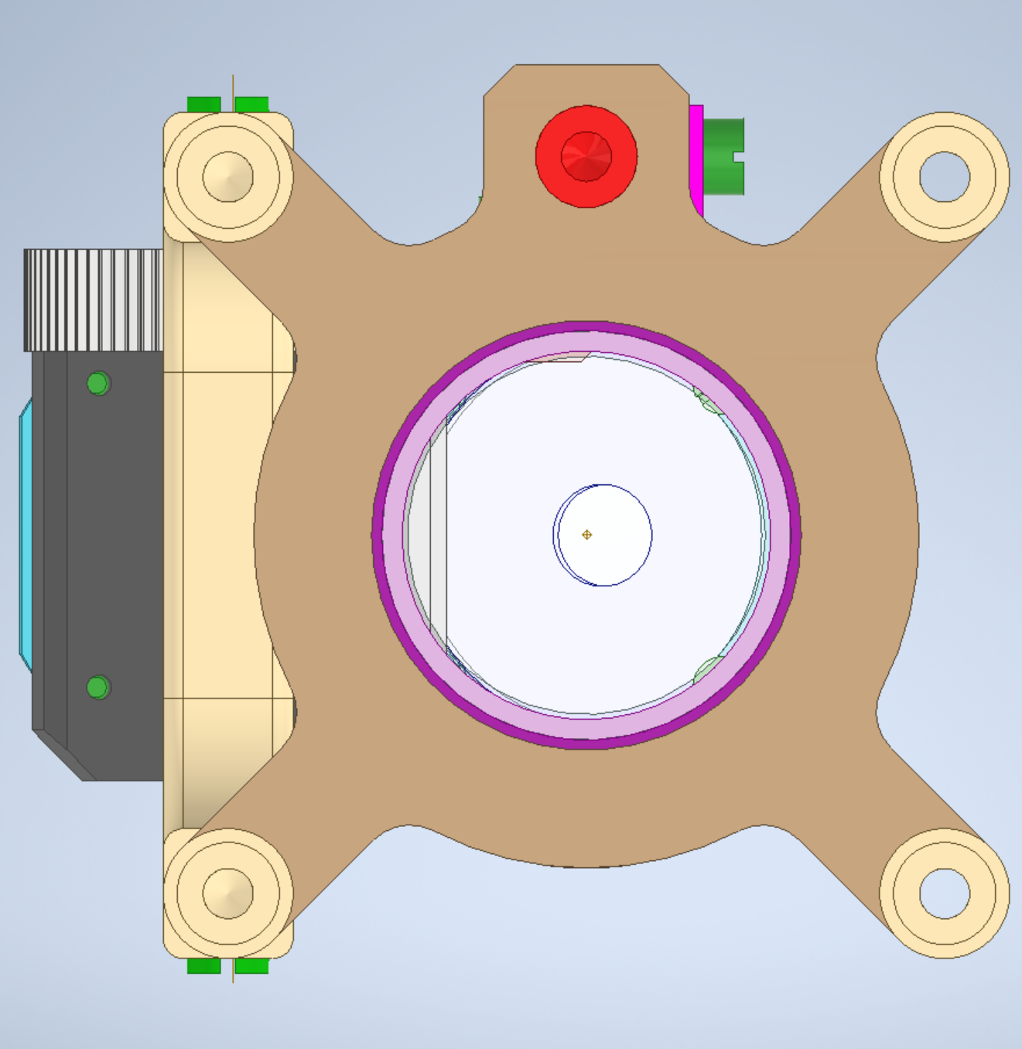
38.1mm Mirrors
Worst Case mirror view blockage

Slide 4
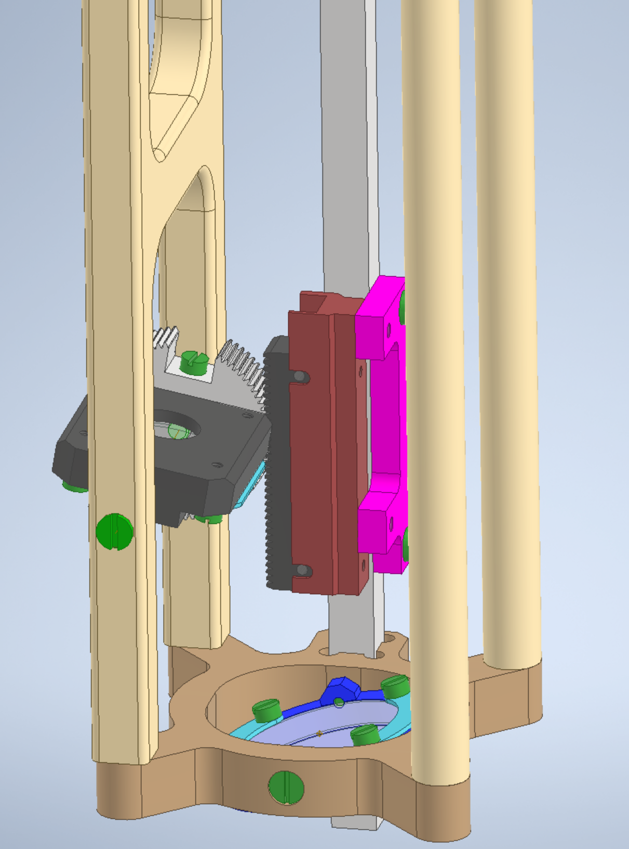
Worst Case Rotating Mirror location

Slide 5
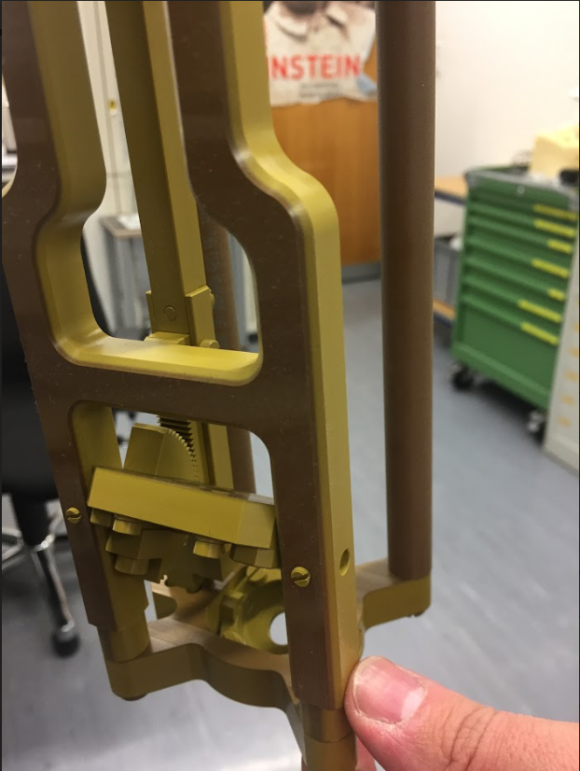
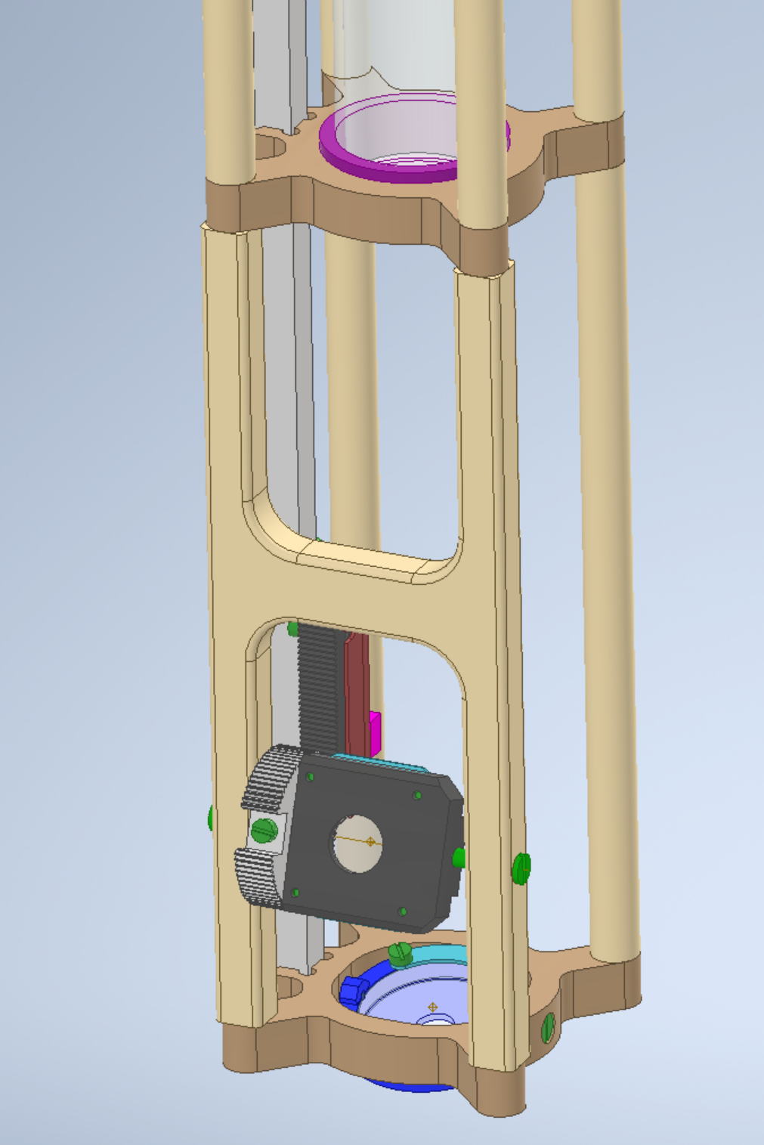
Question: Can we substitute Peek for Torlon?
Cheaper
More vendor choices for material
More choices about machining
Simplified Rotating Mirror Support - Peek
Peek?
Torlon

Slide 6
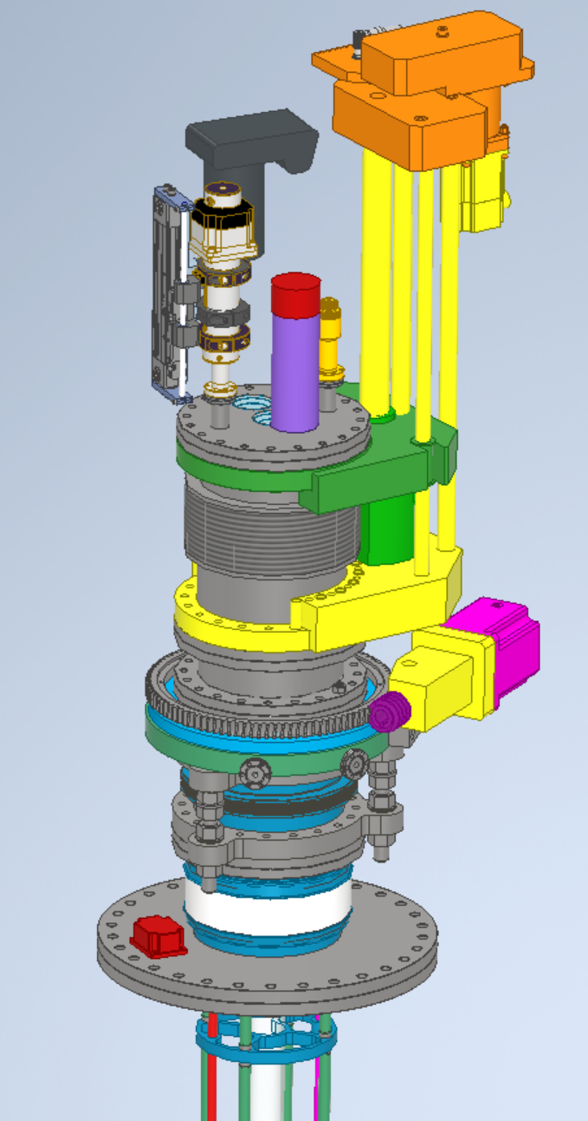
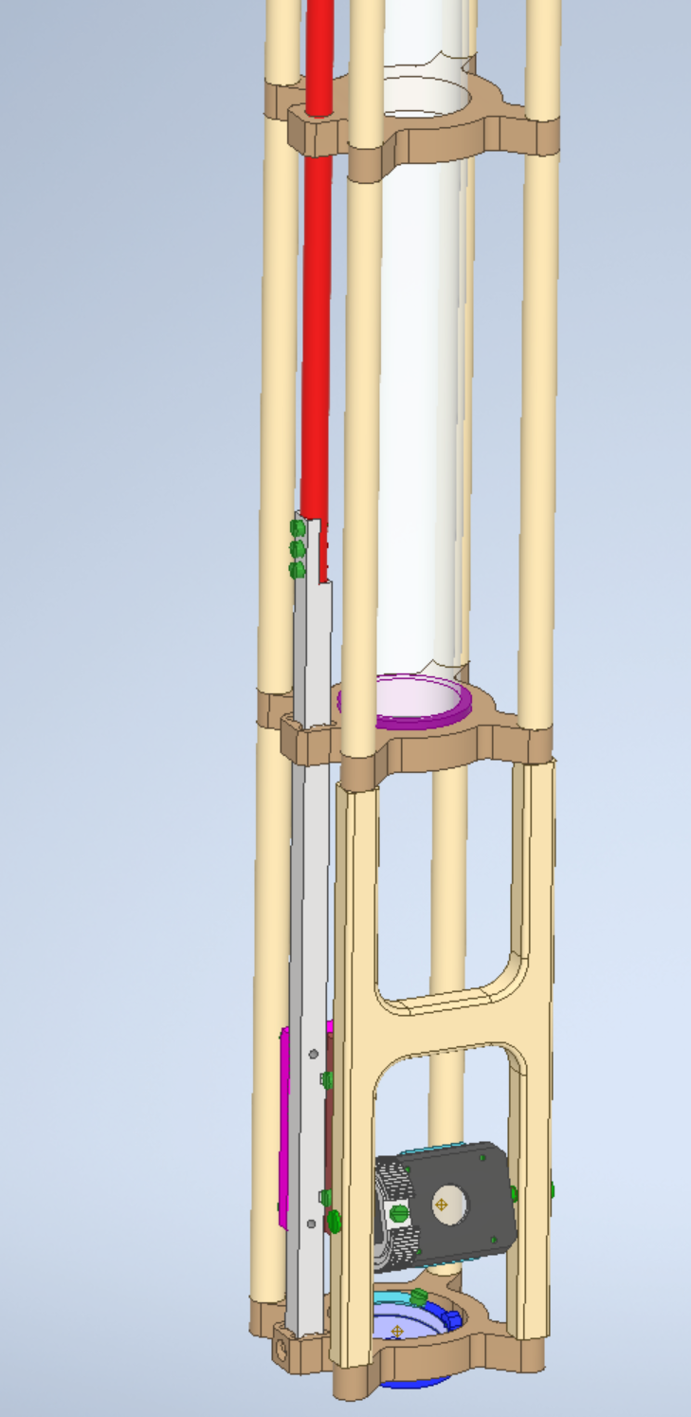
Electrical Break

Slide 7
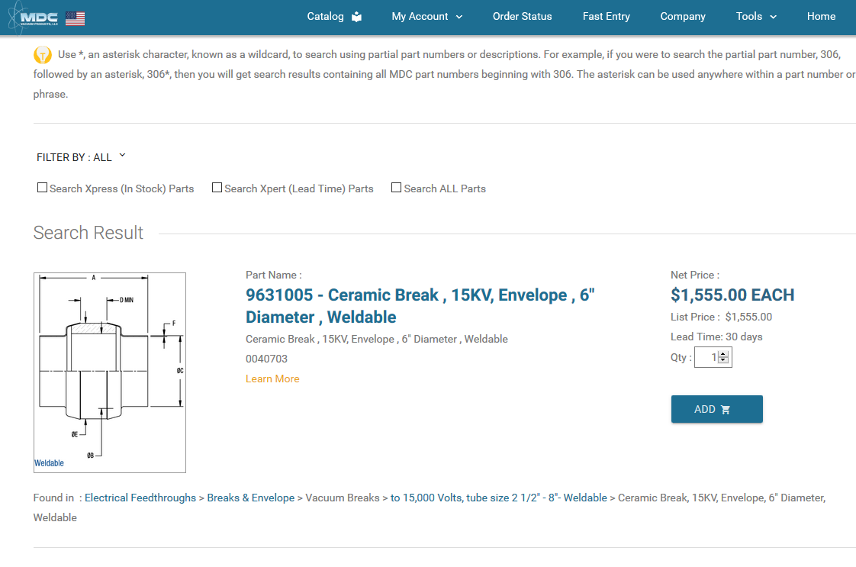
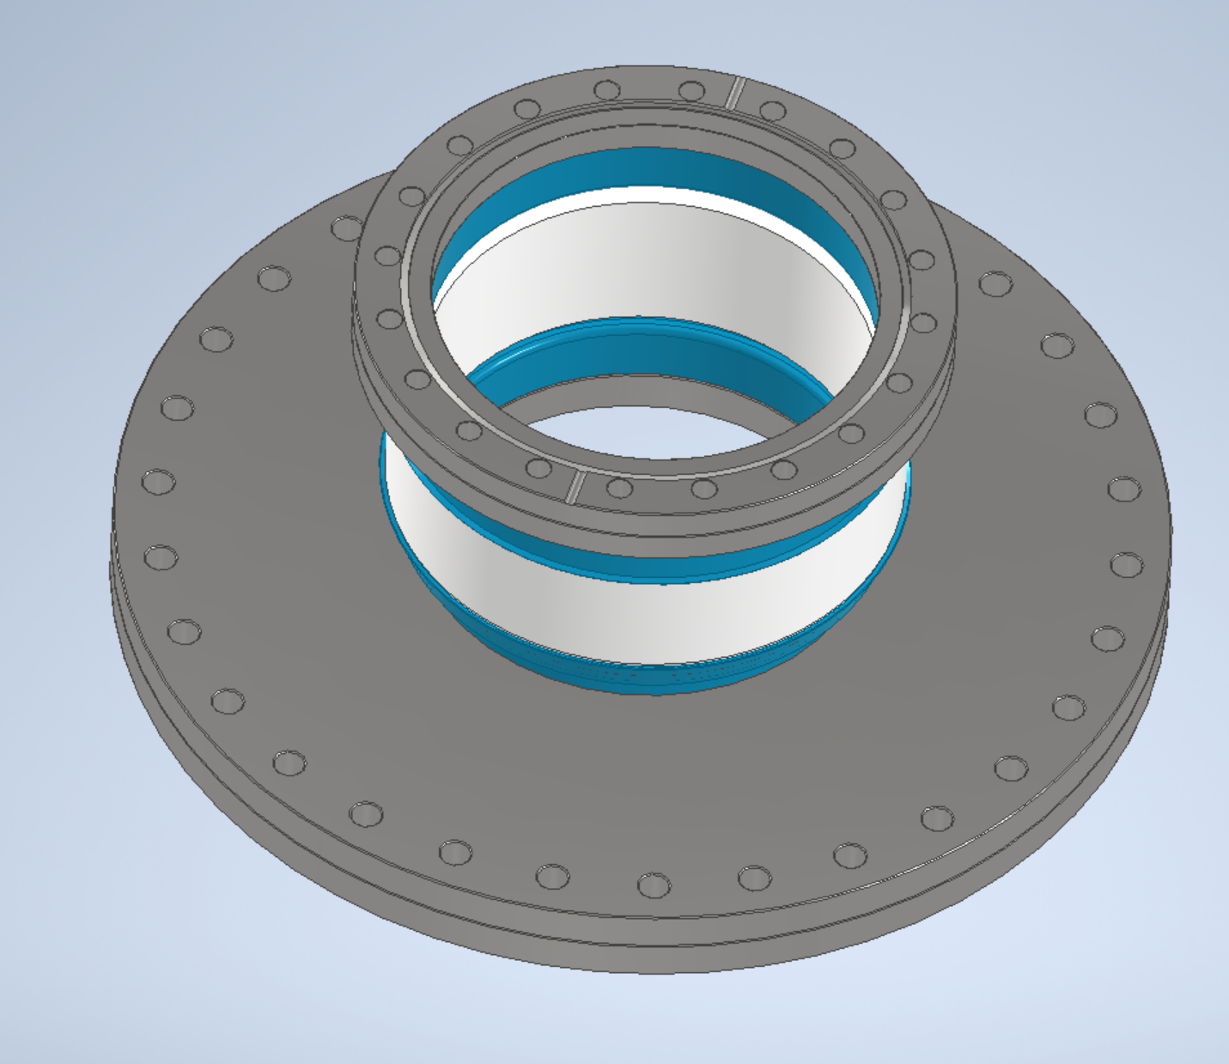
Made a request to MDC for a cost for a ceramic break with Conflat flanges welded in place

Slide 8
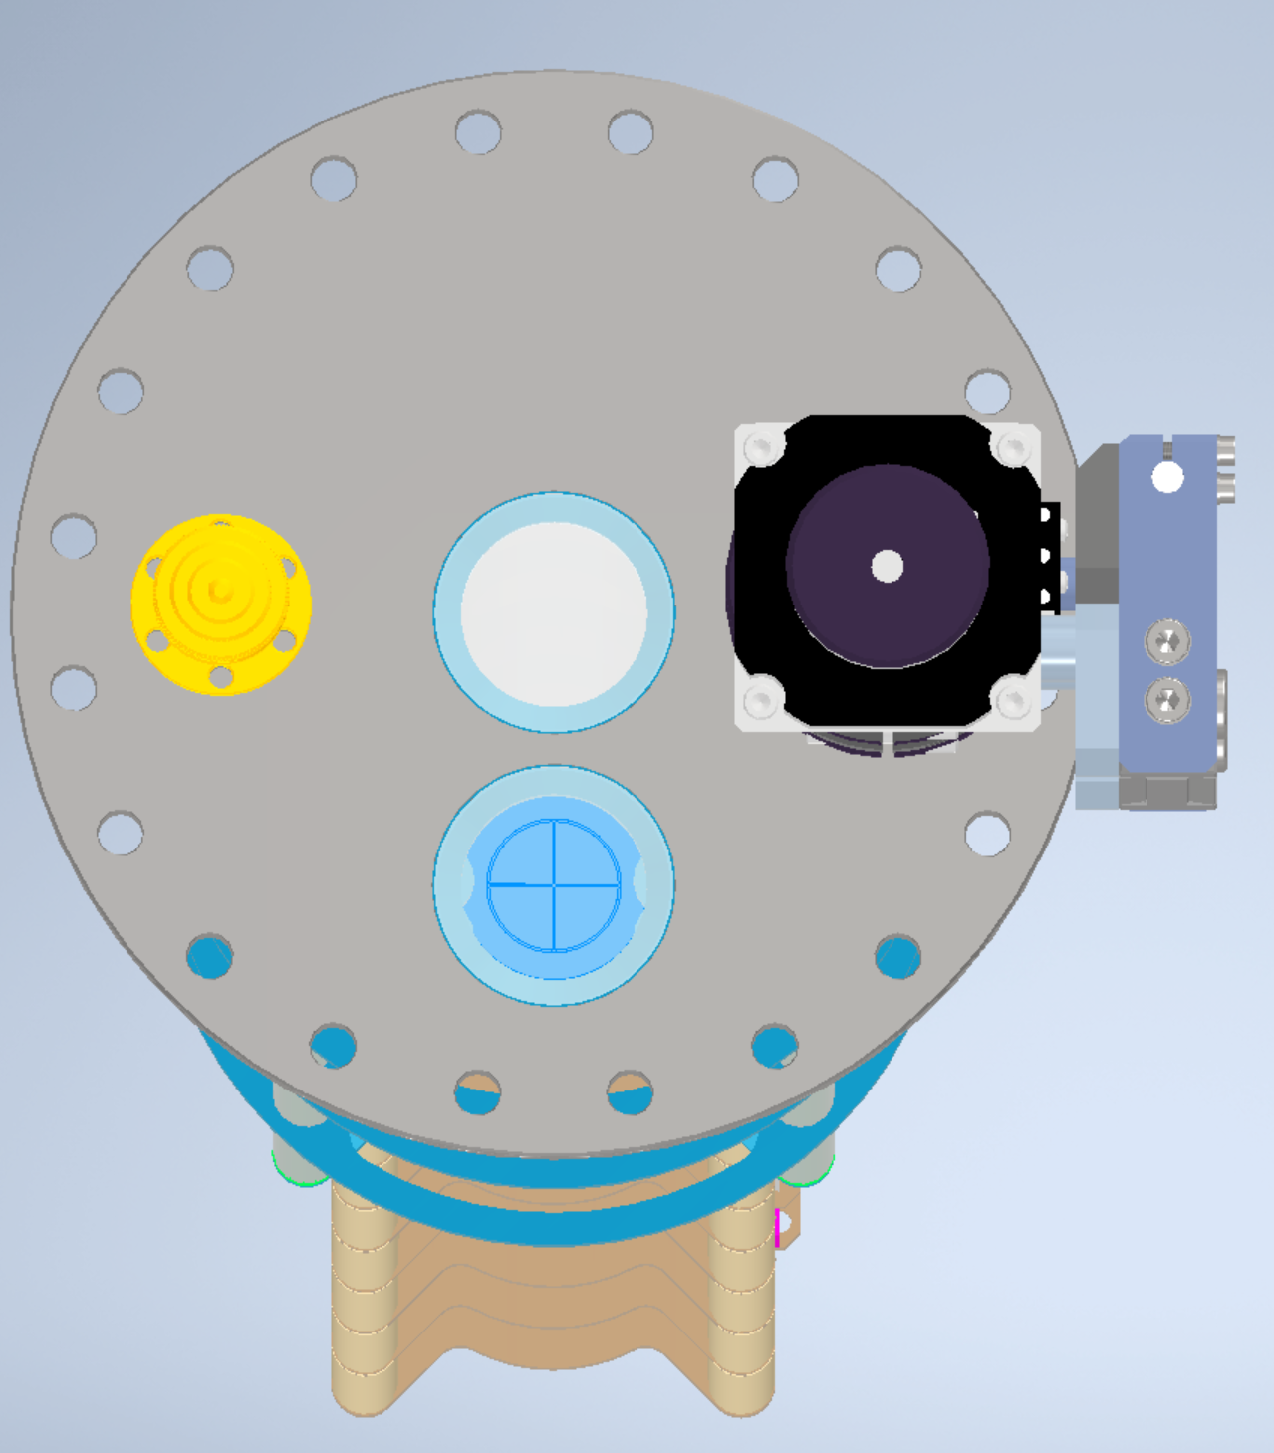
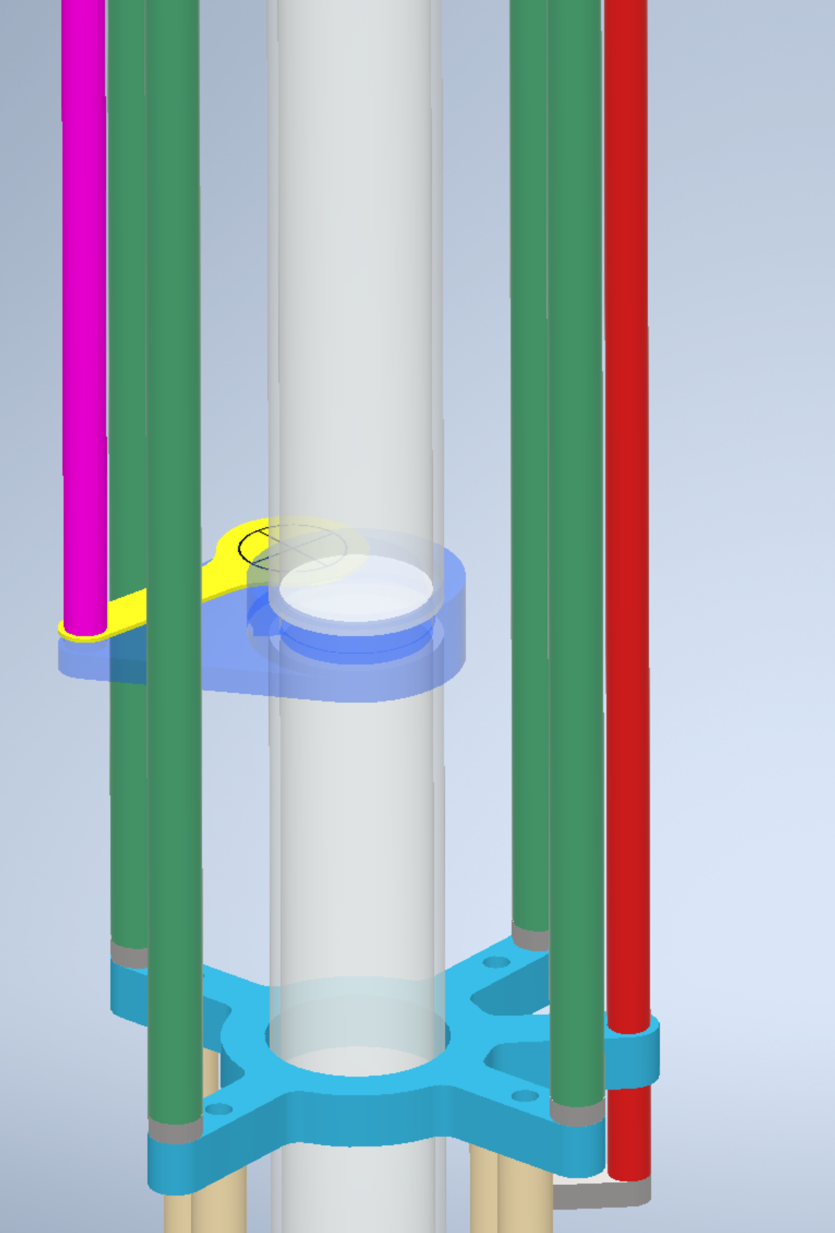
Alignment Target Retracted
Alignment Target in place

