Slide 1
Overview
Booster Connection (WBS 121.06.06)
E. Alcaraz
Requirements and Specifications Review
14 April 2020

Slide 2
Outline
Scope
Requirements Basis
Functional Requirements Specification
Room Data Sheets
Technical Requirements Specification

Slide 3
Scope
The PIP-II Booster Connection will connect the Beam Transfer Line Enclosure to the existing Booster and includes the Main Ring Crossing and tie-in to the Booster.

Slide 4
Scope
Booster Connection

Slide 5
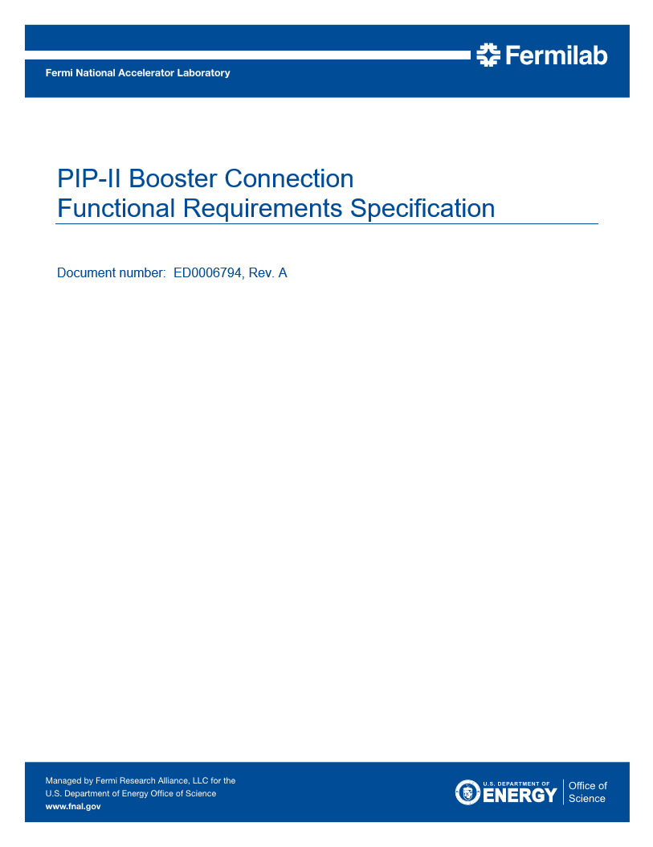
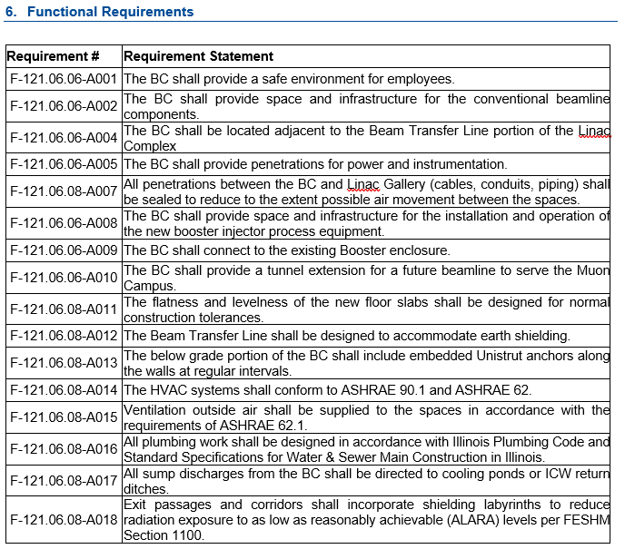
Requirement Basis
Functional Requirements Specification
Teamcenter ED0006794

Slide 6
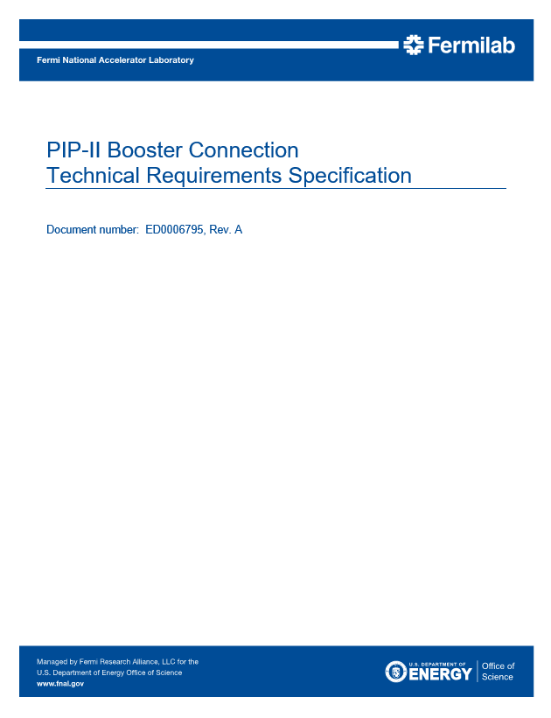
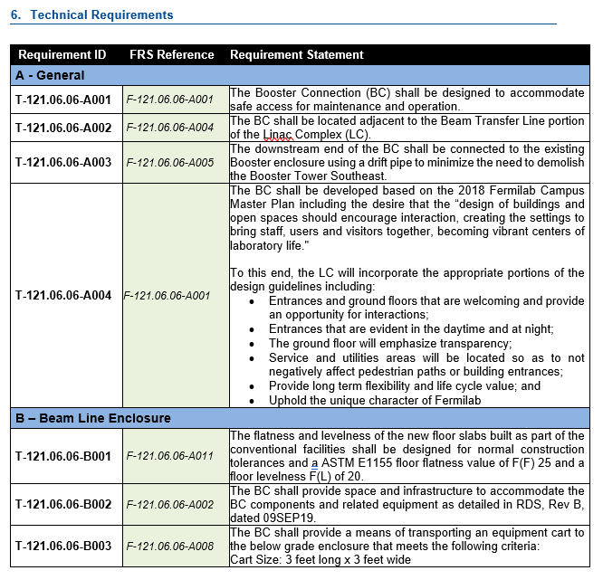
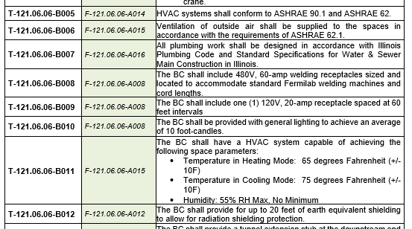
Requirement Basis
Technical Requirements Specification
Teamcenter ED0006795

Slide 7
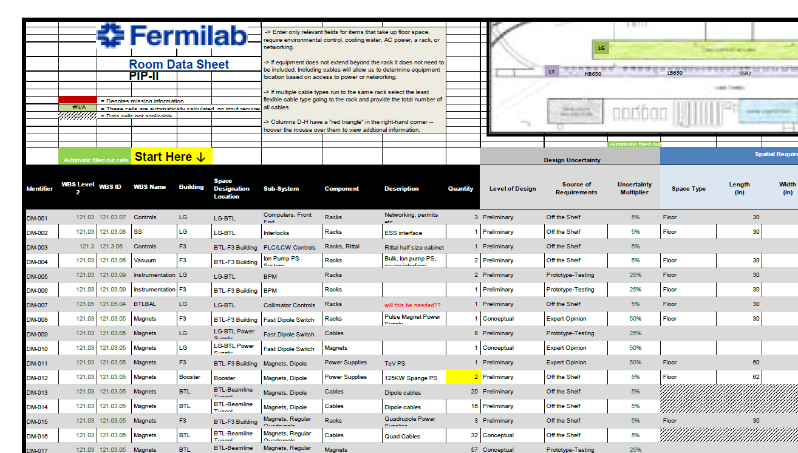
Requirement Basis
Room Data Sheets
Teamcenter ED0009544

Slide 8
End

