Slide 1
Fluctuations in Undulator Radiation (FUR)
Ihar Lobach (UChicago)
Preliminary results
Fri Apr 3rd, 2020
Aliaksei Halavanau, SLAC: theory, design, data analysis
Zhirong Huang, SLAC: theory, design
Valeri Lebedev, FNAL: theory, design
Ihar Lobach, UChicago: theory, design, experiment setup, data analysis
Sergei Nagaitsev, FNAL/UChicago, spokesperson: theory, design, funding
Aleksandr Romanov, FNAL: ring setup, light detection
Jamie Santucci, FNAL: apparatus, light detection
Giulio Stancari, FNAL: design, apparatus, analysis
Alexander Valishev, FNAL: design, IOTA lattice

Slide 2
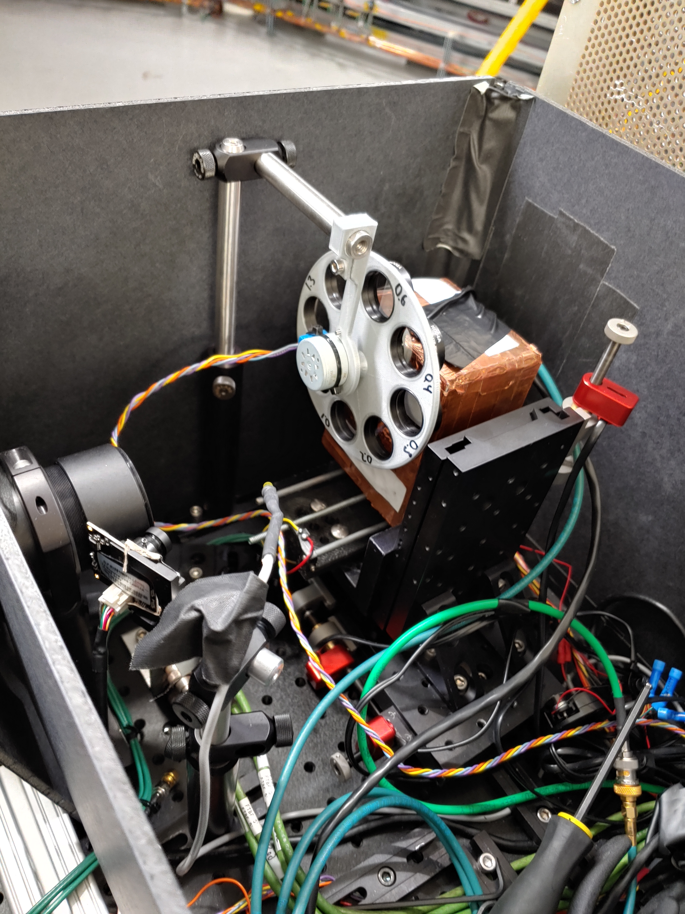
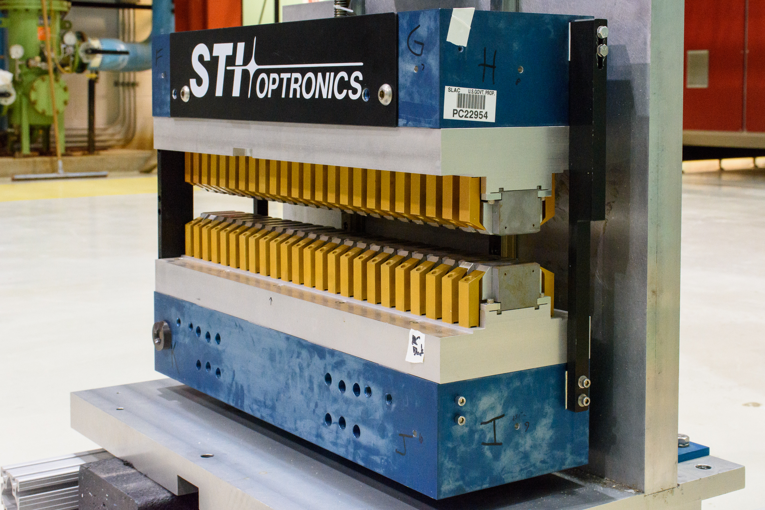
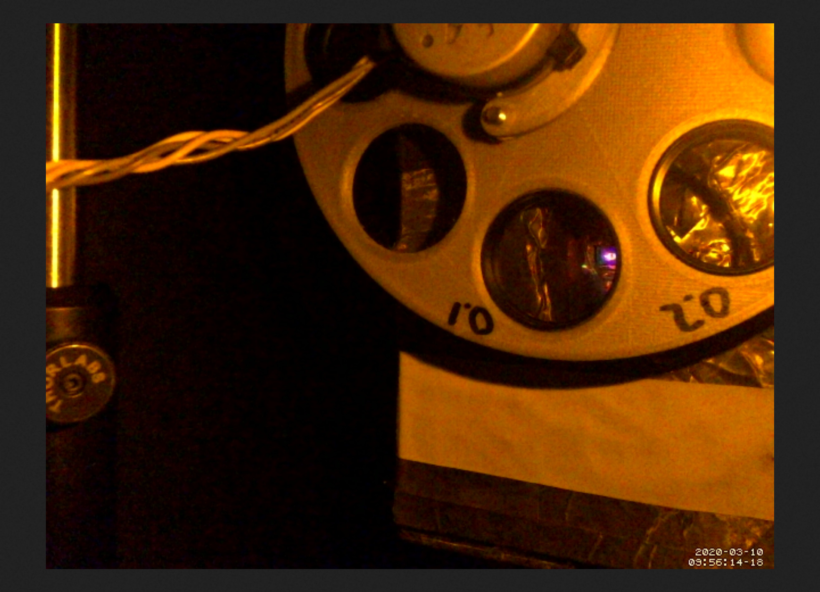
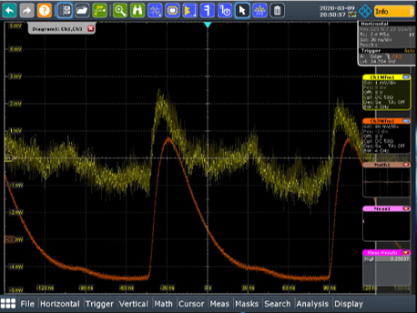
The apparatus
Up to ~1.5 V signal (without comb filter)

Slide 3
Controls
Another absolute measurement of beam current. 4% deviation from DCCT
Improved alignment:
Z-scan (back and forward):
x, y scans with picomotors
z scan with stepper motor

Slide 4
Motivation: reply to PRAB paper’s referees
During Run 1 we had only one measurement of beam’s transverse size at 1.3 mA
The data looked very noisy
The measured number of emitted photons was 3 times smaller than the predicted one, and we did not know the reason why
From Run 1:

Slide 5
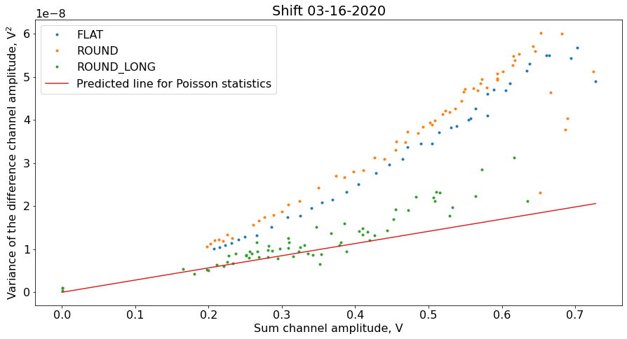
Results of this run: variance of signal’s amplitude
No neutral density filters
Bunch pulsations

Slide 6
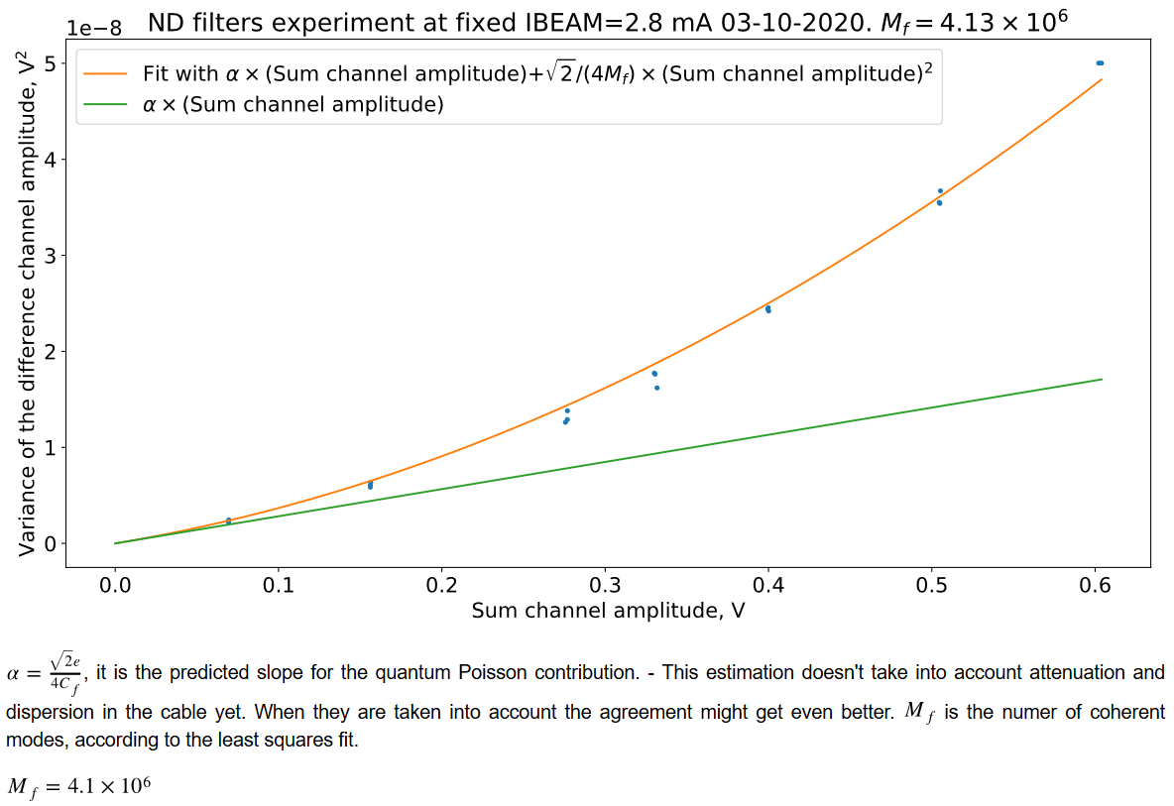
Results of this run: variance of signal’s amplitude
With different neutral density filters, at fixed beam current
More points than during Run 1
thanks to Sasha’s filter wheel

Slide 7
Next step: obtain theoretical curves
Part 1: obtain emittances -> obtain bunch dimensions in the undulator
Emittance y
error = 5%
X:
Emittance x
error = 16%
Y:
*the beam size changes significantly in the undulator

Slide 8
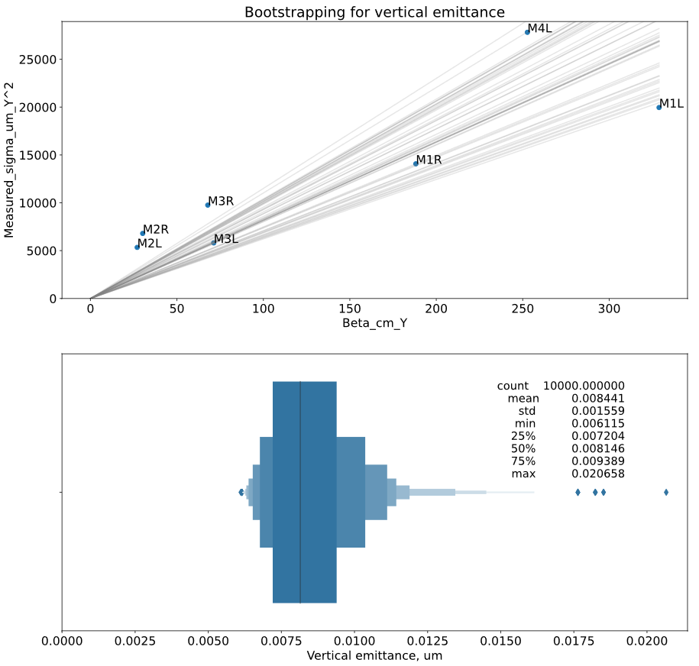
Fitting for vertical emittance (assuming zero dispersion)
Should be a straight line
Uncertainty about 16%

Slide 9
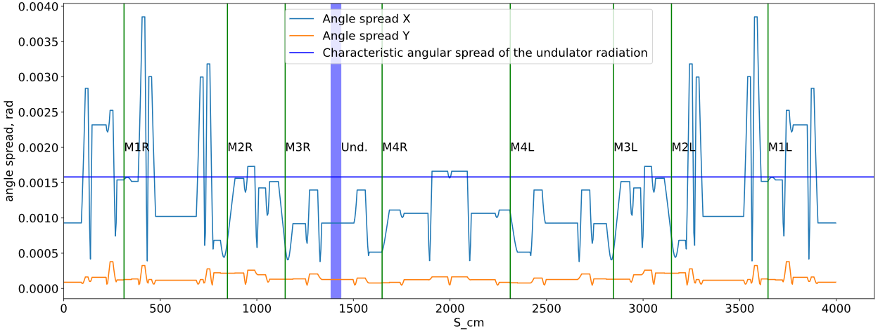
One unfortunate discovery
The spread of angles in the beam is not negligible:
It will add one more numerical integration in the equation. Also electric field’s phase will be important.
Will have to use SRW to get complex electric field (done). The integration will have to be performed on the UChicago’s Midway cluster (in progress), since my laptop runs out of RAM.

Slide 10
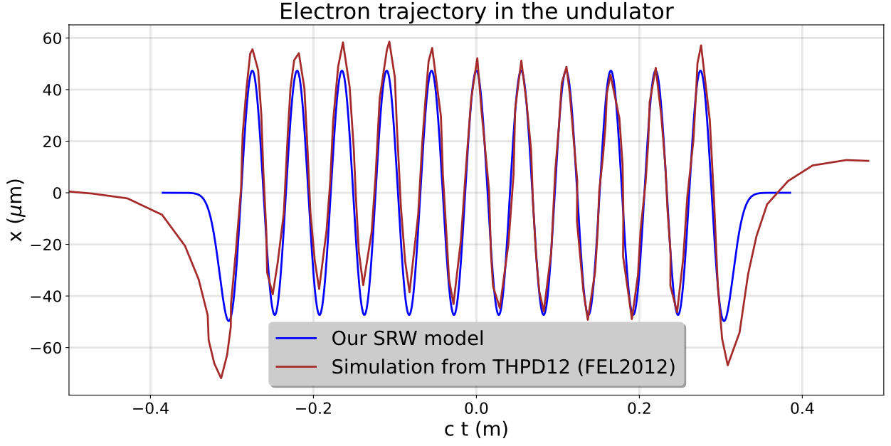
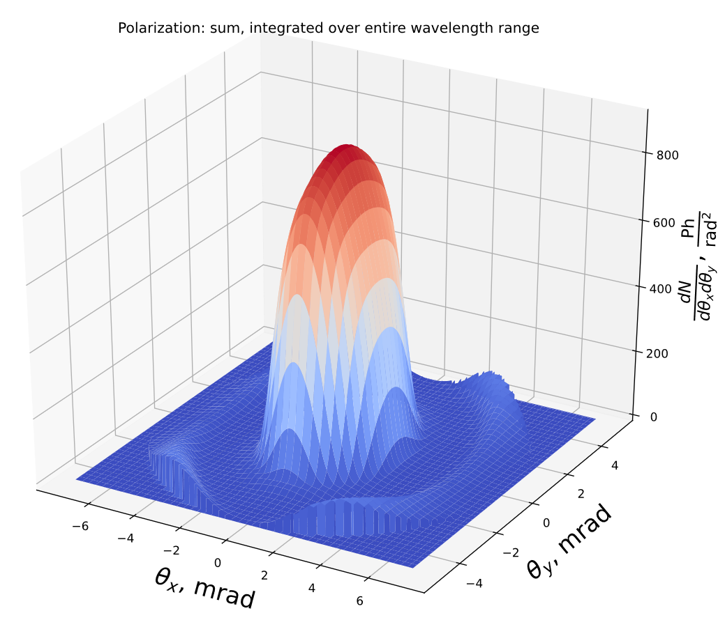
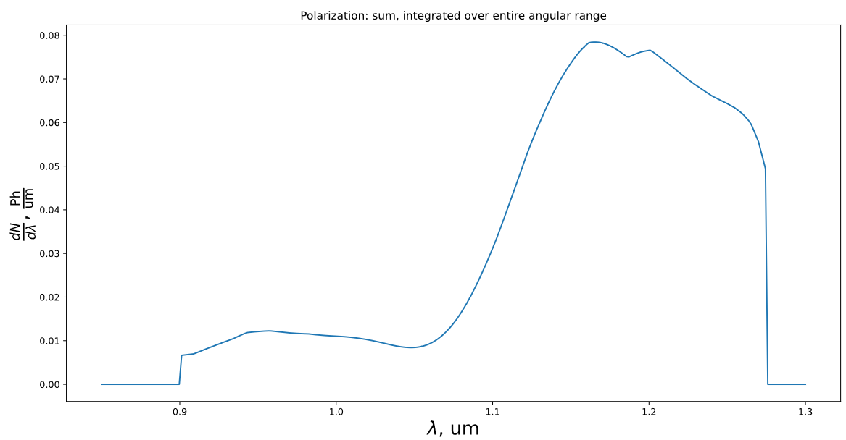
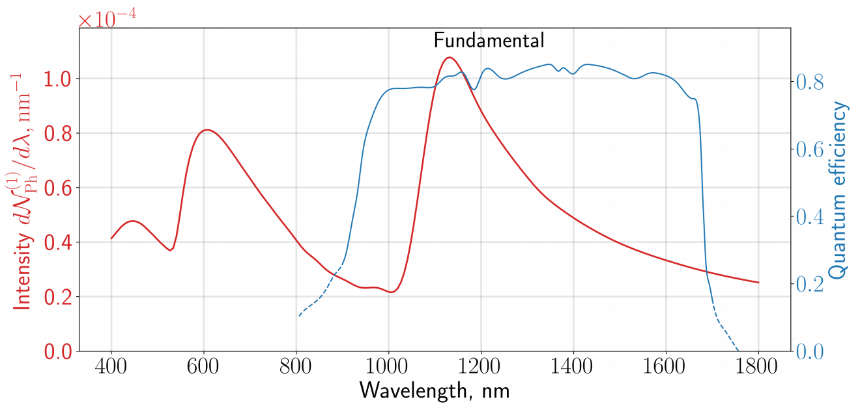
SRW simulation / Why measured photon rate was 3 times smaller than predicted (reason 1)
In actuality, there are rather sharp cut-offs at 0.9 um and 1.275 um:
Spectral properties of mirrors and the lens weren’t accounted for correctly last time:
https://arxiv.org/pdf/1912.06737.pdf
In addition, last time I used K=1. However, K=1.058 is probably more correct

Slide 11
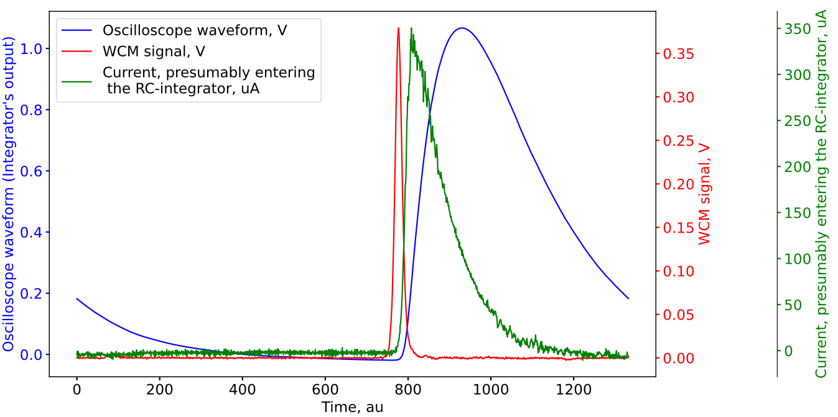
Why measured photon rate was 3 times smaller than predicted (reason 2)
Last time we overestimated the speed of the photodiode. Photodiode’s cut-off: Typ. 60 MHz, Min. 25 MHz
*also, the coefficient Amplitude/Beam current depends on the bunch length slightly

Slide 12
Measured vs. simulated rate
Measured = 0.0094
Predicted = 0.014
Still not taken into account:
Attenuation and dispersion in cables
Vacuum chamber window transmission
Lens’/mirrors’ aperture may be smaller (specs say >90% of diameter is clear aperture)
Still some misalignment of the mirrors?
Electron beam not in the center of the undulator?
Simply slightly incorrect value of K?
Incorrect termination field in the model?
Light spot bigger than the detector’s sensitive area?
Beam energy is not exactly 100MeV?
…

