Slide 1
Neutrino Beamline
Horn A
Preliminary Design Review
Module & SLB Connections
Cory Crowley
24 April 2020

Slide 2
Outline
Hanger Connections
  Motion Allowance
  RH Presets
Survey
Utility Connections
Instrumentation Connections
Stripline Block Remote Clamp
Target Utilities / Instrumentation
Summary

Slide 3
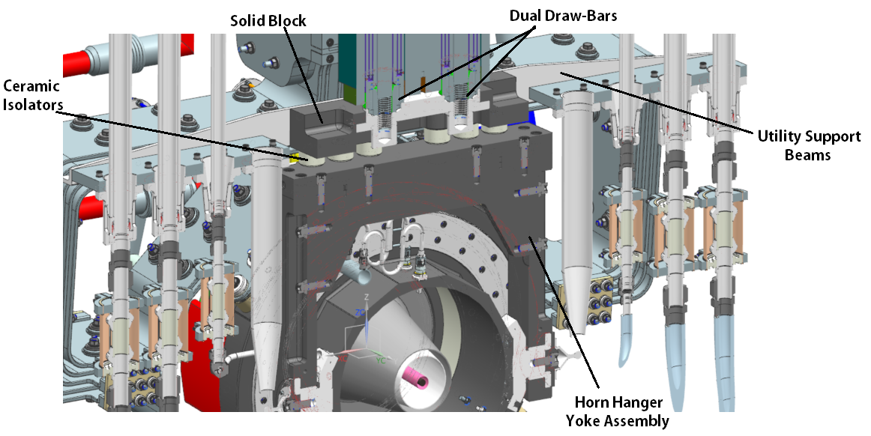
Horn to Module Connection – U.S. Hanger
U.S. hanger serves as rigid linkage for horn positioning & alignment.
Utility support beams are identical U.S. / D.S. & across all horns.
Volume reduction efforts ongoing on large aluminum structures.

Slide 4
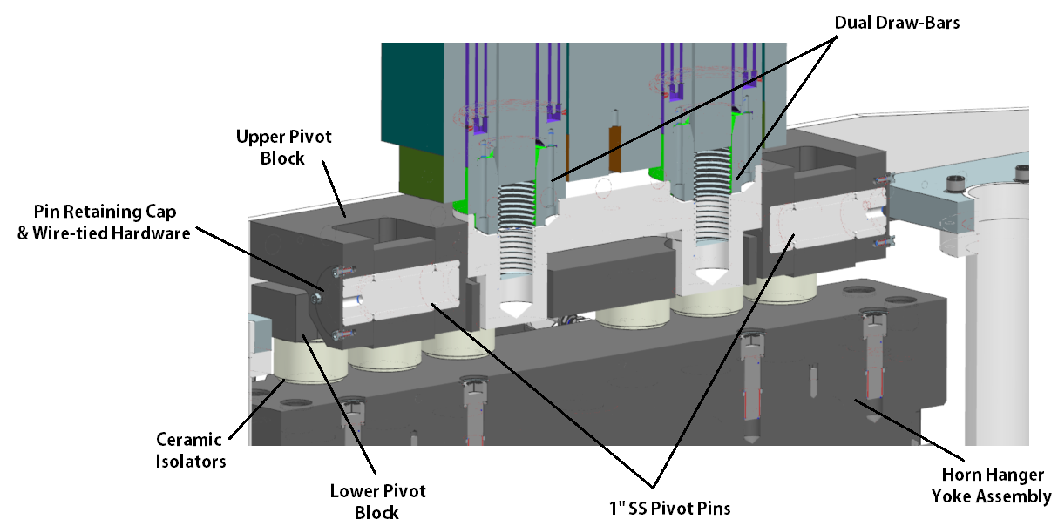
Horn to Module Connection – D.S. Hanger
D.S. hanger serves as swinging linkage for horn expansion.
Pivot block concept like NuMI.
Employs SS bushings inside of 6061-T6 (anodized) bores.

Slide 5
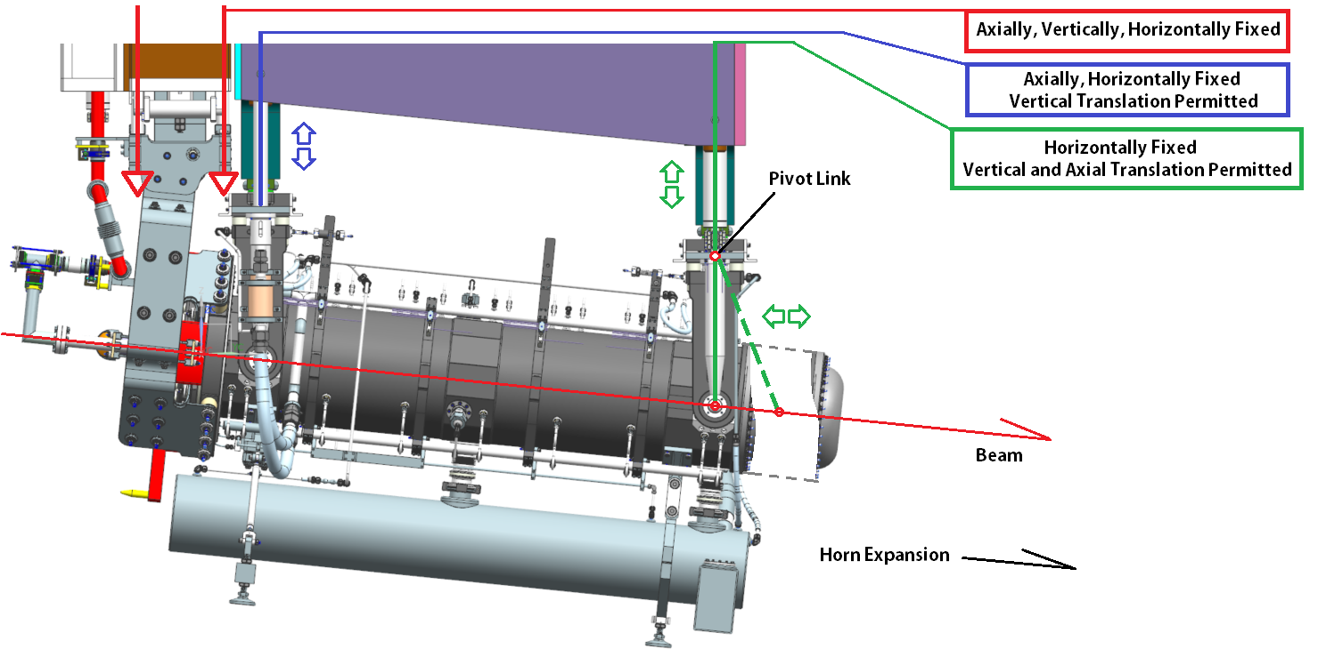
Horn + Hanger Motion
Horn A thermal expansion (axial) on order of ~0.7mm.
D.S. vertical translation due to linkage movement effectively 0mm.
Linkage must exist to not stress hangers / draw bar interface / vertical drive binding.

Slide 6
Horn to Module Connection Cont.
Dual draw-bar arrangement based on NuMI design used.
  Initial single draw bar layout was used.
  Concerns arose regarding horn stability & potential offset issues due to utility line loading.
  Confirmed (see N. Agbo talk) & solved by doubling + spacing connection to horn.
    Large moment load at base of drawbar becomes nice tension/compression load pair.
    Drawbars very robust, and also balances vertical drive system design.
    One large moment essentially became 4, and the horn hangers & drawbar top brackets are stout.
Draw-bars are only responsible for vertical movement, no horizontal translation WRT to module required.
Horizontal translation of horn occurs with mated module assembly.
Drives on top to reduce & simplify target chase mechanism count.

Slide 7
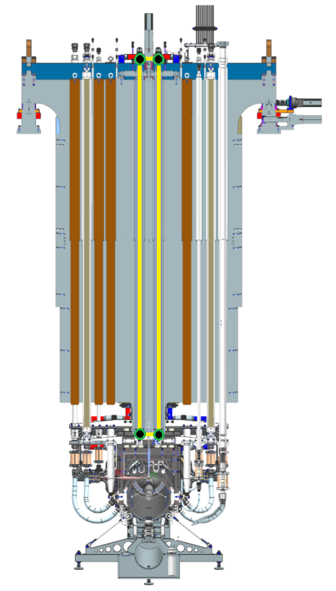
Horn to Module Connection Cont.
Yellow rectangle represents load paths for horn rotation due to asymmetric utility line loads.
Green/Black dots show where moment reactions exist due to compression / tension in drawbar pairs.
Rectangle essentially becomes a slight parallelogram, but negligible.

Slide 8
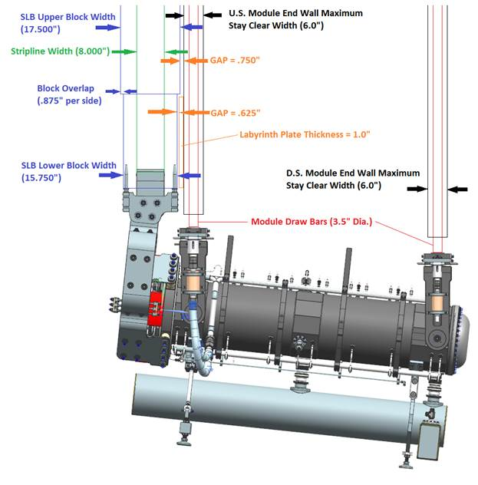
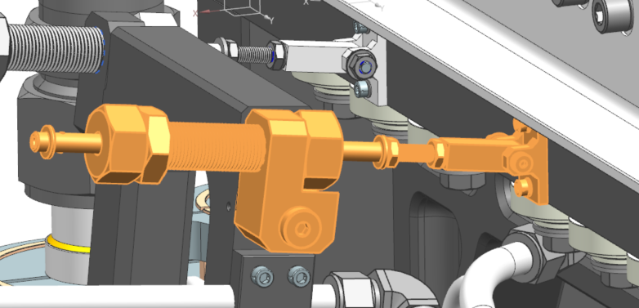
Hanger Adjustment & Remote Handling Compliance
Horn to module connection occurs in workcell and is 100% remotely controlled through hydraulic lift table.
Connection to draw-bars requires some level of compliance to accommodate mis-alignment until positive coupling occurs.
Design is driven from lessons learned in NuMI OPS.

Slide 9
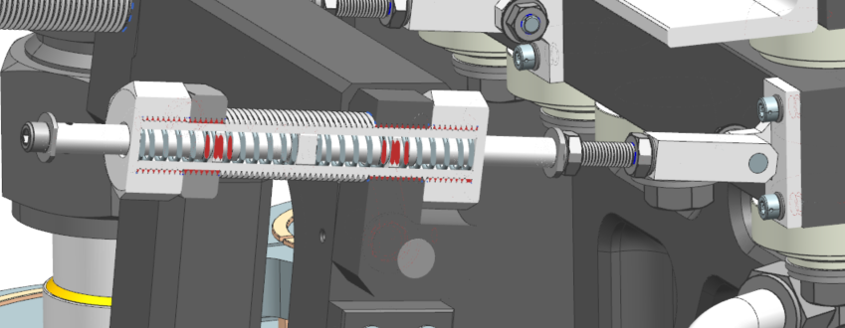
Hanger Adjustment & Remote Handling Compliance
Captured, opposed, dual compression springs.
  Each unit handles both pushing & pulling hangers into correct centerline.
  Standard COTS spring size, so can be exchanged / tuned after trials.
End washers serve two purposes:
  Mechanical hard-stop before hanger to horn interference.
  Visual indication of remaining travel adjustment during connection.

Slide 10
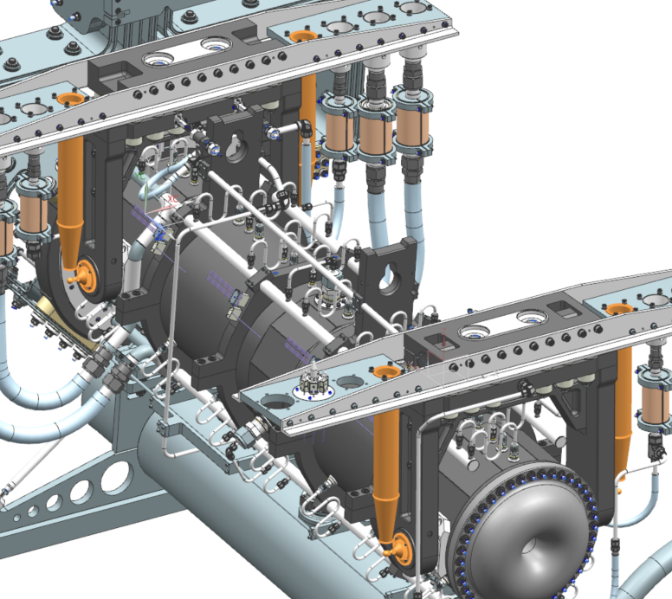
Horn Survey / Fiducial Points
Tooling balls affixed to hanger pivot caps on U.S. / D.S. + B.L. & B.R. positions.
Dedicated guide tubes for stick-mic positioning & ball center reference.
Stainless steel .065” wall construction with COTS exhaust manifold elements.
Temp check remains.
  May switch to 6061.
  May mill slots for volume / EDEP reduction.
  Analysis will decide.

Slide 11
Horn HLS Tracking Concept
Long term horn position monitoring relative to chase structure is desired due to NuMI Issues.
Survey & technical board concept is use of hydrostatic leveling system (HLS).
Would precisely track horn elevation relative to HLS stationed at battlement / THC walls, etc…
Interface understood, but design not well defined.
  Need HLS models.
  Risk assessment high; may phase design.
  Module positioning.
    May need to test through drawbar first, then expand to direct horn attachment.

Slide 12
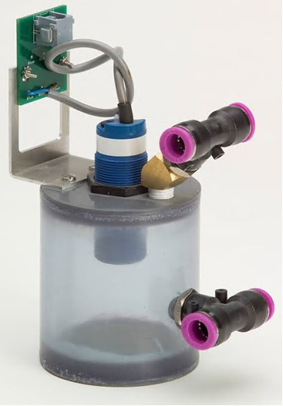
Horn HLS Tracking Concept

Slide 13
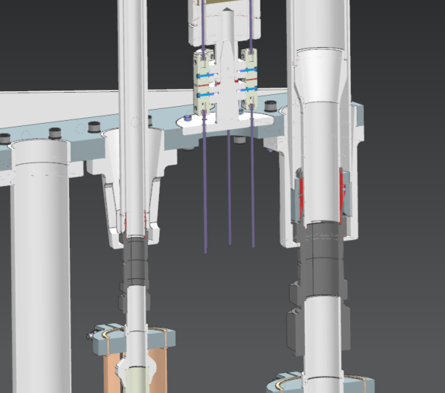
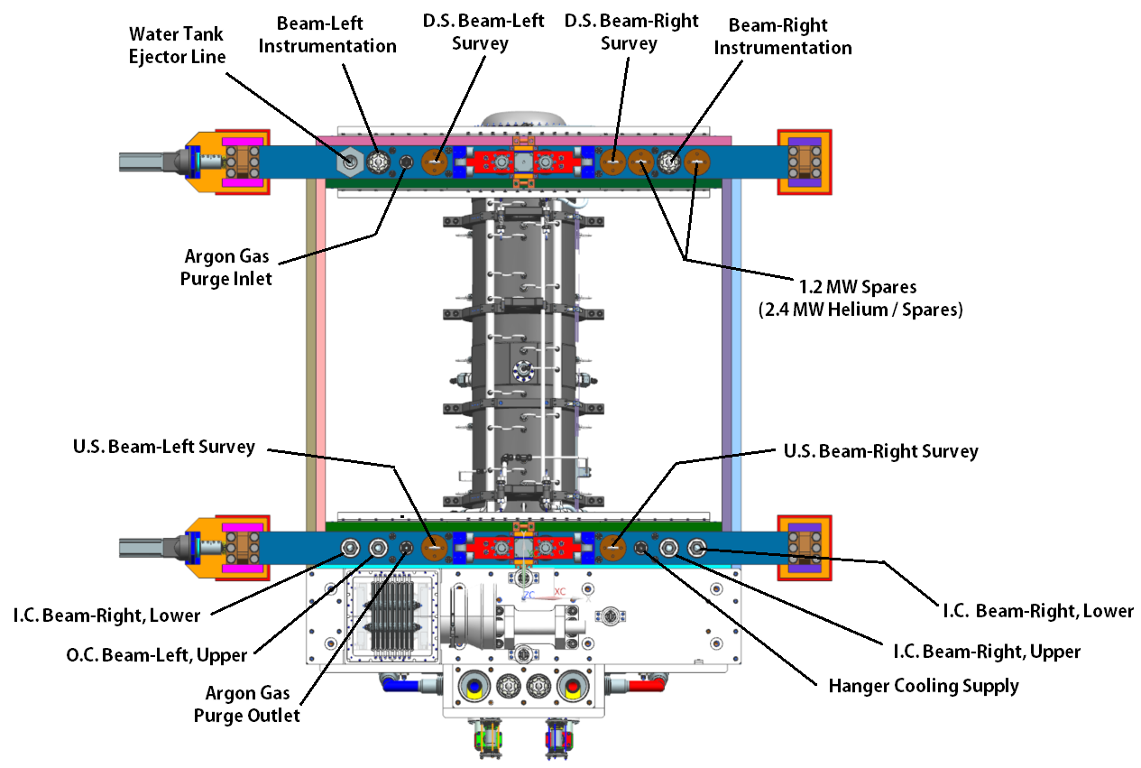
Horn Utility / Instrumentation Line Connections
Horn connections are conceptually identical to NuMI layout.
  Swage fittings up to 2” for water & gas connections.
  Omega Type K thermocouple connectors on hexagon mount.
  Each horn has 2 instrumentation lines, 12 readouts total.
  Temperature only; no field probes.

Slide 14
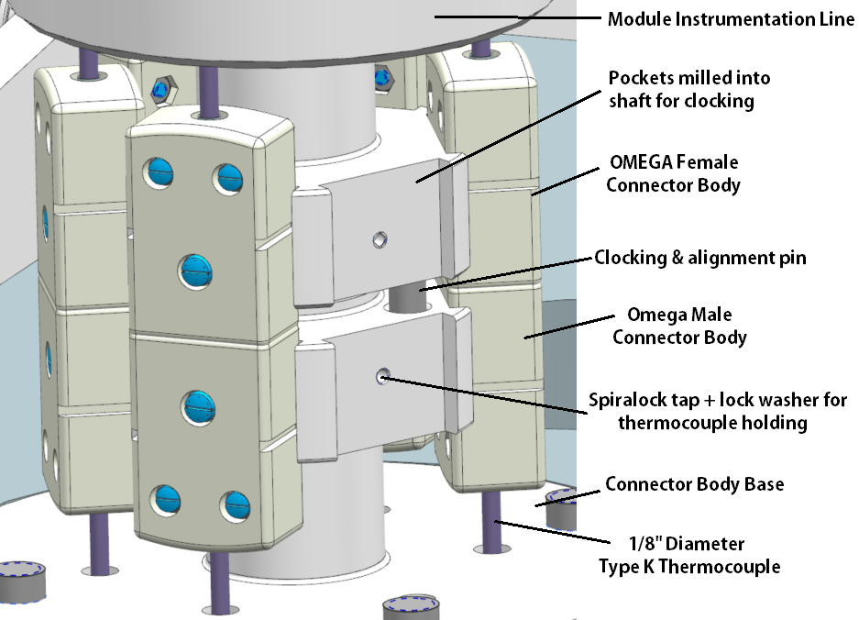
Instrumentation Line Connector Body
Connector bodies on NuMI components have a somewhat delicate connection to ceramic thermocouple bodies.
Were very problematic with older OMEGA connectors & trying to pin in place for clocking.
New style connectors have high degree of accuracy and precision amongst batches.
  Pursued alternative clocking method.
  Eliminated delicate pins & holes.
  Took advantage of larger diameter range available with single end-wall stacking.

Slide 15
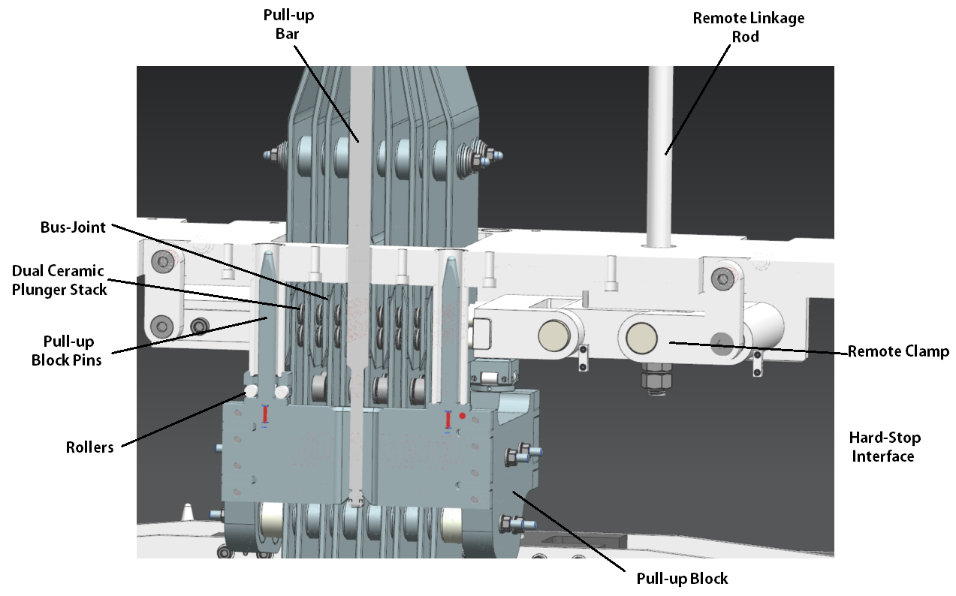
Horn Connection to Stripline Shield Block
Stripline block connection uses NuMI & T2K style remote clamp mechanism.
Two pull-up bars slide through pull-up block in work cell and turn 90 degrees.

Slide 16
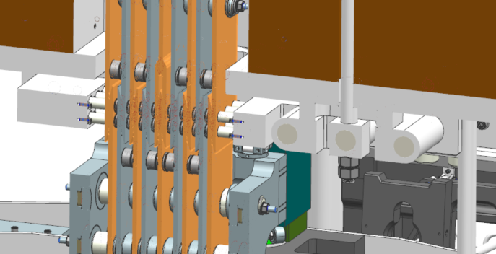
Horn Connection to Stripline Shield Block
Tightened at top of stripline block until both halves come together.
Rigid hard-stop when pull-up bar is torqued. Inherent high-preload connection is clamped again with 48,000lbs (2400PSI @ joint) of force when remote bus linkage is tightened.
HV layers highlighted for reference.

Slide 17
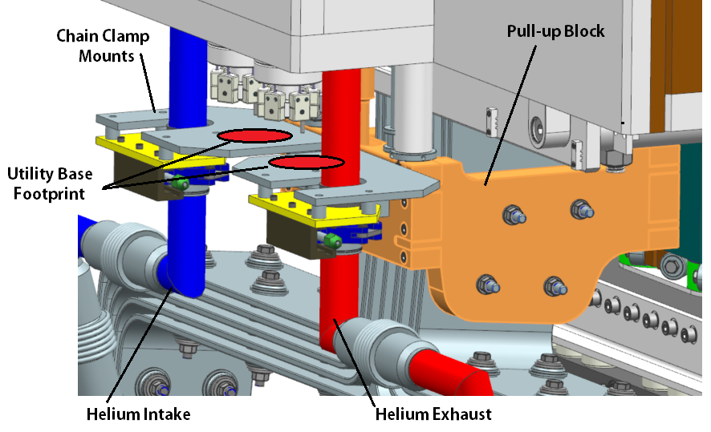
Integrated Target Utility / Instrumentation Line Connections
Target helium connection is identical to T2K layout.
Structural support is horn stripline pull-up block; rigidly attached to SLB.
  Chain clamps + metal seal with ceramic isolators.
Additional functionality is rigid support for instrumentation line bases.
  Spaced between
  helium intake & exhaust.
Must determine impact of helium exhaust @ 180C.
  Thermal isolation?
  Pipe insulation?
  On analysis list; likely negligible or solvable.

Slide 18
Summary
Horn connection to module is extremely robust and structurally sound.
Minimal deflection present with asymmetric utility line loads.
Hangers allow for +/- 1” of U.S. / D.S. movement during hook-up.
Horn thermally expands D.S., holding MCZERO / TGTIP/ HRNAIP constant.
SLB connection is identical concept to NuMI.
  Bus overlap doubled to bring down RMS/in^2 values.
  Clamping force doubled to retain 1400PSI+ joint load.
  Pull-up block spacing increased due to potential arcing concerns.
Target connection to SLB is identical concept to T2K.
  Chain clamp holders & utilities supported from stripline pull-up block.
  Target instrumentation / utility lines are fixed WRT module position.
              Questions?

