Slide 1
Neutrino Beamline Horn A Preliminary Design Review
Horn A Hanger/Stripline FEA
Nnamdi Agbo
22 – 24 April 2020

Slide 2
Outline
Introduction
Structural Analysis for Horn A Hanger Utility Beam Support
Problem Statement
Analysis setup
Analysis Result
Thermal Analysis for Horn A Hanger Utility Beam Support
Problem Statement
Analysis Setup
Analysis Result
Stripline Structural Analysis
Problem Statement
Analysis Setup
Analysis Result
Summary

Slide 3
Introduction
The following analysis were carried to ensure the horn A meets all design requirement necessary to support the goals of the DUNE experiment. This presentation will cover three separate analysis that was performed using Ansys.
All inputs for this analysis (such EDEP) were obtained from appropriate MARS data with proton beam power of 1.2MW assumed.

Slide 4
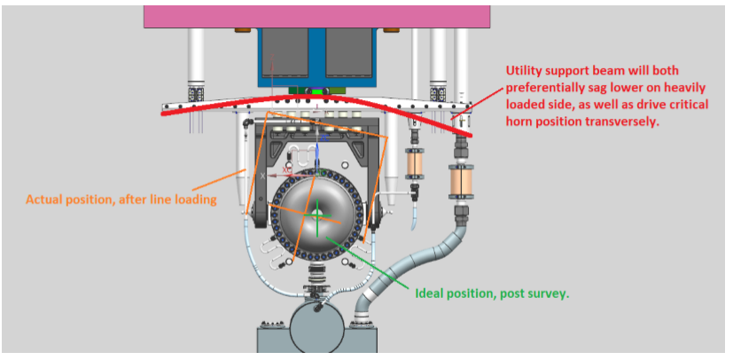
Problem Statement: Hanger Utility Beam Support
Utility support beams for LBNF are significantly longer and more heavily loaded than in prior horn designs. This loading and length could effectively create, due to asymmetrical line loading, a large moment at the connection to the horn & module. The rotation at this point could effectively impact both the ability to thread on utility lines remotely, as well as the overall horn position when in the beamline.
The objective is to perform a structural analysis to determine if;
The Utility Support beam are sufficiently sized
A negligible transverse horn position offset (< 0.01”) results from maximum differential loading scenario

Slide 5
Horn A Model
Single Drawbar connection

Slide 6
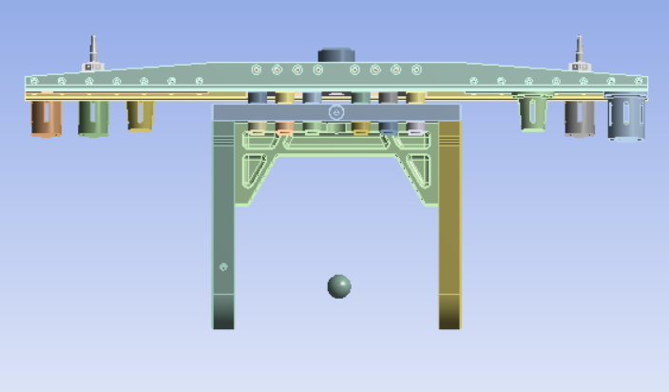
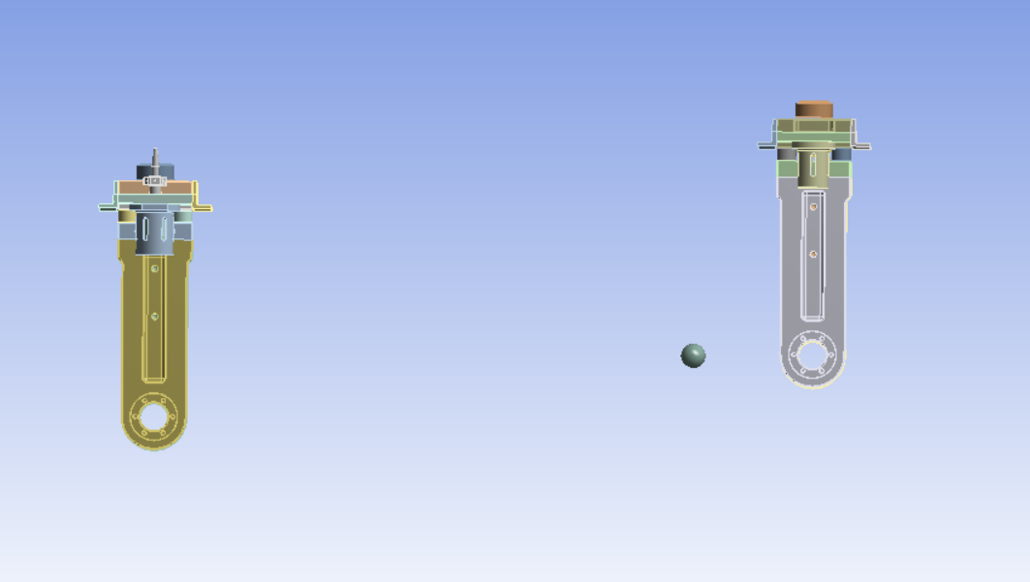
Simplified Analysis Model: Initial Design
250lb
100lb
250lb
200lb
Horn replaced with a point mass to reduce mesh count and increase computational speed.
Remote mass applied at the CG of the model.
Remote point A and B to track horn A transverse displacement due to asymmetric loading
B
A

Slide 7
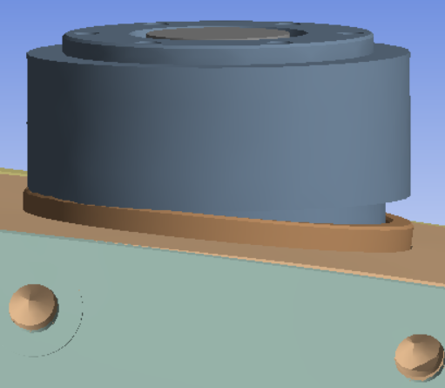
Deformation Results: Initial Design
Max Utility beam deformation : 2.02mm
Image on the R-T Corner showing the effect of the moment created around the Drawbar Connection

Slide 8
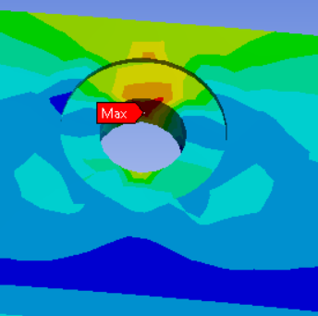
Equivalent Stress: Initial Design
Equivalent stress: 79.18 MPa
Material: Stainless Steel 304
Yield Strength: 215MPa
FOS: 2.7
Material | YTS MPa | Young’s Modulus MPa
304SS | 215 | 200000
6061-T6 | 259 | 68900

Slide 9
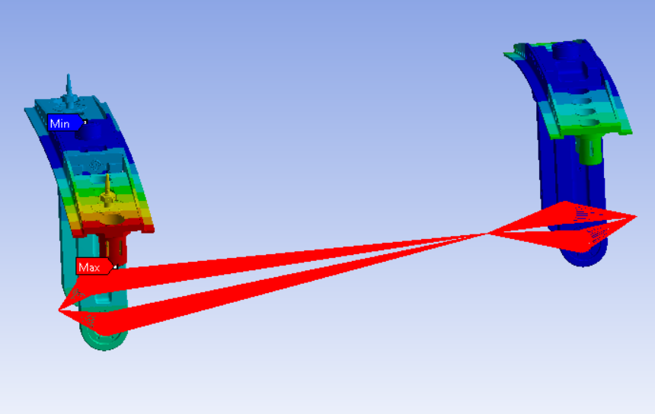
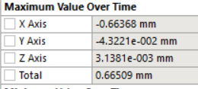
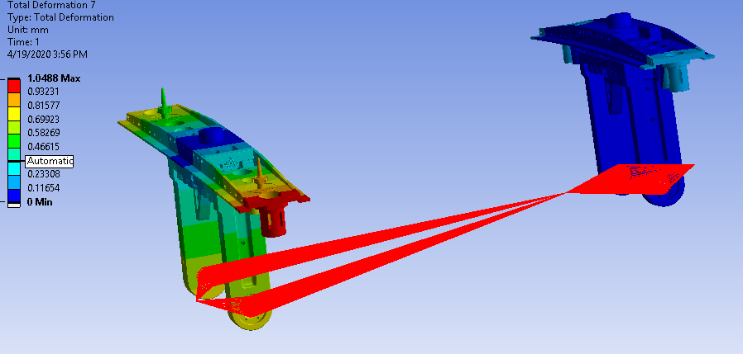
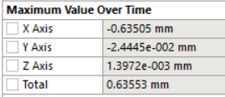
Remote Points Deformation
Pt A & B represent the centers of the horn on either ends so we could track the displacement of these centers
B
A
A
0.026”
With an infinitely stiff utility beam assumed. Displacement of Pt A & B along the principle x axis was relatively the same
A
A
0.025”

Slide 10
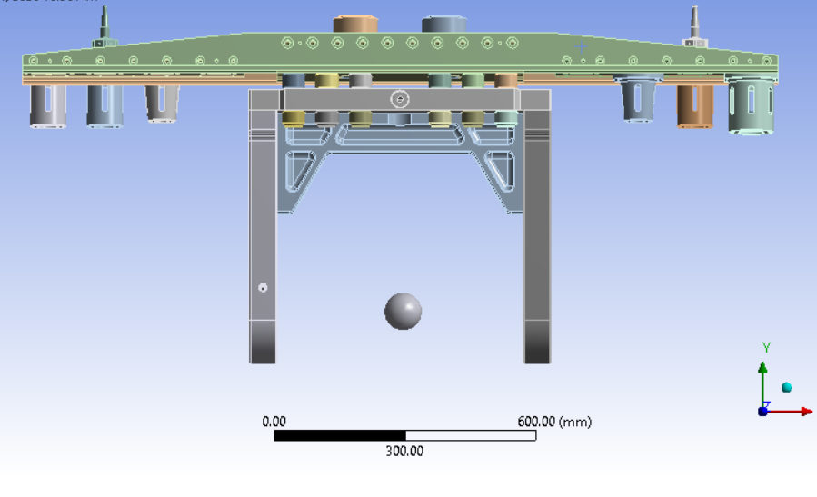
Proposed Design
A new design with two drawbar support was proposed to reduce horn A transverse displacement due to asymmetric loading. The utility beam support mounting bolt holes was equally increased to 10 in the center to better spread the load. Both changes resulted to an improved design as seen on the table below
 | Horn Displacement – Pt A (mm) | Equivalent Stress (MPa) | Max Deformation for Utility Beam Support (mm)
Initial Design | 0.026” (0.67) | 79.18 | 2.02
Updated Design | 0.0028” (0.07) | 50.31 | 0.9

Slide 11
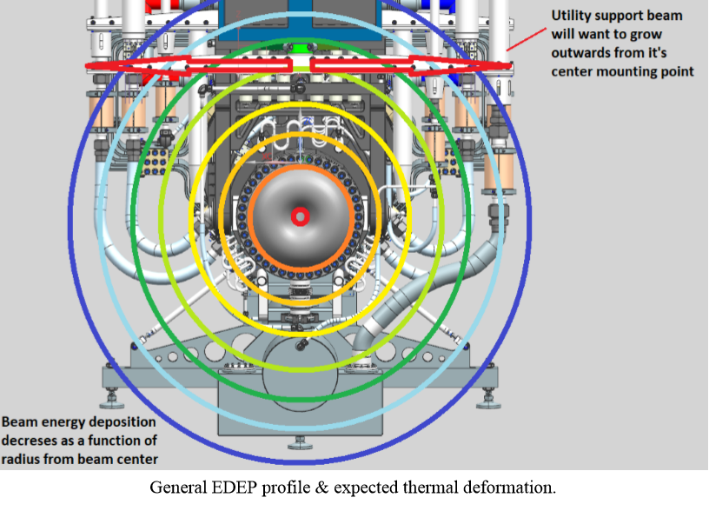
Problem Statement: Thermal Analysis for Horn A Hanger Utility Beam Support
The length of the utility beams is a concern when accounting for thermally induced growth during steady state operation. It is the intention of LBNF that this assembly be used for all high-power operation, and therefore, may experience a significant amount of beam induced internal heat generation (EDEP). Excessive thermal expansion will subtract from the nominal 0.125” radial clearance allowed for all utility lines running through the support module.
The objective is to perform a structural analysis to determine;
Document what & where maximum temperature occurs.
Document what & where maximum deformation occurs
expected steady state thermal clearance between the utility / instrumentation lines and module feedthrough holes

Slide 12
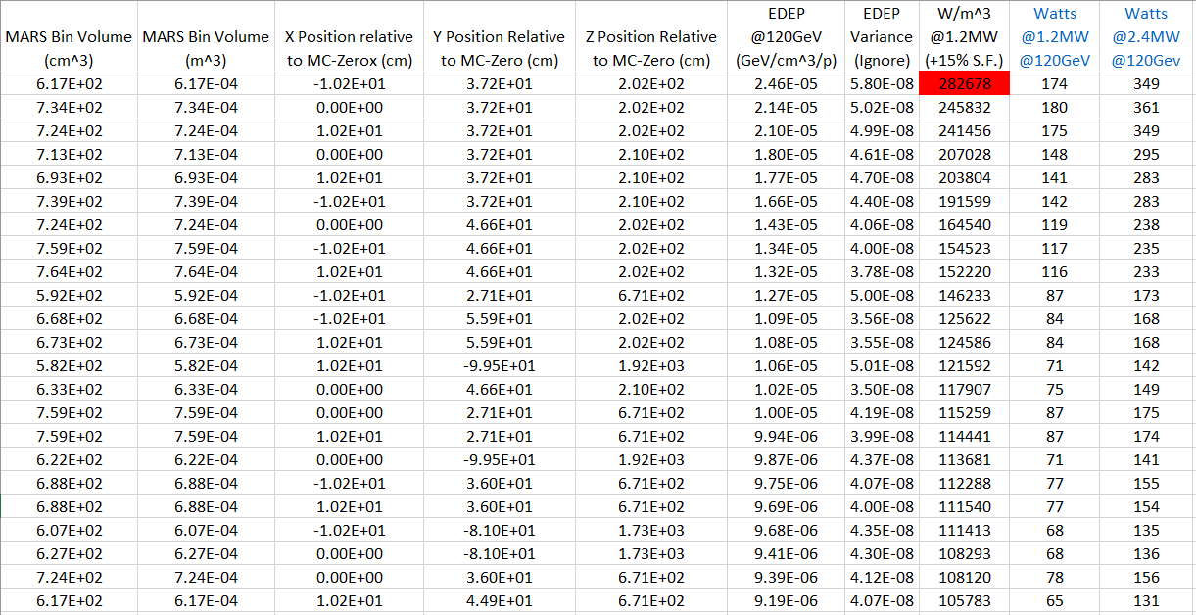
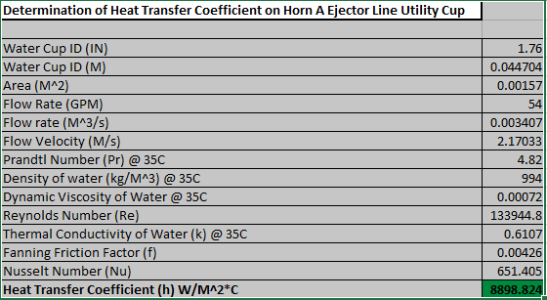
MARS DATA & Boundary Conditions
Boundary Conditions: Provided by Cory
Module end wall snout for horn A gets the most energy (282,678 W/m^3). This was used for all stainless stain parts
Aluminum parts scaled by its mass ratio (set at 40% EDEP)
External surface cooled @10W/m^2*C
Hidden Pockets at 3W/m^2*C
Drawbar contact points held at 25C.
Internal cooling passages should have 6576 W/m^2*C convection cooling @ 25C
Ejector line utility cup have 8898 W/m^2*C convection cooling @ 25C

Slide 13
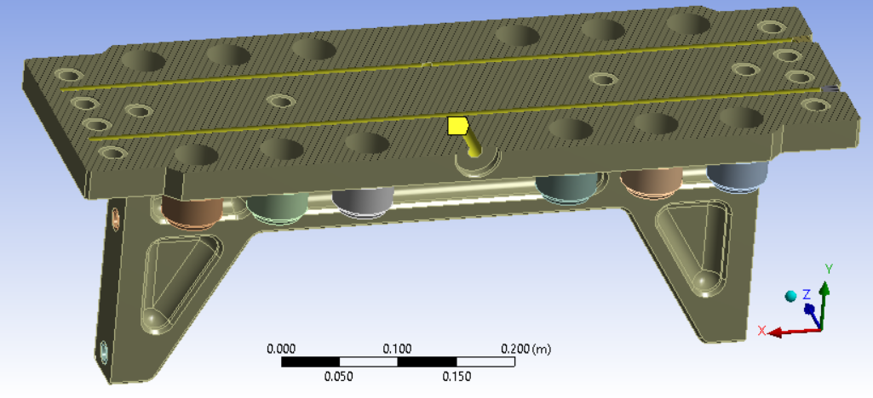
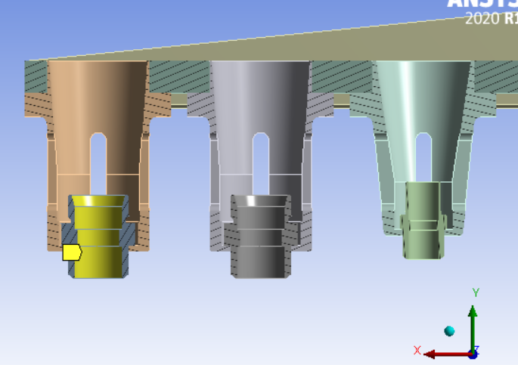
Boundary Conditions
X
Convective cooling applied to only one line (worst case assumed)
Convection cooling of 6576W/m^2*C
Convection cooling of 8898.8W/m^2*C
Convection cooling of 3W/m^2*C of hidden faces
Convection cooling of 10W/m^2*C for external faces
Draw bar contact points held at 25ºC

Slide 14
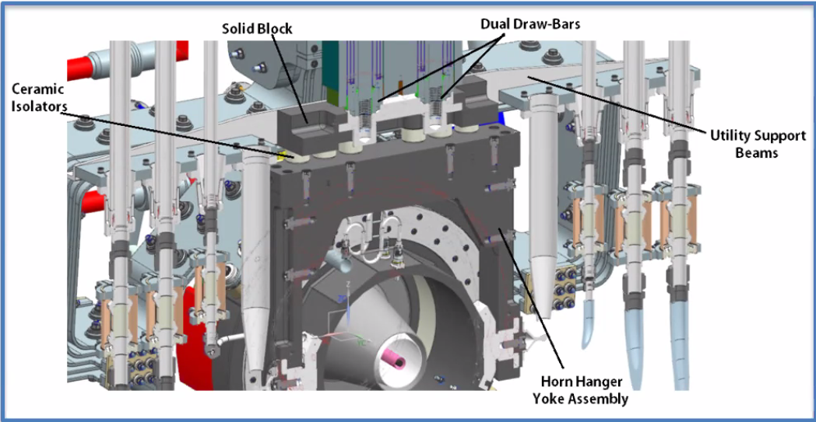
Boundary Conditions
No Cooling Line
Cooling Line
MARS Data (W) | FEA Reaction Probe (W) | Ratio
3635.01 | 3633.96 | 99.9

Slide 15
Material Properties:
304
Initially 304 (changed to 7075-T6)
MGO-PSZ
Material | Thermal Conductivity W/m^2*C | Expansion Coefficient m/m-°C | YTS MPa | Young’s Modulus MPa
7075-T6 | 130 | 0.000025 | 503 | 71700
MGO-PSZ | 2.0 | 0.0000102 | 448 | 200000
304SS | 16.2 | 0.000017 | 215 | 200000
6061-T6 | 167 | 0.000023 | 259 | 68900

Slide 16
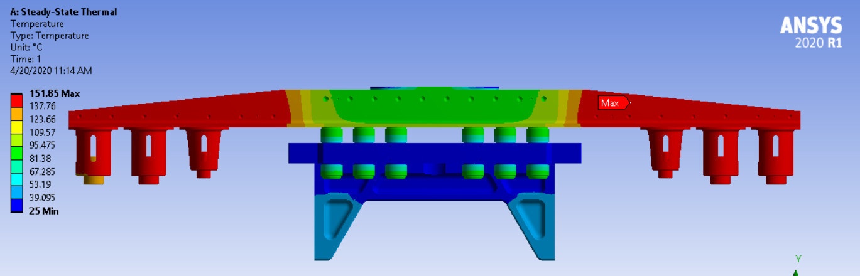
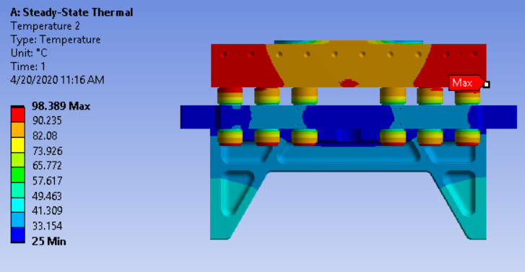
Thermal Results: Max Temperature
Max temperature of 151.8⁰C @ the 304 stainless steel utility beam
98.4⁰C max temperature seen on the Aluminum block shown below

Slide 17
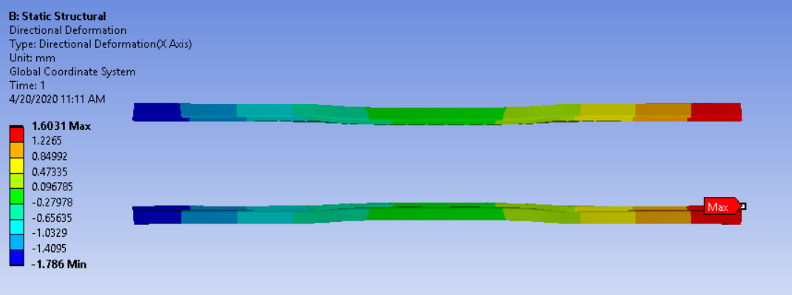
Thermal Structural Results: Deformation
Max deformation of 1.8mm
Radial clearance of 3.175mm between horn module and utility line
Resulting in 1.4mm radial clearance
A material change from 304ss to 7075-T6 suggested for potential improvement in results

Slide 18
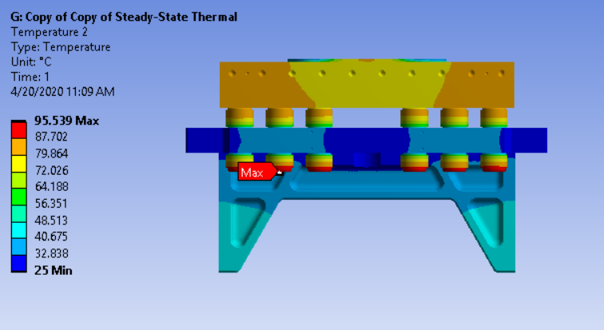
Thermal Results: Max Temperature
Utility beam support changed to 7075-T6 Aluminum
Max temperature dropped to 111.58ºC

Slide 19
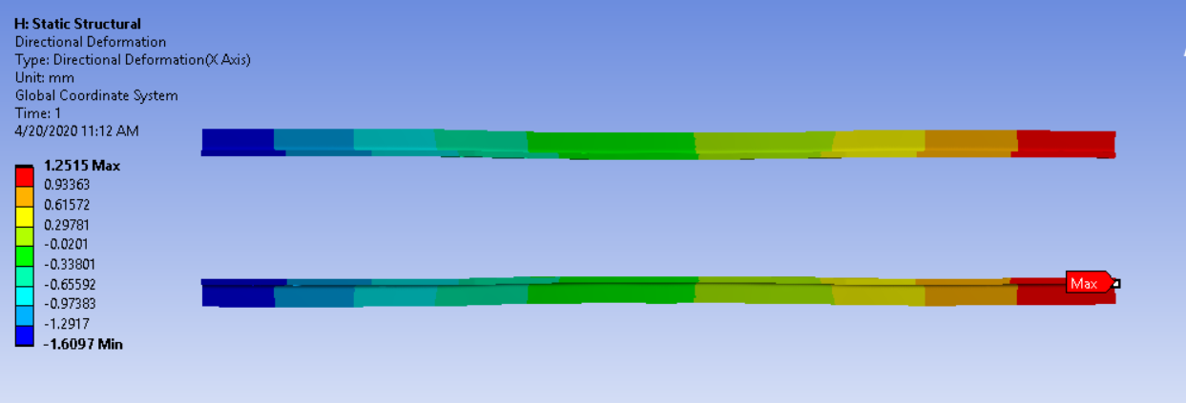
Analysis Inputs: MARS DATA
Max deformation of 1.6mm
Radial clearance of 3.175mm between horn module and utility line
 | Horn Max Deformation | Max Temperature(Deg C)
Initial Design | 1.8 | 151.8
Updated Design | 1.6 | 111.6

Slide 20
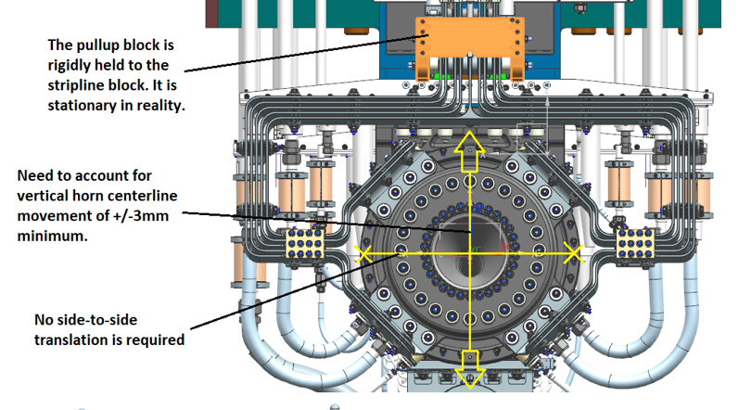
Stripline Analysis: Problem Statement
The segment of horn stripline between the bottom of the stripline block and the mounting points on the face of the horn is designed to provide flexibility while fine-tuning horn position in the beamline during both final survey and beam operation. This segment was historically required to accommodate vertical and horizontal translation on order of +/- 3mm for the NuMI / NOvA design, and successfully did so. Drive system revisions for LBNF have reduced the design requirements on this structure however, as all horizontal translation occurs on the module / horn assembly structure, not independently at the horn.
Vertical translation is now the only motion the stripline must accommodate and the expectation is that it will similarly need to have the ability to shift horn position on order of +/- 3mm.

Slide 21
Boundary Conditions:
Model is fixed at Spike base
A +/- 3mm displacement is applied as shown in the image on the left
3 Load cases applied
LC1: Bolt pretention
LC2: +3mm displacement
LC3: -3mm displacement
+3
-3
Notes:
Striplines are 6101 (YTS- 193MPa) & 6013-T651.
All stripline ceramics are magnesia partially stabilized zirconia (MGO-PSZ is common material identifier).
All bolts / studs are 6Al-4V Grade 5 titanium.
All flat washers are 304SS.
All Bellville washers are 718 Inconel.

Slide 22
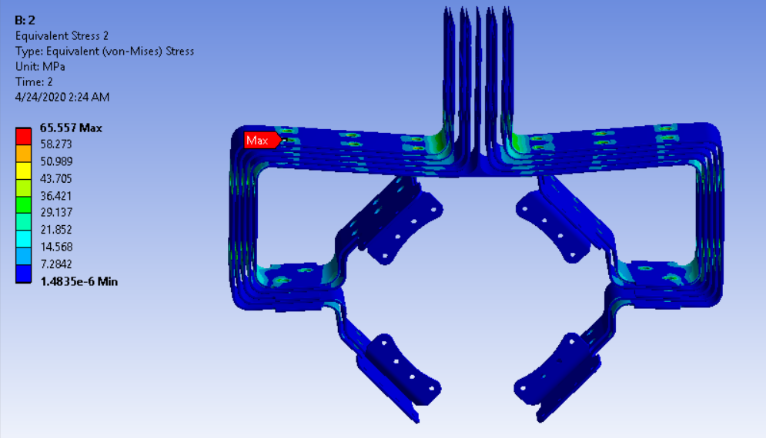
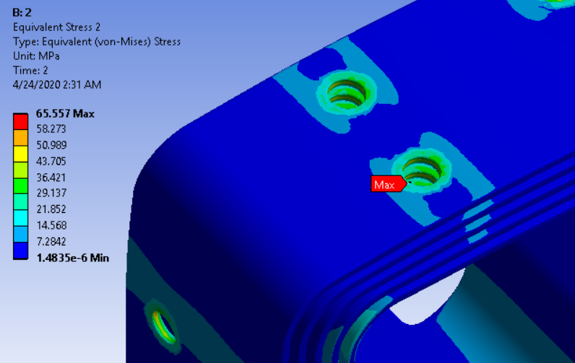
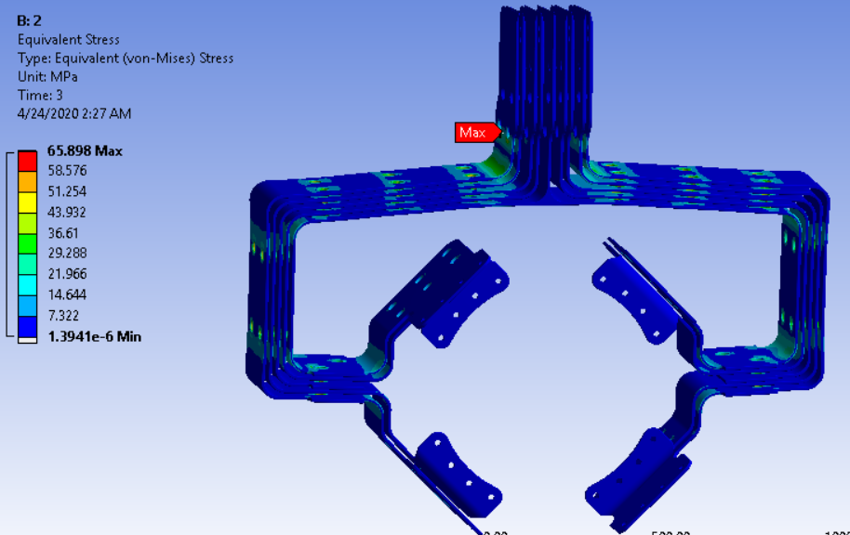
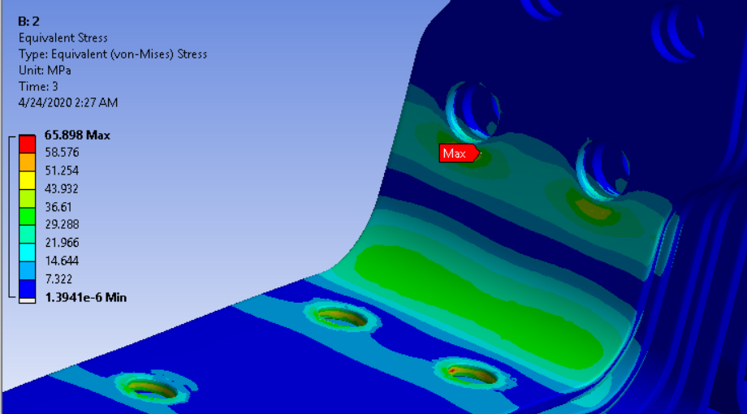
Stress Result: +/-3mm Displacement
LC2: +3mm displacement (Max 65.6MPa)
LC3: -3mm displacement (Max 65.9MPa)

Slide 23
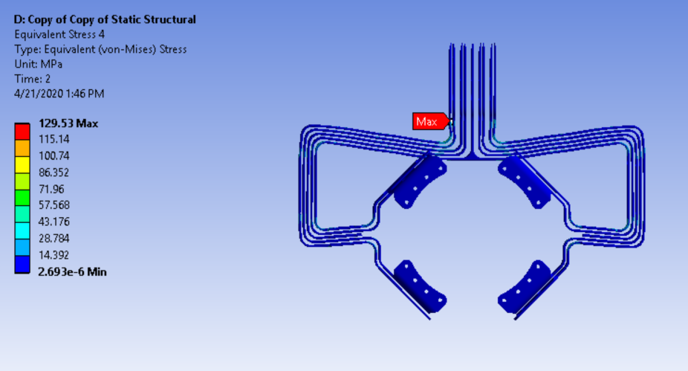
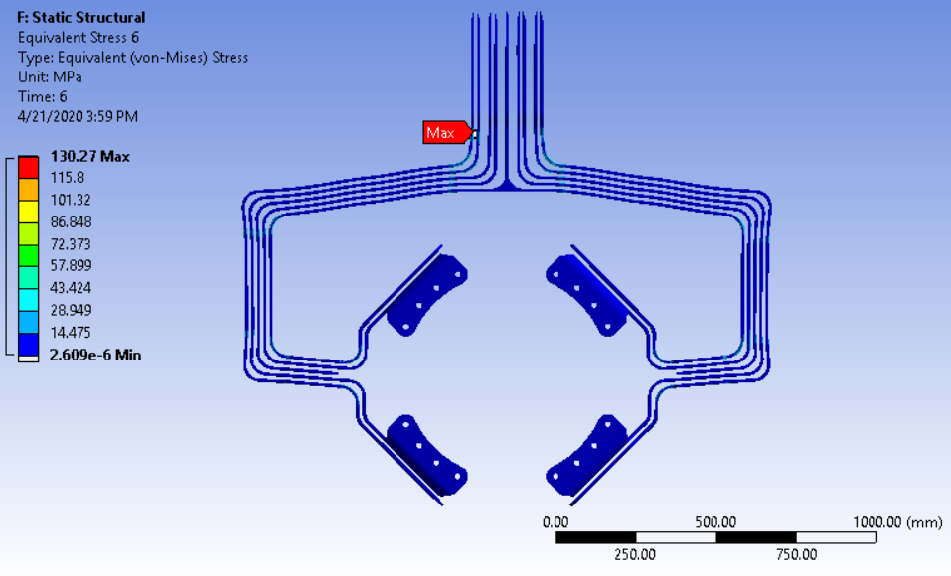
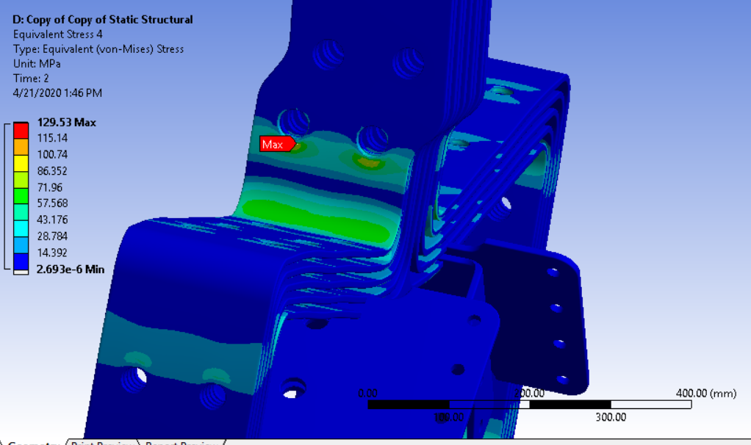
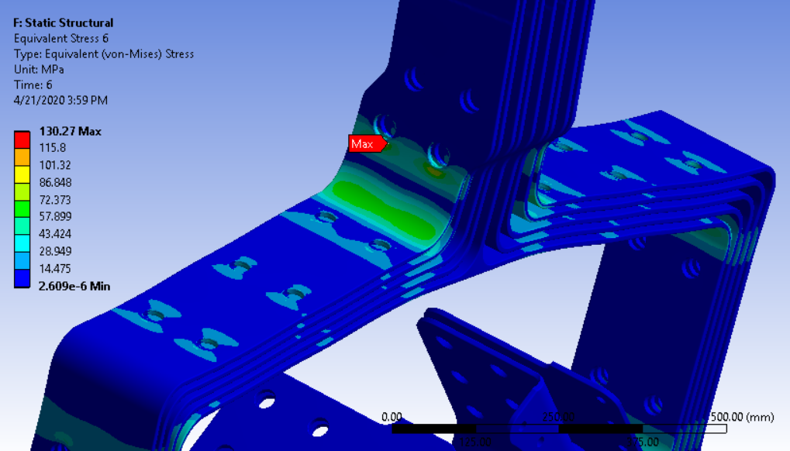
Stress Result: +/- 6mm Displacement

Slide 24
Summary
Structural Analysis for Horn A Hanger Utility Beam Support
Horn A design updated to accommodate two drawbars
The design change resulted to a 0.0028’’ transverse horn displacement which the less than requirement (0.01”) needed to avoid beam misalignment
Equivalent stress below material yield strength showing that design is properly sized
Thermal Analysis for Horn A Hanger Utility Beam Support
Utility beam support material changed to Al7075-T6
Max temperature reported is 111.6 Deg C
Clearance between module feedthrough hole and utility line reduced to approximately 1.6mm due to thermal expansion
Stripline Structural Analysis
Stripline able to accommodate a +/-3mm vertical displacement requirement at Max stress of 65.9MPa
Question?

