Slide 1
Neutrino Beamline Horn A Preliminary Design Review
General Overview: Parameters & Interfaces
Cory Crowley
22 April 2020

Slide 2
Outline
Overview / Position in Beamline
System Interfaces & Parameters
Design Guidance / Assumptions
Requirements & Specifications
Project Requirements
Specifications Worksheet
ESH&Q
Safety Considerations
Documentation
Schedule / Risk / Cost Overview
Summary

Slide 3
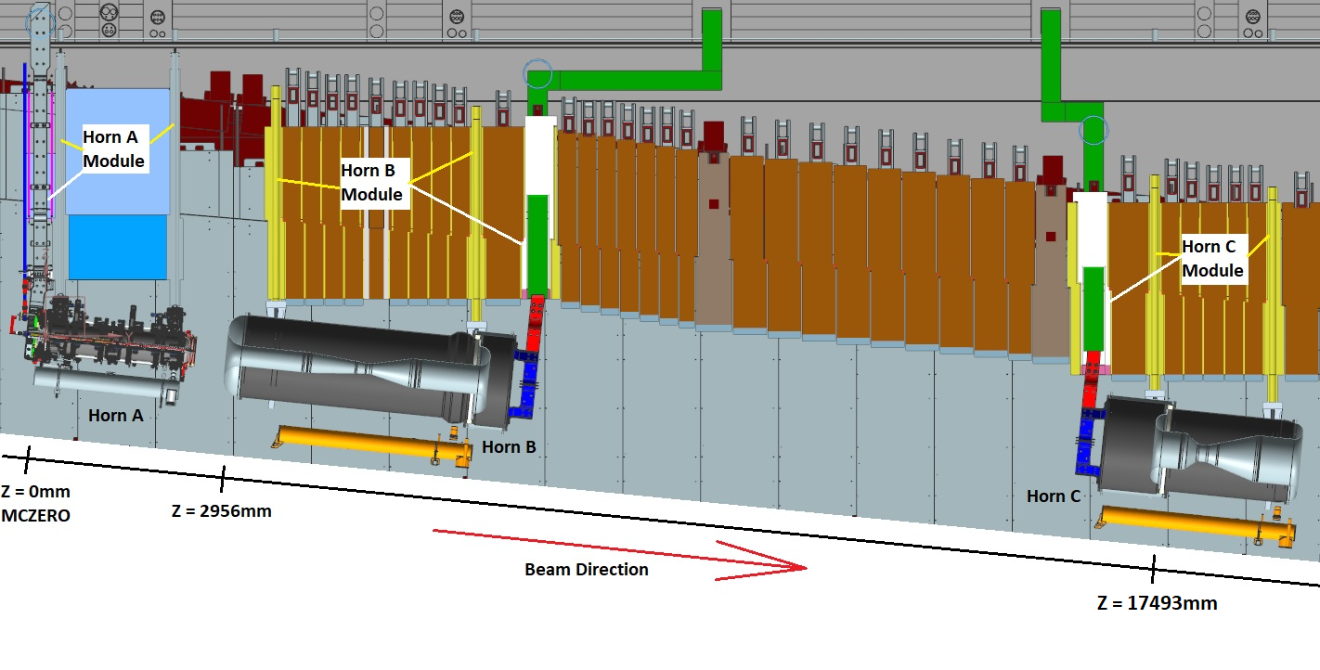
System Scope – Arrangement in Target Chase + Major Components
Three Horn System
Horns A, B, & C + Support Modules with included stripline penetration blocks.
Target is integrated into Horn A & supported from a single module.
Each module provides utility & instrumentation path to supported components.
1.2MW initial horn design; 2.4MW upgradable. Modules designed for 2.4MW.

Slide 4
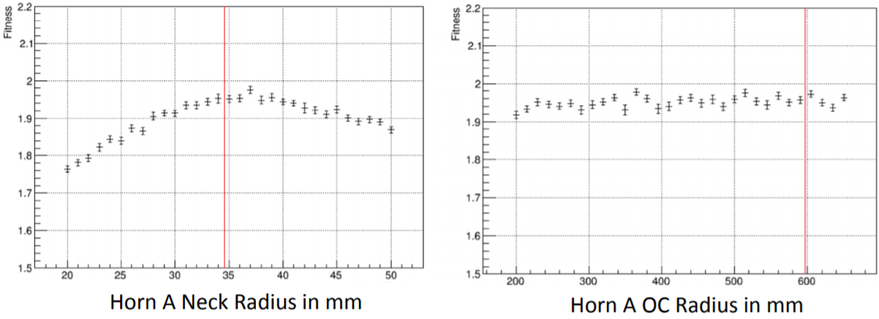
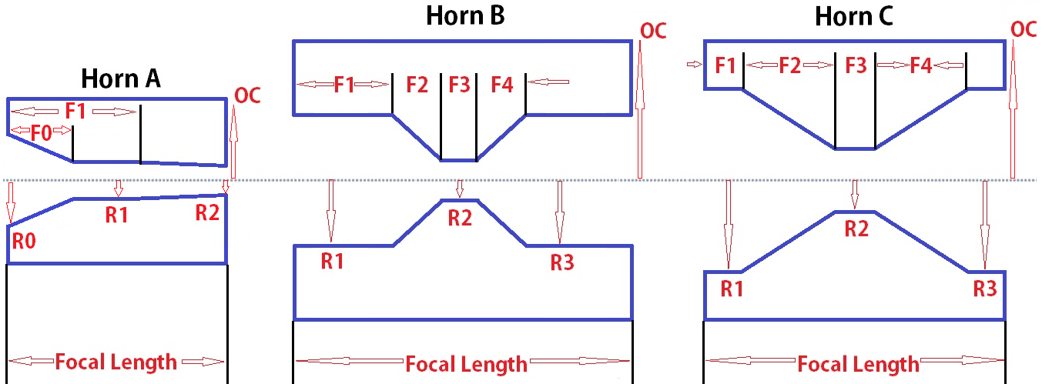
Engineered Horn Parameters
Horns have been packaged into chase and kept most all critical dimensions in Beam Optimization Task Force report, DUNE-doc-2901.
Variations exist from VE, sensitivity, engineering, & manufacturing limitations.
Horn Conductor Parameters | 1.2MW Values
Horn Focal Length, In (mm) | 87.323 (2218)
R0, In (mm) | 5.512 (140)
F0, In (mm) | 15.748 (400)
R1, In (mm) | 1.693 (43)
R2, In (mm) | 1.299 (33)
F1, In (mm) | 46.281 (1175.5)
OC Radius, In (mm) | 8.690 (220.7)
Beamline Position Relative to MC-ZERO, Meters | 0
Horn Inner Conductor Thickness, In (mm) | 0.098 (2.5)
Horn Outer Conductor Thickness, In (mm) | 0.75 (19.1)
Drain Hole Port Diameter, Maximum | 3“ (76.2)

Slide 5
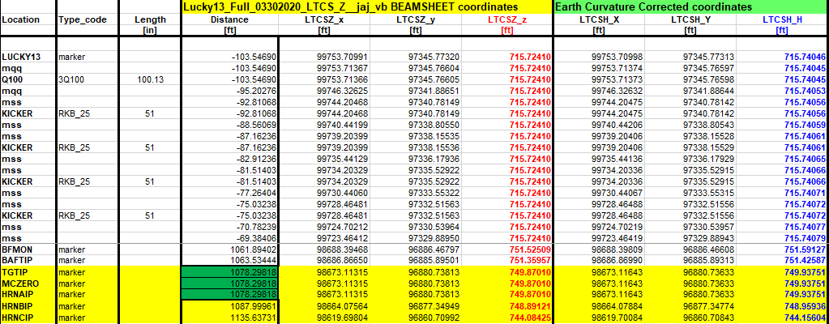
Beam-Sheet Positions
Final Horn A location relative to target & insertion point is reflected on beam-sheet, DUNE-doc-418.
MCZERO is start of Monte-Carlo simulations & origin of target hall chase.
TGTIP / MCZERO / HRNAIP all coincide at same point for 1.2MW design.

Slide 6
Engineered Horn Parameters
Notable Horn A changes:
D.S. End flange thickened in 2018 for fatigue life concerns.
I.C. added 0.5mm wall thickness in 2019 for corrosion / erosion concerns.
F0 / R0 profile added January 2020 to accommodate stiffened target base.
Current equalization sections shortened / transitioned to radial design.
Integrated target changes
Shorted from 2m to 1.5m
Reduction in containment tube wall thickness.
Elimination of D.S. target tube support.

Slide 7
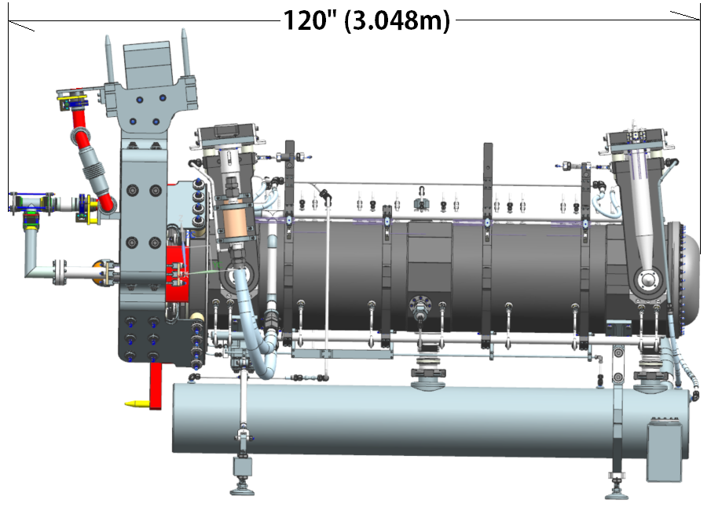
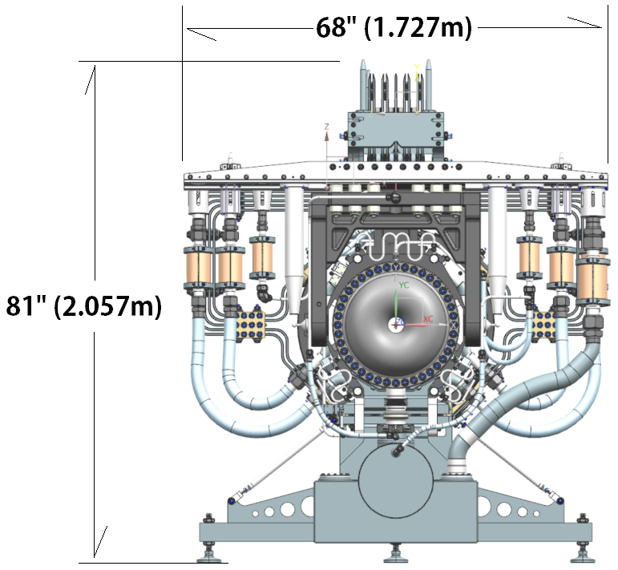
Horn A + Target Package
Large package for horn size (10’ X 7’ X 6’)
Chase must accommodate larger horns.
Utility & power connections must work with 2.4MW.
Weight budget of 5,000lbs (2,273kgs).

Slide 8
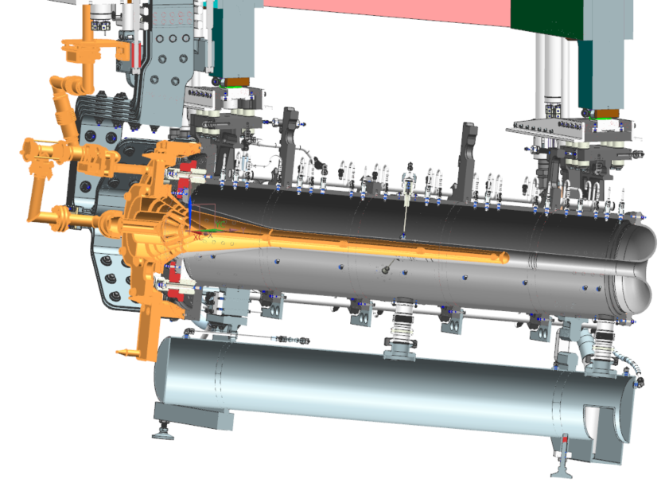
Integrated Target
A 1.5m long, graphite core cantilevered target is affixed to horn and inserted into target chase as a single unit.
NuMI design elements & support structure.
BNB-like voltages & stripline requirements.
T2K-like target package.
Familiar design concepts to the neutrino horn community.

Slide 9
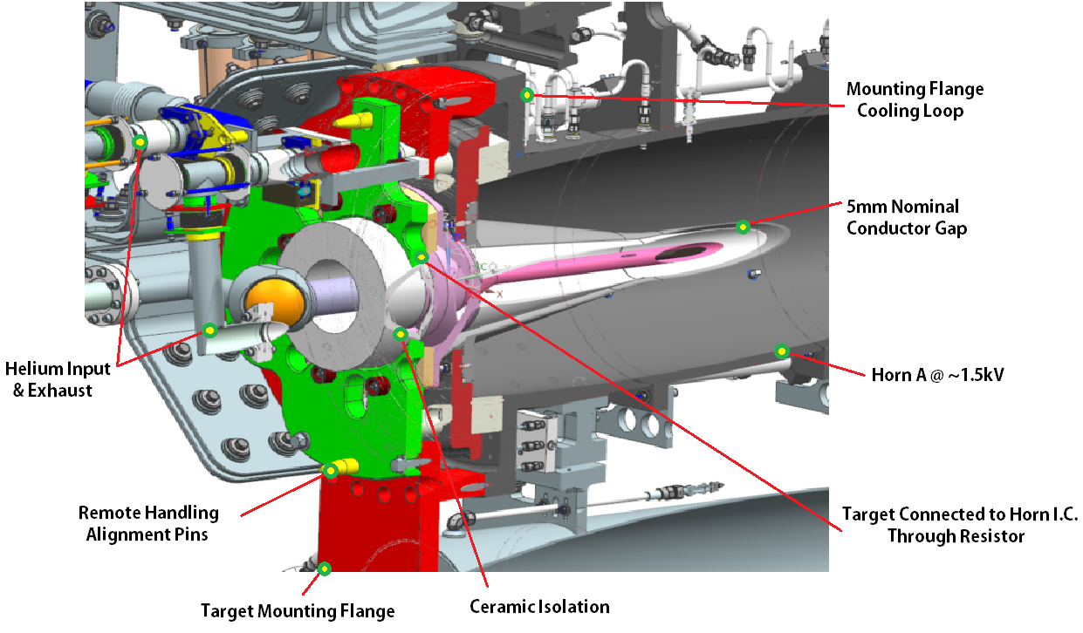
Integrated Target Features

Slide 10
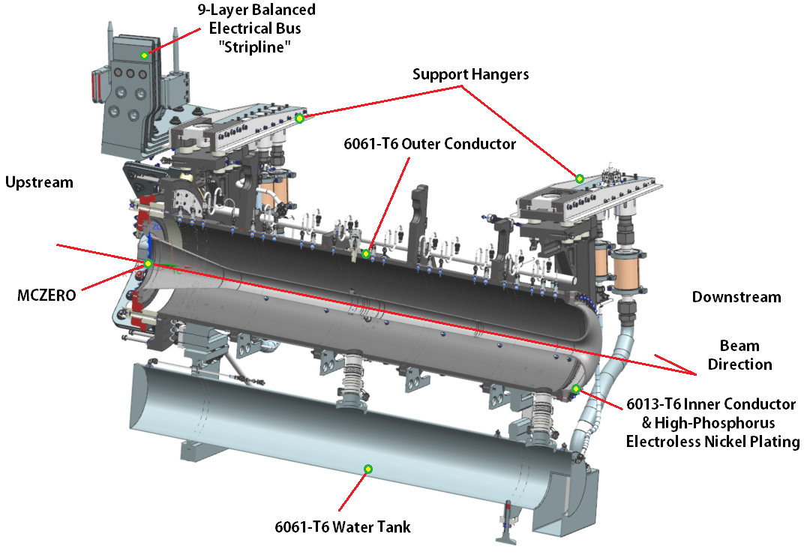
Horn Overview

Slide 11
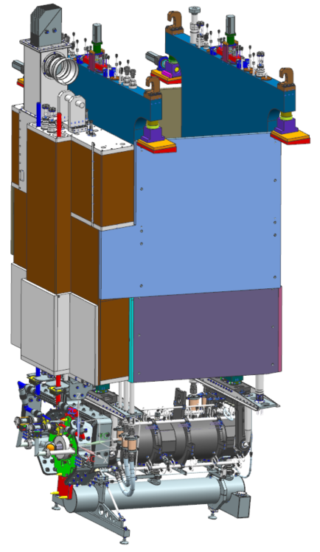
Positioning in Beamline
Horn A + target are mounted to the module mainframe and SLB.
Total remote handling package is shown.
Positioning requirements:
Feature | Range
Vertical Travel | +/- .25” (6.35mm)
Horizontal Travel | +/- .25” (6.35mm)
Axial Variation | +/- .040” (1mm)
Vertical Position | +/- .010” (.25mm)
Horizontal Position | +/- .010” (.25mm)
Utility Line Radial Clearance | +/- .125” (3.18mm)
Minimum U.S. / D.S. Remote Handling Clearance | 6” (152.4mm)

Slide 12
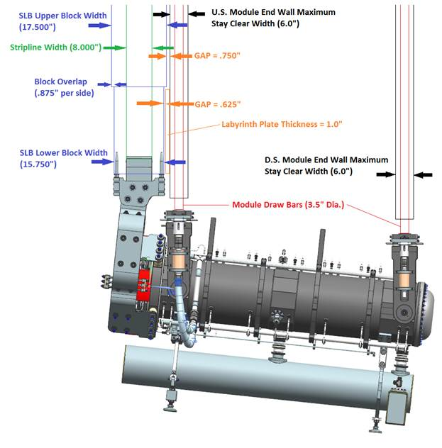
Module Spacing / Limits / Labyrinths
THC crane limit @ 60T.
Horn A + Target budget of 2.5T.
Stripline shield block @ 22.5T
Target Utility Block (TUB) weight budget of 5T.
Lifting fixture budget of 2.5T
Module budget is balance of weight @ 27.5T.
With a 78” wide chase & 120” of shielding, module end & side walls are thin.

Slide 13
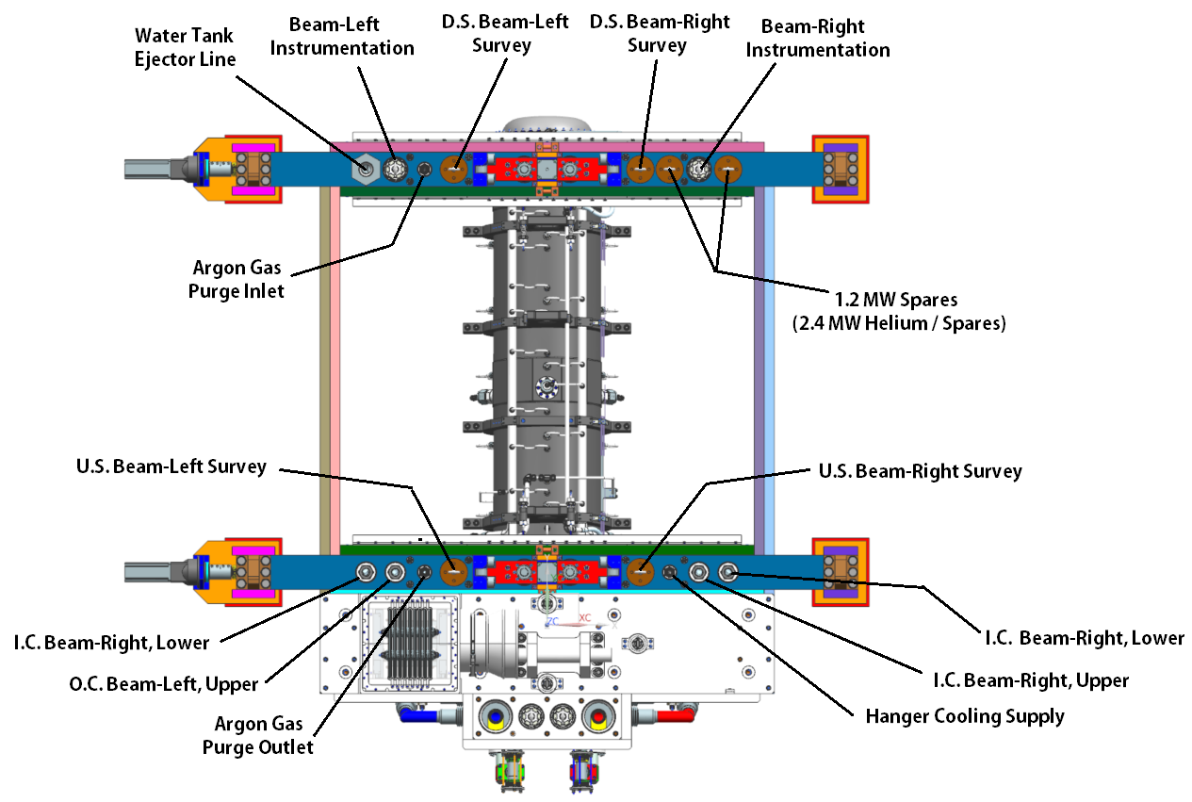
Utility Line Locations

Slide 14
Major Requirements
Proton beam
Proton Beam Energy (GeV) | Protons per Cycle | Cycle Time (s) | Beam Power (MW)
60 | 7.5E+13 | 0.7 | 1.03
80 | 7.5E+13 | 0.9 | 1.07
120 | 7.5E+13 | 1.2 | 1.20
Lifespan
Component | Cycle Life | Minimum Time (yrs)
Horn A | >100,000,000 | 2
Support Module | >1,000,000,000 | 30
Functionality
Allow module, target, conductor bus (stripline) shield block de-coupling.
Allow for re-use after decoupling expired adjacent or integrated component.
Fit within 2m wide chase design from Beamline optimization.
Allow for water cooling, gas cooling, purge gas, etc…

Slide 15
Requirement Tracking / Tracing
High level project requirements are kept in DOORS / CERN EDMS.
Beamline specific requirements with tracebacks to adjoining systems & high level requirements are kept in Beamline SharePoint site. (Example below represents ~20% of Horn content).
Parameter/Specification | Baffle Module | Target Features Support | Target Utility Block | Horn A | Horn A Module | Horn B | Horn B Module | Horn C | Horn C Module | Units
Maximum Beam Power (MW) | 2.4 | 1.2 | 1.2 | 1.2 | 2.4 | 1.2 | 2.4 | 1.2 | 2.4
Horn Conductor Parameters
Horn Focal Length, In (mm) | N/A | N/A | N/A | 87.323 (2218) | N/A | 154.803 (3932) | N/A | 85.984 (2184) | N/A | inch (mm)
R1, In (mm) | N/A | N/A | N/A | 1.693 (43) | N/A | 6.260 (159) | N/A | 11.181 (284) | N/A | inch (mm)
R2, In (mm) | N/A | N/A | N/A | 1.299 (33) | N/A | 3.189 (81) | N/A | 5.158 (131) | N/A | inch (mm)
R3, In (mm) | N/A | N/A | N/A | N/A | N/A | 8.858 (225) | N/A | 14.252 (362) | N/A | inch (mm)
F1, In (mm) | N/A | N/A | N/A | 46.281 (1175.54) | N/A | 47.989 (1218.92) | N/A | 17.197 (436.8) | N/A | inch (mm)
F2, In (mm) | N/A | N/A | N/A | N/A | N/A | 34.057 (865.04) | N/A | 7.739 (196.56) | N/A | inch (mm)
F3, In (mm) | N/A | N/A | N/A | N/A | N/A | 3.096 (78.64) | N/A | 6.019 (152.88) | N/A | inch (mm)
F4, In (mm) | N/A | N/A | N/A | N/A | N/A | 24.769 (629.12) | N/A | 30.095 (764.4) | N/A | inch (mm)
OC Radius, In (mm) | N/A | N/A | N/A | 8.690 (220.73) | N/A | 24.961 (634) | N/A | 24.961 (634) | N/A | inch (mm)
Beamline Position Relative to MC-ZERO, Meters | N/A | N/A | N/A | 0 | N/A | 2.957 | N/A | 17.477 | N/A | meter
Horn Inner Conductor Thickness, In (mm) | N/A | N/A | N/A | 0.098 (2.50) | N/A | 0.118 (3.00) | N/A | 0.158 (4.00) | N/A | inch (mm)
Horn Outer Conductor Thickness, In (mm) | N/A | N/A | N/A | 0.75 (19.05) | N/A | 1.00 (25.4) | N/A | 1.00 (25.4) | N/A | inch (mm)
Drain Hole Port Diameter, Maximum | N/A | N/A | N/A | 3" | N/A | 4" | N/A | 4" | N/A | inch
Component Weights
Maximum Weight Allowance | 114,000lbs (+1000lb Baffle) | 1500lbs | 10000lbs | 3500lbs | 110,000lbs (SLB Included) | 10,000lbs | 105000lbs (SLB Included) | 7,500lbs | 107,500lbs (SLB Included) | lbs
Lifting Fixture Allowance | 4,900lbs | ??? | N/A | 1,000lbs | 4,900lbs | 1,000lbs | 4,900lbs | 1,000lbs | 4,900lbs | lbs
Cooling
Helium Supply Temperature (Nominal, Range) (Celcius) | N/A | 30C | 30C | N/A | N/A | N/A | N/A | N/A | N/A | C
Helium Return Temperature (Nominal, Range) (Celcius) | N/A | 180C | 180C | N/A | N/A | N/A | N/A | N/A | N/A | C
Nitrogen Supply Temperature (Nominal, Range) | ? | N/A | 75F, +5F / -30F | 75F, +5F / -30F | 75F, +5F / -30F | 75F, +5F / -30F | 75F, +5F / -30F | 75F, +5F / -30F | 75F, +5F / -30F | F
RAW Supply Temperature (Nominal, Range) | ? | N/A | N/A | 70F, +5F / -10F | 70F, +5F / -5F | 70F, +5F / -10F | 70F, +5F / -5F | 70F, +5F / -10F | 70F, +5F / -5F | F
SLB Nitrogen Flow
Flow Rate, CFM @ 2.4MW | N/A | N/A | N/A | 3,000 |  | 3,000 |  | 3,000 |  | CFM
Supply Pressure (PSI) | N/A | N/A | N/A | 5PSI |  |  |  |  |  | PSI
Maximum Required Flow Rates
Inner Conductor Line - BRU (1.5" OD Tube W/Swage Connection @ Horn) | N/A | N/A | N/A | 8GPM | N/A | 25GPM | N/A | 15GPM | N/A | GPM
Inner Conductor Line - BRL (1.5" OD Tube W/Swage Connection @ Horn) | N/A | N/A | N/A | 8GPM | N/A | 25GPM | N/A | 15GPM | N/A | GPM
Inner Conductor Line - BLL (1.5" OD Tube W/Swage Connection @ Horn) | N/A | N/A | N/A | 8GPM | N/A | 25GPM | N/A | 15GPM | N/A | GPM
Outer Conductor Line - BLU (1.5" OD Tube W/Swage Connection @ Horn) | N/A | N/A | N/A | 15GPM | N/A | 35GPM | N/A | 25GPM | N/A | GPM
Ejector Line - (2.0" OD Tube W/Swage Connection @ Horn) | N/A | N/A | N/A | 54GPM | N/A | 130GPM | N/A | 84GPM | N/A | GPM
Hanger Cooling Line (1.0" OD Tube W/Swage Connection @ Horn) | 5GPM | N/A | N/A | 5GPM | N/A | 5GPM | N/A | 5GPM | N/A | GPM
Gas Purge Inlet / Outlet (Argon) (1.0" OD Tube W/Swage Connection @ Horn) | N/A | N/A | N/A | 9085cc/min | N/A | 4038cc/min | N/A | 883cc/min | N/A | cc/min
Module | 10GPM | N/A | N/A | N/A | 10GPM | N/A | 10GPM | N/A | 10GPM | GPM

Slide 16
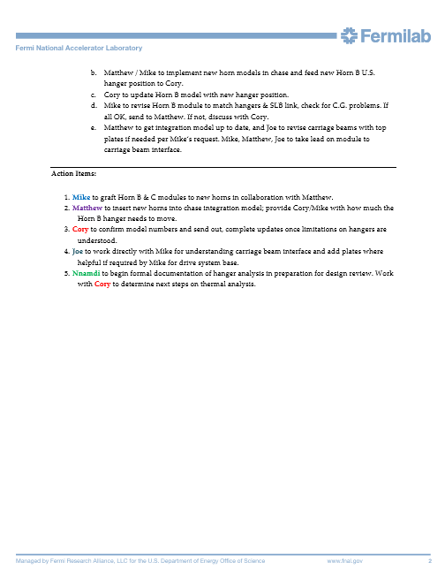
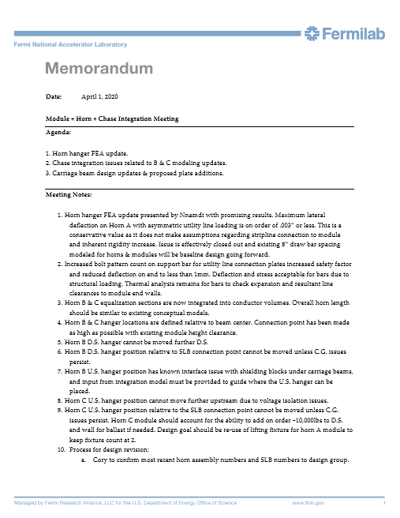
Integration Efforts / Design Tracking
Dedicated bi-weekly meeting held with RAL target group for Horn-Target interface issues. Separate bi-weekly meeting held with Module & Chase engineering & design team for internal interface issues.
Additional communication to adjacent systems occurs as-needed.
Important notes are documented for future reference & task assignments.
Module Notes: DUNE-doc-17289
RAL Notes: DUNE-doc author list & Indico event.

Slide 17
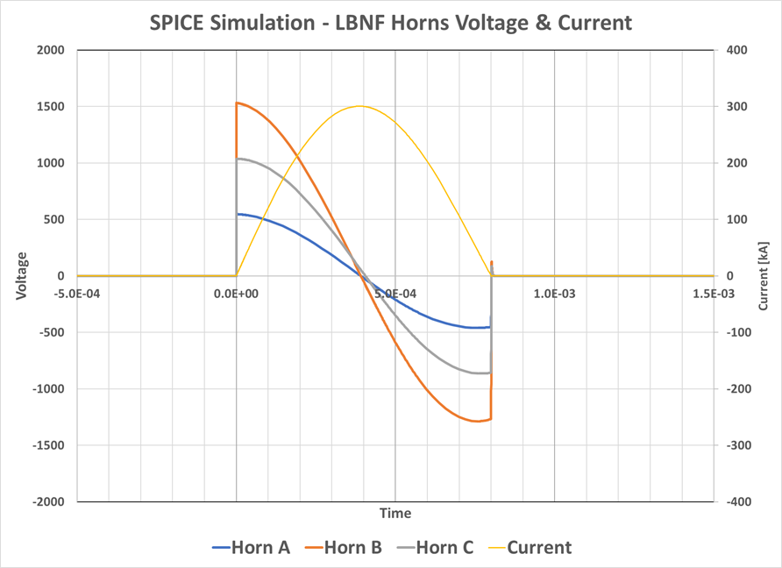
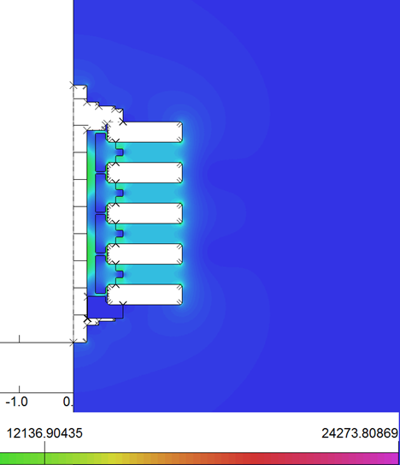
Horn Design – Electrical Considerations
EE Credit: Ken Quinn
Max V @PS | Max Allow. E Field | Max Isolator Path Length Potential | Horn A ΔV | Horn B ΔV | Horn C ΔV
~4500V | 25V/.001” | 5V/.001” | ~550V | ~1550V | ~1050V

Slide 18
Horn Design – Electrical Considerations Cont.
EE Credit: George Krafczyk
Current depth (skin depth) @ 625Hz is fully developed through inner conductor thickness until end flange transition wall surpasses 4.0mm.
Horn stripline is 9.5mm thick X 203.2mm wide (3/8” X 8”).
Impedance matched from P.S. stripline to horn face. Nominal stripline width is 304.8mm (12”), with a 12.7mm (½”) gap between layers.
Transitions to a 8” wide stripline with 3/8” gap at shield block to account for weight limitations on module assembly and bent blank pattern fitment on 12” wide stock from mill.

Slide 19
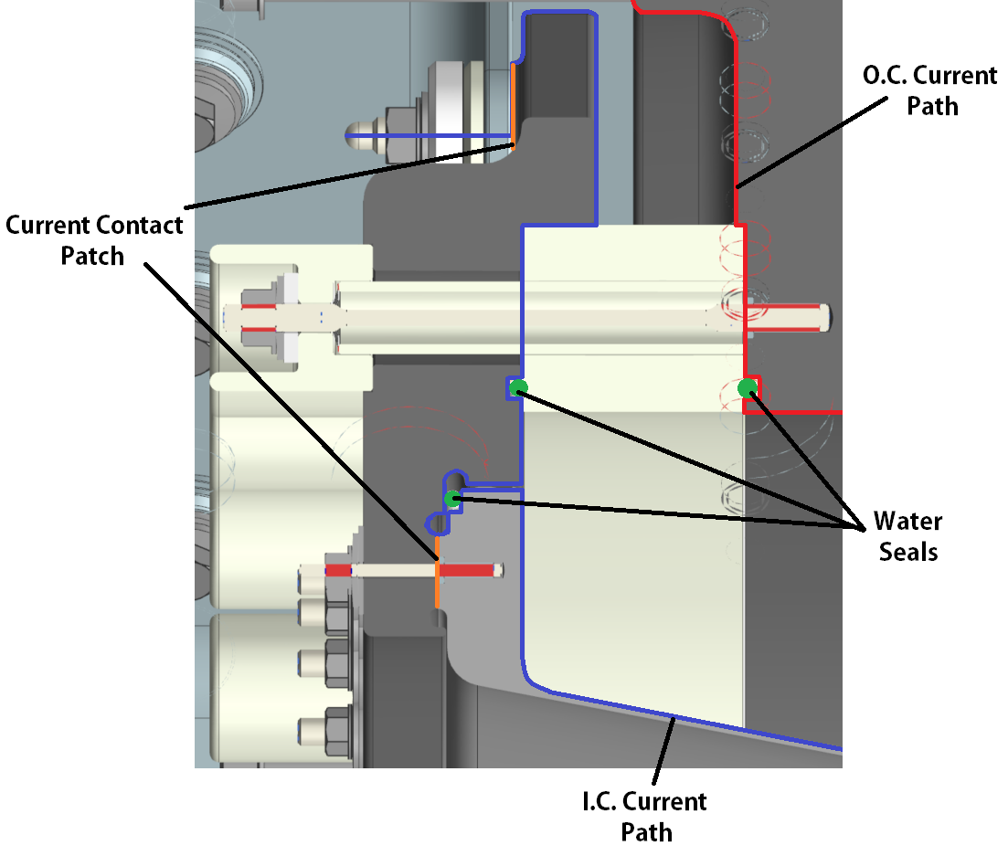
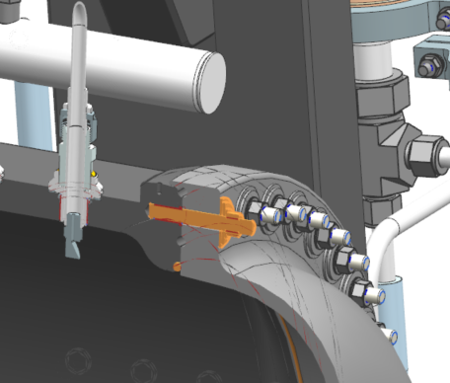
Basic Layout: U.S. & D.S.
U.S. end has standard seal arrangement, 2 @ ceramic ring + 1 @ connecting flange to inner conductor interface.
Inner conductor current flows through connecting flange.
D.S. turn-around has single water seal & profiled to facilitate draining.

Slide 20
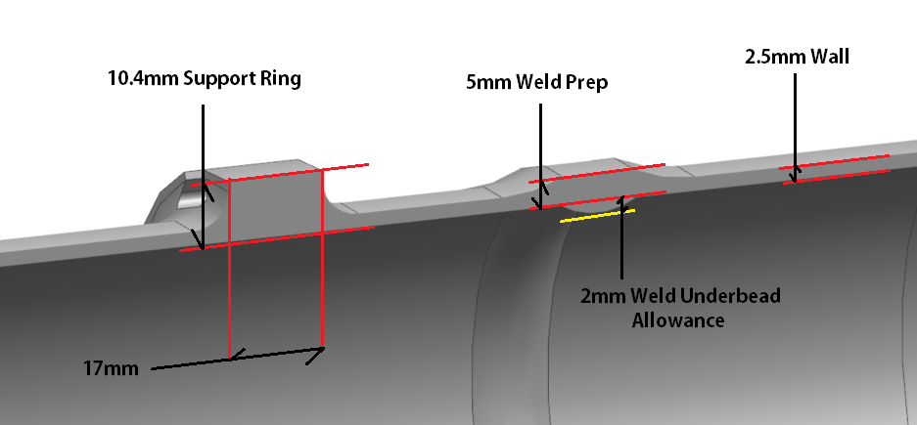
Basic Layout: Horn Profile
Nominal I.C. conductor thickness is 2.5mm, O.C. 19.05mm (3/4”).
Both welds (2) are 5mm thick (2 x wall for 50% weld efficiency), so precisely matches NuMI weld preparation reference measurements of 0.197” for CNC TIG welding program generation.
Conductor supports “spider supports” have dedicated ring on I.C. for mounting nuts and mimic NuMI style & shape.

Slide 21
ESH&Q
ESH&Q requirements identical to all critical beamline components.
Pressurization aspects (vessels, piping).
Mixed waste (keep beryllium, silver, cadmium, etc… content low).
Disposal (remove RAW / contain contamination).
Assembly (specialized tools, fixtures, rigging, procedures).
Quality aspect is most applicable to horns.
Technically demanding devices that take years to build.
Performance or Q/A issues have major ramifications for programmatic goals.
Material certification records.
Vendor prequalification testing.
Component inspection, X-ray, CT scan, & signoff records.
Fabrication, assembly, and installation procedures.

Slide 22
Horn A Schedule Overview
Final Design Review & release for fabrication ~February 2021.
Horn A prototype build follows and lasts through ~May 2023.
Prototype Horn A will be run through a 250,000 pulse minimum break-in period on test stand.
Verify water flow rates, voltage isolation, stripline vibrations, conductor vibrations, magnetic field accuracy, water drain rates, heat transfer coefficient, module connections, & entire target exchange mechanism.
Production build begins 2025, implementing any design iterations from prototype horn. Efforts ongoing to advance prototype testing & subsequent production horn schedule.
Production horn build and test schedule mimics prototype horn A.
Substantial testing with RAL provided targets is accounted for.

Slide 23
Integrated Schedule
Integration activities start March 2023 once majority of Horn A assembly is complete.
Assemble target mounting flange to horn face.
Test complete assembly with dummy target in test stand after magnetic field mapping complete.
Specific activities for Horn A prototype & Target prototype in 2025.
Additional integration & testing in 2027 with production Horn & Target.
Horn A & Target commissioning scheduled for 2028.

Slide 24
System Risks
Design risks are actively updated.
Some have been retired:
No vendor for inner conductor nickel plating.
No vendor for outer conductor anodizing.
Unacceptable magnetic field uniformity at horn drain ports
Technically challenging ones are actively being worked on:
Ceramic isolator design for voltage breakdown / corona inception.
Vendor qualification for friction stir welded striplines.
Schedule, resource, & accident type risks remain:
Production timelines.
Component damage.
Major interface issues during testing.

Slide 25
Cost Overview
Horn A + prototype & ancillary equipment have TPC on order of 7M.
Horn A items are cost driver for Horns WBS due to:
Prototype horn build before production horn build.
Buys most universal horn fixturing & NRE items.
Bulk of engineering design & component prototypes.
M&S cost drivers for Horn A
Inner conductor fabrication.
Outer conductor machining.
Stripline fabrication & ceramics package.
Labor
~14k hours for tested, “delivered” prototype & production horns.
Minor coverage for integrated target.
Fitment, test stand oversight, exchanger calibration, etc…

Slide 26
Summary
The technically demanding Horn A interfaces are the integrated target, mating interface to the support module, and the connection to the power supply.
Horn A preliminary design is derived from FNAL design experience on NuMI / NOvA horn production and operations.
Design elements successfully employed by other focusing horns have been implemented.
The requirements are clearly defined, and engineering parameters & specifications continue to be defined as we approach final design.
Horn cost estimates continue to be updated. No major (20%+) variations to date have been identified from vendor budget estimates.
Review material is available for all major design aspects of Horn A.
Questions?

