Slide 1
Neutrino Beamline Horn A Preliminary Design Review
Introduction
Keith Gollwitzer
22 April 2020

Slide 2
Review Plan
Three half days – mornings
Agenda on Indico
Projects->LBNF->Beamline->Beamline Reviews
Review Committee is encouraged to ask questions anytime
After each technical talk there is 15 minutes for discussion
Entire review is being done via Zoom
Please turn off video to save bandwidth
Seems to be a problem when have more than half a dozen connected
Please keep muted when you are not talking

Slide 3
Introductions
Review Committee
Kris Anderson (FNAL/AD/Target System Department)
Yun He (FNAL/AD/Target System Department)
Eric Zimmerman (University of Colorado)
Presenters
Cory Crowley – LBNF Horn Systems Technical Manager
Ang Lee – Horn FEA Expert
Zhijing Tang – Horn FEA Expert
Jacob Kintner – FEA & Piping System Expert
Meredith Lee – Horn Production & Assembly Process Engineer
Nnamdi Agbo – FEA & Test Stand Design

Slide 4
DUNE & LBNF
The Deep Underground Neutrino Experiment will be a world-leading experiment for neutrino science, potentially transforming our understanding of why the universe exists as it does.
The Long-Baseline Neutrino Facility is the infrastructure necessary to send a powerful beam of neutrinos 800 miles through the earth, and measure them deep underground at South Dakota’s Sanford Underground Research Facility.
DUNE/LBNF project will be the first internationally conceived, constructed, and operated mega-science project hosted by the DOE in the U.S.

Slide 5
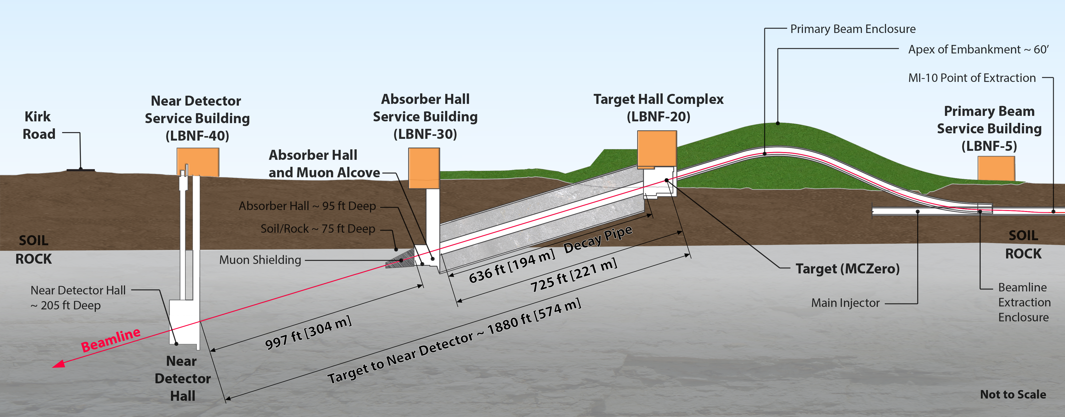
LBNF Near Site

Slide 6
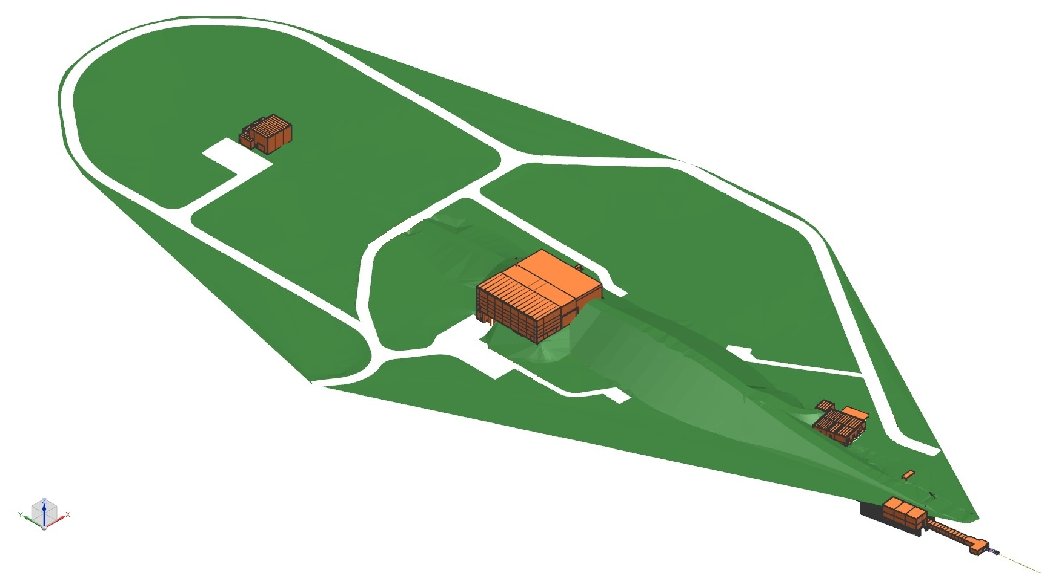
LBNF Near Site – Beamline Scope
Absorber Complex
Nu Beam
to SURF, SD
Target Complex
Primary Beam Complex
Proton Beam
from MI

Slide 7
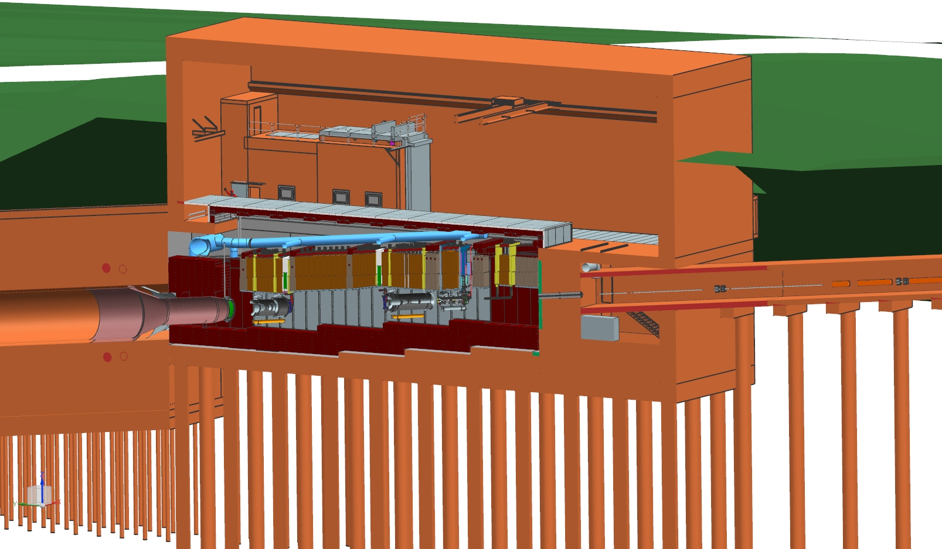
Target Complex – Target Hall (old)
Target
Hall
Work-Cell
←Beam
Primary Beamline
Decay
Vessel

Slide 8
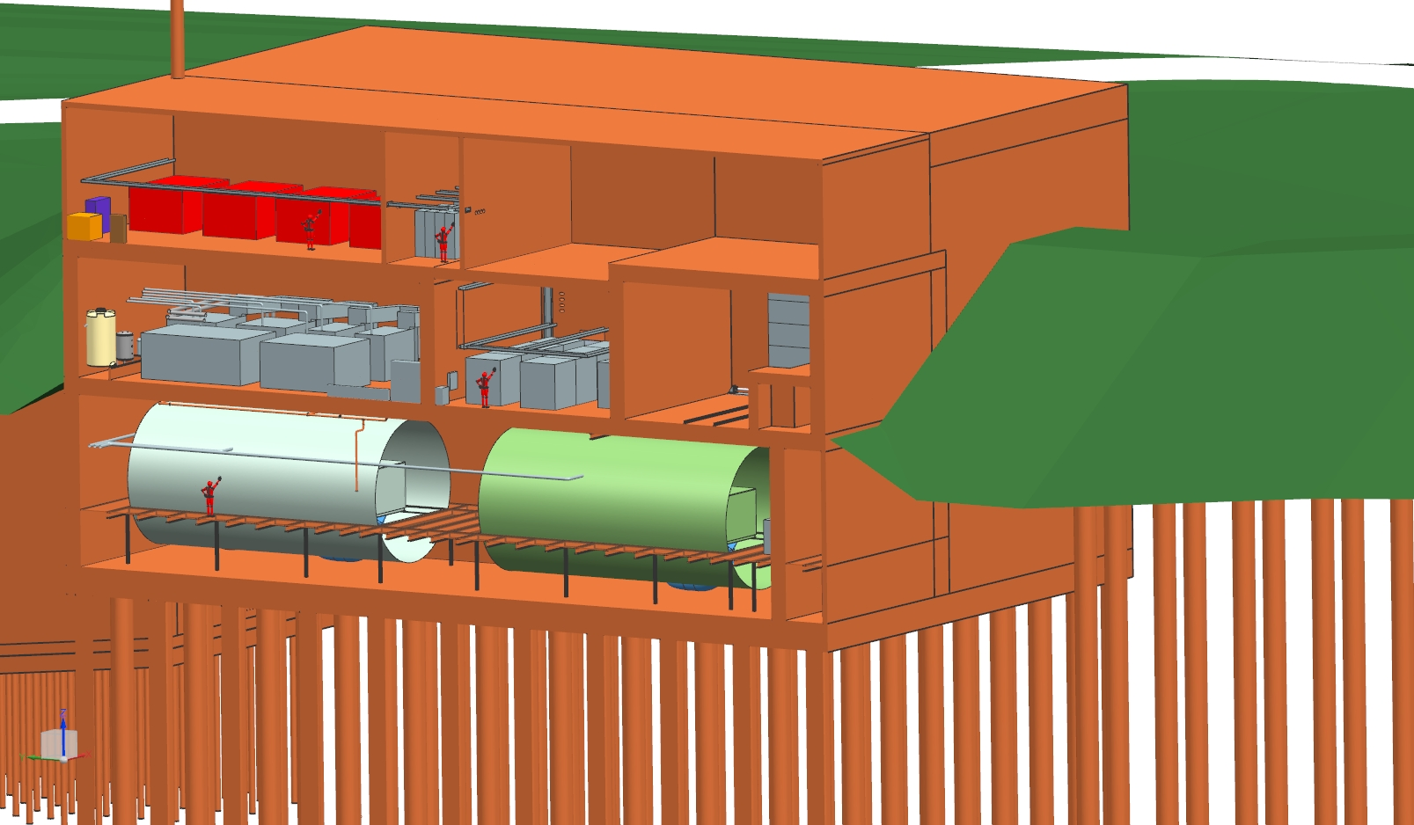
Target Complex – Support Rooms (old)
Helium Room
Controls Room
RAW Room
Power Supply Room
Access to Target Hall
←Beamline
Decay Vessel Cooling N₂ System
Target Shield Pile Cooling N₂ System

Slide 9
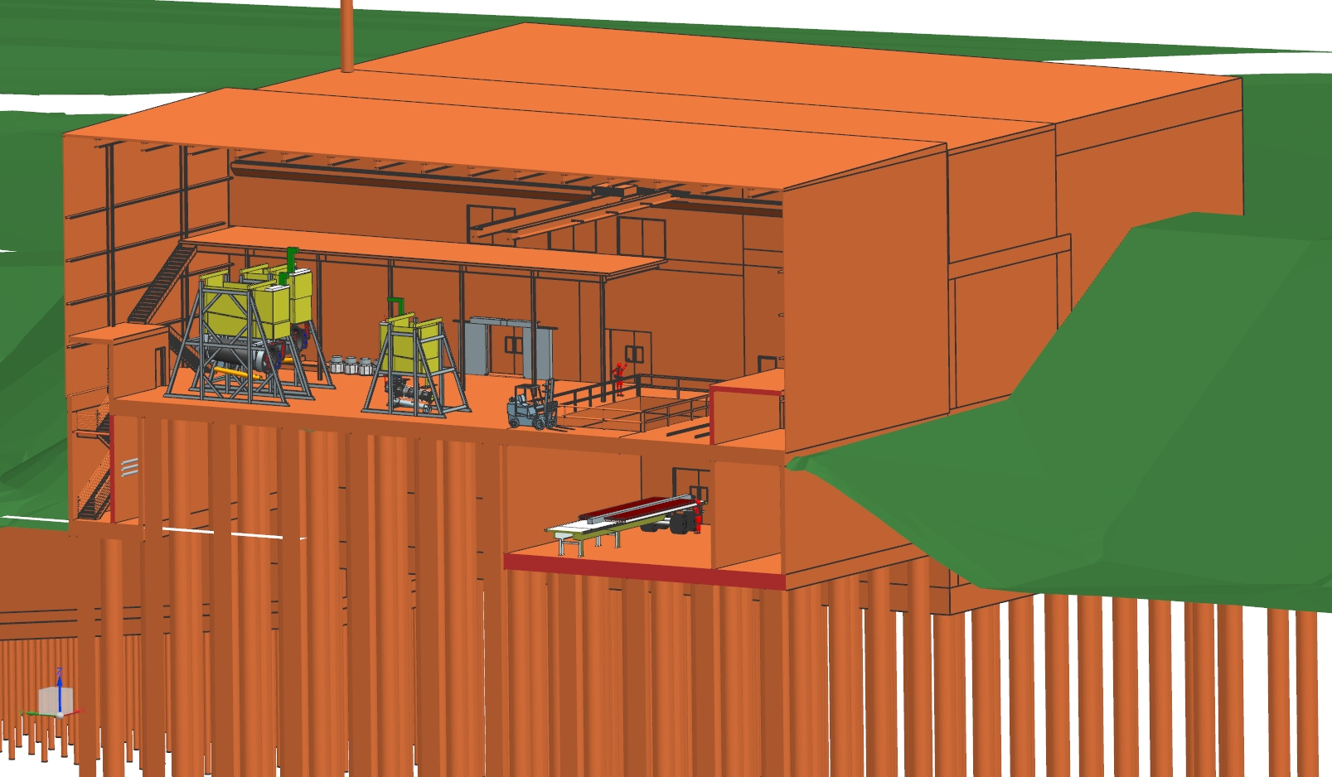
Target Complex – Service Bay (old)
Service
Bay
←Beamline
Truck
Bay

Slide 10
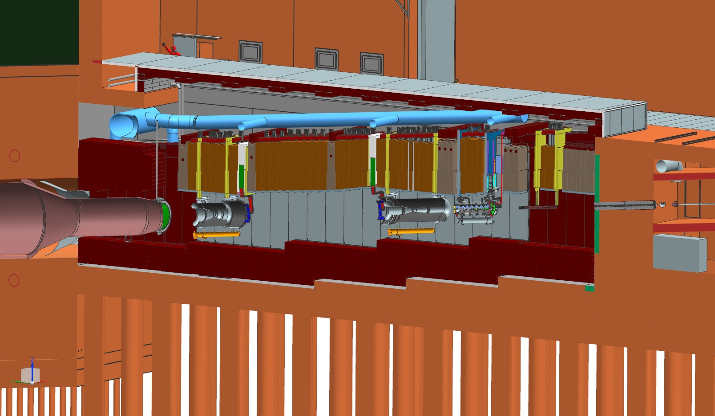
Target Station
Work Cell
Target
Hall
Hatch Covers
Primary
Beamline
Decay
Vessel
N₂ Gas
He Gas
Decay Pipe Upstream Window
Horn A with Target
Primary Beam Window
Horn C
Cooling
Panels
Horn B
Baffle
Steel Shielding

Slide 11
Plan
Preliminary Design Review: this week
Final Design: May 2020 – Feb 2021
Prototype Fabrication: Feb 2021 – Apr 2023
Prototype Testing: Sep 2024 – Apr 2025
Design Revision: Jan 2025 – May 2025
Production Fabrication: Dec 2024 – May 2027
Production Testing: May 2027 – Dec 2027

Slide 12
Charge -- 1 of 2
Does the preliminary design meet the requirements of the optimized beamline parameters?
Is the design maturity presented for the Horn A conductors, stripline, interfaces, and ancillary systems at a level appropriate for the Preliminary Design Phase, as guided by the LBNF / DUNE Review Plan?
Based on acceptable progress for Preliminary Design as 50 to 70%, with 100% equal to “completion of Preliminary Design phase”.
Are areas where components are awaiting forthcoming development well understood?
Final Design will be drawing-intensive in comparison to the first two phases of design.
Have suitable engineering analyses been performed and documented, and reviewed/peer reviewed and approved, where applicable?
Does the anticipated design life meet experimental requirements of 1E8 pulses or 2 years of operation prior to failure?
Have the ES&H issues been identified and analyzed appropriately?
Have the Fermilab Engineering Manual standards been applied to the design?

Slide 13
Charge -- 2 of 2
Have potential design, manufacturing, and installation risks and challenges been identified within the Horn A WBS, and has it been adequately planned to address these during the final design?
Are difficult design features and possible prototyping issues identified? es the preliminary design meet the requirements of the optimized beamline parameters?
Is the level of integration with other LBNF beamline entities appropriate for this stage of the work? I.E. Are interfaces and collaborative design inputs being managed appropriately?
A major Horn A system interface is the integrated target, which is being designed and built by RAL. Have all integration activities pertaining to the mating of these components been identified?
Are there any outstanding design considerations for the integrated target which have not been identified by the design teams?.
Select Horn A components are currently undergoing estimation review through the Project Estimator. This includes the submission of sample packages to outside vendors for spot-checking of current values. With this in mind, a cursory check of the cost and sche dule are desired:
To verify top level cost estimates for prototype and production horn fabrication & testing.
To question sufficiency of design resources with known complexity of certain features, such as stripline ceramics design, stripline welding, & conductor welding

