Slide 1
Neutrino Beamline Horn A Preliminary Design Review
Cooling System Requirements & Design
Cory Crowley
22 April 2020

Slide 2
Outline
Power Inputs
EDEP
Joule Heating
Heat Transfer Coefficients
Experimental Testing & Scaling
Requirement Generation
Design Layout & Prototyping
Summary

Slide 3
Power Input
Cooling requirements are driven by heat input into conductors.
Heating totals are a summation of EDEP results from modeling group (DUNE-doc-8759, 2m RAL cylindrical target), and the joule heating from the current pulse (DUNE-doc-10494).
It is generally best for material strength, fatigue life, and displacement concerns to keep conductor volumes as cool as possible.
100C max; 80C desired & lower better.
Approach over the years has been to maximize cooling, and see if resultant temps are acceptable.
Concerns to keep in mind:
Water film on conductors.
Horns drive RAW requirements; ejector flows scale by 2-3X horn needs.
Drain port sizes, system pressures, erosion of conductors.

Slide 4
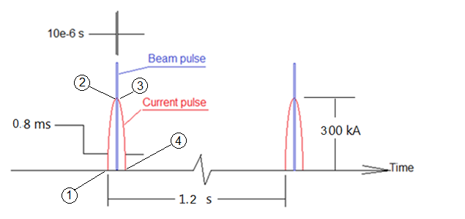
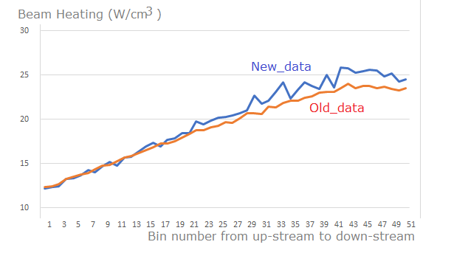
Power Input
$$w= σ_{e}j^{2}=σ_{e}{\left(\frac{I}{A}\right)}^{2}=σ_{e}{\left(\frac{I}{2πRt}\right)}^{2}$$
Source Credit:
Zhijing Tang
Horn A Conductor Heating | Power (kW)
Joule Heating | 5.4
Beam Heating | 28.0
Total Heating | 33.4

Slide 5
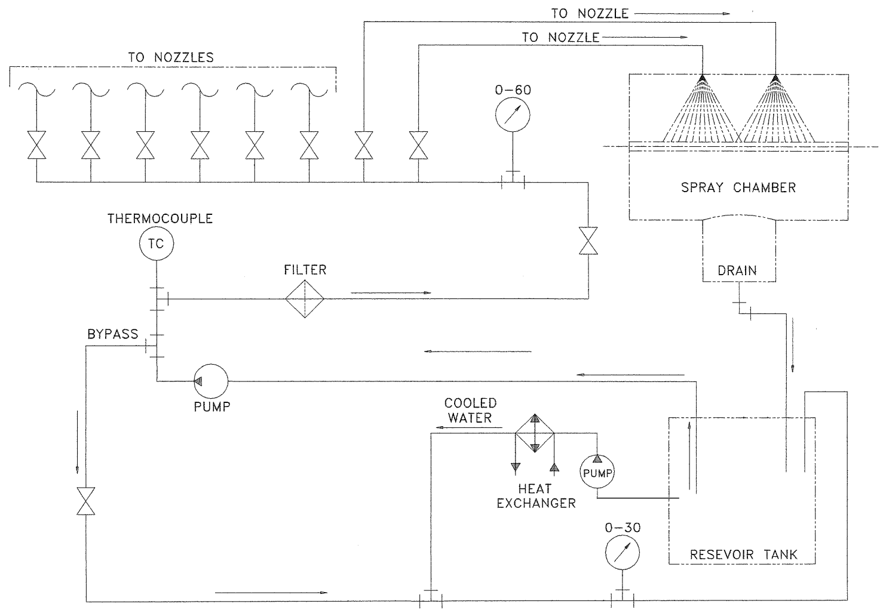
Testing Inputs
Study completed in 2013, which was an iteration of a previous study, to better gauge heat transfer coefficients across nozzle capacities.
Available in ED0000569 & DUNE-doc-12760.
Test cart still maintained and will be back in use this year for additional testing.

Slide 6
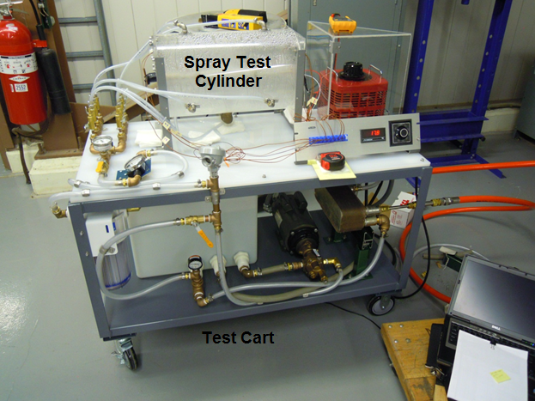
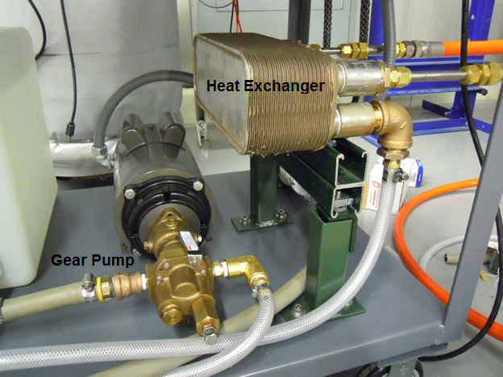
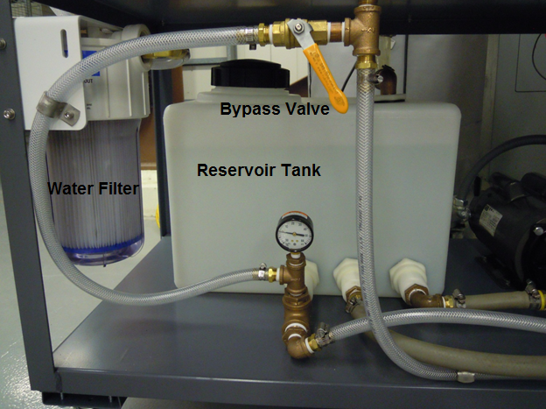
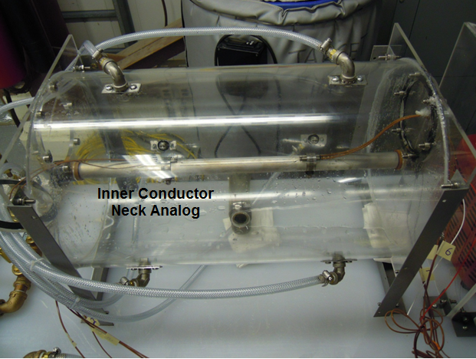
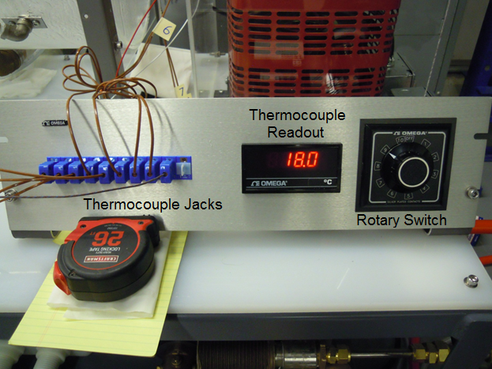
Experimental Testing

Slide 7
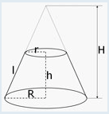
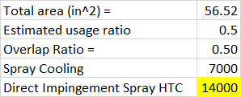
Cooling Parameters
Scaling
Geometry
Flow
Coverage
1.2MW LBNF Horn A I.C. Cooling Coefficient Range | R | r | H | L | Conductor Lateral Surface Area (in^2) | Totals | Area of Spray Nozzles (in^2) | Ratio of Direct Spray | Ratio of Film | Spray Cooling Contribution | Film Cooling Contribution | Total Cooling W/m^2*C | De-Rate ~1500W/m^2*C
0in - 46.281in | 1.69 | 1.69 | 46.28 | 46.28 | 492 | 492 | 332.775 | 0.68 | 0.32 | 6567 | 324 | 6891 | 5500
46.281in - 87.323in | 1.69 | 1.30 | 41.04 | 41.04 | 386 | 386 | 288.405 | 0.75 | 0.25 | 7263 | 252 | 7516 | 6000

Slide 8
Cooling Parameters
Inner conductor HTC drives most cooling.
O.C. & end flange rates + forced nitrogen are ancillary.

Slide 9
Flow Requirements
Conductor Position | I.C. Manifold # 1 BRU | I.C. Manifold # 2 BRL | I.C. Manifold # 3 BLL | O.C. Manifold # 4 BLU
I.C. Nozzle 1 | 1/8TEK-SS5 | 1/8TEK-SS5 | 1/8TEK-SS5 | N/A
I.C. Nozzles 2-8 | H1/8VV-316SS9508 | H1/8VV-316SS9508 | H1/8VV-316SS9508 | N/A
I.C. Nozzle 9 | 1/8TEK-SS5 | 1/8TEK-SS5 | 1/8TEK-SS5 | N/A
O.C. Nozzles 1-10 | N/A | N/A | N/A | F10119111
Cooling Medium | Required Temperatures
Nitrogen Supply Temperature (Nominal, Range) | 75F, +5F / -30F
RAW Supply Temperature (Nominal, Range) | 70F, +5F / -10F
Manifold | Required Flows | Required Pressures
Inner Conductor Line - BRU (1.5" OD Tube W/Swage Connection @ Horn) | 8GPM | 40PSIG
Inner Conductor Line - BRL (1.5" OD Tube W/Swage Connection @ Horn) | 8GPM | 40PSIG
Inner Conductor Line - BLL (1.5" OD Tube W/Swage Connection @ Horn) | 8GPM | 40PSIG
Outer Conductor Line - BLU (1.5" OD Tube W/Swage Connection @ Horn) | 15GPM | 40PSIG
Ejector Line - (2.0" OD Tube W/Swage Connection @ Horn) | 54GPM | -7.8PSIG
Hanger Cooling Line (1.0" OD Tube W/Swage Connection @ Horn) | 5GPM | 40PSIG
Gas Purge Inlet / Outlet (Argon) (1.0" OD Tube W/Swage Connection @ Horn) | 9085cc/min | 1.3PSIG

Slide 10
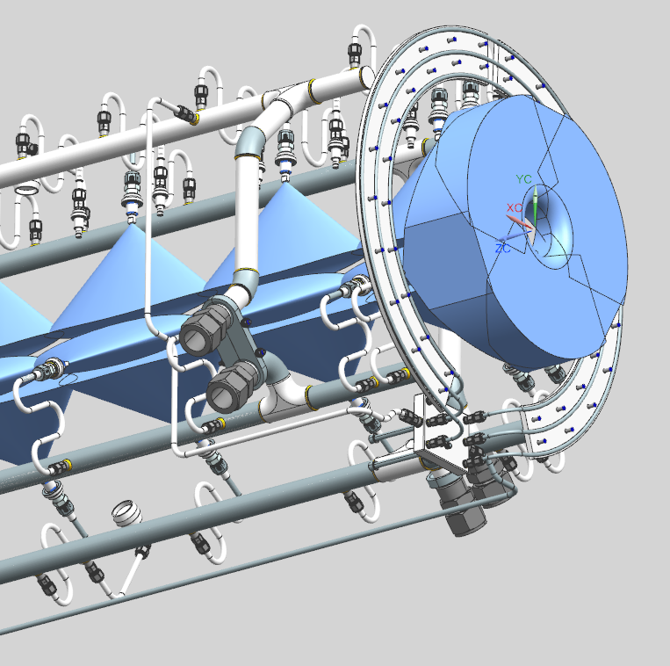
Horn A Cooling System Layout
Four primary manifolds supply all conductor cooling.
3 for I.C.
1 for O.C.
Standard layout for all horns.
Horn B drives flow requirements.
Manifolds are 1.5” O.D. X .120” wall 316L seamless tube.
Elbows are 1-1/4” Schedule 10S (.109” wall).

Slide 11
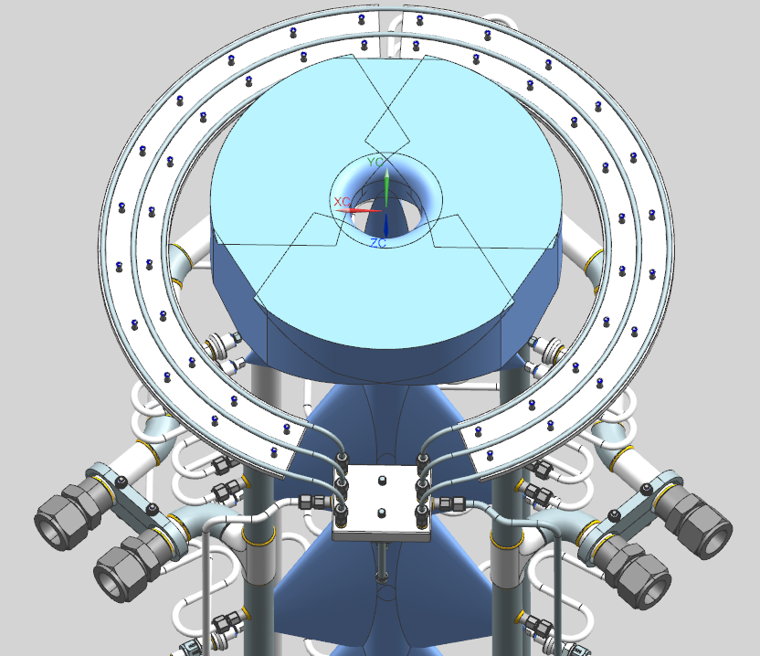
Horn A Cooling System Layout

Slide 12
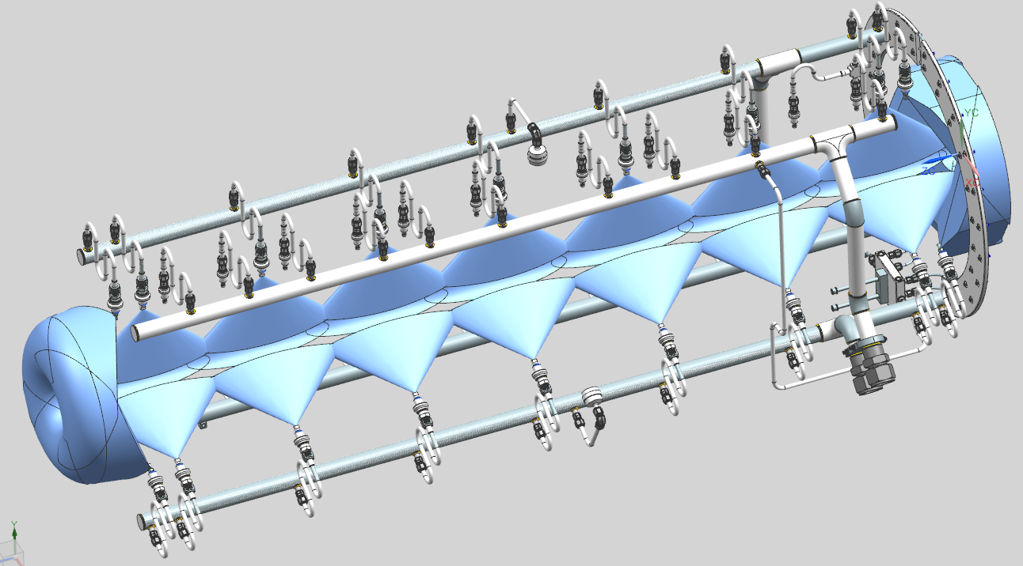
Horn A Cooling System Layout
Manifold | Tube Specs | Material
Inner Conductor Nozzle Feed | .375” O.D. X .035” Wall | 316L SS Seamless Tube
Outer Conductor Nozzle Feed | .375” O.D. X .035” Wall | 316L SS Seamless Tube
Argon Purge | .500” OD X .049” Wall | 316L SS Seamless Tube
U.S. Outer Conductor Flange Loops | .250” OD X .049” Wall | 5052 Al Seamless Tube

Slide 13
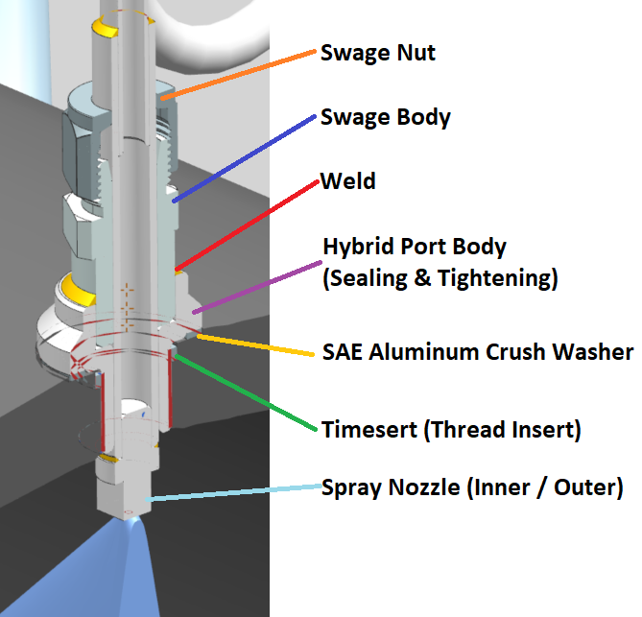
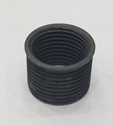
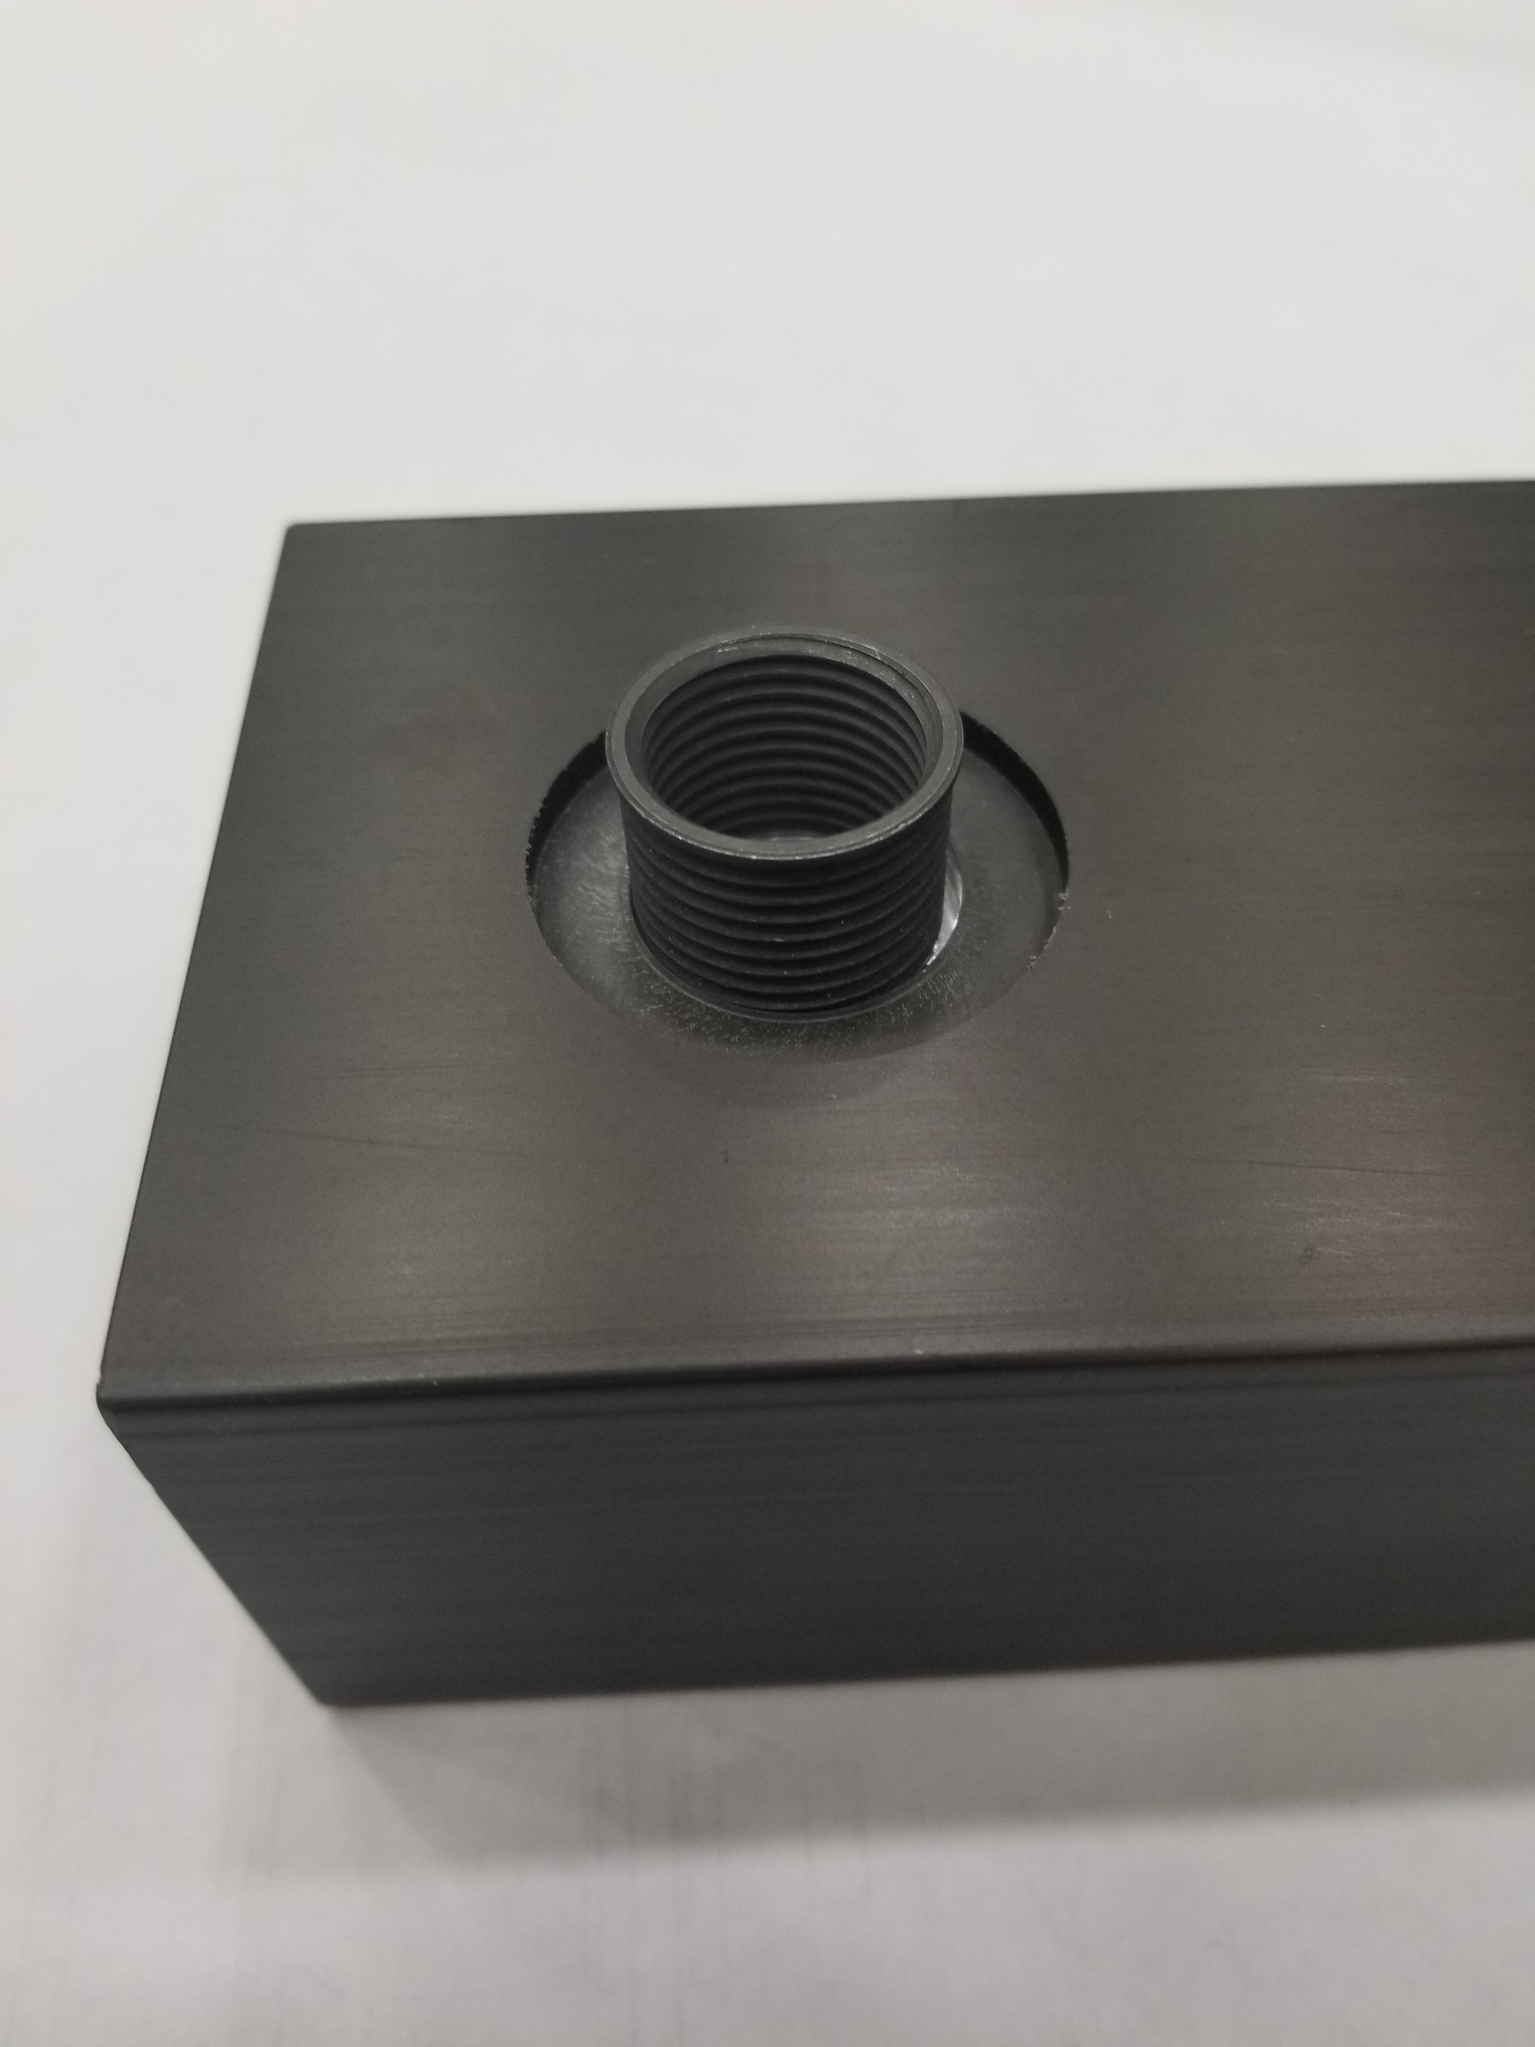
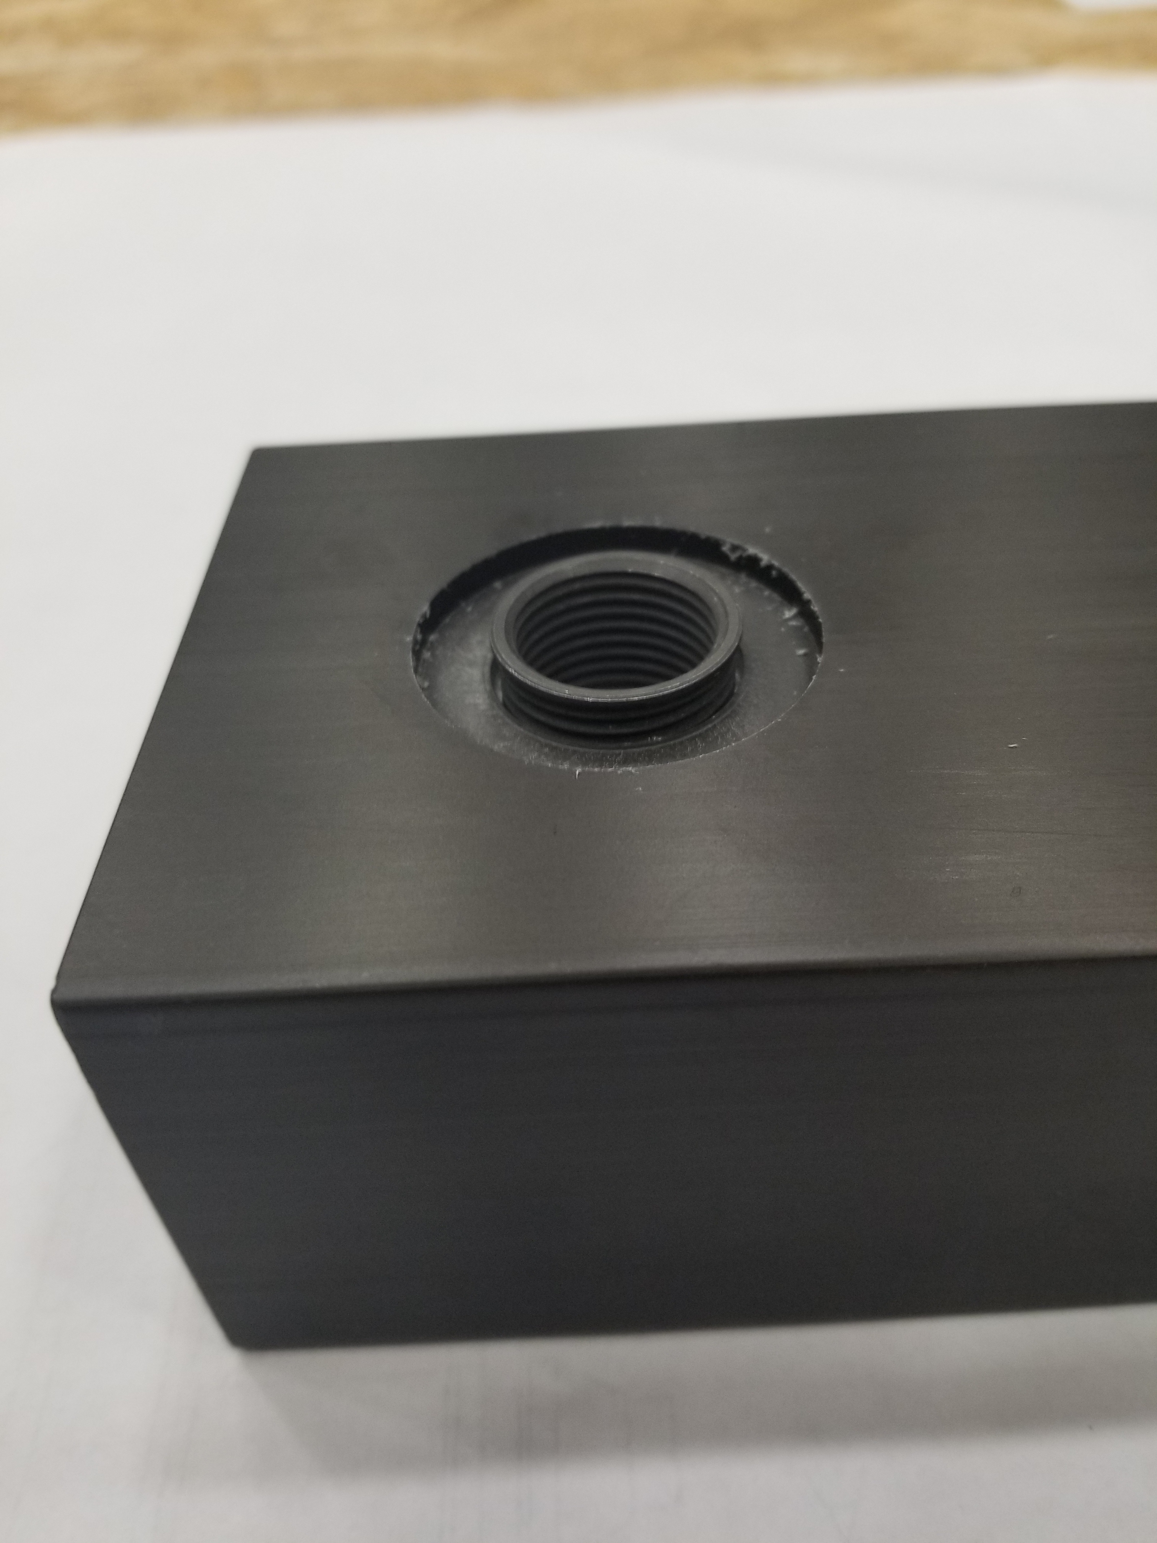
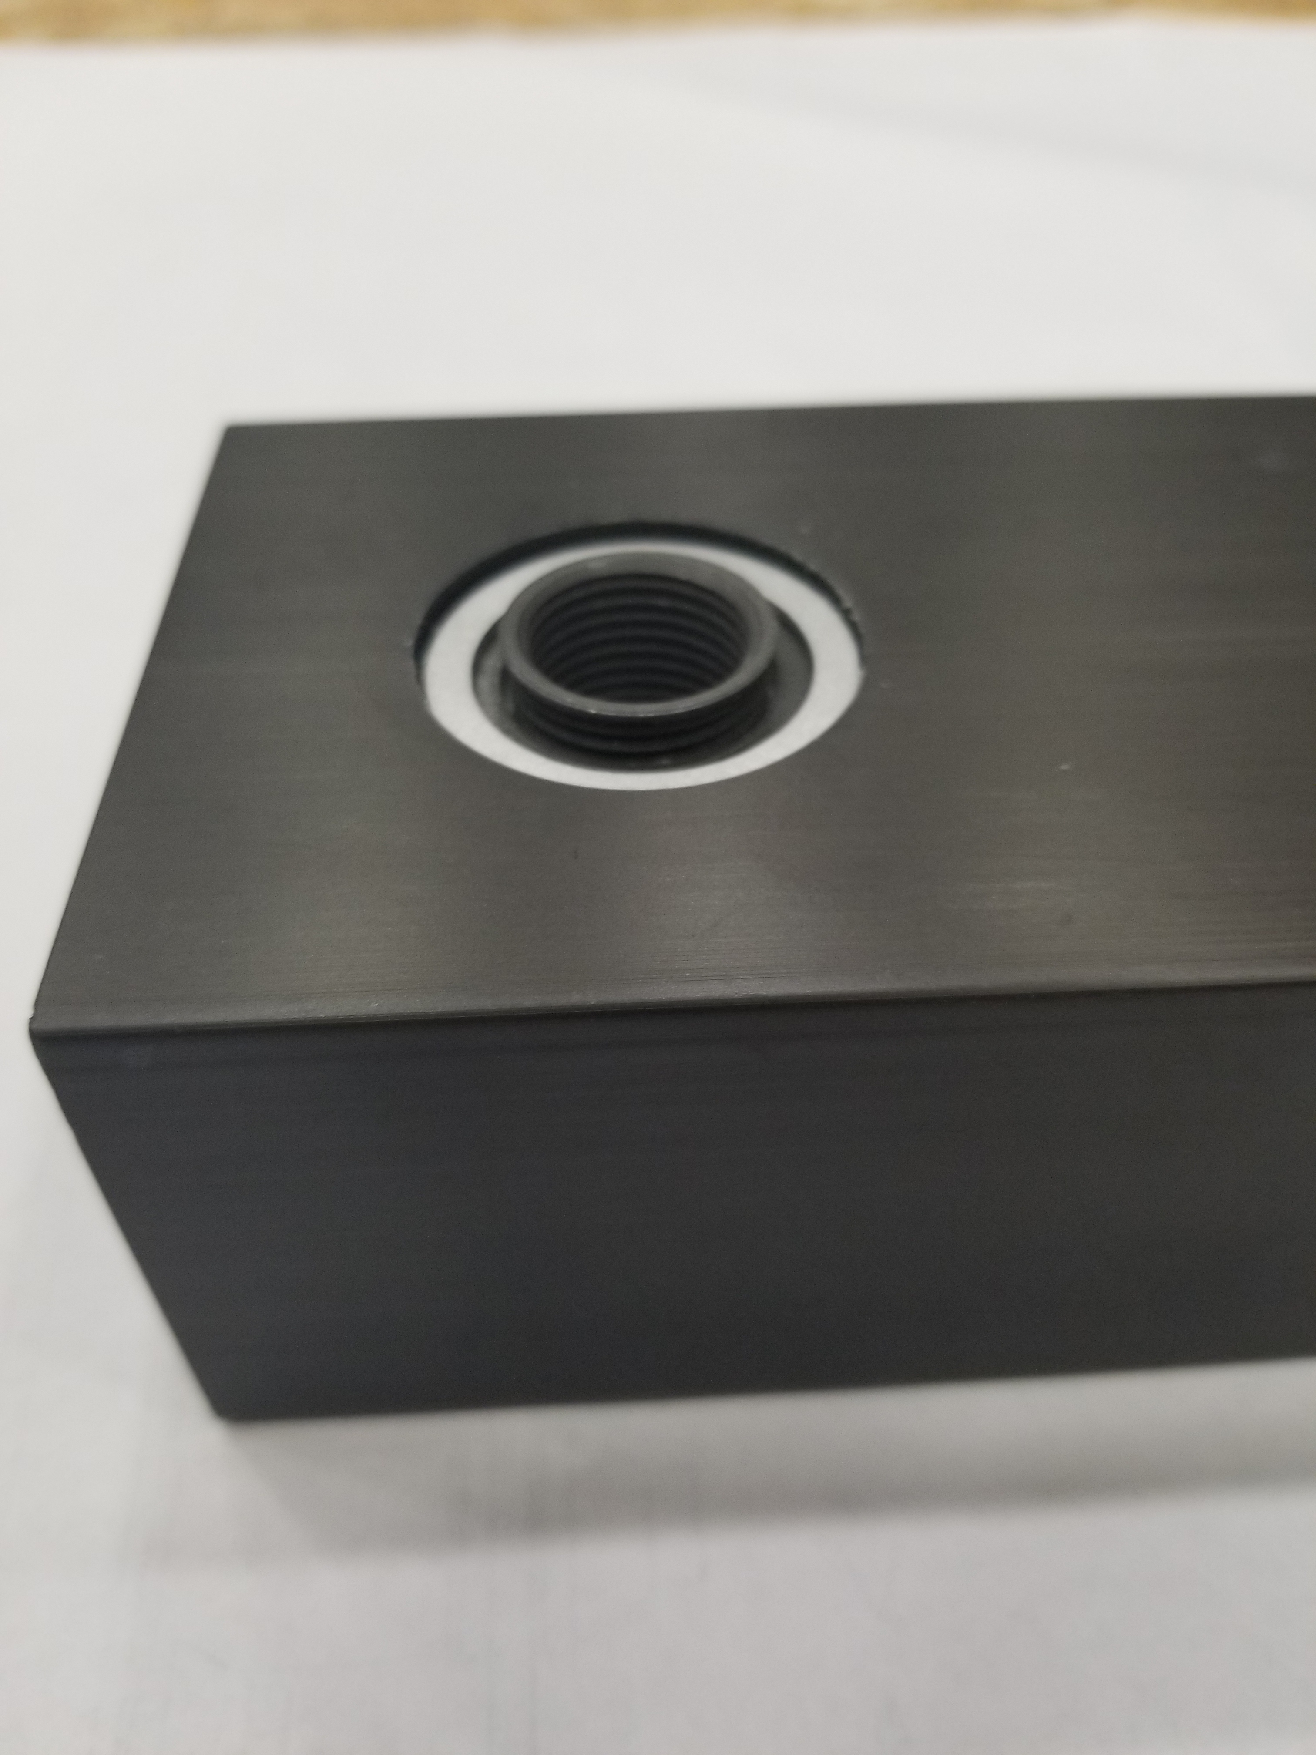
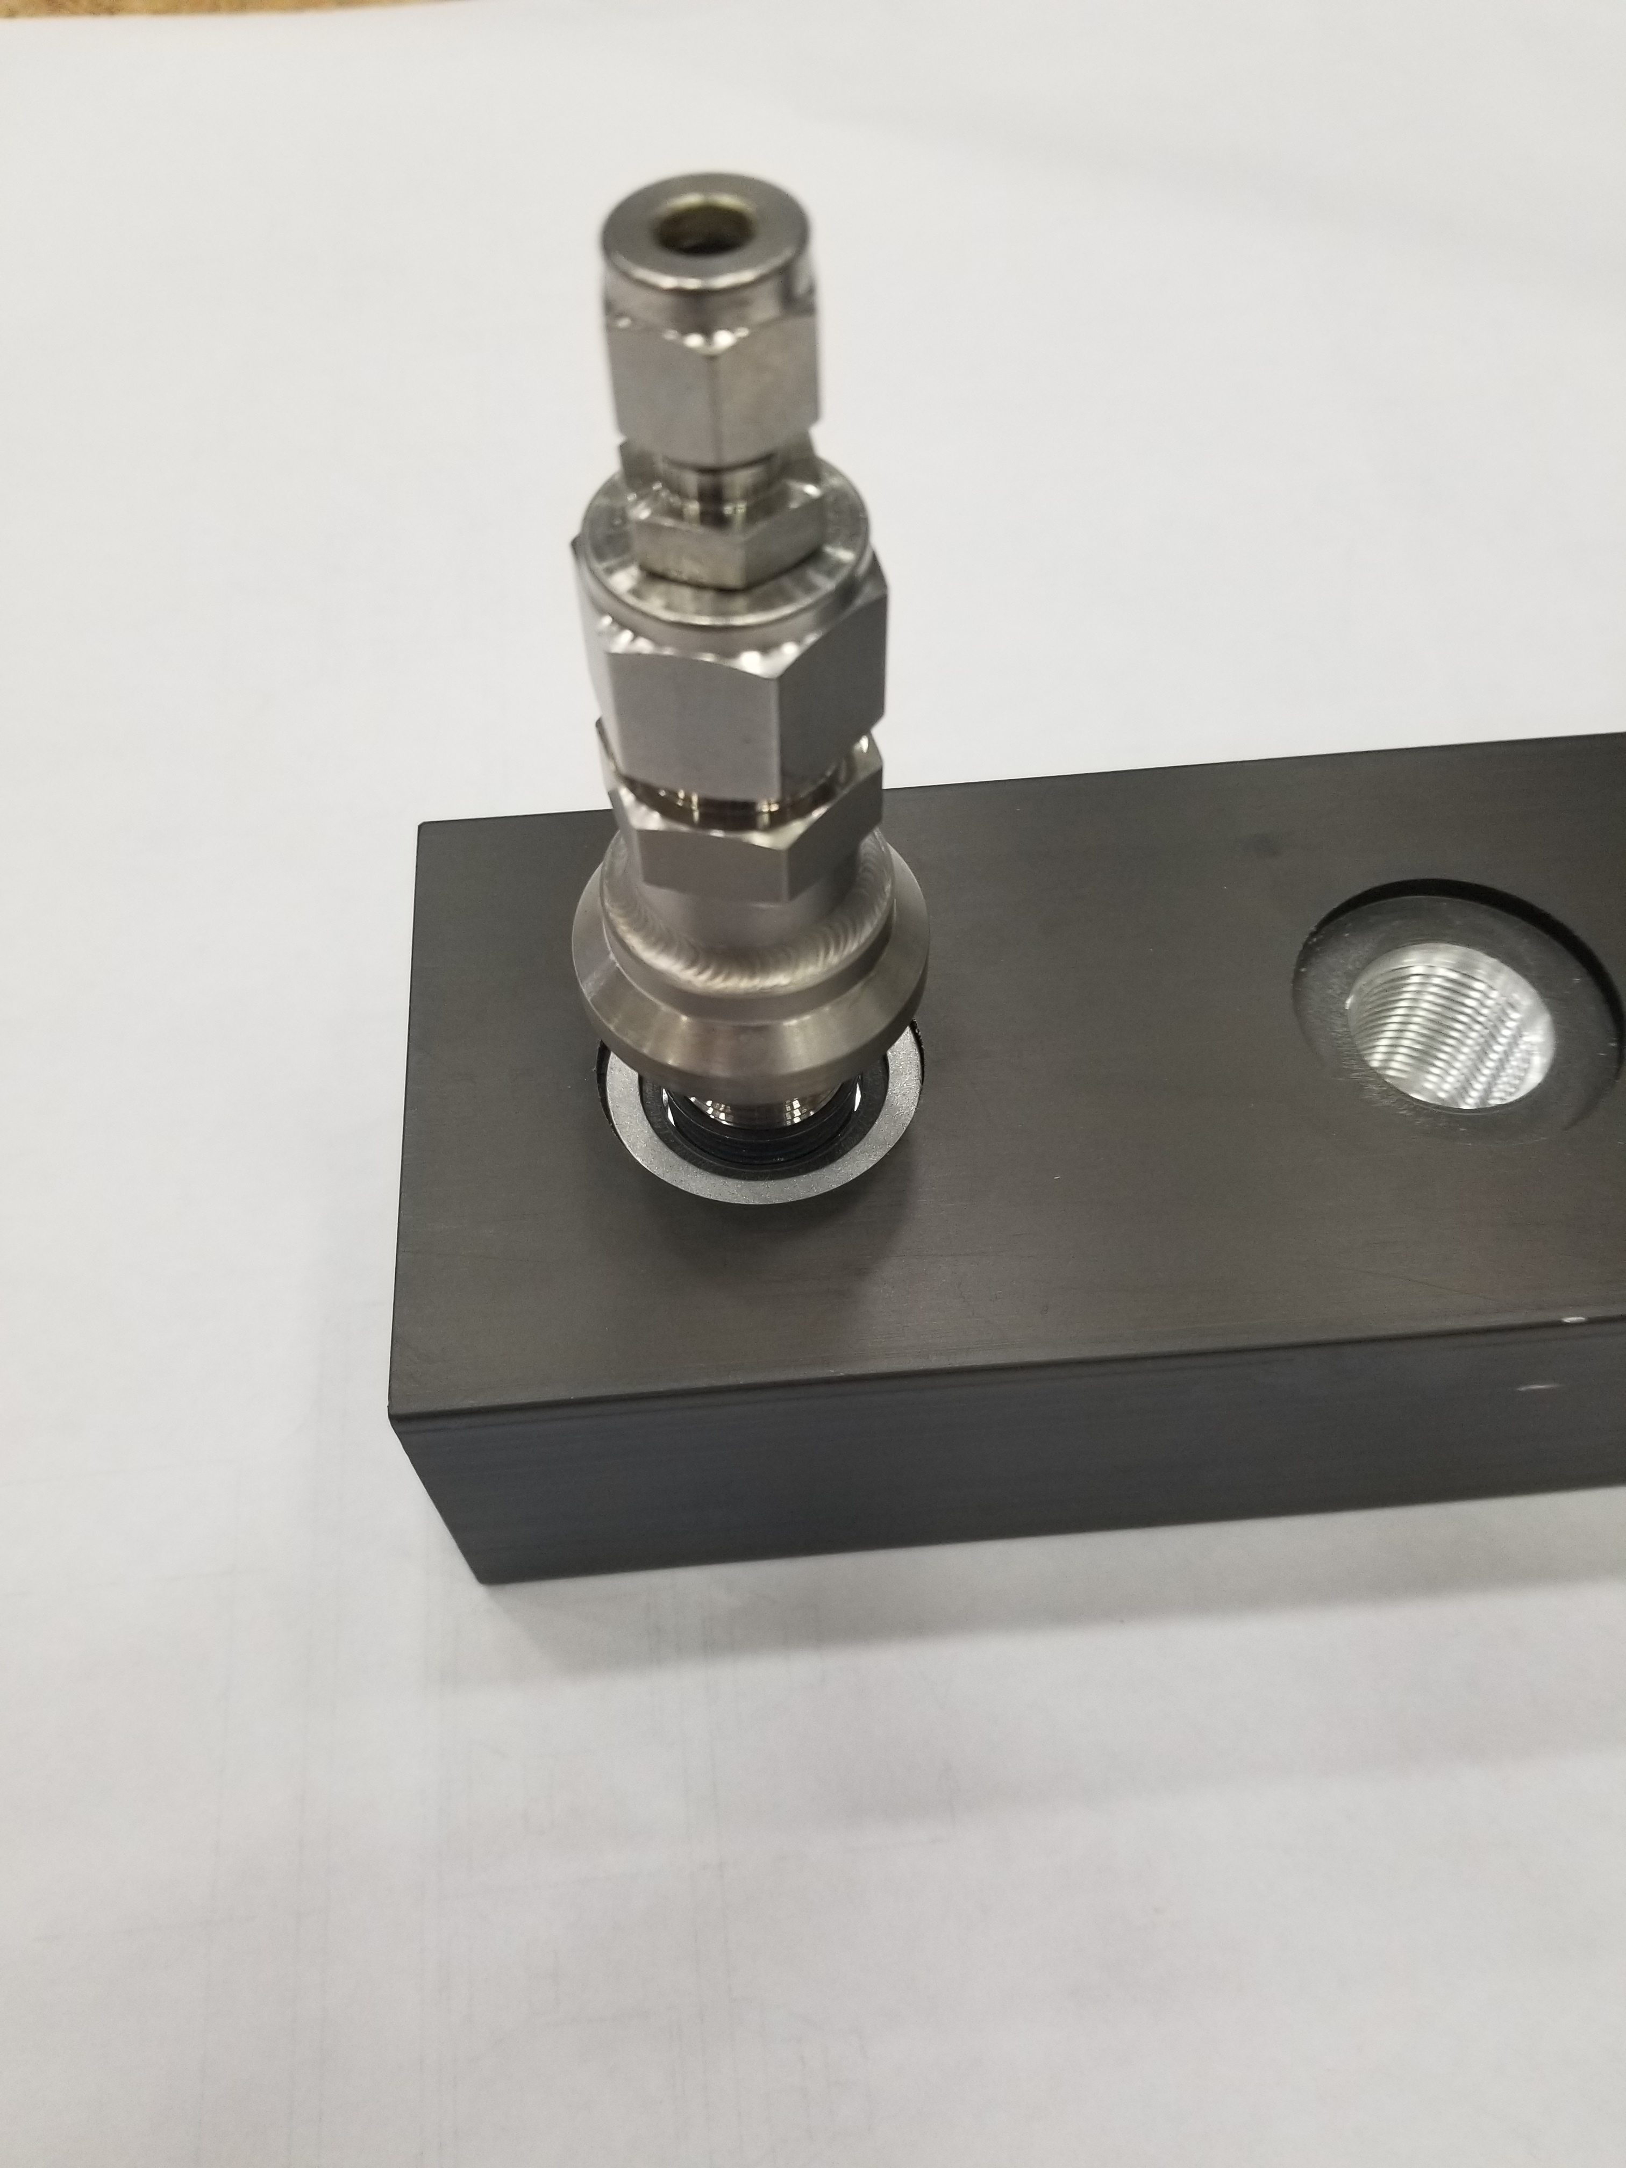
Horn A Design Prototypes – Water Ports
LBNF Horns pursue a revision of port design as compared to NuMI / BNB. Different from T2K as well.
Small footprint, inexpensive, immediate assembly, high pressure rating, & reduced component count.
Required prototype testing in preparation for design review & to verify resilience of concept.

Slide 14
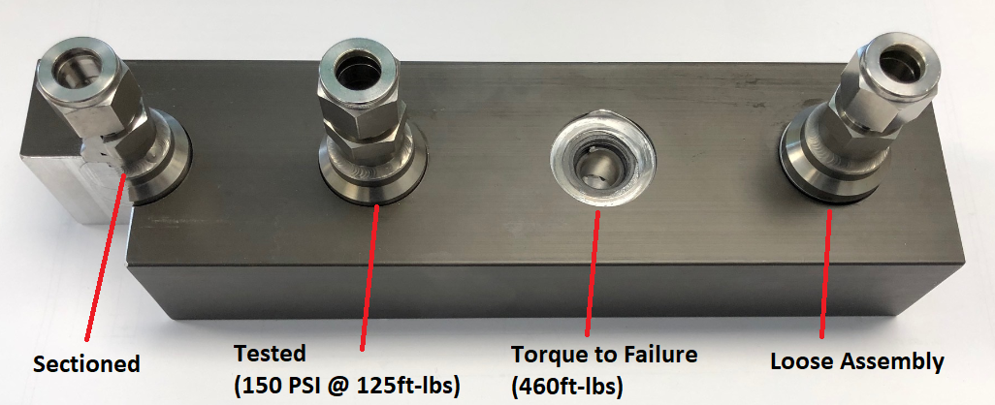
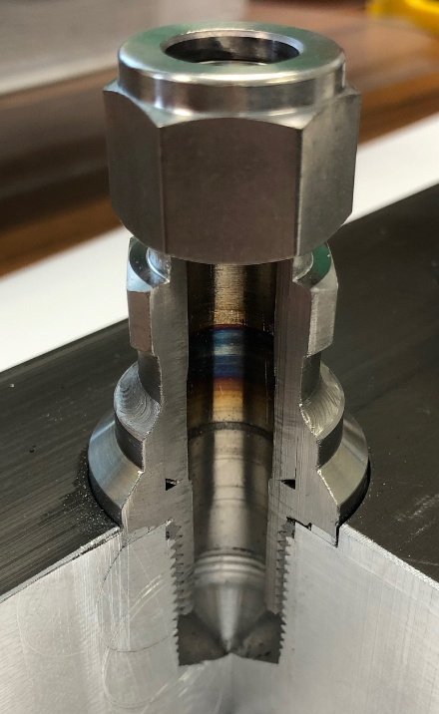
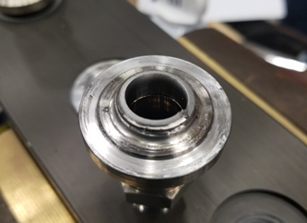
Horn A Design Prototypes – Water Port Testing

Slide 15
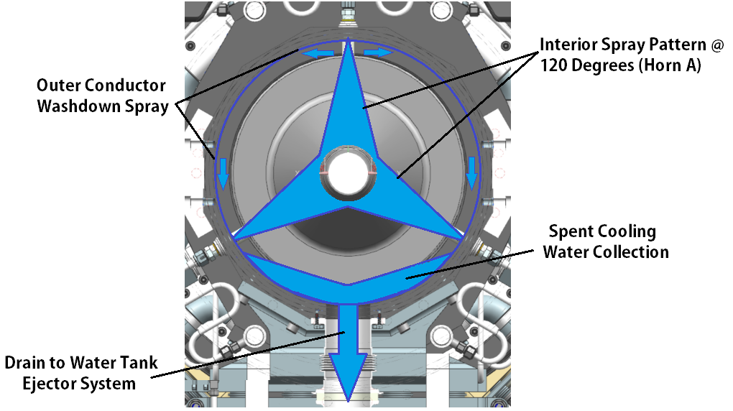
Horn A Cooling System Layout
Identical cooling layout to NuMI / NOvA.
Pattern spacing adjusted for coverage & nozzles upsized for flow.

Slide 16
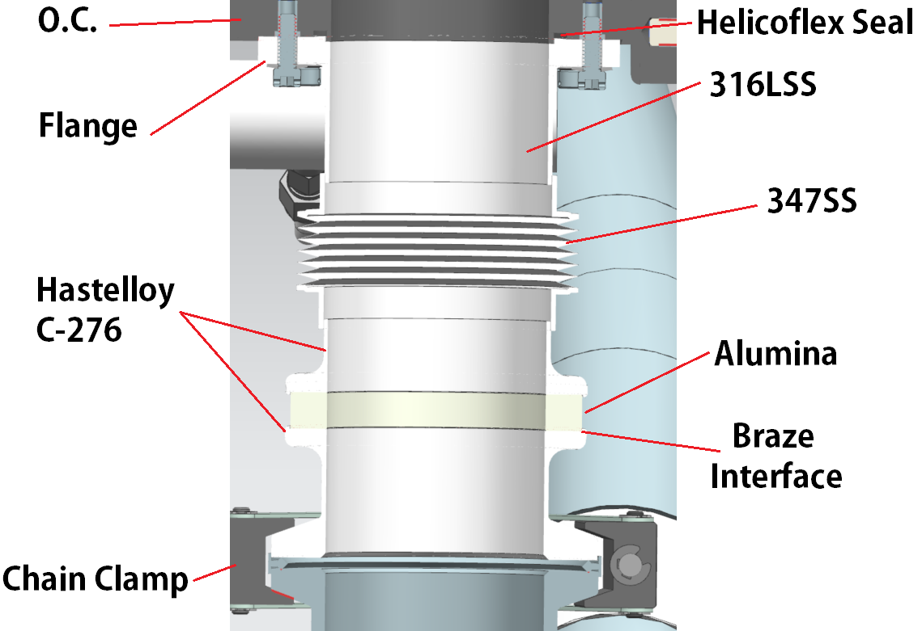
Horn A Conductor Drain
Designed to remove weld from outer conductor.
Electrical break added to both ports to eliminate current flow.
Final connection is NW80 chain clamp.
3” ID for both drains.
Careful consideration must be made regarding SS welds.
Joining Hastelloy C-276 to 347SS will require ENiCrMo-3 filler wire.
High nickel content to prevent stress + stress corrosion cracking.
.060” SS wall + no pressure should be fairly resilient.

Slide 17
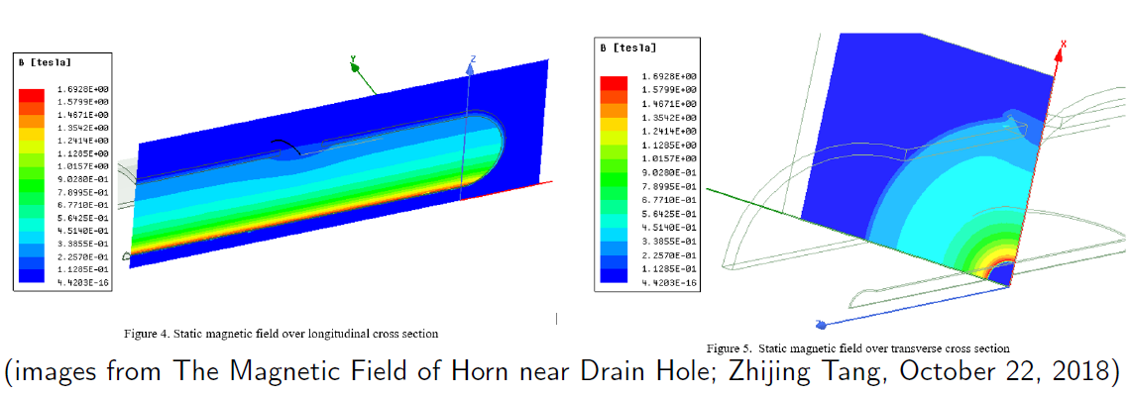
Horn A D.S. Drain Hole Effect on Magnetic Flux
BIWG expressed concerns related to D.S. drain hole.
Not located in current equalization region.
At critical location in conductor relative to field uniformity.
What is current density at that location?
What is it doing to magnetic field?
Magnetic field profile developed and input into g4lbnf flux simulation.

Slide 18
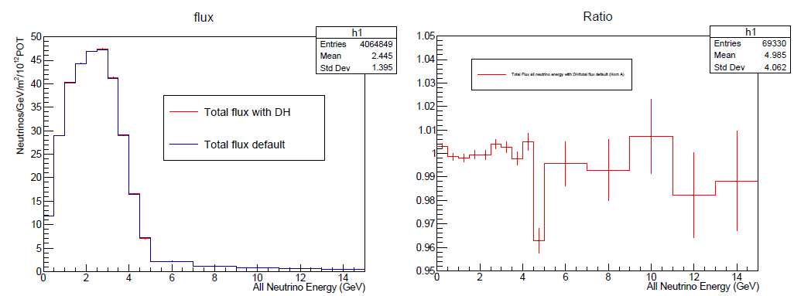
Horn A D.S. Drain Hole Effect on Magnetic Flux
First comparison is nominal flux & flux with added drain port field map.
Ratio plotted is total flux of all neutrino energy (with drain ports), over nominal total flux of all neutrino energy.
Initially looks like up to 4% effect.
Additional runs reduced this concern.
Analysis Credit:
Zarko Pavlovic

Slide 19
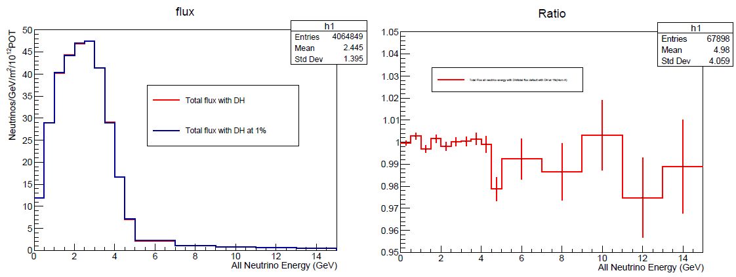
Horn A D.S. Drain Hole Effect on Magnetic Flux
Second comparison is nominal flux & flux with added drain port field map @ 1% effect (1/100th of total field distortion).
Ratio plotted is total flux of all neutrino energy (with drain ports) @ 1% effect, over nominal total flux of all neutrino energy.
This run shows that initial 4% effect is likely due in part to poor statistics. 1% effect still shows 3% or so.
Analysis Credit:
Zarko Pavlovic

Slide 20
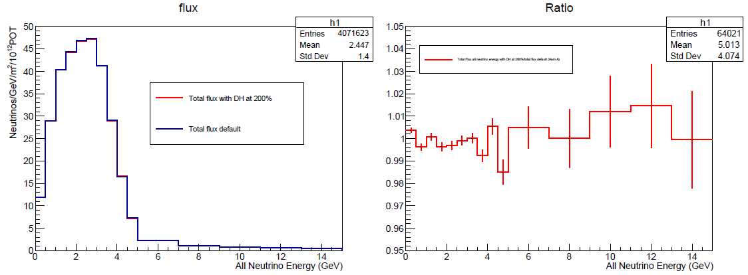
Horn A D.S. Drain Hole Effect on Magnetic Flux
Third comparison is @ 200% effect (2 X total field distortion).
Ratio plotted is total flux of all neutrino energy (with drain ports) @ 200% effect, over nominal total flux of all neutrino energy.
~2% effect on ratio. Lower than expected as compared to 1% distortion. Simulation conclusions are that ratio variations are due to statistics. Actual effect on flux is less than 1%.
There are not enough pions out at the drain port radius to matter much with regards to overall flux.
Analysis Credit:
Zarko Pavlovic

Slide 21
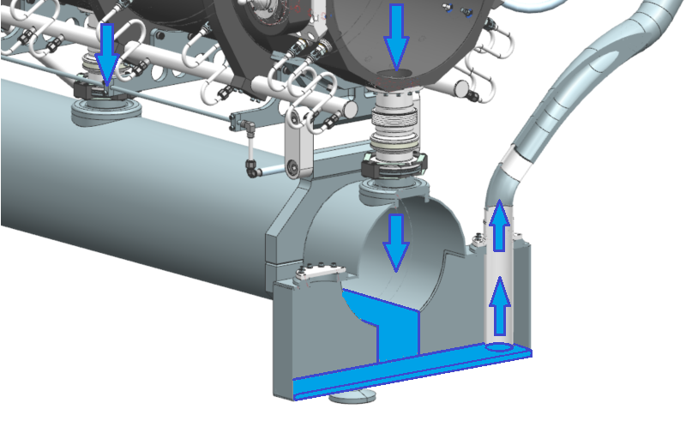
Horn A Water Tank
Water tank is sized to handle 100% of RAW piping input volume so system shutdown does not fill horn volume with water.
Provides protection against errant current pulse and potential hydraulic shock to conductors.
2X Ejection Ports.
Sump pit
Direct line to hangers
6061-T6 construction
100% seam welds utilizing ER4043 & critical aluminum weld preparation spec.

Slide 22
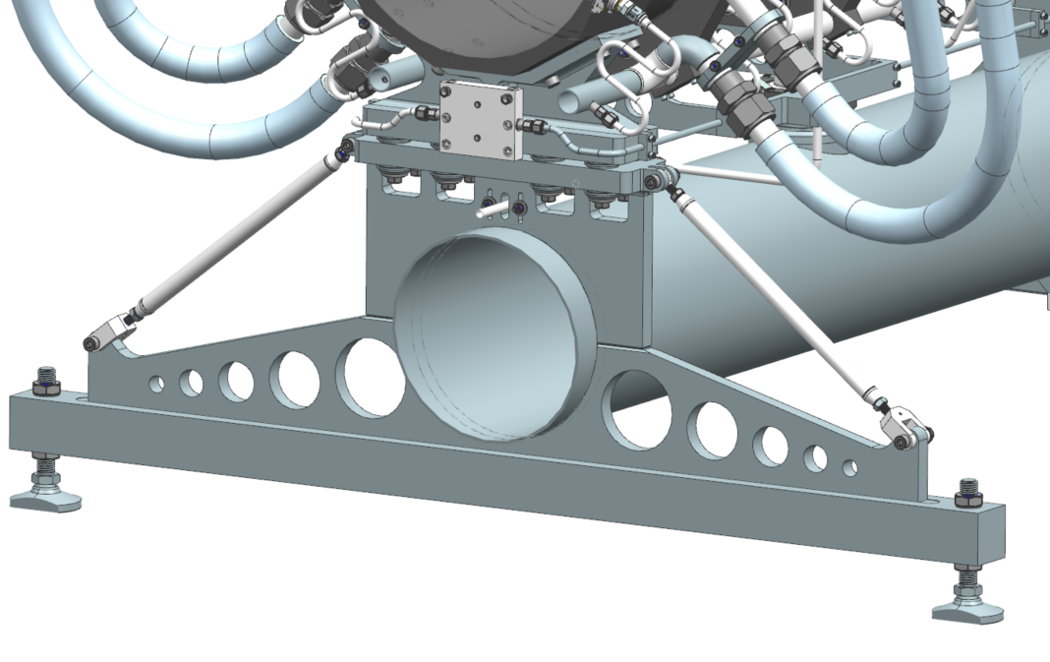
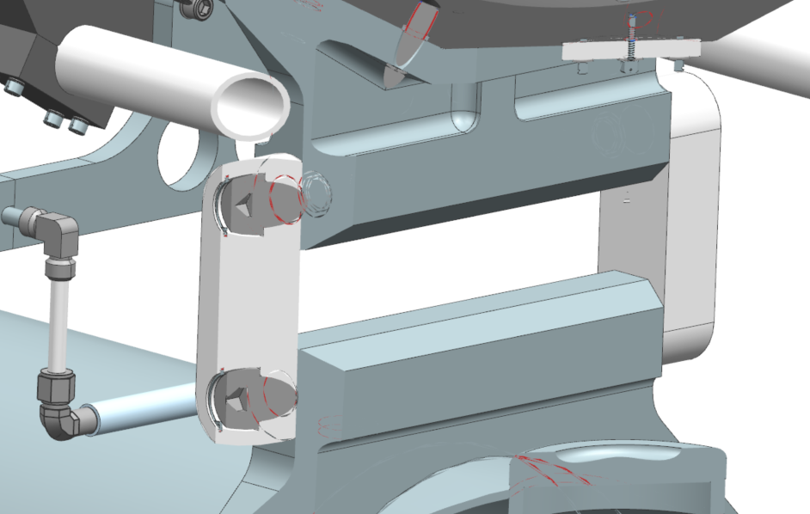
Horn A Water Tank Structure
Water tank connection to horn allows for thermal expansion.
U.S. fixed relative to horn; D.S. constrained by 2 swinging link connections to shoulder bolts with internal snap rings to prevent backing out.
Lowers component count & no adjustments required.
Assemble, tighten U.S support rods, & complete alignment with leveling feet (2 U.S. & 1 D.S. / 3-point plane).

Slide 23
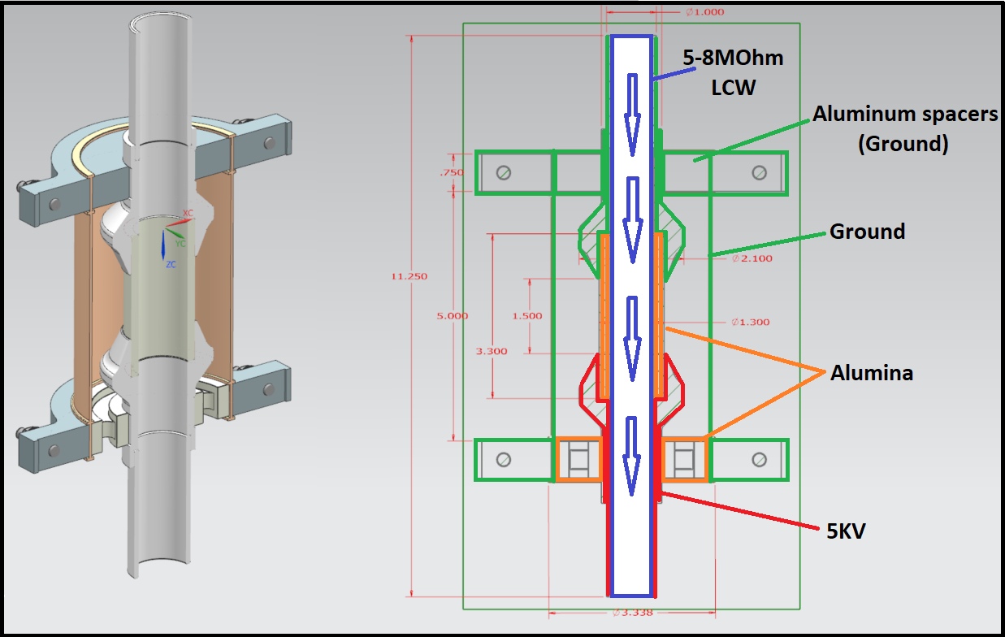
Horn A Manifold Isolation
All water & gas manifold mechanical designs copy NuMI.
Electrical isolation different, but overall concept is the same.
Four sizes:
2.0” Ejector (New)
1.5” Supply
1.0” Supply
0.5” Vent

Slide 24
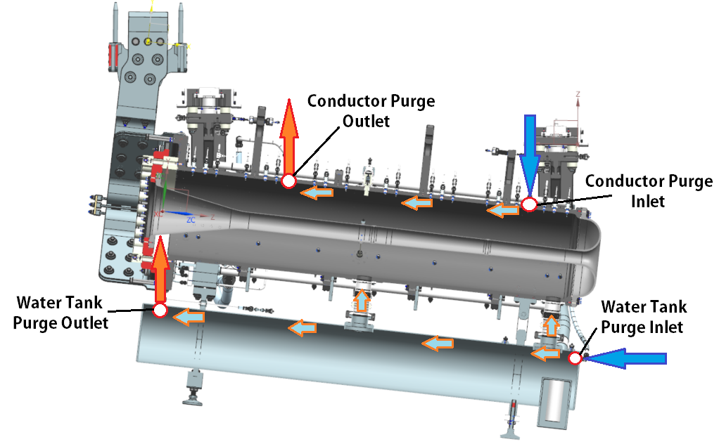
Horn A Conductor Volume Purge
Dissociation of RAW to Hydrogen & Oxygen requires forced gas purge to keep concentrations in volume under explosive limit.
RAW group using Argon to flush out system back to expansion tank headspace.
Twin inlet / outlet with purge inlet D.S. & purge outlet U.S.
Combine at top outlet tee.
2.4MW Requirements:
See DUNE-doc-18321
9085cc/min
~1.28PSIG

Slide 25
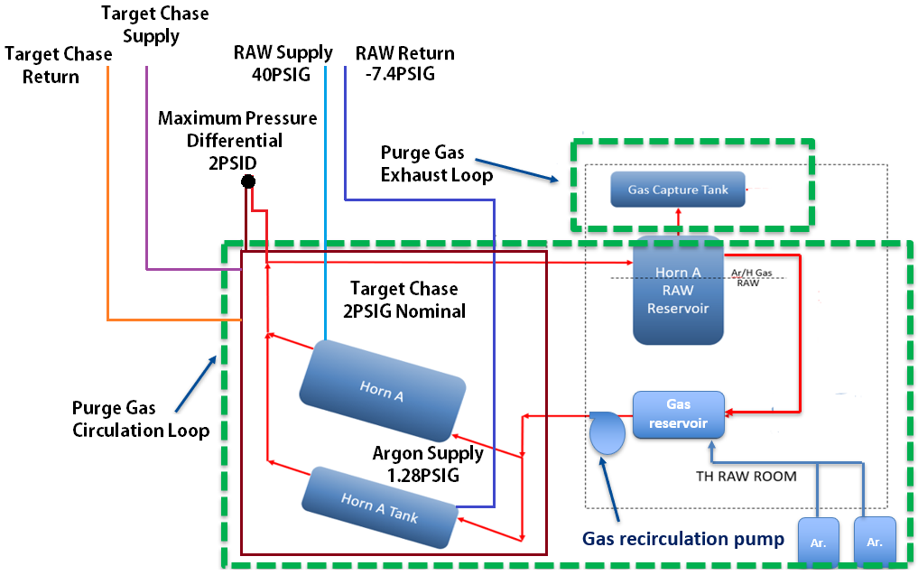
Horn A Conductor Volume Purge
Complex horn pressure ranges.
Chase nitrogen at 2PSIG; design max 5PSIG.
Recombination system at 1.28PSIG. Design max must stay below lower explosive limit.
Raw supply @ 40PSIG / Ejector suction head effects @ -7.4PSIG.
Sources:
Karl Williams &
Des Deshpande

Slide 26
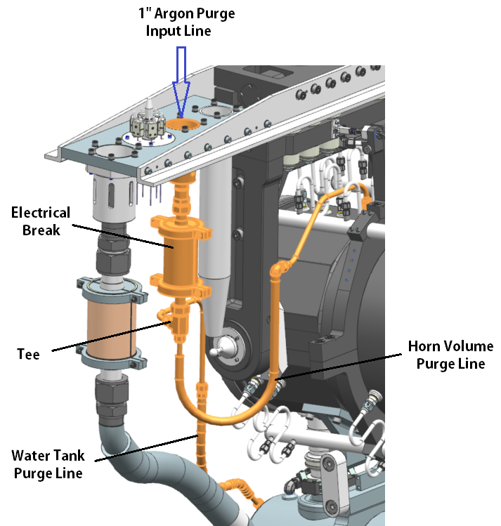
Horn A Purge System Layout
1” Supply (swage fitting / utility cup).
Tee after isolation.
Flex lines and manifolds present; ancillary brackets will be added on conductor & hangers.

Slide 27
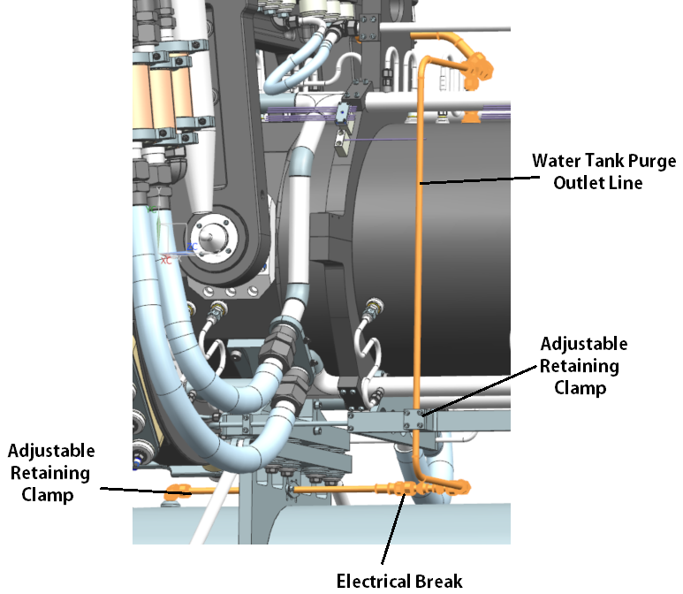
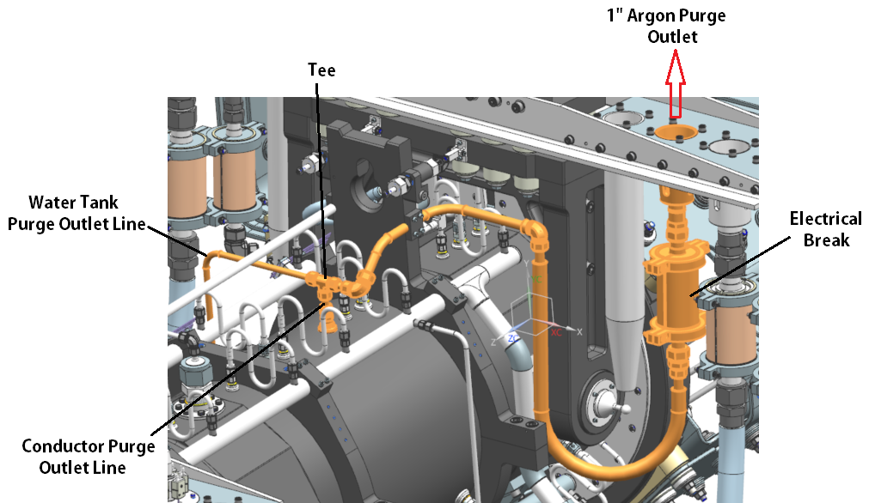
Horn A Cooling System Layout
1” Outlet + flex lines & brackets in place.
Tee back together before isolation.

Slide 28
Summary
Cooling system requirements & parameters are well defined.
System design & detailed models complete, drafting package underway.
Heat transfer coefficients determined from historical testing, recent testing, and theoretical determination.
Will confirm values on prototype Horn.
Nozzle choices, flow rates, pressures all have some flexibility.
Conductor temperatures have remaining overhead if cooling over-estimated.
Account for compounding safety factors…
We need to use our prototype horn as a prototype horn.
Water tank isolation will see minor modifications.
Questions?

