Slide 1
Neutrino Beamline
Horn A
Preliminary Design Review
Answers to Day 1 Questions
Cory Crowley
23 April 2020

Slide 2
Outline
Homework:
1. Make RAW drawings available to committee.
2. Create / find documentation defining horn connection to the module or remote handling efforts.
3. What does D.S. Target mount look like.
4. Total end cap loading.
5. Original FEA results without pre-tensioning.
6. Resistivity comparison between 6013 & 6061.

Slide 3
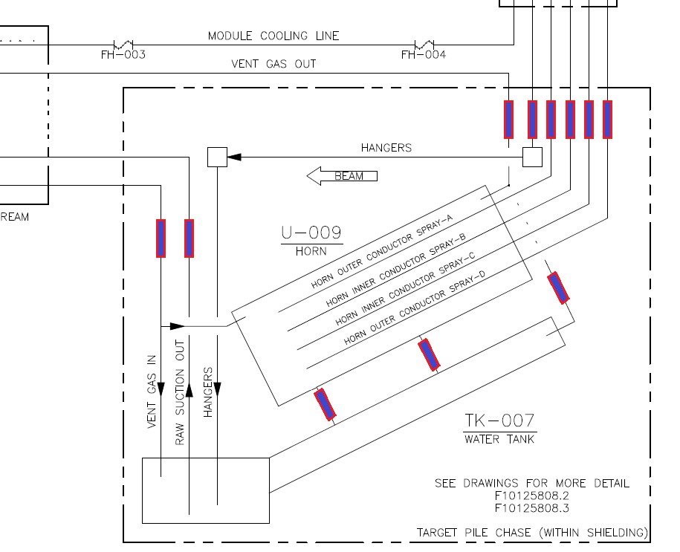
1. Isolator Locations on RAW Circuit

Slide 4
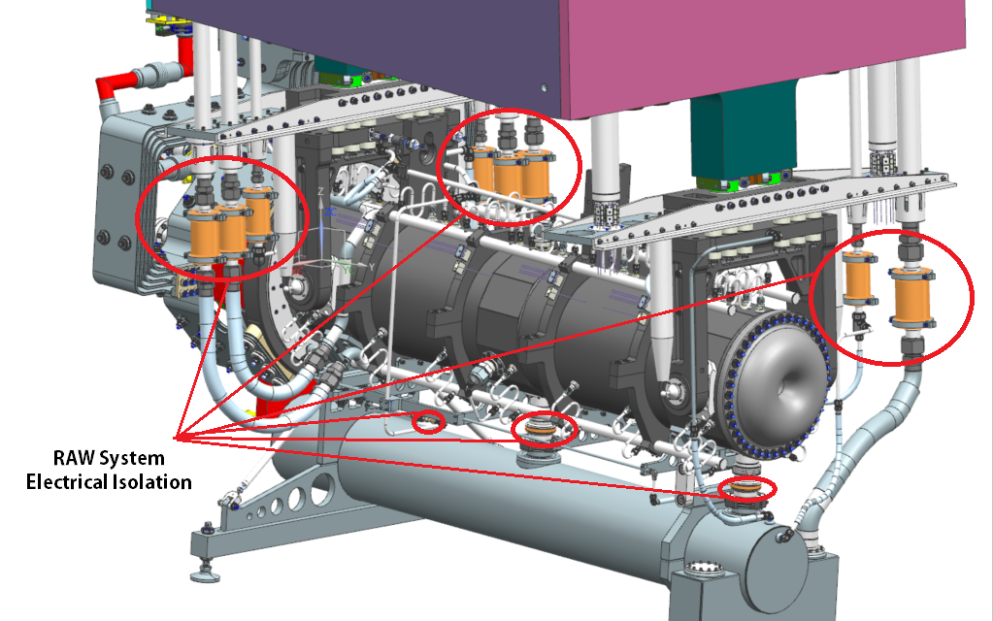
1. Isolator Locations on RAW Circuit

Slide 5
2. Horn Connection to Module Documentation
See Friday talk: “Module / SLB Connections”.
See Friday talk: “Support Hanger Analysis & Deflection FEA”.
See RH conceptual design talk: DUNE-doc-14618
See RH conceptual design talk: DUNE-doc-18340

Slide 6
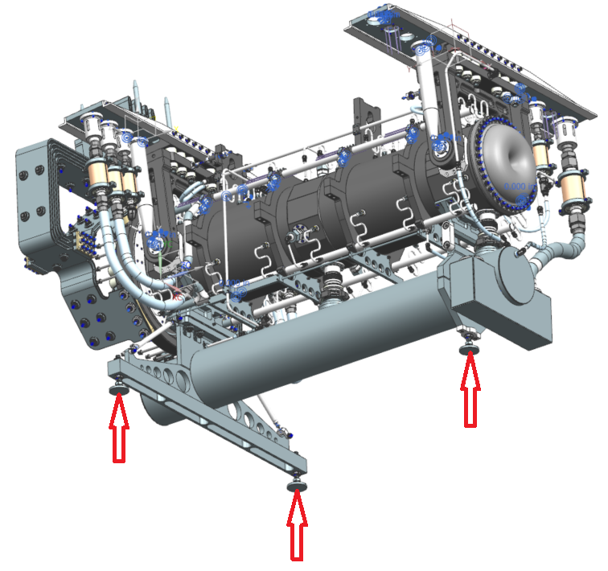
2. Horn Connection to Module Documentation
Three support feet on horn water tanks define a plane.
Feet are adjusted to make final assembly sit Earth level & plumb.

Slide 7
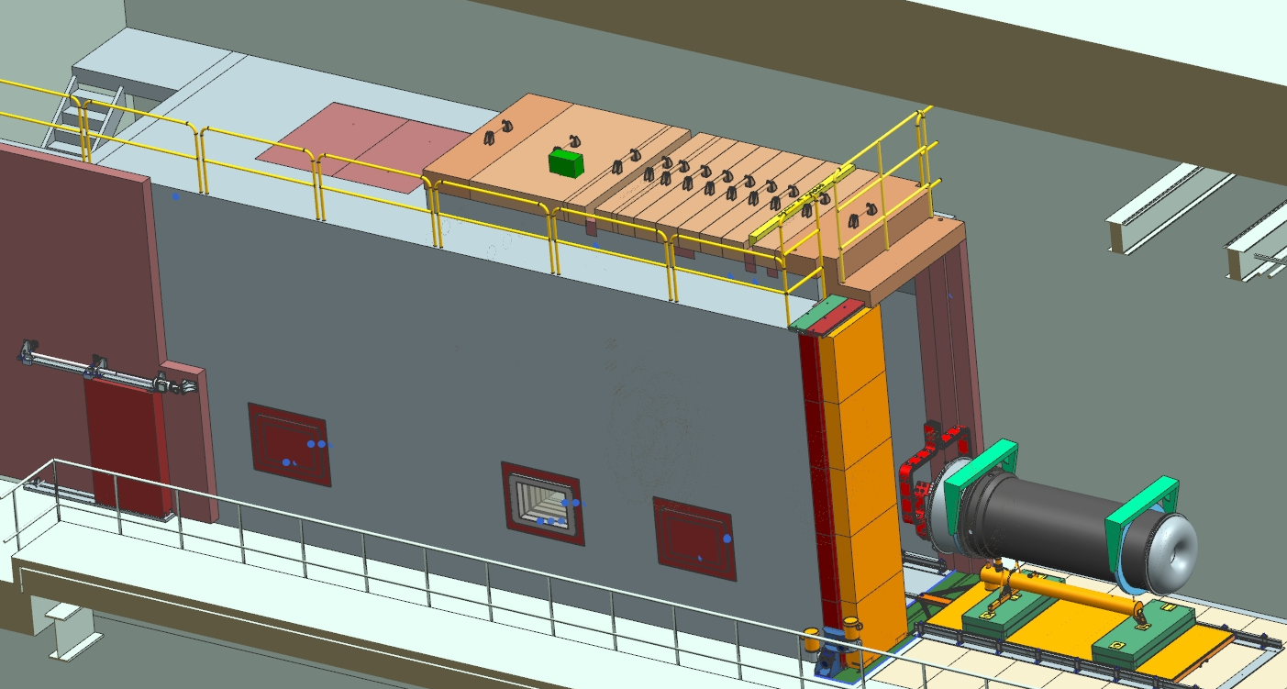
2. Horn Connection to Module Documentation
Design Credit: V. Sidorov

Slide 8
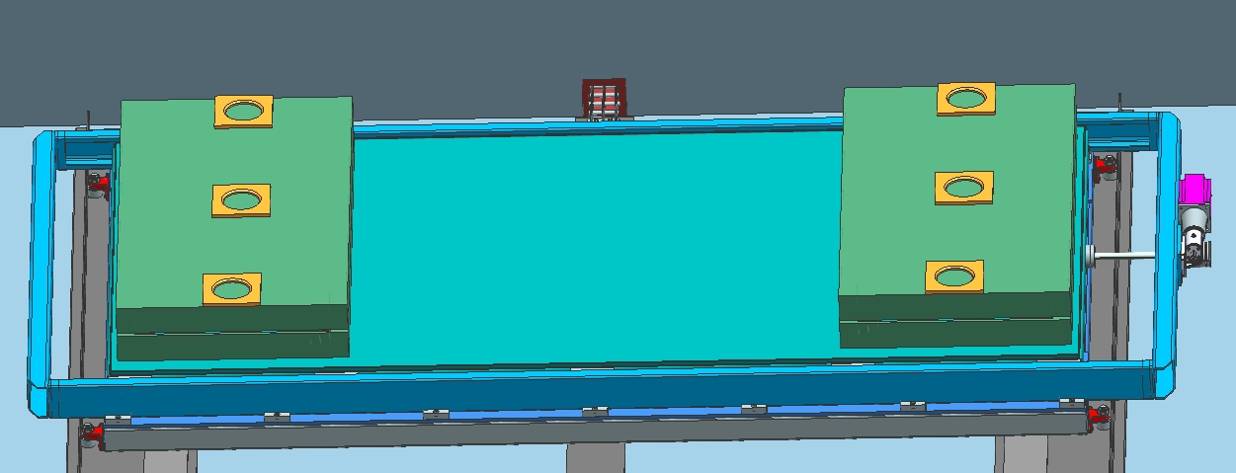
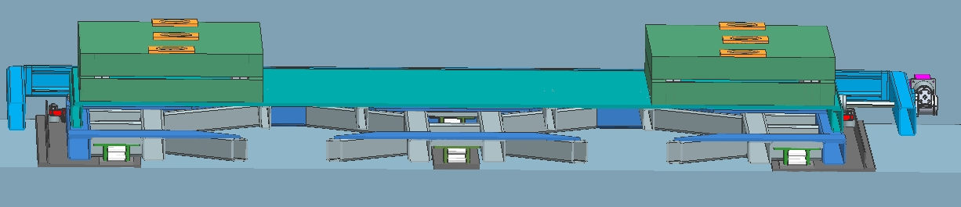
2. Horn Connection to Module Documentation
Design Credit: V. Sidorov

Slide 9
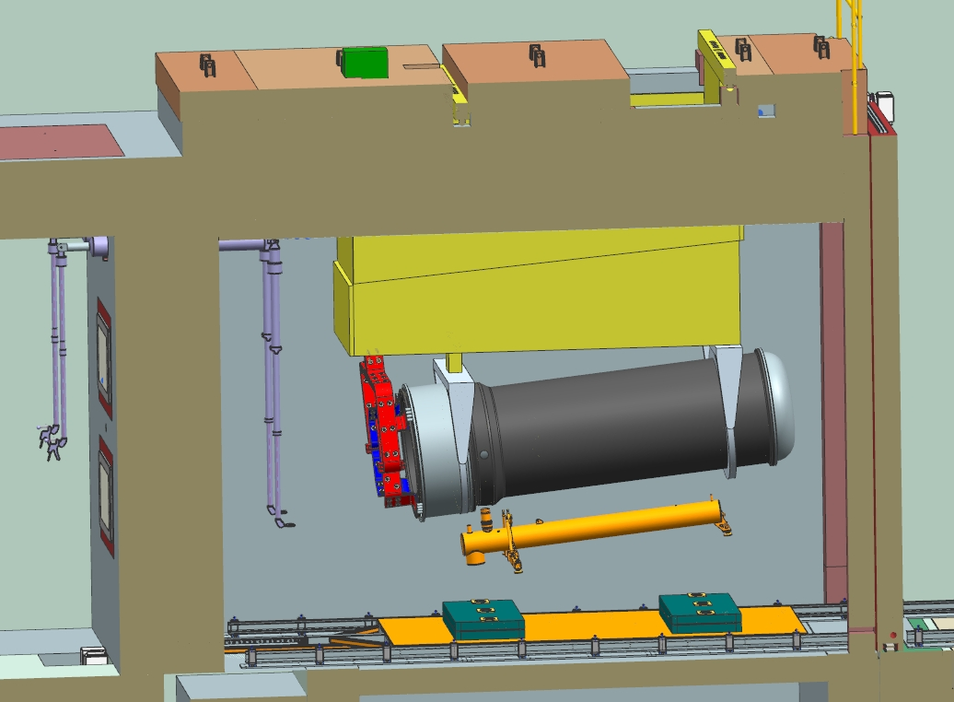
2. Horn Connection to Module Documentation
Design Credit: V. Sidorov

Slide 10
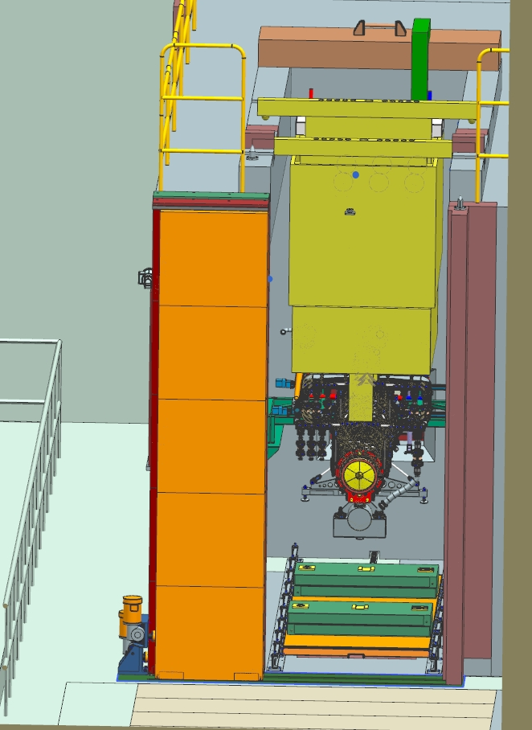
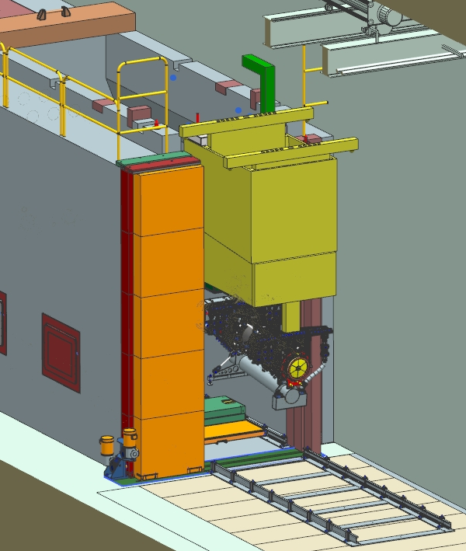
2. Horn Connection to Module Documentation
Design Credit: V. Sidorov

Slide 11
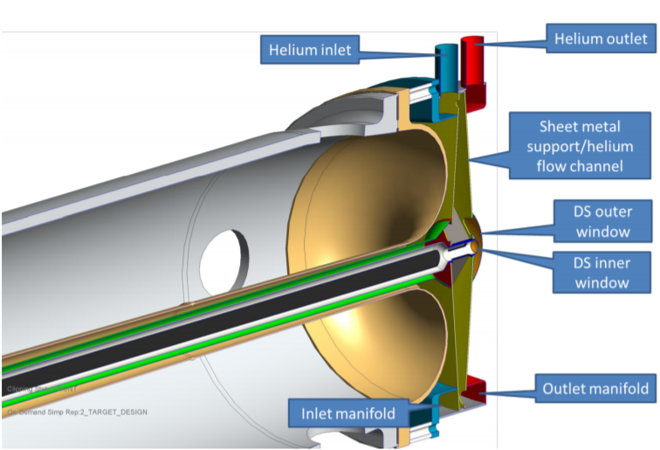
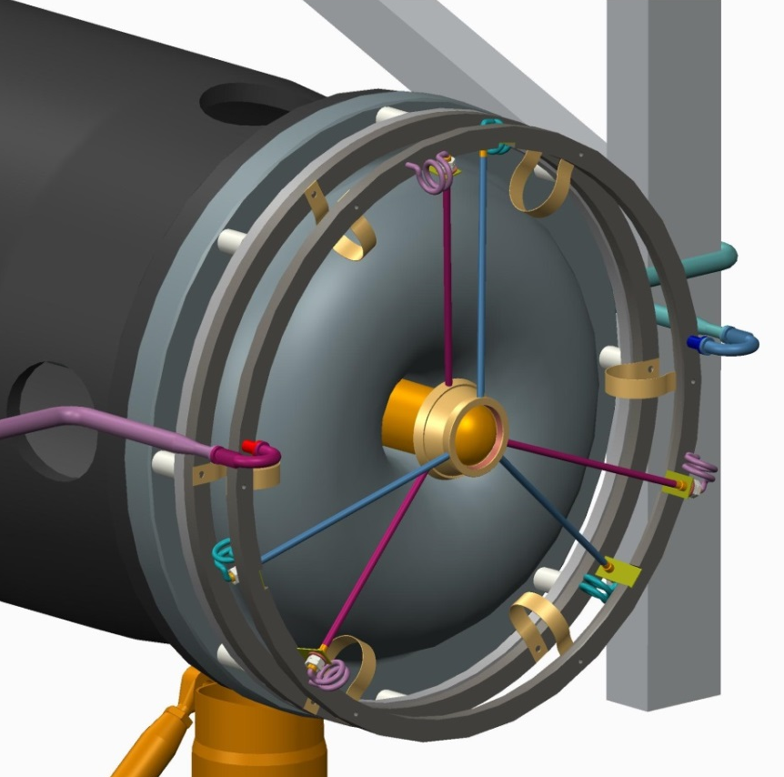
3. D.S. Target Mount
Design Credit: RAL
Left: One long target with D.S. Support
Right: Two separate targets with D.S. horn flange mounting scheme

Slide 12
4. & 5. FEA
4. Total end cap loading. WIP
5. Original results without pre-tensioning. WIP

Slide 13
6. Resistivity Comparison Between 6013 & 6061

Slide 14
5. Resistivity Comparison Between 6013 & 6061

Slide 15
5. Resistivity Comparison Between 6013 & 6061
6061-T6
Average Width (cm) | 5.09
Average Height (cm) | 1.272
Length between test points (cm) | 83.82
Temperature (Degrees C) | Current (I) | Voltage (V) | Resistivity (Ohm-cm) | % IACS
25 | 51.4237 | 0.0024994 | 3.75431E-06 | 45.9
40 | 51.3745 | 0.0026158 | 3.93291E-06 | 43.8
60 | 51.3780 | 0.0027870 | 4.19003E-06 | 41.1
80 | 51.3691 | 0.0029512 | 4.43766E-06 | 38.9
100 | 51.3691 | 0.0031152 | 4.68426E-06 | 36.8
6013-T651
Average Width (cm) | 5.192
Average Height (cm) | 1.362
Length between test points (cm) | 83.82
Temperature (Degrees C) | Current (I) | Voltage (V) | Resistivity (Ohm-cm) | % IACS
25 | 51.3745 | 0.0024346 | 3.99801E-06 | 43.1
40 | 51.3601 | 0.0025792 | 4.23666E-06 | 40.7
60 | 51.3600 | 0.0027345 | 4.49177E-06 | 38.4
80 | 51.3628 | 0.0028762 | 4.72427E-06 | 36.5
100 | 51.3625 | 0.0030221 | 4.96394E-06 | 34.7
I.C. rough average temp with 6013 yields 40.7%IACS.
6013 represents a relative 7% conductivity drop from standard 6061, with a 32% increase in fatigue life.

Slide 16
5. Resistivity Comparison Between 6013 & 6061

Slide 17
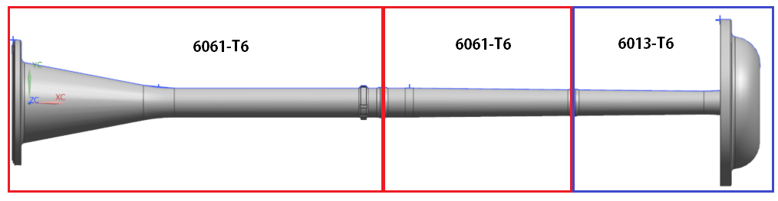
5. Resistivity Comparison Between 6013 & 6061
Proposal:
D.S. End flange remains 6013-T6 for Cory / Zhijing flange thickness optimization efforts and fatigue life considerations.
U.S. “stalk” + mid section remains at 6061-T6.
  Reduces effect to EE support conductor calculations.
  Removes 1 forging for Horn A, stalk can be made from billet.
  Negligible impact on bulk conductor S.F. It’s not the weak point, so 6013 is an improvement, but an unnecessary one at this time.

