Slide 1
Neutrino Beamline Horn A Preliminary Design Review
Spider Support Design
Cory Crowley
23 April 2020

Slide 2
Outline
Design Layout / Motivation
Materials
Corrosion
Support Settings
Preload
Tuning
Manufacturing Plans
Prototype Assembly & Summary

Slide 3
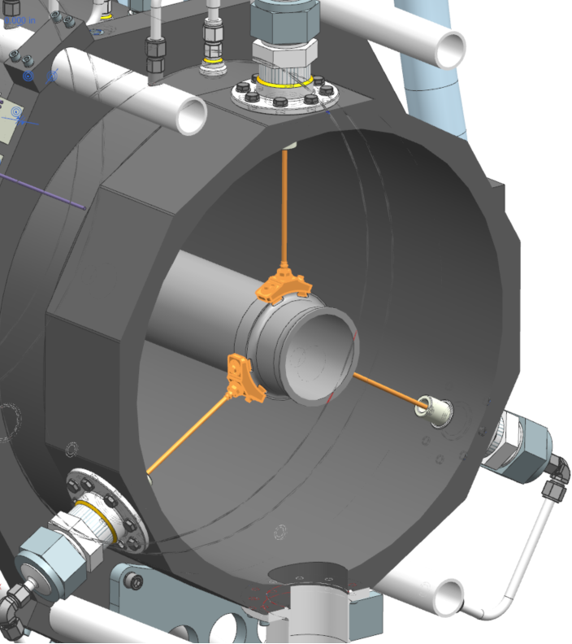
Design Layout
LBNF Horns, utilize “spider” supports to function as a structural link between conductors.
Design goal is to accomplish:
Tertiary conductor alignment.
Primary: Machining.
Secondary: Alignment Welds.
Tertiary: +/- .002” Concentricity.
Vibration damping.
Raise natural frequencies.
Add some level of damping.
Buckling Resistance where applicable.

Slide 4
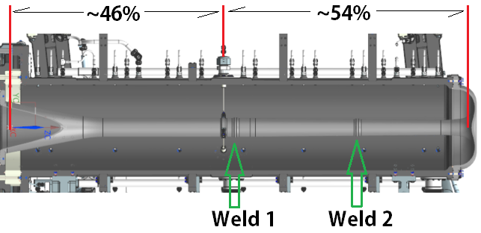
Design Layout Cont.
Horn A incorporates 3 supports, arranged in a 120 degree azimuth spacing, at approximately half-way point of conductor length.
Biased slightly U.S. to provide room for Weld 1.

Slide 5
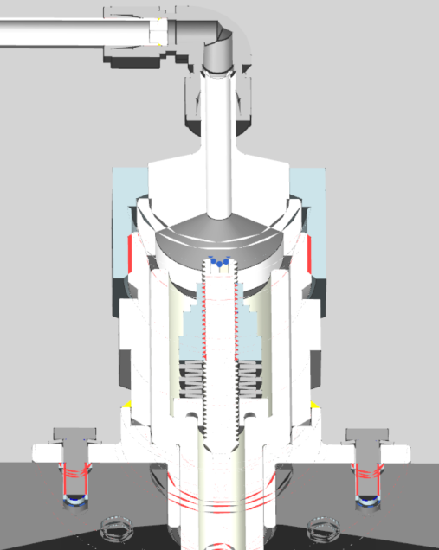
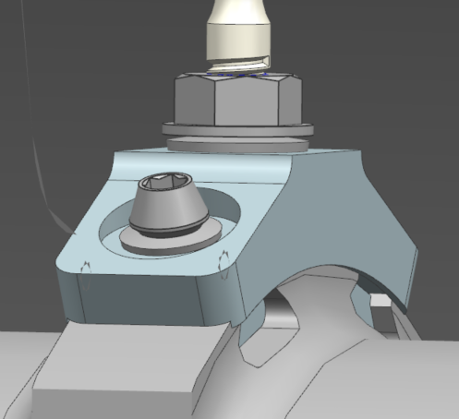
Design Layout Cont.
Connection to conductor made with an aluminum mounting bracket.
Double dove-tail nut arrangement.
Thread insert / Belleville / Spiralock flange nut at spoke location.
Stainless steel flange weldment affixed to outer conductor.
Internal ceramic.
Isolated hardware.
Actively cooled.
Helicoflex seal.

Slide 6
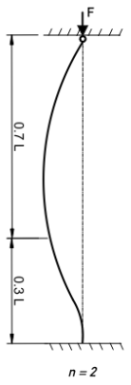
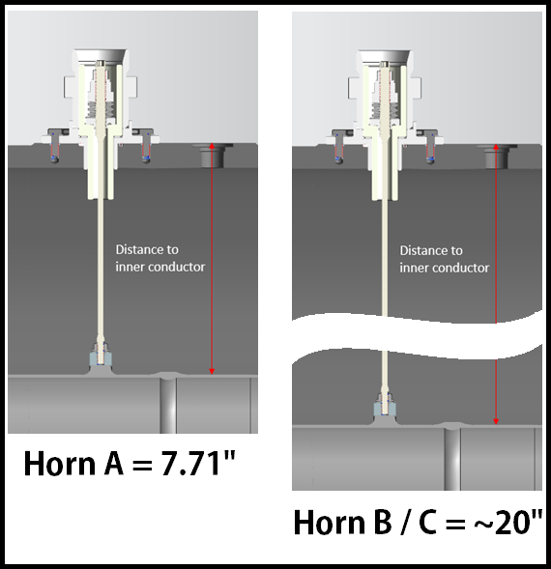
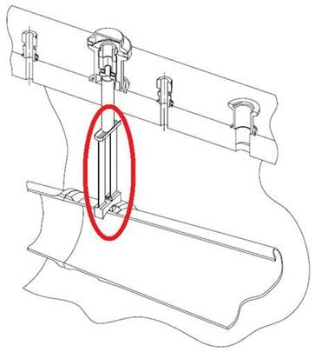
Design Motivation
Tensile spoke arrangement had three purposes:
Easily scale to varying horn diameters.
Eliminate buckling concerns.
Minimize material present for secondary interactions.
Constant diameter spoke regardless of conductor ratios.
Columns for larger conductor ratios were ~13X equiv. spoke area.
Known drawback: Tensile loading.

Slide 7
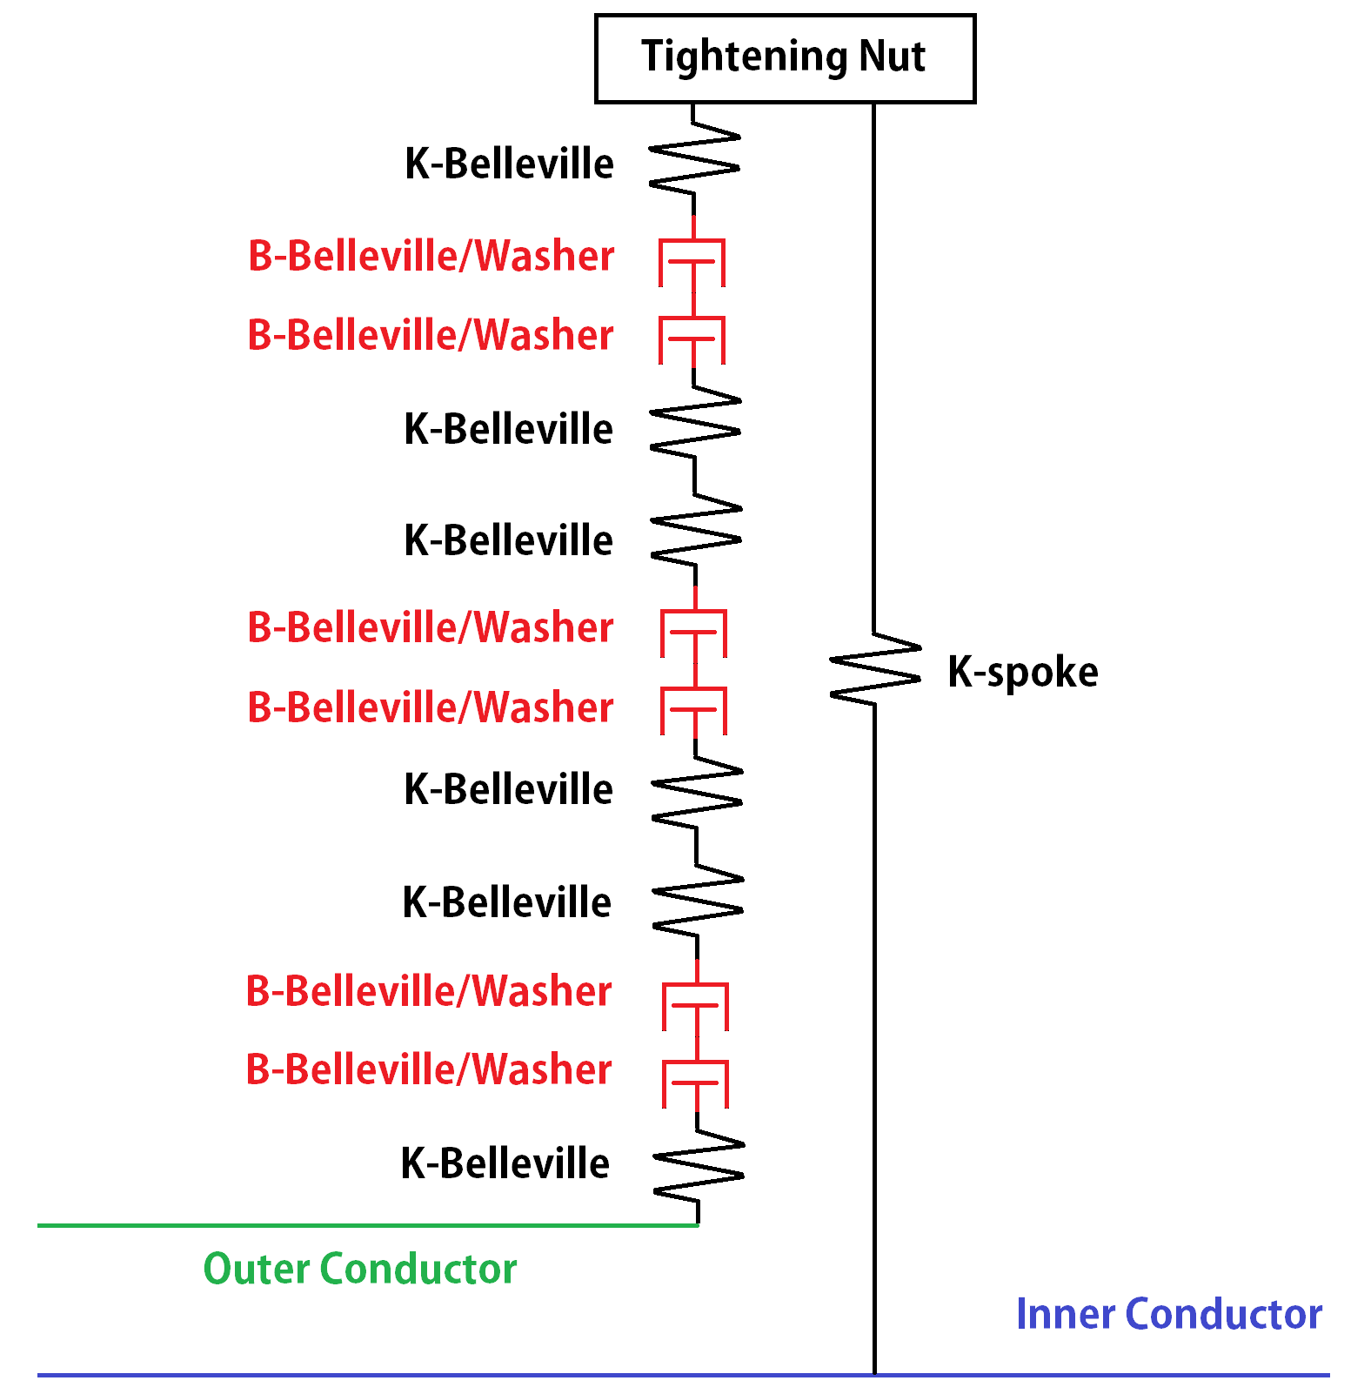
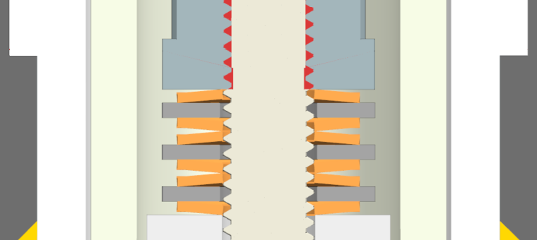
Design Layout Cont.
6X Belleville washer series arrangement allows for:
Higher relative displacement.
Larger range of travel.
Spacer washers allow for:
Circular washer contact (no point to point edge interface).
Scrubbing / damping.

Slide 8
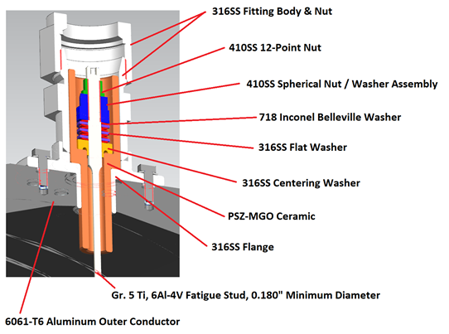
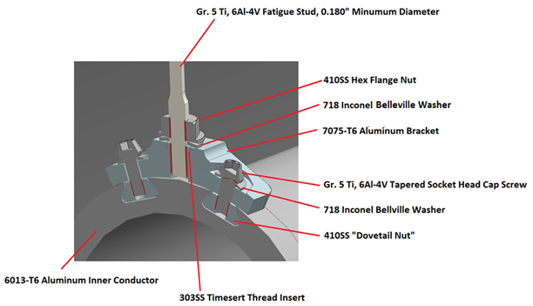
Materials
O.C. Assembly
316LSS / 410SS.
718 Inconel.
Alumina / Zirconia.
I.C. Assembly
303SS / 410SS.
718 Inconel.
7075-T6 Aluminum.
6Al-4V Titanium.
All 410SS to be passivated.

Slide 9
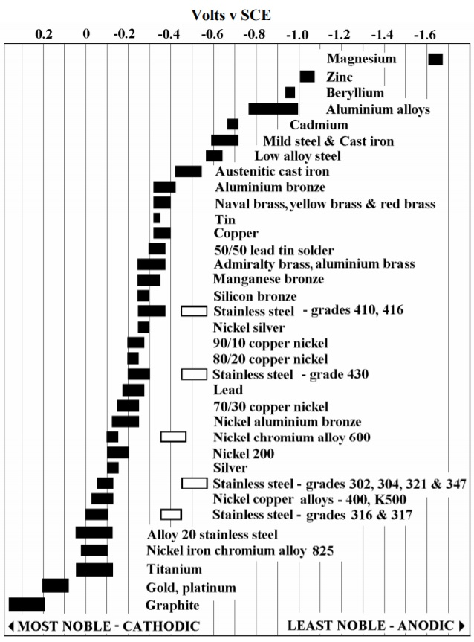
Corrosion
All materials used in horn applications, but not all together AND in water…
Corrosion concerns arose at prior reviews & design discussions.
SS is OK.
Nickel plating OK.
Inconel OK.
What happens to titanium???
It is the most noble; minimal corrosion expected.
Un-plated aluminum is the system anode.
Need large bare aluminum surface to preferentially corrode. (Water Tank).

Slide 10
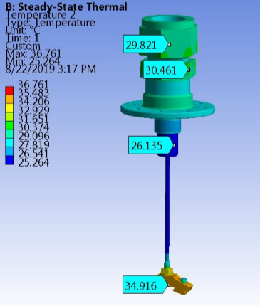
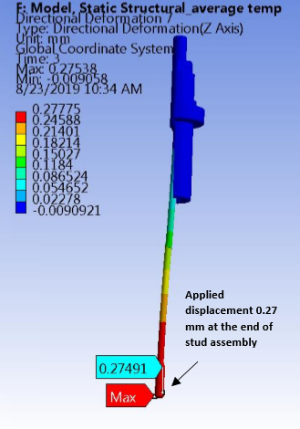
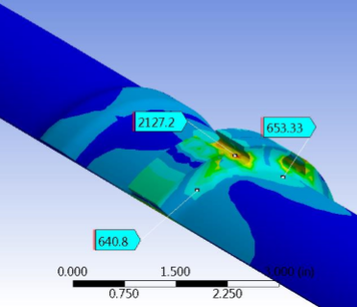
Stress & Temperature
Structural considerations are major concern; prototype on test stand + disassembly & inspection.
Investigated operating temp, stress, deformation. Matched deflection to I.C. displacement.
Analyzed conductor connection; will incorporate into final I.C. run.
FEA Credit: Ang Lee

Slide 11
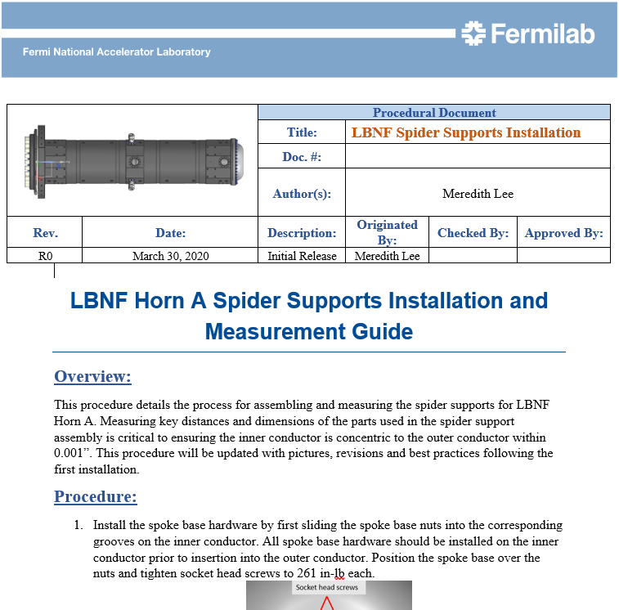
Support Settings / Preload
Spider support tension load drivers:
Provide large force range to move stiffer horns after assembly.
Reach mid-range Belleville displacement.
Allow generous S.F. on spoke & Horn A I.C.
Solon Spring P/N: 61240718.
570lb flat load.
.016” deflection.
Roughly .048” displacement on washer assembly @ 50% load for 6 washers.
Driving LBNF Horn procedure development.

Slide 12
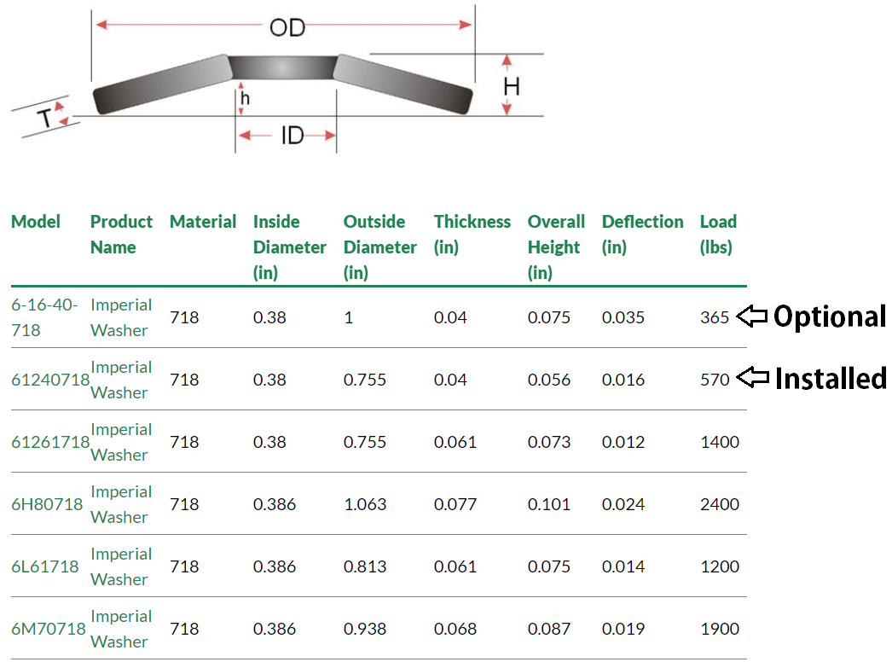
Tuning
Spider support spring rate can be tuned based on experimental vibration testing if needed.
Change preload.
Change spring rate.
Different washers.
+/- washer count.
Parallel arrangement.
1.063” Max Diameter.

Slide 13
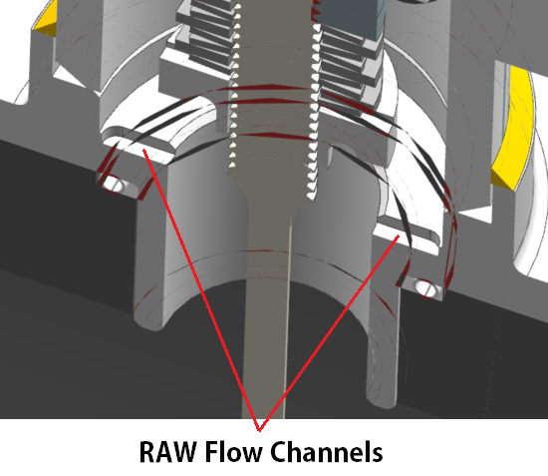
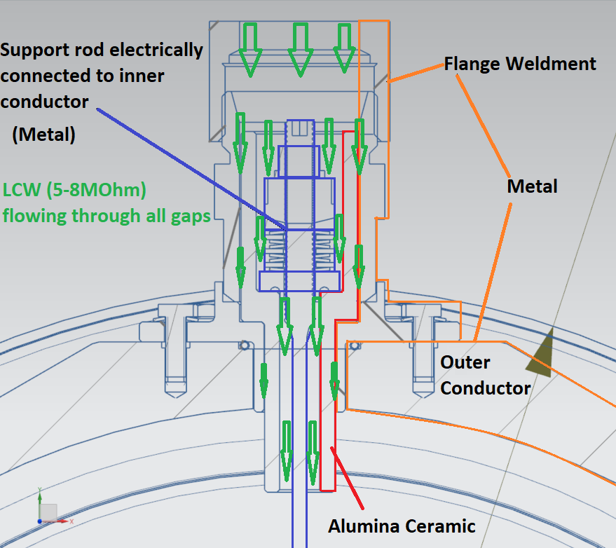
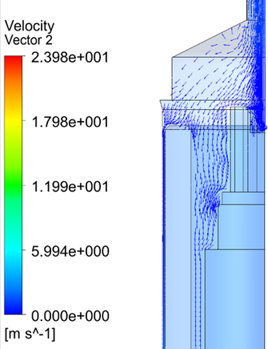
Electrical Considerations
Maintain electrical isolation.
Stagnant water would be known issue with this arrangement.
Solution is to actively flow RAW through all internal passageways to flush out assembly.
Both internal & external hardware stack-up are flushed.
Dedicated flow channels milled in flange base and main washer.
FEA Credit:
Jacob Kintner

Slide 14
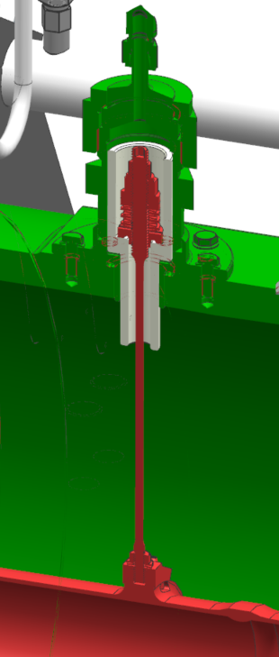
Electrical Considerations
Scalable design must account for maximum anticipated ΔV.
~500 ΔV @ Horn A.
~800 ΔV @ Horn B. Horn B drives spacing.
Alumina ceramic desired.
Cheaper manufacture.
Lower dielectric constant.
Low stress @ 285lbs max anticipated preload.
Consideration of losses via induced current & dissipation of magnetic energy.
123mW @ 1sec rep rate for current induction.
87mW @ 1sec rep rate for magnetic dissipation.
No concern from EE Support.
Calculation:
Howie Pfeffer

Slide 15
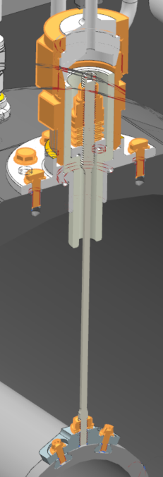
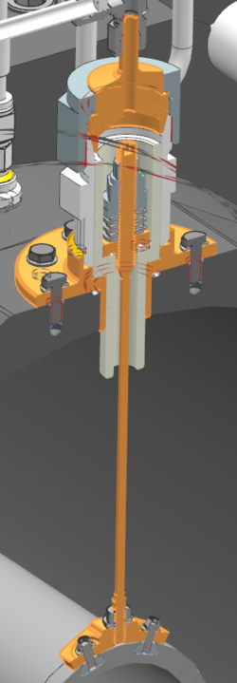
Manufacturing Plans
~50% are COTS.
3X ceramic tubes paired with bulk ceramics purchase for Horn.
Balance bid out to machine shops.
Spoke will have rolled threads and 32 finish on .180” diameter tensile element.
No plan on plating other than passivation for 410SS & nickel for aluminum bracket.
COTS
Vendor Bid
Ceramic Bulk PO

Slide 16
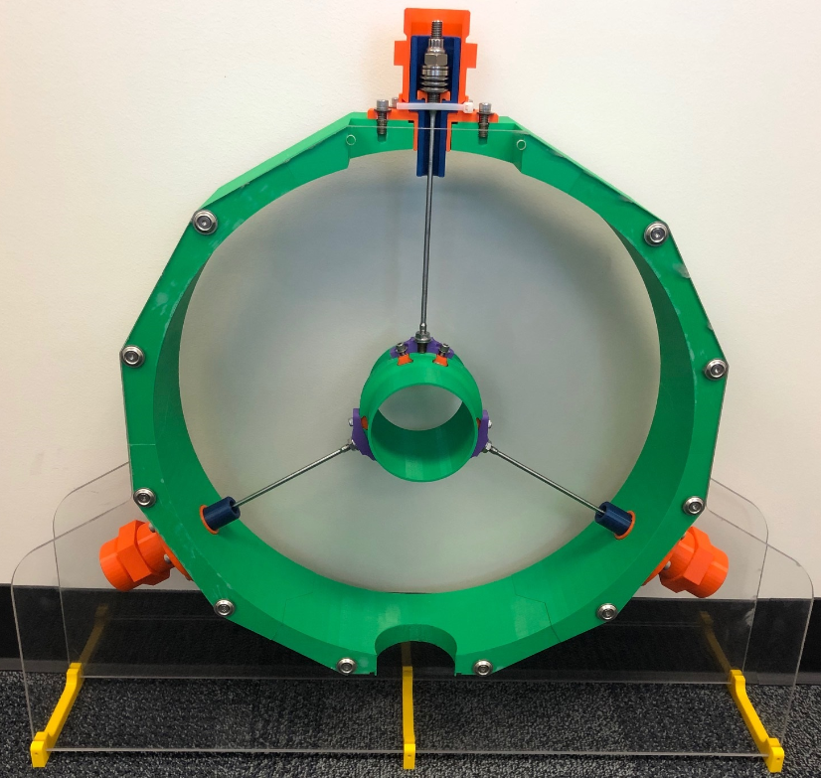
Prototype Assembly
Print Credit: Quinn Peterson
Generated 3D prototype.
Serves as training aid.
Practice installation.
Practice alignment.
Communicate electrical isolation concerns.

Slide 17
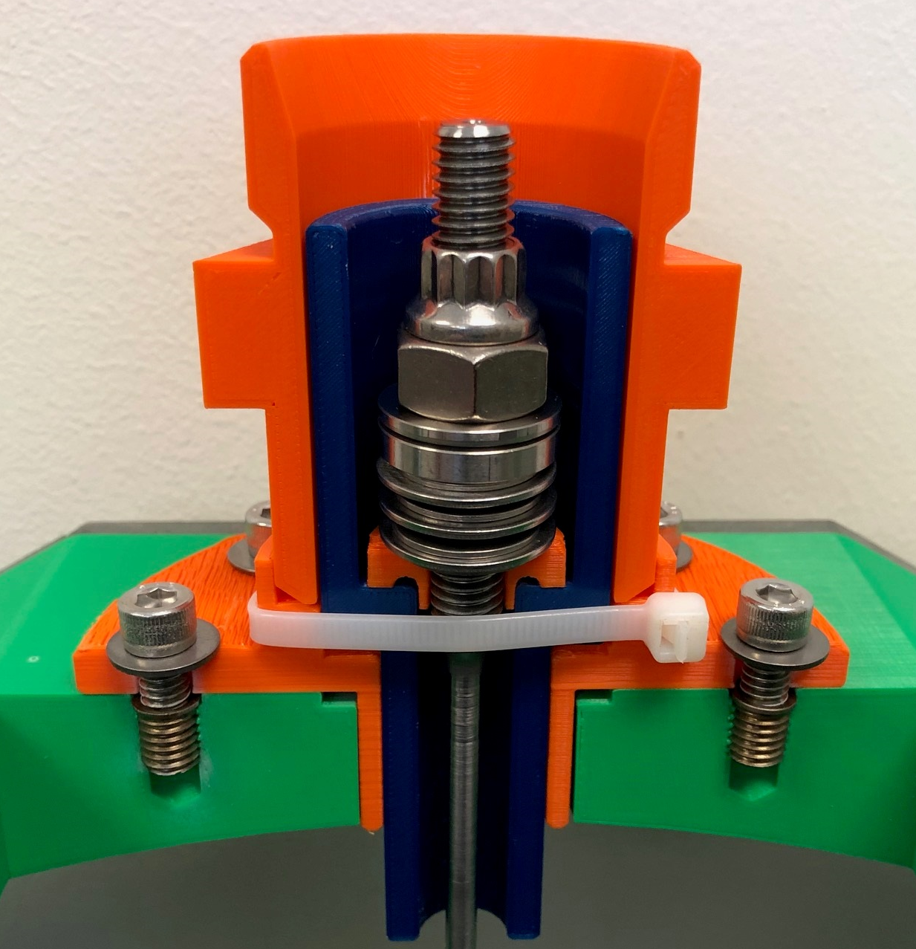
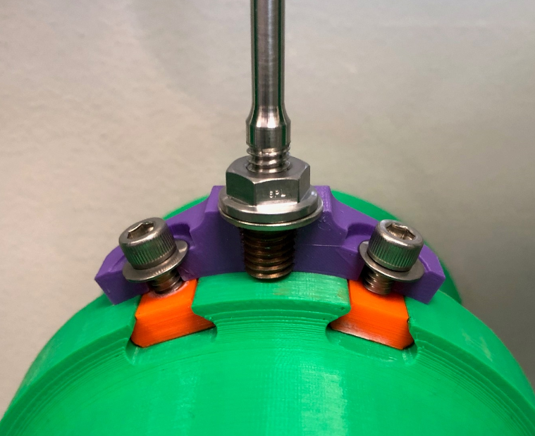
Prototype Assembly
Print Credit: Quinn Peterson

Slide 18
Summary
Design efforts complete & drawing package is available.
Thermal & structural analysis complete.
Electrical analysis underway & ~800 ΔV maximum not foreseen to be an issue.
Can change overall spacing & gaps to make design work if needed.
Will be proven prior to final design release.
Full scale test to occur on Horn A prototype assembly & test stand.
Will measure conductor displacements (Laser Doppler Vibrometer)
Can change out Belleville washers or adjust preload if needed.
No manufacturing issues identified to date.
RAW orifice sizing, FEA, & setting procedure talks describe design further.
Questions?

