Slide 1
Neutrino Beamline Horn A Preliminary Design Review
Stripline FEA & Final Run Plans
Zhijing Tang, Cory Crowley
23 April 2020

Slide 2
Outline
Stripline Inputs
Events and Time Scales
Stripline Thermal Model
Heat loads, boundary conditions, solutions
Structural Model
Mechanical loads, load cases, displacements, stresses
Fatigue Safety Factors
Final FEA run plans

Slide 3
Stripline Inputs
Geometry snapshot from 2018 using Beam Optimization Task Force (BOTF) parameters, defined in DUNE-doc-2901 & preliminary Horn A stripline model.
Backscatter EDEP from RAL 2m cylindrical target as defined from DUNE-doc-8759, with 1.15 multiplier for uncertainty.
Cooling conditions from AD/TSD HTC test summary & historical inputs.
Current pulse parameters from BOTF / DUNE-doc-294 / DUNE-doc-10494.

Slide 4
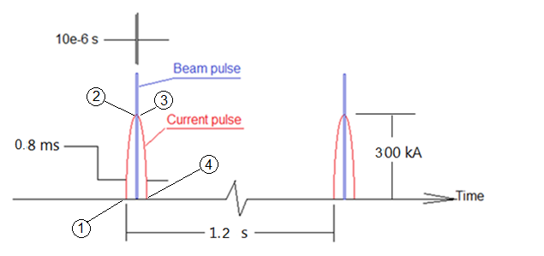
Events and Time Scales
Current Pulse
Length 0.8 ms
Peak 300 kA
Beam Pulse
Length 10 μs
120 GeV beam
7.5e13 Protons

Slide 5
Preliminary Stripline Finite Element Model

Slide 6
Heat Loads (W/m³)
Joule Heating --- current input, program will calculate
Beam Heat --- From Mars simulation (about 1/6 of joule heating)
segment | A | B | C | D | E
1 | 371 | 317 | 310 | 366 | 268
2 | 921 | 915.5 | 974.5 | 1021 | 991
3 | 1664 | 1652 | 1651.5 | 1881 | 1960
4 | 1672.5 | 1676.5 | 1738.5 | 1802 | 1992.5
5 | 1626.5 | 1671 | 1698.5 | 1815 | 1661.5
6 | 1653.5 | 1622 | 1745 | 1740 | 2046.5
7 | 1433 | 1586.5 | 1702.5 | 1405 | 1405
8 | 1469 | 1544.5 | 1571.5 | 1652.5 | 1569.5
9 | 1798.5 | 1979 |  | 2168 | 2109.5
10 | 1882 | 2179 |  | 2298 | 2000.5
11 | 1742.5 | 1682.5 |  | 1698.5 | 1761
12 | 1931 | 2206.5 |  | 2287 | 2023.5
13 | 3066 | 2945 |  | 2268 | 2037
14 | 3010 | 3294 |  | 3341 | 3163

Slide 7
Cooling Conditions

Slide 8
Cooling Conditions Cont.

Slide 9
Temperature Solution

Slide 10
Structural Model Loads
Thermal load --- temperature (fluctuation in time < 0.01 C)
Gravity --- weight (Constant)
Magnetic load --- use ANSYS Maxwell 3D to calculate the magnetic force (varies with time)
Bolt preload --- 26688 newton per bolt (constant)
We solve two sets of solutions:
1) Solution with (maximum) magnetic load and
2) Solution without magnetic load

Slide 11
Displacements (mm)

Slide 12
Equivalent Stresses (Striplines only) (Mpa)

Slide 13
Material Strength for Al 6101-T6
Static stress maximum 42 Mpa, compared with yield strength, safety factor is more than 4.
Fatigue safety factor SF can be calculated using modified Goodman equation: Sa/Sf + Sm/Sy = 1/SF,
SF = 2.823 for 10⁷ cycles, and SF =2.035 for 10⁸ cycles
Ultimate stress Su (MPa) | Yield stress Sy (MPa) | # of cycles | Fatigue Stress 2*Sf (MPa)
200 | 172 | 10⁷ | 90
 |  | 10⁸ | 60

Slide 14
Calculate Fatigue Safety Factor

Slide 15
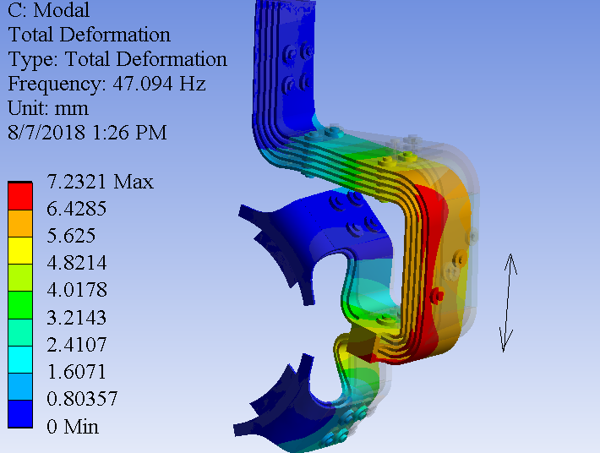
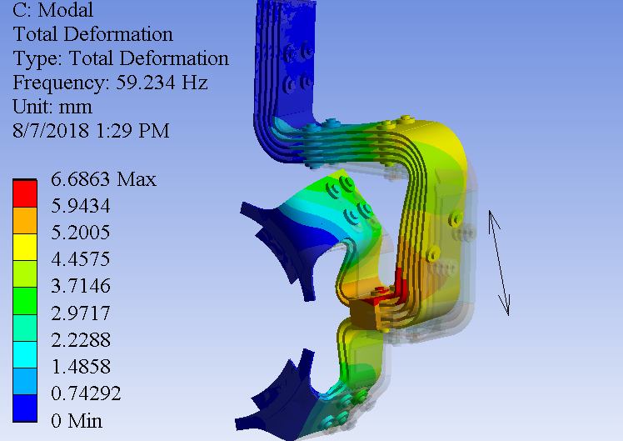
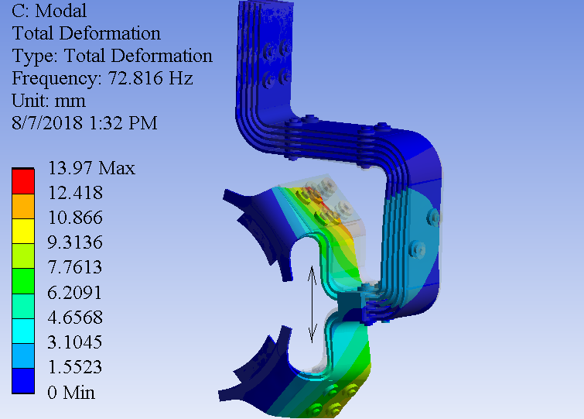
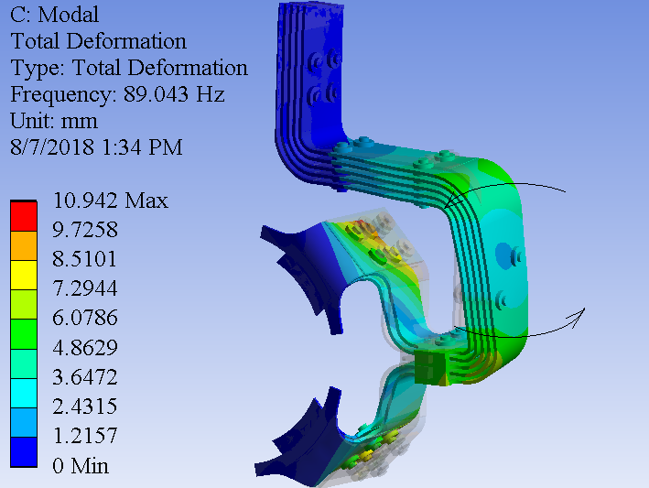
Modal Analysis
Mode | Frequency (Hz)
1 | 32.127
2 | 47.094
3 | 59.234
4 | 72.816
5 | 89.043

Slide 16
Stripline Summary
FEA assuming half symmetry.
Thermal solution is solved for temperature distribution. Maximum temperature is 50 C.
Structural solutions are solved for displacement and stress for both with magnetic load and without magnetic load. Maximum displacement is 0.42 mm, and maximum stress is 42 Mpa.
Fatigue safety factor is calculated from the structural solutions. Minimum SF = 2.035 for 10⁸ cycles.
First five frequencies and vibration modes are extracted from modal analysis.

Slide 17
Analysis Plans for Final Stripline Run
Use most recent snapshot of stripline geometry.
Use updated conductor analysis for boundary condition inputs.
Incorporate bolt group additions & changes assuming prototype efforts are successful.
Confirm operating temperatures for pull-up block and remote clamp connection.
Keep 115% EDEP to account for further target iterations or backscatter concerns.
Must experimentally confirm HTC values during mounted test stand run.
Questions?

