Slide 1
Neutrino Beamline Horn A Preliminary Design Review
Electrical Isolation Challenges
Cory Crowley
23 April 2020

Slide 2
Outline
Stripline Recap
Thermocouples
Module Connections
Water Lines
Water Tank
Summary

Slide 3
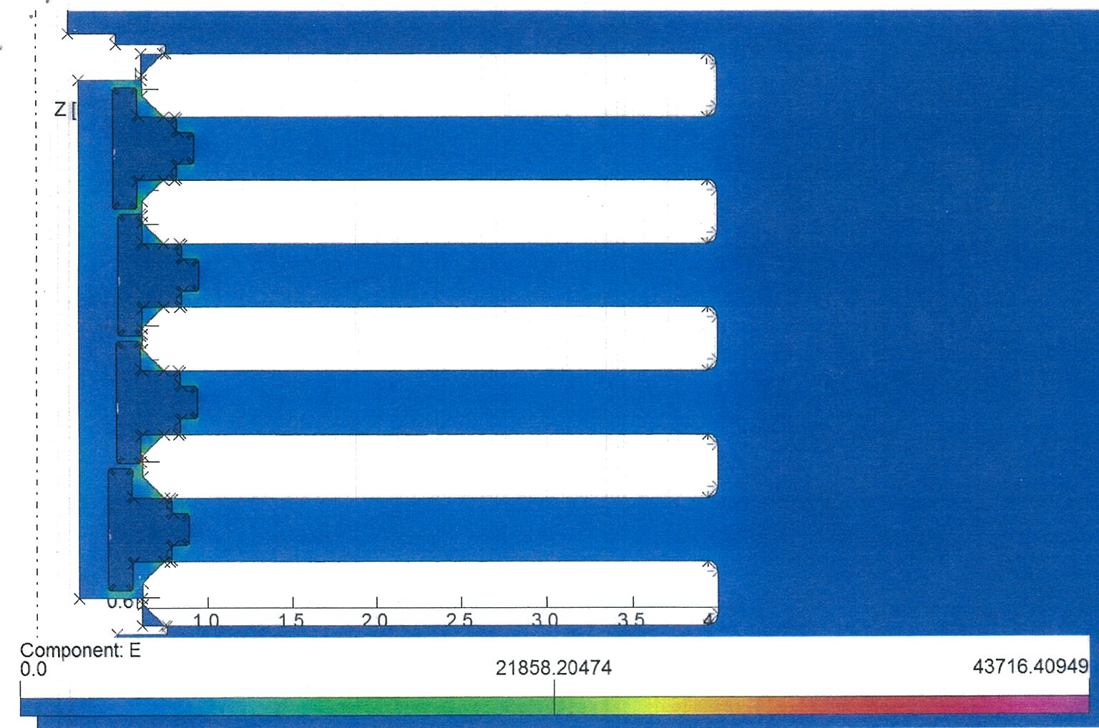
Stripline Issues
Limitations best described in stripline design & prototyping talk.
Top down issue is 5kV to ground and 1.6kV across horns will always be tough unless gaps are 4-5X larger.
Simple alumina tubes & bolt groups would push cross section to ~18”+?
Big ship to steer.
PS Specs
Stripline
Shield blocks
Horn SL packaging
Corona inception in ionized areas unknown.

Slide 4
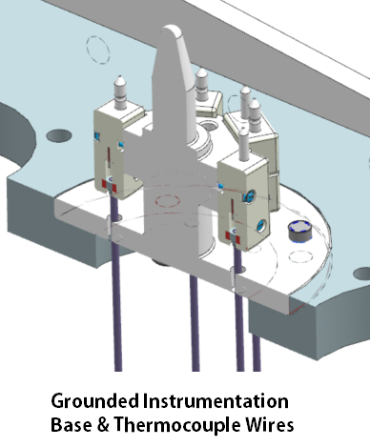
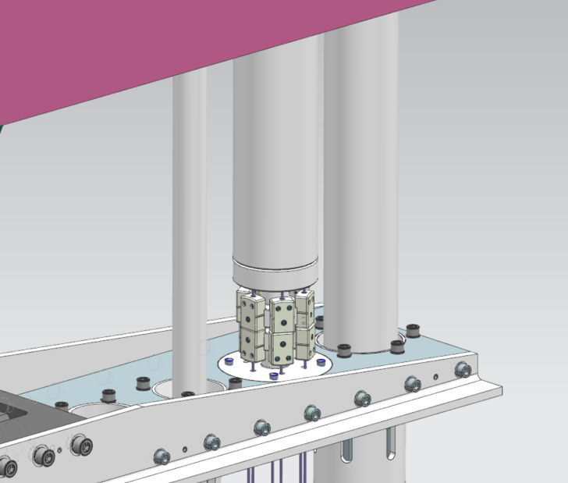
Thermocouples / Instrumentation
Problem: How to get thermal monitoring on 5kV horn.
Designing for Horn C.
Considering edits for Horn A @ ~1-1.5kV.
NuMI has luxury of ~700V operation.
BNB (10kV) monitors overall water temp.

Slide 5
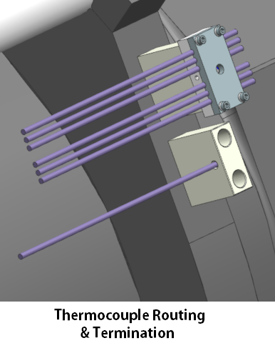
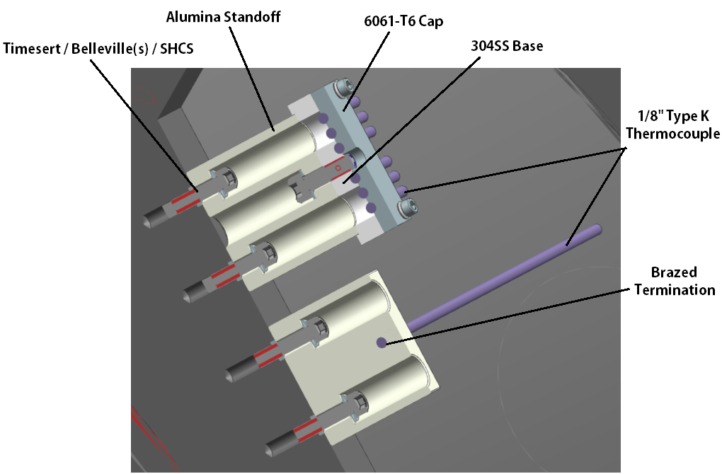
Thermocouples / Instrumentation Cont.
Solution: More alumina?
Routing blocks are a non-issue. Not measuring anything, just structural.
Termination blocks can have brazed thermocouple wire, but have long τ.
Cannot bring thermocouples to horn voltage; will multiply complications.
Lack knowledge of more direct HV temperature indication in rad area.

Slide 6
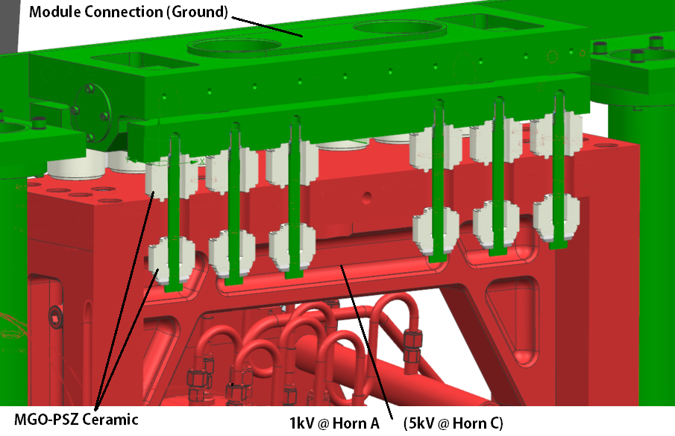
Horn Connection to Modules
Horns need similar interface to modules as striplines @ 5kV.
Nested / swaged ceramics + grounded through bolts.
May need to round off tops of bolt heads if arcing occurs.

Slide 7
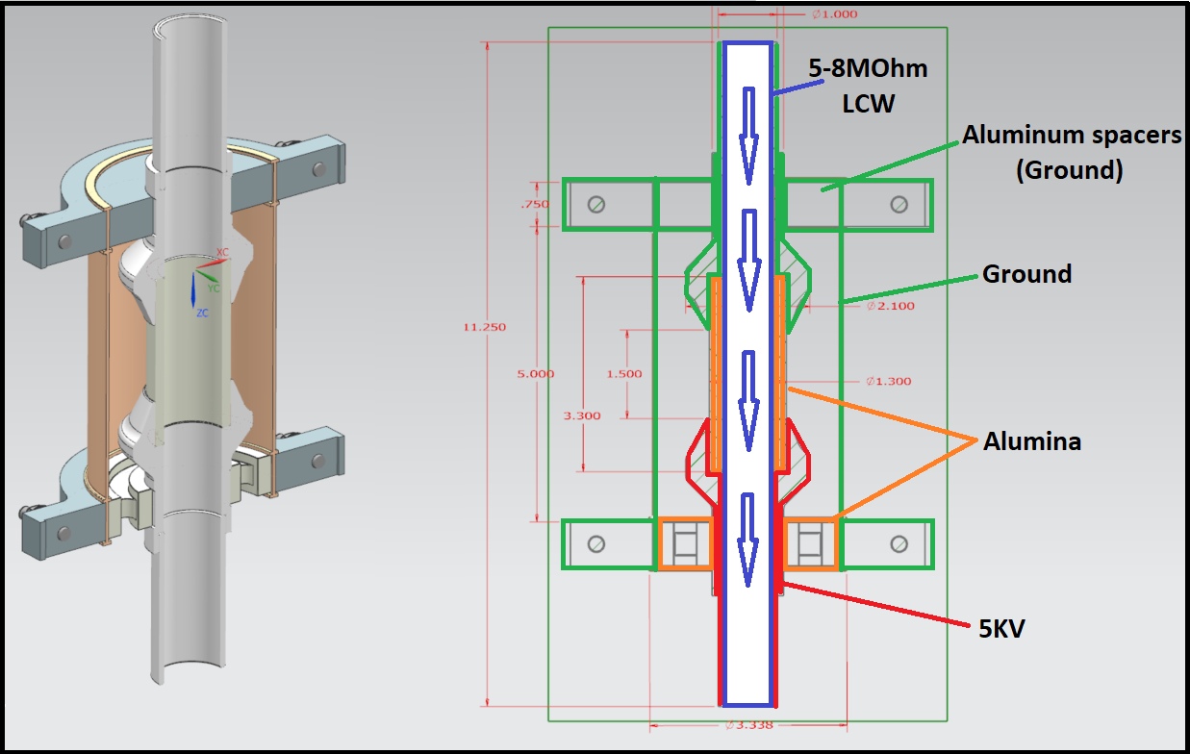
Water Connections to Ground
LBNF (& NuMI) horns rely on critical ceramic juncture to ground at module connection for all water manifold isolation.
Invar 36 shell can no longer float electrically.
Ceramic on top would be debris reservoir. Must be on bottom.

Slide 8
Plating Concerns
Some materials are not desired in RAW system.
Poor polymer choices are well known, some metals less so.
RAW System Material Listing | Horn Use | Issue
Stainless Steel | Yes | None
Aluminum | Yes | None
Titanium | Yes | None
Inconel | Yes | None
Alumina Ceramic | Yes | None
Zirconia Ceramic | Yes | None
Nickel | Yes | None
Copper | No | Plating / Corrosion
Zink | No | Plating / Corrosion
Tin | No | Plating / Corrosion
Brass | No | Plating / Corrosion
Graphite | Yes | None
UHMWPE | Yes | None
Teflon | No | Breakdown / Orifice Risk
PVC | No | Chloride Formations / Corrosion
Viton | Yes | None
Steel | No | Corrosion

Slide 9
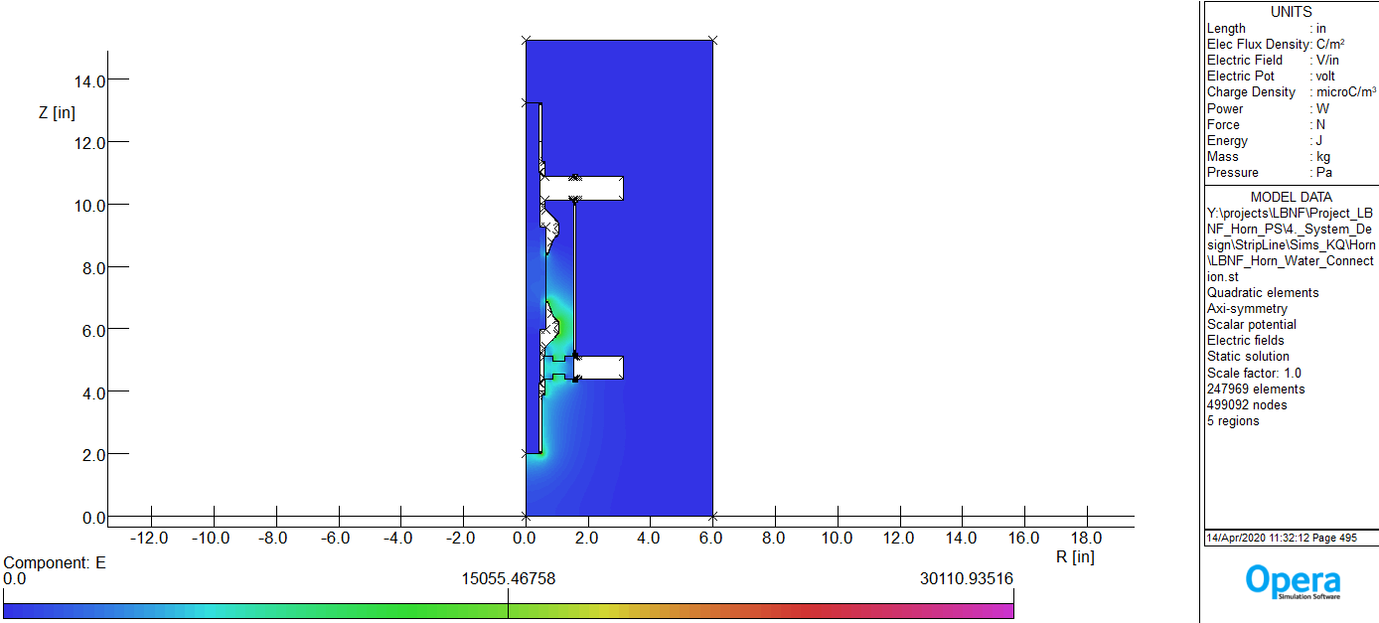
Electric Field Analysis
Initial uncertainties on ceramic design.
Wanted to keep Invar 36 clamshell cover for rigidity.
RAW modeled with dielectric @ 25C & 8 Mohm-cm resistivity.
Analysis Credit:
Ken Quinn

Slide 10
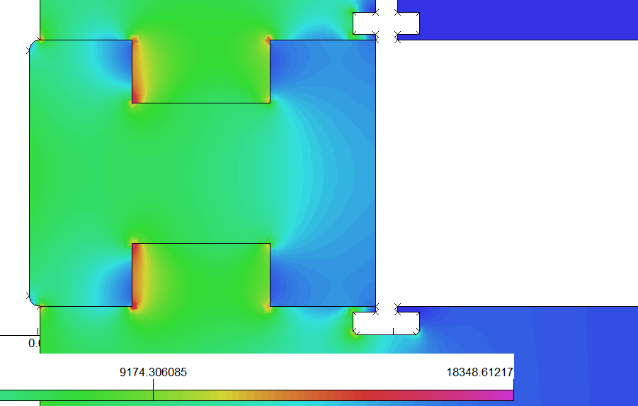
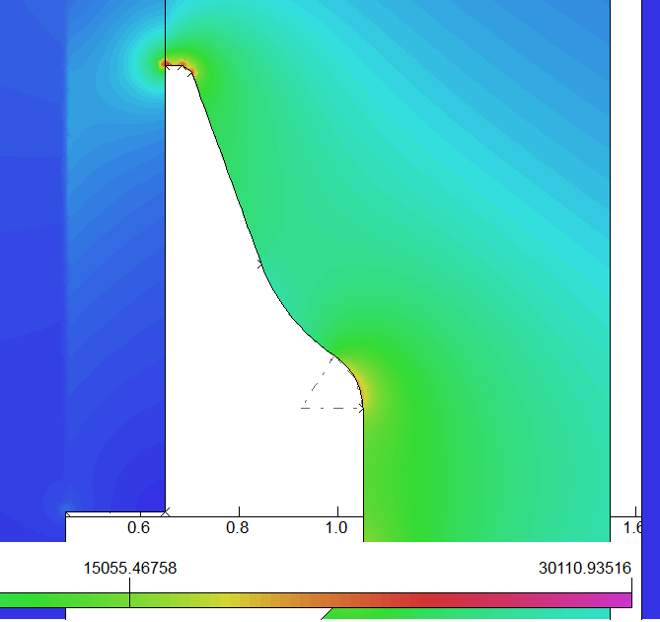
Electrical Break Interfaces
First pass has acceptable results.
Must refine edge conditions with ceramic vendor, but worst case is modeled.
Taper on SS. adapter generally fixed for ceramic stress riser concerns.
Analysis Credit:
Ken Quinn

Slide 11
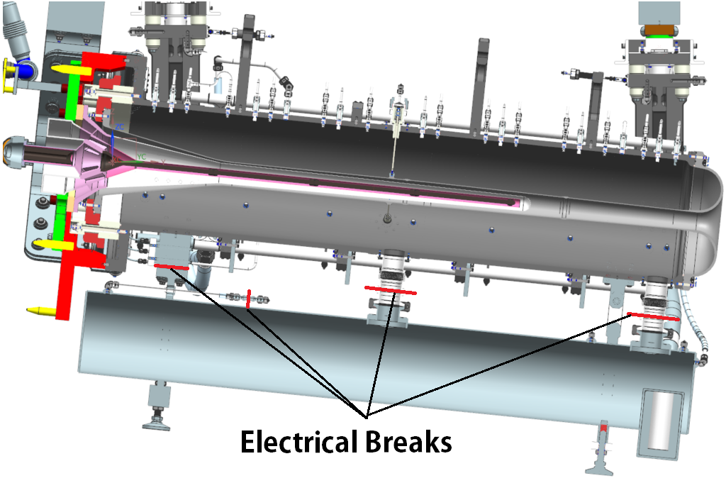
Water Tank Short Circuit
Some current short circuits through water lines, but not much.
SS resistivity high + small conductor path relative to O.C.
Water tank short circuit is primary issue.
Identical resistivity as O.C, large current path, delicate SS bellows.

Slide 12
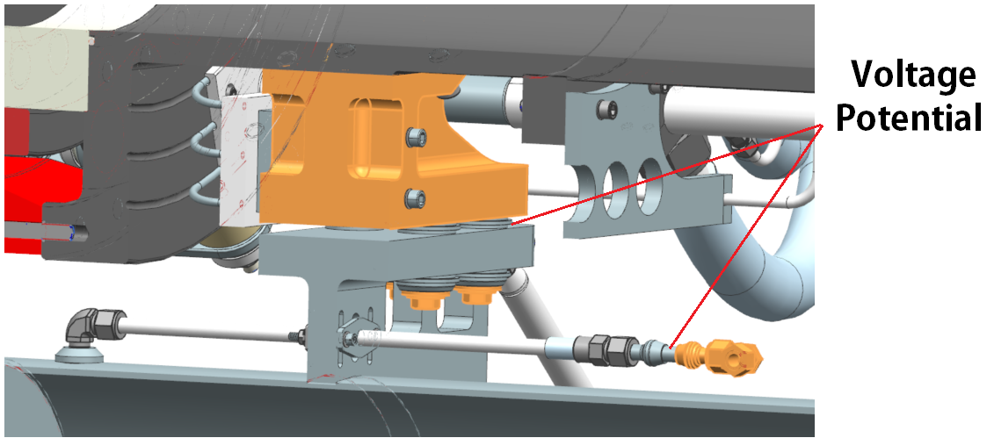
Isolation Scheme
Water tank rigidly fixed at one end with identical ceramics from 1.6kV approved stripline ceramics.
Essentially identical connection as employed at hanger + module.
Small isolator present on gas volume exchange system.

Slide 13
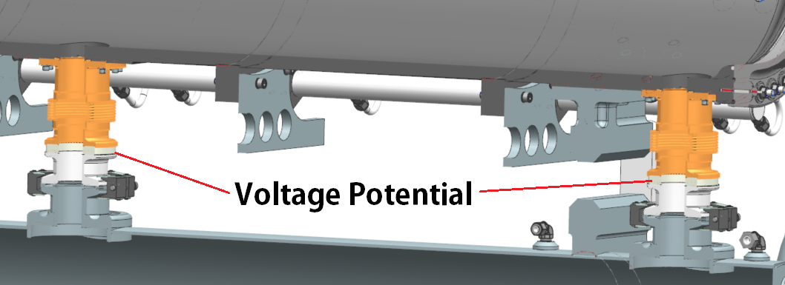
Isolation Scheme Cont.
Dual water tank drain ports have brazed alumina ceramic ring between bellows & NW80 flanges to eliminate current path.
Water tank still tied to O.C. through swinging link on D.S. end.
Cannot float electrically + isolation present on all critical elements.

Slide 14
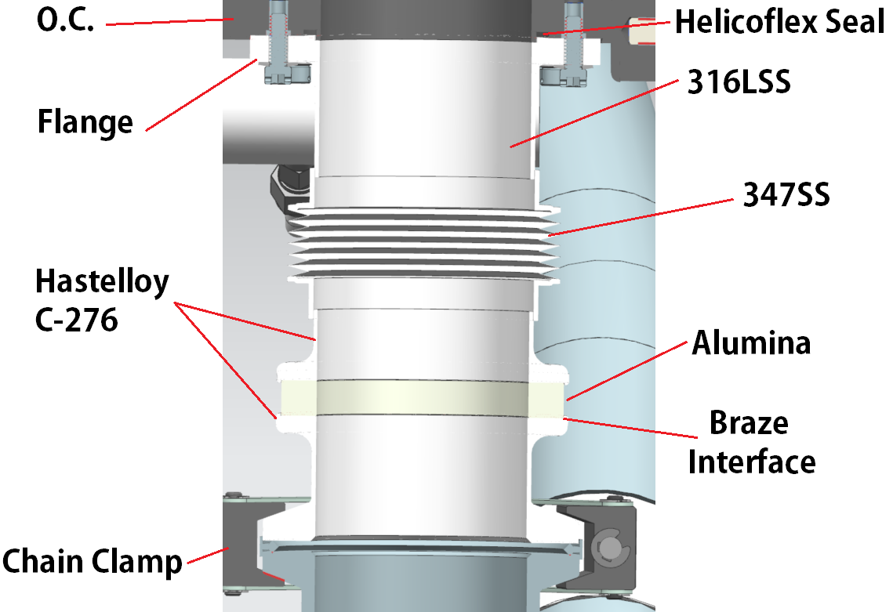
Current Preliminary Design
Flange connections straightforward, ceramic joint is not.
Bellows in to absorb shock, and ceramic is on tank structure and not horn.
Ceramic must stay in compression.
Current joint has braze primarily in shear + compression.
Likely to fail.
Must use C-276.
Corrosion
CTE matching

Slide 15
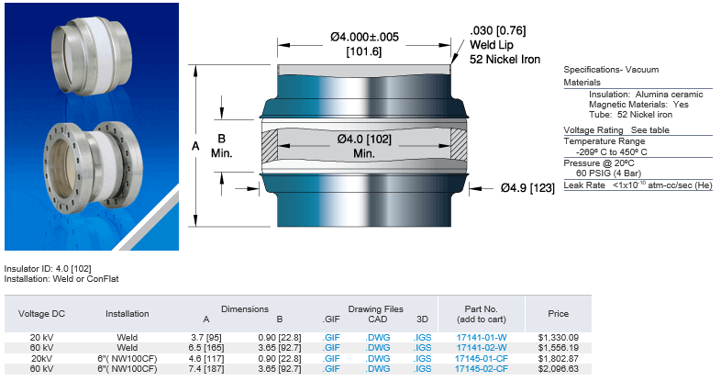
Vendor Direction / Design Change

Slide 16
Summary
Voltage isolation went from a non-issue at conceptual design… “Just copy NuMI…” to forefront of design & prototyping.
Most NuMI ceramic elements planned for carryover are unusable.
Efforts to standardize interfaces and reduce various component counts allow for one design to be analyzed.
Prototyping efforts on stripline will set tone for design going forward.
Either full speed ahead & duplicate on all horns, or big decisions on metallization of ceramics ($$$), interfaces to ground, change to alumina & accept lower bolt preloading? etc…
RAW isolators are experimentally OK with minimal design changes.
Thermocouples will give steady state temps over long time constant.
Water tank isolator design needs a revision to get braze out of shear.
Questions?

