Slide 1
Neutrino Beamline Horn A Preliminary Design Review
Answers to Day 1 & 2 Questions
Cory Crowley
24 April 2020

Slide 2
Outline
Homework:
1. Make RAW drawings available to committee.
2. Create / find documentation defining horn connection to the module or remote handling efforts.
3. What does D.S. Target mount look like.
4. Total end cap loading.
5. Original FEA results without pre-tensioning.
6. Resistivity comparison between 6013 & 6061.
7. Show stripline tooling.

Slide 3
4. Total End Cap Loading
16 kN, (~3600lb).
5. Original FEA Safety Factor Without Pre-tensioning.
1.71 w/6061-T6.
With 6013-T6, likely ~2.
With 6013-T6 + 1.8m target & no D.S. target mount, thinning of flange likely.
Will use 6013-T6 on end cap only + 1.8m target & no D.S. target mount, + lowering outer conductor HTC for better conductor expansion balancing.

Slide 4
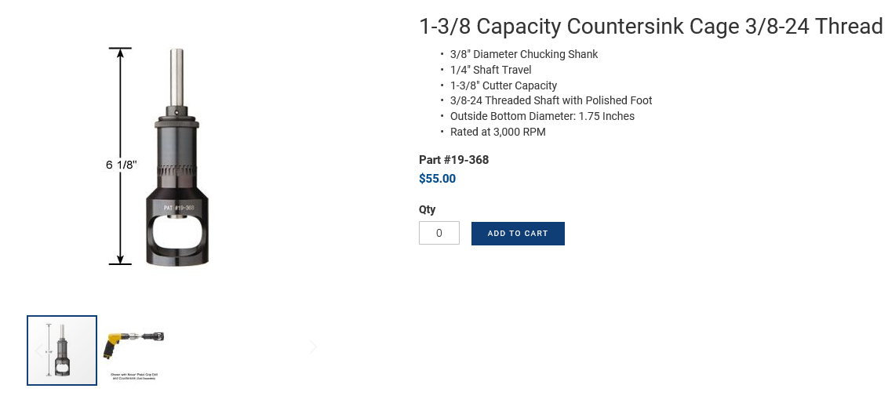
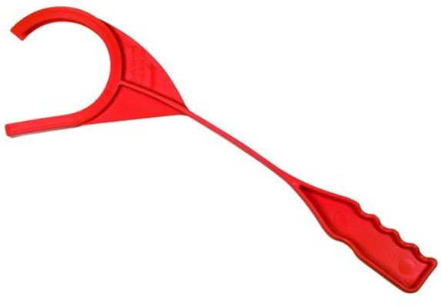
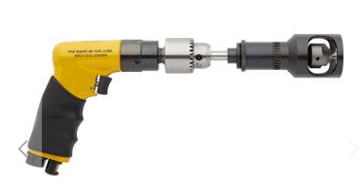
7. LBNF Stripline Tooling

