Slide 1
650 MHz 40 kW RF Amplifier Requirements & Specification Workshop
Elvin Harms
L2 Manager, Accelerator Systems
20 May 2020

Slide 2
Welcome
Purpose
Logistics & Schedule
Introductions
Outcome

Slide 3
Purpose
On behalf of the PIP-II Accelerator Systems/High Power RF team, you are invited to a PIP-II workshop to discuss and refine Requirements for the 650 MHz 40 kW RF Amplifiers. The intent of this workshop is to bring all stakeholders together to revisit the existing Functional and Technical requirements and update them in order for the amplifiers ultimately built and delivered for PIP-II to be able to fully meet performance requirements. Since the requirements were originally written circa 2015, the design of PIP-II has seen significant advancement and a greater understanding of the needed performance necessitates an updated set of documents to clearly spell out, especially for designers and fabricators, what the critical parameters and values are. Rather than a formal review of the Requirements, which will occur in the near future, a workshop format is preferred to look at the existing requirements against the Physics Requirements and in a collegial way determine areas needing revision, update, and even addition or deletion. The end result of this workshop is to have sufficient information so as to re-write the amplifier FRS and TRS documents for subsequent review and approval within a few weeks.

Slide 4
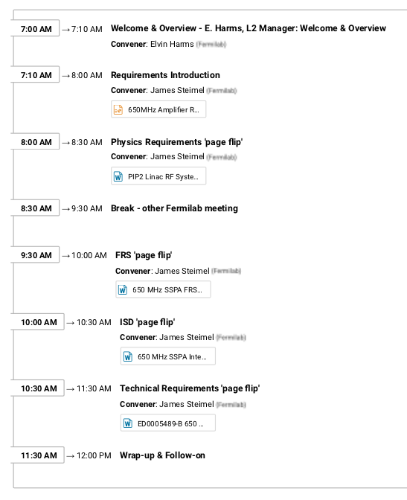
Logistics & Schedule
Workshop format
Presentations by Jim Steimel
‘page flips’ though documents
Note areas needing modification
Indico downtime from 0800-0830
download docs beforehand
Fermilab staff special meeting 0830 - ~0930 (CDT)
No scheduled breaks except at 0830
Promptly finish at noon (CDT)
Safety
Be aware of your surroundings
Identify alerts and exits in case of emergency

Slide 5
Introductions
Invited participants include
PIP-II project management
Partners
RF colleagues
Fermilab
Jefferson lab
SLAC
‘Go around the table’ and introduce ourselves

Slide 6
Outcome
The end result of this workshop is to have sufficient information so as to re-write the amplifier FRS and TRS documents for subsequent review and approval within a few weeks.
FRS and TRS will form (new) basis for design work by IIFC partners
Let’s get to work!

Slide 7
Thank you!
Grazie
धन्यवाद
Merci
650 MHz 40 kW Amplifier Requirements

