Slide 1
PIP-II LB650 650MHz RF Amplifier Requirements
Jim Steimel
40kW 650MHz RF Amplifier Requirements and Specification Workshop
May 20, 2020

Slide 2
Introduction & Agenda
The purpose of this workshop is to examine the current collective requirements documents of the RF amplifiers for completeness and accuracy.
The participants should also verify that the requirements are organized in a format that can be audited.
The first section of this overview reviews the PIP-II and amplifier requirements flow-down and organization.
The second section clarifies some of the critical requirements that have complicated interfaces.

Slide 3
Requirements FlowDown - Functional
Beam Lattice
Simulation
PRD
RF Systems
FRS
HPRF L3
FRS
650MHz Amplifier
GRD
FRS – Functional Requirements Spec
GRD – Global Requirements Doc
PRD – Physics Requirements Doc
PRD
SRF Cavity Parameters

Slide 4
Requirements FlowDown - Technical
Master ICD
FRS – Functional Requirements Spec
ICD – Interface Control Doc
ISD – Interface Spec Doc
PRD – Physics Requirements Doc
RDS – Room Data Sheet
TRS – Technical Requirements Spec
RDS
ISD
650MHz Amplifier
FRS
650MHz Amplifier
Design Plan
650MHz Amplifier
PRD
RF Systems
TRS
650MHz Amplifier

Slide 5
RF System PRD Content
RF System PRD evaluates the RF system from LLRF drive to cavity.
The aspects of cavity field regulation are defined.
System level constraints are distributed between the different components (i.e. delay, loss, gain).
Table 6‑1: LLRF Dynamics Specifications
Parameter | Value
Delay Budget | 5000 us max
Amplifier Delay | 100 ns max
RF Power Distribution Delay | 500 ns max
RF Fanback and Drive Delay | 600 ns max
LLRF System Delay | 3800 ns max
LLRF System Proportional Gain | 40 dB min
Feedforward Error Vector Magnitude | 10% max
Error in Feedforward Program Timing | 500 ns max
Overshoot Budget for Power Amplifier | 15%
Example table from RF System PRD showing distribution of RF dynamics parameters.

Slide 6
FRS Content
FRS defines the scope of a system or component and its necessary functions.
It also lists the pertinent standards that the design is required to comply with.
The L3 FRS (HPRF) captures functional requirements common to all HPRF systems. The amplifier FRS is focused on the amplifier itself.
RF Amplifier Primary Requirements
Requirement # | Requirement Statement
F-ED0003413-A001 | The amplifier shall have sufficient and stable gain to maintain the closed loop bandwidth for cavity field regulation as specified in PRD.
F-ED0003413-A002 | The amplifier shall be capable of providing sufficient power to accelerate a continuous stream of beam current in the LB650 cavities with amplitude specified in GRD.
F-ED0003413-A003 | The amplifier shall respond to changes in drive amplitude and phase quickly enough to maintain closed loop stability as specified in PRD.
F-ED0003413-A004 | The amplifier shall respond to changes in drive amplitude and phase with sufficient precision to compensate for beam loading in the cavity as specified in PRD.
F-ED0003413-A005 | The amplifier shall be able to provide for pulsed operation for purposes of conditioning SRF cavities and input couplers.
Example table from 650 MHz SSPA FRS.

Slide 7
Master ICD Content
The Master ICD contains a functional description of interfaces between L3 systems.
These interfaces are labeled and tracked to insure that designs capture them in ISDs
2500 | 023 | 2500-023 | LLRF RF drive for LB650 power amplifier inputs (LLRF) | The LLRF system (LLRF) shall provide cables that mate properly with the Low Beta 650 MHz (LB650) cavity RF power amplifier drive inputs. |  | Inspection; Demonstration; Measurement | 121.3.03 HPRF; 121.3.04 LLRF | 121.3.04 LLRF shall define a RF connector and cable for the LLRF system drive output; 121.3.03 HPRF shall define the connector for the RF power amplifier input. HPRF shall also define maximum power of drive, minimum available power of drive, maximum power slope, and cleanliness of signal. | 121.3.04 LLRF | 121.3.04 LLRF shall provide the necessary cable and connectors to connect between the LLRF drive and RF power amp input signals. | 121.3.03 HPRF | 121.3.03 HPRF shall install the cable between the LLRF system and the RF power amplifier. | ED0003413 - FRS, 650 MHz 40kW Amplifier; ED0005489 - TRS, 650 MHz 40kW Amplifier
2500 | 024 | 2500-024 | LB650 amplifier directional coupler forward and reflected power signals (LLRF) | RF power distribution (HPRF) shall provide the signals from the LB650 amplifier directional couplers. The two cables (forward and reflected) should mate with the coupled outputs and the LLRF fan-in. |  | Inspection; Measurement; | 121.3.03 HPRF; 121.3.04 LLRF | 121.3.03 HPRF shall define a RF connector and cable for the directional coupler connections. HPRF shall also define the coupling ratio and directivity of the coupler; 121.3.04 LLRF shall define the connector for the LLRF system cavity signal fan-in . | 121.3.03 HPRF | 121.3.03 HPRF shall provide the necessary cable and connectors to connect between the LB650 directional couplers and the LLRF fan-in. | 121.4.03 TI; 121.4.05 LI | 121.4.03 TI shall provide installation support to LLRF and HPRF for installation in PIP2IT; 121.4.05 LI shall provide installation support to LLRF and HPRF for installation in PIP-II | ED0004190 - FRS, 8 Channel Down Converter; ED0005166 -TRS, 8 Channel Down Converter
2500 | 025 | 2500-025 | LB650 cavity power amplifier ready status signal (LLRF) | RF power distribution (HPRF) shall provide a LB650 amplifier ready signal to the LLRF system. The cable with the signal should mate with the amplifier connection and the LLRF connection. |  | Inspection; Demonstration; | 121.3.03 HPRF; 121.3.04 LLRF | 121.3.03 HPRF shall define a cable and connector for the amplifier connections to the LB650 amplifier ready signal; 121.3.04 LLRF shall define the connector for the LLRF system. LLRF shall also define the electrical standard for the digital standard. | 121.3.03 HPRF | 121.3.03 HPRF shall provide the necessary cable and connectors to connect between the LB650 amplifier ready signal and the LLRF. | 121.3.03 HPRF | 121.3.03 HPRF shall install the cable between the LLRF system and the RF power amplifier status output. | ED0005729 - FRS, RF Protection Interlocks; ED0006125 - TRS, RF Protection Interlocks; ED0003413 - FRS, 650 MHz 40kW Amplifier; ED0005489 - TRS, 650 MHz 40kW Amplifier
Example entries from ICD for LB650 HPRF.

Slide 8
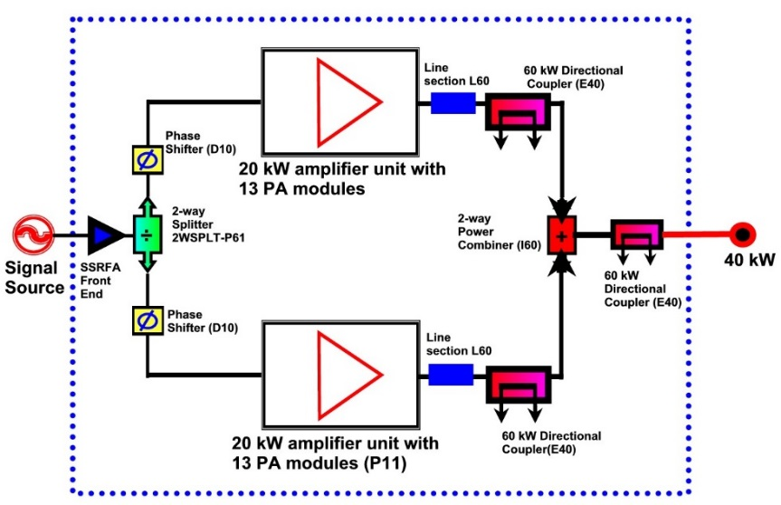
Design Plan Content
The design plan describes the pertinent aspects of the design that satisfy the requirements.
The design plan helps clarify the technical requirements and provides a platform for confirming that requirements are satisfied.
Example illustration from 650 MHz SSPA Design Plan.

Slide 9
ISD Content
The ISD defines the technical details of interfaces to external systems.
The ISD acts as the primary reference for information on pertinent component specifications.
Requirement # | Parameter | Value | Reference
I-ED0006360-E001 | Connection | 50Ω, N-type connector (F) on master rack panel for ½” flexible coaxial cable
I-ED0006360-E002 | Input Return Loss | -15 dB Max
I-ED0006360-E003 | Input drive for Max Power | 5 dBm Max
I-ED0006360-E004 | Input drive (before damage) | 15 dBm Max
I-ED0006360-E005 | Minimum RF Drive Pulse Length | 10 μs Min
Example table from 650 MHz SSPA ISD LLRF system parameters.

Slide 10
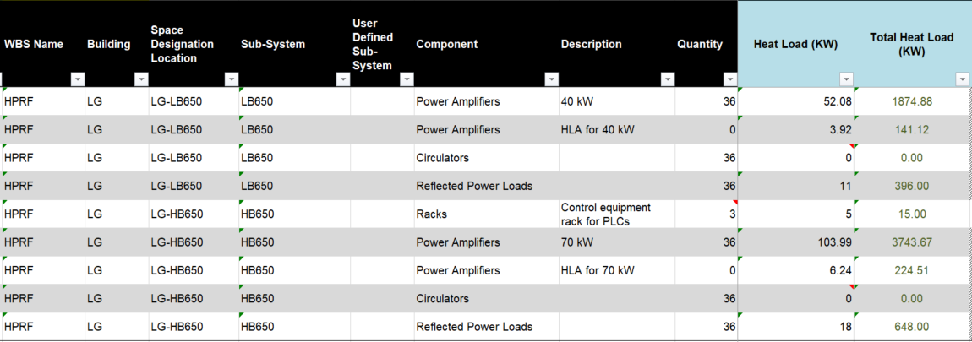
RDS Content
The RDS acts as an ISD document for building infrastructure.
This includes space, water cooling, AC power requests, and other items.
Example table of 650MHz amplifier parameters in RDS.

Slide 11
TRS Content
Example table of 650MHz amplifier TRS
TRS defines the detailed and numerical specifications required to create a system or component.
These requirements with the FRS should give a designer sufficient information to design the system or component independent of other systems.
Sr. | Parameter | Value
1 | Centre Frequency | 650 MHz
2 | Bandwidth @ 3 dB | ±2 MHz, 4 MHz minimum
3 | Peak power output (typical peak) | 44 kW CW Max
4 | Power output @ 1 dB compression | 40 kW CW
5 | Gain | 71 dB minimum, 40 kW output with +1 to +5 dBm drive
6 | Output VSWR Handling | 1.4:1 minimum
7 | Harmonics | -30 dBc, tested within 2 GHz bandwidth
8 | Spurious | -60 dBc including power supply modulation, tested within 2 GHz bandwidth
9 | Minimum RF Drive Pulse Length | 10 μs Min
10 | Input overdrive protection | +5 to +16 dBm range

Slide 12
PRD Requirements - Power
Power estimates based on cavity voltage and phase estimates from version-controlled lattice data from TraceWin simulation.
Nominal coupling defined by SRF but estimates allow for up to 25% variation in setting.
Distribution losses estimated at 10% and dynamic overhead is 15%.

Slide 13
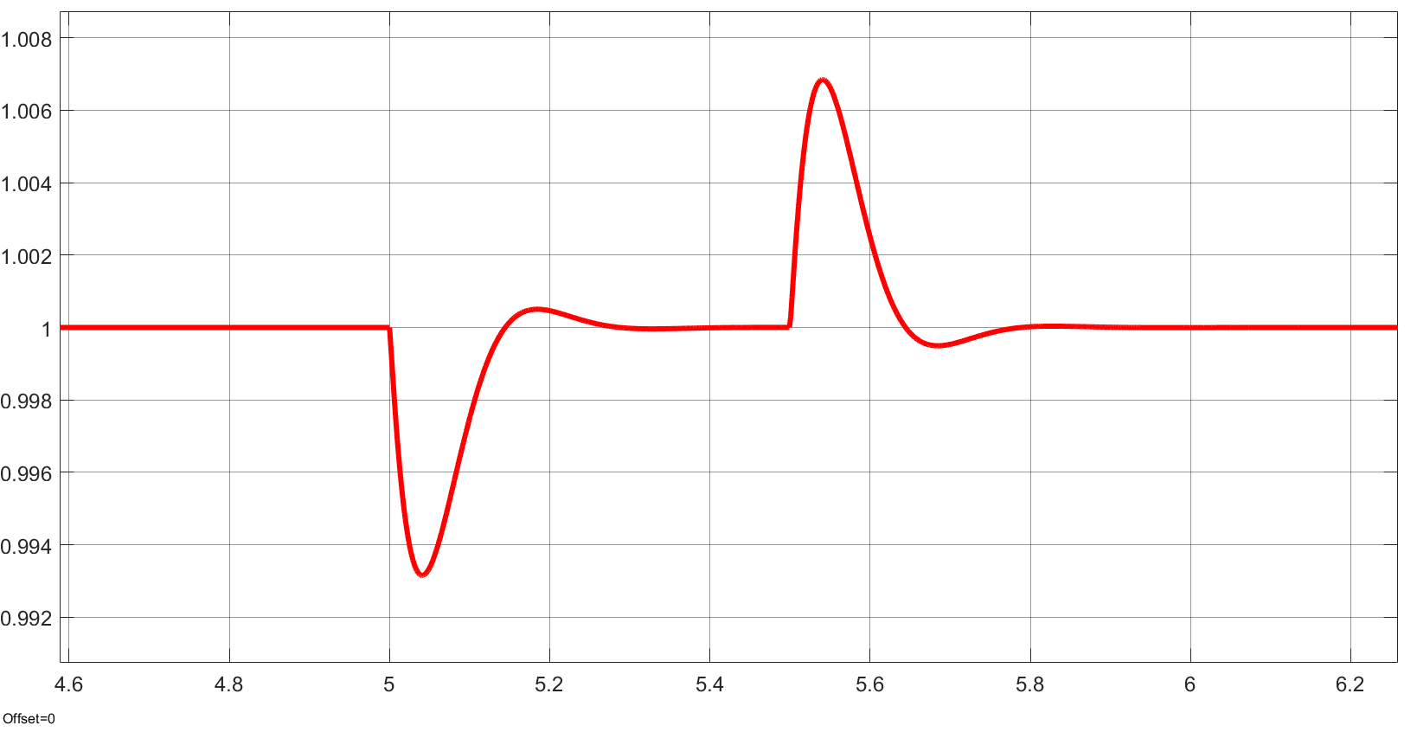
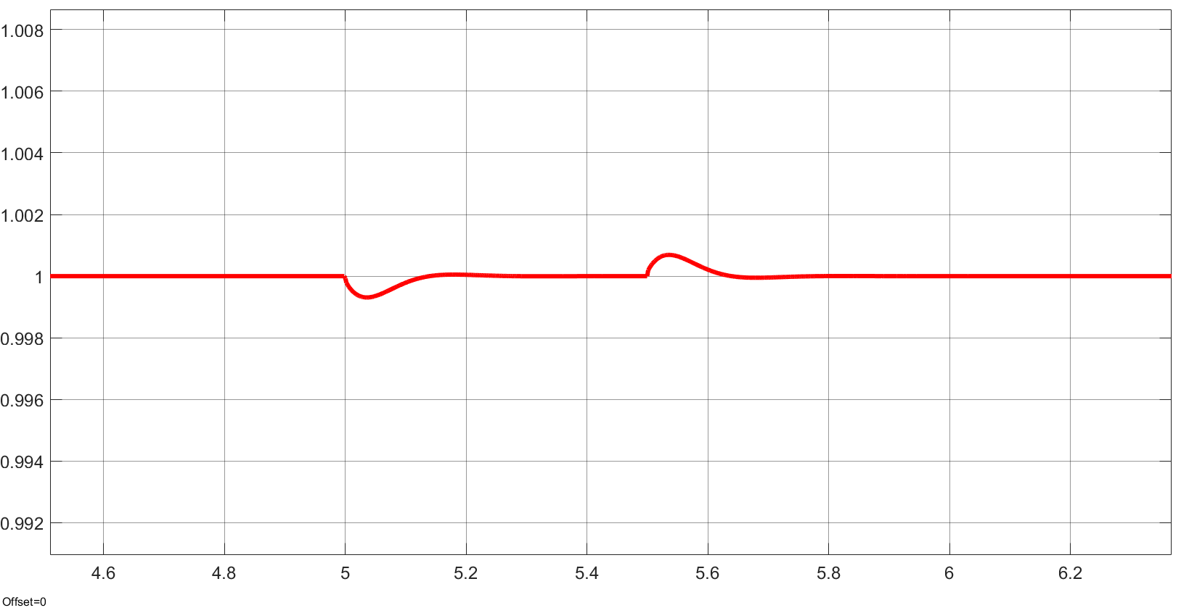
PRD Requirements – Beam Pulse – Feedforward
Relative gradient error no feedforward
Cavity gradient and phase stability specified to be better than 0.065%.
Top plot shows relative effect of beam pulse on cavity with only feedback applied. Gradient errors are 10x allowable deviation.
Bottom plot shows relative gradient with RF feedforward with 10% error in current matching.
Relative gradient error with feedforward

Slide 14
PRD Requirements - Specifications for Feedforward
For feedforward to deliver cavity gradient stability in the presence of a beam pulse, the current delivered to the cavity must match the beam within 10%.
The LLRF system is capable of timing the pulse and setting the amplitude, but the amplifier must have precise gain at the instant of the power request.
The minimum specified gain must still be maintained at the power request, or the feedback will not be able to correct errors in time.
The DC supplies must have a combination of sufficient stored energy and its own feedforward pulse to respond to the transistors’ demand for more power.

Slide 15
ISD Requirements - RDS
The gallery building design is being finalized, so the space, power, and cooling requirements need to be stable in the interface requirements.
RDS assumes that the amplifiers are running at 42% efficiency at the 1 dB compression point.
The large number of amplifiers for the linac dictate a high percentage of the power consumption and cooling load making this an important specification.
Output power used to calculate efficiency is contained in the fundamental frequency spectrum.
Excess noise figure and harmonics can have a negative affect on efficiency.

Slide 16
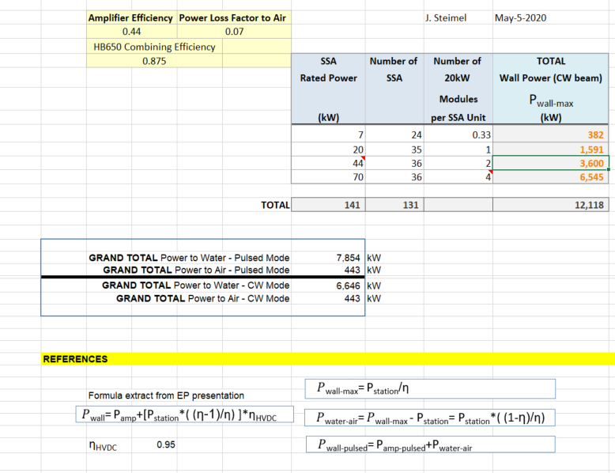
ISD Requirements - RDS
Sample RDS Parameters and Calculations

Slide 17
Workshop Presentations and Questions
The following documents will be reviewed in a “page flip” format in the following sessions.
RF Systems Physics Requirements Document
Are high level requirements captured in sufficient depth to accurately specify amplifier parameters?
650MHz Amplifier Functional Requirements Specifications
Are functional requirements complete?
Are sufficient standards listed?
650MHz Amplifier Interface Specifications Document
Are interfaces sufficiently identified?
650MHz Amplifier Technical Specifications Document
Do technical specifications trace from functional and interface specifications?
Are technical calculations accurate?
Are specifications verifiable as listed?

