Slide 1
PIP-II Straight Ahead Beam Absorber
Final Design Review
Nandhini Dhanaraj
18 May 2021

Slide 2
Outline
I. Introduction and Background Requirements Flow Down Beam Parameters II. Design Concept Design Criteria Iterative Design Process Optimized Design III. Thermal Design MARS Energy Deposition Data Finite Element Analyses Transient Thermal Time Averaged Steady State Thermal Thermal Stress without Pre-stress Thermal Stress with Pre-stress Transient Dynamic Analysis Overall Thermal Design Summary | III. Mechanical Design Shrink Fit Finned Plates, Hilman Rollers and Cover Window IV. Ancillary Items Installation and Fabrication Plans Quality Control Risk Assessment Cost V. Overall Summary

Slide 3
I. Introduction and Background

Slide 4
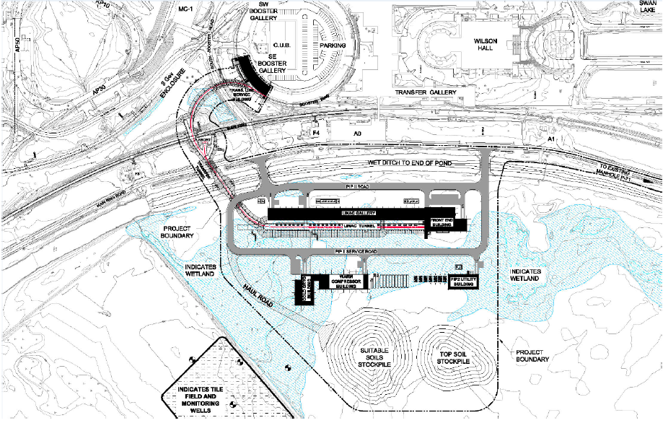
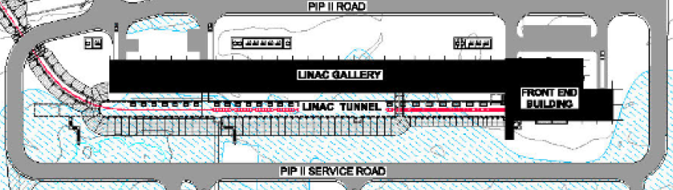
Site Map and Absorber Location
A
Single Absorber used at two locations: 400 W and 2 kW
Beam Direction
B
2 kW Location
400 W Location

Slide 5
Nomenclature
Beam Energy | Actual Average Beam Power | Beam Power used in Simulations
177 MeV | 190 W | 400 W
1 GeV | 1.13 kW | 2 kW
Nomenclature:
2 kW refers to an actual average beam power of 1.13 kW at a beam energy of 1 GeV. All analyses have been performed for the 2 kW data and will be referred to as such throughout these slides.
400 W refers to an actual average beam power of the 190 W at a beam energy of 177 MeV. All analyses have been performed for the 400 W data and will be referred to as such throughout these slides.
The absorbers are also referred to as “Straight Ahead Dump”, “Straight Ahead Absorber”, “Portable Absorber” and “Commissioning Absorber”

Slide 6
Requirements Flow Down
The relevant design requirements for the portable absorber flow down from the Technical Requirements Specification (Project Teamcenter Doc. # ED0011432) and are listed below:
Requirement # | Requirement Statement
T-121.05.02.03-A001 | Both absorbers shall operate for at least 10 years.
T-121.05.02.03-A004 | The 2 kW portable Absorber shall be able to operate without active beam sweeping and water cooling.
T-121.05.02.03-A005 | Both absorbers shall provide enough shielding to prevent surface and ground water contamination.
T-121.05.02.03-A006 | Both absorbers shall provide enough shielding to minimize the residual radiation.
T-121.05.02.03-A010 | The 2 kW absorber shall be able to absorb up to 1.13 KW of 1 GeV LINAC beam for 4 hrs.
T-121.05.02.03-A011 | The 2 kW absorber shall be safely exposed to 4.2E18 H-/year at its final location.
T-121.05.02.03-A012 | The 2 kW absorber shall be safely exposed to 2.0E18 H-/year at the 177 MeV location.

Slide 7
Beam Parameters
Table capturing the major Beam Parameters
Particle Species | H-
LINAC Pulse Duration | 0.55 msec
Repetition Rate | 1 Hz
Maximum Duty Factor | 0.055%
Beam Spot Size | Beam Sigma 2.5 mm
Beam Kinetic Energy | 1 GeV | 177 MeV
Actual Average Beam Power | 1.13 kW | 190 W
Average Beam Power used in Analyses | 2 kW | 400 W
Reference:
PIP II Straight Ahead Dump Requirements and Specifications, I. Kourbanis, 07/20/20

Slide 8
II. Design Concept

Slide 9
Design Criteria
The following are the criteria used for the design of the absorber
The absorber shall satisfy the requirements of absorbing the beam as stated in the TRS (Technical Requirements Specification)
Shall be designed to have provisions to efficiently remove the heat load from the beam energy deposition
Shall be designed to have adequate shielding to limit the residual radiation levels to ALARA
The core material’s temperature shall be below its oxidation levels

Slide 10
Material Selection
Based on the design criteria, Graphite was chosen to serve as the core of the absorber due to the following properties it exhibits.
Low atomic number (Z=6) and low mass density (1820 kg/m^3) to absorb the beam, reduce interactions and limit residual radiation
High melting point (~3000 C) to withstand the thermal load from the beam
High oxidation temperature (~450 C)
Good thermal shock resistance

Slide 11
Iterative Design Process
Propose a Conceptual Design
Perform MARS Simulations
Propose an optimized design
Propose a re-design
Perform Thermal Simulations (FEA)
Is the design acceptable?
If Room available for Optimization
No
Yes
Design Complete

Slide 12
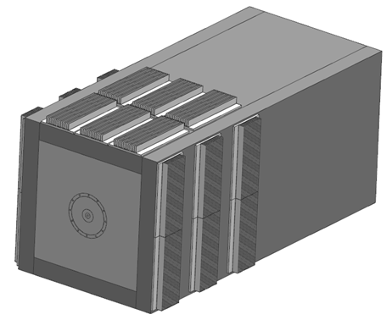
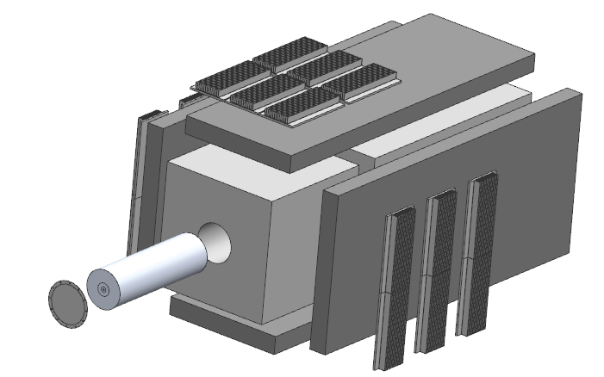
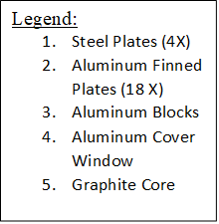
Optimized Design
1
3
2
3
1
4
5
Component/Part | Nominal Dimensions
Graphite Core (2 segments) * | OD 152.4 mm X 254 mm L
Aluminum Block | Center Bore Dia. 152.4 mm X 480 mm Sides X 1400 L
Steel Plates Top and Bottom (2 Nos.) | 480 mm W X 1400 L X 70 mm Thick
Steel Plates Sides (2 Nos.) | 620 mm W X 1400 L X 70 mm Thick
Aluminum Finned Plates (18 Nos.) | 152.4 mm W X 300 mm L X 40 mm Thick
* Graphite core in 2 segments due to limitations in size availability and to facilitate shrink fit

Slide 13
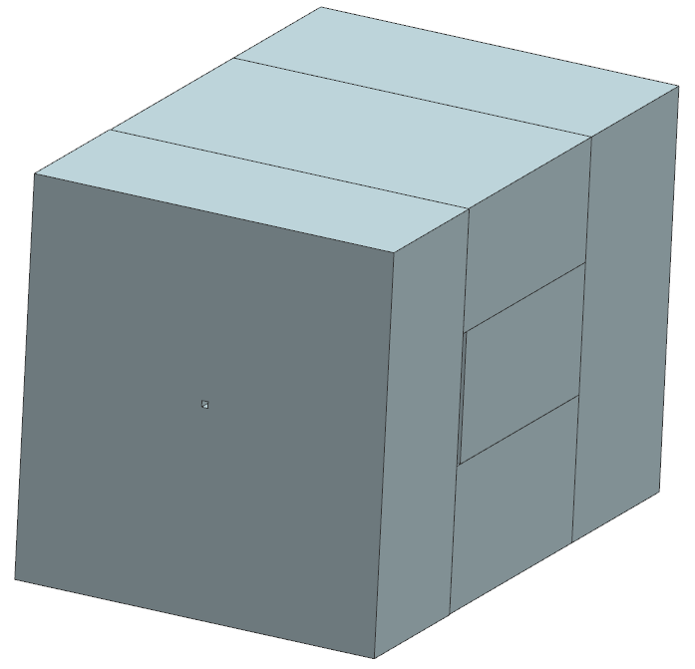
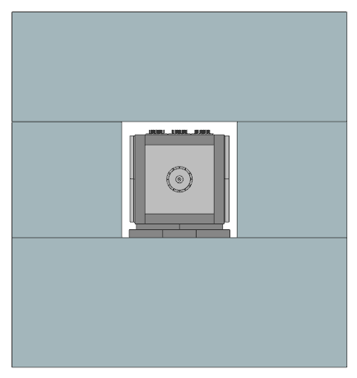
Integrated Model of 2 kW with Concrete Shielding
3539.4 mm
Concrete
2469.8 mm
Hilman Rollers between Absorber and Base Plate
2326.8 mm
Steel Base Plate
Aluminum Cover Window over the Graphite Core
Beam Pipe Slot

Slide 14
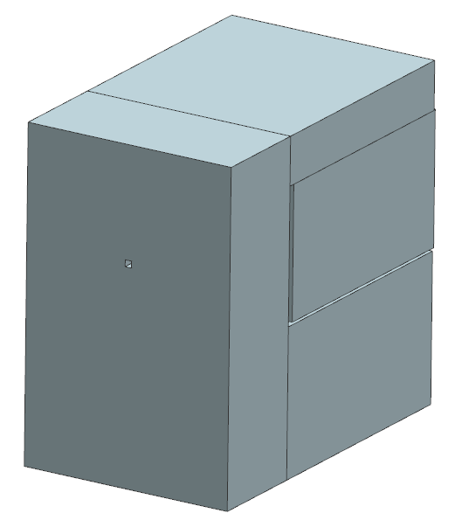
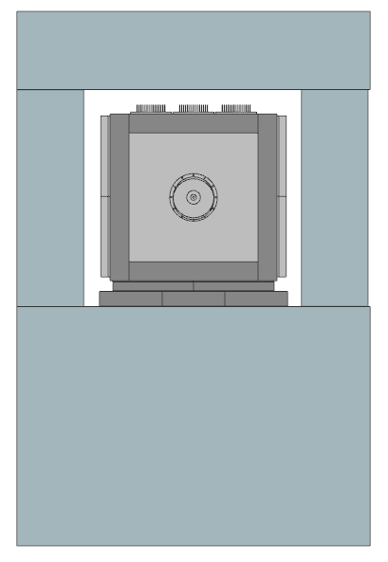
Integrated Model of 400 W with Concrete Shielding
2140.4 mm
Concrete
1998 mm
Hilman Rollers between Absorber and Base Plate
1313 mm
Beam Pipe Slot
Steel Base Plate
Aluminum Cover Window over the Graphite Core

Slide 15
II. Thermal Design – MARS Data

Slide 16
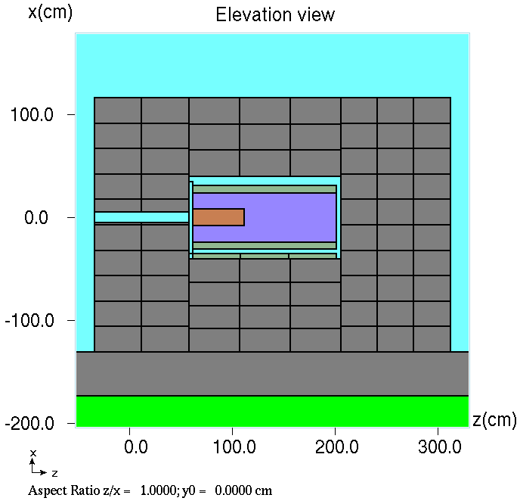
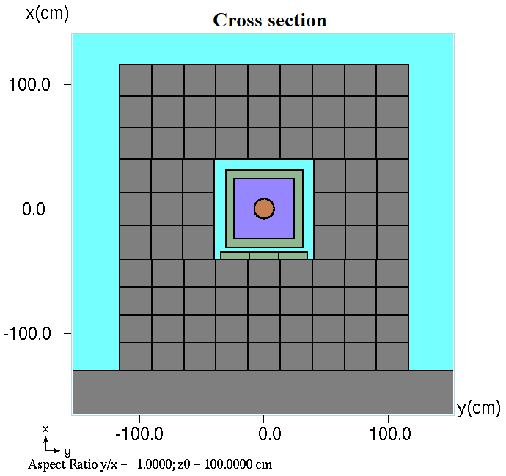
MARS Model for the 2 kW Absorber
Image Courtesy: Igor Rakhno

Slide 17
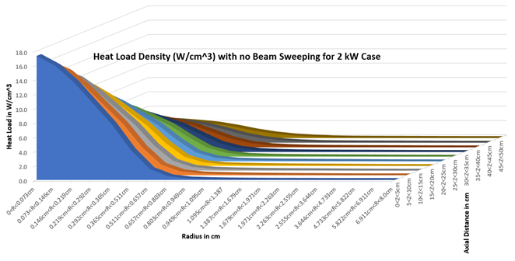
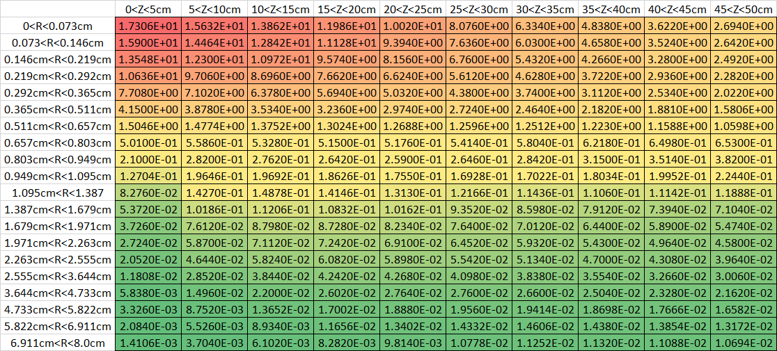
MARS Energy Deposition Data for 2 kW Absorber
Peak Heat Load Density at 2 kW: 17.31 W/cm^3

Slide 18
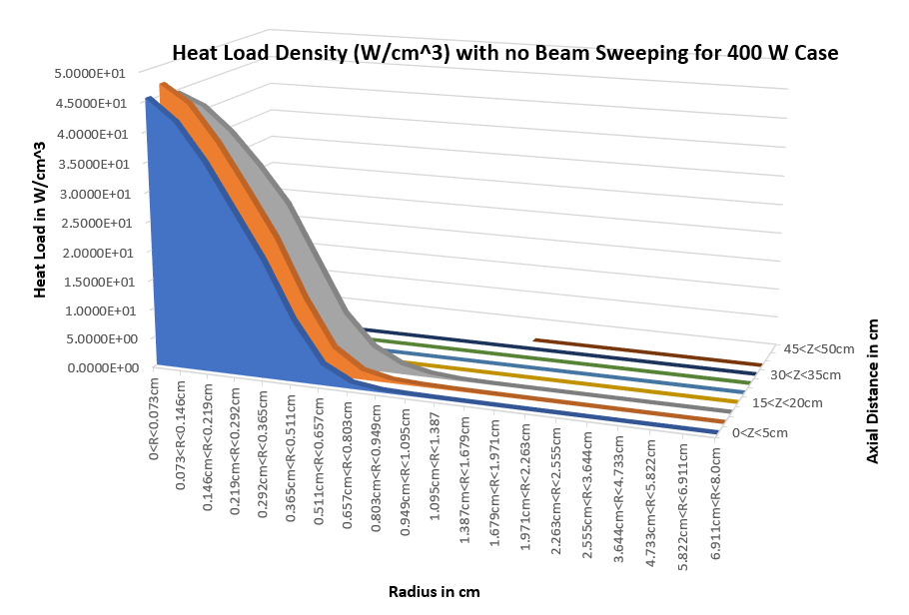
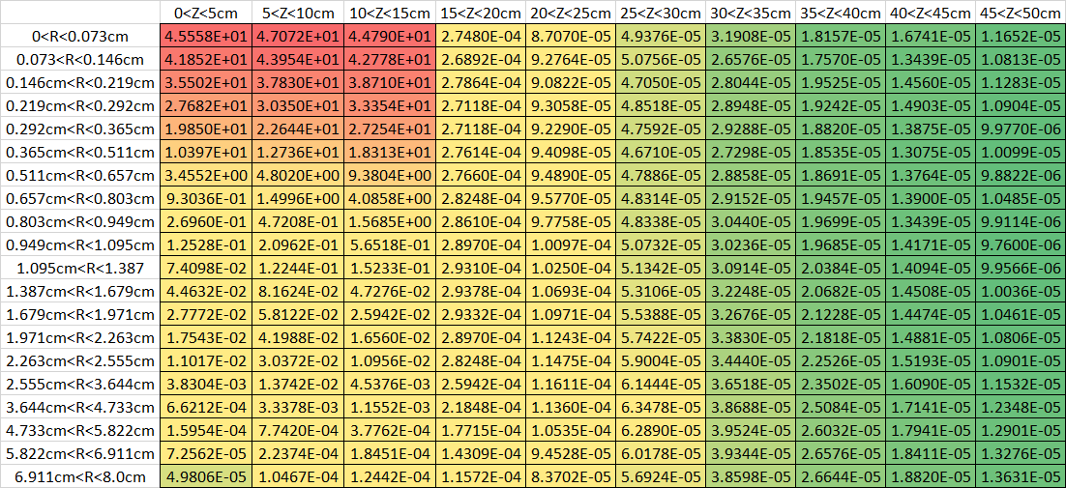
MARS Energy Deposition Data for 400 W Absorber
Peak Heat Load Density at 400 W: 47.1 W/cm^3

Slide 19
Summary of Heat Deposition in the Absorber Assembly
Component | Heat Load Deposited for 2 kW Location (W) | Heat Load Deposited for 400 W Location (W)
Graphite Core | 467.1 | 377.5
Aluminum Block | 892.1 | 2.8
Steel Casing | 176.8 | 1.7
Steel Plate at the Bottom | 13.4 | 0.25
All Concrete | 191.2 | 2.1
Total | 1741 W | 384.4 W
Peak Heat Load Density for Graphite Core | 17.31 W/cm^3 | 47.1 W/cm^3
“The difference in the peak heat loads densities between the 2 kW and 400 W absorber is attributed to the fact that at lower energies, the peak local energy deposition is usually higher at the beginning, but loses energy at a faster rate, whereas in the case of higher energies, the particles can travel longer distances without losing much energy”, Igor Rakhno, 12/30/2020.

Slide 20
II. Thermal Design -
Finite Element Analyses

Slide 21
Material Properties
Material | Thermal Conductivity (W/m-K) | Density (Kg/m^3) | Yield/Ultimate/Compressive Strength (MPa) | Used on
Graphite – TM Grade | 60 | 1820 | Negligible / 41 / 110 | Absorber Core
Aluminum 6061-T6 | 167 | 2700 | 280 / 310 / 280 | Aluminum Block encasing the Graphite core and Fin Assembly
Structural Steel | 60 | 7850 | 250 / 460/ 250 | Steel Casing around Aluminum Block and Base Plate
Stainless Steel | 15.1 | 7750 | 207 / 586 / 207 | Hilman Rollers
Concrete | 0.72 | 2300 | Negligible / 5 / 41 | Shielding around Absorber
Air | 0.026 | 1.2 | Not Applicable | Air Gaps

Slide 22
Contact Conditions
Contact Source | Contact Target | Type of Joint | Contact Condition | TCC estimated using formulas (W/m^2-K) | TCC used in the Analyses (W/m^2-K)
Graphite Core outer surface | Aluminum Block inner surface | Interference fit of .01 inch | Bonded | 1.7e5 | 1000 [Appendix B], [7], [8]
Aluminum Block | Structural Steel Plates on all sides (4 plates in total) | Bolted with .75 inch bolt | Bonded | >1000 | 1000 [Appendix B], [7]
Structural Steel Plates | Structural Steel Plates | Bolted with .75 inch bolt | Bonded | >1000 | 1000 [Appendix B], [7]
Structural Steel Base Plate | Concrete Bottom | Self-Weight | Bonded | N/A | 10 (corresponds to an air gap of .10 inch or 2.6 mm)
Aluminum Window | Aluminum Block | Bolted | Bonded | N/A | 50 (corresponds to an air gap of .02 inch or 0.52 mm)
Aluminum Fins | Structural Steel Plates | Bolted | Bonded | N/A | 50 (corresponds to an air gap of .02 inch or 0.52 mm)
Graphite Core | Aluminum Cover Window | Contact | Bonded | N/A | 10 (corresponds to an air gap of .10 inch or 2.6 mm)

Slide 23
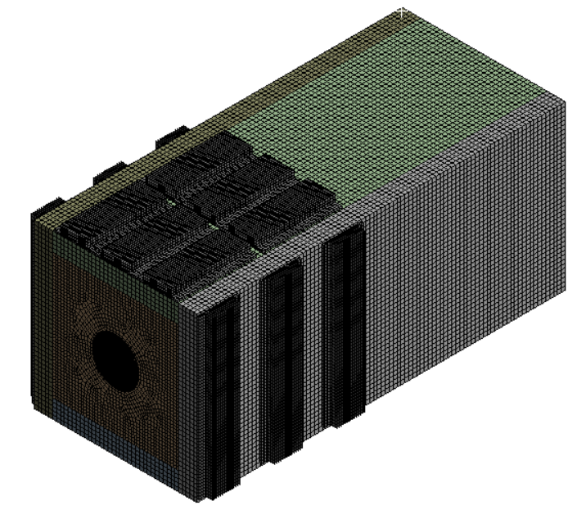
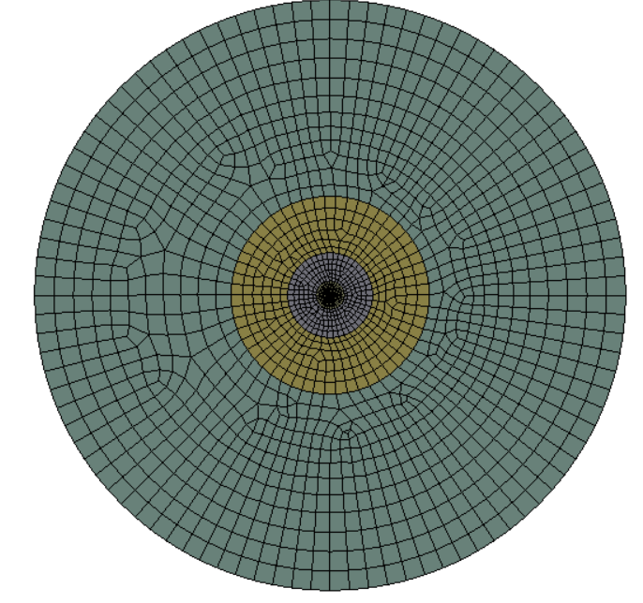
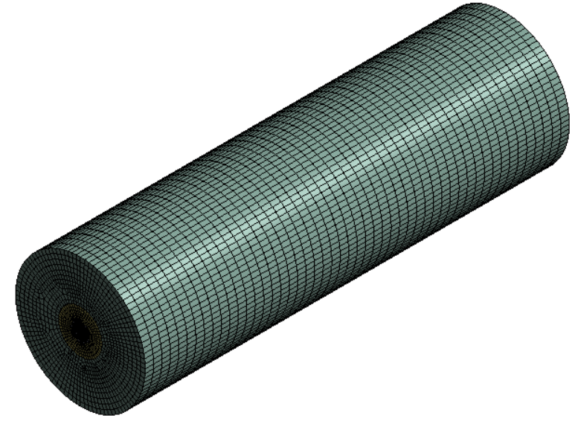
Meshed Model
A
Absorber Assembly
B
Graphite Face
Mesh Statistics for Absorber Assembly, A:
No. of Elements: 492093
No. of Nodes: 2202214
C
Graphite Core

Slide 24
Boundary Conditions - Heat Transfer Coefficients
The cooling scheme for the absorbers was chosen to be natural air convection. The following table provides the comparison between the typical heat transfer coefficients available in literature for natural stagnant air convection (optimistic) and the nominal heat transfer coefficients used in the analyses.
Location | Optimistic Heat Transfer Coefficient (W/m^2-K) | Nominal Heat Transfer Coefficient (W/m^2-K)
Outer surfaces/perimeter of Absorber not including the Fins | 5 | 3
Concrete inner walls around Absorber | 5 | 3
Concrete outer walls | 5 | 3
Fin gaps | 3 | 2 (0.5 – 1.5^{*)}
Outer surface of beam window | 5 | 3
Beampipe Slot | 3 | 2
Base Plate Steel | 5 | 3
* As a reference, NuMI Stripline measurements were 2 W/m^2-K for an air gap of 3/8 inch

Slide 25
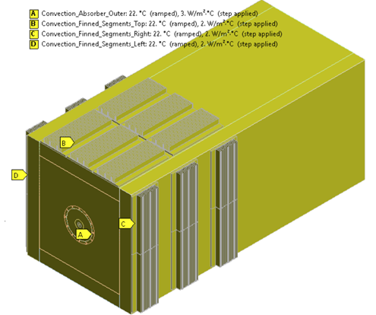
Boundary Conditions - Heat Transfer Coefficients (contd.)

Slide 26
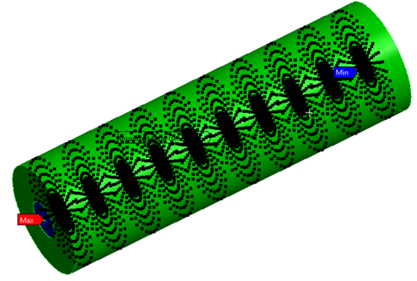
Heat Loads
Image of Beam Energy Deposition mapped from MARS to ANSYS Model for Graphite core
Data points generated using MATLAB code

Slide 27
Transient Thermal at Average Beam Power

Slide 28
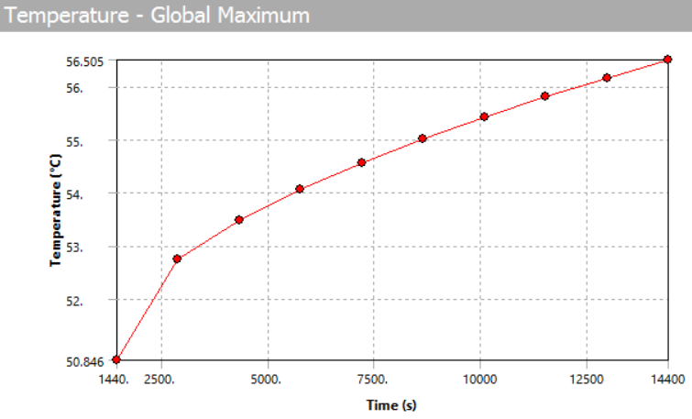
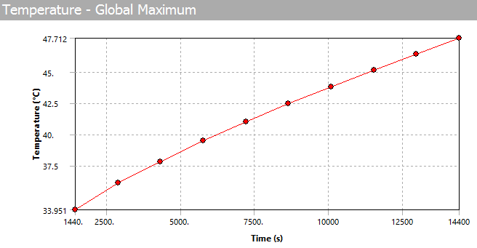
Transient Analysis with Time Averaged Beam Power
Goals:
Estimate time required for Absorber to attain steady state
Estimate temperature attained for 4 hours of continuous operations
Estimate max. temperatures attained as a function of time and compare to allowable
Results:
400 W Results | 2 kW Results
Max. Temperature Plot for 4 hours of avg. power in the Graphite core: 56.51 C | Max. Temperature Plot for 4 hours of avg. power in the Graphite core: 47.71 C

Slide 29
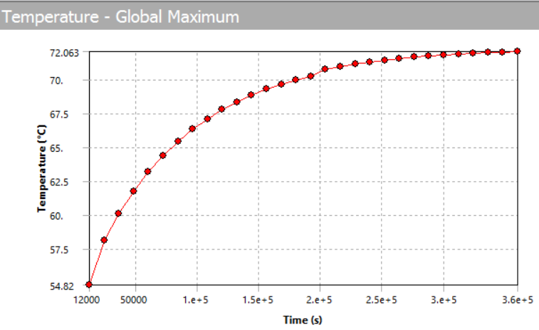
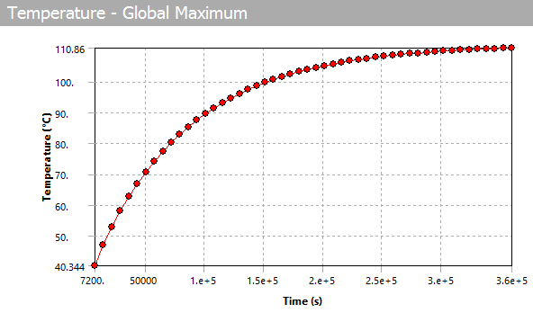
Transient Analysis with Time Averaged Beam Power (contd.)
400 W Results | 2 kW Results
Max. Temperature Plot for 100 hours of avg. power in the Graphite core: 72.063 C | Max. Temperature Plot for 100 hours of avg. power in the Graphite core: 110.86 C

Slide 30
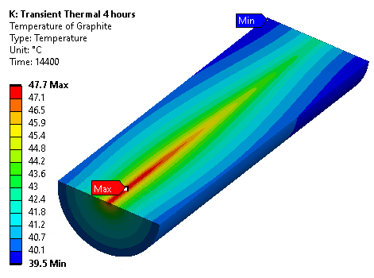
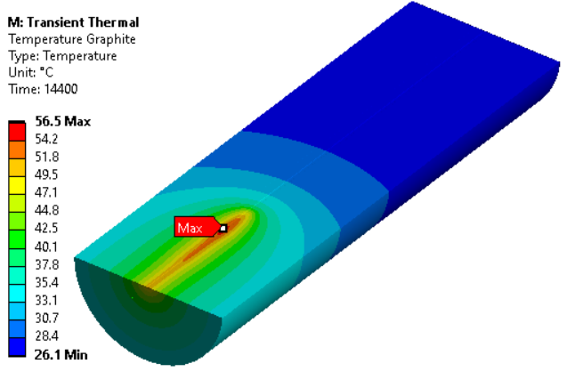
Transient Analysis with Time Averaged Beam Power (contd.)
400 W Results | 2 kW Results
Max. Temperature Plot for 4 hours of avg. power in the Graphite core: 56.5 C | Max. Temperature Plot for 4 hours of avg. power in the Graphite core: 47.7 C

Slide 31
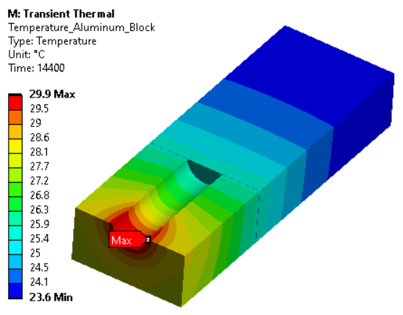
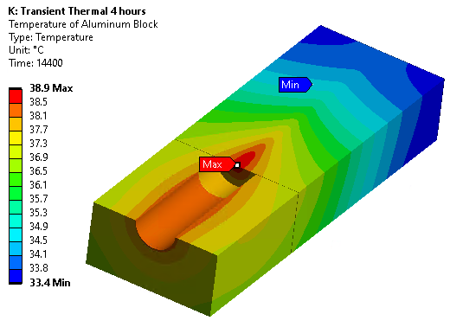
Transient Analysis with Time Averaged Beam Power (contd.)
400 W Results | 2 kW Results
Max. Temperature Plot for 4 hours of avg. power in the Aluminum Block: 29.9 C | Max. Temperature Plot for 4 hours of avg. power in the Aluminum Block: 38.9 C

Slide 32
Transient Analysis with Time Averaged Beam Power (contd.)

Slide 33
Summary - Transient Analysis with Time Averaged Beam Power
Time estimated for absorber to attain steady state for both absorbers 400 w and 2 kW ~ 100 hours
After 4 hours of continuous operation, max. temperature for Graphite core
  400 W case = 56.51 C
  2 kW case = 47.71 C
Aluminum block temperatures well below 100 C. No concern of creep, stress relaxation and loss of temper grade

Slide 34
Steady State Thermal Analyses

Slide 35
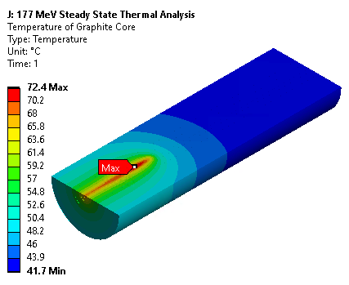
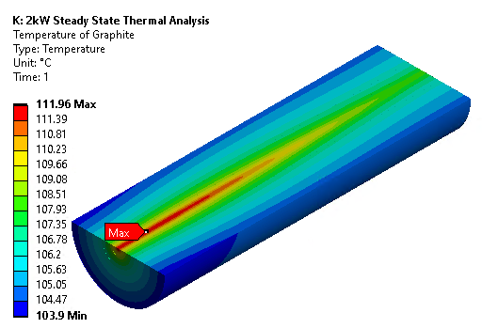
Steady State Thermal Analyses
Goals:
Estimate the steady state temperatures of absorber components
Compare results with previous Transient thermal time averaged analysis
Compare the reaction probe heat load to MARS data and Scoping calcs.
Results:
400 W Results | 2 kW Results
Max. Temperature at Steady State in the Graphite core: 72.4 C (compared to 72.1 C from previous Transient) | Max. Temperature at Steady State in the Graphite core: 111.96 C (compared to 110.9 C from previous Transient)

Slide 36
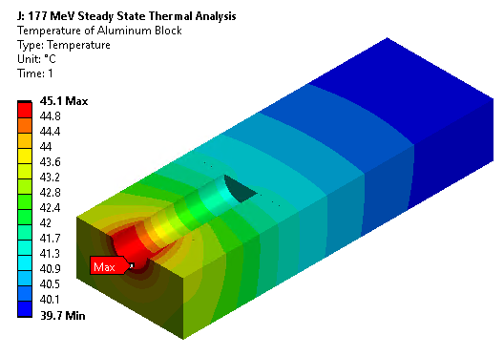
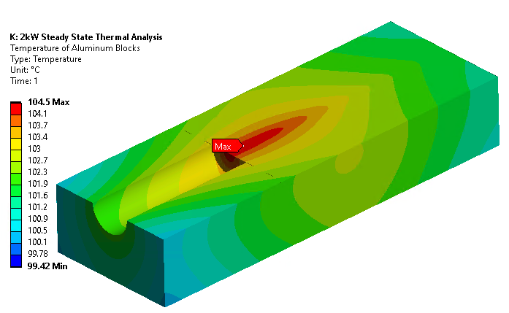
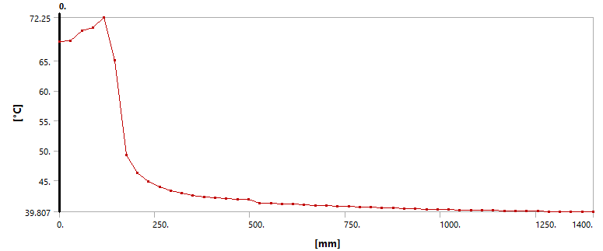
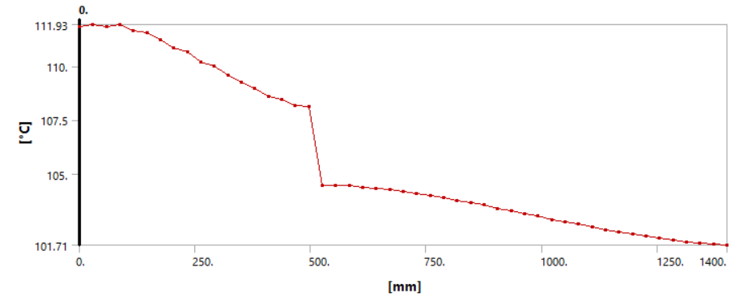
Steady State Thermal Analyses (contd.)
400 W Results | 2 kW Results
Max. Temperature at Steady State in the Aluminum Block: 45.1 C | Max. Temperature at Steady State in the Aluminum Block: 104.5 C
Temperature Profile Axial Path
Temperature Profile Axial Path

Slide 37
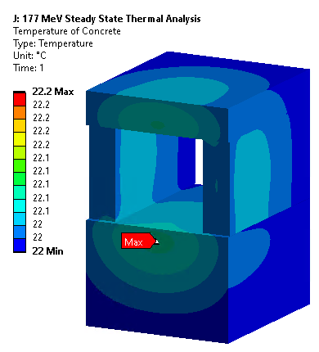
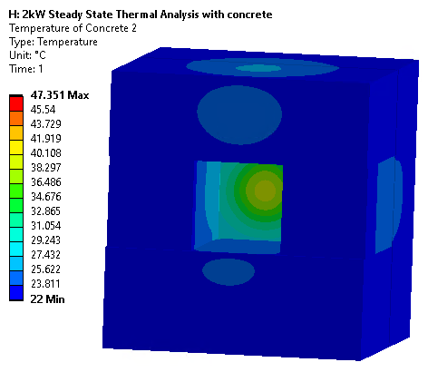
Steady State Thermal Analyses (contd.)
400 W Results | 2 kW Results
Max. Temperature at Steady State in the Concrete Shielding (except front): 22.2 C | Max. Temperature at Steady State in the Concrete Shielding (except front): 47.351 C

Slide 38
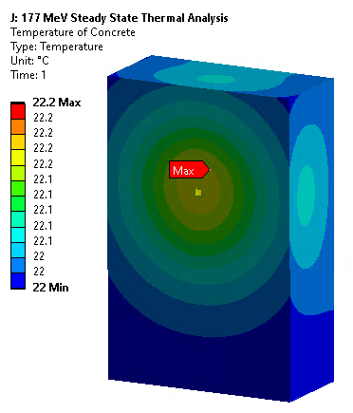
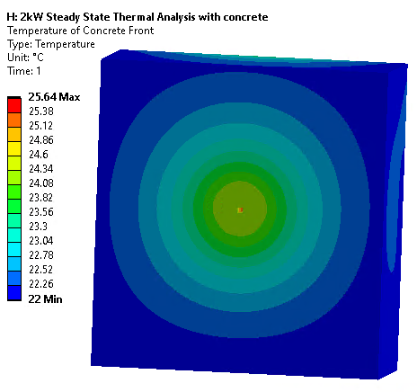
Steady State Thermal Analyses (contd.)
400 W Results | 2 kW Results
Max. Temperature at Steady State in the Front Concrete Shielding: 22.2 C | Max. Temperature at Steady State in the Front Concrete Shielding: 25.64 C

Slide 39
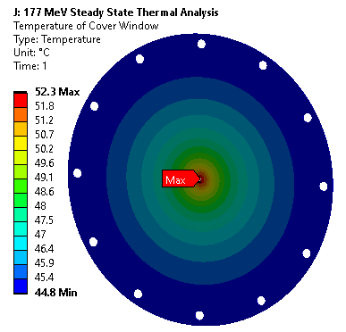
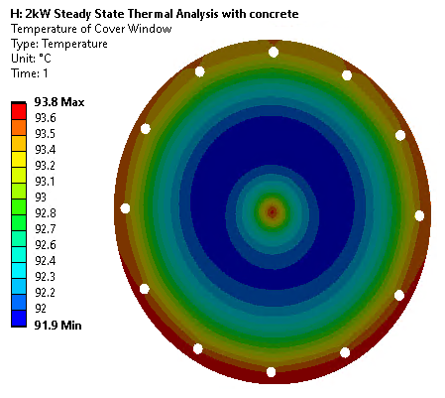
Steady State Thermal Analyses (contd.)
400 W Results | 2 kW Results
Max. Temperature at Steady State in the Aluminum Cover Window: 52.3 C | Max. Temperature at Steady State in the Front Concrete Shielding: 93.8 C

Slide 40
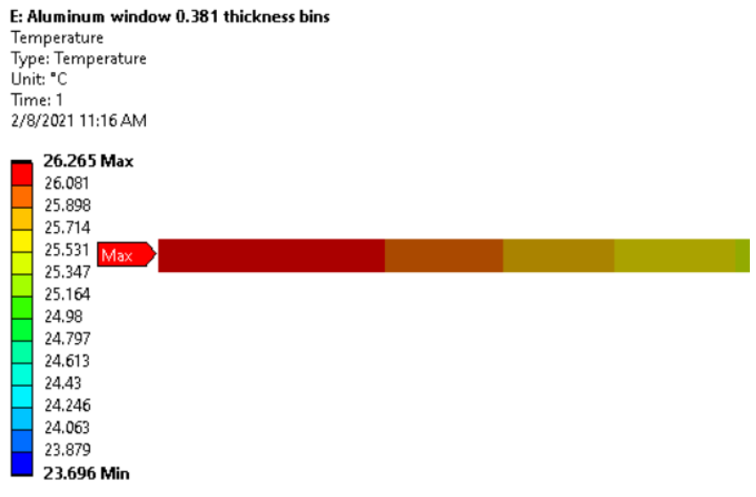
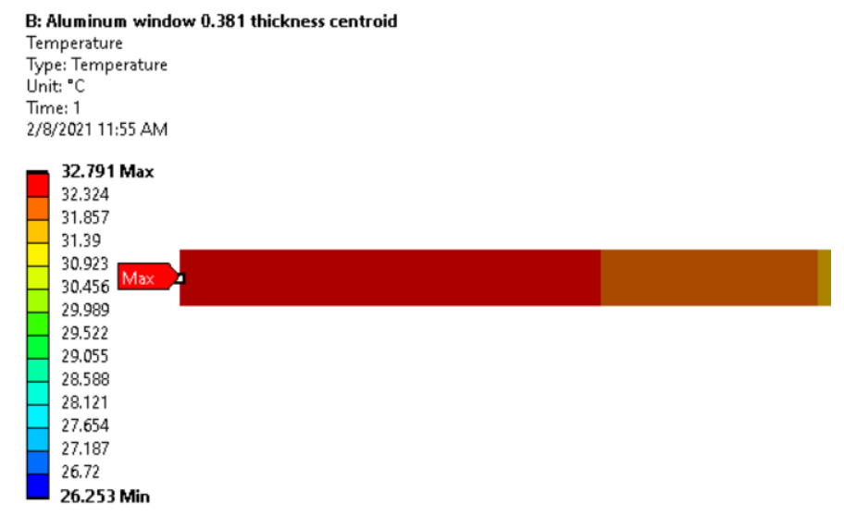
Cover Windows Analysis
2 kW Case
400 W Case

Slide 41
Steady State Thermal Analyses with Average Power (contd.)
400 W Results | 2 kW Results
Reaction Load Comparison: | Reaction Load Comparison:

Slide 42

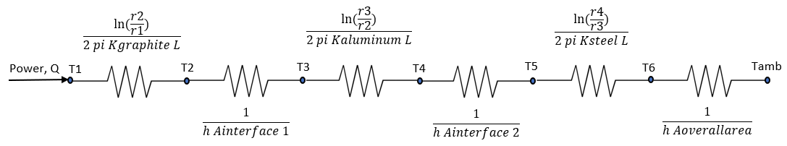
Scoping Calculations – Thermal Resistance Network
Assumptions:
Heat deposition was only considered in the initial 150 mm length of the model, as this was the peak region for the energy deposition from MARS
Thermal gradients only in the radial direction
The Aluminum block and Steel plates were also considered to be cylindrical
The beam spot radius considered was one sigma, i.e. 2.5 mm
The convective coefficient used was 3 W/m^2-K
Only linear material properties, i.e. no temperature dependent properties
No finned plates were considered
Steel Radius, r4
Aluminum Radius, r3
Graphite Radius, r2
Beam Spot Radius, r1

Slide 43






Scoping Calculations (contd.)
Resistance | Values (K/W) | Location
 | 0.065 | In Graphite core
 | 0.0139 | Interface between Graphite and Aluminum, TCC = 1000 W/m^2-K
 | 0.0073 | In Aluminum (wall thickness 163.8 mm)
 | 0.0044 | Interface between Aluminum and Steel, TCC = 1000 W/m^2-K
 | 0.0045 | In Steel (plate thickness 70 mm)
 | 1.14 (0.896, de-rated for shape) | To ambient
$$\frac{ln⁡(\frac{r2}{r1})}{2 pi Kgraphite L}$$
$$\frac{1}{h Ainterface 1}$$
$$\frac{ln⁡(\frac{r3}{r2})}{2 pi Kaluminum L}$$
$$\frac{1}{h Ainterface 2}$$
$$\frac{ln⁡(\frac{r4}{r3})}{2 pi Ksteel L}$$
$$\frac{1}{h Aoverallarea}$$

Slide 44
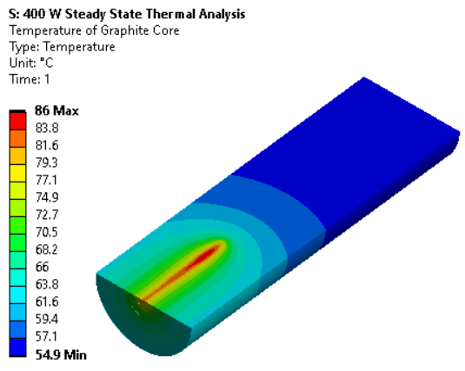
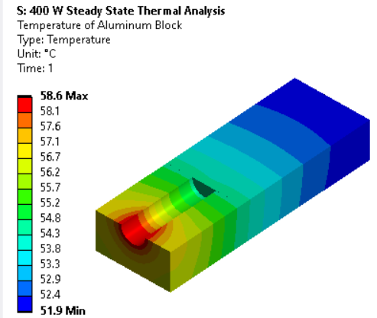
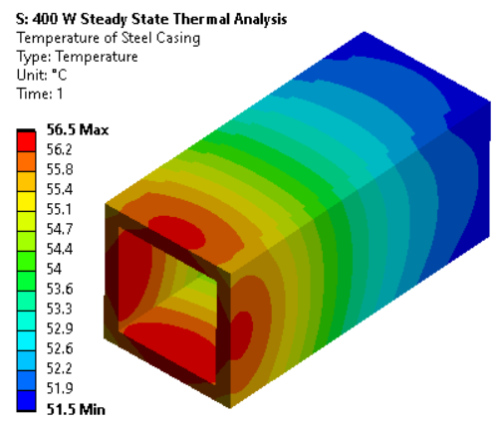
Scoping Calculations
Thermal Resistance Network results
Temperature difference (deltaT) from Thermal network calculations = 58 C
Temperature difference (deltaT) from ANSYS simulations = 64 C
Percentage difference between ANSYS and Hand Calculations ~ 10%

Slide 45
Summary – Steady State Thermal Analysis
Steady state max. temperatures for absorber components estimated
Max. temperature of Graphite core matches very well with temperatures estimated from the previous Transient analysis
Reaction probe results from FEA agrees very well with MARS heat load data. Smaller differences are only conservative
Thermal resistance network results agree within 10% of ANSYS results

Slide 46
Summary – Steady State Thermal Analysis (contd.)
Observed the effect of peak power density being greater in the 400 W case compared to the 2 kW case (slide 18 for reference)
Effect of Thermal Contact Conductance characterized by temperature jumps observed in results

Slide 47
Thermal Stress Analyses – No Pre-Stress

Slide 48
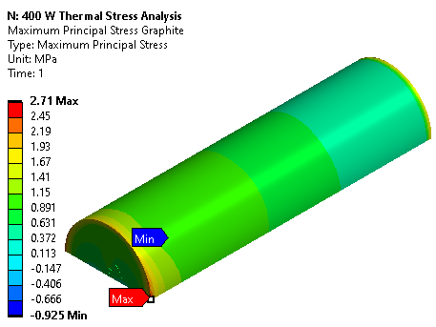
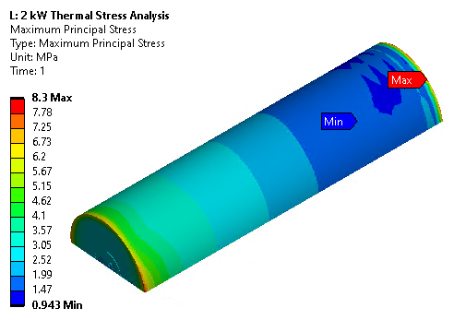
Thermal-Stress Analysis with no Pre-stress
Goals:
Analyze stress states in absorber components due to difference in CTE (Coefficient of Thermal Expansion)
Verification of failure criteria and comparison of results to allowable
Estimation of safety factors
Results:
400 W Results | 2 kW Results
Maximum Principal Stress in Graphite: 2.71 MPa | Maximum Principal Stress in Graphite: 8.3 MPa

Slide 49
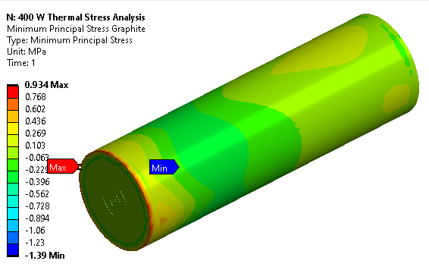
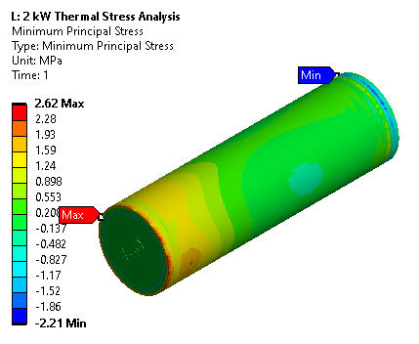


Thermal-Stress Analysis with no Pre-stress (contd.)
400 W Results | 2 kW Results
Minimum Principal Stress in Graphite: -1.39 MPa Maximum Von-Mises Stress in Aluminum: 22.3 MPa | Minimum Principal Stress in Graphite: -2.21 MPa Maximum Von-Mises Stress in Aluminum: 46.5 MPa

Slide 50


Thermal-Stress Analysis with no Pre-stress (contd.)
400 W Results | 2 kW Results
Mohr-Coulomb Criteria for Graphite Core: Max. of 0.066 | Mohr-Coulomb Criteria for Graphite Core: Max. of 0.2

Slide 51
Thermal-Stress Analysis with no Pre-stress (contd.)
Component |  | 400 W case |  | 2 kW case |  | Allowables
 |  | 4 hours of continuous operation | 100 hours of continuous operation | 4 hours of continuous operation | 100 hours continuous of operation
Graphite | Maximum Principal Stress in MPa | 2.71 | 15.4 | 8.3 | 69.3 | Graphite Ultimate: 41 MPa
 | Safety Factor | 15 | 2.7 | 5 | 0.6
Graphite | Mohr-Coulomb Stress Ratio | 0.066 | 0.2 | 0.2 | 0.88 | Stress Ratio <1
 | Safety Factor | 15 | 5 | 5 | 1.14
Aluminum 6061-T6 | Von Mises Stress in MPa | 22.3 | 76.1 | 46.5 | 253 | Aluminum Yield: 280 MPa
 | Safety Factor | 12.6 | 3.7 | 6 | 1.1

Slide 52
Summary - Thermal-Stress Analysis with no Pre-stress
Stress states of absorber components have been studied. All stresses for 4 hours operation scenario are within safe limits.
Von Mises criteria and Mohr-coulomb criteria applied to Aluminum block and Graphite core, respectively. For 4 hours operation scenario, no failure is predicted. For 100 hours the Graphite may fail due to differential thermal stresses.
Good safety factors have been achieved through design for 4 hours operation case

Slide 53
Thermal Stress Analyses – with Pre-Stress and Thermal Condition

Slide 54


Thermal-Stress Analysis with Pre-stress
Goals:
Analyze stress states including effect of Shrink fit, applying Thermal Condition (uniform temperature in each component)
Results:
2 kW Case, 4 hours Results | 2 kW Case, 100 hours Results
Normal Stress in Graphite: -11.9 to -19.33 MPa | Normal Stress in Graphite: 2.43 to -16.21 MPa

Slide 55

Thermal-Stress Analysis with Pre-stress (contd.)
20 MPa
Shrink Fit Interfacial Pressure
Interference, Radial | delta | 0.005 | inch
 |  | 0.127 | mm
Radius Graphite Core | ri | 0
 | R | 76.2 | mm
 |  | 3 | inch
Radius of Aluminum Jacket | ro | 240 | mm
 |  | 9.448819 | inch
Elastic Modulus Graphite | Ei | 1.45E+04 | MPa
Poisson's Ratio of Graphite | vi | 0.17
Elastis Modulus of Aluminum 6061-T6 | Eo | 6.89E+04 | MPa
Poisson's ratio of Al 6061-T6 | vo | 0.33
Denominator LHS |  | 2.26E-05
Denominator RHS |  | 5.72E-05
Full denominator |  | 6.08E-03
Interfacial Pressure | p | 2.09E+01 | MPa

Slide 56
Summary - Thermal-Stress Analysis with Pre-stress
The stress state in absorber due to shrink-fit has been modeled and analyzed. After 4 hours of operation, the shrink fit still holds up good and loses about 20% on average.
It is not recommended to operate the absorber for 100 hours continuous

Slide 57
Transient Dynamic Analyses

Slide 58


Transient Dynamic Analysis
Boundary Conditions for the Axisymmetric Graphite Core: Thermal and Structural
Goals:
Study the thermal stress waves
Estimate Fatigue Life
Analysis Setup:
Model consisted of Graphite core only
Heat load of single pulse at peak power of the beam
Element size used 100 microns
Time stepping of 10 ns for structural part

Slide 59
Transient Dynamic Analysis Results
The normal stress (X-direction) of the center node was plotted in the graph shown below
Parameter | Result
Maximum Stress σmax, MPa | 3.024
Minimum Stress σmin, MPa | 1.97
Stress Amplitude σa, MPa | 0.527
Mean Stress σm, MPa | 2.497
Stress Ratio (σmin/σmax) R | 1.54
Amplitude Ratio (σa/σm) A | 0.211

Slide 60
Fatigue Considerations
Maximum stress for fatigue estimated using deltaT from single pulse (14 C) following 4 hours operation where max. temp ~48 C
Maximum stresses from thermal conditions estimated using formula shown below and calculated to be 3.024 MPa:
Minimum stress estimated from temperature at end of 4 hours, it was assumed that the temperature would drop down to 48 C before subsequent pulse

Slide 61

Fatigue Considerations (contd.)
Temperature Rise in the Graphite Core from a Single Beam Pulse
Temperature in C
Time in seconds

Slide 62

Fatigue Considerations (contd.)
Normalized Applied Stress is 0.45 at Nf = 10^7 Cycles
The plot is for IG-110 Graphite, which has a fatigue life of 10^7 cycles at a normalized applied stress of 0.45. The normalized applied stress for the 2 kW absorber is 0.124.

Slide 63
Fatigue Considerations (contd.)
Fatigue plots of IG-110 Graphite used from available literature. Ultimate stress is 24.4 MPa compared to the 41 MPa of Graphite TM grade.
The normalized applied stress for IG-110 Graphite for same loading conditions analyzed is 0.124, which is off the chart. Thus, fatigue life is better than 10^7 cycles.
Actual number of beam pulses that will be aborted is 604,800 per year over the lifetime of 10 years of the absorber.

Slide 64
Summary – Dynamic Analysis
Thermal stresses have been studied and are found to be very low in the order of a few MPa.
Fatigue is not an issue and fatigue life is better than 10^7 cycles

Slide 65
Overall Thermal Design Summary
Analysis | Conclusions
Transient Thermal with Average Power | Time estimated for absorber to attain steady state 100 hours Actual temperatures attained in 4 hours of operation much less than 100 C No concern of Aluminum creep, pre-stress relaxation and loss of temper grade
Steady State Thermal Analyses | Steady state temperatures match very well with temperatures from 100 hours transient analysis Reaction probe results from ANSYS agrees very well with MARS heat load data Thermal resistance network results agree well (~10%) with ANSYS results It was decided to add a small fan to re-circulate the air around the absorber Several conservative factors have been built into the design, such as the Thermal Contact Conductance, Conservative Heat Transfer Coefficients.
Thermal-Stress Analyses without pre-stress | Stresses due to difference in CTE is not a concern for 4 hours operation. All within allowable values Not recommended to run the absorber continuously for 100 hours without additional cooling due to higher stresses in Graphite core and Aluminum block
Thermal-Stress Analyses with pre-stress | Verified that the thermal-stresses due to shrink fit will still hold very well at the 4 hours operating conditions Small areas of Graphite lose pre-stress up to 50 % of pre-stress for 4 hours operation
Transient Dynamic Analysis | Dynamic stresses are not an issue, stress amplitudes are very small (~ 3 Mpa) Fatigue not a concern: fatigue life better than 10^7 cycles compared to expected 604,800 of aborted pulses per year for 10 years

Slide 66
III. Mechanical Design

Slide 67

CAD Assembly of the Absorber (F10151075)
Component | Weight in kg | Weight in lbs
Absorber Assembly | 3081.83 | 6794.3
Concrete Shielding for 400 W | 11345.66 | 25012.9
Concrete Shielding for 2 kW | 47637.96 | 105023.7

Slide 68
Mechanical Design Elements
The following are the design elements that were considered in the Mechanical Design of the Absorber
  Shrink Fit of the Graphite Core and Aluminum Block
  Finned Plates Design
  Cover Window Design
  Hilman Rollers

Slide 69

Shrink Fit Design
Pictures from G-2 Installation
Interference of 0.01” (same as used for G-2 beam dump)
The Graphite core OD will be machined 0.01” larger than the Aluminum block ID.
Shrink fit procedure adapted from the G-2 experience

Slide 70


Shrink Fit Design (contd.)
The Graphite core has a longitudinal slot cut into it to allow for air to escape during installation.
The Graphite core would also be broken to 2 segments to ensure that the Graphite itself does not heat up too much.
Picture and Drawings from G-2 Design

Slide 71



Finned Plates Design
Finned Plate Procured from Vendor
Finned Plate Machined to have Optimum Spacing
Design based on Bar-Cohen et al. “Design of Optimum Plate-Fin Natural Convection Heat Sinks”

Slide 72

Cover Window Design
Aluminum Cover window (Graphite dust catcher) similar to G-2 design shown in drawing.

Slide 73

Hilman Rollers
A set of 4 Hilman Rollers each having a capacity of 5 ton will be used to move/install the Absorber core assembly.
298.45 mm x 112.776 mm x 79.502 mm

Slide 74
IV. Ancillary Items

Slide 75

Installation of Absorbers in the LINAC Tunnel
Integrated CAD Model
Absorber components moved to tunnel through high-bay building hatch
Assembled at 177 MeV location
Allow for cooldown after 177 MeV commissioning
Disassembly of absorber/shielding
Absorber core moved to final 2 kW location
High-Bay Building
Shield Wall
Beam Direction
203 feet (61.8 meters)
177 MeV Location
Absorber at 2 kW Location

Slide 76

Installation of Absorbers at 2 kW Location
Integrated CAD Model
177 MeV Location
563 feet (171.5 meters)
Beam Direction
2 kW Location
Absorber at 2 kW Location

Slide 77

Installation of Absorbers in the LINAC Tunnel (contd.)
Envelope Space available in the Tunnel Aisleway
Absorber with Concrete Shielding at the 177 MeV Location

Slide 78


Quality Control
A Quality Control document is in place for the absorber and contains information pertaining to the QC plan (PIP-II-Doc-5343).

Slide 79

Risk Assessment
An Engineering Risk Assessment (ERA) has been performed for the absorber as per the Fermilab Engineering Manual and has been placed in Teamcenter # ED0013593.
A snapshot is shown below:

Slide 80

Risk Assessment (contd.)
Snapshot of Risk Assessment Criteria

Slide 81

Preliminary Material Cost Information for Major Components

Slide 82
V. Overall Summary

Slide 83
Overall Summary
The design of the Straight Ahead Beam Absorber has been presented
Thermal design predicts steady state temperatures will not be attained during the planned 4 hour operation of beam
Temperatures attained during normal 4 hour operations are very low << 100 C and no concern of oxidation, creep of Aluminum, loss of temper grade of Aluminum and stress relaxation
Thermal stresses (static and dynamic) and Fatigue failures not an issue for normal operations
Mechanical design of shrink fit based on prior experience with G-2, proven technology

Slide 84
Overall Summary (contd.)
Ancillary items such as Installation, QC, Risk Assessment and Preliminary material cost have also been presented
The more detailed information will be presented at the Construction Readiness Review (CRR).
Overall, the design meets the requirements.

Slide 85
Backup Slides

Slide 86

Installation of Absorbers in the LINAC Tunnel
A conceptual/preliminary installation plan has been determined for the absorbers.
  The components of the absorber assembly will be transported to the high-bay building and into the tunnel space through a service hatch.
  The components will be assembled (including the shielding required for the 177 MeV location) on to a dedicated exoskeleton cart equipped with rollers.
  The full assembly will be moved (rolled) into place at the 177 MeV location which is about 200 feet from the shield wall at the tunnel entrance.
Absorber Assembly at the 177 MeV Location
Backup

Slide 87


Bolts Design
The plots show the shear stress on the face of the Aluminum block. As an estimation, it was assumed that the bolts would need to withstand the shear forces due to the differential thermal contraction.
It can be seen from the plots that most of the faces see about 1 MPa of shear stress with some small regions going beyond, but all within 5 MPa. There are stress concentrations at the tip but there will be no bolts installed there.
The shear forces from this plot can be estimated to be between (0.98 MN to 4.9 MN)

Slide 88
Bolts Design (contd.)
The shear strength of the bolts were estimated using the formula shown below from the AISC Structural Stainless Steel – Steel Design Guide.
Using 1 inch bolt diameter in shear with threads excluded the nominal shear stress is 0.55 * Fu = 275 MPa, where Fu = 500 MPa from the AISC steel guide (choosing the weakest Fu), we get, Rn = (4.9E6 * pi * d^2)/4 = 0.14 MN.
Considering 50 bolts and 0.75 (LRFD), we get 7 MN for this joint, which is a conservative estimate.

Slide 89
Air flow Bounding Calculations
Variable | Value | Units
Heat Load | 1200 | watts
Specific Heat of Air | 1006 | J/kg-K
Density of Air | 1.2041 | kg/m^3
deltaT between inlet and outlet | 5 | C
Volumetric Flow rate | 0.198 | m^3/sec
 | 419.8 | cfm
Anticipate actual fan of size ~ 100 – 200 cfm

Slide 90
Shrink Fit Calculations
Shrink Fit Calculations
Graphite Core | Nominal OD | 152.4 | mm
Aluminum 6061-T6 | Nominal Hole Diameter | 152.146 | mm
Aluminum 6061-T6 | alpha at 160 C | 2.40E-05 | per C
Ambient Temp |  | 30 | C
deltaT |  | 130 | C
Change in hole diameter for Aluminum Block | change in diameter (deltaD) deltaD = nominal hole dia*alpha*deltaT | 4.75E-01 | mm
 |  | 1.87E-02 | inch
Graphite OD change | alpha at 45 C | 7.20E-06
 | deltaT | 23
 |  | 2.52E-02 | mm
Heater Capacity Calculations
Density of Aluminum 6061-T6 | 2700 | kg/m^3
Volume of Aluminum 6061-T6 | 0.31344 | m^3
Mass of Aluminum 6061-T6 | 846.288 | kg
Specific Heat of Aluminum 6061-T6 | 896 | J/kg-C
deltaT | 130 | C
Heating time assumed 1 hour | 3600 | sec
Wattage of Heater Required, Q | 27382.1184 | Watts

Slide 91

Normal Stress for no Pre-stress Case

