Slide 1
AccU-BTLBA (Beam Transfer Line and Beam Absorber )
WBS 121.05.02
Meiqin Xiao, Introduction
BTLBA Collimators FDR Review
October 4, 2022

Slide 2
Outline
Scope of WBS 121.05.02
BTL( Beam Transfer Line) Lattice functions and Locations for 2 collimators
BTL outline -- 3D view
Proposed PIP-II BTL Beam Instruments from Oct 2019
FRS (Function Requirement Specifications) and TRS ( Technical Requirement Specifications)
Schedule
Review charge
Summary

Slide 3
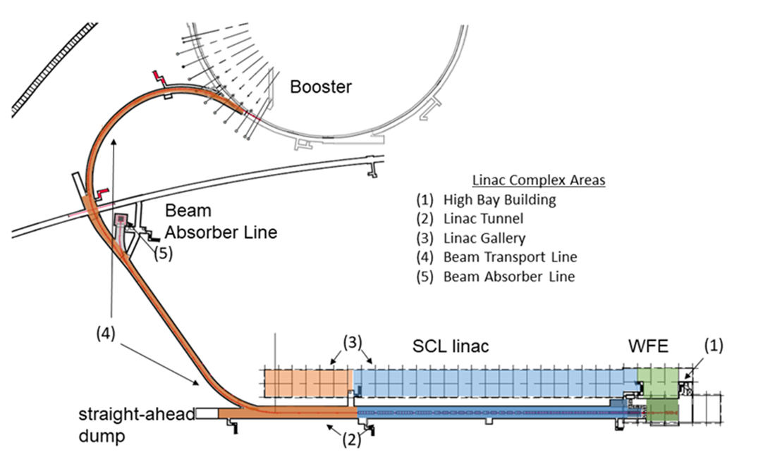
Scope of WBS 121.05.02
121.05.02.02 BTLBA Beam Transfer line
Beam line lattice.
Beam line collimators
Deliver 2 beamline collimators
121.05.02.03 BTLBA Beam absorbers
Beam absorbers
Deliver the main Beam absorber and 1 movable absorber.
121.05.02.04 BTLBA – Gamma-t-Jump
MI Gamma-t Jump
Deliver and install 16 gamma-t quads and 4 Power Supplies
Future line to Mu2e upgrade
25 KW Absorber
Collimators
H
V
MovableAbsorber

Slide 4
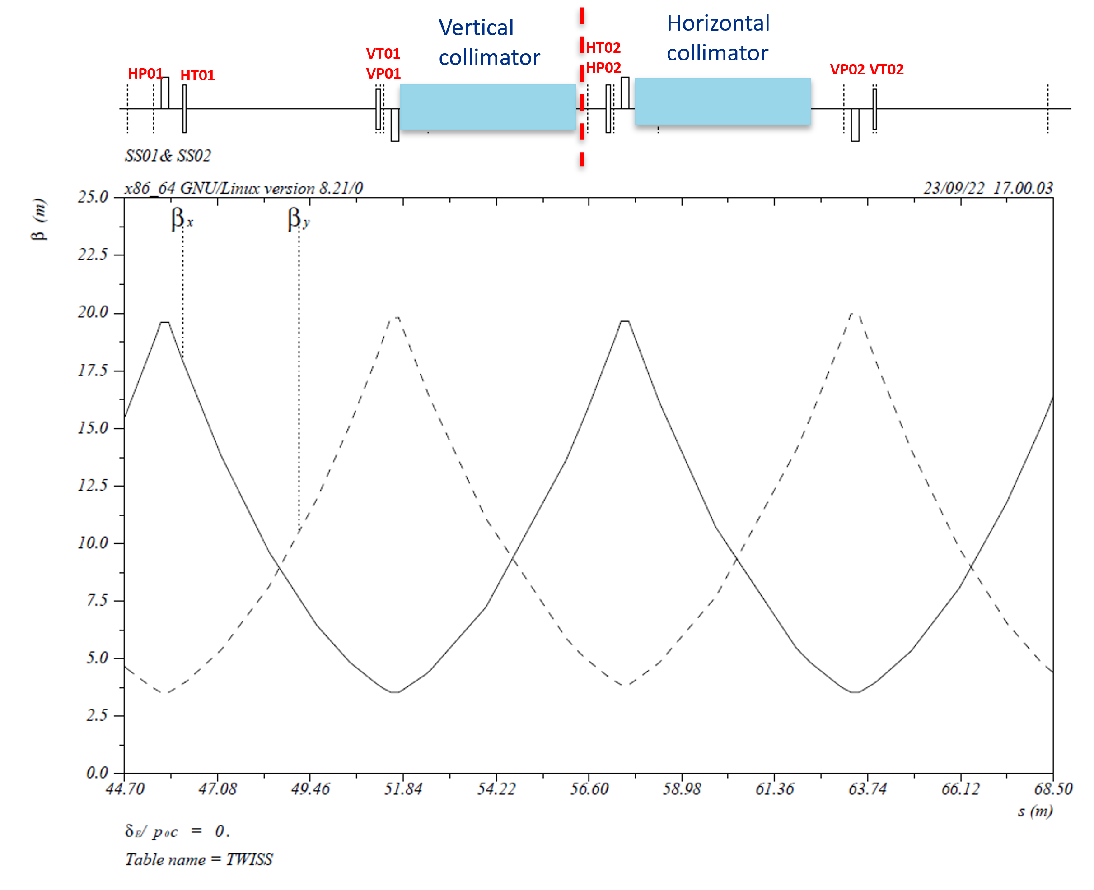
BTL lattice functions
Collimators
Used to adjust phase advances in H/V planes, specifically designed for collimators requirements.
V
H
Phase trombone
Beam size σ~ 2 mm
D_{max} ~ 3 m
~18 m

Slide 5
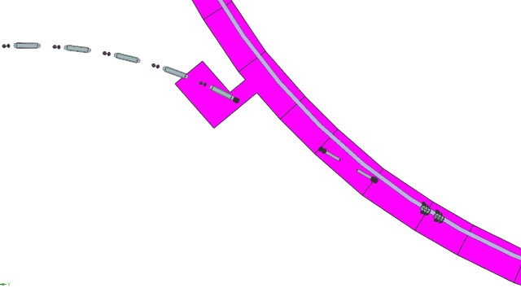
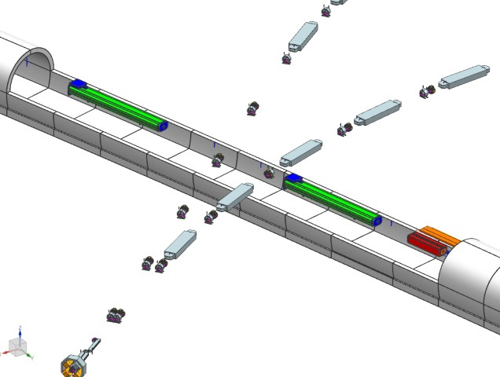
Layout of Linac, BTL, BAL, and Mu2e Line(3D CAD Model)
Linac
Booster
BTL_ARC1
Beam absorber
Portable dump
BTL
BAL
BTL_ARC2
MR Tunnel to the
Test Beam Facility
Chute
BTL
Mu2e line

Slide 6
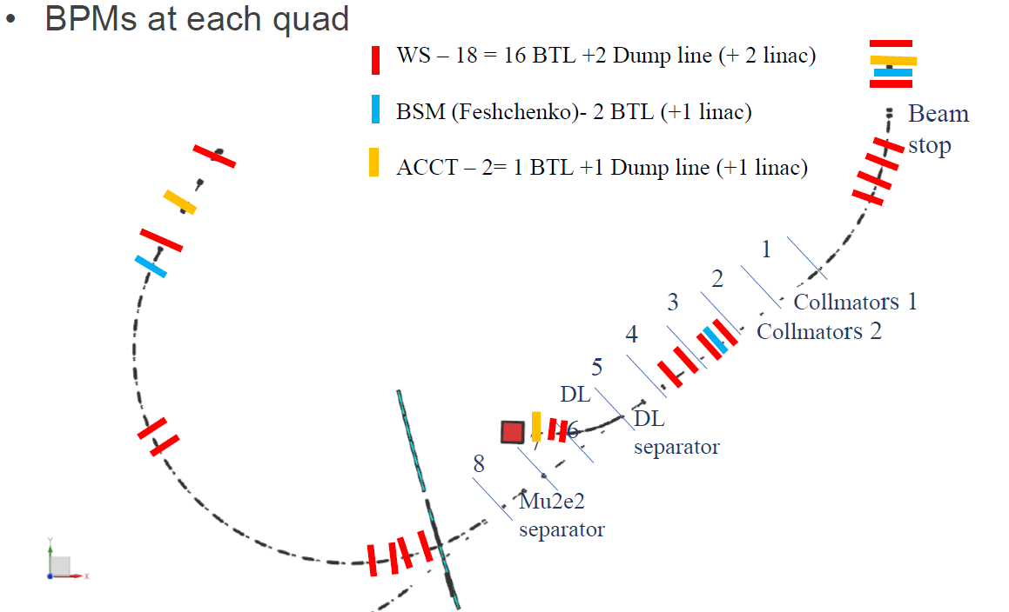
Proposed PIP-II BTL Beam Instruments from Oct 2019
BPM and BLM at each quad
Wire scanner – 16
Bunch shape monitor (Feschenko) – 2
ACCT – 2
Warm BPM – 58
Large aperture BPM – 1
BLM Ion – 65
Laser emittance monitor – 1
Standard setting: 1 BPM+1BLM for each quad
We will ask for 2 additional BLMs placed around the collimators

Slide 7
FRS and TRS of the BTL Collimators
Type | Document | Status
Founction requirement Specification (FRS) | ED0010235 | Completed
Technical requirement Specification (TRS) | ED0011431 | Completed
Interface Specification Document (ISD) | ED0016674 | Developed
The following key assumptions are relevant to these requirements:
The maximum PIP II Linac beam energy is 1 GeV. Booster injection energy is 0.8 GeV.
Particles per pulse 6.7E12 (Booster Injection)
The max average beam power is assumed to be 17 KW (operations)
Collimators are designed for 25 KW beam power.
Max number of beam pulses per year 5.36E8
It is assumed that the final collimator shielding will be designed to be assembled in the tunnel.

Slide 8
Technical Requirements (Design)
Requirement # | Requirement Statement
Configuration
T-121.05.02.02-001 | Shall be maintenance free and have a lifetime of at least 10 years.
T-121.05.02.02-002 | Shall be single plane collimation at each location (H or V)
T-121.05.02.02-003 | The beamline length for each collimator shall be less than the 4.398 m space available, including installation considerations.
T-121.05.02.02-004 | The collimator beam pipe shall have 2” ID to match the BTL beam pipe.
T-121.05.02.02-005 | The primary collimator jaw shall be at least 7.5” thick copper in the beam direction.
 | The primary collimator jaw shall be located in 25” from the upstream flange
T-121.05.02.02-006 | Each collimator shall have a thick single jaw movable primary, fixed secondary jaw, thick dual jaw movable secondary, and a fixed mask.
T-121.05.02.02-007 | All collimators shall have a minimum of 20” of A36 steel shielding around beam pipe.
T-121.05.02.02-008 | All collimators shall be at minimum 20” A36 steel shielding
T-121.05.02.02-009 | All collimators shall be equipped with external marble 4” thick
T-121.05.02.02-010 | All collimators shall be within an external transverse envelope of +/- 28 inches in both H & V from the beam center
T-121.05.02.02-011 | Each installed in the tunnel piece shall have weight under 6,000 lb.
T-121.05.02.02-012 | All heavy collimator components shall have threaded pick up points for hoist rings.
T-121.05.02.02-013 | Each collimator unit shall be fiducialized and to be able to be aligned in reference to beam centerline with the following dx, dy, dz, phi, bearing. Typical alignment tolerances are 0.25mm and angles are 10 mr.
T-121.05.02.02-014 | All collimators shall be protected against overheating.
T-121.05.02.02-015 | All collimators shall be equipped with motion controls.
T-121.05.02.02-016 | All movable collimators shall be positionable with an accuracy of better than the 1/20th of the beam sigma.
T-121.05.02.02-017 | The movable collimators shall be prevented from getting less than 2” from the opposing secondary collimator. (OR BEAM CENTER)
T-121.05.02.02-018 | The movable collimators shall be movable to a position at least 1mm from the beam center.
T-121.05.02.02-019 | The movable collimator shall be protected from, in all situations, damage caused by actuation (e.g. unintended hard stops or contact with the collimator housing).

Slide 9
Technical Requirements (Design)
Collimator stand requirement
T-121.05.02.02-020 | The collimator stand shall support components for a center of beam position of 1.3 m above floor surface and take in to account specified floor flatness criteria.
T-121.05.02.02-021 | The collimator stand shall allow for positioning of the supported components to within the alignment specification.
T-121.05.02.02-022 | The collimator stand full range of alignment travel shall be at least +- 25 mm.
T-121.05.02.02-023 | The collimator stand shall support the component it is designed to support with standard excess capacity.
T-121.05.02.02-024 | The collimator stand shall support the components in a way that minimizes tipping hazards during installation and operation.
T-121.05.02.02-025 | The collimator stands shall be coated to reduce corrosion.
T-121.05.02.02-026 | Sharp corners should be minimized when possible for all mechanical parts.
T-121.05.02.02-027 | Mounting plates for floor, ceiling or wall mounting shall accommodate Hilti bolts or Uni-Strut embedment.
T-121.05.02.02-028 | Support stand components shall be selected to minimize galvanic corrosion and galling.
T-121.05.02.02-029 | Replaceable parts, such as bolts and washers, should be commonly available.
T-121.05.02.02-030 | Unique components fabricated for these support stands should be of common materials and fabricated using common methods that can be repeatable with a high degree of accuracy when using different vendors.
T-121.05.02.02-031 | Support stands shall be transportable on carts pulled by electric tunnel vehicles.
T-121.05.02.02-032 | Any one component of a stand should be moveable by two or fewer people and not require the use of lifting devices except to hold stand components in position for attachment to walls or ceilings.
Capabilities and Performance
T-121.05.02.02-033 | Each collimator shall be able to absorb 1 GeV H- at 170 Watts average power

Slide 10
Technical Requirements (Radiological)
User Interface and Safety
T-121.05.02.02-034 | Collimators shall interface with Radiation Safety Interlock Systems
T-121.05.02.02-035 | Collimators shall provide enough shielding to limit prompt dose in all adjacent public areas to “unlimited occupancy” levels of < 0.05 mrem/hr
T-121.05.02.02-036 | Collimators shall provide enough shielding to limit prompt dose in the west end of the Booster East Tower to “radiation area – no occupancy limits” levels of < 0.25 mrem/hr
T-121.05.02.02-037 | Collimators shall satisfy following limits for drinking water C_{f} < 20 piC/ml-yr ³H and C_{f} < 0.2 piC/ml-yr ²²Na
T-121.05.02.02-038 | Collimators shall satisfy following Requirement for surface water C_{f} < 2000 piC/ml-yr ³H and C_{f} < 10 piC/ml-yr ²²Na
T-121.05.02.02-039 | Collimator shall provide enough shielding to minimize the residual activation of accelerator components to a level of 100 mrem/hr at 1 ft
T-121.05.02.02-040 | Collimator shall provide enough shielding to minimize the residual activation of accelerator tunnel walls to a level of 100 mrem/hr at 1 ft.
T-121.05.02.02-041 | Each Support stand shall incorporate “Safety by Design”.
T-121.05.02.02-042 | The three-point stand designs shall minimize tip potential during installation by utilizing the calculations described in Beams-Doc-DB #5042.
T-121.05.02.02-043 | When installation of the component on the stand is complete it shall be constrained in all six degrees of freedom.

Slide 11
Schedule
PRR Review : 28-Feb-23
Fabricate Collimators parts: 9-Jan-24-------12-Jul-24
Final Assembly and Testing: 15-Jul-24-------15-Oct-24
2

Slide 12
Review charge
Are the requirements documented, clear, complete, and appropriate?
Is the proposed design for the BTLBA Collimators likely to meet requirements? Explain any deficiencies or concerns.
Are there any features present (or absent) that threaten the intended function and performance of this design?
Are the connections and interfaces of the collimators well understood?
Have safety and environmental aspects been appropriately considered?
Have quality aspects been appropriately considered?

Slide 13
Summary
The lattice of the beam lines is fixed. The trombone in the straight section was specifically designed for the adjustment of the phase advance for the collimators to the foils in the Booster.
The instrumentations for the collimation need are considered.
PRR is scheduled
Thank you for your attentions.

