Slide 1
PIP-II BTL Collimators Thermal Finite
Element Analysis
Raul Campos
BTL Collimators FDR Review
October 4, 2022

Slide 2
Outline
Analysis and modeling assumptions
Materials
Loads, contacts and boundary conditions assumptions
Temperature results for different analysis cases
Stresses due to beam on, beam off cycles
Accident case scenario

Slide 3
Finite Element Analysis and Modeling Assumptions
Steady-State Heat Transfer Finite Element Analysis of multi-body collimators model with energy deposition from beam as input load
The purpose of the analysis is to calculate steady-state temperatures to determine whether active cooling is required
Energy deposition into collimators material normalized from MARS Energy deposition calculations for 25kW beam to 1% of 25kW beam power (250W deposited into material)
All heat loss from the system is through free convection (5 W/m^2K ) to 32 deg C ambient air
Higher mesh density at locations with energy deposition gradients
Conservative thermal conductance between Jaws and Chamber
Nonlinear radiation heat transfer between jaws and chamber was modeled

Slide 4
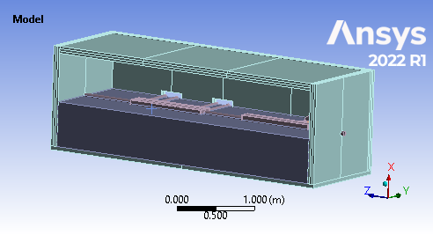
Model Geometry and Materials
Materials Thermal Conductivities:
Aluminum ~ 150 W/mK (Ansys default)
Copper - 401 W/mK (Ansys default)
Marble - 3 W/mK
Stainless Steel – 15.1 W/mK (Ansys default)
Steel – 60.5 W/mK (Ansys default)
Defeatured Collimators CAD model used in FEA
Heat transfer resistance between components modeled with thermal contact conductance

Slide 5
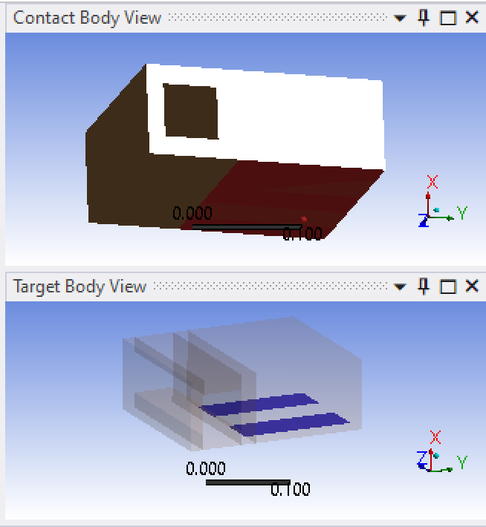
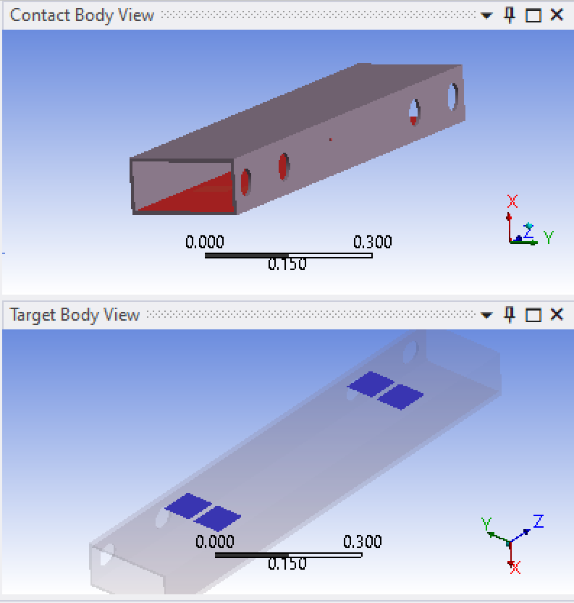
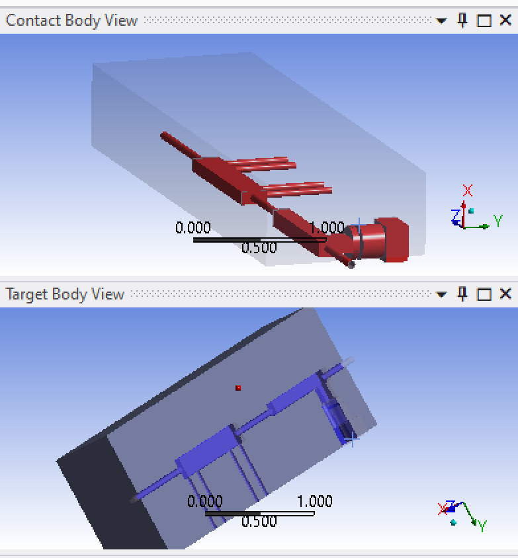
Selected Thermal Contacts Conductances
Thermal radiation between jaws and vacuum chamber was also included in model
Primary Jaws to Vacuum Chamber
No contact, 200 or 1500 w/m^2K
Secondary Jaws to Vacuum Chamber through 3in pads
1500 w/m^2K
Vacuum Chamber
to bottom part of shield
1500 w/m^2K
Vacuum Chamber
to top part of shield
10 w/m^2K

Slide 6
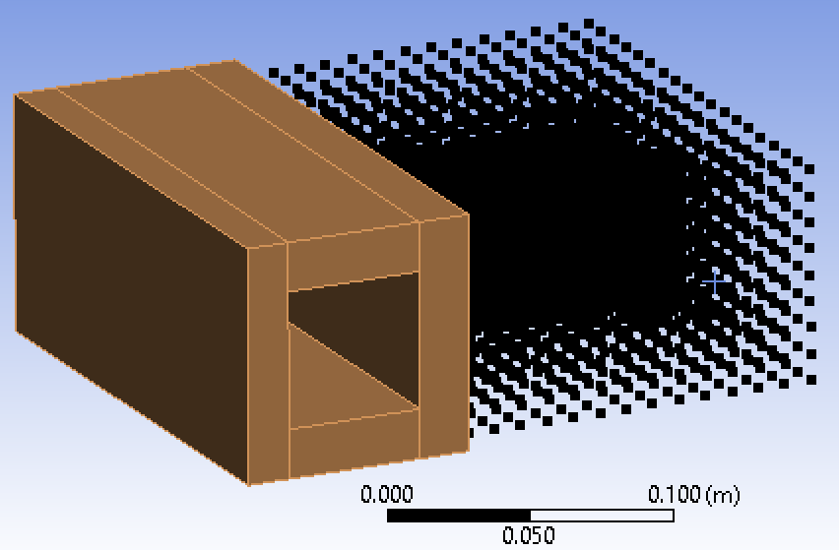
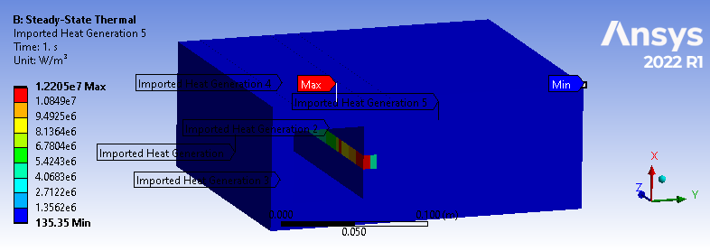
Energy Deposition, normalized to 250W total
Totals | Mapped Edep, W | Scaled Edep, W
Pipes | 7.53 | 8.91
Jaw 2 Combined | 10.15 | 12.01
Vacuum Chamber | 9.34 | 11.05
Jaw1Cu1 | 3.05 | 3.61
Jaw1Cu2 | 63.84 | 75.53
Jaw1Cu3 | 3.57 | 4.23
JawCu4 | 3.64 | 4.31
JawSt | 7.93 | 9.38
Inner Shield | 101.99 | 120.66
Total | 211.06 | 249.70
Scale factor to 249.7W (250W-.3W on ceramic shield) | 1.18
MARS data courtesy of Dali Georgobiani. Data was scaled up to 250W total energy deposition mapped into finite element model
Mesh and body dimensions consistent between MARS and FE model to reduce data mapping errors

Slide 7
Boundary Conditions
All heat loss from the system is through free convection (5 W/m^2K ) to 32 deg C ambient air
Nonlinear steady-state model (radiation) results verified with reaction at convection boundary condition to be in the range of the 250W input

Slide 8
All-Copper Primary Jaw Analysis Cases and Results
Analysis Case | Radiation Emissivity | Jaws Contact (no contact, contact) | Primary Jaw Conductance to Chamber | Copper to Stainless Jaw Conductance (Full contact, bolt contact) | Chambers Conductance to Top Inner Shield (10, remove other options) | Ambient Temp, 32 deg C only | Primary Jaws Max Temp, deg C | Secondary Jaws Max Temp, deg C
Step 1 | 0.1 | No contact | 1500 W/m2K | NA | 10 W/m2K | 32 | 421.2 | 72.0
Step 2 | 0.6 | No contact | 1500 W/m2K | NA | 10 W/m2K | 32 | 193.7 | 45.6
Step 3 | 0.1 | Contact | 1500 W/m2K | NA | 10 W/m2K | 32 | 58.4 | 37.1
Step 4 | 0.6 | Contact | 1500 W/m2K | NA | 10 W/m2K | 32 | 57.5 | 36.8
Step 5 | 0.8 | Contact | 1500 W/m2K | NA | 10 W/m2K | 32 | 57.0 | 36.7
Step 6 | 0.1 | Contact | 200 W/m2K | NA | 10 W/m2K | 32 | 89.1 | 37.1
Step 7 | 0.6 | Contact | 200 W/m2K | NA | 10 W/m2K | 32 | 82.7 | 36.8
Step 8 | 0.8 | Contact | 200 W/m2K | NA | 10 W/m2K | 32 | 79.8 | 36.7
Baseline
Loss of contact between jaws and vacuum chamber

Slide 9
Baseline Temperature Results – Primary Jaw, baseline

Slide 10
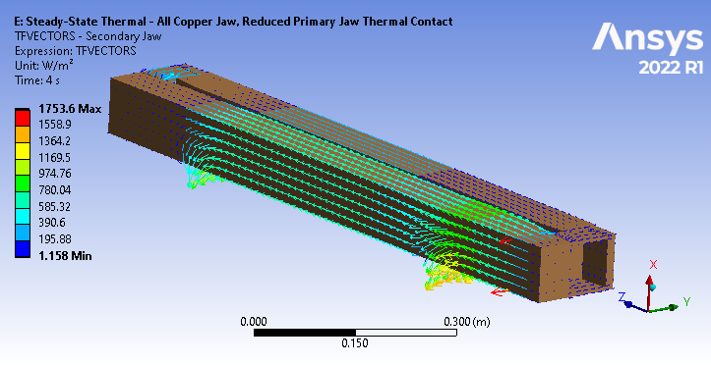
Heat Flux Vectors, baseline
Radiation and conduction heat flux
Heat flux through thermal radiation
Heat flux through contact pads

Slide 11
Baseline Temperature Results – Secondary Jaw

Slide 12
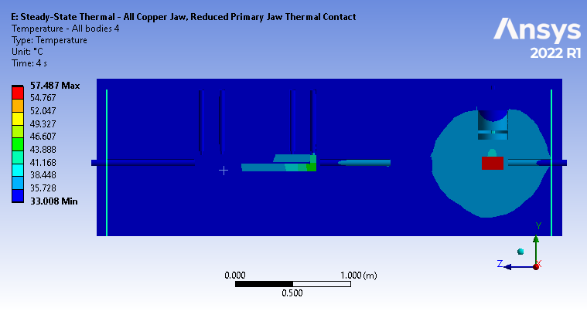
Baseline Temperature Results

Slide 13
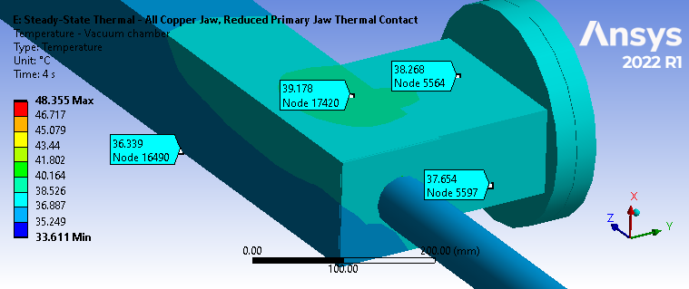
Baseline temperatures – Vacuum chamber

Slide 14
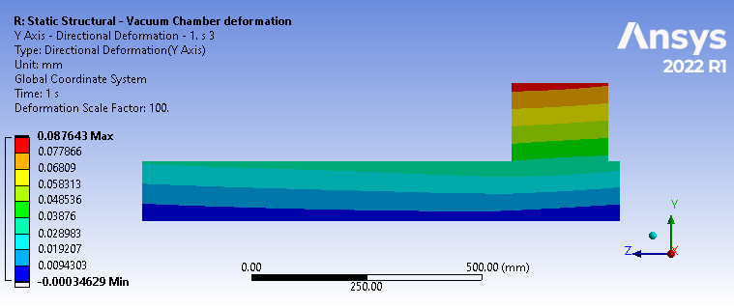
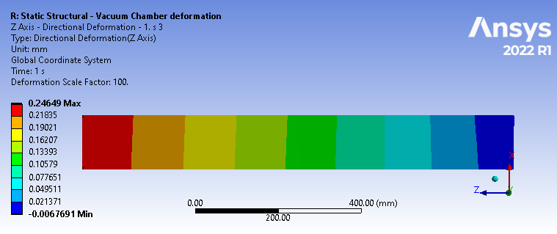
Baseline Thermal Expansion – Primary Jaw Vacuum Chamber
Vertical thermal expansion = 0.038mm
Transverse thermal expansion = 0.08mm
Longitudinal thermal expansion = 0.26mm

Slide 15
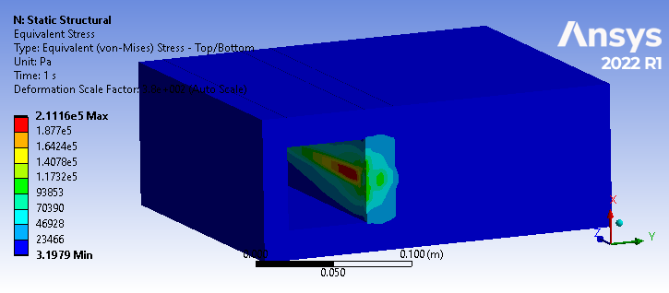
Stresses due to Beam on and off cycles
Instantaneous energy deposition load during 0.00055 sec pulse and 0.0495 sec cool down cycle,
with baseline contacts and boundary conditions
pulse length | 0.00055 | sec
Rep rate | 20 | pulses/sec
beam off between pulses | 0.04945 | sec
Stress due to thermal cycle is insignificant. There is no risk of thermo-mechanical fatigue

Slide 16
Stresses due to Beam on and off cycles
Instantaneous energy deposition load during 0.00055 sec pulse and 0.0495 sec cool down cycle,
with baseline contacts and boundary conditions
pulse length | 0.00055 | sec
Rep rate | 20 | pulses/sec
beam off between pulses | 0.04945 | sec
Stress due to thermal cycle is insignificant. There is no risk of thermo-mechanical fatigue

Slide 17
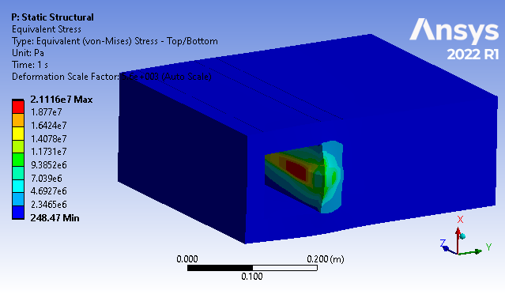
Accident scenario – 25kW energy deposition
25kW accident scenario energy deposition scaled from normal operation (250W energy deposition distribution), with baseline contacts and boundary conditions
pulse length | 0.00055 | sec
Rep rate | 20 | pulses/sec
beam off between pulses | 0.04945 | sec
Maximum temperature is not an issue with analyzed contacts and boundary conditions for the initial seconds of accident scenario, but could be for longer duration of 25kW energy deposition
21 MPa stresses due to temperature gradient below endurance limit (50 MPa for assumed annealed copper) so there is no risk of thermo-mechanical fatigue failure

Slide 18
Conclusions
Jaws maximum temperature evaluated over a range of thermal radiation and thermal contact conductance conditions.
Temperature distributed evenly in the vertical and transverse directions, so there is minimal warping expected.
Small temperature gradient during beam on and off cycles do not cause thermo-mechanical fatigue concerns.
Accident scenario of 25kW energy deposition does not cause a risk of thermo-mechanical fatigue failure due to thermal gradient for assumed 50 MPa endurance limit. Energy deposition for more than a few seconds could cause a temperature issue
Mechanical contact between jaws and vacuum chamber is necessary for conduction heat transfer.
Thermocouple measurements on collimator could be used for thermal model validation and calibration.

Slide 19
Stainless Steel-Copper Primary Jaw Analysis Assumptions and Results
Analysis Case | Radiation Emissivity | Jaws Contact | Primary Jaw Conductance to Chamber | Copper to Stainless Jaw Conductance | Chambers Conductance to Top Inner Shield | Ambient Temp, deg C | Primary Jaws Max Temp, deg C | Secondary Jaws Max Temp, deg C
Step 1 | 0.6 | No contact | 1500 W/m2K | 1500 W/m2K | 10 W/m2K | 32 | 196.5 | 45.6
Step 2 | 0.6 | Contact | 1500 W/m2K | 1500 W/m2K | 10 W/mK | 32 | 76.1 | 36.9
Step 3 | 0.8 | Contact | 1500 W/m2K | 1500 W/m2K | 1 W/mK | 32 | 75.1 | 36.9
Step 4 | 0.8 | Contact | 1500 W/m2K | 1500 W/m2K | 10 W/mK | 32 | 74.7 | 36.8
Step 5 | 0.8 | Contact | 1500 W/m2K | 1500 W/m2K | 10 W/mK | 28 | 70.9 | 32.8
Step 6 | 0.8 | Contact | 1500 W/m2K | 1500 W/m2K | 100 W/mK | 32 | 74.2 | 36.6
Step 7 | 0.8 | Contact | 1500 W/m2K | 200 W/m2K | 100 W/mK | 32 | 91.8 | 36.8
Step 8 | 0.8 | Contact | 200 W/m2K | 1500 W/m2K | 100 W/mK | 32 | 89.5 | 36.8
Only radiation from Jaws to vacuum chamber
Reduced conductance between primary Jaw and Chamber
Reduced conductance between copper and stainless parts of primary Jaws
Baseline
Higher conductance to top shield
0.6 Emissivity
Lower conductance to top shield
28C ambient temp
0.6 Emissivity

