Slide 1
AccU-BTL Installation
WBS 121.05.03
Denton Morris, L3 - BTL Installation
BTLBA Collimators FDR Review
October 4, 2022

Slide 2
Outline
Introduction and Scope
Interfaces and Interferences
Installation Readiness Review Process
Installation Activities

Slide 3
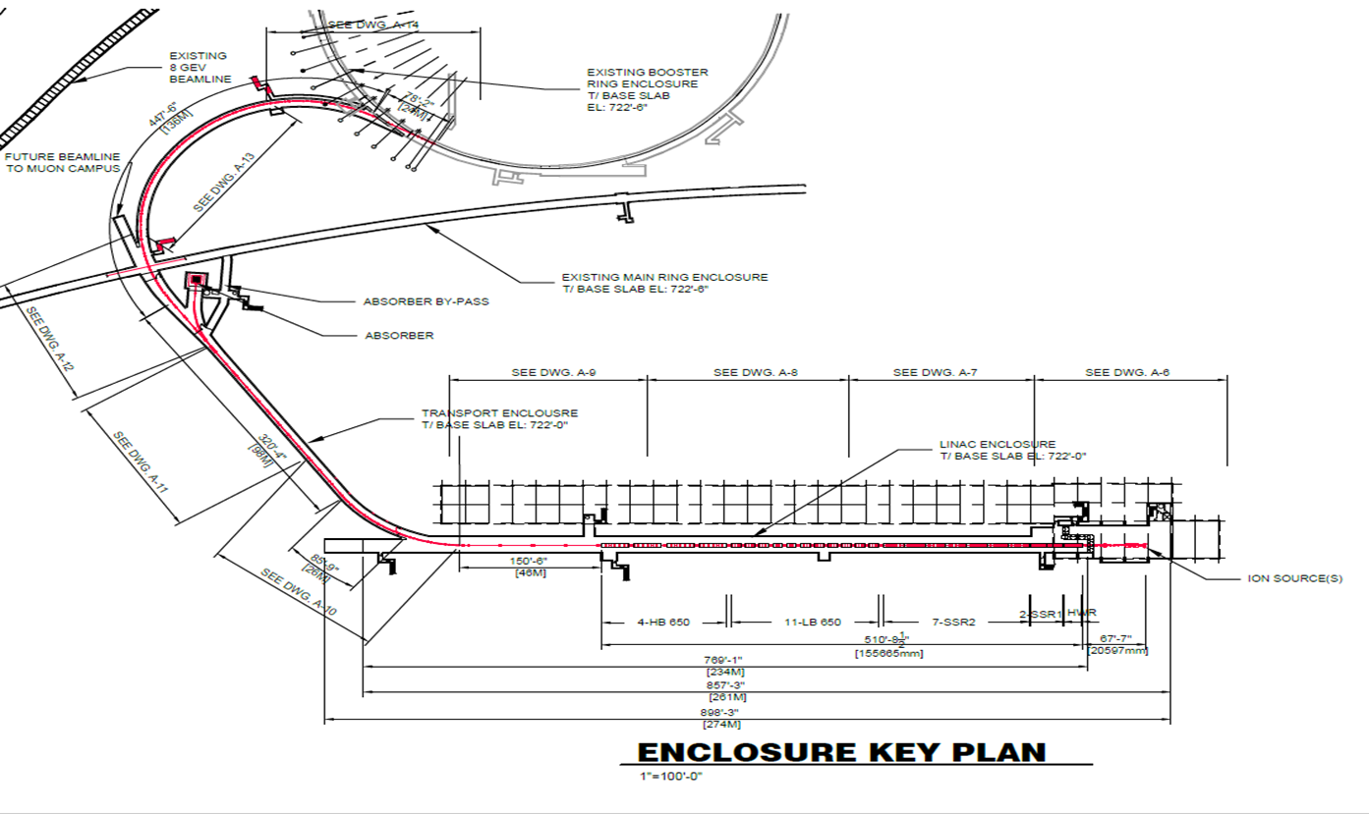
Introduction and Scope
Denton Morris
WBS 121.05.03
BTL Installation L3
Scope:
Installation of all components downstream of the Linac low particulate vacuum
beam valve, up to and including the Booster injection girder.
Magnets, stands, beam pipe, instrumentation, cables, hoses, absorbers and collimators among other items.

Slide 4
Interfaces
BTL components, including the collimators, interface to Conventional Facilities, Building Utilities, Installation, Vacuum, Controls etc. (Contained in Interface Control Document)
Interface issues identified:
Machine side cable trays intersect collimator
Due to collimators the aisle side cable trays encroach into “Keep Clear” volume
LCW headers interfere with collimator
LCW Make-up/Return lines interfere with collimator
LVDT/drive system encroaches into “Keep Clear” volume

Slide 5
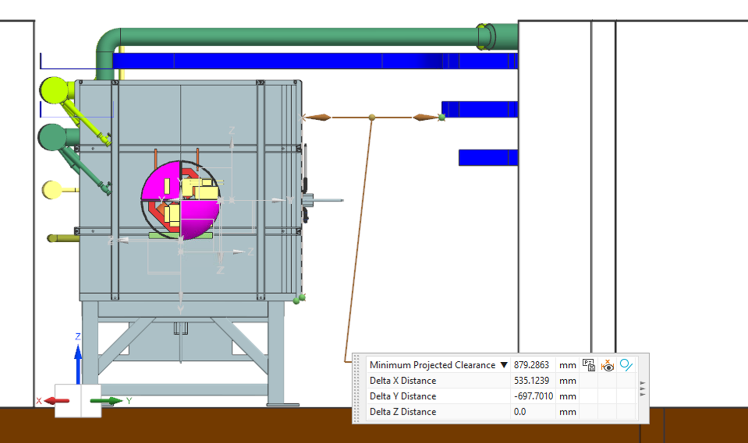
Installation interferences

Slide 6
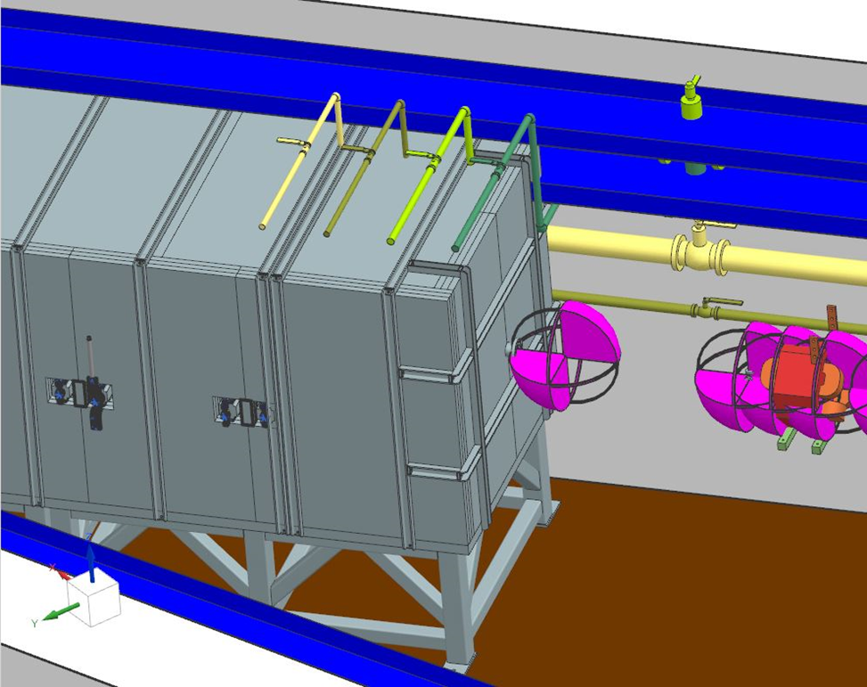
Installation interferences
Absorber RAW make-up and F37
LCW tie in lines needed to be moved
further downstream.

Slide 7
Installation
Installation process begins with an Installation Readiness Review
The IRR is part of the Validation and Verification process prior to accepting components for installation into the BTL.
Gives the system L3s the opportunity to demonstrate that the components are as expected by the Project, meeting all fundamental and technical requirements, have passed QC, are properly documented using a traveler system, are configured in an agreed upon manner for installation and have all the necessary installation documentation.

Slide 8
Validation and Verification Process
FRS/TRS
PDR/FDR
QC
QC
Installation
Readiness
Review
Installation
Activities
ORC
ARR
Travelers
Travelers
Configuration
Configuration
Documentation

Slide 9
Installation Activities
Following Hand-off of enclosure:
Metrology stake-out
Stand Installation w/ Metrology
Collimator assembly on stand w/Metrology
Cable pulls – motors, LVDTs, limit switches, thermocouples
Terminate cables
Vacuum connections
Leak Check
Motion control, LVDT, limit switch check-out
Thermocouple test
Close out QC
Update Travelers
Prepare for ORC

Slide 10
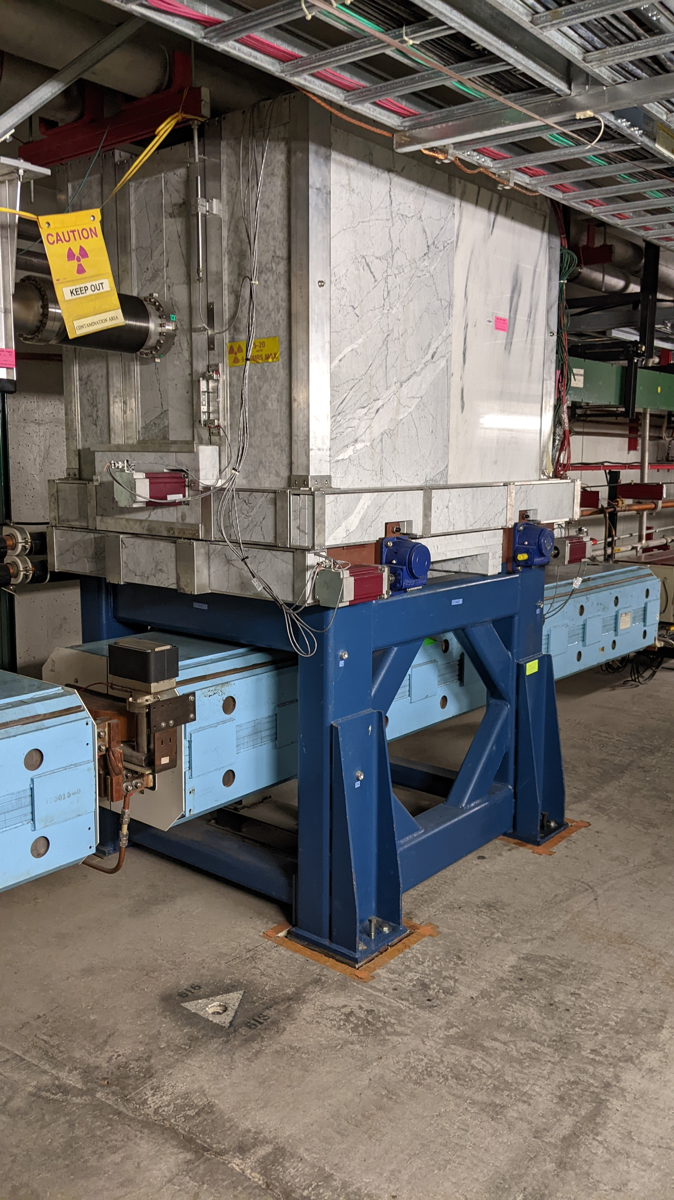
Installation
The installation process will be similar to other systems we have installed:
MI-8 (Two pairs of collimators)
MI-30 (One primary and four secondary collimators)
RR-62 (One primary and two secondary collimators (Pictured to the right))

