Slide 1
PIP2IT 650 MHz HPRF Distribution FDR PDR Response
Victor Grzelak
PIP2IT 650 MHz RF Distribution FDR
August 25th, 2020

Slide 2
PDR Response - Recommendation #1
Reviewer recommendation: Antennas are problematic in a personnel safety system for non-ionizing radiation. The distribution system needs to consider a parallel method for protecting against non-ionizing radiation, such as a low pressure interlock in the distribution system
Agree: The design of distribution system now includes gas barriers. The sections that are isolated can be pressurized and monitored if gaps occur.
Clarifying point, the antennas are for EMI/EMC not personnel safety.
Personnel safety follows FESHM 4320 guidance
While any part of the distribution line is open, there will be a LOTO procedure. All opening of lines will be followed with an inspection, leak verification and consultation of Safety officer

Slide 3
PDR Response - Recommendation #2
Reviewer recommendation: The circulator needs to have a detailed specification that includes test plans and vendor expectations.
water temperature/variance, water path circulator to load
load design
isolation over power band
Agree: All completed in the updated TRS. Which Ding will discuss
Water temperature is 86-90F, water flow for circulator and load are parallel paths
Load rated to greater than 120kW power
Isolation spec is 26dB at 650MHz 20dB in bandwidth
Test plan for circulator is written

Slide 4
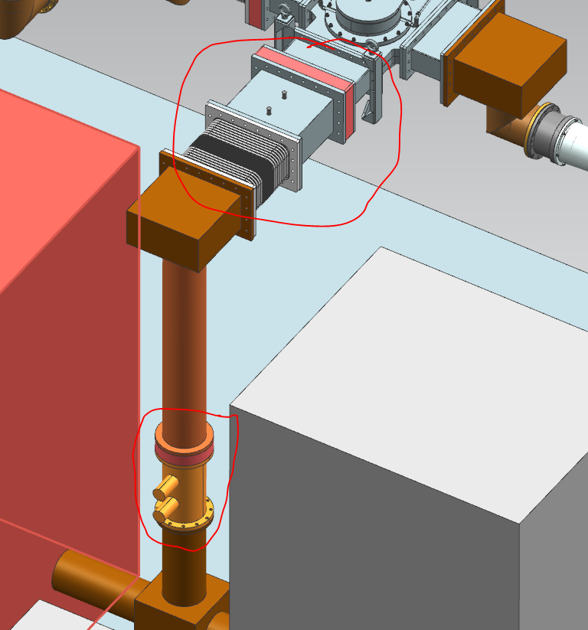
PDR Response - Recommendation #3
Reviewer recommendation: For the PIP2-IT test stand consider installing a coaxial dual directional coupler after the SSA combiner.
Agree: The design of
distribution system now
includes a WR1150 dual
directional coupler after the
SSA combiner to each
distribution line.

Slide 5
PDR Response - Recommendation #4
Reviewer recommendation: Consider a bottoms up review of the labor plan after you have developed thorough installation and test plans for the system and components.
Agree: A review of the labor plan will be discussed amongst engineers and technicians
Feedback and revisions will be implemented into future version

Slide 6
PDR Response - Other
Lifting plans will be developed in compliance with FESHM 10200. Critical lifts will be identified before FDR.
Will be produced after the circulator and waveguide is in hand
Critical lift will be written for circulator and large coax
Suggest having a first article test for the circulator before releasing production units
This requirement is part of the purchase contract
Will consult with procurement department

Slide 7
PDR Response - Other
Circulator - Arc detector is not presently in the RFPI scope.
Arc detection in the circulator specification
In the RFPI scope
Directional Coupler- Specify that it is pressure capable.
Now in the directional coupler specification
EH&S - Non-ionizing radiation: Need better guidance
All installations will be in compliance with FESHM4320
Antennas how do you verify them? How often? Who owns them?
Antennas measured against a known source correlated with NARDA in antenna location.
RFPI owns the antennas used for the interlock system

