Slide 1
HEPnOS: HEP data processing on Object Store
Saba Sehrish and Matthieu Dorier
HEP CCE IOS

Slide 2
HEP data processing
In current HEP frameworks, an event is the unit of independently-processed data.
  In a collider experiment, an event represents a collision, or a beam crossing
  In many neutrino experiments, the beam spill is a time window that defines an event
There are levels of data aggregation (run/subrun/event); sometimes more (subevent)
An event contains collections of “data products”
  Most data products are a sequence of structured objects (e.g. a collection of hits)
An event is processed as a whole, new data products are added to events at each processing step.
Final steps of analysis summarizes ensembles of events e.g. histograms and fitted models.
Notes:
Current HEP frameworks, e.g. art and CMSSW
In neutrino world, an event is not as well-defined as in collider experiments. Each experiment determines how to slice the data taken during a time window.
Levels of data aggregation are also similar, except the subrun, which is called a luminosity block.
In neutrino experiments, sometime there is more, e.g. a subevent, which corresponds a fixed duration time window within a spill.
For example for NOvA …
Approximately each 1.3 seconds, a 10 𝜇s pulse of neutrinos is generated by the Fermilab accelerator complex, and directed to the NOvA detectors.
The data collection period corresponding to one such pulse is called a spill. A slice is a fixed-duration time window around a period of detector activity discovered with in a spill. A run is a period of data collection which rep- resents a stable period of detector operations. Runs have a typical temporal duration of a few hours to a maximum of 24 hrs.

Slide 3
Traditional HEP data processing
The traditional computing environment for HEP data processing is mostly batch processing on distributed computing grid farms.
The applications are developed around computing constraints. e.g. memory of a grid node, how big of a file can be transferred over network, etc.
  Large number of small intermediate files for different steps
The processing tasks are sequential and file-based.
Notes:
multi-threading has been implemented at the framework level
Applications are optimized for memory.
Nodes where jobs get scheduled, need to get the data files required for the job, that limits how big files get.
Thousands of grid jobs.

Slide 4
An HEP workflow example with current processing model
Notes:
This figure shows two art processes, and the interactions with the filesystem. The middle column shows data products that added to the event at each step.
The figure shows that Noise filtering reads in Raw data and produce raw digits and deconv then utilizes those and generates waveforms.
There are intermediate files that get generated all the file handling and also writing and reading requires massive synchronizations. This is all sequential, and no pipelining.
The goal is to have an improved workflow that is more suitable for HPC.

Slide 5
As a part of our SciDAC4 project
Rethinking both traditional data organization and access is crucial for HEP science to effectively use HPC resources.
We are moving from having workflows that are organized based on the requirements of the grid computing infrastructure to ones that are based on the requirements of the scientific domain.
We are demonstrating these points using real HEP processing applications.

Slide 6
Mochi: a little background
Mochi is a set of components
  RPC/RDMA (Mercury)
  Threading/Tasking (Argobots)
  Database management, storage management, etc.
Mochi is a methodology
  For developing components
  For composing them
  For working with end-users

Slide 7
HEPnOS: high-energy physics’ new object store
Multiple instances of remotely-accessible in-memory databases
Stores C++ objects (serialization using Boost)
Hierarchical organization (Datasets, Runs, Subruns, Events, Products)
Data conversion and ingestion from HDF5
Documentation: https://hepnos.readthedocs.io/en/latest/

Slide 8
HEPnOS: data organization
Datasets contain other Datasets and Runs
  Datasets are identified by a name
Runs contain Subruns
Subruns contain Events
  Runs, Subruns, and Events are identified by a number
Containers (Datasets, Runs, Subruns, and Events) can contain Products
Products are instances of C++ objects
  Products are identified by their C++ type, and a label

Slide 9
HEPnOS: example programs
#include <hepnos.hpp> using namespace hepnos; int main(int argc, char** argv) { if(argc != 2) { std::cerr << "Usage: " << argv[0] << " <configfile>" << std::endl; exit(-1); } std::string configFile(argv[1]); DataStore datastore = DataStore::connect(configFile); }

Slide 10
HEPnOS: example programs
// Get the root of the DataStore DataSet root = datastore.root(); // Create a DataSet DataSet example = root.createDataSet("example"); // Create 5 DataSets in example3 for(unsigned i = 0; i < 5; i++) { std::string datasetName = "sub"; datasetName += std::to_string(i+1); example.createDataSet(datasetName); } // Iterate over the child datasets std::cout << "Datasets in example: " << std::endl; for(auto& dataset : example) { std::cout << dataset.name() << std::endl; } // access a DataSet by its full name DataSet sub2 = root["example/sub2"]; // find the sub3 DataSet DataSet::iterator it = example.find("sub3"); std::cout << it->fullname() << std::endl;

Slide 11
HEPnOS: example programs
// create a Run Run r = example.createRun(42); // access a Run by its number Run r = example[42];
Essentially: Datasets act like an std::map<string,DataSet> and an std::map<uint64_t,Run>; Runs act like an std::map<uint64_t,SubRun>, Subruns act like an std::map<uint64_t,Event>
Typical functions: find(), begin(), end(), lower_bound(), upper_bound(), etc.

Slide 12
HEPnOS: example programs
struct Particle { std::string name; double x, y, z; Particle() {} Particle(const std::string& name, double x, double y, double z) : name(name), x(x), y(y), z(z) {} template<typename Archive> void serialize(Archive& ar, const unsigned int version) { ar & name; ar & x; ar & y; ar & z; } };

Slide 13
HEPnOS: example programs
Event event = subrun.createEvent(32); // Store a product into the event { Particle p("electron", 3.4, 4.5, 5.6); ProductID pid = event.store("mylabel", p); } // Reload a product from the event { Particle p; bool b = event.load("mylabel", p); if(b) std::cout << "Particle loaded succesfully" << std::endl; else std::cout << "Particle wasn't loaded" << std::endl; }
You may also store vectors of objects and access subvectors

Slide 14
HEPnOS: other interesting features
AsyncEngine
  I/O may be done in the background automatically
  Configurable number of background threads
WriteBatch
  Products are generally small, batching them improves performance
  Configurable batch size and cache size
  Can be used with AsyncEngine
Prefetcher
  Containers and Products can be prefetched automatically during iterations
  Configurable batch size and cache size
  Can be used with AsyncEngine

Slide 15
HDF2HEPnOS: data ingestion from HDF5 files
HDF2HEPnOS
  Python program that analyses the content of an HDF5 file and produces corresponding C++ class with both read functions from HDF5 and boost serialization functions for HEPnOS
HEPnOS-Dataloader
  Compiled against the generated C++ classes
  Uses a work queue to read HDF5 files in a distributed manner
  Converts HDF5 files into C++ objects and store them into HEPnOS

Slide 16
HEP application view of HEPnOS
A distributed data service for managing HEP data
Makes data products available from simulation and experiment through multiple phases of workflows (on demand).
Accelerates access by retaining data in distributed memory throughout the multiple phases.
Supports parallelism by providing global view of data and by removing software artifacts related to the filesystem.
Notes:
Main point: We have a vision of how to management HEP data on HPC systems to permit better application scaling.
The frameworks available within experiment have abstractions for substituting new methods for handling physics objects.
Our vision is integration of advanced I/O and parallel calculations into experiment framework infrastructure.
There are several frameworks within experiments used for different purposes – analysis frameworks are an easier starting point.
A good way forward we are working towards is to use the available data model abstractions and substitute alternative storage mechanisms through a physics event interface.
HPC enable this: global file system, flexible scaling.
All the HEP experiments we work with have one or more frameworks or systems for making the running of production computational pipelines possible.
We have the abstractions in our frameworks to accommodate this.
Means we need to address issues with I/O of data and processing – when scaling is needed

Slide 17
HEPnOS and Framework
Leverage existing modular framework abstraction and extensible data models
Hierarchical namespace matching physics concepts
  Include levels (or layers) of data aggregation with metadata
  Datasets / runs / intervals / events / physics object containers
Bulk ingest and iterative access
Write-once, read-many
Read in data at start of run and write results to persistent storage at the end of a campaign
C++ API
Notes:
The HEPnOS event store is built using Mochi, a framework for developing specialized data services for use in HPC. Mochi allows use of state of the art libraries (e.g., LevelDB for key/value storage) while providing convenient APIs to scientists.
Collaboration with Argonne Team

Slide 18
HEPnOS example with actual LArSoft data products used by DUNE
Used existing art framework-related software:
  gallery provides access to event data in art/ROOT files from outside the art framework.
  pre-existing builds of the LArSoft data product libraries.
Used some of the data product classes from LArSoft (used by DUNE, etc.)
  std::vector<recob::Hit>
  std::vector<recob::Track>
  art::Assns<recob::Hit, recob::Track>,
  which are bidirectional associations between hits and tracks.
Used Docker containers for easy portability of development environment
Prototype programs are already running to read from:
  existing art/ROOT data files, and to write to the HEPnOS data store
  the HEPnOS data store, and verify the integrity of the data

Slide 19
Extending to ICARUS workflow - WIP
Notes:
Separate framework modules/applications/processes, each generates new data product that gets written to an event goes to and stays in HEPnOS store during the processing.
This workflow is the one we recently starting working with.
Spacepoint GNN not an art process.
Some of the step are slower than the other, many things running the slow parts and few running the fast parts. Two of these things can run on a different hardware

Slide 20
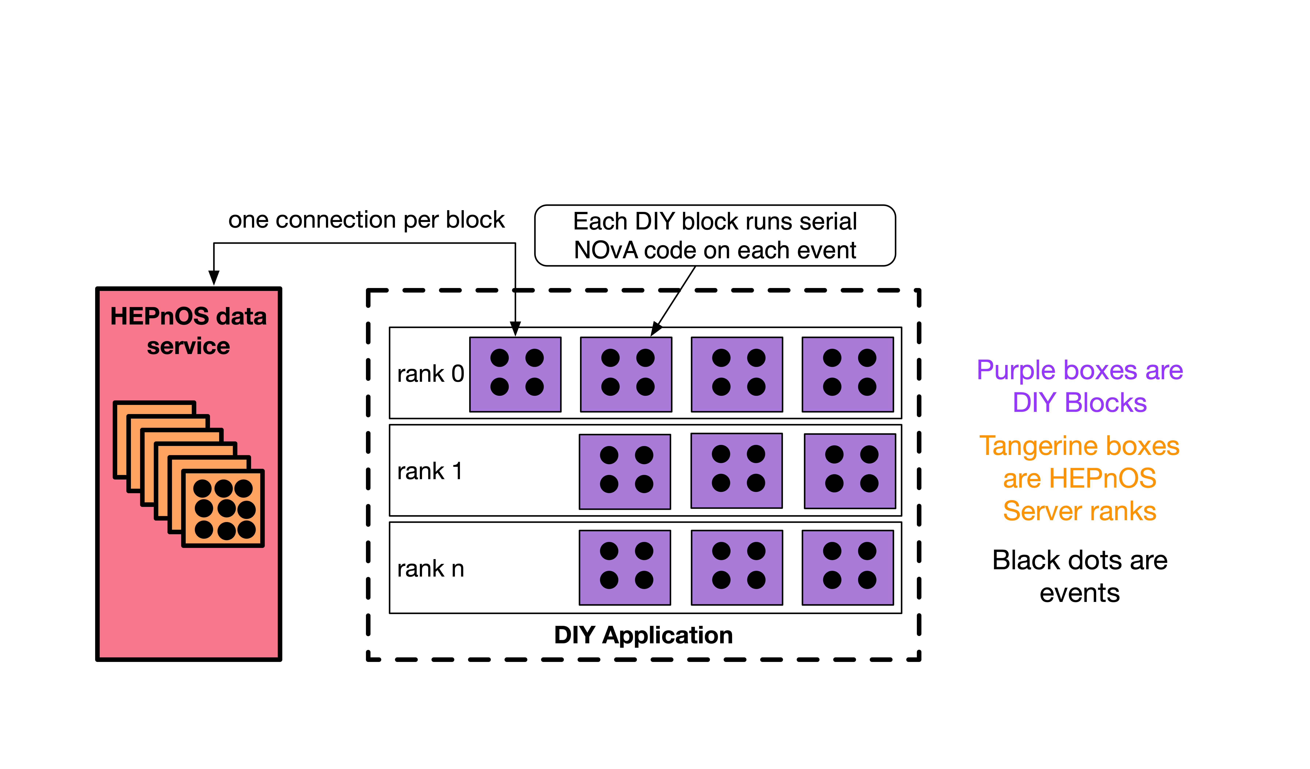
HEPnOS for an analysis application
NOvA’s “4th analysis” of neutrino candidate selection.
The program is a DIY-based MPI parallel application, using data structures and candidate selection code from NOvA.
Our application code provides all the parallelization, and NOvA code is unaware of parallelism.
The NOvA code is modified only to remove file reading.
Data from HEPnOS store is read into
NOvA-specific objects in memory.
Use containers to deliver complex software
stack to ALCF and NERSC.
We are currently tuning the configurations
for optimal performance on ALCF.
Input data
reads
DIY data loader application
writes
HEPnOS Store
reads
DIY neutrino candidate selection application
uses
NOvA CAFAna code
Notes:
We are using NOvA’s analysis application, root macros, traditionally is run as number of processes equal to the number of files.
What is DIY? An open-source package of scalable building locks for data movement tailored to the needs of large-scale parallel analysis workloads.
Application is launched as a single mpirun.
Experiment code didn’t change, event selection application uses “cuts” defined in NOvA code and presents data in the form those cuts expects.
For this application our starting input data was in HDF5, we have developed a data loading application for bulk ingest to HEPnOS.

Slide 21
Another example HEP data analysis workflow
Notes:
This figure shows an example HEP data analysis workflow from NOvA.
Particle and eventID application writes hundreds of thousands of output files, typically a few TB.
Reduction from millions of events to a few selected events.
We want data to be available to the analysis workflows without being going to the filesystem at every single step.
HEPnOS
We want easy to write, scalable and efficient analysis programs.
HDF5

Slide 22
Code example: The user interface looks a lot like our current user interface
hepnos::DataStore datastore(configfile);
for (auto it = datastore.begin(); it != datastore.end(); ++it)
for (auto const& ds : *it)
for (auto const& r : ds.runs())
for (auto const& sr : r)
for (auto const& e : sr) {
std::vector<recob::Hit> hits;
art::InputTag hit_tag("gaushit", "", "PrimaryReco");
e.load(hit_tag, hits);
// .. do something with the vector of Hits ..
}

Slide 23
SciDAC project team
HEP and ASCR Collaboration
  LHC and neutrino physics: N. Buchanan (CSU, NOvA/DUNE), P. Calafiura (LBNL, LHC-ATLAS), Z. Marshall (LBNL, LHC-ATLAS), S. Mrenna (FNAL, LHC-CMS), A. Norman (FNAL, NOvA/DUNE), A. Sousa (UC, NOvA/DUNE)
  FASTMath Optimization: S. Leyffer (ANL), J. Mueller (LBNL)
  RAPIDS Workflow, Data Modeling: T. Peterka (ANL), R. Ross (ANL)
  Data science: M. Paterno (FNAL), H. Schulz (UC), S. Sehrish (FNAL)
  J. Kowalkowski – PI (FNAL)
Research Associates and Graduate students
  Steven Calvez (CSU/PD), Pengfei Ding (FNAL), Matthieu Dorier (ANL/PD), Derek Doyle (CSU/GS), Xiangyang Ju (LBNL/PD), Mohan Krishnamoorthy (ANL/PD), Jacob Todd (UC/PD), Marianette Wospakrik (FNAL/PD), Orçun Yıldız (ANL/PD)
http://computing.fnal.gov/hep-on-hpc/

Slide 24
Acknowledgement
This material is based upon work supported by the U.S. Department of Energy, Office of Science, Office of Advanced Scientific Computing Research, Scientific Discovery through Advanced Computing (SciDAC) program, grant 1013935.

