Slide 1
Dune-ND: ArgonCube 2x2
Linda Bagby
Electronics Integration Meeting
Power Supply Options
April 16, 2020

Slide 2
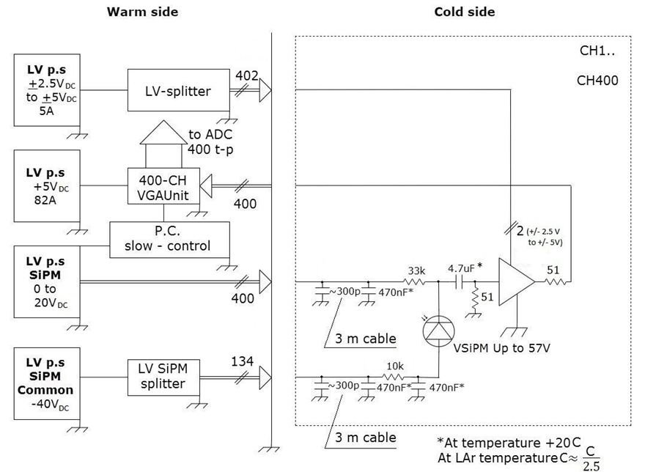
Light Readout Concept Requirements
LV ASIC Bias (LMH6624)
+/-5V, 4A
or +5 to +12V, ?A
LV ASIC Bias Splitter
passive (1→402 ch)
PGA (VGA) LV PS
2 options I/P
+5V/90A
+/-5V/45A
LV SiPM Bias
20V/?A
SiPM Common Bias
-40 to 57V/?A
SiPM Com Bias Splitter
Passive (1→134 ch)
LV ASIC BIAS
+/- 5V
4A
LV PGA BIAS
+5V/90A
OR
+/-5V / 45A
Need PS
Is this for all 4 modules or each module?

Slide 3
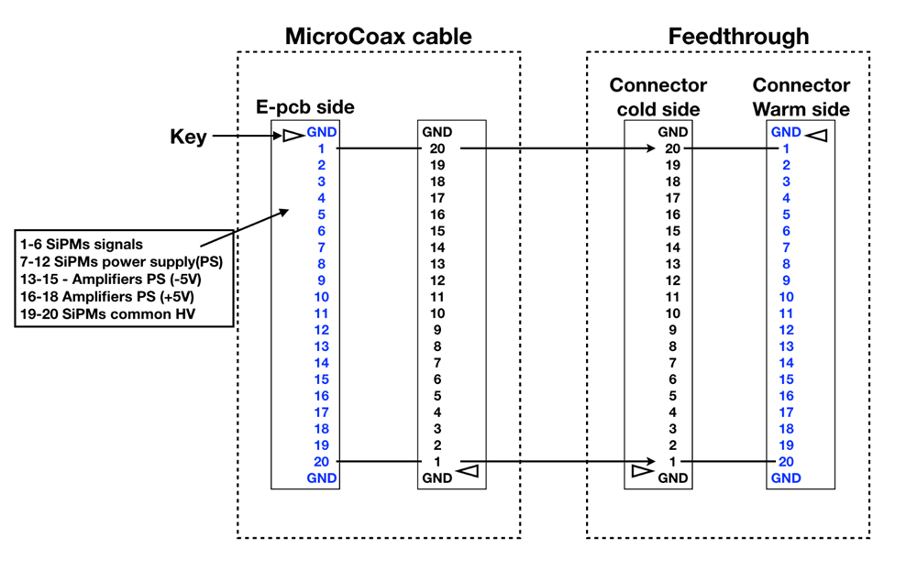
Connectorization—What we have…
Connector and cable part number?
Where is the coax shield connected?
16 connectors per module

Slide 4
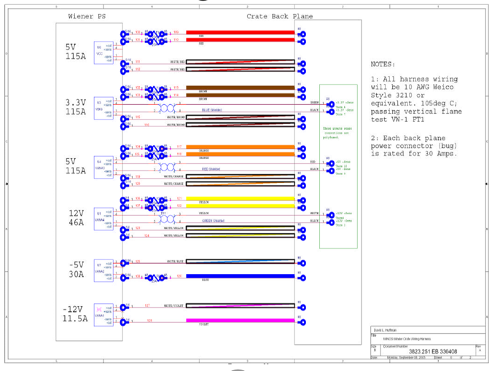
MINOS Minder
LV ASIC Bias (LMH6624)
+/-5V, 4A
PGA (VGA) LV PS
2 options I/P
+5V/90A
+/-5V/45A

Slide 5
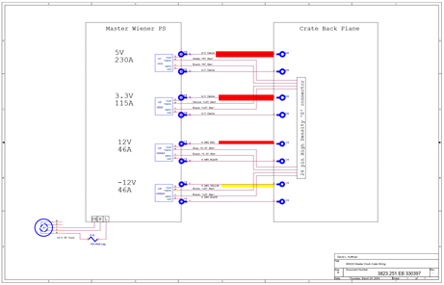
MINOS Master
LV ASIC Bias (LMH6624)
+/-5V, 4A
PGA (VGA) LV PS
2 options I/P
+5V/90A
+/-5V/45A

Slide 6
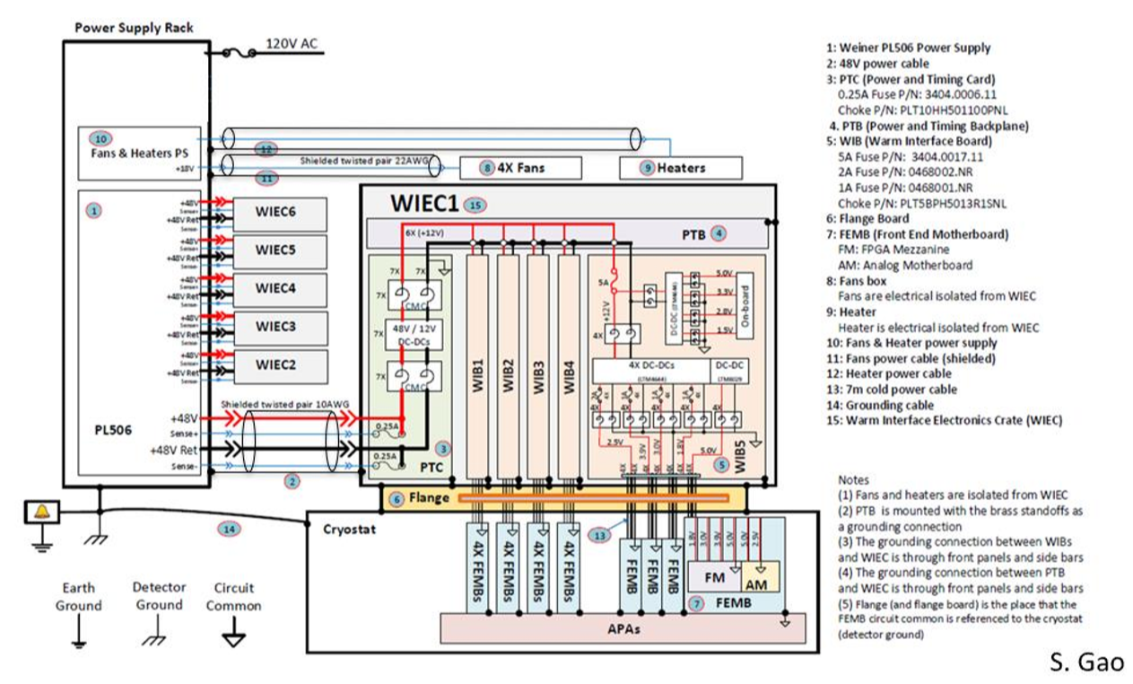
System distribution example

Slide 7
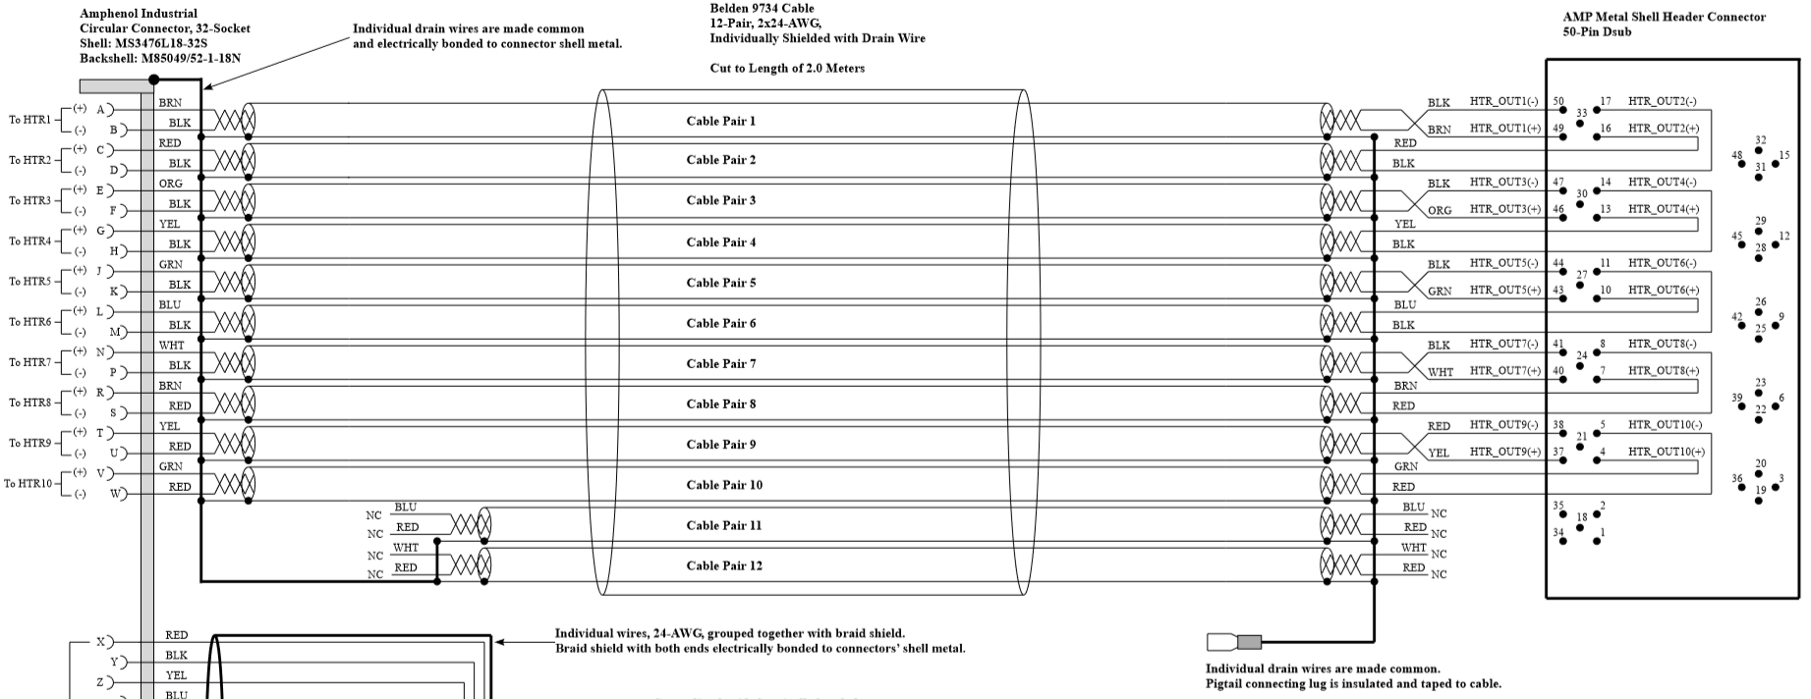
Connectorization—Details we need...
Connector and cable part number
Signal name
Polarity
Pin designation
Conductor color
Shield termination location

Slide 8
SEDR and ORC Information

Slide 9
What is an ORC Review?
Prior to operation, experiments, projects, and R&D (Research and Development) efforts may require an ES&H (Environment, Safety, and Health) review depending on the hazards or risks involved. The ES&H review may consist of multiple reviews by subject matter experts (SME’s) from a variety of committees depending upon the hazards involved. The ES&H review procedure is designed to review these projects and to ensure proper documentation and reviews have been conducted. The Operational Readiness Clearance (ORC) process is used to capture the recommendations, findings, and ultimate recommendation to operate from these various committees.
http://esh-docdb.fnal.gov/cgi-bin/ShowDocument?docid=3311

Slide 10
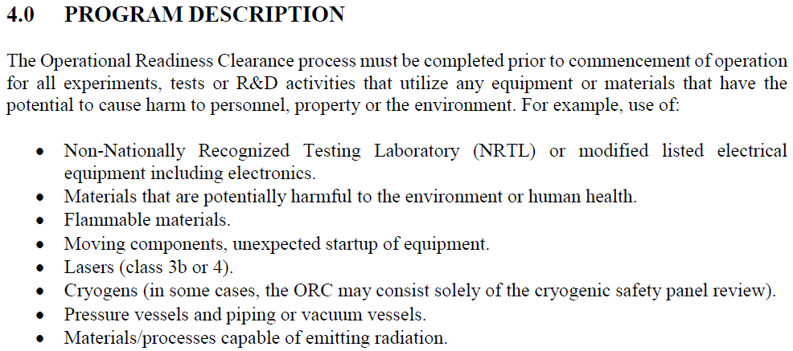
ORC or NOT????
All equipment, temporary or ‘production’, requires a review at some level.
Angela Aparicio and the responsible engineer for the various disciplines looks at each case to determine the level of the review.
Electrical/Electronics equipment: Linda Bagby

Slide 11
Custom vs Commercial Equipment
Custom electrical equipment is defined as electronics that are not commercially available.
Printed circuit boards designed by anyone other than a commercial company (engineer, collaborator, physicist, post doc, grad student).
Chassis containing a collection of commercial parts with internal wiring completed by the user.
Modified commercial equipment.
Extending a power cord.
Equipment that does not contain a Nationally Recognized Testing Laboratory (NRTL) seal.
Commercial electrical equipment typically has a NRTL seal.

Slide 12
Guidance Sources
All experiments within the Neutrino Division (ND) follow the Particle Physics Division (PPD) guidelines for Operational Readiness Clearance (ORC) reviews and utilize the Fermilab Office of Program Planning TSW (Technical Scope of Work) and ORC webpage.
Link to the Particle Physics Division Operational Readiness Clearance (PPD ORC)
http://www-ppd.fnal.gov/ESHBMGOffice/orc.html
Office of Program Planning
http://programplanning.fnal.gov/tsw_orc/
Link to the Fermilab Environment, Safety and Health Manual (FESHM)
http://eshq.fnal.gov/manuals/feshm/

Slide 13
Where does one start??
Use the PPD ORC page to determine the hazards for a given subsystem
http://www-ppd.fnal.gov/ESHBMGOffice/orc.html
Hazard Checklist
http://www-ppd.fnal.gov/eshbmgOffice/SafetyPDFs/HazardIDChecklist.pdf
Hazards include:
Flammable (Gases or Liquids)
Gases
Chemicals
Radioactive Sources
Target Materials
Nuclear Materials
Class 3b or Class 4 Lasers
Electrical Equipment
Mechanical Structures
Vacuum Vessels
Pressure Vessels and Pressure Piping
Fire and Life Safety
Radiation Safety
Trip, Fall, and Strain relief considerations

Slide 14
3 Step Process: Step 1
Safety Engineering Design Review (SEDR)
Performed on custom designed or modified commercial equipment.
Requirements (chassis level)
A SEDR Request document containing:
General description of the chassis.
Simplified (block) electrical diagram of the chassis, including commercial components, with special emphasis on power handling issues. These must be of sufficient detail that reviewers can verify the experimenters have observed good systems engineering practices and have used proper fusing, wire sizes, insulation, termination, etc.
Schematics, Artwork, Bill of Materials, of custom manufactured circuitry or modifications of commercial components of similar detail.
Sample of the equipment to be reviewed.
An Engineering Note is useful.
Should be done during the PRE-PRODUCTION phase of a design to allow time to complete any ‘required’ findings before going into production.

Slide 15
3 Step Process: Step 2
partial Operational Readiness Clearance (pORC)
A mechanism for powering up one subsystem while others are being installed or assembled.
Performed on a subsystem’s fully populated electronics racks or a subsystem’s collection of equipment which will be operated at a test stand, experimental building, or in a beamline enclosure.
Includes all intra AND inter rack connections, including external AC Distribution.
Requirements (rack or subsystem level)
Simplified (block) electrical diagram of entire installation, including commercial components, with special emphasis on power handling issues. These must be of sufficient detail that reviewers can verify the experimenters have observed good systems engineering practices and have used proper fusing, wire sizes, insulation, termination, etc.
Line diagrams of custom manufactured circuitry or modifications of commercial components of similar detail.
Fully populated rack.
Can be done at experiment’s enclosure or other site before racks are moved to enclosure.
Includes SEDR Findings report, subsequent actions, and final approval.

Slide 16
3 Step Process: Step 3
Final Operational Readiness Clearance Walkthrough (ORC)
Documentation consists of a ‘wrapper’ around all of the subsystem partial Operational Readiness Clearance review findings and responses.
This is a final walkthrough by safety to insure the installation is complete and ready to go.

Slide 17
Electrical Equipment Support
On the Particle Physics Division Operational Readiness Clearance webpage, under Electrical Equipment, there are 2 useful links to use as guidance.
http://www-ppd.fnal.gov/ESHBMGOffice/orc.html
Electrical Safety ORC Review Guidelines
http://esh-docdb.fnal.gov/cgi-bin/ShowDocument?docid=3270
Electrical Design Standards
http://esh-docdb.fnal.gov/cgi-bin/ShowDocument?docid=2781
To assist in the preparation of electronics rack builds and a method of organizing documentation for reviews, operations, and maintenance.
Rack Build tool
Electronics Documentation Links

Slide 18
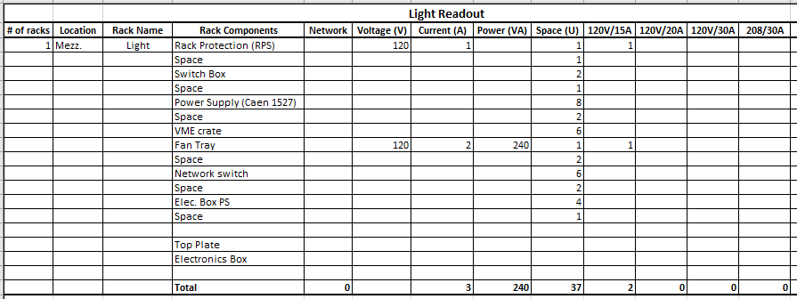
Rack Build Example
List all rack equipment
Useful to have a system block diagram

Slide 19
NRTL Seal and CE Mark

Slide 20
Electrical Equipment Approvals
Per the Department of Energy’s prime directive to Fermilab, Fermilab is required to follow the National Electrical Codes (NEC) and Occupational Health and Safety Administration (OSHA) guidelines.
OSHA requires all commercial equipment to be approved by the electrical Authority Having Jurisdiction (AHJ).
The AHJ for Fermilab is David Mertz.
Nationally Recognized Testing Laboratories list:
https://www.osha.gov/dts/otpca/nrtl/nrtllist.html

Slide 21
CE Mark
OSHA requires Nationally Recognized Testing Laboratories (NRTLs) to be independent from the manufacturer.
The CE mark is a manufacturer’s self-certification, therefore, the mark does not meet OSHA requirements.
https://www.osha.gov/dts/otpca/nrtl/nrtl_faq.html
For custom designs or CE marked equipment, there are 3 solutions:
Safety Engineering Design Review (SEDR).
Have vendor obtain a Nationally Recognized Testing Laboratory (NRTL) listing so the equipment bears a NRTL seal.
Have a Nationally Recognized Testing Laboratory (NRTL) representative perform a field inspection of the equipment on site.

Slide 22
Summary
A ‘low noise’ AC Distribution system will be used at Fermilab.
Equipment must operate at voltages/frequency readily available on the US power grid.
All set-ups must have a safety review. Level of the review is based on hazards.
Generate block diagrams of all systems.
Power requirements (voltage/current) must be provided for all equipment.
Identify building or detector power.
Use the Rack Build tool to itemize equipment.

