Slide 1
Low Energy Calibration
Robert Svoboda
2020 CALCI Review
May 28, 2020

Slide 2
Content
The calibration systems
Why do low energy calibrations?
Systematic uncertainties in LBL Physics
Supernova physics
Other physics
What do we get from low energy calibrations?
Absolute energy scale
Detector variations over the active volume
Time-dependent variations
Previous Experience

Slide 3
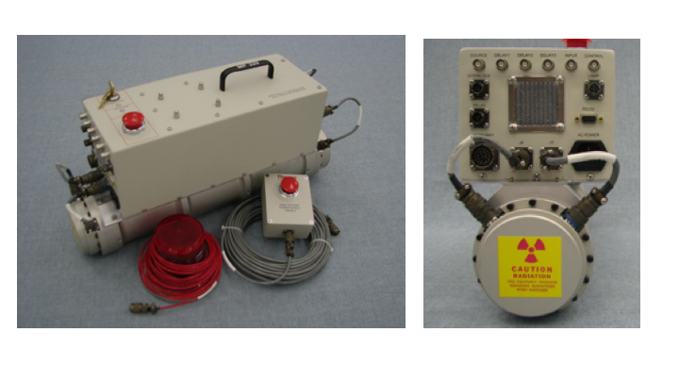
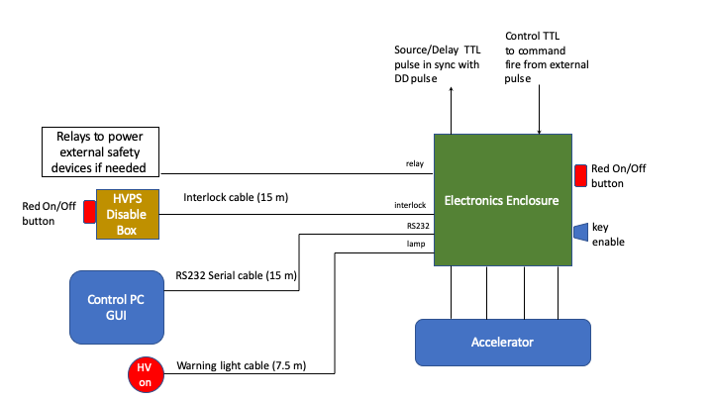
Pulsed Neutron Source
Deuterium-Deuterium (DD) generators are sources that produce a short (5-200 μs) pulse of neutrons via the reaction:
Typical DD generator source
Typically 100-1000 n/pulse
No neutrons when turned off
Commercially available ~$175k
Portable
DT used in many physics experiments
Super-Kamiokande, SNO, SNO+,…
Control setup for CERN test

Slide 4
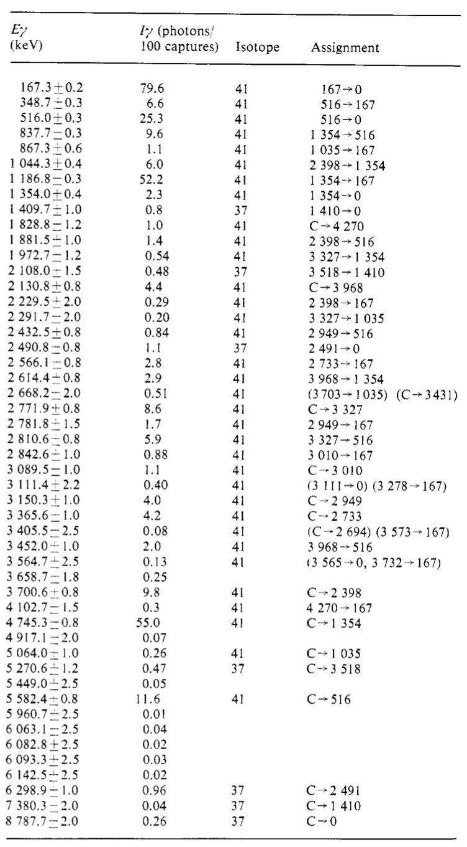
Pulsed Neutron Source
Deployed outside the cryostat so no issues with contamination or operation in a cold environment
Neutrons can travel many meters into the detector and reach all parts of the active volume
The basic calibration is via neutron capture on 40-Ar which yields a 6.0988 MeV gamma cascade.
38-Ar and 36-Ar give 6.6 and 8.8 MeV but are only 0.4% abundance
gamma cascade
from natural argon
well-understood to,
with the SUM
of gamma enegies
understood to
4 significant figures

Slide 5
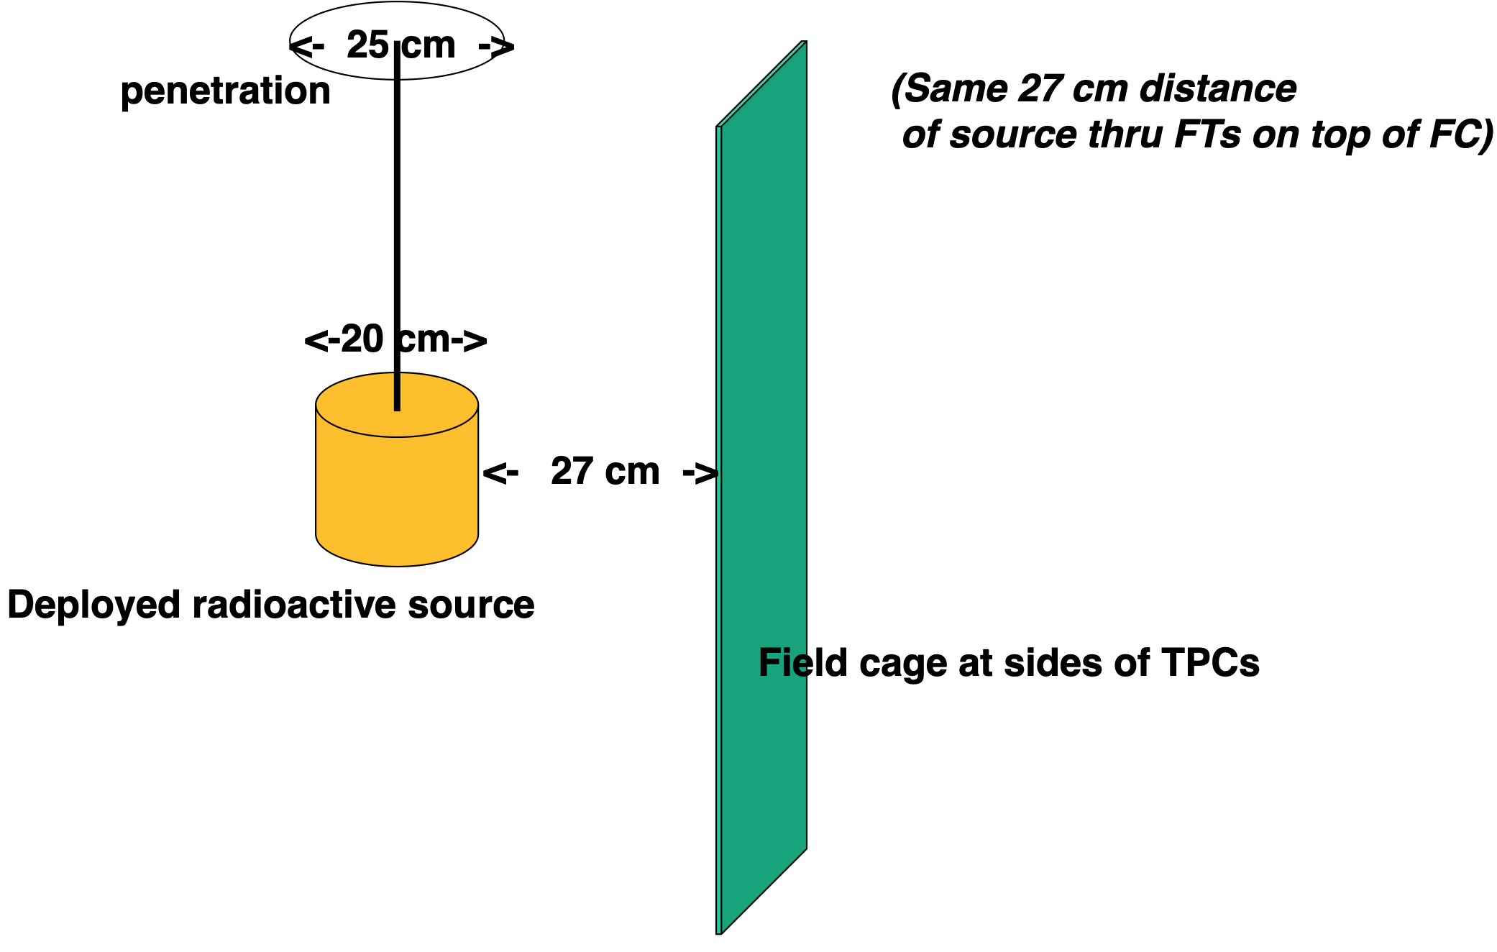
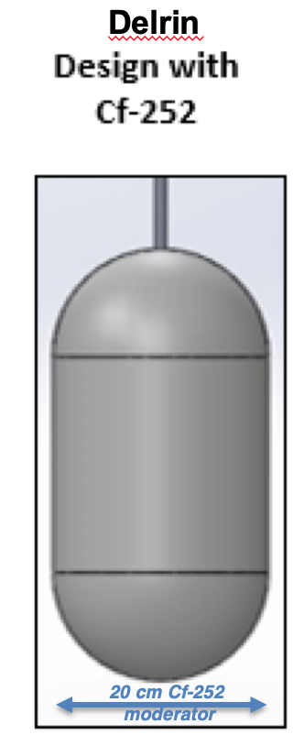
Radioactive Source Deployment
A Cf-Ni gamma source can be deployed to specific locations in the detector to give precision 9 MeV gamma measurements
Completely passive device
Gamma spectrum well-understood
Very inexpensive
source is sized
to fit into a standard
25 cm port.

Slide 6
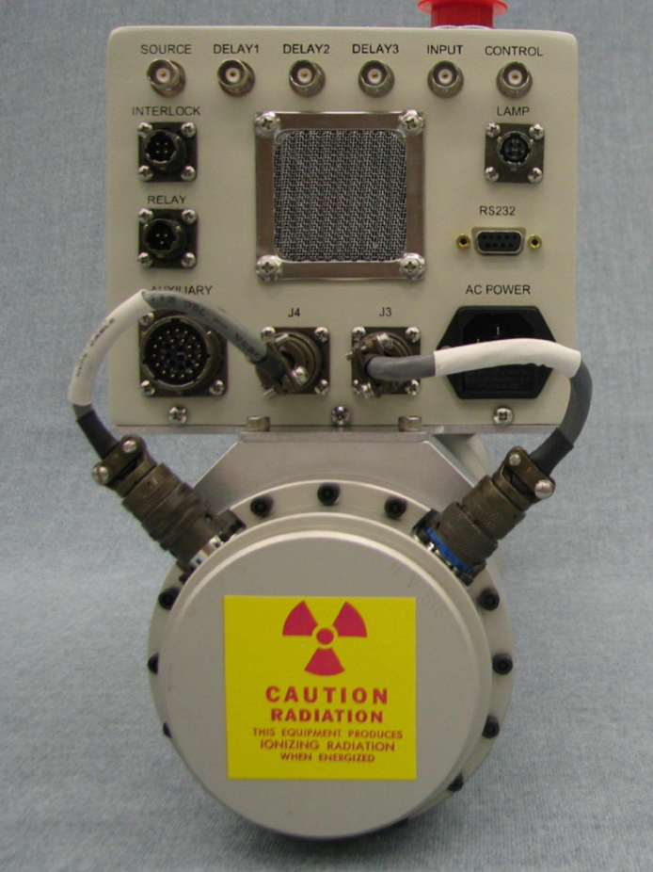
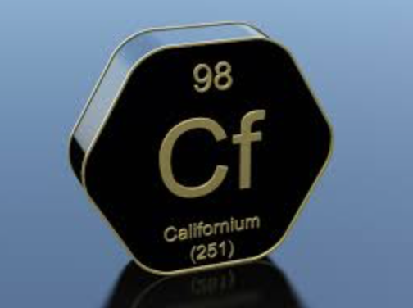
Why do we need these devices?

Slide 7
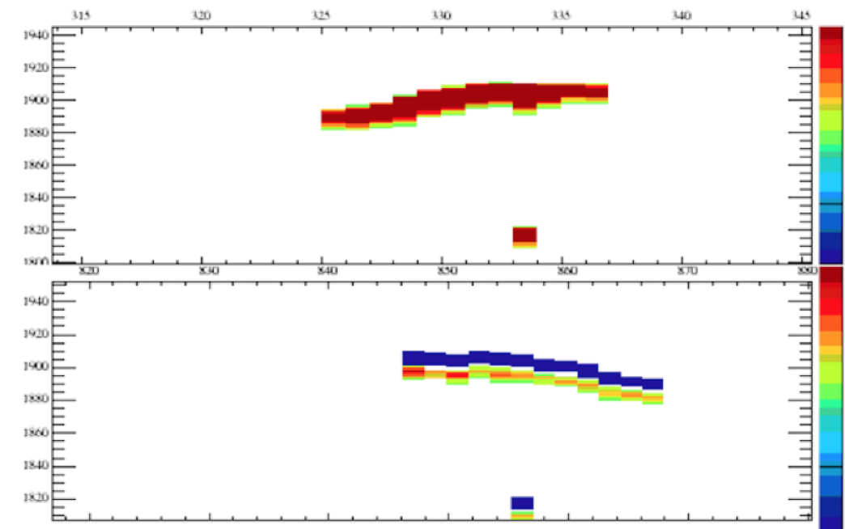
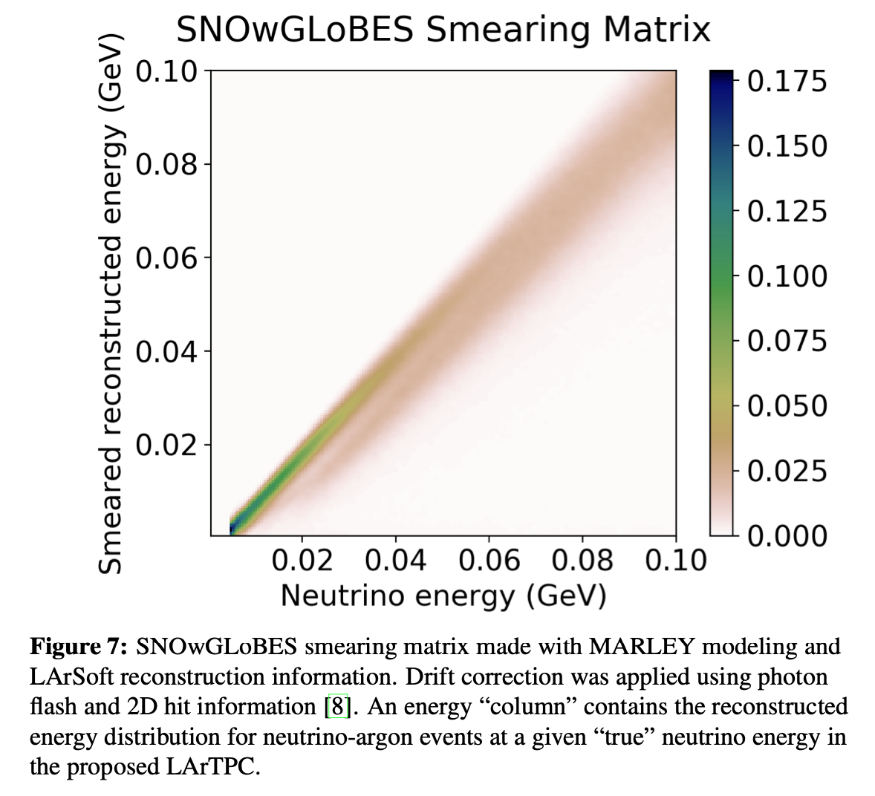
Supernova
The requirements for energy resolution for SN events are fairly loose since the complexity of the final states (including neutrons) systematically smears the reconstructed energy
The requirements on the energy threshold for individual events to be recorded and the trigger efficiency are more relevant
Smearing of MARLEY generated events by physics and reconstruction is equivalent to roughly a 20% energy resolution
Report by E.Conley DocDB-14068 details the effects of detector performance on SN spectral parameter measurements
Simulation of 30 MeV SN neutrino interaction in DUNE
(E.Conley, DocDB-14068 v7, 2019)

Slide 8
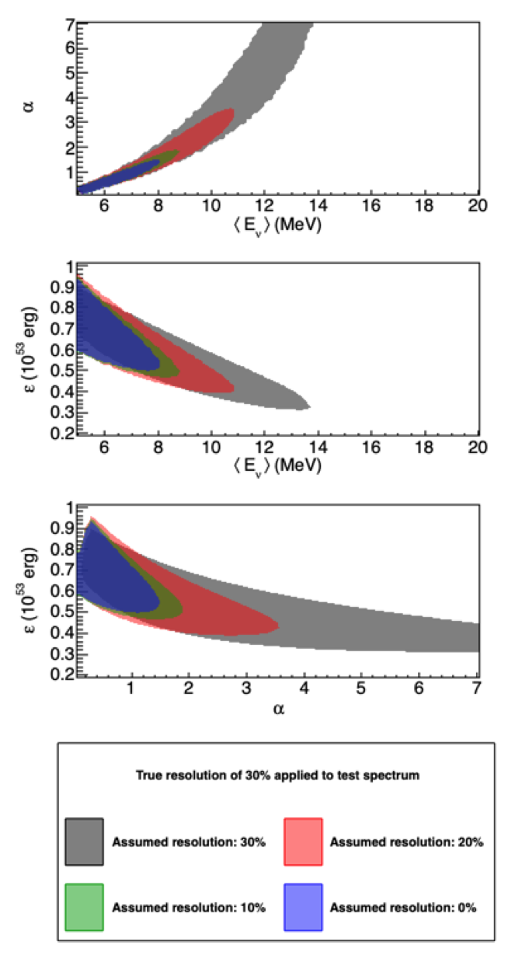
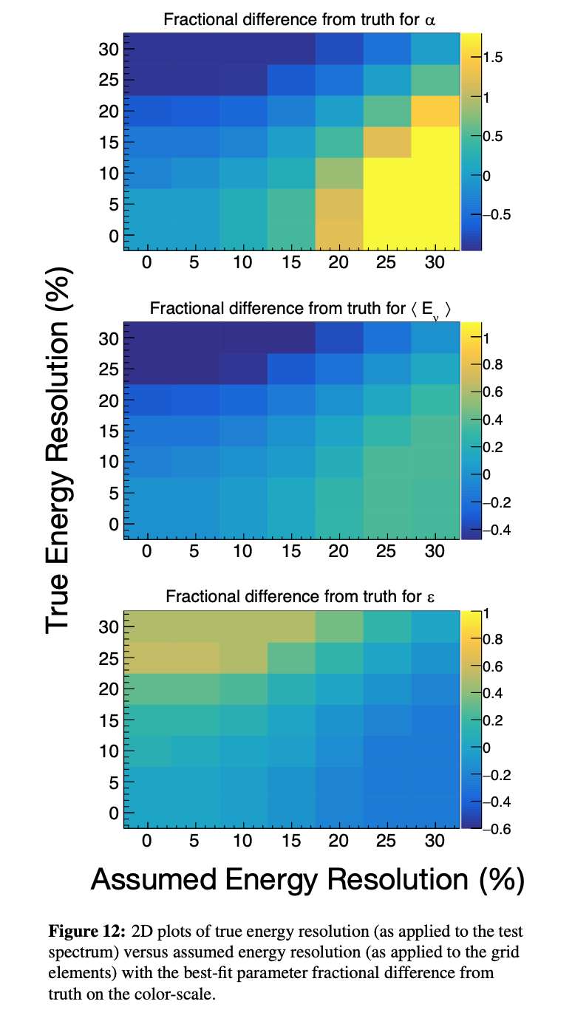
Supernova
(Left) Effects on SN spectral parameter measurements for making wrong assumptions on a “true” 30% energy resolution
(Right) Fractional difference from the
“true” value of spectral parameters from incorrect energy resolution assumptions
Recommended Uncertainty
Requirements:
Energy Scale: <5%
Energy Resolution: <10%
Energy Threshold
Uncertainty: <1.5 MeV
(E.Conley, DocDB-14068 v7, 2019)
note: this study assumes a 5 MeV step threshold – current expectation is higher with more gradual turn on.

Slide 9
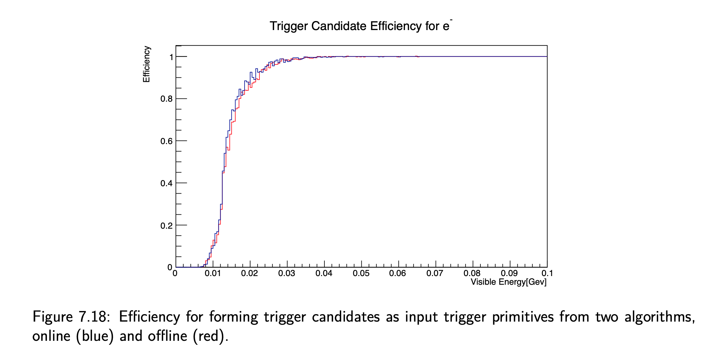
Trigger efficiency (TDR)

Slide 10
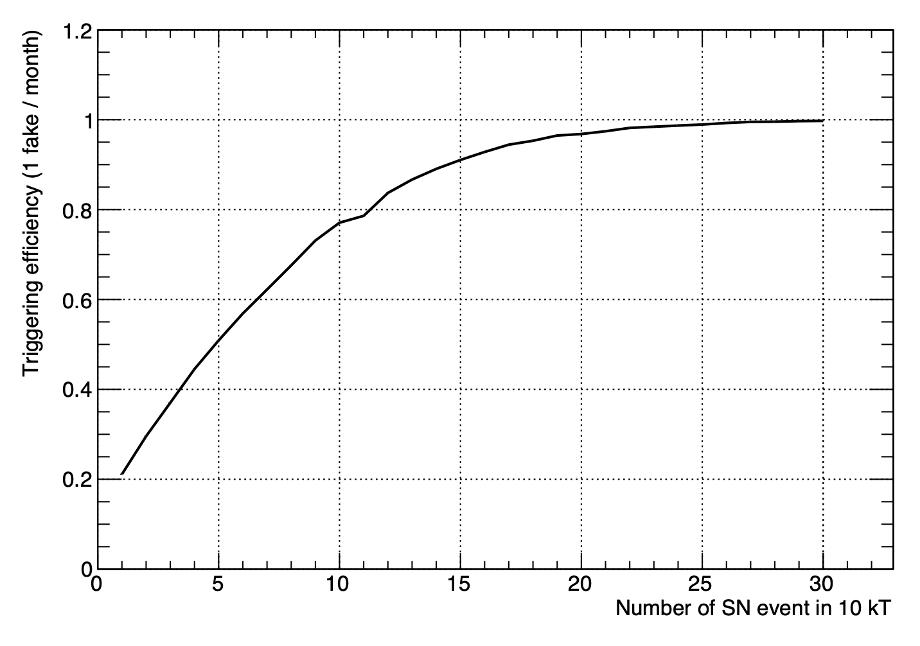
Supernova Burst Trigger
LMC
100% inside
our home galaxy
current trigger algorithm efficiency as a function of number of events in a 10 kton module of the SP FD
(from TDR)
(Note: this may change depending
on the neutron background)
Testing of the SN trigger algorithm is critical, as it is not a simple system and depends on being able to correlate small over the whole detector. The PNS is essentially a “fake” SN with the 6.1 MeV energy and few second time scale similar to what is expected.

Slide 11
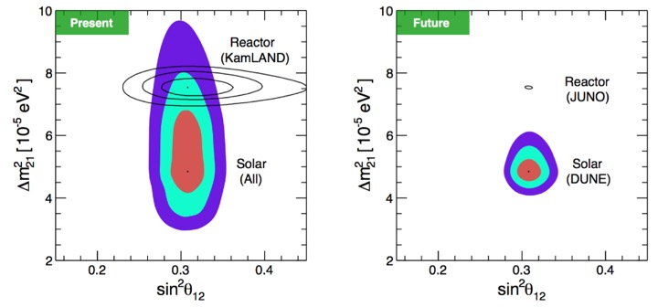
Other Physics: Solar
Achieving an energy resolution of 7% at 5 MeV could allow DUNE
to make an important measurement in solar neutrinos. Exact energy
uncertainties yet to be determined, but low energy calibrations are certainly key.
8-B neutrino
day/night effect
measurement
using both
ES and ArCC
100 kton-yrs

Slide 12
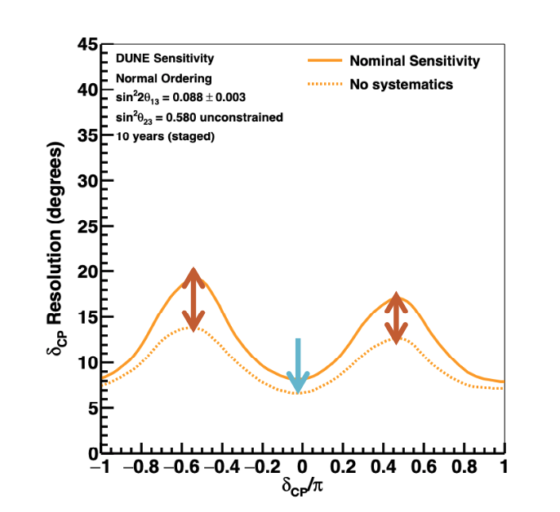
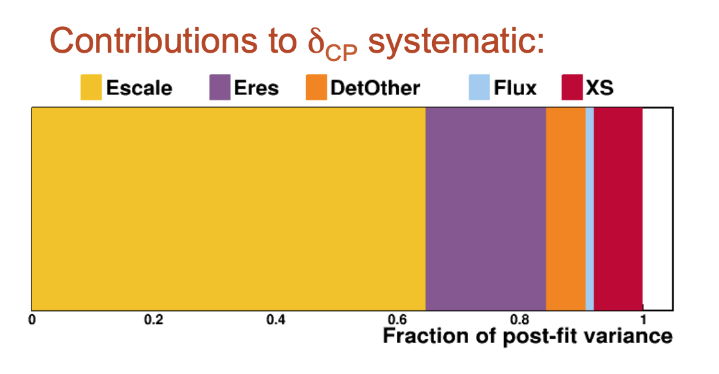
Systematic uncertainty in δ_{CP} due to the absolute energy scale
This is the major detector uncertainty
remaining after ND inputs
assumes 2% systematic
shift in energy scale
Includes full FD simulation and automated
reconstruction; parametrized ND samples;
detailed treatment of systematics
..of course, this assumes
the energy scale shift is
constant over 7 years
(E.Worcester, ND Review June 2019)

Slide 13
Systematic uncertainty in δ_{CP} due to the absolute energy scale
How will we reach 2% energy scale uncertainty?
Through-going CR muons
dE/dx issues underground
coverage and rate
Stopping CR muons
coverage and rate
Low energy sources
extrapolation issues
What role can calibration sources at ~10 MeV play in physics at ~1 GeV?
Could the uncertainty be reached with CR muons?

Slide 14
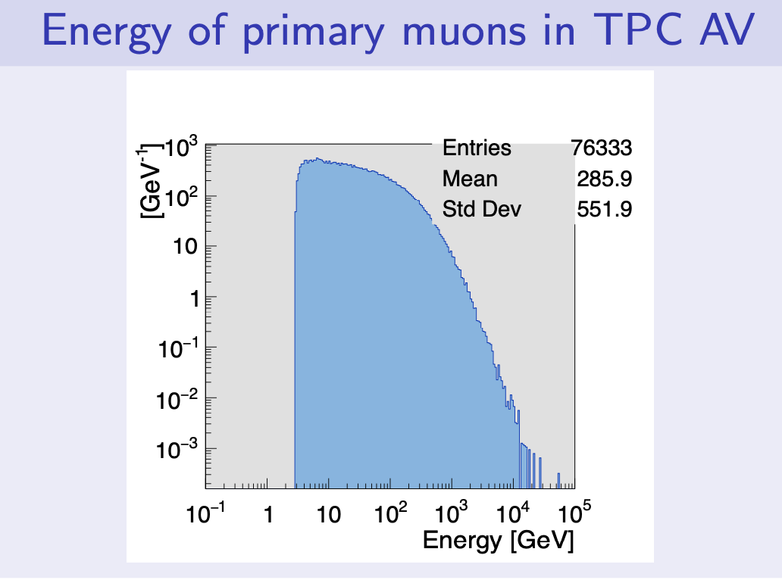
CR Muon Energy Spectrum
muon energy distribution at sea level
30.6 days of throughgoing CR muons
Mean E_{μ} ~ 4 GeV
3% stopped μ
Adam, W. & Bergauer, Thomas & Dragicevic, Marko & Friedl, M. & Frühwirth, Rudolf & Haensel, S. & Hrubec, J & Krammer, M & Oberegger, M. & Pernicka, M. & Schmid, Stefan & Stark, R. & Steininger, H. & Uhl, D. & Waltenberger, Wolfgang & Widl, Edmund & Mechelen, P. & Cardaci, M. & Beaumont, W. & Tsang, K.. (2009). Performance studies of the CMS Strip Tracker before installation. 10.1088/1748-0221/4/06/P06009.
V.Pec Cosmic WG update 20200326

Slide 15
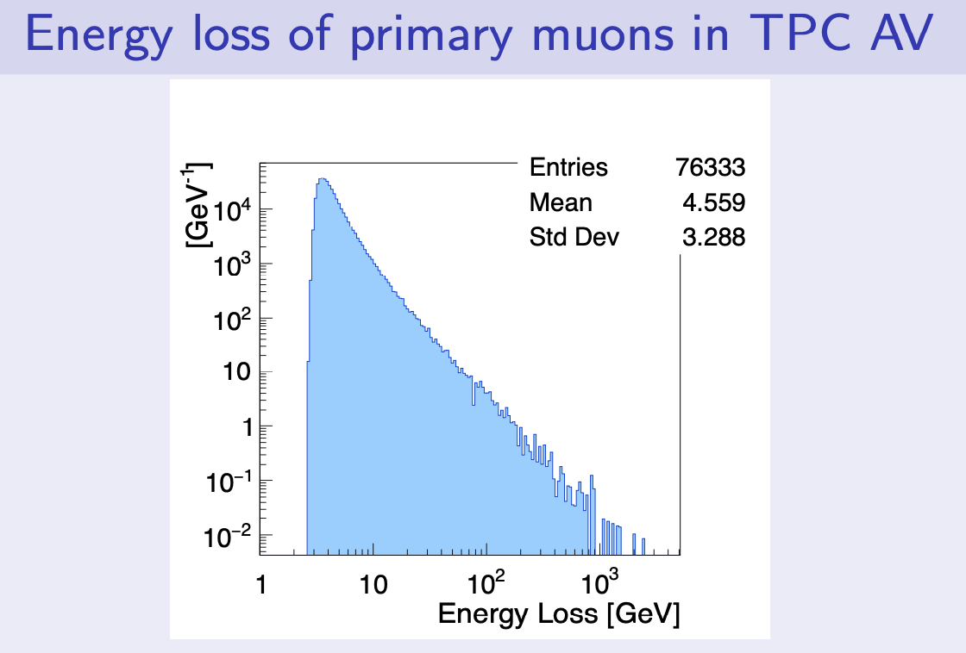
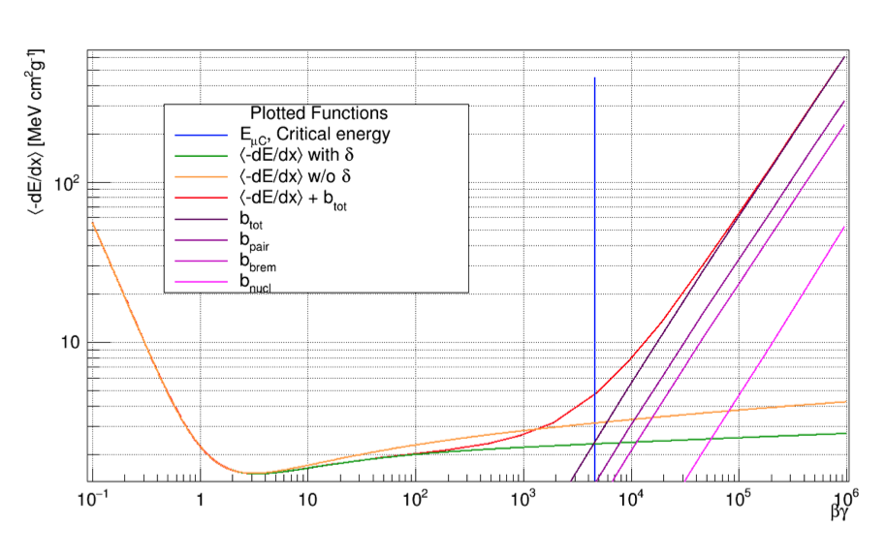
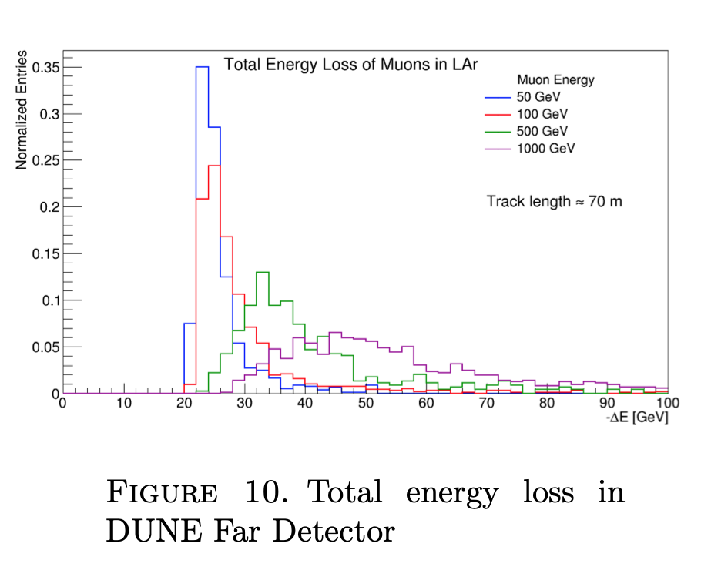
CR Muon Energy Loss
mean energy
(Ingles, Junk, and Marchionni)
V.Pec Cosmic WG update 20200326
variation in
muon dE/dx
for fixed
energy muons
At 280 GeV simulations show a wide
spread in dE/dx due to the fact that
Bremsstrahlung and direct pair production
become increasingly important.
Michels from stopped muons are useful,
but only about one every 8 minutes/module

Slide 16
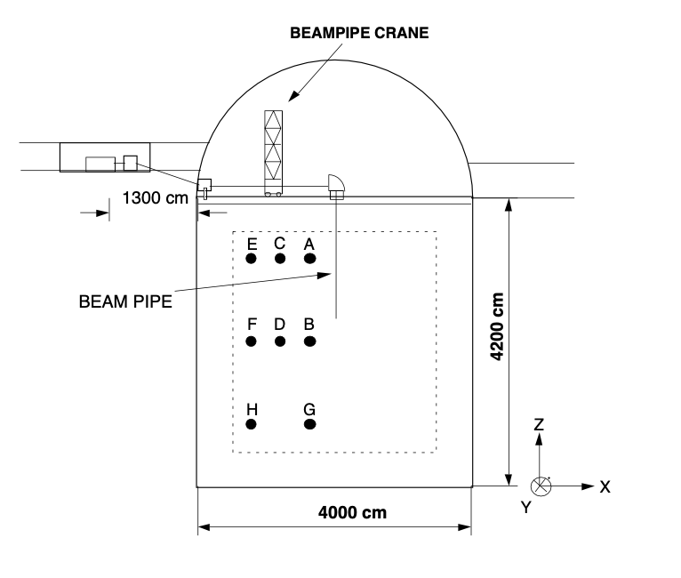
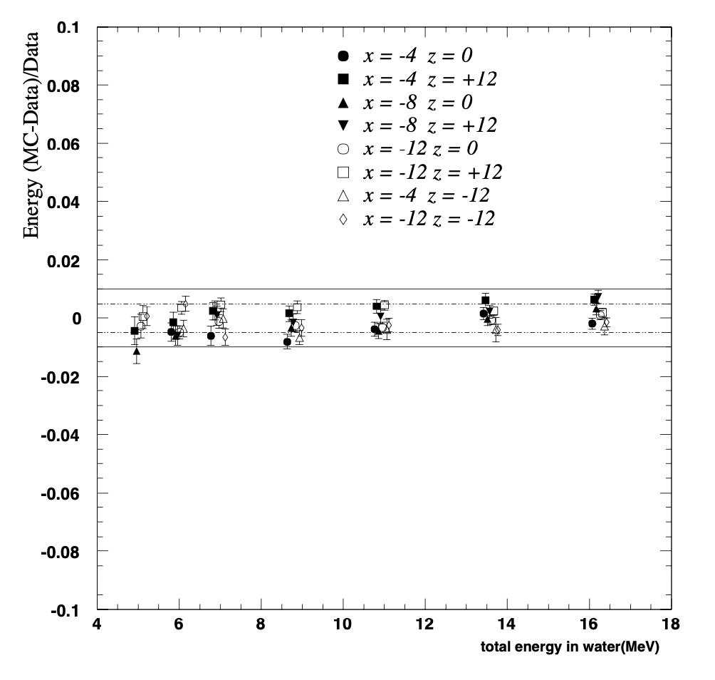
Super-Kamiokande Experience
Repeated at
many locations
At low energy Super-Kamiokande was able to achieve and maintain <1% systematic shift in the energy scale
DT generator every few months
Electron LINAC with a moveable beam pipe into the fiducial volume
Automated optical and electronics calibration nearly continuously
+/- 1%
(MC-Data)/Data
direct injection
LINAC data
Electron energy

Slide 17
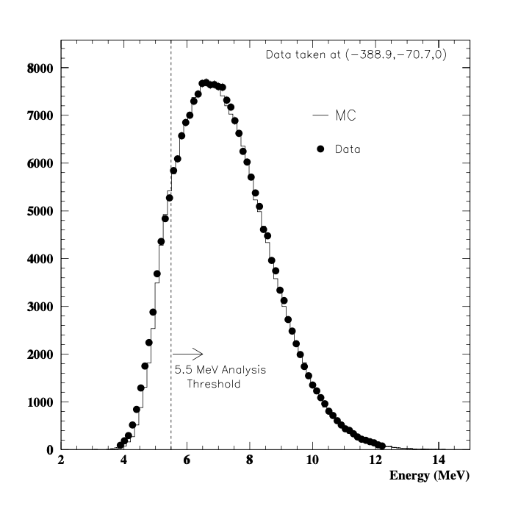
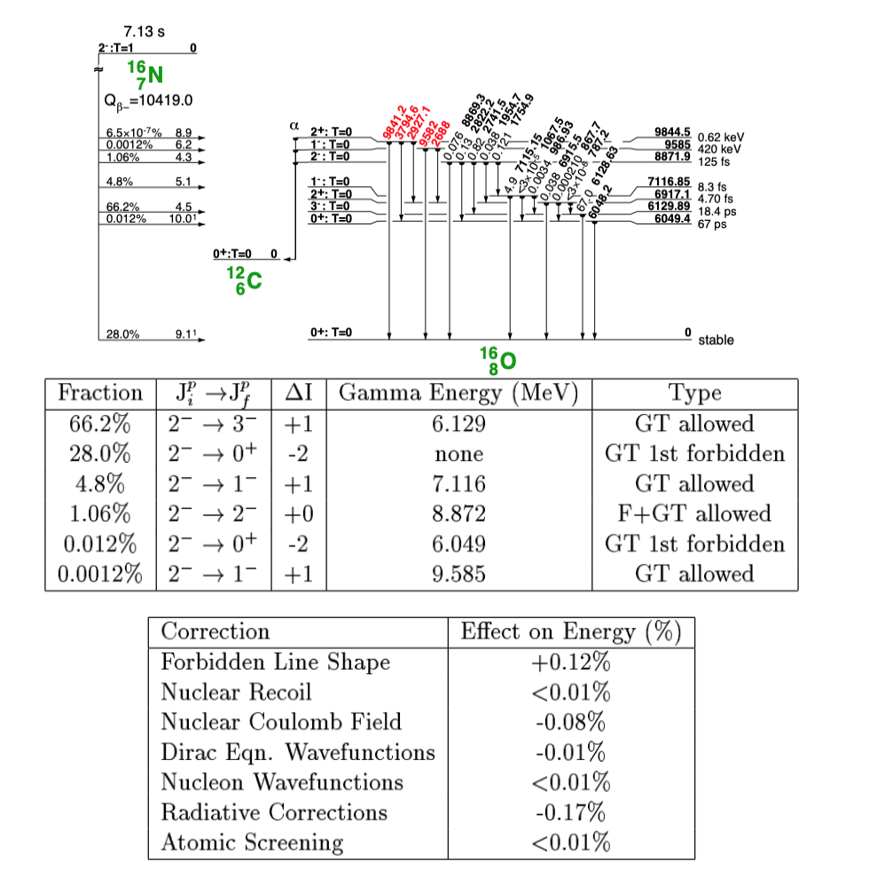
Super-Kamiokande Experience
Need to know the systematic
uncertainties in the standard
candle physics to <1%
(R.Svoboda, et al)
Absolute energy scale to 0.7% accuracy

Slide 18
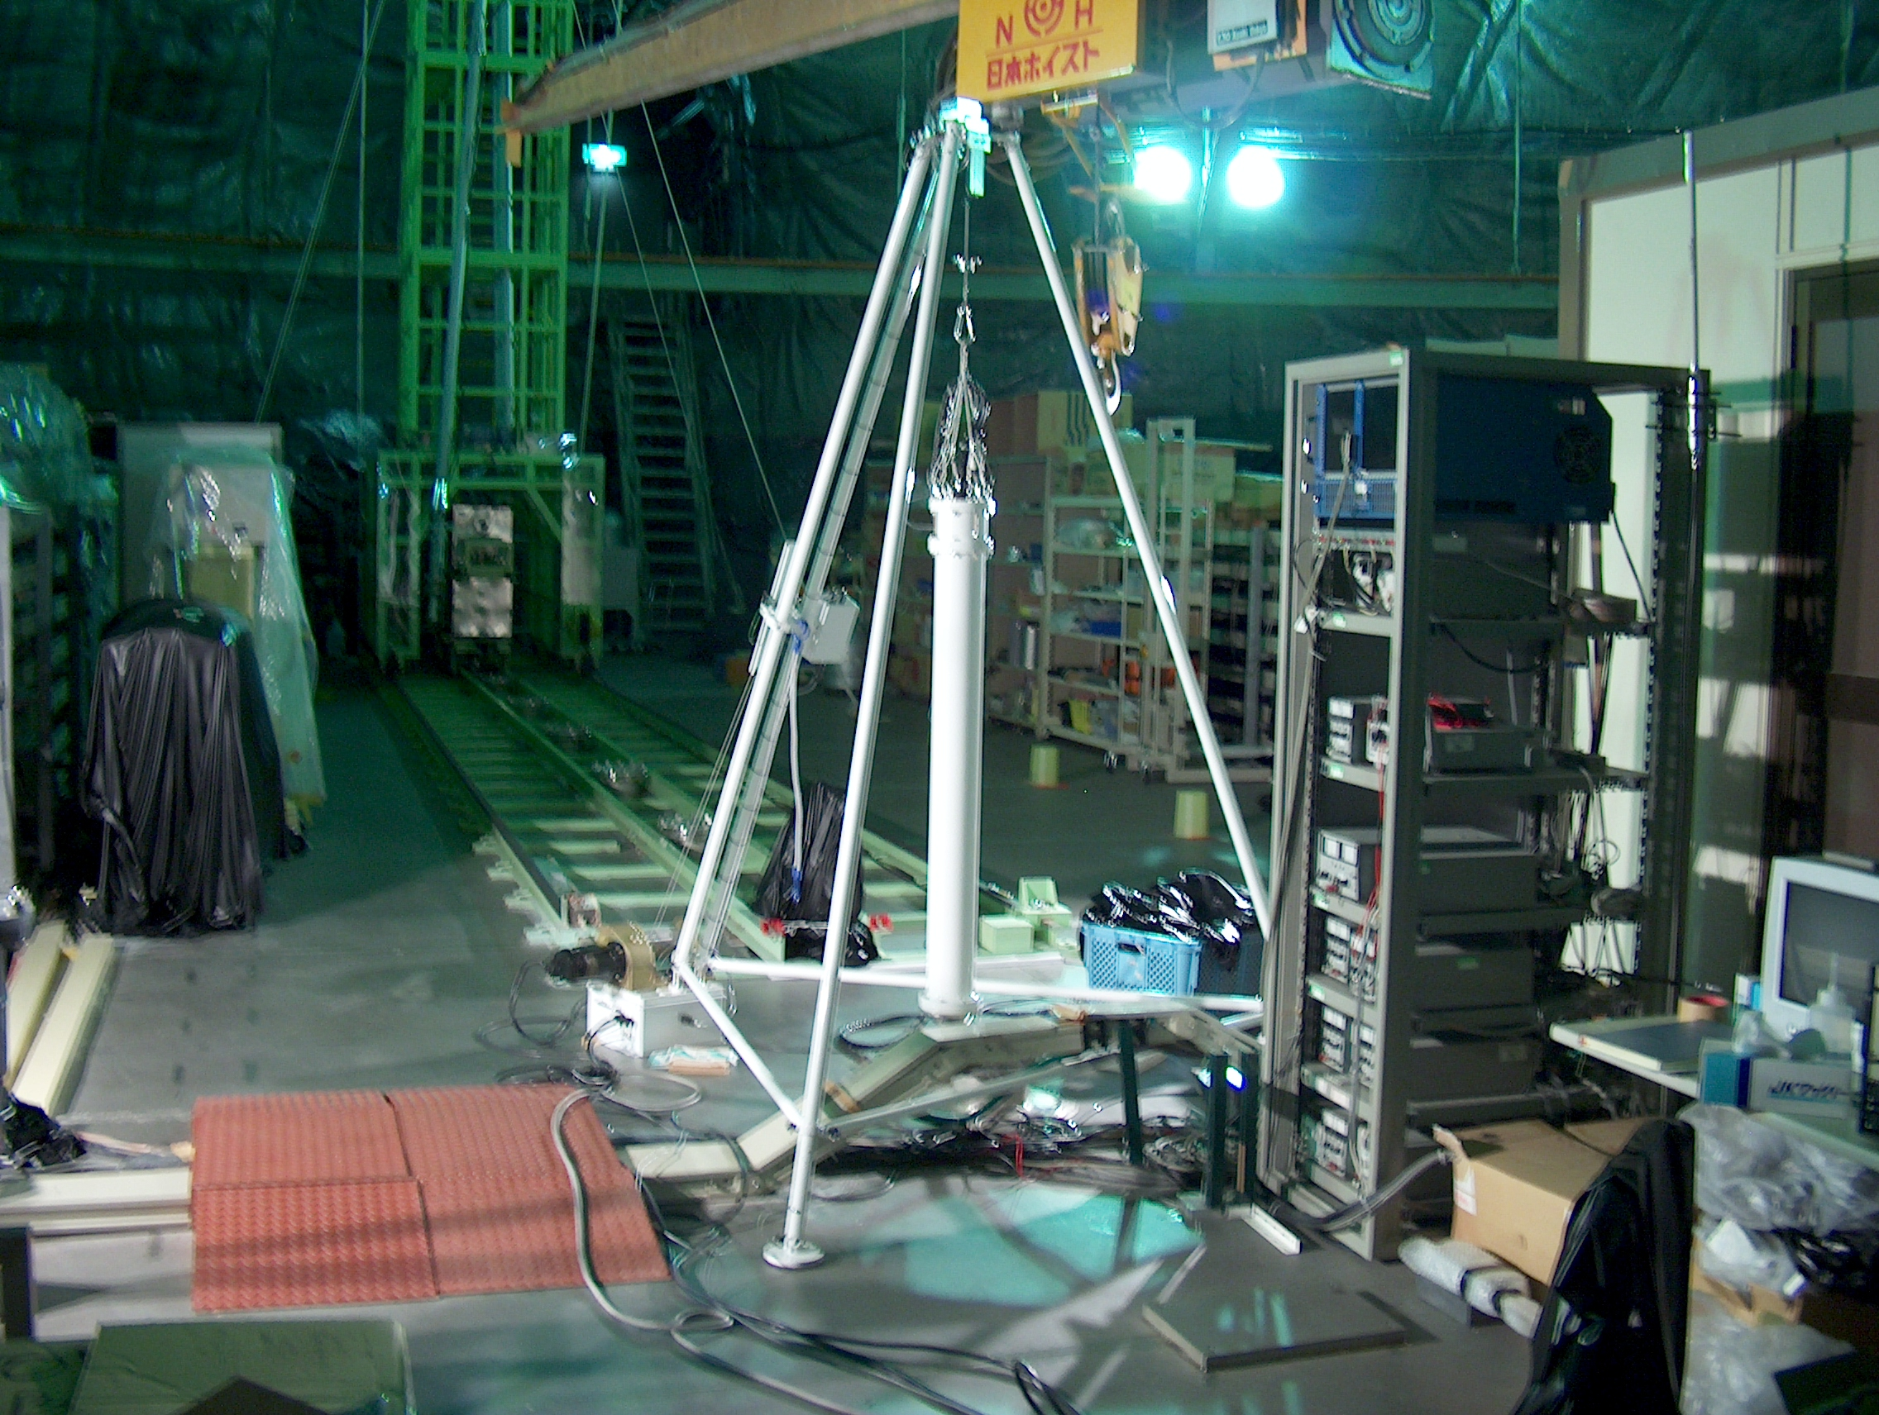
Super-Kamiokande Experience
Moveable
LINAC
At low energy Super-Kamiokande was able to achieve and maintain <1% systematic shift in the energy scale
DT generator every few months
Electron LINAC with a moveable beam pipe into the fiducial volume
Automated optical and electronics calibration nearly continuously
Portable
DT Generator

Slide 19
Time Variation in SK
In SK it was not enough just to do a calibration once in a single spot
Moveable LINAC that could be placed at many different radii and depths, and a deflecting magnet to change electron direction
Portable DT generator that could do a complete calibration at a single port in about a day.
Experienced changes in backgrounds due to circulation ”cells” that formed in the large tank due to miniscule temperature variations of few tenths of a degree. These patterns were affected by forced circulation configuration from pumps.
Need to make sure that 1996 neutrino energy scale and resolutuon are the same as 2016 energy scale and resolution. In all DUNE studies I am aware of this is automatically assumed.
Will not automatically be true…

Slide 20
Time Variation in DUNE
We should not expect the DUNE cryostat to be a benign isothermal mass of liquid argon with no currents or variation in drift parameters over a decade
We should not expect that the energy scale measured in 2026 for neutrinos will be the same in 2036. Need to prove it to be credible
Need a “standard candle” that is invariant over decade time scale and can be deployed in many different locations
BTW – It would be interesting to look at a systematic energy scale shift between neutrino running and anti-neutrino running, as they occur years apart.

Slide 21
Time Variation in DUNE
Will neutrinos measured
in 202x have the same
Energy scale systematic as
anti-neutrinos in 202x+7?
Need to prove that it is so.
Our competition will.

Slide 22
Conclusions
Energy scale systematic shifts and energy resolution uncertainties affect all our physics measurements
Number of options for calibrations is very limited, but low energy sources represent one way to address problems in spatial and time variation across the detector
Experience with previous precision neutrino measurements calls for a relentless program of calibration checks by as many techniques as possible.

Slide 23
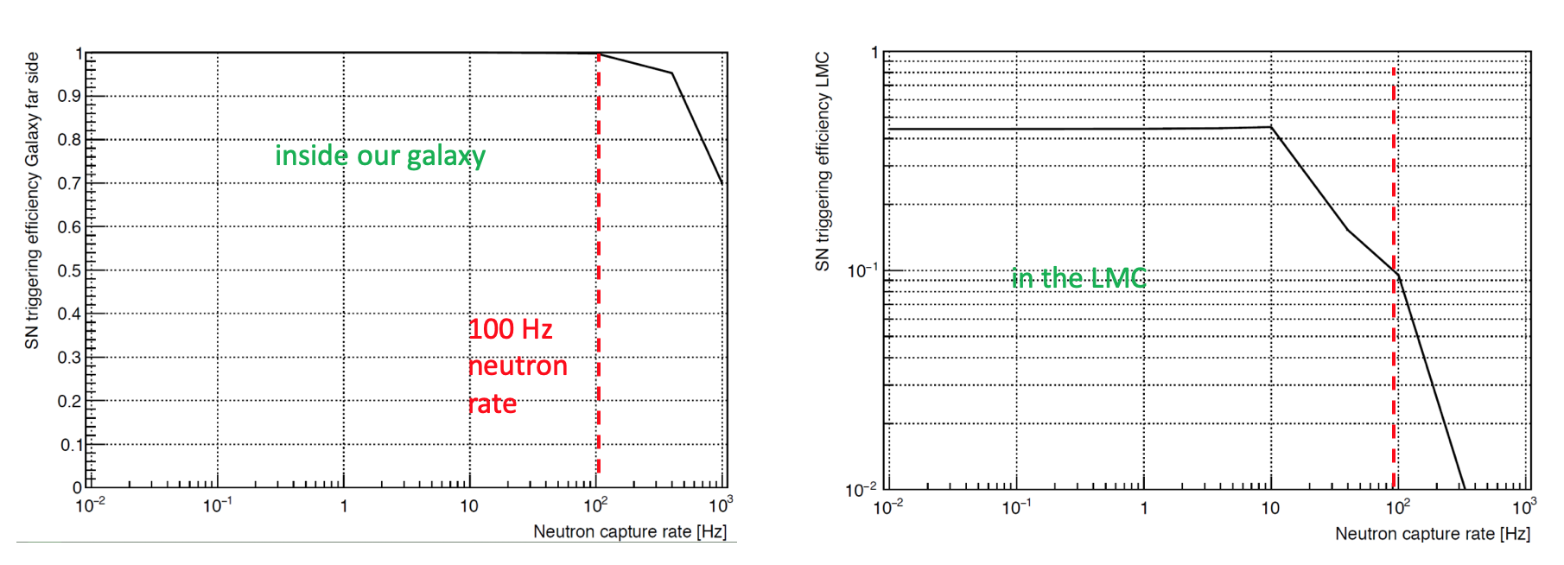
Supernova Trigger: background effects
current trigger algorithm efficiency as a function of neutron background rate

Slide 24
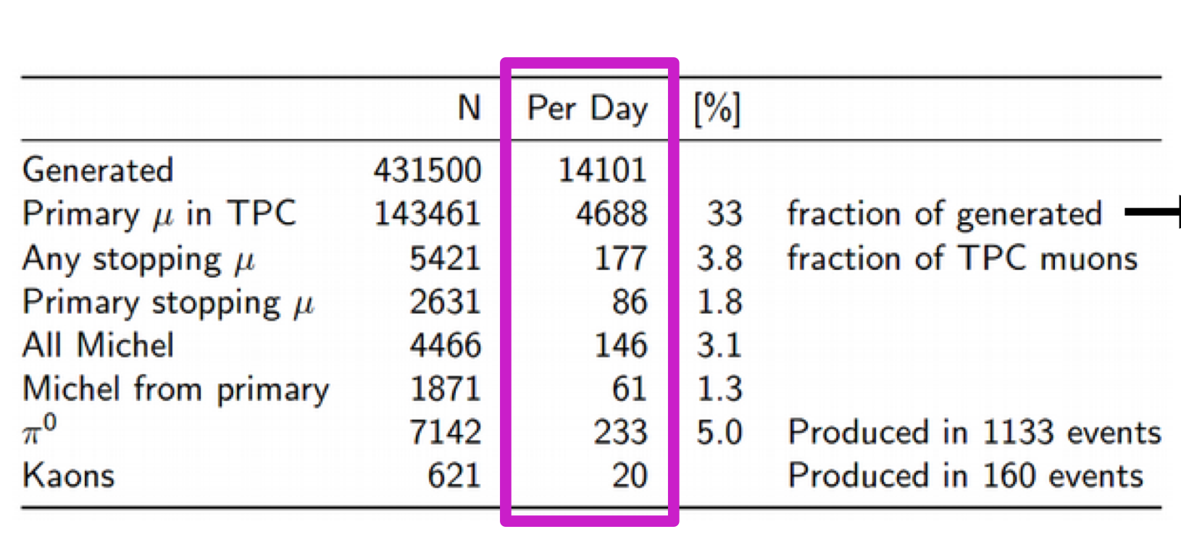
Cosmic Ray Rates

Slide 25
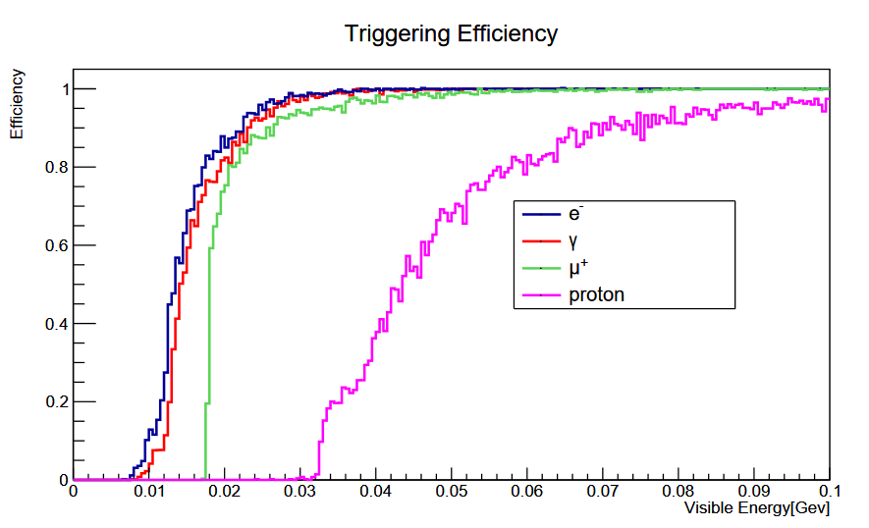
Trigger Efficiency with Electron/γ Sample
David Rivera, David Last & Josh Klein
(with default DAQ trigger
and continuous data taking)
DUNE threshold in TDR
(majority of RSDS data planned to be recorded with just one APA at a time recording ALL hits free-running
and rest of detector uses default DAQ trigger and continuous data taking w/ partitioned DAQ
-> can offline compare to the definition of efficiency for SN bursts and single solar neutrino events)

