Slide 1
HB650 Minimum MAWP Analysis
13 May 2020

Slide 2
Assumptions
Only analyzing the last/furthest HB650 in the tunnel, which is the worst case
Required relief rate is 4.5 kg/s using the same methodology as LCLS-II cryomodules.
Assuming 6” vent header coming out of HB650, connects to a rupture disc and then goes into 10” vent header which runs through the entire tunnel + a short vertical run out of the tunnel. Total length is ~230 m.

Slide 3
Required Relief Rate
Loss of beam vacuum
Use the same methodology as LCLS-II cryomodule, based on tests done on DESY/TESLA cryomodules
Heat flux on uninsulated surface is scaled from 1.6 W/cm² for DESY/LCLS-II cryomodule based on orifice size
Biggest beam orifice diameter is 71 mm in HB650 vs. 76.5 mm in LCLS-II
1.38 W/cm² heat flux to HB650 beam tube, scaled based on orifice area 1.38 = (71^2/76.5^2)*1.6
total uninsulated cavity surface area is 3.78 m²
total heat load is 5.21E04 W
Latent heat of liquid helium is 2.34E04 J/kg
required relief rate is 2.23 kg/s
Loss of insulating vacuum
Use the same methodology as LCLS-II cryomodule, based on tests done on DESY/TESLA cryomodules
Heat flux on insulated surface (10 layers of MLI) is 0.6 W/cm²
17.24 m² insulated 2 K surface area in HB650, including cavity vessels, 2 phase pipe, 2 K return pipe and 2 K supply line
Total heat load is 1.03E05 W
Latent heat of liquid helium is 2.34E04 J/kg
Required relief rate is 4.4 kg/s (round up to 4.5 kg/s to account for uncertainties)
This is the worst case relief rate.

Slide 4
Pressure drop in relief header, 4” rupture disc
Pressure at cavity is 2.38 bara, 110% of the MAWP (2.17 bara)
Pressure drop across rupture disc
1.3 bar of 1.4 bar pressure drop occurs in the vent header.
Note:
no margin for relief capacity.

Slide 5
Summary
Relief Capacity [kg/s] | Relief Capacity Margin | Minimum MAWP [bara]
 |  | 3” RD | 4” RD | 6” RD
4.50 | 0% | 2.32 | 2.17 | 2.11
4.95 | 10% | 2.52 | 2.35 | 2.28
5.40 | 20% | 2.72 | 2.53 | 2.46

Slide 6
To reduce to 2 bar MAWP – Option 1
One way to allow lower MAWP is shorten the relief/vent header. Current relief header in CDS is ~230 m for the last HB650.
Assuming the cryomodule relief header stays the same.
Using a 6 inch rupture disc.
Relief Capacity [kg/s] | Relief Capacity Margin | Max Header Length [m]
4.50 | 0% | 215
4.95 | 10% | 185
5.40 | 20% | 164

Slide 7
To reduce to 2 bar MAWP – Option 2
Another way to allow lower MAWP is to reduce required relief rate, which is 4.5 kg/s during lost of insulating vacuum.
To reduce the required relief rate, the insulating vacuum pumping port sizing has to be reduced.
Apply the same methodology used for beam orifice, the heat flux can then be scaled from 0.6 W/cm²
If the pumping port (orifice most likely to introduce loss of insulating vacuum) is smaller 65.5 mm in diameter, the heat flux can then be scaled down to 0.48 W/cm² (0.65 W/cm² from DESY crash test, 76.5 mm orifice diameter. (65.5/76.5)^2 * 0.65 = 0.48).
The required flow rate is thus reduced to 3.51 kg/s.
Relief header capacity with 20% margin is 4.21 kg/s when HB650 has 2 bar MAWP.

Slide 8
Fast Cooldown
Preliminary fast cooldown calculation was completed
Assumptions:
Pressure at cavity location limited to 2 bara
Pressure at the compressor suction fixed at 1.1 bara
CMs | Slow cooldown flow rate g/s | Fast cooldown flow rate g/s
SSR1 | 12 | 33
SSR2 | 12 | 33
LB650 | 29 | 70
HB650 | 29 | 70
HWR | 9 | 70

Slide 9
Thank You

Slide 10
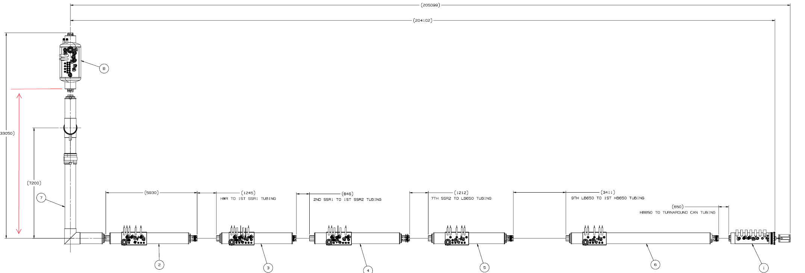
Backup , relief header geometry

Slide 11
Backup, snapshot of calculation spreadsheet

