Slide 1
HWR Status and Cryogenic Overview
A Partnership of:
US/DOE
India/DAE
Italy/INFN
UK/UKRI-STFC
France/CEA, CNRS/IN2P3
Poland/WUST
Joe Ozelis
05/14/20

Slide 2
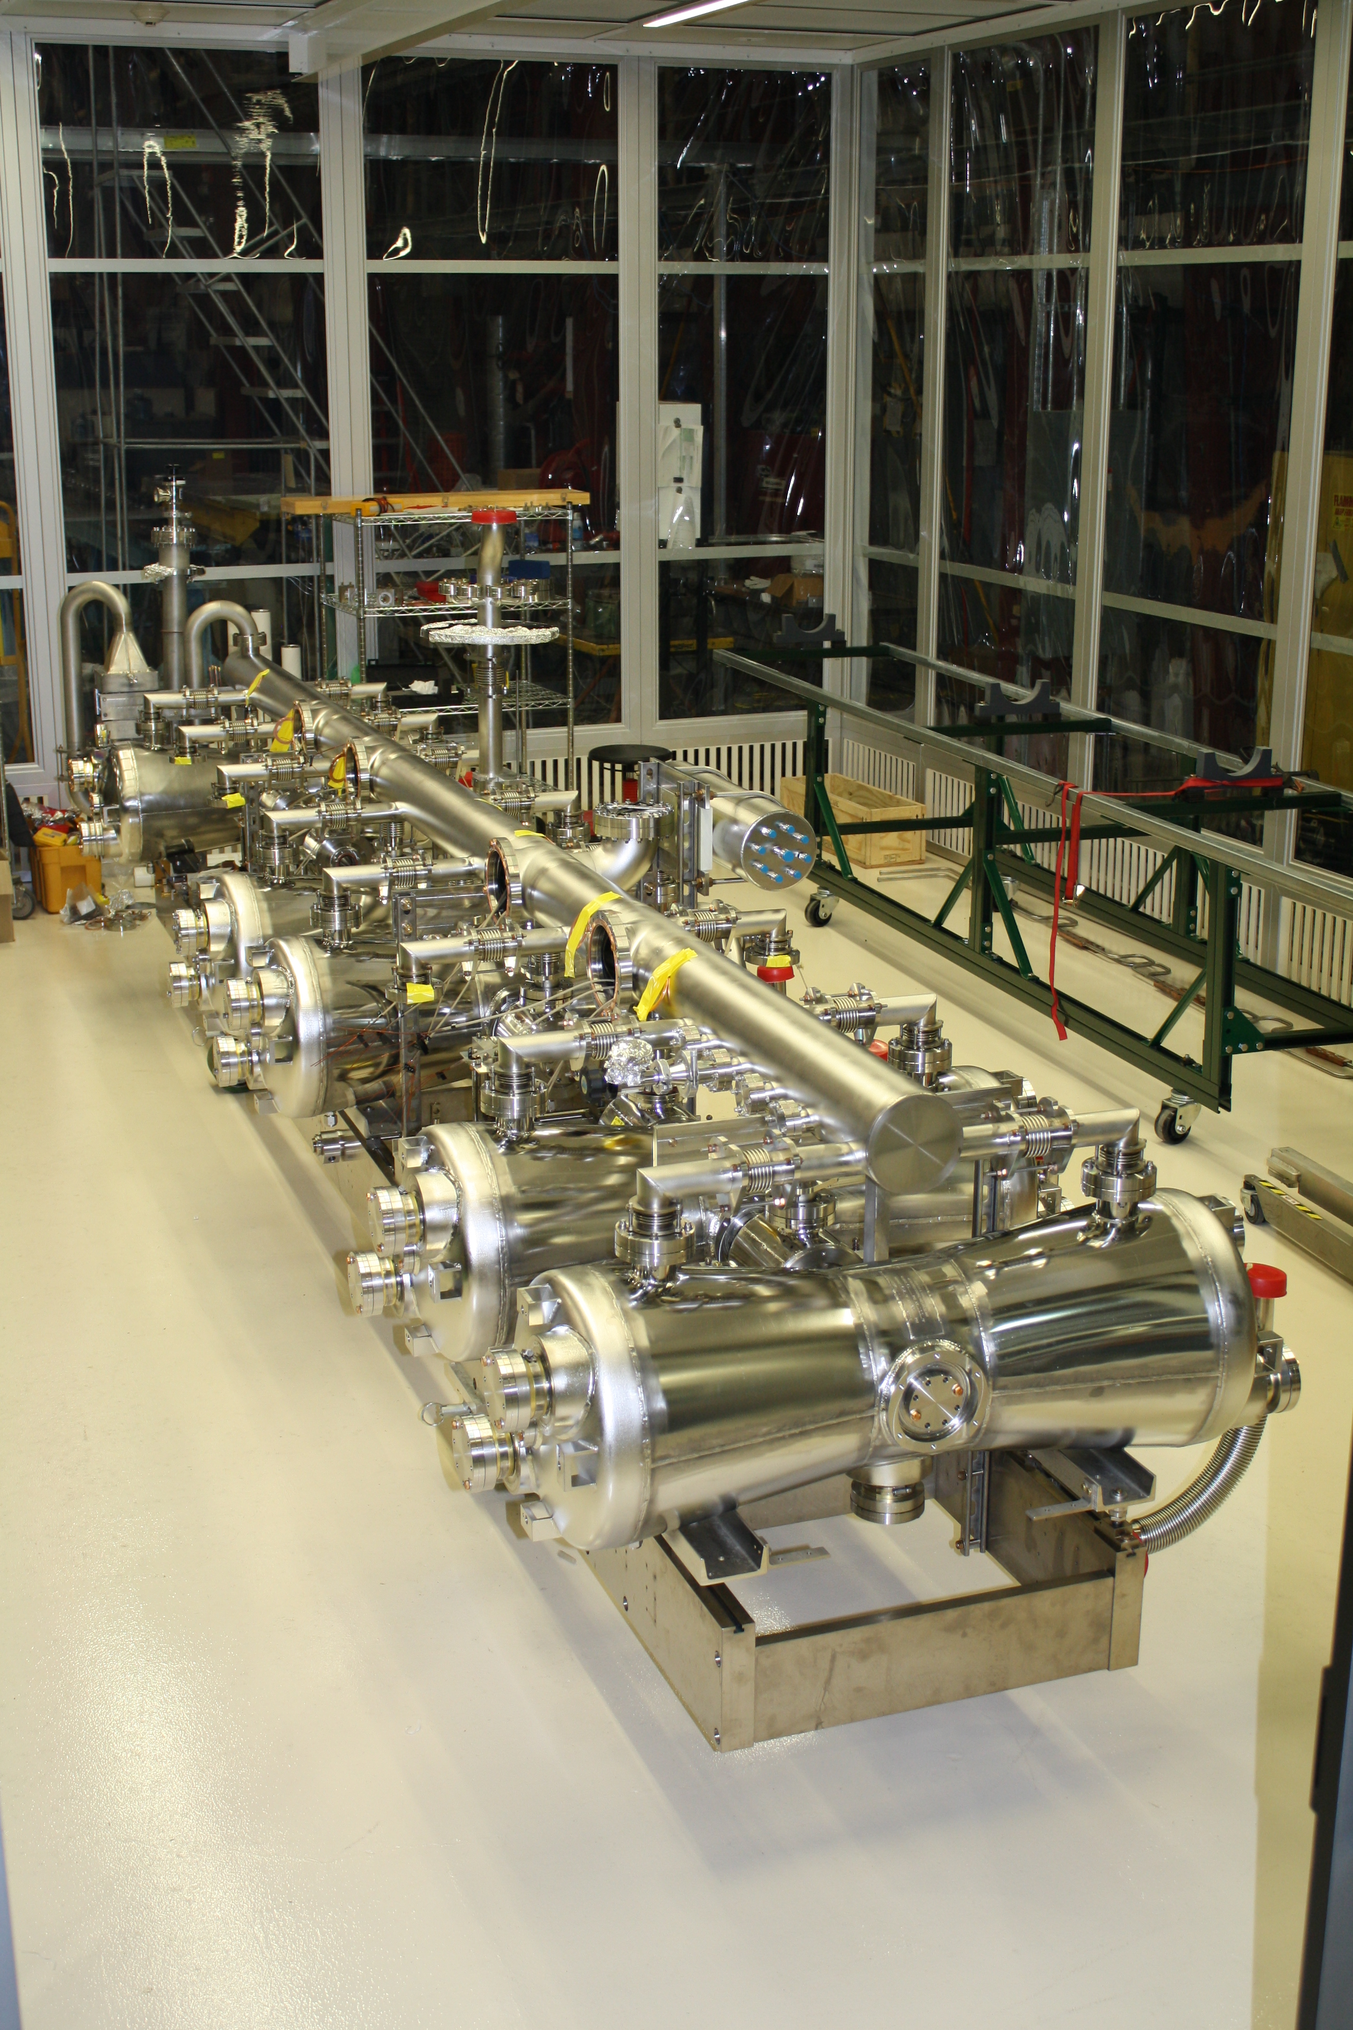
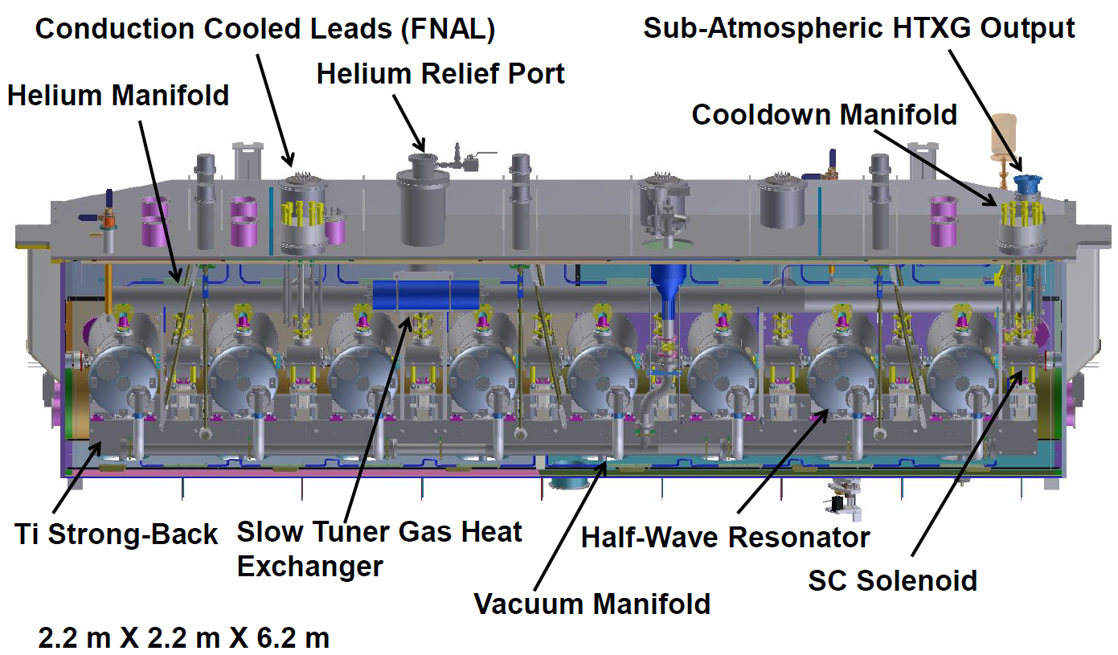
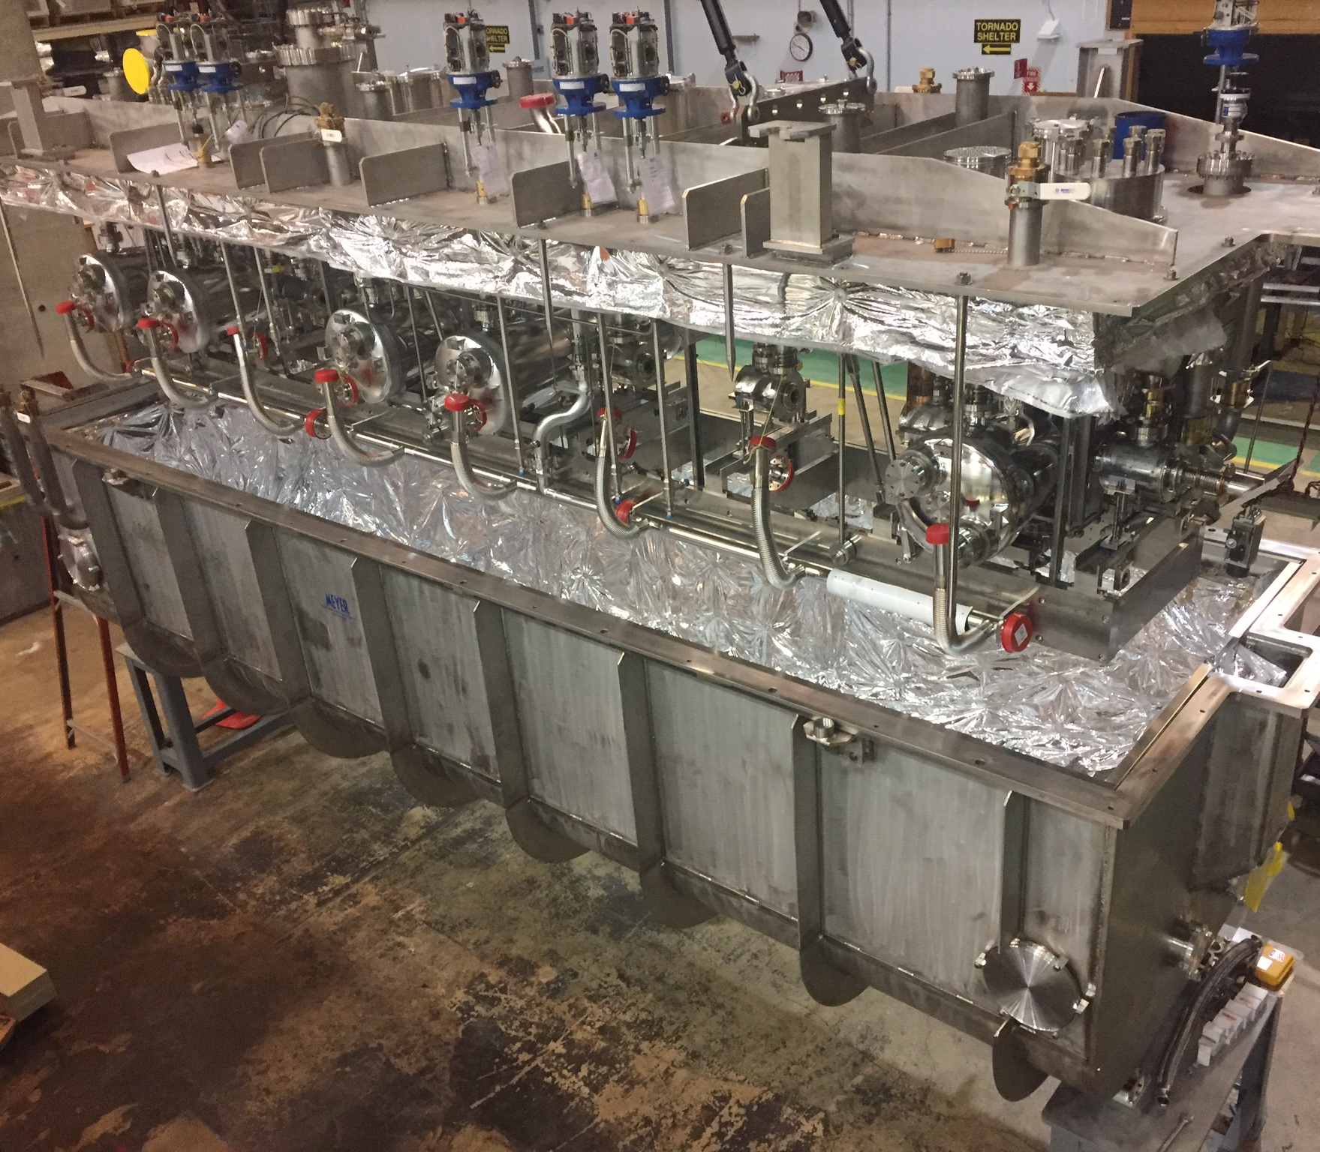
Introduction – HWR CM
The HWR CM employs “half-wave resonator” cavities, mounted on a Ti strong back, with a He manifold connecting the He ckts above them. Beam focusing elements (solenoids) and BPMs are placed after each cavity. This “cold mass” is suspended from the cryostat “lid” and inserted into the vacuum vessel “box”. This is the so-called “top down” CM design.
Cold Mass & Lid Going into the Box

Slide 3
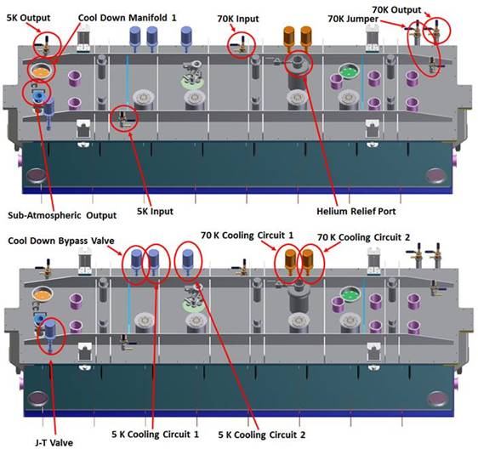
Cryogenic Valves & Bayonets

Slide 4
Cryogenic Valves & Bayonets
There are 7 bayonet penetrations (FNAL design) w/manual valves:
5K input, 5K output
50K input, 50K output, 50K “jumper” (2)
Sub-Atm ckt
There are 6 WEKA valves/controllers:
J-T
J-T Bypass
5K cooling circuits (2)
50K cooling circuits (2)

Slide 5
Cryogenic Circuits
50K thermal shield – upper and lower
50K coupler cooling intercepts
5K strongback cooling circuit
5K coupler cooling circuit
4K/2K cavity/solenoid supply
2K JT H/X

Slide 6
HWR CM Heat Load (as documented in ED0008200)
Cavity heat loads based on nominal operating gradients and measured Q₀ at that gradient.

Slide 7
Cryogenic Instrumentation - Thermometry
Cavities : 2 ea., top (He V flange), bottom (cooldown fitting) – 16 total, Cernox
Couplers : 2 ea., 5K (flange), 50K (flange) – 16 total (8 PT, 8 Cernox)
Solenoids : 1 ea., top (He V flange) – 8 total, Cernox
Tuners : 1 ea., top plate – 8 total, PT
Thermal Shield : 5 ea., top, 4 sides – 5 total, PT
Tuner HX : 1 ea., side – 1 total, PT
2K He Manifold : 2 ea., pipe, 50K intercept – 2 total, 1Cernox, 1PT
J-T Output Valve : 1 ea., output – 1 total, Cernox
LHe Input & Output Valves: 2 ea, 5K, 50K intercepts – total 4, 2 Cernox, 2 PT
TI Strongback : 1 ea., hanger mount – 1 total, Cernox
TI Hanger : 1 ea., 50K intercept – 1 total, PT
63 Installed RTDs
Connectors : Solid Sealing FA16523 – 8 total

Slide 8
Cryogenic Instrumentation - Heaters
Cavities : 1 ea., bottom – 8 total
Solenoids : 1 ea., bottom – 8 total
Helium Manifold : various locations – 4 total
Strongback : various locations – 4 total
2K HX Output Line : on output side – 7 total
Couplers : on coupler #1 – 1 total
32 installed heaters Caddock M850-50.0-1% : 50Ω , 50W
Connectors : Solid Sealing FA16523 – 2 total

Slide 9
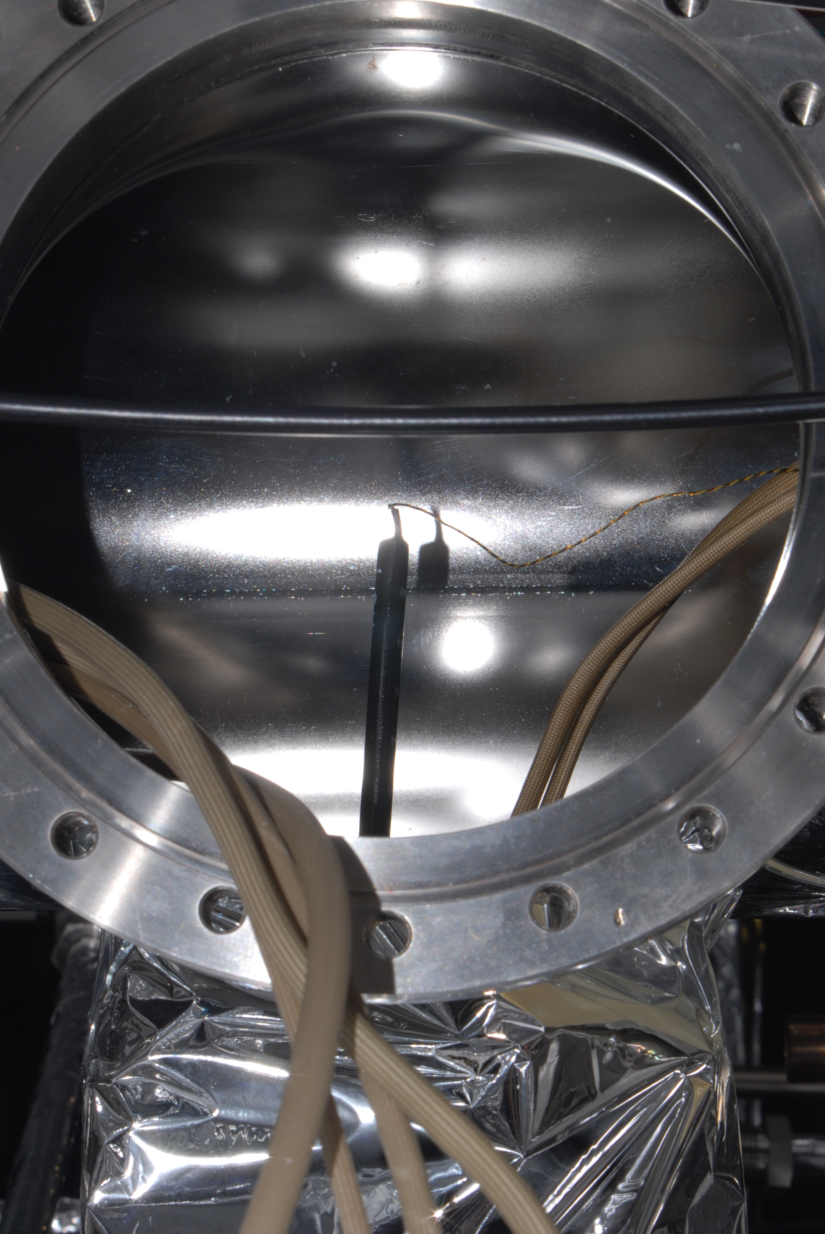
Cryogenic Instrumentation - He Level Probes
He level probes installed in 2K manifold, protrude into solenoid “chimney”.
2 probes – AMI Model 3D-28-20
28 cm active length
30 cm overall length
Interfaces via Solid Sealing FA16523
connector

Slide 10
HWR Status
Delivered to PIP2IT in late October 2019 after attempted thermal shield repair (arrived from ANL in August 2019)
Installation followed:
Install couplers
Install vacuum systems
Complete tuner gas manifold/line fabrication/installation
Cabling
Electrical checkout
HPRF distribution
Fabricate and install u-tubes
Alignment (external) and alignment (cold mass)measurements
Leak checking and pressure testing
Leak in lower 50K shield, thought to be repaired, was still present
Moved ahead with cooldown using only top shield

Slide 11
HWR Status – Cooldown
HWR was “buttoned up” and ready for cooldown, pending ORC approval, by late January.
Began 50K top shield cooldown 2/24/2020
Followed by 50K coupler/intercepts circuit
Additional 2K heat load due to loss of bottom shield ~ 14W
Cooldown of 5K circuit began 2/27/2020
Cavities, solenoids, coupler and strongback intercepts
No cooldown (or warm-up) rate restrictions (fast or slow)

Slide 12
HWR Status – Cooldown
A few hiccups along the way
Balancing flow to 5K strongback circuit and 5K cold mass circuit
Some interference with LCLS-II CM
Strongback flow stagnated until proper valve opened
Uncertainty about target liquid level
PID loop tuning less than optimal initially
But now have established a parameter set that provides stable 2K operation and adequate liquid level.
Setpoint of 90-91% on 2nd LL probe
1st probe is lower, so equivalent setpoint of ~100% doesn’t provide control “headroom”
Difference of about 3% (after taking account height difference) between probes indicates slight tilt of 2K header – about 1.2” between 1st/8th cavities
Difference in fill position between solenoids (at ~0” wrt header) and cavities (~0.75” wrt header) caused some confusion in interpretation of data
Additional 2K heat load due to absence of lower/side thermal shield estimated at 14W (8W calculated)

Slide 13
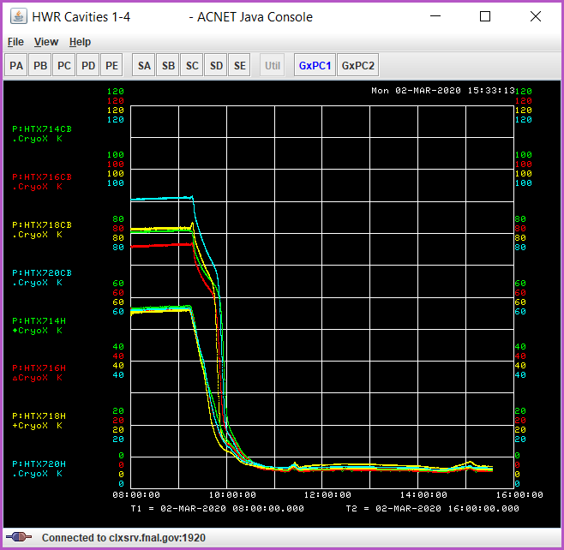
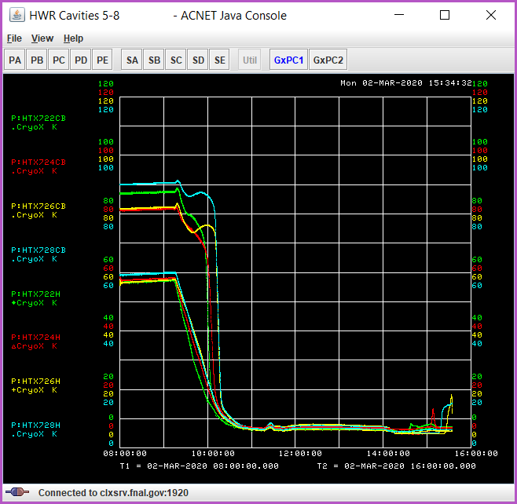
HWR Status – Cooldown
What it looks like when it goes well…

Slide 14
HWR Recent Status – Test Activities
Preparing for RF testing
Logistical issues delayed beginning of 2K RF testing until week of 3/23/20
Proceeded with (completed) 2K testing of magnet packages while waiting on “logistics”.
Then COVID19 lab shutdown suspended operations…
HWR CM is sitting at 4K

