Slide 1
SSR Scope and Status
Donato Passarelli
SRF/Cryo Integrated Workshop
May 14, 2020

Slide 2
SCOPE

Slide 3
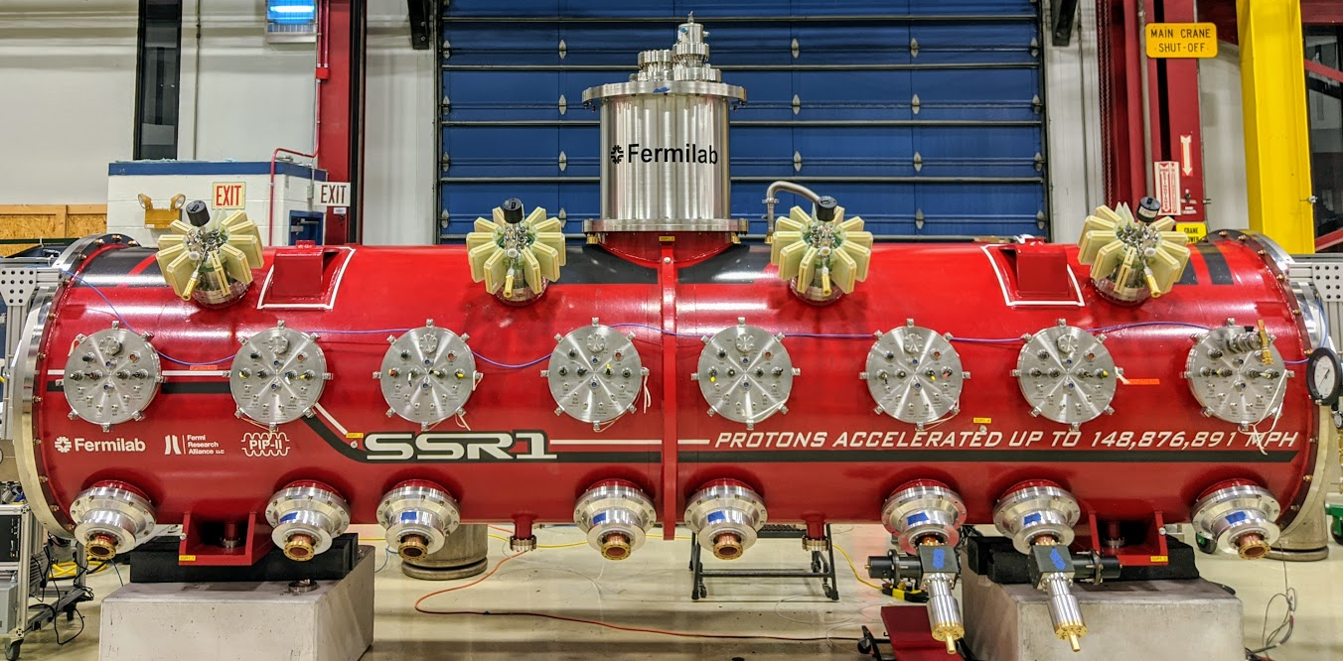
Scope and Deliverables
WBS 121.02.03
SFRs – Single Spoke Resonator CryoModules
Management, design, procurement, fabrication, and testing of the Single Spoke Resonator cavities and cryomodules.
10
 | SSR1 | SSR2
# CMs | 1+2 | 1+7
Cavities per CM | 8 | 5
Solenoids per CM | 4 | 3
CM configuration c: cavities; s: solenoids | 4x (csc) | sccsccsc
CM length (m) | 5.2 | 6.5
Proto SSR1 cryomodule
Final scope will be delivery of qualified CMs ready for installation into PIP-II tunnel

Slide 4
Scope and Deliverables
Item | Quantity | DOE | BARC (India) | CNRS/IN2P3 (France)
SSR1 proto CM (not installed in the LINAC)
Cryomodule | 1 | 1
Jacketed Cavities | 8 | 10 | 2
Couplers | 8 | 11
Tuners | 8 | 10 | 2
SC Solenoids | 4 | 5
Cold BPMs | 4 | 5
SSR1 CM 1-2
Cryomodule | 2 | 2
Jacketed Cavities | 16 | 9 sets of Nb | 18
Couplers | 16 | 18
Tuners | 16 |  | 16
SC Solenoids | 8 |  | 10
Cold BPMs | 8 | 10
CM assembly and final qualification testing at Fermilab
SC5/6/7 L. Lari

Slide 5
Scope and Deliverables
Item | Quantity | DOE | BARC (India) | CNRS/IN2P3 (France)
SSR2 ppCM (not installed in the LINAC)
Cryomodule | 1 | 1
Jacketed Cavities | 5 | 3 | 2* | 3
Couplers | 5 | 4 | 3* | 4
Tuners | 5 | 1 | 2* | 4
SC Solenoids | 3 |  | 4*
Cold BPMs | 3 | 4
SSR2 CM 1-7
Cryomodule | 7 | 6 | 1
Jacketed Cavities | 35 |  | 5 | 40
Couplers | 35 |  | 5 | 40
Tuners | 35 |  | 5 | 37
SC Solenoids | 21 |  | 23
Cold BPMs | 21 | 23
*IIFC Addendum 1
CM assembly and final qualification testing at Fermilab
SC5/6/7 L. Lari

Slide 6
Partners
BARC
CNRS/IN2P3
India
France
DAE/BARC
Sub-Project Coordinators
Fermilab
Sub-Project Managers
CNRS/IN2P3
Sub-Project Coordinators

Slide 7
REQUIREMENTS and SPECIFICATIONS

Slide 8
EPDM for PIP-II SSR scope
Engineering Process Documentation Management (EPDM) | Teamcenter No.
Prototype SSR1 | ED0001256
Production SSR1 | ED0011856
Pre-production SSR2 | ED0001257
Production SSR2 | ED0011912
The EPDMs listed contain all the references for the Design, Procurement, Fabrication, Assembly and Testing for all components and subassemblies for the cryomodule.

Slide 9
SSR1 Requirements and Specifications
 | Prototype CM | Production CM
FRS | ED0001316 | ED0011838
TRS | ED0009534 | ED0011907
ISD | ED0004129 | ED0011908
Internal ISD | N/A | ED0011405
P&ID | F10082628 | F10137214
EPDM | ED0001256 | ED0011856

Slide 10
SSR1 Requirements and Specifications (cont’d)
 | Prototype CM | Production CM
Fabrication Specification | ED0001256 (CM/Tuner) ED0371029 (Cav) ED0001772 (Coupler) ED0004855 (Sol) | ED0011856 (CM/C/C/T) ED0011935 (Sol)
Acceptance Plan | N/A | N/A (CM) ED0012002 (Cav) ED0011961 (Coup/Tune/Sol)
Acceptance Criteria | N/A | N/A (CM) ED0012003 (Cav) ED0011962 (Coup/Tune/Sol)
Due to the Potential for Multiple Fabrication Specifications, the EPDM is Referenced

Slide 11
SSR2 Requirements and Specifications
 | Prototype CM | Production CM
FRS | ED0001829 | ED0011909
TRS | ED0009651 (CM) ED0009784 (C/C/T) ED0011214 (Sol) | ED0011910 ED0009784 (C/C/T) ED0011214 (Sol)
ISD | ED0010943 | ED0011911
Internal ISD | ED0011023 | ED0011023
P&ID | F10117244 | F10137882
EPDM | ED0001257 | ED0011912

Slide 12
SSR2 Requirements and Specifications (cont’d)
 | Prototype CM | Production CM
Fabrication Specification | ED0001257 (CM/C/C/T) ED0011935 (Sol) | ED0011912 (CM/C/C/T) ED0011935 (Sol)
Acceptance Plan | ED0011897 (In2P3) ED0011957 (DAE) | ED0011963 (In2P3) ED0011961 (DAE)
Acceptance Criteria | ED0011898 (In2P3) ED0011958 (DAE) | ED0011964 (In2P3) ED0011962 (DAE)

Slide 13
Requirements
Main Cryomodule Parameters | Units | SSR1 | SSR2
Energy for section | MeV | 10 to 32 | 32 to 177
Cavities (solenoids) per cryomodule | # | 8 (4) | 5 (3)
Cryomodule flange-to-flange length | m | 5.3 | 6.5
2 K heat load | W | < 33 | < 71
5 K heat load | W | < 55 | < 48
50 K heat load | W | < 206 | < 185
Environmental magnetic field | mG | ≤ 15 | ≤ 15
Transverse cavity (solenoids) alignment error, RMS | mm | ≤ 1 (0.5) | ≤ 0.5 (0.5)
Angular cavity (solenoids) alignment error, RMS | mrad | ≤ 5 (0.5) | ≤ 5 (0.5)

Slide 14
Requirements
Main Cavities Parameters | Units | SSR1 | SSR2
Frequency | MHz | 325 | 325
Cavity operating temperature | K | 2.0 | 2.0
β_{g} (β_{opt}) |  | 0.186 (0.222) | 0.398 (0.472)
Aperture diameter (Effective length) | mm | 30 (205) | 40 (438)
Operating energy gain per cavity | MV | 2.05 | 5
Unloaded cavity quality factor (Q₀) at 2K |  | 8.2×10⁹ | 8.2×10⁹
MAWP at room temperature (at 2K) | bar | > 2.05 (4.1) | > 2.05 (4.1)
Sensitivity to LHe pressure fluctuations | Hz/mbar | < 25 | < 25
Coupler power | kW | 10 | 20

Slide 15
Interfaces
PIP-II Master Interface Control Document: TC# ED0010433
121.02.03
SSR
121.03.03
High Power RF
121.03.06
Vacuum
121.03.04
Low Level RF
121.03.07
Controls
121.03.02
Accelerator Physics
121.02.05
Cryo Plant
121.06.05
Linac Complex
121.04.03
Test Infrastructure
121.02.06
Cryo Distribution Systems
121.03.09 Beam Instr.
121.03.05 Magnet PS

Slide 16
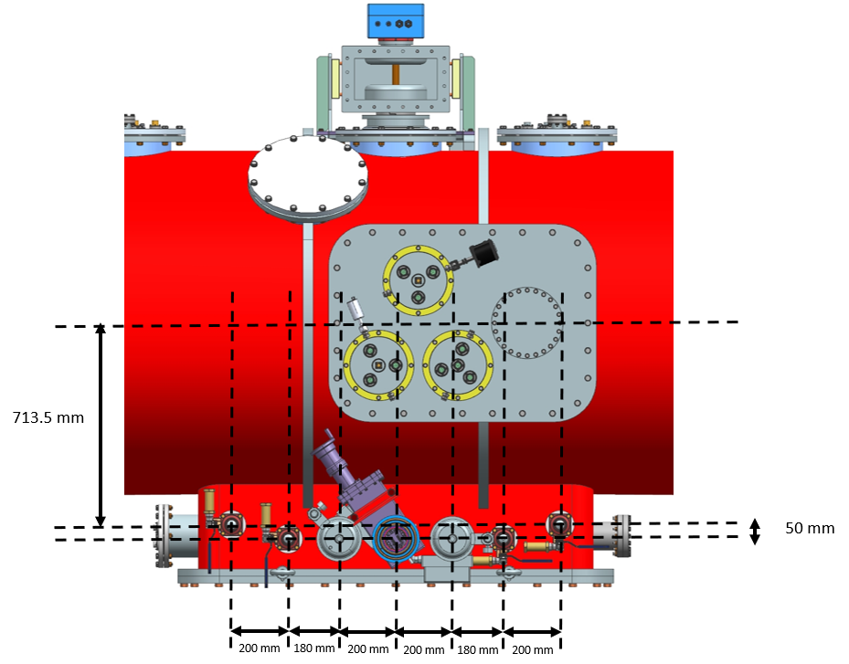
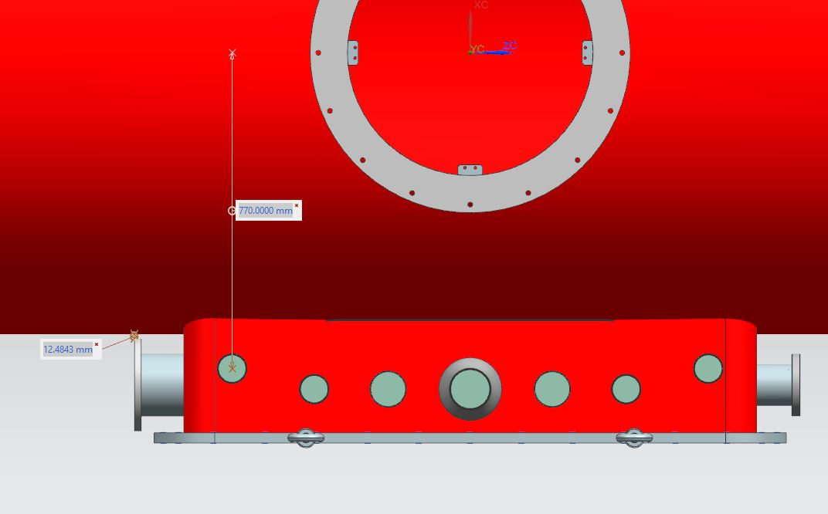
Standardization of Interfaces
Guidance and requirements for the instrumentation are available in Teamcenter through several documents (TRS, FRS, ISD and the PIP-II cryomodule design handbook).
The heat exchanger will be common to SSR1, SSR2, LB650 and HB650 cryomodules.
The gate valve on the pumping line (Ref MDC 302004) and bayonets will be common to all cryomodules.
The cryogenic valves will be similar but the diameter may change, based on pressure drop calculations
The cryogenic size port will have similar layout for SSR1, SSR2, LB650 and HB650 cryomodules. Just the distance from the vacuum vessel will change between SSR and 650 cryomodules.
770 mm
650 Configuration
SSR Configuration

Slide 17
TECHNICAL PROGRESS

Slide 18
Proto SSR1 CM: assembly completed

Slide 19
CM testing at PIP2IT
Procedures and travelers:
Transportation traveler Vector 464489
Installation traveler: Vector 464539
Testing procedure: In progress
The testing of the proto SSR1 CM will validate:
Installation, alignment and external interfaces
Warm strongback layout
Scheme to monitor and maintain the alignment of key-elements during and after cooldown
Cryogenics and heat loads performance
Solenoids and current leads performance
RF performance of cavity, coupler and
tuner
Instrumentation layout

Slide 20
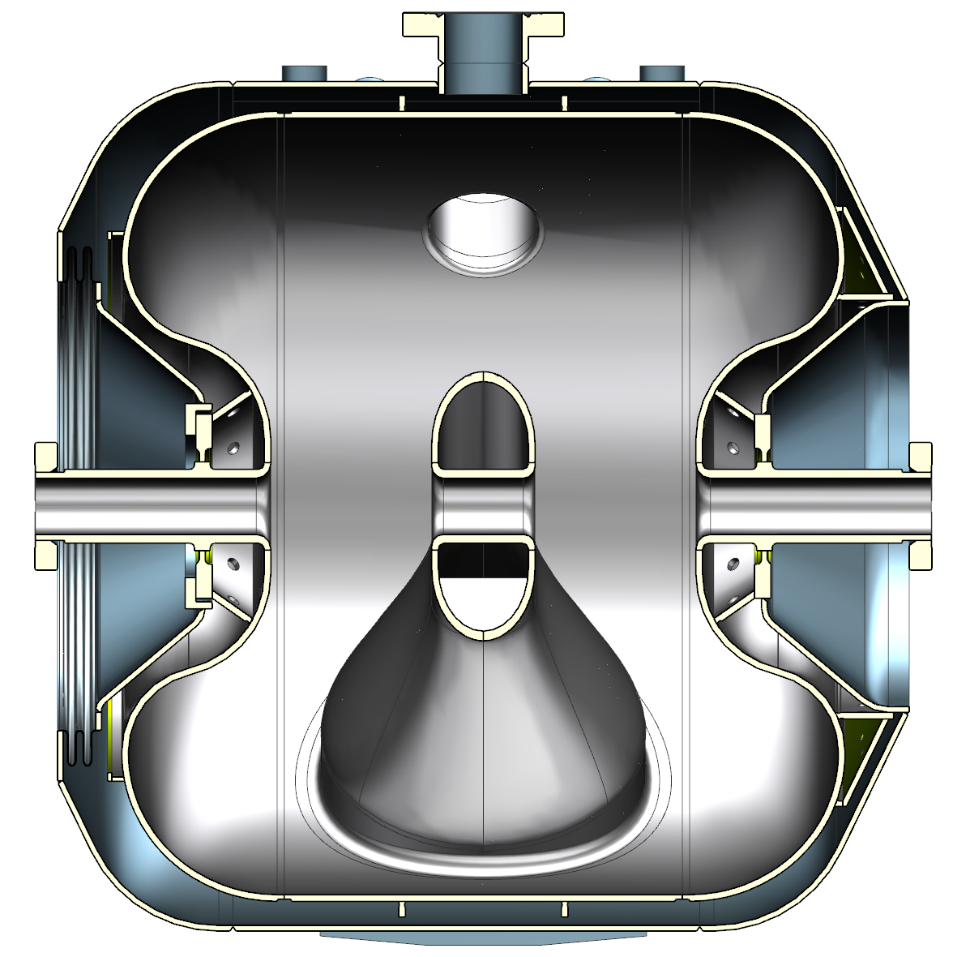
SSR2 cavities
Ring end view
Cross section
Procurement of cavities was initiated
3 from FNAL; 3 from CNRS/IN2P3; 2 from BARC

Slide 21
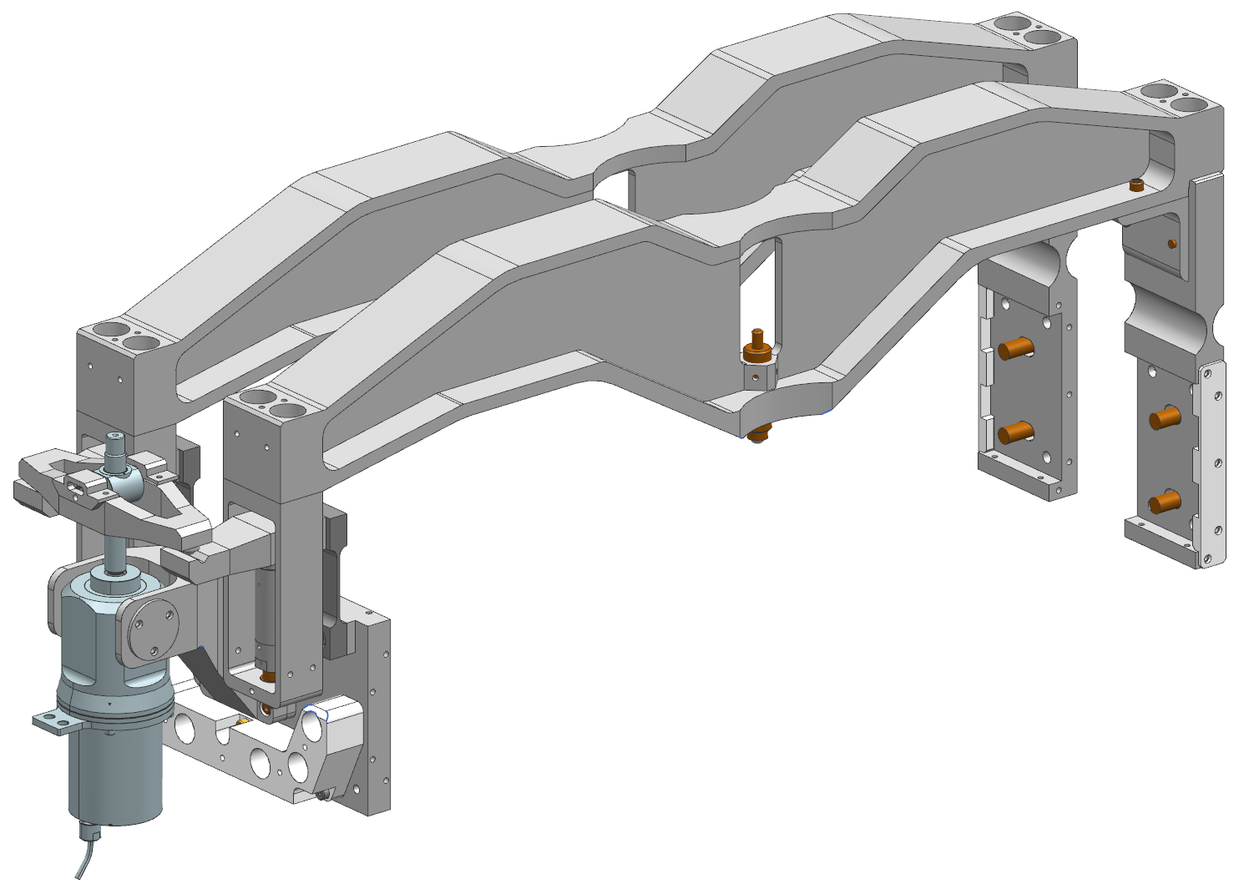
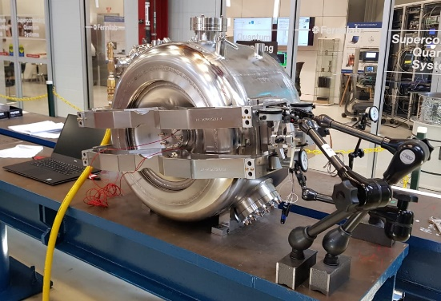
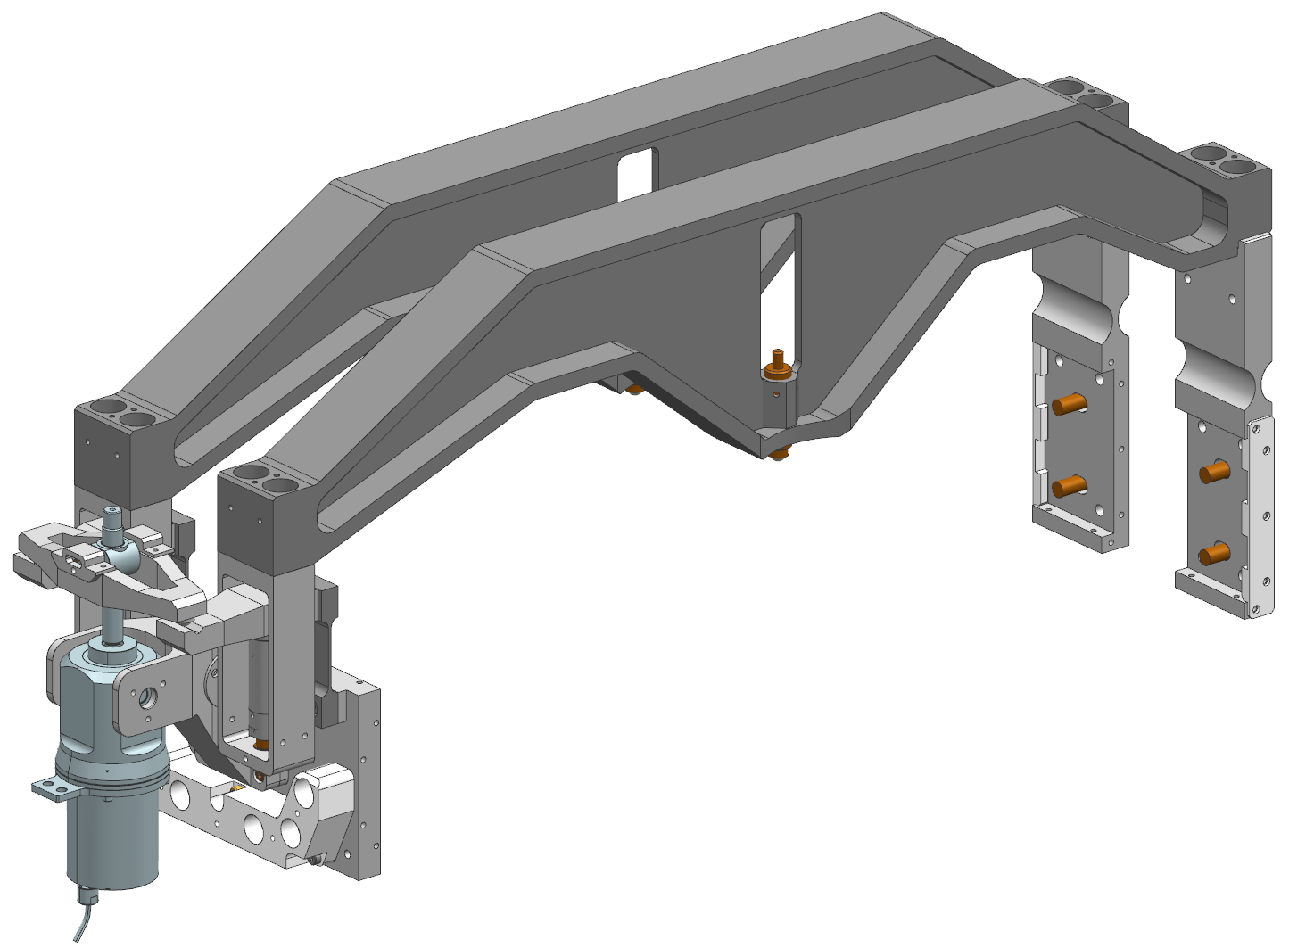
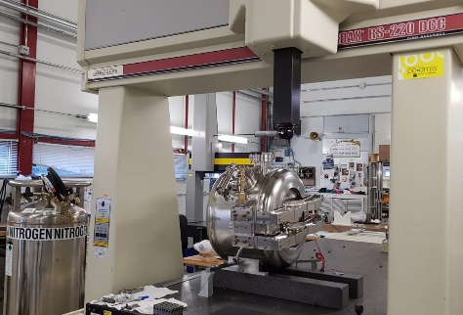
SSR2 tuner
SSR1 tuner design
FEM Optimization
Parametric optimization
Topology optimization
P2
P3
P1
P4
SSR1 tuner tests
SSR2 tuner design
Procurement of tuner is ongoing

Slide 22
SSR2 coupler
Design completed

Slide 23
SSR2 string assembly and cryomodule
TC# F10127014
Design is ongoing

Slide 24
Thank you for your attention!

