Slide 1
Cryoplant Scope
Ben Hansen, L3/CAM
May 12, 2020

Slide 2
Outline
Scope Introduction
Capacity Requirements
Cryoplant Layout and Cryo Interfaces
Summary

Slide 3
Scope Introduction

Slide 4

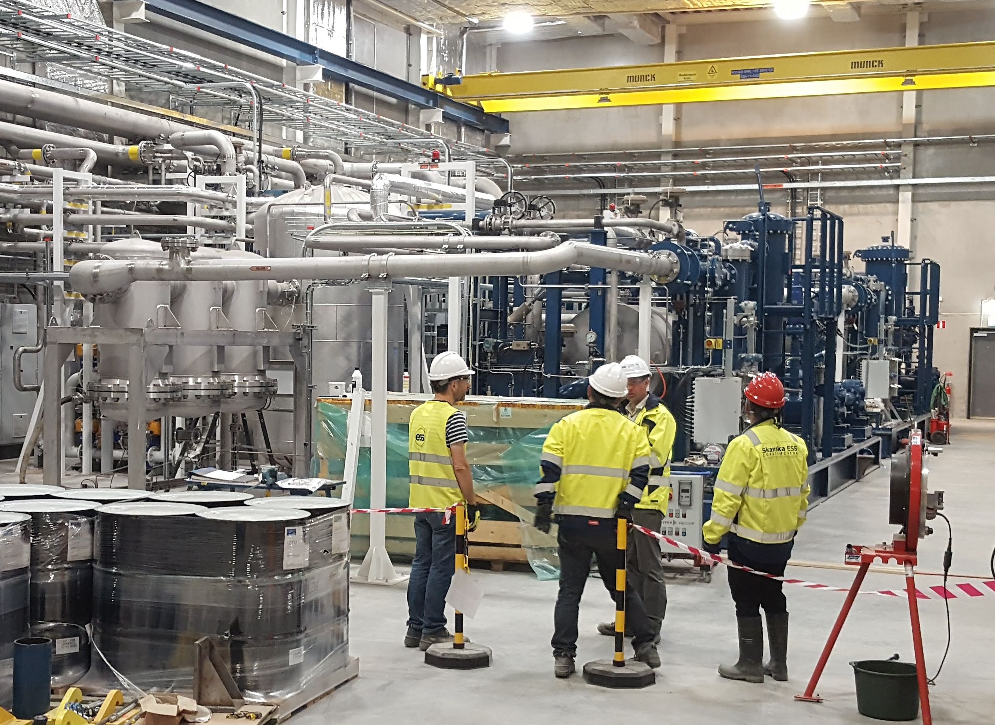
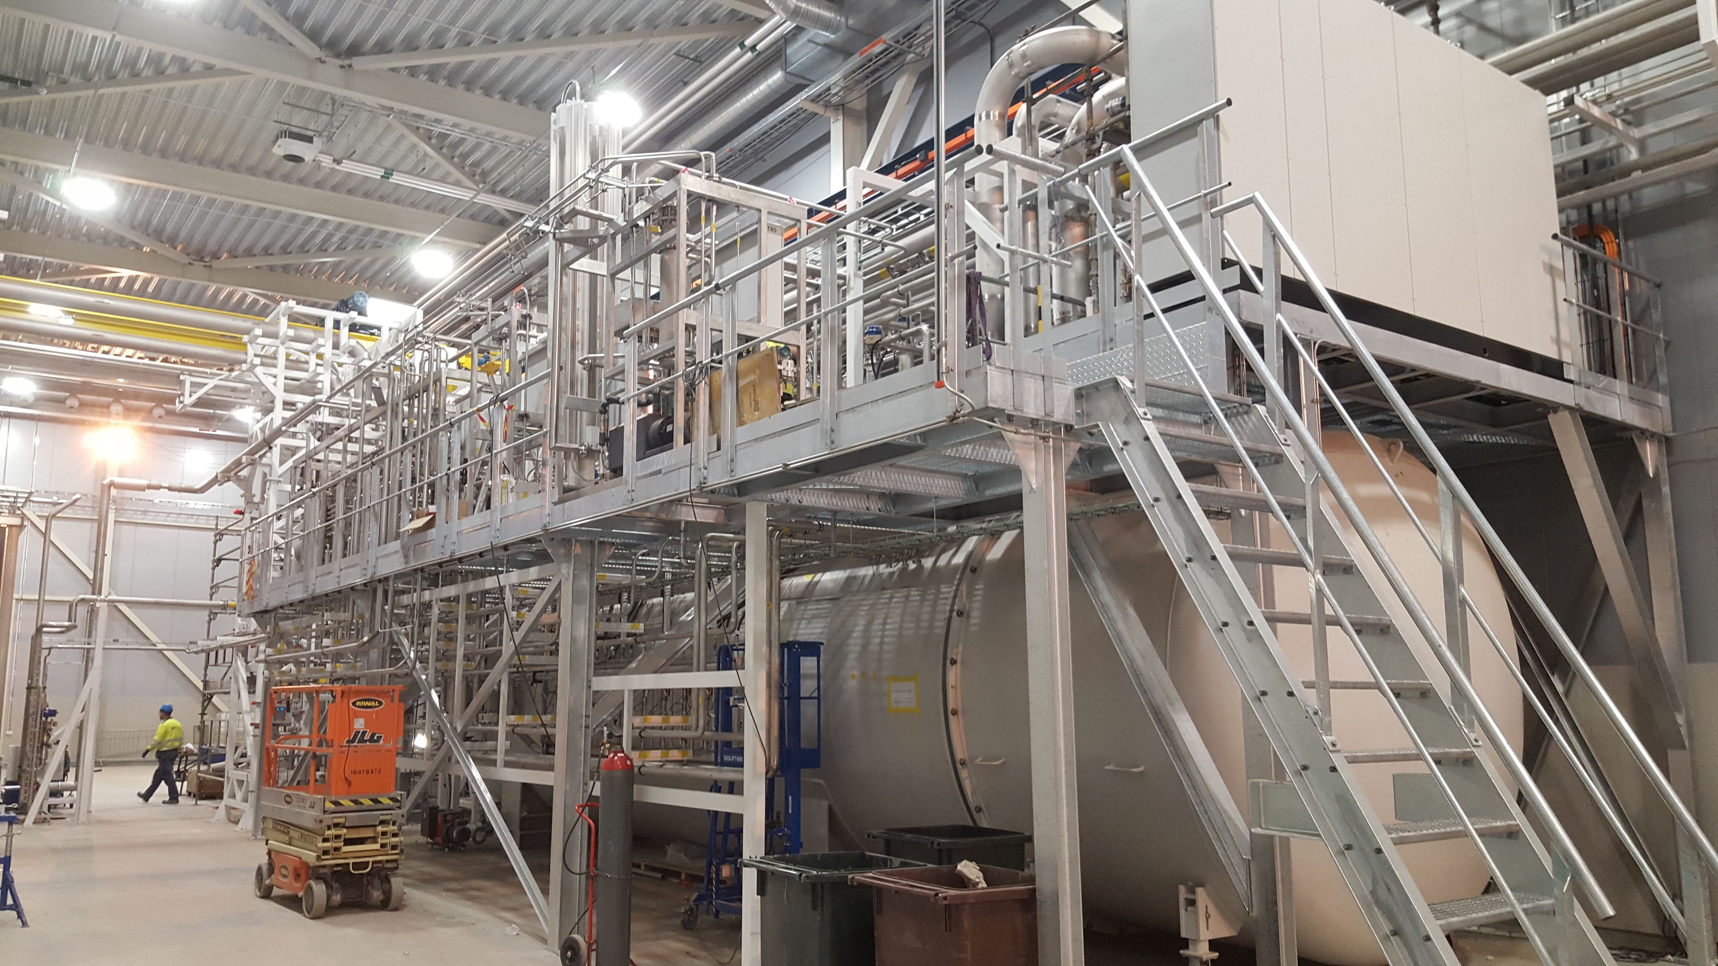
Scope and Deliverables – DAE India
Helium Cryogenic Plant Purchased from Industry
  Coldbox
  Warm Compressor System
Jointly developed Cryoplant specification between DAE/India and Fermilab during BARC SPC long-term visit
Weekly meetings with SPC and 2 long-term visitors from DAE/India at Fermilab.
ESS Compressor Room
ESS Coldbox

Slide 5
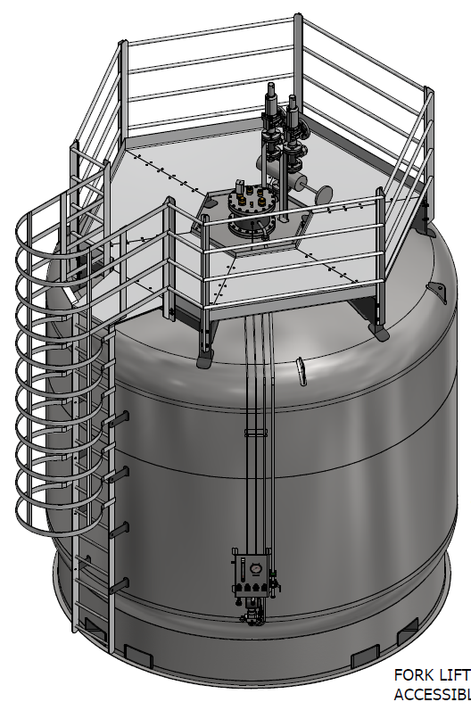
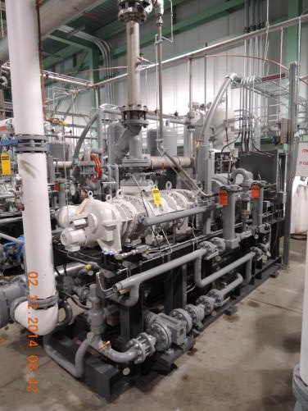
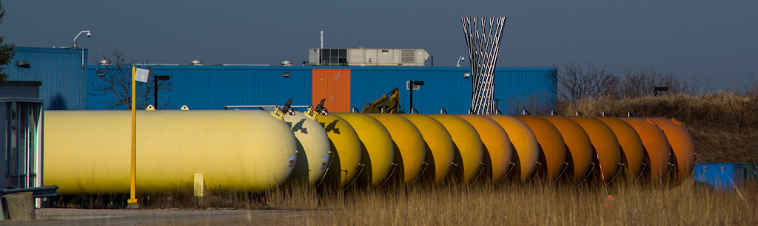
Scope and Deliverables - Fermilab
Services:
  Cryoplant equipment rigging
  Cryoplant Installation
New Equipment:
  Liquid Helium (LHe) Dewar
  Helium Purifier
  Helium Transferline from Coldbox to Dewar
  LN2 Transferline from Dewar to Purifier
  Controls and Instrumentation for Fermilab scope
  Liquid Nitrogen (LN2) Dewar
Existing/Repurposed Equipment:
  Recovery/Purification Compressor
  6x Gas Helium (GHe) Storage Tanks

Slide 6
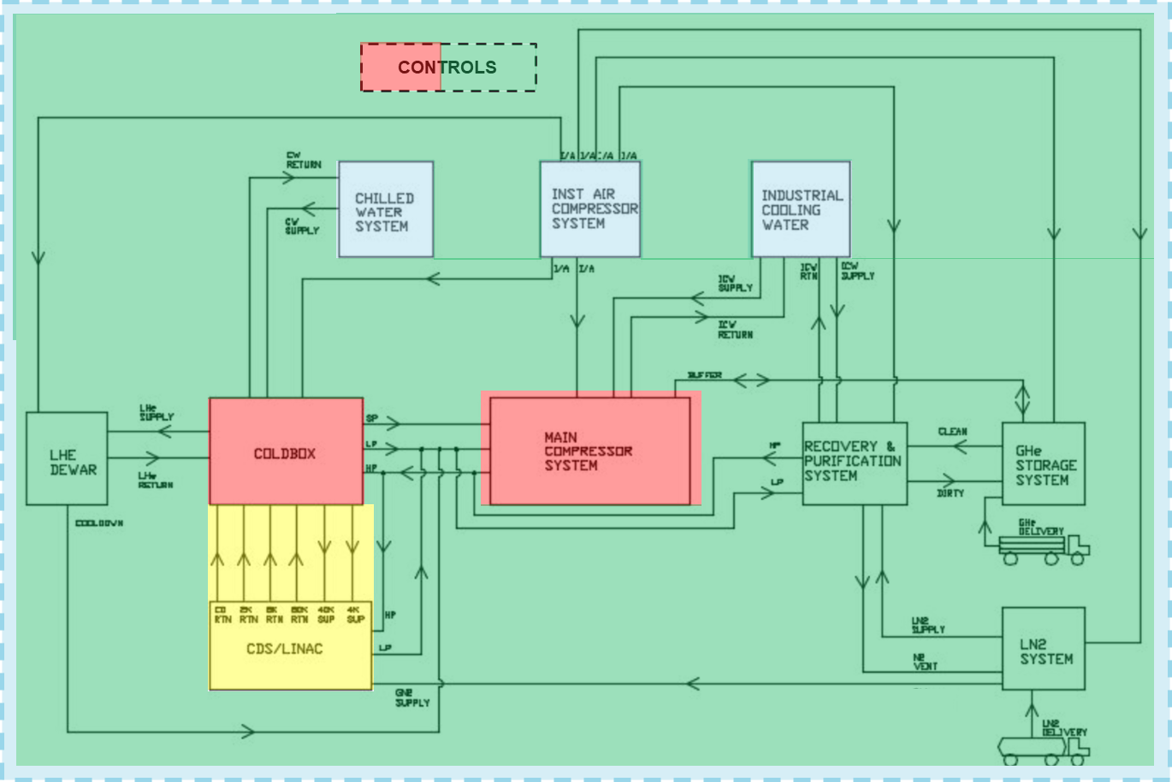
Integrated Scope
CP Vendor*
FNAL CryoP
FNAL CF
FNAL CDS
* Vendor work managed by BARC with Fermilab Involvement

Slide 7
Capacity Requirements

Slide 8

Cryoplant Capacity Safety Factors
Safety factors, representing the heat load uncertainties and operational overcapacity were explicitly defined to avoid mis-sizing
𝐹_{𝑆} = 1.3, static heat load safety factor
𝐹_{𝐷} = 1.1, dynamic heat load safety factor
𝐹_{𝑂} = 1.05, operational safety factor
$$Q_{C}=F_{O}\left({F_{S}Q}_{S}+{F_{D}Q}_{D}\right)$$
Heat Load Summary:
 | 2K (isothermal) | 2K (non-isothermal) | 5K (supply/return) | 40K (supply/return)
CM Dynamic [W] | 1386 | 0 | 146 | 757
CM Static [W] | 203 | 0 | 677 | 3132
CDS [W] | 0 | 258 | 134 | 1971
Total Nominal [W] | 1590 | 258 | 957 | 5860
Total with SF [W] | 1879 | 352 | 1275 | 7839

Slide 9
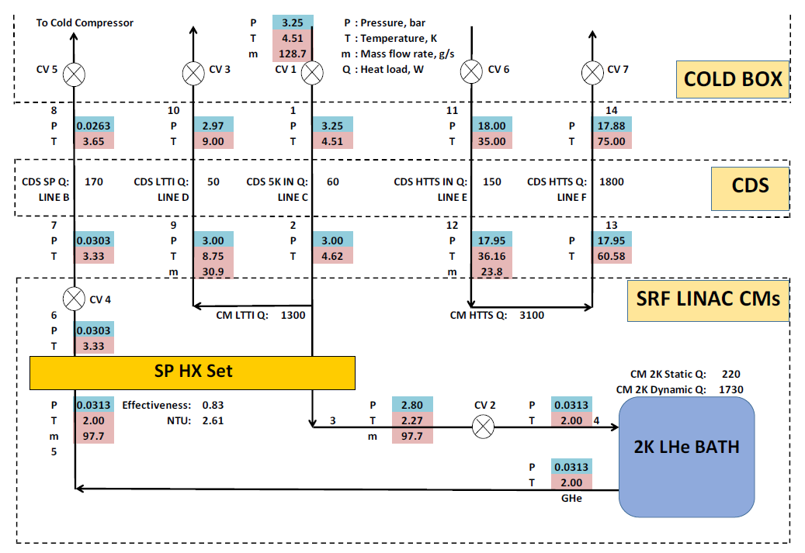
Cryoplant Capacity – Requirements
Charge #1
A combined thermodynamic and hydraulic analysis of the CDS and CM system was used to refine the Cryoplant requirements
2K heat load is a combination of isothermal and non-isothermal
The JT Heat Exchanger effectiveness, 2K return flow rate and temperature.
JT Hxer Effectiveness is 0.87 and specification jointly written with SRF CM design group

Slide 10
Cryoplant Capacity – Requirements
Cryoplant Requirements:
1879
Specified Capacity:
Capacity (W) | 2 K | LTTS | HTTS
Maximum | ≥ 1,900 | ≥ 1,500 | ≥ 9,100
Nominal | ≥ 1,750 | ≥ 1,150 | ≥ 7,000

Slide 11
Cryoplant Layout and Interfaces

Slide 12
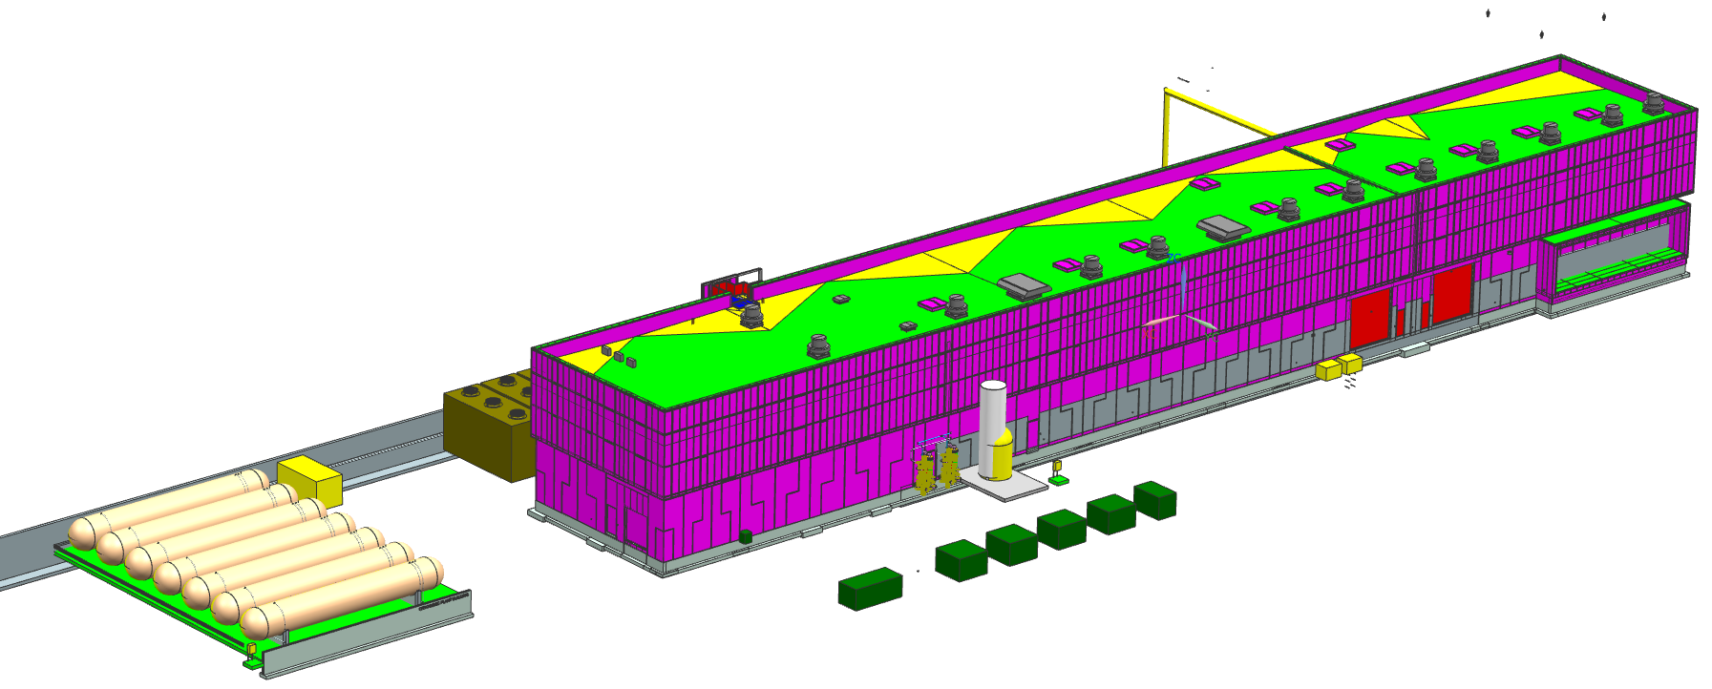
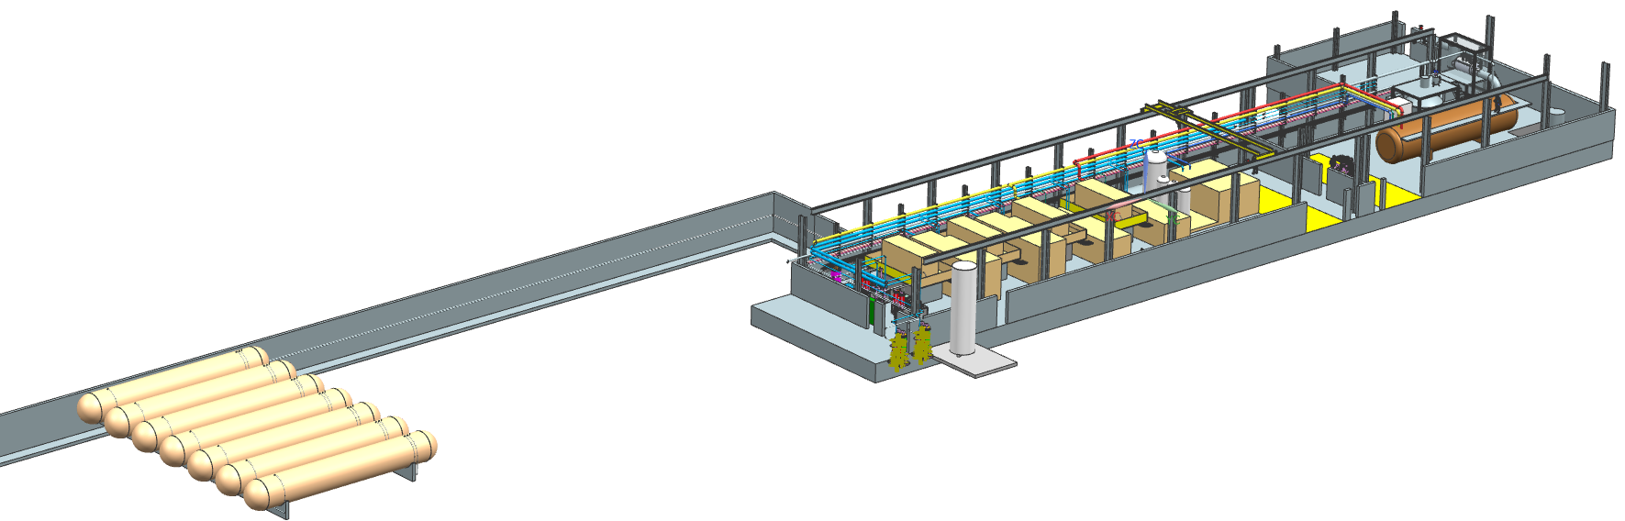
Cryoplant Building
5/13/2020

Slide 13
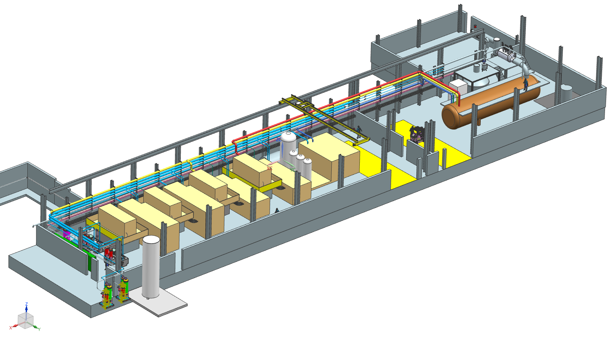
Cryoplant Building Layout
Offices/Commissioning Room
Purification System
Coldbox Station
Compressor Station

Slide 14
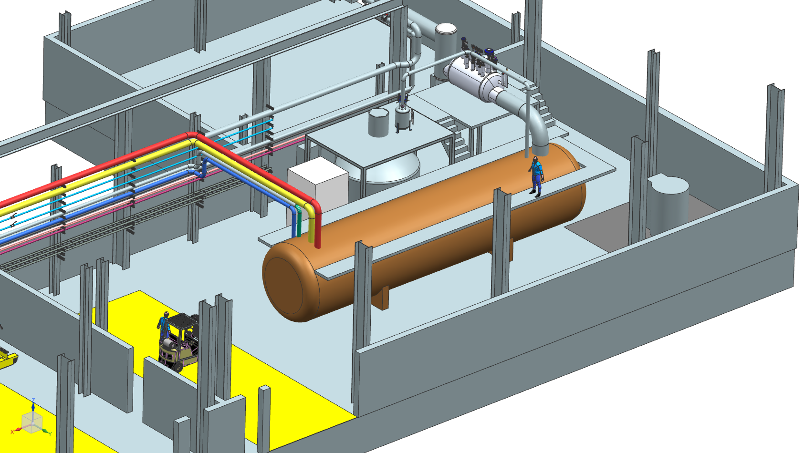
Coldbox Station
CDS Distribution Box
10 kL Dewar
Evap
Coldbox

Slide 15
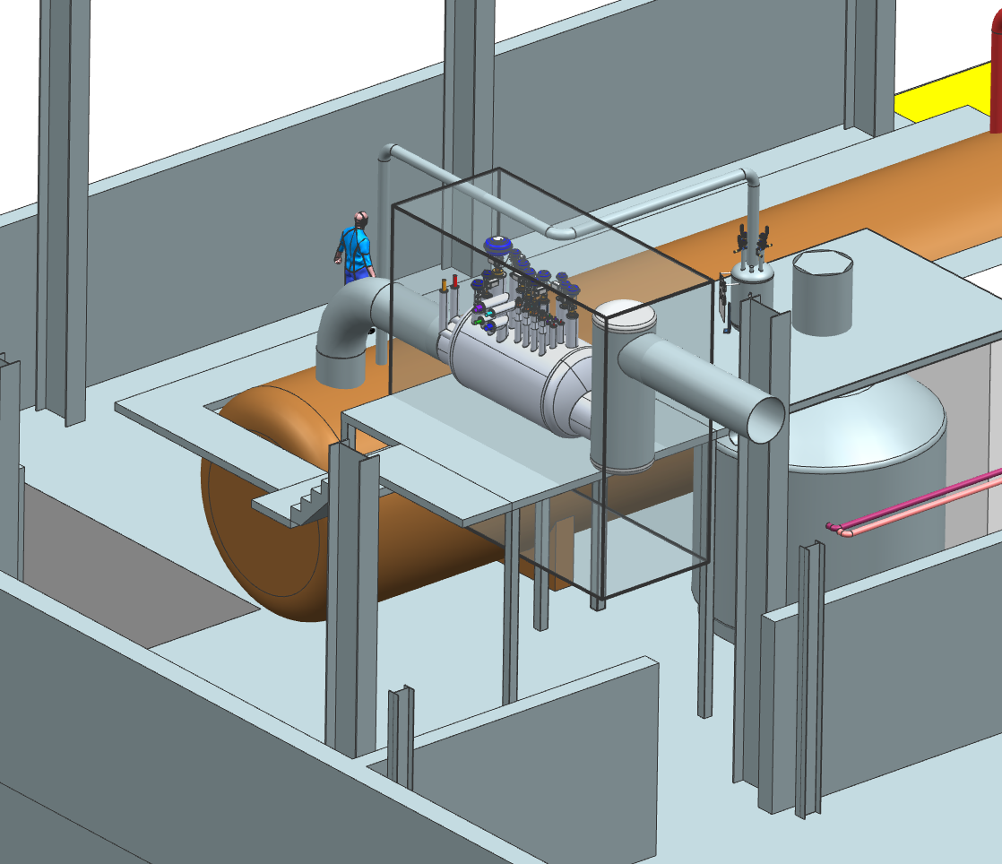
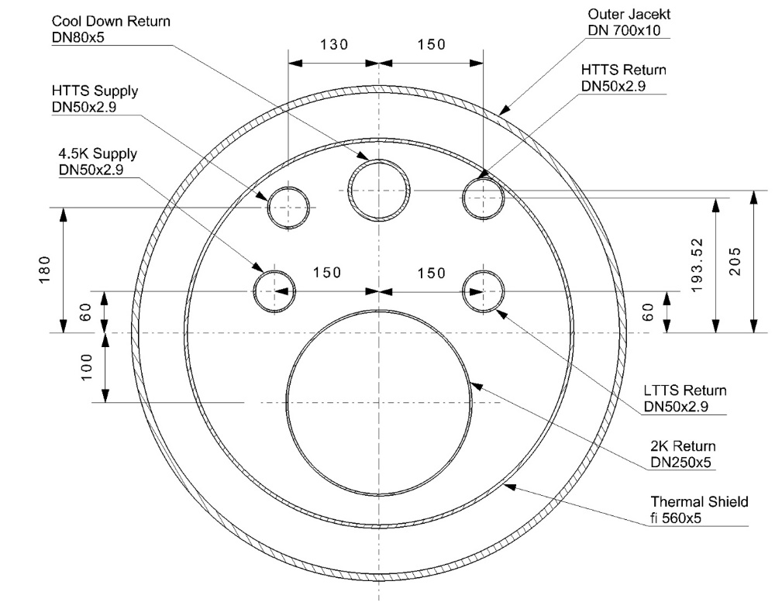
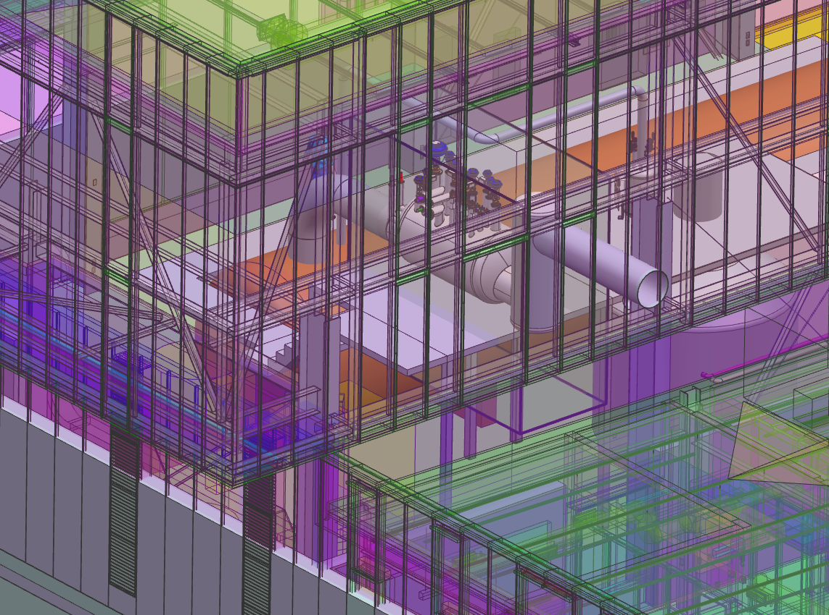
CDS Interface
Defining critical interfaces including
  Interface to Coldbox
  Location and envelop size for Distribution Box (DB)
  Location and Window for TL and warm headers exiting Cryoplant Building
Warm headers include LP, GN2 and HP

Slide 16
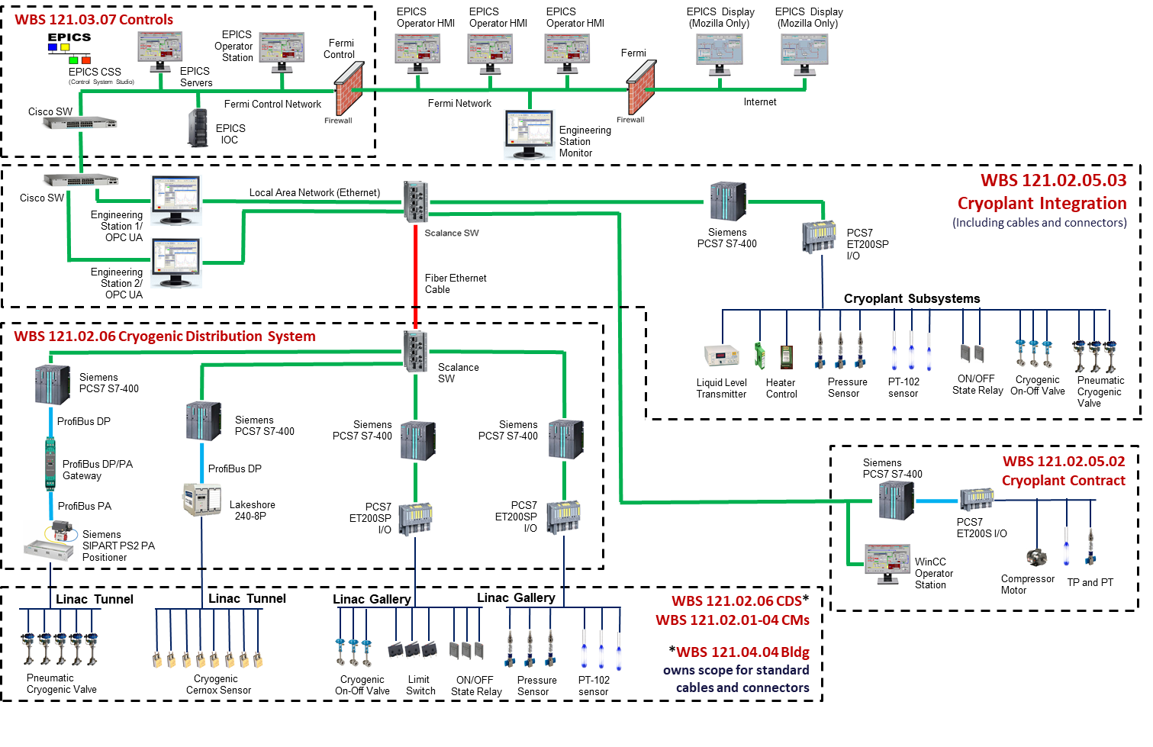
PIP-II Cryoplant Interfaces - Controls
5/13/2020
Notes:
Cryoplant PLCs interface with CDS PLCs via local ethernet connection and to the Controls via OPC and EPICS

Slide 17
End

