Slide 1
Interfaces Between SRF/Cryo Systems
Alex Martinez
Integration Coordinator
Technical Integration Group
Thursday, May 14, 2020

Slide 2
PIP-II Interface Management Method
Interfaces are managed globally through the use of the Master Interface Control Document (ICD) – ED0010433
Tabulates interfaces between L3’s (internal interfaces managed within the discretion of the individual L3’s and the given L2)
Provides top-level details of the interfaces and references documents where the interface details are located (i.e. ISD, drawings, etc.)
All changes to interfaces are processed as outlined in the “PIP-II Interface Management Plan (ED0007942)”
Managed by the PIP-II Integration Coordinator
Master ICD released monthly
Currently ~770 interfaces have been defined

Slide 3
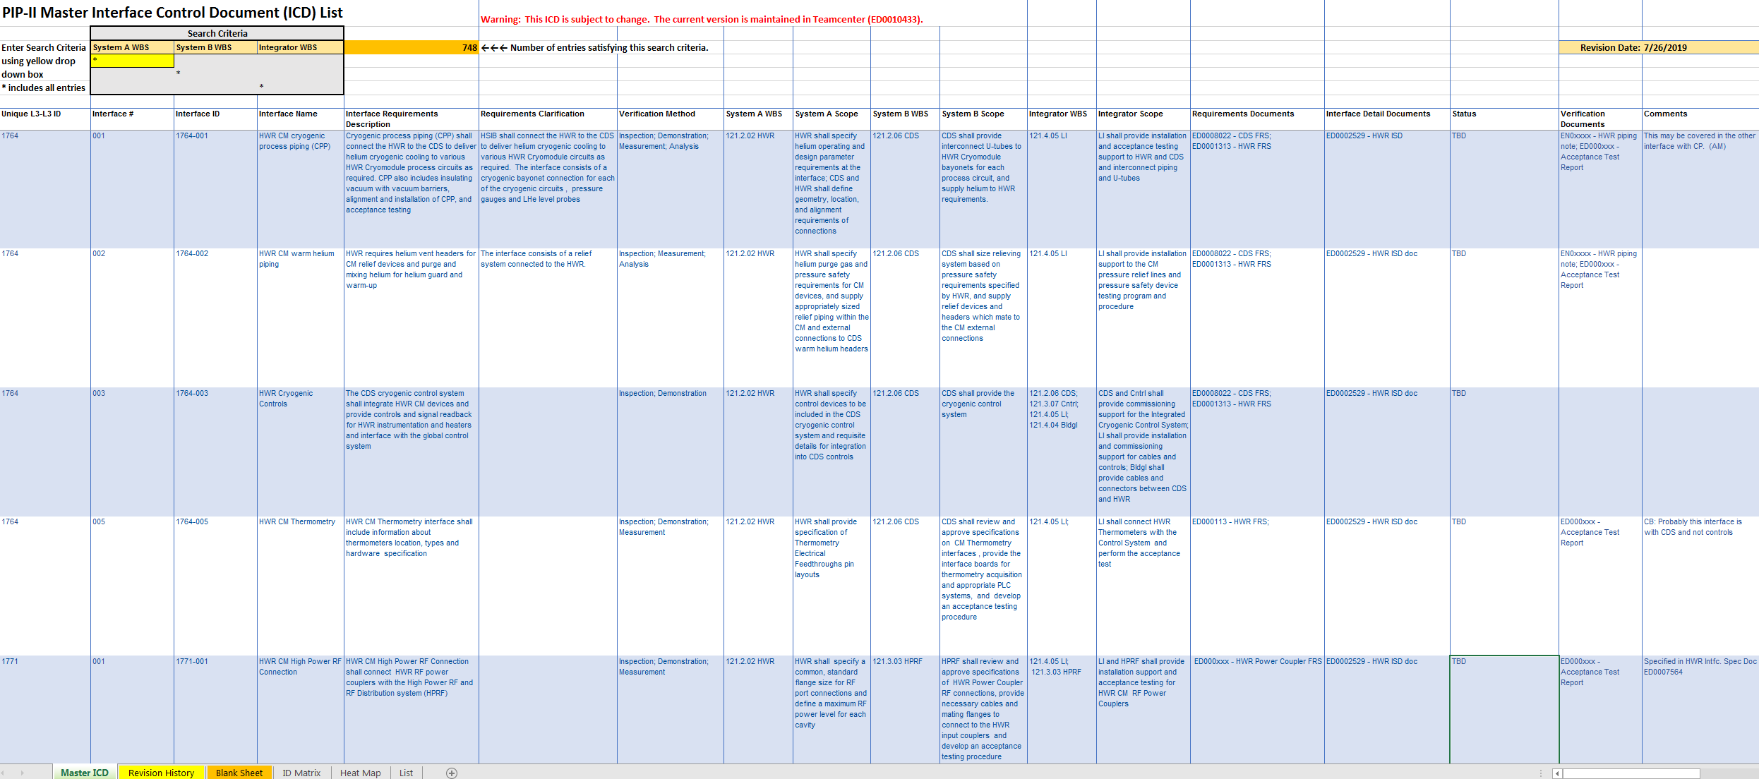
Master ICD Sheet Details

Slide 4
Master ICD Sheet Details – continued

Slide 5
Interfaces between SRF/Cryo Systems
Currently 14 interfaces have been defined between these systems
Process Piping Interfaces (cryogenic) – 4 interfaces
HWR CM to CDS
SSR CMs to CDS
650 MHz CMs to CDS
CP to CDS
Warm Piping Interfaces (suction/vent headers) – 4 interfaces
HWR CM to CDS
SSR CMs to CDS
650 MHz CMs to CDS
CP to CDS (all warm headers including discharge)
Cryogenic Controls Interfaces – 5 interfaces
HWR CM to CDS
SSR CMs to CDS
650 MHz CMs to CDS
CP to CDS (PLC integration)
CP to CDS (Signal exchange with Controls, CDS is Integrator)
Thermometry Interfaces (cryogenic) – 1 interface
HWR CM to CDS

Slide 6
Interface Specification Documents (ISD)
HWR CM ISD – ED0002529
SSR1 CM ISD’s
Prototype CM ISD – ED0004129
Production CM ISD – ED0011908 (placeholder)
SSR2 CM ISD’s
Pre-production CM ISD – ED0010943 (placeholder)
Production CM ISD – ED0011911 (placeholder)
LB650 CM ISD – TBD
HB650 CM ISD’s
Prototype CM ISD – ED0007562
Production CM ISD – TBD
CDS ISD – ED0011880 (placeholder)
CP ISD – ED0011884 (placeholder)
*** Many ISD’s still need to be created ***

Slide 7
Discussion
Review an example ISD
Are existing interfaces well defined?
Are there any interfaces missing (between SRF/Cryo systems)?

Slide 8
Discussion – continued
Cooldown Requirements/Constraints (imposed by CM’s to CDS typically)
Should these be considered interfaces?
Currently not listed
Examples
High temperature shield constraints
Cooldown rate constraints
Cavity fast cooldown requirements

