Slide 1
PIP-II Cryogenic System Operating Modes
Andrew Dalesandro and Ram Dhuley
Integrated Cryogenics Workshop Review
14 May 2020

Slide 2
Outline
CDS cooldown requirements
CDS HTTS – 80 K Circuit
Cooldown
Steady State
Warmup
CDS LTTS – 5 K Circuit
Cooldown
Steady State
Pumpdown
Warmup
CDS Steady-State
Note: operating modes and parameters are still in design and development. Specifics presented may be subject to change

Slide 3
CDS Cooldown - Requirements
During HTTS cooldown/warmup
Monitor Cryoplant Turbine String 1 temperatures
Monitor CD Return line pressure and flow rate back to LP Suction
During 5 K circuit cooldown/warmup
Monitor Cryoplant Turbine String 3 temperatures
Monitor CD Return line pressure and flow rate back to LP Suction
Monitor CP liquid dewar pressure and fill level
During 2 K pumpdown
Monitor CP 2 K liquid level and heater input power
Monitor cold compressor stability

Slide 4
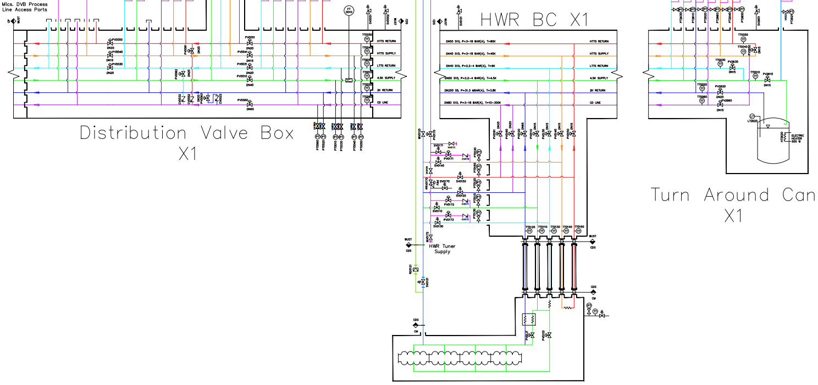
CDS Cooldown – HTTS
1
2
1. Flow from HTTS Supply in DVB, through CDS HTTS Linac
2. Return flows to CP through cooldown valve in DVB from HTTS Return to CD Return line

Slide 5
CDS Steady State – HTTS
1
2
Transition to steady-state:
1. Slowly open DVB HTTS Return valve
2. Close DVB HTTS cooldown valve
Regulate CDS HTTS temperature with HTTS Return valve as needed

Slide 6
CDS Warmup – HTTS
1
2
1. Flow warm gas from HP supply into HTTS at DVB; flow through CDS HTTS Linac
2. Return warm gas flows to CP CD Return using DVB cooldown valve

Slide 7
CDS Cooldown – 5 K Circuit
2
1
1. Flow from 4.5 K Supply in DVB, through CDS Linac
2. Return flows to CP through cooldown valves in DVB from CDS LTTS Return and 2 K Return circuits

Slide 8
CDS Steady State – 5 K Circuit
1
2
CP
Transition to steady-state:
1. Slowly open DVB LTTS Return and 2 K Return valves
2. Close DVB LTTS Return and 2 K Return cooldown valves
Regulate CDS LTTS temperature with LTTS Return valve as needed

Slide 9
CDS Pumpdown – 2 K Circuit
1
2
1. Regulate CDS 2 K Return pressure in Turnaround Can Phase Separator with TC 2 K Return valve
2. Use CDS TC PS ~ 500 W heater to commission 2 K load
CP must compensate ~ 1.5 kW locally to operate CDS at 2 K using CP cold compressors

Slide 10
CDS Warmup – 5 K Circuit
1
2
1. Flow warm gas from HP supply into 4.5 K Supply at DVB; flow through CDS HTTS Linac
2. Return warm gas flows to CP CD Return using DVB cooldown valve

Slide 11
Thank You

