Slide 1
PIP-II Cryogenic System Operating Modes
Andrew Dalesandro and Ram Dhuley
Integrated Cryogenics Workshop Review
14 May 2020

Slide 2
Outline
CM cooldown requirements and assumptions
CM HTTS – 80 K Circuit
Slow cooldown
State-state
Warmup
CM LTTS – 5 K Circuit
Slow cooldown
Option 1
Option 2
Option 3
Fast cooldown
5 K Fill
2 K Pumpdown
Warmup
Note: operating modes and parameters are still in design and development. Specifics presented may be subject to change

Slide 3
CM Cooldown – Requirements & Assumptions
Slow Cooldown ➔ 80 K < T < 300 K
HWR → no constraints
SSR1/2 → HTTS temperature rate of change ≤ 20 K/hr
LB/HB650 → HTTS temperature rate of change ≤ 20 K/hr
Intermediate Cooldown ➔ 45 K < T < 80 K
No Q-disease requirements for HWR, SSR1/2, or LB/HB650
No thermal constraints or required cooldown rate
Fast Cooldown ➔ 5 K < T < 45 K
HWR, SSR1/2 → no requirement
LB/HB650 → Hold for 1 hour at 45 K
LB650 → ≥ 43 g/s LHe flow through Nb transition temperature
HB650 → ≥ 72 g/s LHe flow through Nb transition temperature
HWR, SSR1/2 → MAWP = 4.1 bara
LB650 → MAWP = 2.05 bara
HB650 → MAWP = 2.05 bara
2 K Pump-down ➔ 2 K < T < 5 K
Single CM or many CMs with 2 K Return nominally at 31 mbar

Slide 4
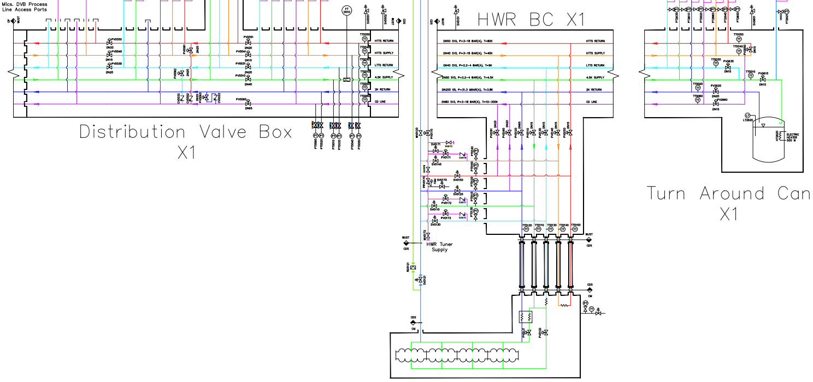
CM HTTS - Slow Cooldown
1
2
1. Circulate warm gas to establish flow in CM HTTS circuit and vent through HTTS cooldown valve
2. Slowly open HTTS Supply valve
Monitor temperatures and pressures to satisfy CM slow cooldown requirements
Mix warm and cold gas

Slide 5
CM HTTS - Steady State
Transition to CM HTTS steady-state:
Slowly open HTTS Return valve in CDS Bayonet Can
Close HTTS Return cooldown valve
Regulate temperature of CM HTTS as needed using HTTS Return valve in BC

Slide 6
CM HTTS - Warmup
Close CDS BC Supply and Return valves
Open CDS cooldown valve HTTS Return
Slowly open warm supply valves on the HTTS circuit
Circulate warm gas slowly through CM to boil off liquid, and raise temperatures within allowable pressure and temperature limits

Slide 7
CM 5 K Circuit - Slow Cooldown → Option 1: 4.5 K Supply
Gas flow path during controlled cooldown of cryomodule LTTS and cavities.
Option 1: Use 4.5 K Supply
Pros
Uses primary supply for CM cavity circuit
Cons
Does not directly cooldown CM 5 K intercept load or CDS LTTS Return U-tube
Unclear when to best cooldown 5 K intercept load
Unclear if fast cooldown can be successful without cooling down 5 K intercept
Mix warm and cold gas

Slide 8
CM 5 K Circuit - Slow Cooldown → Option 2: LTTS Return
Gas flow path during controlled cooldown of cryomodule LTTS and cavities.
Option 2: Use LTTS Return
Pros
LTTS Return directly cools CM 5 K intercept
Cons
Does not directly cooldown CM cavity supply line or CDS 4.5 K Supply U-tube
Unclear when to begin cooldown of cavity supply line
Unclear if fast cooldown can be successful through LTTS Return
Mix warm and cold gas

Slide 9
CM 5 K Circuit - Slow Cooldown → Option 3: 4.5 K Supply and LTTS Return
Gas flow path during controlled cooldown of cryomodule LTTS and cavities.
Option 3: Use both Supply and Return
Pros
Cool down full CM cavity circuit concurrently
Cons
Complex: operator must control fours valves and monitor ~ three different temperature readbacks and cavity pressure simultaneously
Mix warm and cold gas

Slide 10
CM 5 K Circuit - Fast Cooldown
Hold cavity temp. steady at 45 K for 1 hour
With CM cooldown valve throttled, open CDS BC 4.5 K Supply valve
Open CM cooldown quickly, keeping cavity pressure < 2 bara
Once LHe accumulates in cavity helium vessels, transition to 5 K Fill Mode

Slide 11
CM 5 K Circuit - 5 K Fill Mode
Slowly open CM JT valve
Close CM Cooldown valve
Regulate liquid level with CM JT valve as needed

Slide 12
CM 2 K Circuit - 2 K Pumpdown
Stabilize cavity LHe level
Close Bayonet Can 2 K cooldown valve
Slowly open BC 2 K Return valve, regulate 2 K LHe bath pressure
Regulate liquid level with CM JT valve as needed

Slide 13
CM 5 K Circuit - Warmup
Close CM JT valve. Open CM Cooldown Valve
Close CDS BC Supply and Return valves
Open CDS cooldown valve 2 K Return
Slowly open warm supply valves on the 5 K circuit
Circulate warm gas slowly through CM to boil off liquid, and raise temperatures within allowable pressure and temperature limits

Slide 14
Thank You

