Slide 1
Welcome to the
GARD ABP Workshop 2
S. Nagaitsev
Most of the planning work is being done as a “community effort”, led by: Z. Huang (SLAC), J. Power (ANL), J.-L. Vay (LBNL), L. Spentzouris (IIT), J. Rosenzweig (UCLA), P. Piot (NIU), and S. Nagaitsev (Fermilab)
April 15, 2020

Slide 2
Why are we here?
We are here to discuss the Accelerator and Physics research needs for the HEP and to define our long-term strategic road map.
Most recent HEPAP presentation about GARD by J. Rosenzweig:
https://science.osti.gov/hep/hepap/Meetings/201911

Slide 3
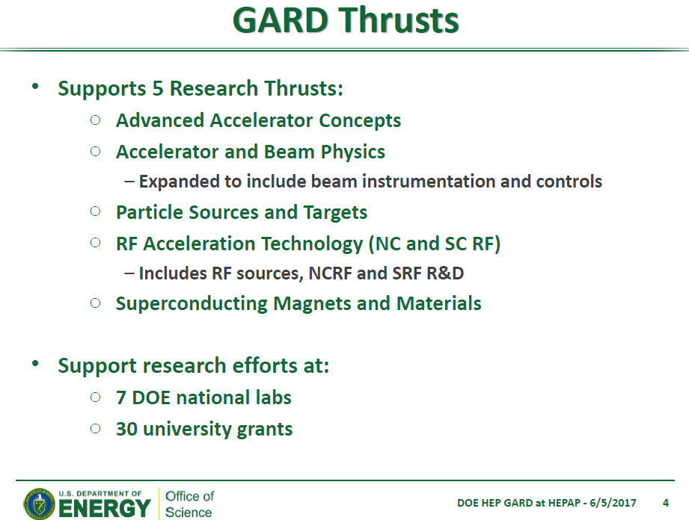
The ABP thrust supports research efforts at 4 DOE national labs (SLAC, LBNL, Fermilab, ANL)
and ~10 university grants

Slide 4
Introduction
All GARD thrusts, except for the ABP, have now completed their strategic planning.
  AAC, RF, HFM are published
OHEP has asked me (Aug 2018) to initiate, coordinate and lead this planning process for the ABP.
  It’s a group effort. We started regular (weekly) phone meetings in Oct 2018.
  We hope that our roadmap would have the following features
    It should be exciting and contain great physics opportunities (for labs and universities)!
    It should be distinct (should not look like service to other thrusts or Ops). Also, distinct from CBB (NSF-funded)
    It should advance the HEP strategic goals (at present, the P5 report and the upcoming Snowmass study)
    It should be helpful to other offices within DOE.

Slide 5
What is a roadmap?
A roadmap is a strategic plan that defines a goal or desired outcome and includes the major steps or milestones needed to reach it. It also serves as a communication tool, a high-level document that helps articulate strategic thinking—the why—behind both the goal and the plan for getting there.

Slide 6
2014 P5 report, 2015 GARD report, other GARD road maps
https://www.usparticlephysics.org/ -- the P5 report
https://science.osti.gov/~/media/hep/hepap/pdf/Reports/Accelerator_RD_Subpanel_Report.pdf -- GARD report
https://science.osti.gov/~/media/hep/pdf/accelerator-rd-stewardship/Advanced_Accelerator_Development_Strategy_Report.pdf -- the AAC roadmap
https://science.osti.gov/~/media/hep/pdf/Reports/DOE_HEP_GARD_RF_Research_Roadmap_Report.pdf -- the RF roadmap
https://science.osti.gov/~/media/hep/pdf/Reports/MagnetDevelopmentProgramPlan.pdf -- the HF magnet roadmap
Notice that these are all DOE documents (more about it later)

Slide 7
Synergies
9 DOE national labs claim Accelerator Science and Technology as one of their core capabilities:
  https://nationallabs.org/site/wp-content/uploads/2017/05/National-Labs-all-r.pdf
The GARD ABP thrust shares many topics and physics issues with R&D activities at other (non-HEP) labs and universities
  OHEP is sensitive to the fact that they do not “own” the entire ABP phase space
So, it is essential for us to invite ALL labs to our discussions and to get a “buy-in” from them.
  But we must focus on the HEP research needs
Other DOE SC offices are very interested in what we are doing.

Slide 8
Science is proposal-driven
We are to bring to OHEP proposals for research and they respond (with guidance, requirements, and/or funding)
  Accelerator scientists (like all scientists) should be continuously proposing new ideas and experiments
There is no clear single funding agency for Accelerator Physics at National Labs (like ASCR for computing)
  ECAs, NSF (for universities)
  GARD as a whole is to address “Technology Gaps” for HEP; ABP is supported as a small fraction.
Our roadmap should address both “Knowledge gaps” and “Technology gaps” in Accelerator and Beam Physics.
It will help OHEP to strengthen their case and it will help every scientist in our field.

Slide 9
Our process
Define ABP scope, mission, vision, challenges, activities
  Done (2018 – 2019)
Collect ideas and research topics to address challenges and to advance the mission
  Two workshops, Dec 2019 (LBNL) and April 2020 (by Zoom)
  Start forming a roadmap: a timeline of R&D steps with milestones
  Draft a ~30-page document, describing the exciting research opportunities and the draft roadmap
HEP Basic Research Needs Workshop on GARD ABP
  Sponsored by OHEP
  Example: https://www.orau.gov/brndrd2019/
Publish the Roadmap document, based on the workshop and our draft document

Slide 10
Definitions and vision statement
Accelerator and beam physics is the science of the motion, generation, acceleration, manipulation, prediction, observation and use of charged particle beams.
The Accelerator and Beam Physics (ABP) thrust focuses on fundamental long-term accelerator and beam physics research and development.
The ABP thrust explores and develops the science of accelerators and beams to make future accelerators better, cheaper, safer, and more reliable. Particle accelerators can be used to better understand our universe and to aid in solving societal challenges.

Slide 11
GARD ABP mission statement
The primary scientific mission of the ABP thrust is to address and resolve the Accelerator and Beam Physics Grand Challenges. Other equally important ABP missions are associated with the overall DOE HEP missions:
  Advance physics of accelerators and beams to enable future accelerators.
  Develop conventional and advanced accelerator concepts and tools to disrupt existing costly technology paradigms in coordination with other GARD thrusts.
  Guide and help to fully exploit science at the GARD beam facilities and operational accelerators.
  Educate and train future accelerator physicists.

Slide 12
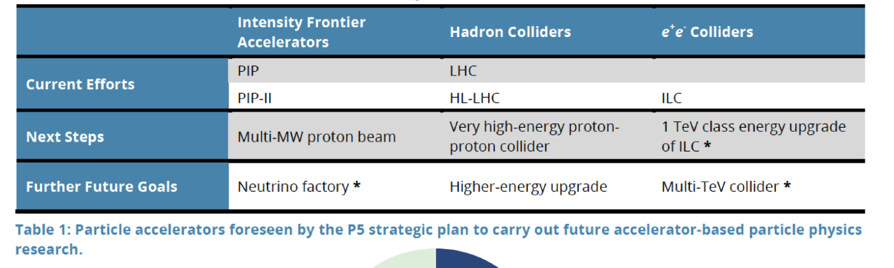
The 2014 P5 report provided physics drivers for accelerator R&D
We should also anticipate the upcoming Snowmass process (2021)

Slide 13
Snowmass 2021: DPF, DPB, DNP, DAP, DGRAV
Snowmass 2021: https://snowmass21.org/
Accelerator Frontier (Contacts: Steve Gourlay, Tor Raubenheimer, Vladimir Shiltsev )
Topical groups
  AF1: Beam Physics and Accelerator Education
  AF2: Accelerators for Neutrinos
  AF3: Accelerators for EW/Higgs
  AF4: Multi-TeV Colliders
  AF5: Accelerators for PBC and Rare Processes
  AF6: Advanced Accelerator Concepts
  AF7: Accelerator Technology R&D
Townhall meeting at the Apr APS meeting (Sat Apr 18)

Slide 14
ABP Grand challenges
Grand challenge #1 (beam intensity): How do we increase beam intensities by orders of magnitude?
Grand challenge #2 (beam quality): How do we increase beam phase-space density by orders of magnitude, towards quantum degeneracy limit?
Grand challenge #3 (beam control): How do we control the beam distribution down to the level of individual particles?
Grand Challenge #4 (beam prediction): How do we develop predictive “virtual particle accelerators”?
Link to Grand Challenges (a more detailed description):
https://docs.google.com/document/d/11XhutaKropA9kToZhrYmCsoDf6oBunhuQ8mPgYhkJiA/edit?usp=sharing

Slide 15
Workshop #1 WGs
Workshop #1 (LBNL, Dec. 9-10, 2019):
  (WG1) Single-particle dynamics, including nonlinearities, and spin dynamics.
  (WG2) High-brightness beam generation (including polarized beams), transport, manipulation and cooling.
  (WG3) Mitigation and control of collective phenomena: instabilities, space charge, beam-beam, beam-ion effects, wakefields, and coherent synchrotron radiation.
  (WG4) Connections to other GARD roadmaps (cross-cutting WG1-3)
Draft summary report: https://indico.fnal.gov/event/22709/material/1/

Slide 16
Workshop #2 WGs
Workshop #2 (by Zoom, Apr - May, 2020):
(WG1) Advanced accelerator instrumentation and controls.
(WG2) Modeling and simulation tools (including energy deposition); fundamental theory and applied math.
(WG3) Early conceptual integration and optimization, maturity evaluation
(WG4) Connections to other GARD roadmaps; synergies with non-HEP

Slide 17
Speaker guidelines
Emphasize broad forward-looking research topics other than your specific R&D program
Focus on your view of future challenges and methods to address those challenges.

