Slide 1
Comments on FCC-hh, SPPC, HE-LHC
D. Schulte, CERN

Slide 2
Overview
The main hadron collider proposals:
FCC (Future Circular Collider)
  FCC-hh: A hadron collider with 100 TeV proton-proton collisions 20 ab⁻¹ integrated luminosity
    Next to CERN, using existing accelerators as injector
  FCC-ee: A first stage that could cover 90, 160, 240 and 365 GeV electron-positron collisions
    using the same tunnel
CEPC / SppC (Circular Electron-positron Collider/Super Proton-proton Collider)
  CEPC: A lepton collider with 90, 160 and 240 GeV as a higgs/Z factory
  SppC: An upgrade to collider protons, first 75 TeV with 2x15 ab⁻¹, upgraded to 125 to 150 TeV
HE-LHC (High Energy LHC)
  Using the LHC tunnel with FCC-hh type magnets to reach 27 TeV with 10 ab⁻¹

Slide 3
Hadron Collider Parameters
 | LHC / HL-LHC | HE-LHC | FCC-hh Initial Final |  | Sppc
Cms energy [TeV] | 14 | 27 | 100 | 100 | 75
Lumin. [10³⁴cm⁻²s⁻¹] | 1 / 5 | 16 | 5 | 20-30 | 10
Circumference | 26.7 | 26.7 | 97.75 | 97.75 | 100
Arc dipole field [T] | 8 | 16 | 16 | 16 | 12
Bunch charge | 1.15 / 2.2 | 2.2 | 1 | 1 | 1.5
Bunch distance [ns] | 25 | 25 | 25 | 25 | 25
Backgr. events/bx | 27 / 135 | 440 | 170 | <1020 | ?
Bunch length [cm] | 7.5 | 7.5 | 8 | 8 | 7.55

Slide 4
Design Status
CDRs exist for all three proposals
Fundamentally technology is within reach or expected to be available in future
Most important technology that is being developed are magnets
  define the timescale together with cost considerations
Feel confident that FCC-hh design goals can be achieved
Much more work is ahead
Still, need to develop TDRs
Important to improve margins on many issues
Novel, improved technologies should be considered
Alternative, improved operation modes (e.g. 12.5 ns bunch spacing) require solutions
Do not have outcome of European Strategy Update yet
mainly whether a scenario with FCC-hh first is considered
at this moment hard to judge urgency and required ramp-up of studies
some studies will be useful also for HL-LHC

Slide 5
FCC-hh Layout
Layout for CERN site
Two high-luminosity experiments (A and G)
Two other experiments combined with injection at 3.3 TeV (L and B)
Two collimation insertions
  Betatron cleaning (J)
  Momentum cleaning (E)
Extraction insertion (D)
Clean insertion with RF (H)
Circumference 97.75km
Can be integrated into the area
Can use LHC or SPS as injector

Slide 6
Integrated Lattice
Arc
Main experiments
Special experiments
Momentum collimation
Betatron collimation
Extraction
RF
Full integrated lattice exists
large amount of work (code, matching, tuning, …)
some small issues remain to be solved
some proposals for improved desgins to be integrated

Slide 7
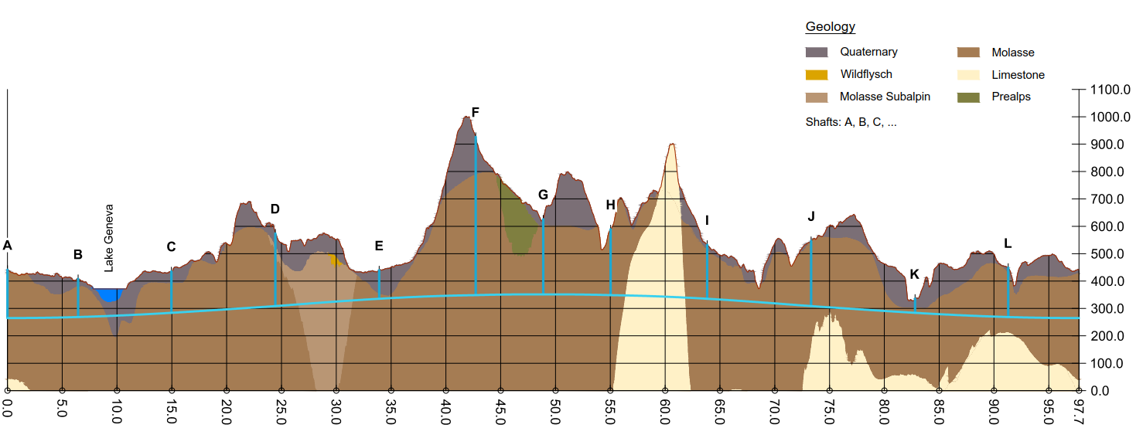
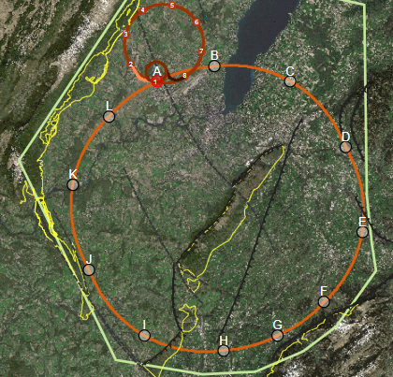
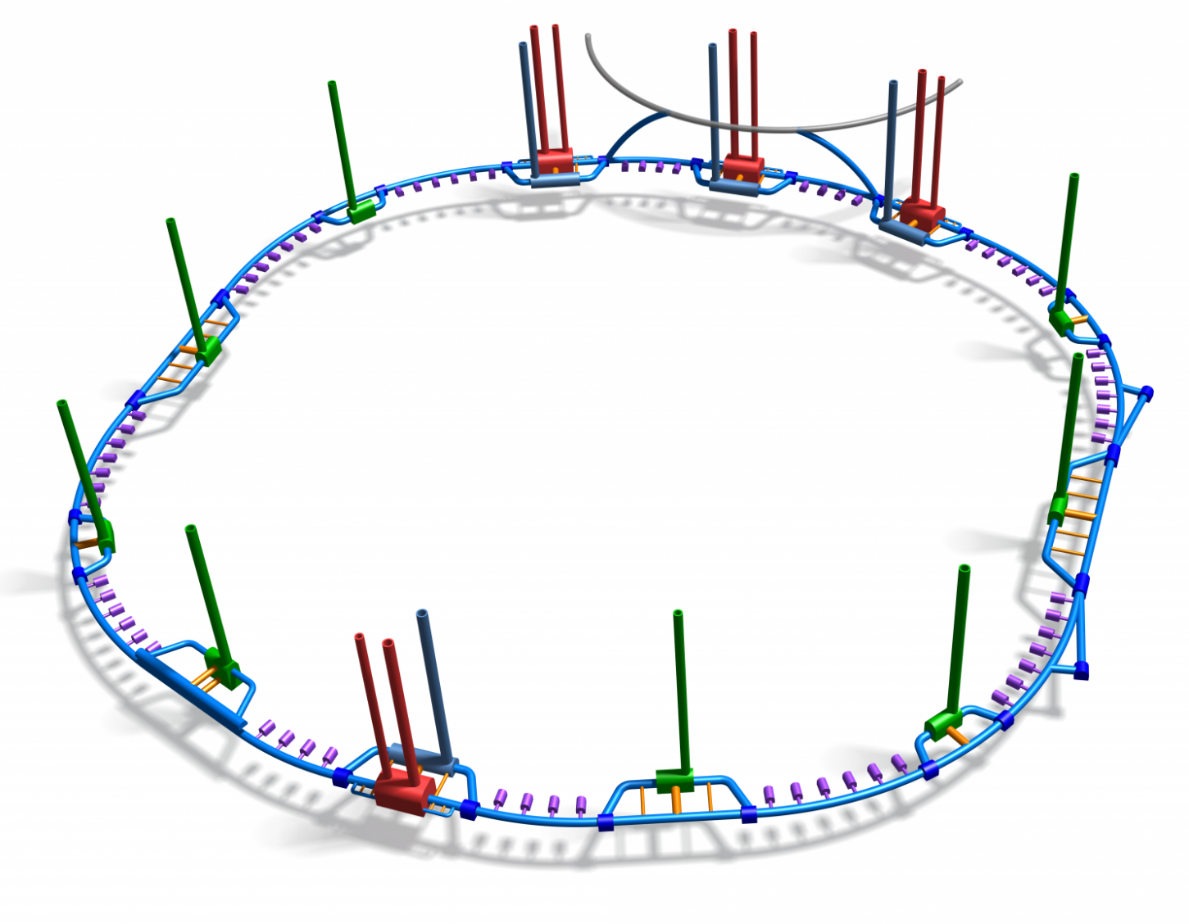
Site and Infrastructure Planning
FCC-hh: Detailed studies of site, civil engineering, power availability
Planning of project implementation
SppC also is studying sites
HE-LHC has a known site, challenge is to fit everything in it

Slide 8

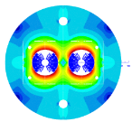
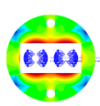

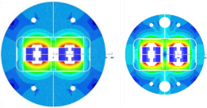

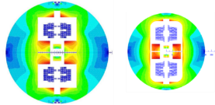
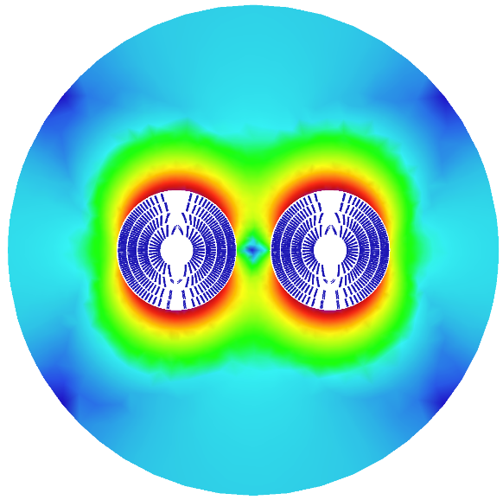

Magnet Development
Cosine theta
Need 16 T to reach 50 TeV /beam
Move from NbTi (LHC technology) to Nb₃Sn
14.3 m long dipoles
Magnet is key cost driver
Improve cable performance
Reduce cable cost
Improve fabrication of magnet
Minimise amount of cables
Push lattice filling factor
Block design
Safety margin from 18% to 14%
Reduced inter-beam distance from 250 to 204 mm
Stray field up to 0.1 T
Total conductor (incl. copper) from O(10 kt) to 7.6 kt
Iterations with lattice designers for field quality
Common coils
Canted coils

Slide 9
Beam Parameters
 | Initial | Final
Luminosity L [10³⁴cm⁻²s⁻¹] | 5 | 20-30
Background events/bx | 170 | <1020
Bunch distance Δt [ns] | 25
Bunch charge N [10¹¹] | 1
Fract. of ring filled η_{fill} [%] | 80
Norm. emitt. [μm] | 2.2
Max ξ for 2 IPs | 0.01 (0.02) | 0.03
IP beta-function β [m] | 1.1 | 0.3
IP beam size σ [μm] | 6.8 | 3.5
RMS bunch length σ_{z} [cm] | 8
Crossing angle [σ’] | 12 | Crab. Cav.
Turn-around time [h] | 5 | 4

Slide 10
Luminosity Drivers
Maximise the beam current
Risks:
High stored energy and losses
Impedance and electron cloud
Aperture should be minimised for dipole cost
High synchrotron radiation load due to high beam energy
Squeeze the beam as much as possible
Harder than in HL-LHC (scaling with energy)
More collision debris due to higher luminosity and energy
Limited by beam-beam emittance growth and particle losses and ability to make emittance
Somewhat more difficult than HL-LHC due to longer L*
For integrated luminosity:
Fast turn-around critical for luminosity
Minimise time for stops etc.
High availability with more components than LHC
Maximising current also maximises time between new fills

Slide 11
Luminosity per Fill
Our goal is 8 fb⁻¹ per day,
peak luminosity below 3 x 10³⁵ cm⁻²s⁻¹ to keep collision debris at bay
Maximum integrated luminosity per day 25.9 fb⁻¹
Impact of fill time
Naïve optimistic assumption for fills:
Burn beam at 3 x 10³⁵ cm⁻²s⁻¹ in two experiments
Need 4 hours to refill the machine with beam
Our choice N = 10¹¹: 3.2 hours to burn the full beam
Can at best produce 11.5 fb⁻¹ per day
Turn-around time is crucial

Slide 12
Turn-around Time
FCC goal is < 2 h nominal
But assume 4 h on average
D. Nisbet, K. Fuchsberger, R. Fernandez et al.
Improvements of beam control
would help to reduce difference between minimum and average turn-around time, direct improvement of luminosity
Largest difference between theory and practice in setup time
But this contains time to recover from failures
So should be counted in different budget

Slide 13
Current Limitation
Synchrotron radiation
N = 10¹¹ yields 5 MW of radiation power
Even at 50 K need about 100 MW of cooling power to remove heat
30 W/m in arc, sophisticated vacuum system design
Collective effects (single beam)
Can design collider to be able to cope with effects, but involves cost
Actually, selection of beam screen radius and collimation aperture to make sure we can tolerate current
Collimation, machine protection and beam transfer
Circulating energy for N = 10¹¹ in each beam is 8 GJ
Find that N = 10¹¹ is sufficient to reach the goal with a bit of reserve

Slide 14
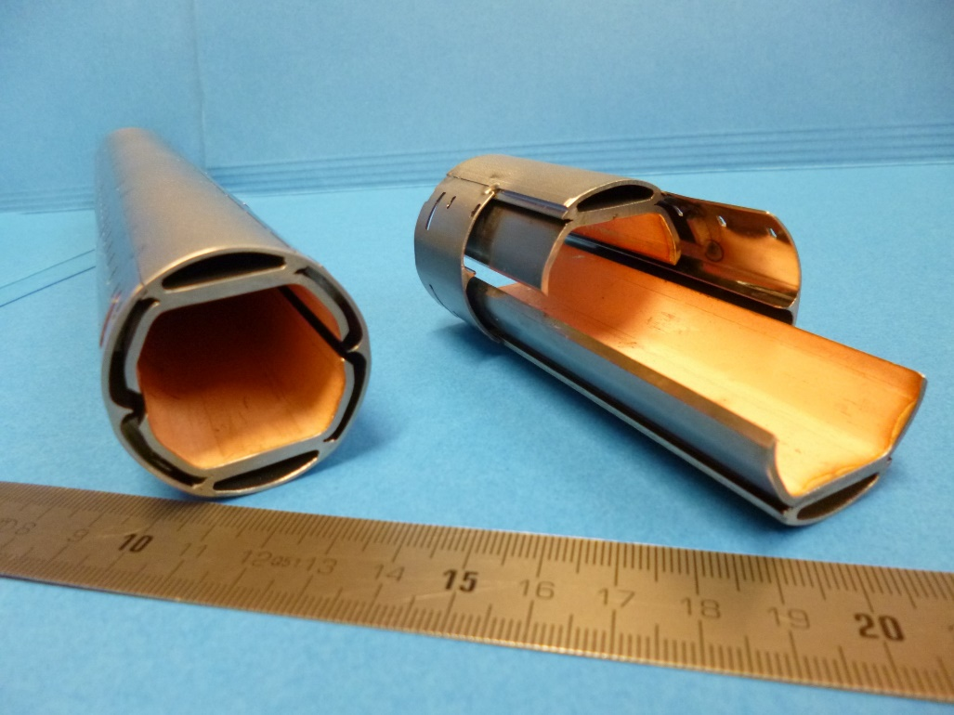

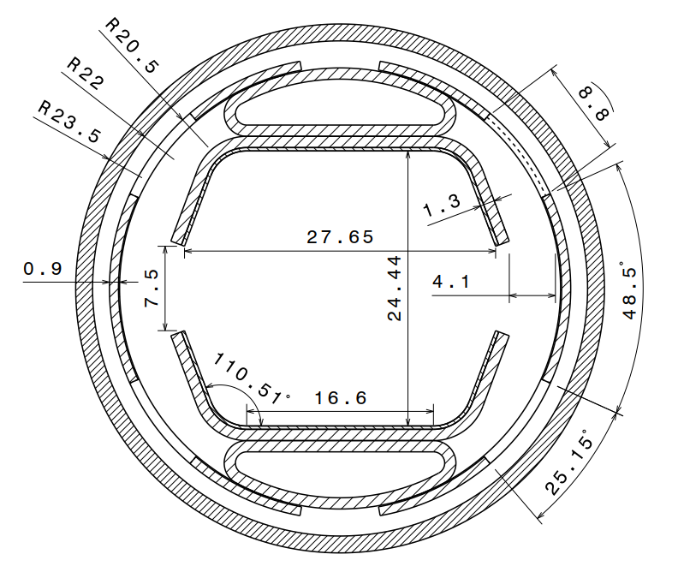
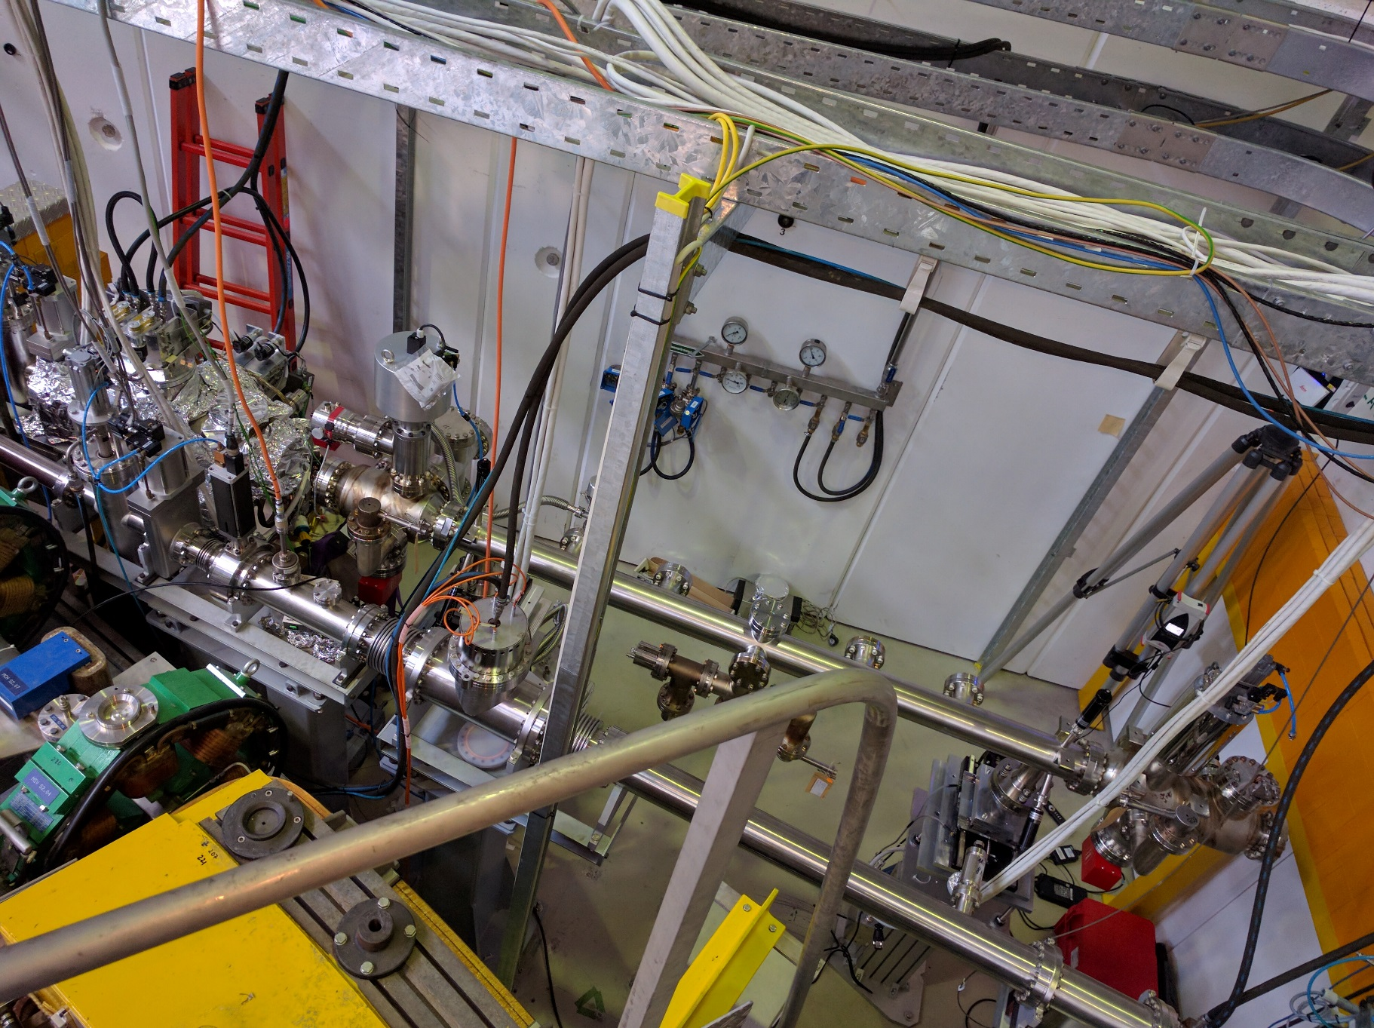
FCC-hh Beampipe
30 W/m synchrotron radiation (LHC: 1 W/m)
Make it small to make magnet cheap
Magnet aperture 50 mm (LHC 56 mm)
Prototype
Laser treatment / carbon coating against ecloud
Extract photons for great vacuum
Test station in ANKA
Strong to withstand quench
Low impedance:
aperture, copper coating,
Hide pumping holes from beam for low impedance
50 K for efficiency

Slide 15
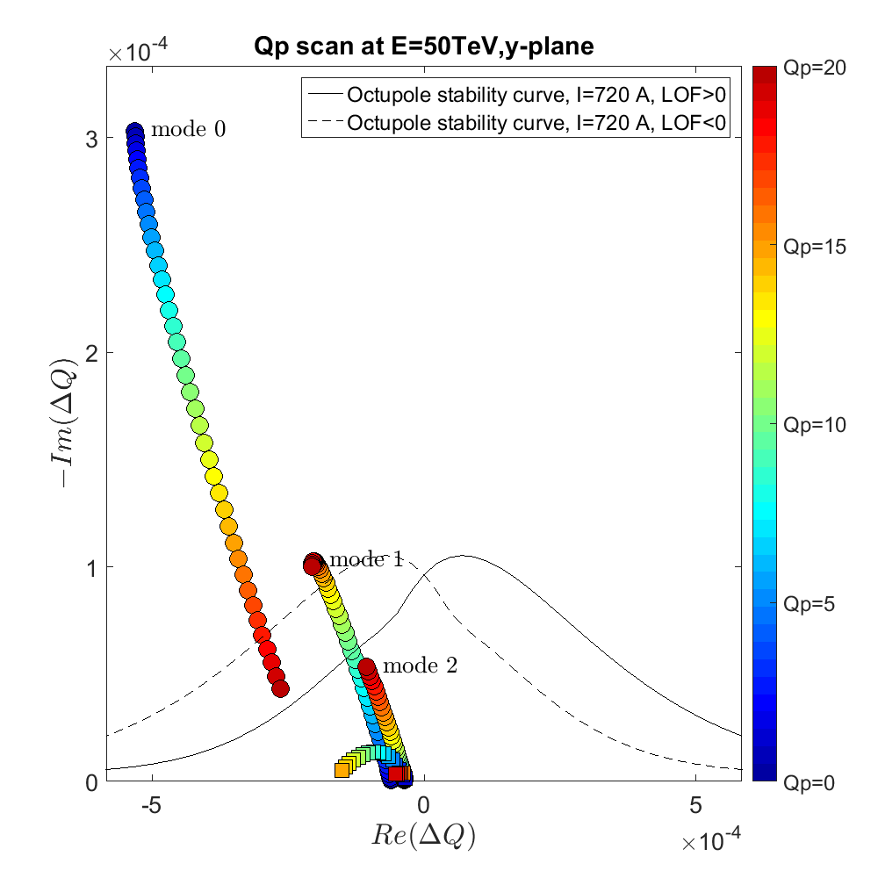
Impedances
Impedance effects important at injection and flat top
Taken into account in design
More work to improve data base
particularly fast extraction kickers
Octupoles alone cannot ensure beam stability
Need too much strength, compromise dynamic aperture
Feedback to stabilise rigid multi-bunch effects
Use octupoles to stabilise higher modes
Rigid mode is cured by chromaticity
Other modes are made worse
Further optimised bunch-by-bunch feedback
Electron lens
Intra-bunch feedback
RF quadrupoles
Consider drastic decrease of emittance during run
Further improve impedance model
Fast kickers and collimators

Slide 16
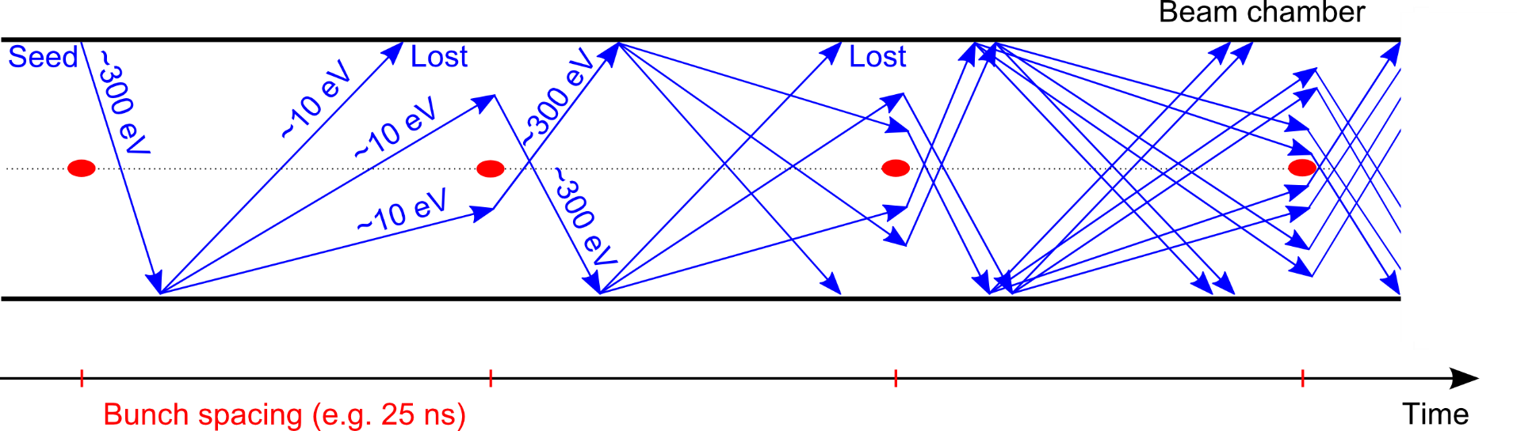
Electron Cloud
Solution exists in principle for 25 ns:
Beam pipe design minimises electron production by photons
Carbon coating or laser treatment ensure secondary emission yield <1.2 for beam stability
Yield of 1.0 or below required for 12.5 and 5 ns spacing
would reduce background per bunch crossing
More detailed studies to increase margin
Experimental verifications of solutions
Also important for HL-LHC
Further improvements to ensure 12.5 and 5 ns spacing to allow better physics

Slide 17
Beam-beam Effects
Emittance growth from beam-beam jitter has to be limited to 10⁻⁸ per turn (about 11% per hour)
Need to understand jitter sources better
survey of potential sources
magnet jitter maybe less well understood in LHC than we thought, since beampipe shields it
Beam-beam effects lead to beta-beating which can impact machine optimisation
Needs to be controlled to ensure collimation system efficiency
Crab crossing is key
More optimisation of beam-beam vs. impedance and resonances
Beam-beam feedback to ensure 10⁻⁴ beam stability
Survey of jitter sources
Orbit feedback with noise at 10⁻⁴
Optics control with beam-beam
Crab crossing essential to control beam emittance
To achieve 3% at current working point (same as LHC) need crab crossing and well controlled phase advance (1%)
More stable working points exist but need full study (also impedances)

Slide 18
Beam-beam Effects
Emittance growth from beam-beam jitter has to be limited to 10⁻⁸ per turn (about 11% per hour)
Need to understand jitter sources better
survey of potential sources
magnet jitter maybe less well understood in LHC than we thought, since beampipe shields it
Beam-beam effects lead to beta-beating which can impact machine optimisation
Needs to be controlled to ensure collimation system efficiency
Crab crossing is key
More optimisation of beam-beam vs. impedance and resonances
Beam-beam feedback to ensure 10⁻⁴ beam stability
Survey of jitter sources
Orbit feedback with noise at 10⁻⁴
Optics control with beam-beam
Crab crossing essential to control beam emittance
To achieve 3% at current working point (same as LHC) need crab crossing and well controlled phase advance (1%)
More stable working points exist but need full study (also impedances)

Slide 19
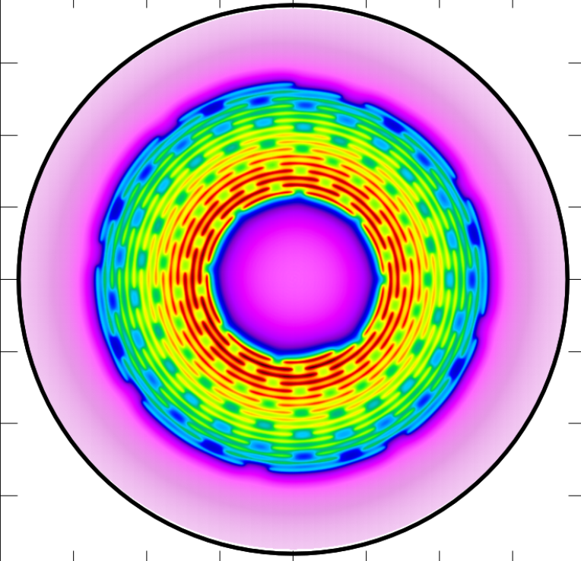
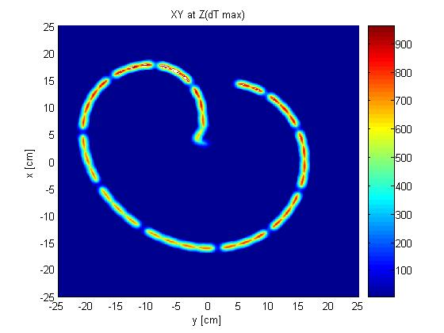
Machine Protection Challenge
Extraction and machine protection are challenging
8 GJ kinetic energy per beam (2000 kg TNT)
FCC-hh beam dilution pattern at dump
Misfiring of extraction kicker is critical
Have to extract beam
Could damage machine
LHC beam dilution pattern at dump
Robust design of extraction system
e.g. superconducting septa
shielding
Potential extraction at next turn requires control of circulating beam
Limit kick of individual kicker so that beam can turn once more
Tail cleaning via hollow electron lens can help to avoid losses
1.6m
Painting of the beam with two resonant circuits
need to diagnose functioning of system in situ during run
capacitors can change

Slide 20
Collimation
Design allows machine to operate under bad conditions: 12 MW losses/12 minute lifetime to diagnose
Had to work hard to find the solutions, further improve and study required also for ion operation
1) Use of thin primaries, no skew collimator
2) Protection of chicane (1 MW)
3) Protection/design of secondaries
4) Protection of arcs (kw)
General collimation performance studies
Verify robustness of required coating to ensure essential impedance reduction
Develop collimation operation while colliding to reduce betafunction at IP
  identify and solve risks for machine
2)
4)
3)
1)

Slide 21
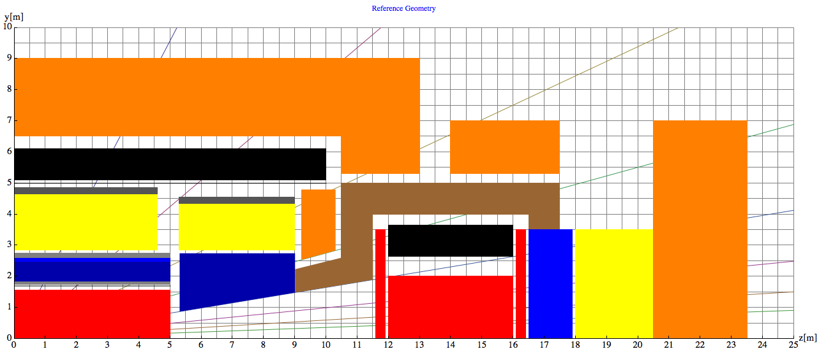
FCC-hh MDI
Tracking
Ecal
HCAL
Magnets and cryostat
Muons
Uses forward solenoid
Alternative option with forward dipole considered
Add. protection
TAS
Triplet
Hall half length: 33m
Tunnel before triplet: 7m
L*=40 m
Detector half length 23.5m
Space to open 9.5m

Slide 22
Experimental Insertion Magnets
Each experiment produces 500 kW of collision debris
strictly proportional to luminosity
have to shield magnets
Are above current radiation limit (dose) by a small factor
Can improve magnet technology (other raisins)
Can improve shielding
Further improvements of optics design and operation might help
Also at limit of neutron flux
Are at limit of 1/300 DPA
Better experimental understanding of limits
Replacement of magnets possible but challenging
Robust materials
Improved masking
Improved beamline design
Improved operation

Slide 23
Conclusion
Conceptual design for FCC-hh (SppC, HE-LHC) is solid
  Do not see any showstopper
  Contanct for FCC–hh: Daniel Schulte
  HE-LHC is deemphasized
  SppC: Yifan Wang
Important work in all areas required to move toward a project
  Improved performance (e.g. 12.5 ns bunch spacing)
  Improve robustness (e.g. collimation system design)
  Alternative solutions (e.g. electron lens)
  Cost reduction (e.g. lower injection energy, smaller aperture)
Need to develop proposed solutions into technical ones
  at the time of a technical design report

Slide 24
Specific Issues
Crab crossing is instrumental
Beam-beam can be close to the limit
  Try to find better working point or mitigation
Tight tolerance for beam-beam jitter (10⁻⁴)
  can we consider an IP feedback?
Electron cloud main driver for bunch distance
  improved performance could reduce detector background
Impedances are acceptable but design could be improved by impedance mitigation
  intra-bunch feedback, faster bunch-by-bunch feedback, electron lens, wires
  could allow smaller aperture and cost reduction
  could allow lower injection energy
  currently, need beam-beam for stability, puts constraints on operation
Fast control and diagnostics to speed up injection procedures

Slide 25
Specific Issue, cont.
Collimation is a critical design driver
  could impact site choice and cost
  more robustness would be important
  removal of tails would help machine protection (misfiring of extraction kicker)
Shielding of IP magnets
  magnet survival possible but close to limit
Safe extraction
  complex painting of beam on dump requires robust kicker system where status can be diagnosed permanently
    e.g. knowledge of capacitors in kicker circuits
…

Slide 26
Reserve

Slide 27
Beam Parameters and Luminosity
 | Initial | Ultimate
Luminosity L [10³⁴cm⁻²s⁻¹] | 5 | 20-30
Background events/bx | 170 | <1020
Bunch distance Δt [ns] | 25
Bunch charge N [10¹¹] | 1
Fract. of ring filled η_{fill} [%] | 80
Norm. emitt. [μm] | 2.2
Max ξ for 2 IPs | 0.01 (0.02) | 0.03
IP beta-function β [m] | 1.1 | 0.3
IP beam size σ [μm] | 6.8 | 3.5
RMS bunch length σ_{z} [cm] | 8
Crossing angle [σ’] | 12 | Crab. Cav.
Turn-around time [h] | 5 | 4
Beam physics
Interaction region design
Power consumption
Beam stability
Damage potential
Beam dynamics studies show this will work

Slide 28
Beam Parameters During a Fill
Synchrotron radiation is important at 50 TeV
5 MW for both beams
30 W/m per beam in the arc
Need to protect magnets from heat
Significant damping (1 h transverse damping time)
Beam burns off rapidly
Fast turn-around is key
LHC with modified magnet powering

Slide 29
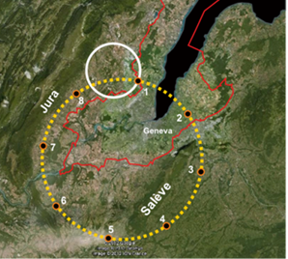
FCC Goal
FCC study develops a conceptual design of a new facility
FCC-hh defines infrastructure
100 TeV proton-proton collisions, 20 ab⁻¹ per experiment
7x LHC energy and 7x HL-LHC integrated luminosity
Use existing infrastructure to generate beam
New ~100km-long collider ring
LHC
Potential first stage FCC-ee offers electron-positron collisions from 90 GeV to 365 GeV
Unprecedented electron-positron collision energies >208 GeV
Much higher event rates at previously reached energies (O(10⁵) times as many Z as at LEP/LEP2)
FCC
FCC-eh Proton-electron option is also possible
HE-LHC Proton-proton option in LHC tunnel with FCC-hh technology
Consistent with implementation at CERN

Slide 30
Lattice Scaling
Have to adjust optics to first order
Energy scalings
r=(E/E₀)^{1/3} or r=(E/E₀)^{1/2}
r=(B/B₀)^{-2/3} or r=(B/B₀)^{-1/2}
Technology scalings
Constant aperture
Reduced aperture proportional to beam size
Start for FCC-hh:
Insertions with energy (FCC-hh 1400m vs. LHC 500m,
two insertions longer because most difficult)
Arc with energy and technology but constant aperture (cells length 200m vs. 100 m)

Slide 31
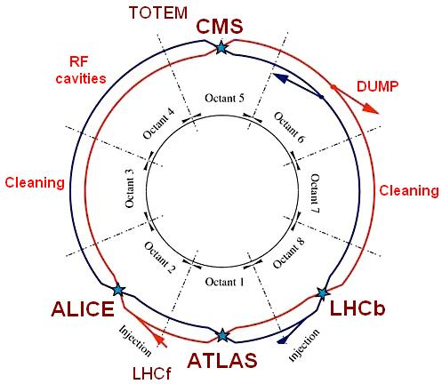
HE-LHC
Physics goals:
2 x LHC collision energy in LHC tunnel using FCC-hh magnets
  I. e. cms energy > 27 TeV
  Required some iterations of the design
Target integrated luminosity ≥ 10 ab⁻¹ over 20 years
Strategy:
Use FCC-hh magnets & FCC-hh vacuum system
Use HL-LHC crab cavities & long-range wire compensation
Use HL-LHC/LIU parameters (25 ns baseline)
No major modifications of LHC tunnel

Slide 32
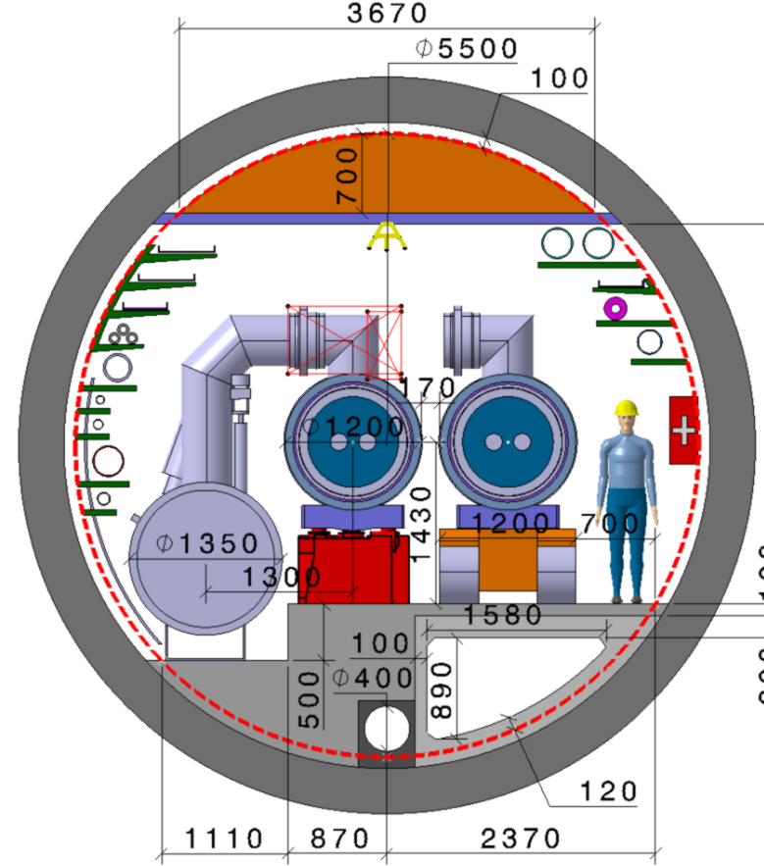
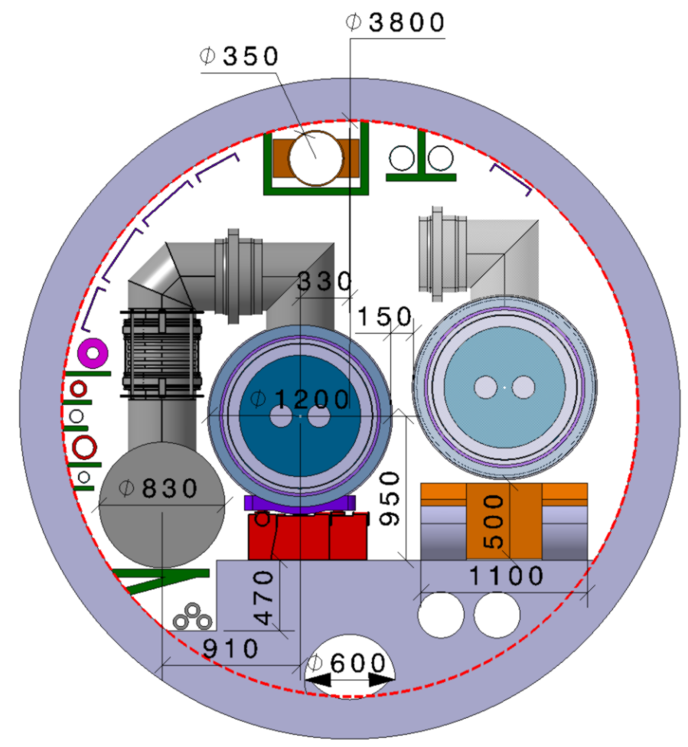
HE-LHC Challenges and Optics
Challenges:
LHC tunnel is small
Insertions are short
But seem able to cope with this
Two arc lattice options considered
First has higher energy (27.3 TeV)
Second has better dynamic aperture
Injector (SPS) likely needs upgrade with superconducting magnets (from 0.45 to 1.3 TeV)
Insertions design requires new approaches (e.g. superconducting magnets in collimaiton section?)
HE-LHC
FCC-hh

Slide 33
Current Limitation
Can only use some temperatures in order to maintain good vacuum
<20, 40K-60K, 100K-120K, >190K
Ph. Lebrun, L. Tavian,
V. Baglin et al.
300MW
200MW
100MW
Beam current is possible
2K is cheapest for dipole magnets
Choose 50 K
Need 20 x 5 MW = 100 MW for cooling
Proton beams emit about 5 MW of synchrotron radiation

Slide 34
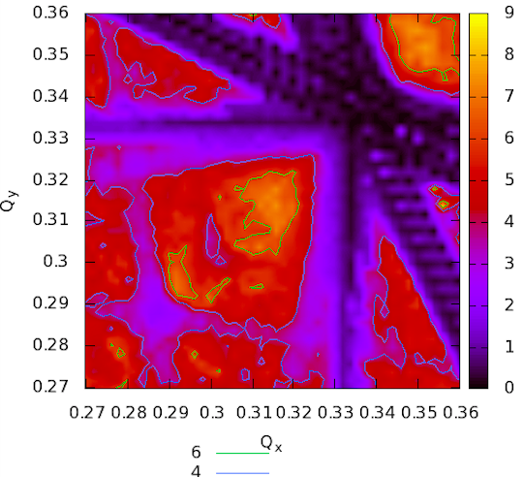
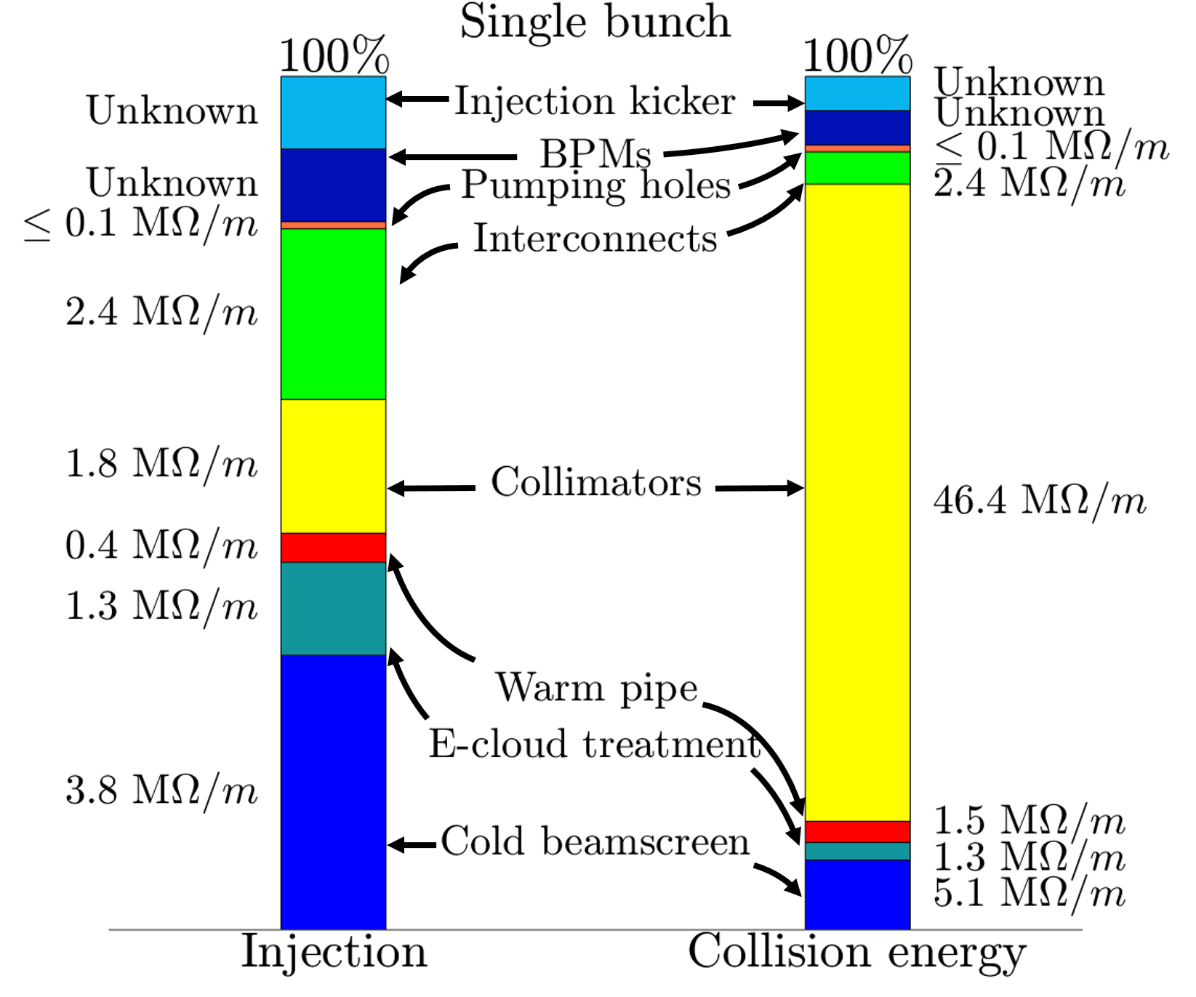
Beam Dynamics
Beam dynamics studies
validate the design
Beam-beam studies
Instabilities:
Impedances, octupoles,
electron lens, feedback, ..
Electron cloud, coatings, …
Beam handling:
Collimation, injection, extraction, …
Lattice design, integration of octupoles for stability etc. corrector design, dynamic aperture studies, …

Slide 35
FCC-hh Beam Losses
8 GJ kinetic energy per beam
Boing 747 at cruising speed
2000 kg TNT
400 kg of chocolate
  Run 25,000 km to spent calories
O(20) times LHC
Designed shielding to cope with the 500 kW collision debris per experiment
1.6m
FCC-hh beam dilution pattern at dump
Triplet design allows for thick shielding
LHC beam dilution pattern at dump
Collimation system design
Designed system that can cope with the losses
Detailed studies and optimisation of performance
Also reduction of impedance
1.6m

Slide 36



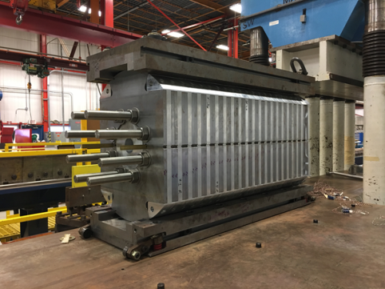
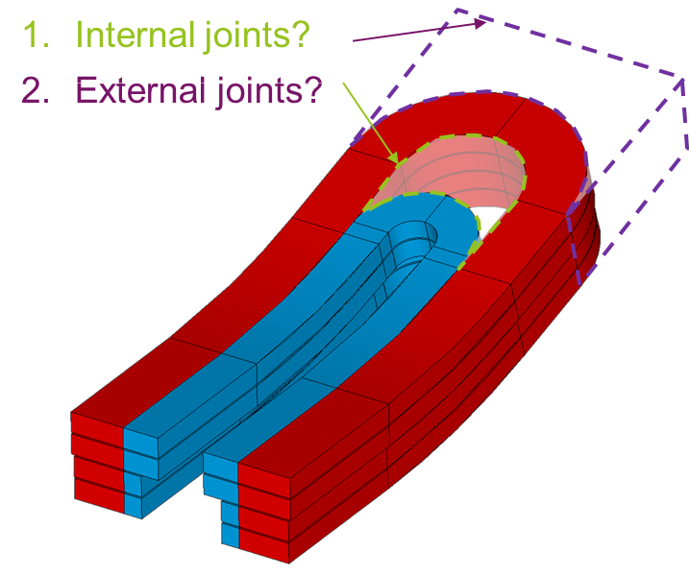
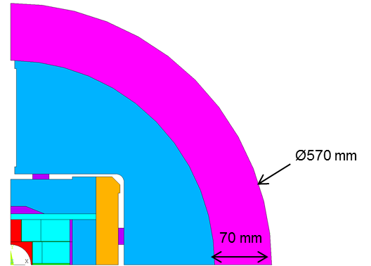
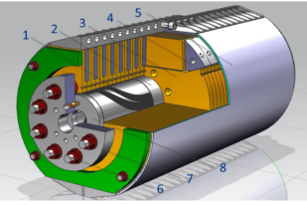
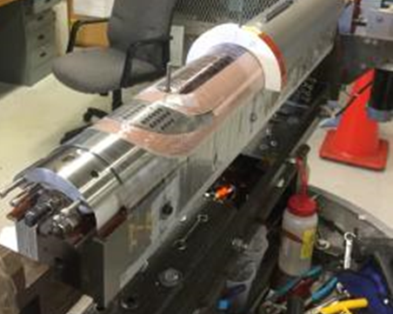
Magnet Models
With today’s state of the art conductors:
15 T achievable at 14 % margin
17 T at short sample
Cos-theta and common-coil model magnet programs are under preparation
15 T dipole demonstrator
60-mm aperture
4-layer graded coil
Showed 14.5 T

Slide 37
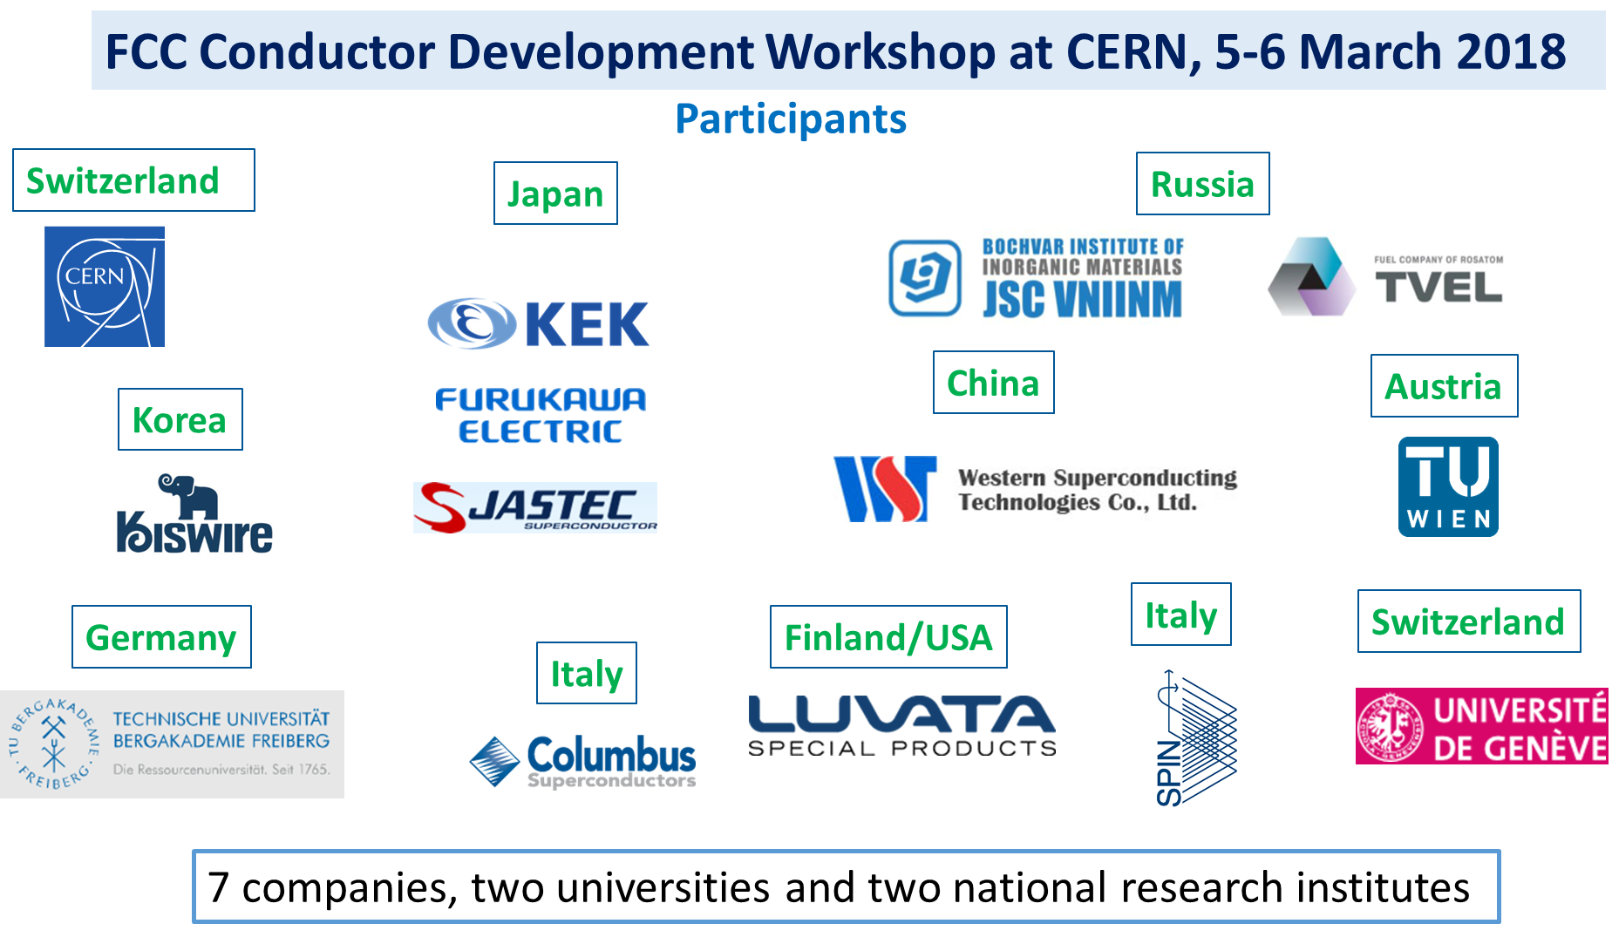
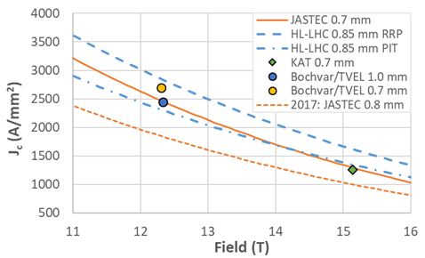
Conductor
New activity with many collaborators started in 2017 with ambitious targets
Wire diameter | mm | ∼ 1
Non-Cu Jc (16 T, 4.2 K)* | A/mm² | ≥ 1500
Unit length | km | ≥ 5
Cost | €/kA m** | ≤ 5
Yellow: FCC_1
Green: FCC_2
Blue: FCC_3
Dashed red: FCC_4
Dashed blue: HL-LHC
First wires almost reached HL-LHC requirements
Measurements @ CERN (4.2 K)
goal

Slide 38
HE-LHC Challenges and Optics
Challenges:
LHC tunnel is small
Insertions are short
But seem able to cope with this
Might have to upgrade SPS from 0.45 to 1.3 TeV using superconducting magnets
HE-LHC
FCC-hh

Slide 39
Injection Options
 | Energy range | Magnet design | Filling time | # of ramps | Bunches per cycle
scSPS | 26 GeV - 1.3 TeV | Sc NbTi/ s.apert. | 37 min | 35 | 4x160
HEB@LHC | 450 GeV – 3.3 (6.5) TeV | Sc NbTi/ d.apert. | 44 min | 4 | 33x80 per ring
HEB@FCC | 450 GeV - 3.3 TeV | Superferric/s.apert. | 29 min | 2 | 130x80
B. Goddard, W. Bartmann, F. Burkard et al.
The baseline is 3.3 TeV from LHC
Injection of about 40 minutes possible with faster ramping in LHC
The main alternative is 1.3 TeV from a superconducting SPS
Similar injection time
Issues are:
Normalised aperture at injection reduced to 60%, i.e. 4.5σ for primaries
Impedance effects increase by factor 2.5
Field quality at lower injection field, the values are being investigated
LHC experiment is foreseen

Slide 40
Energy Considerations
Physics demands 100 TeV for FCC-hh, HE-LHC, the highest one can do in LHC tunnel
Obviously, requires combination of arc length, magnetic field and filling factor
Important cost factor
But site is also very important, must fit next to CERN
Parameter choice
Arc filling factor of 80% in LHC
  Not much to be gained, hard to do much better
Magnetic field depends on technology
  For FCC-hh choice from magnet team: Ni₃Sn with 16 T
    Idea: most ambiteous to be available at project timescale
    Note: cost of last little bit a field is quite high
  Now also consider HTS
100 km tunnel possible with connection to CERN complex and required for 16 T
  shorter tunnel also possible if field can be higher, e.g. 80 km

