Slide 1
Early conceptual integration, optimization and maturity evaluation: High power-energy proton and neutrino sources
Alexander Valishev
GARD ABP Roadmap Workshop 2
30 April 2020

Slide 2
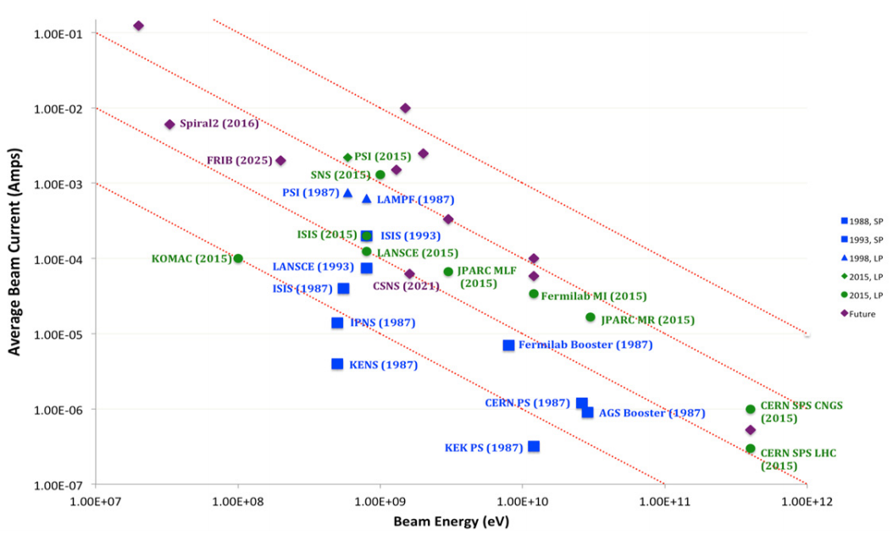
High Power Proton Beam Facilities
Chart courtesy
S. Cousineau (2015)
1MW

Slide 3
High Power-Energy Proton Beam Facilities
Present
SNS (1GeV, 1.4MW)
J-PARC (30 GeV, 0.55 MW)
Fermilab PIP (120 GeV, 0.75 MW)
Planned / under construction
PIP-II (120 GeV, 1.2 MW)
J-PARC (30 GeV, 0.75 – 1.2 MW)
ESS (2 GeV, 5MW)
Beyond – multi-MW
J-PARC (3MW)
SNS (10 MW)
Fermilab (2.4 MW)

Slide 4
Grand Challenges – all 4 apply from the ABP list
High power and energy machines are limited by
Beam loss
How do we increase beam intensities by orders of magnitude without increasing losses?
How do we control the beam distribution down to the level of individual particles?
How do we increase beam phase-space density by orders of magnitude?
How do we develop predictive “virtual particle accelerators”?
All are addressed at Workshop #1 and earlier this Workshop
Power efficiency
Target capabilities

Slide 5
Motivation for this talk
Many of the discussed research topics address issues relevant to high-power proton machines in a focused and isolated manner
NB some integrated effort already presented this workshop (e.g. J.-L. Vay and D.Bruhwiler, S.Cousineau)
Higher level conceptual integration research is necessary in order to
Develop practical facility scenarios
Define ranges of parameters
Identify shortfalls and risk areas
Bridge to other GARD thrusts and stimulate collaboration

Slide 6
Impact on GARD ABP Mission
Component of ABP Mission:
Guide and help to fully exploit science at the GARD beam facilities and operational accelerators.
Goal and Impact:
Develop practical facility scenarios combining state-of-the art knowledge of beam physics and technology in an integrated self-consistent high-level proposal for discussion within community and with funding agencies
Risks:
There are many case-specific unknowns, no universal approach

Slide 7
Key Milestones
In preparation for Snowmass’21 develop integrated multi-MW power upgrade scenarios for the Fermilab accelerator complex
Balanced approach – based on the existing infrastructure limitations and planned upgrades but at the same time include ‘blue sky’ components to enable far-reaching and cost-effective upgrade capabilities
Update strategy based on SNS, PIP-II experience

Slide 8
Synergies
Many synergistic activities exist in NP
FRIB
SNS (see S.Cousineau’s talk at Workshop #1)

Slide 9
Collaborations
Presently mostly Fermilab-centric effort
Need to establish links with Target thrust, technology thrusts

