Slide 1
GARD ABP Workshop 2:
Working Group #3 Introduction:
“Early Conceptual
Integration and Optimization and Maturity Evaluation”
Co-Conveners:
John Seeman (SLAC)
Vladimir Shiltsev (FNAL)
Jamie Rosenzweig (UCLA)
April 30, 2020

Slide 2
HEP Missions (P5):
Large Accelerator Systems
  Intensity frontier
  Energy frontier: hadron
  Energy frontier: lepton
  Colliders and accelerators beyond Standard Model
High-impact and relevance to HEP.

Slide 3
Introduction: ABP Grand challenges
Grand challenge #1 (beam intensity): How do we increase beam intensities by orders of magnitude?
Grand challenge #2 (beam quality): How do we increase beam phase-space density by orders of magnitude, towards quantum degeneracy limit?
Grand challenge #3 (beam control): How do we control the beam distribution down to the level of individual particles?
Grand Challenge #4 (beam prediction): How do we develop predictive “virtual particle accelerators”?

Slide 4
Workshop #2 Working Groups
Workshop #2 (Virtual meeting, April-May 2020):
  (WG1) Advanced accelerator instrumentation and controls.
  (WG2) Modeling and simulation tools (including energy deposition); fundamental theory and applied math.
  (WG3) Early conceptual integration and optimization, maturity evaluation.
  (WG4) Connections to other GARD roadmaps; synergies with non-HEP.

Slide 5
ABP Mission
The primary scientific mission of the ABP thrust is to address and resolve the Accelerator and Beam Physics Grand Challenges. Other equally important ABP missions are associated with the overall DOE HEP missions:
  Advance physics of accelerators and beams to enable future accelerators.
  Develop conventional and advanced accelerator concepts and tools to disrupt existing costly technology paradigms in coordination with other GARD thrusts.
  Guide and help to fully exploit science at the GARD beam facilities and operational accelerators.
  Educate and train future accelerator physicists.

Slide 6
WG#3: Early Conceptual
Integration and Optimization and Maturity Evaluation
Talks cover the overall accelerator physics concerns of:
1) The general scope and cross limitations of accelerator physics and technical issues to achieve the specific goals of future accelerators.
2) Illuminate how the accelerator physics and technical optimization of this new state-of-the-art accelerator facility has or will be accomplished to arrive at a suitable optimum.

Slide 7
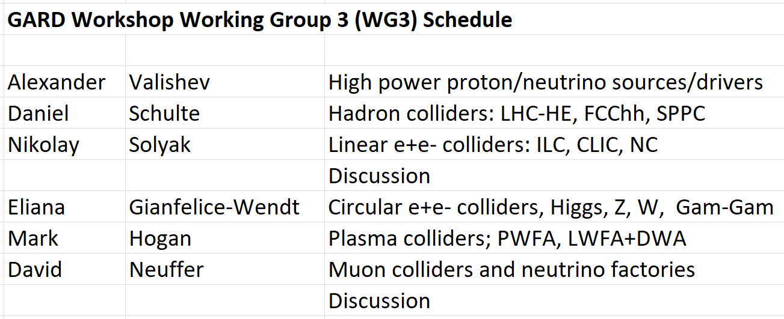
Schedule

Slide 8
WG#3 Discussion topics
1)

