Slide 1
Personnel Safety with moving detectors
Discussion topics
E-Stop buttons
Perimeter Light Curtain
Sweep & Clear entire cavern
Maintenance issues

Slide 2
General description
Unmanned, remote control movement
Movement max speed is 10.2 cm/min.
Each detector weight is approx. 900 tonnes.
When magnets are fully operational, humans may not be allowed to be present
Open questions-
How best to stop a moving detector in case of an emergency?
How quickly can a detector stop?
Maintenance movement option?

Slide 3
General detector arrangement

Slide 4
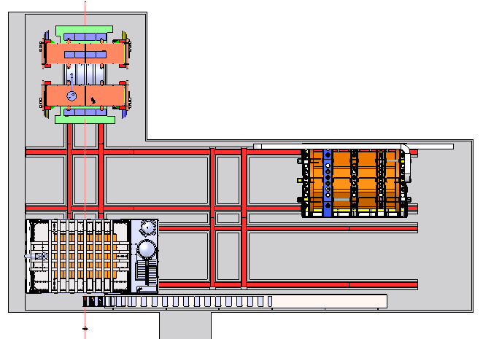
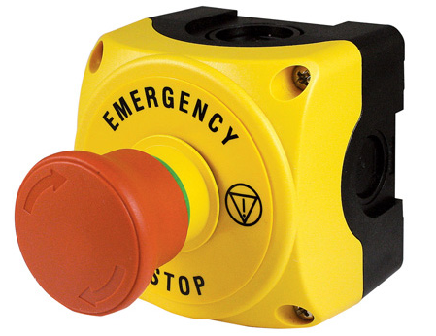
E-Stop buttons
Provide a large number of E-Stop buttons, spaced per safety requirements
Press a button to stop movement
Moderate cost option

Slide 5
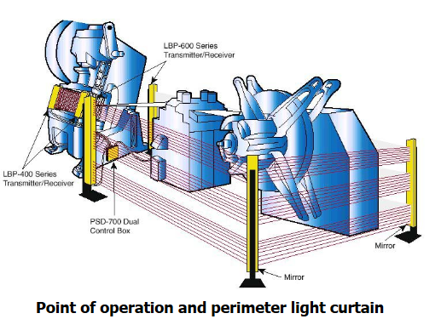
Perimeter Light Curtain for E-Stop
Create a perimeter laser beam curtain that moves with each detector
Break the curtain anywhere to stop movement
Higher cost option

Slide 6
Cavern is sealed during movement
Prior to operation or any movement, the cavern is cleared of personnel
All doors are locked
Maintenance movement override method TBD
Expected to be lowest cost option

Slide 7
Define sudden E-Stop
How fast is a sudden stop?
How fast can a detector stop without damage?
Sloshing issues?
LAr Modules are like pendulums, what happens?
Other unknowns?
Looking to have FEA analysis performed, asked for costs & schedules

Slide 8
ES&H to provide requirements
What are the requirements for each case?
Gathering info has started

