Slide 1
Photon Detector System: Documentation Summary
David Warner
SP Photon Detector System Preliminary Design Review
18-19 June, 2020

Slide 2
Outline
Documentation goals of the review
Design. Document. Execute.
Required documentation summary
Design documents
Requirements documents
Installation documents
Interface documents
Engineering analysis documents (compliance office interface)
QA/QC documents
Cost/schedule documents
Tracking documents
Extra documents
Presentations
Summary

Slide 3
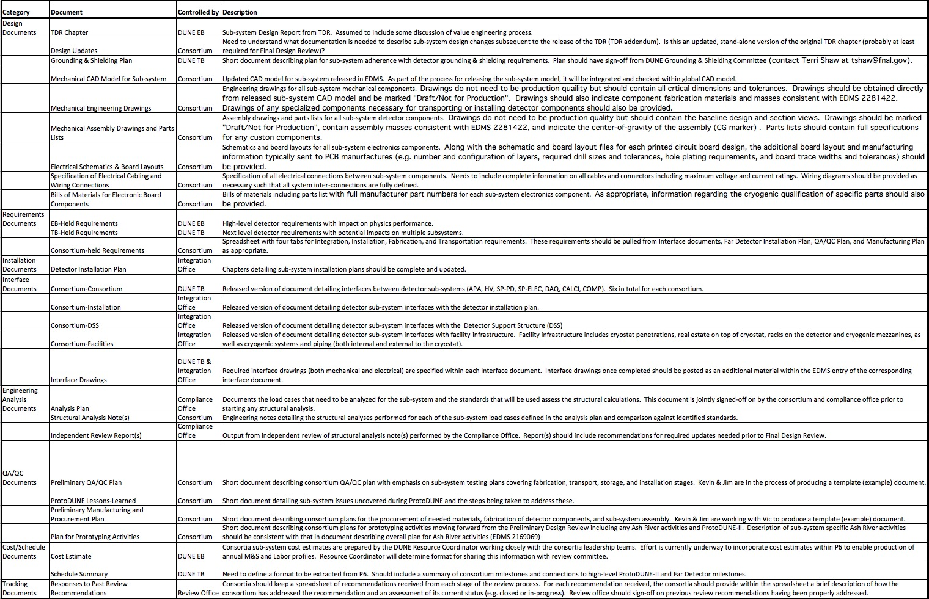
Project Office List of Required Documentation

Slide 4
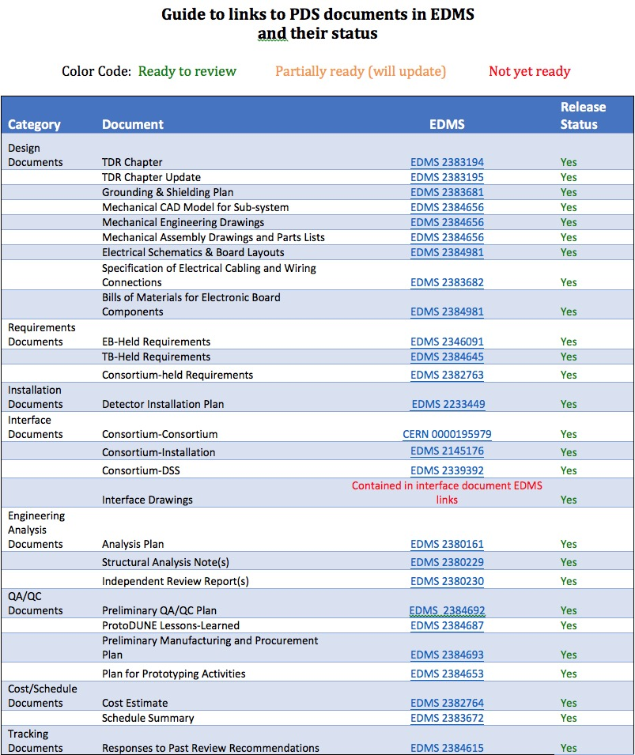
PD EDMS Guide (EDMS 2383199)

Slide 5
EDMS Layout (PDR documents of links to documents found here)
PDS-Consortium Interfaces
DAPHNE Internal Review-- Obsolete)
Compliance Office Documents
Compliance Office Documents
Module, Rail, flange design
DAPHNE, Cold amplifiers, flange feedthrough, cables, grounding)
Not currently used-- see presentations, PD Electricals
Not currently used
Consortium held requirements
Not currently used
P6 budget, schedule summary
Documents specific to reviews, including internal reviews

Slide 6
Mechanical BOM/Drawing/Model Guide (EDMS 2384656)
Will connect to PBS Structure

Slide 7
Using the BOM table

Slide 8
Guide to Electrical Documents (EDMS 2384981)

Slide 9
Design Documents (Design remains significantly unchanged since TDR)
TDR and TDR update document
Full set of electrical specifications
Grounding and shielding description
Schematic and (most cases) board layout and Gerber files
Cabling plan
Bill of Materials for major (and most minor) components
Full set of mechanical specifications
Component CAD models (.step) and drawings (.pdf)
Assembly CAD models (.step) and drawings (.pdf)
Bill of materials (Workbook and assembly drawing BOMs, including fasteners in many cases)

Slide 10
Requirements Documents
3 EB-held requirements
Four TB-held requirements
Consortium held-requirements in EDMS 2382763
Approximately 140 consortium-held requirements and specifications covering the entire PD system

Slide 11
Installation and Interface Control Documents
Detector installation plan in EDMS 2233449
Interface control documents
PDS/Consortium documents in CERN 0000195979
PDS/APA
PDS/JT-HV
PDS/JT-DAQ
PDS/JT-CALCI
PDS/TPC
PDS/JT-COM
PD/Installation EDMS 2145176
PD/Detector Support Structure (DSS) EDMS 2339392
Released and in-progress versions

Slide 12
Engineering Analysis Documents (Compliance Office)
Analysis plan EDMS 2380161
Structural analysis note EDMS 2380229
Independent Review Reports EDMS 2385859
7. Conclusion for the 60 % design review:
The status of the design of the PD is in a status acceptable for the PD 60 % design review. The analysis plan is validated and can be used for the structural analysis required for the Final Design review.

Slide 13
QA/QC Documents
Preliminary QA/QC plan EDMS 2384692
Extensively developed for X-ARAPUCA
SiPM QA plan posted
Continuing for other PD subsystems
ProtoDUNE 1 lessons learned EDMS 2384687
Manufacturing and procurement plan EDMS 2384693
“International flavor” to capture needs of an international consortium
Plan for Prototyping activities EDMS 2384653
Ash River & PSL module tests
Supercell tests in Brazil, Italy, Spain
ICEBERG
Cold box test at CERN (end-to-end readout test into DAQ)
ProtoDUNE 2
Documentation being developed on ProtoDUNE 1 Structure

Slide 14
Cost and schedule
Costbook and narrative description from P6 (EDMS 2382764)
Based on detailed BOMs, including vendor quotes and estimates as well as time and motion studied from ProtoDUNE and other test stations
Schedule with key milestones, schedule narrative, based on P6 (EDMS 2383672 )
NOTE: Does not include COVID-19 impacts

Slide 15
Additional documents
Responses to past reviews (EDMS 2384615)
Results from internal DAPHNE review (EDMS 2385075)
An introduction to PDS and 60% design review documentation (EDMS 2383202)
Xenon doping at ProtoDUNE update (EDMS 2382770)
Status of data analysis and plans for future development

Slide 16
Presentations (Execution)
We will describe the full PD system in presentations at this review including:
Physics simulation justifying performance specifications of PDS
Prototype and ProtoDUNE 1 results validating fundamental design choices
Mechanical design including:
Module design
Support Structure
Monitoring system
Cryostat flange design
Photosensors including results from ProtoDUNE and first data from custom splits
Electronics including
PD electrical connections, signal routing on module
Active ganging (cold amplifier) design and testing
Signal cable plan, routing, grounding plan
DAPHNE design and prototype planning
Power supplies and cabling
Monitoring system design and validation

Slide 17
Summary
We are presenting a photon detector system design and documentation set ready to proceed to preparing for the final design review (FDR).
We have validation in ProtoDUNE and other test sites to demonstrate we will meet our specifications and requirements, and prospects to do better yet by the FDR.
We have a plan for additional validation and testing.
While delays due to the COVID 19 crisis have slowed our prototyping plans, our laboratories are re-opening and exciting times await.
We understand our cost and schedule.
Exciting opportunities are being investigated (e.g. xenon doping) but they are not baseline and not required to meet PD system requirements.

