Slide 1
Photon Detector System: Module, Support Structure, APA Interface System Design
David Warner
SP Photon Detector System Preliminary Design Review
18-19 June, 2020

Slide 2
Outline
Light collector system design concept
PD module design
Supercell
Module
Rail support system
Electrical connections
Cable routing
Through APA frame
Between upper and lower APAs
Cable trays & crossing tube
Cryostat flange
Summary

Slide 3
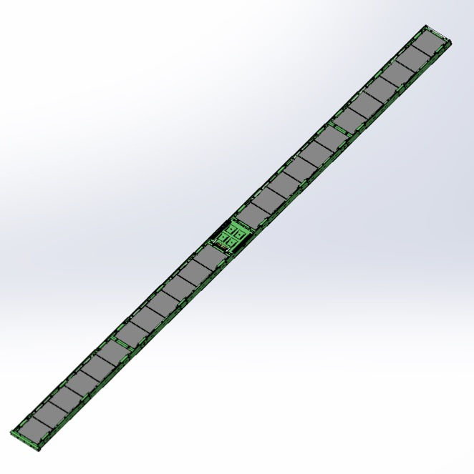
Photon Detector Module– Basically unchanged since TDR
Photon light detectors come in bar-shaped modules.
2090mm X 118mm X 23.5mm
Each bar consists of 4 optically-isolated readout channels called “Supercells”.
Module form factor was selected to allow for installation into APA fame after wire wrapping.
Supercell 4
Supercell 2
Supercell 3
Active Ganging
Supercell 1

Slide 4
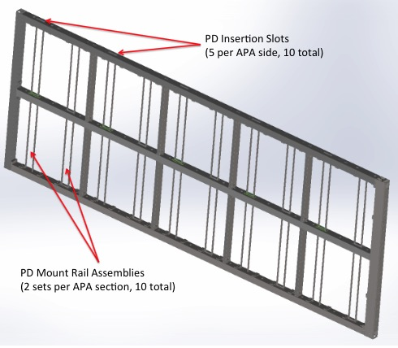
Photon Detector Mounting
APA Slots
Photon detectors are supported in APA frames.
Mounted in stainless steel rails.
Sail systems provided by PD consortium.
Support Rails
10 PDs per APA, 5 per side
PD Module mounted in APA Rails

Slide 5
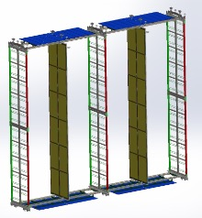
APAs mounted in TPC slices
In the DUNE FD, the APAs are stacked in pairs, and arranged in slices as in the figure.
Note that this implies central APA PD modules must collect light from both directions.
Also has implications for cable routing.
CPA
Upper APA
Lower APA

Slide 6
System Summary (By the numbers)
Item | Number (value)
Per Module
Readout channels | 4
Photosensors | 192
Dichroic Filters | 24 (48)
WLS plates | 4
Readout Cables | 1
Mass | 3.2kg
Per APA
PD modules | 10
Readout cables | 10 (lower), 20 (upper)
Per 10kt detector module
PD modules | 1,500
Readout channels | 6,000
DAPHNE modules | 150

Slide 7
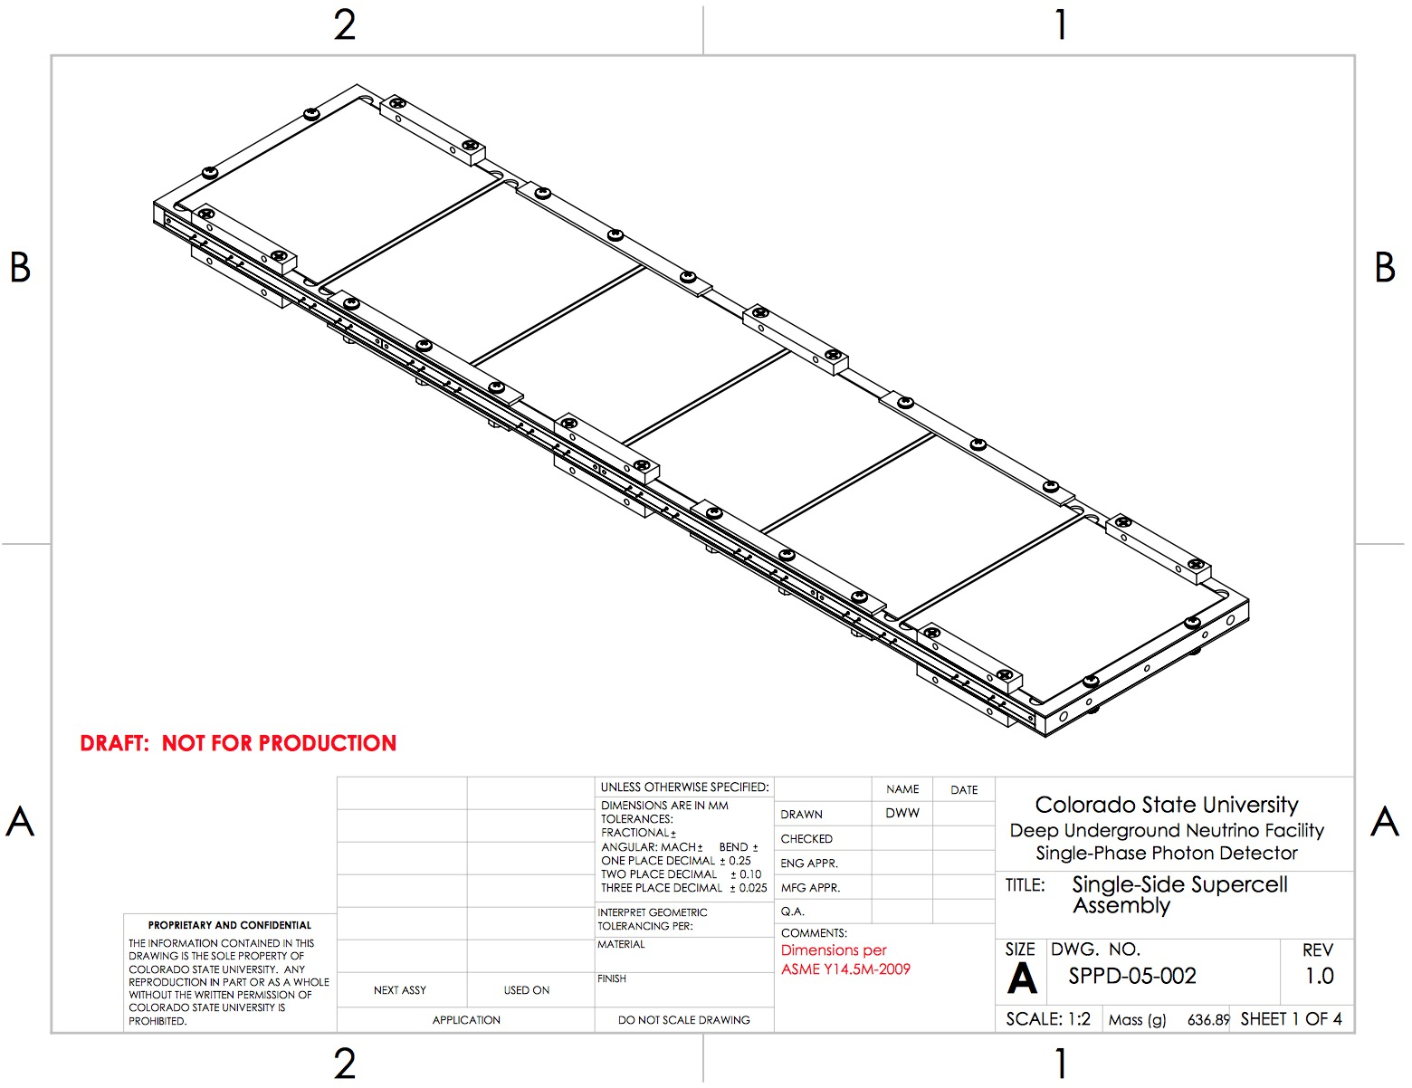
PD Module Design: Supercell (i)
A photon detector contains 4 independent readout channels called “Supercells.”
Each supercell has 6 (12) dichroic filter windows, 1 WLS bar, and 48 photosensors.
They come in single-direction and 2-direction flavors.

Slide 8
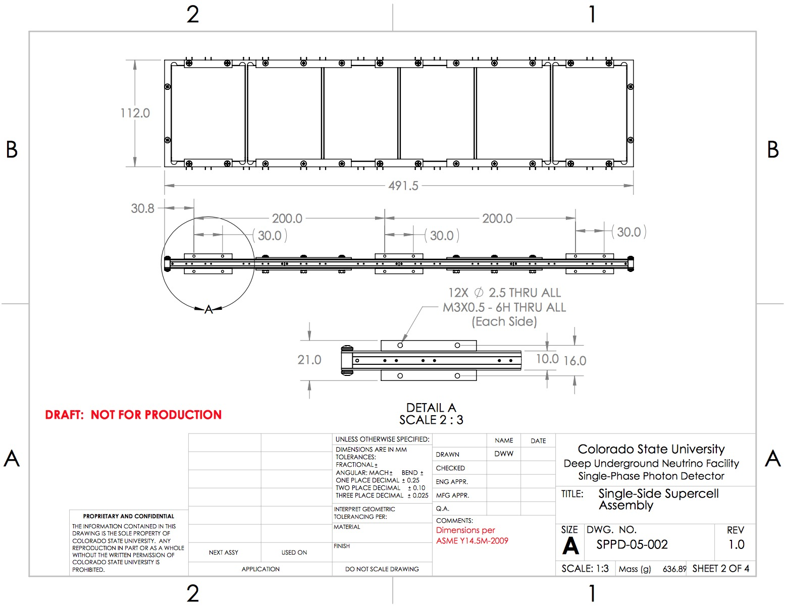
PD Module Design: Supercell (ii)
A supercell is approximately 490cm long and 12 cm wide.
Each supercell is read out as an independent readout channel.
This, and the spacing of bars in the APA frame (approximately ½ meter apart) defines the granularity of the PD readout.

Slide 9
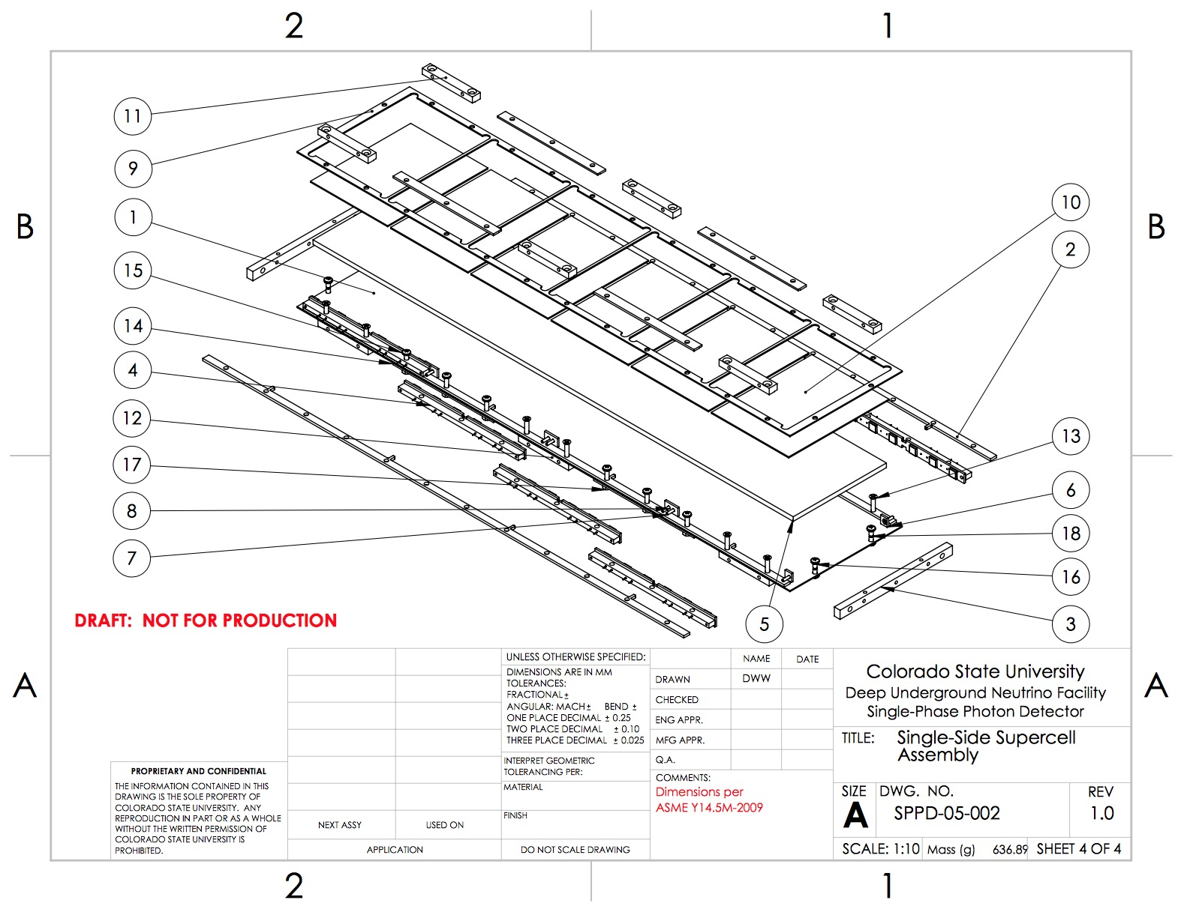
PD Module Design: Supercell (iii)
Filter Plates
WLS plate
6-SiPM Array (8)

Slide 10
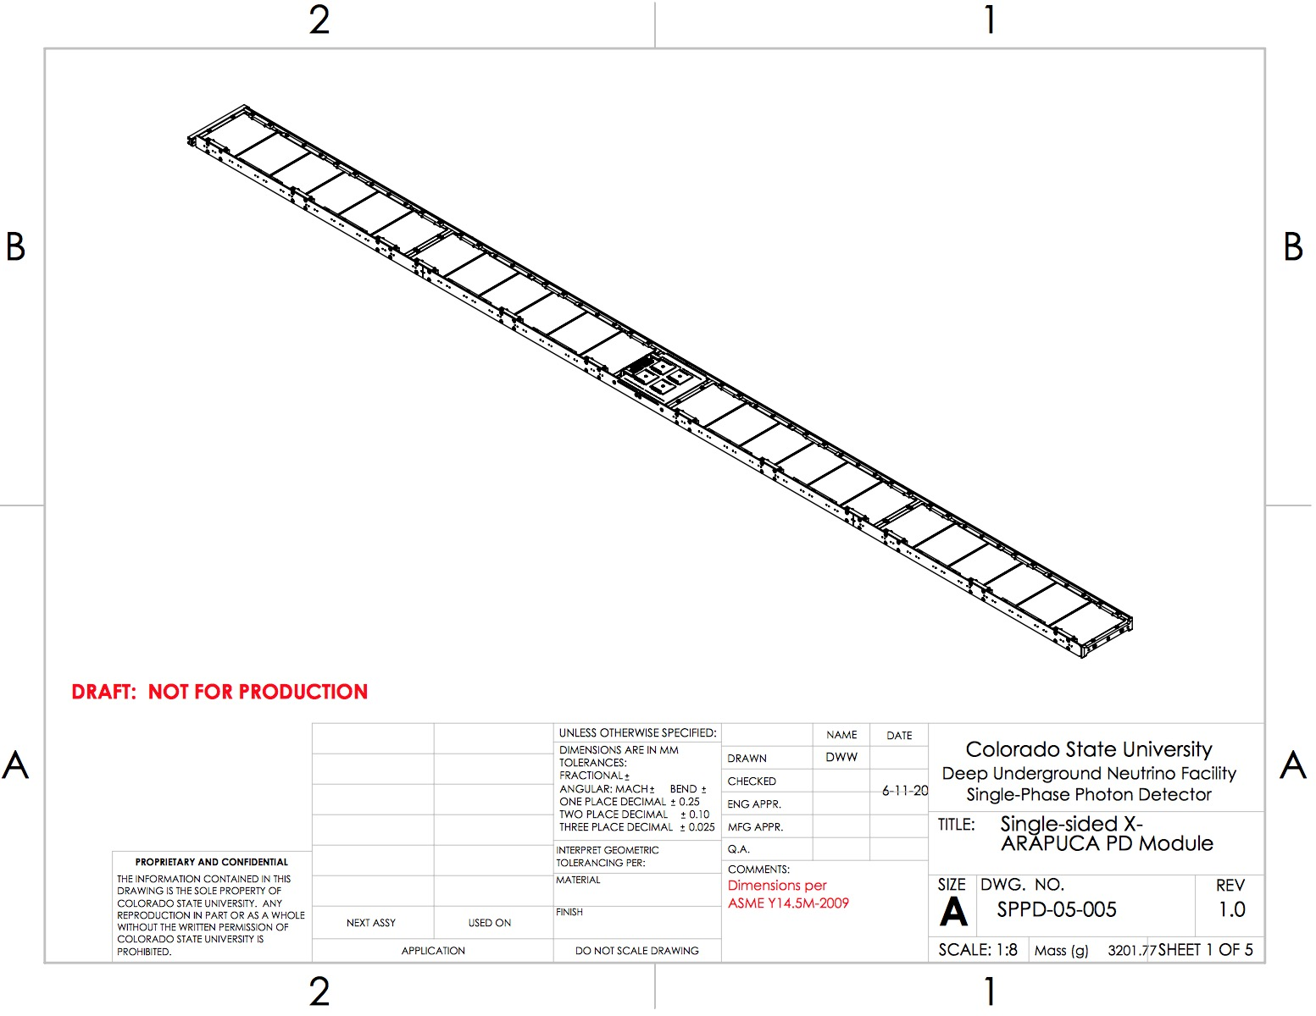
PD Module Design: Module Assembly (i)
4 supercells are assembled into 1 module.
Each module has 4 readout channels.
Signals routed through PCBs on module sides (collected in center).
Ganging amplifiers
Photosensor signal path
(both sides)

Slide 11
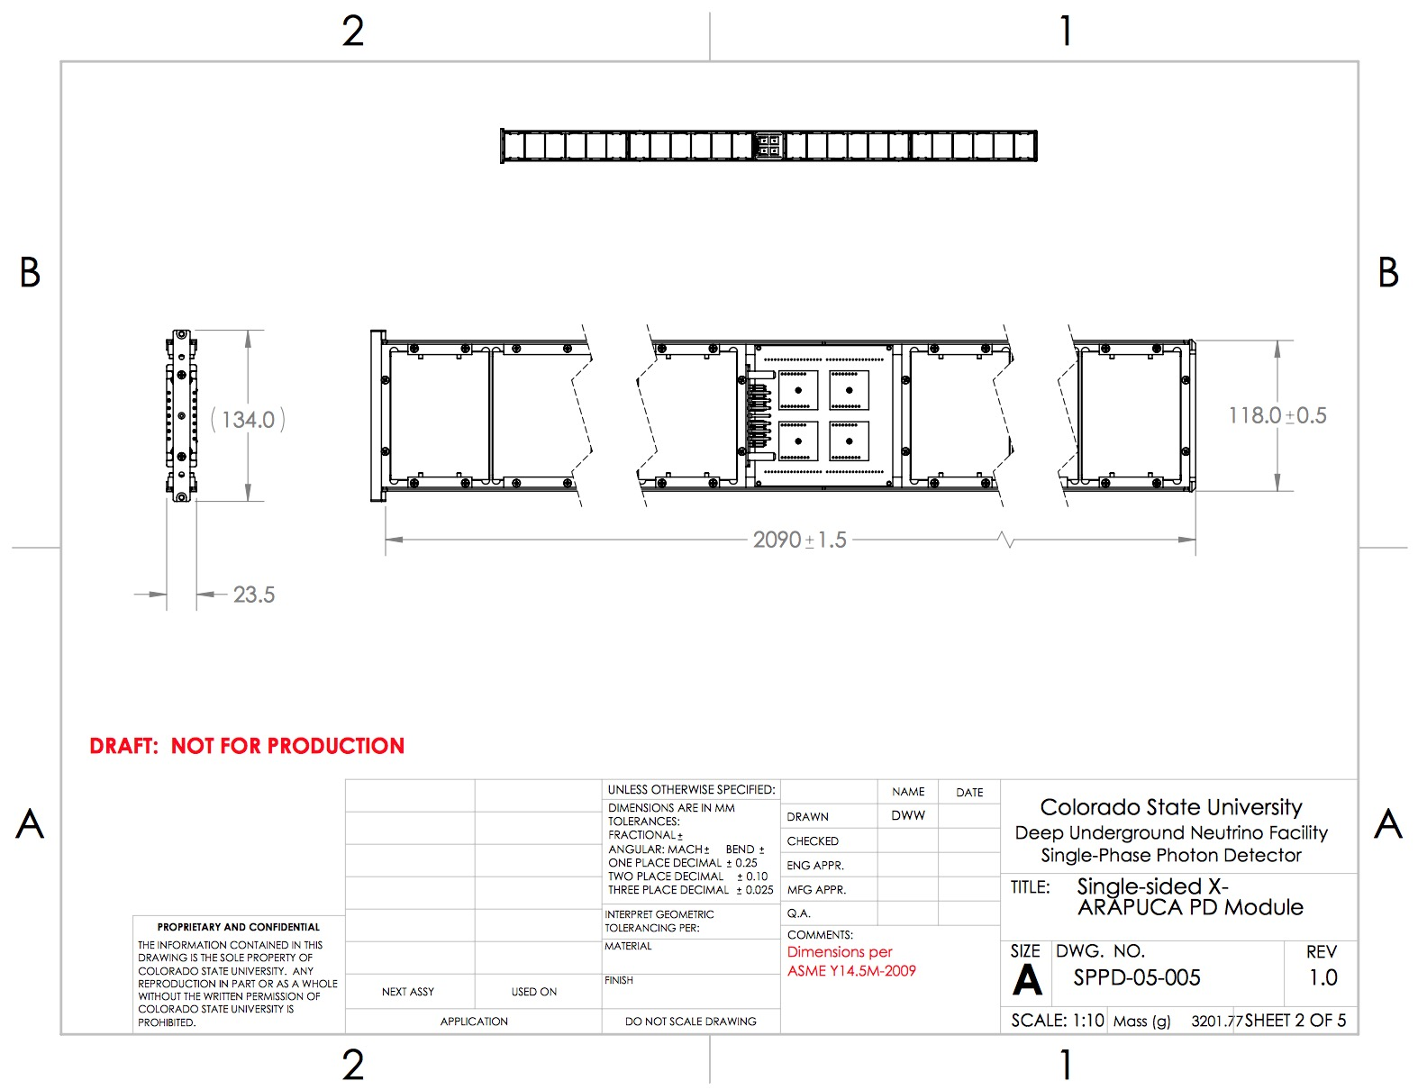
PD Module Design: Module Assembly (ii)
Maximum (inc. tolerance) cross section 134.25 X 23.75mm, This fits into SPS side tube slot (134.75 X 24.75 inc. tol.)
Module active length 2090 +/- 1.5mm.

Slide 12
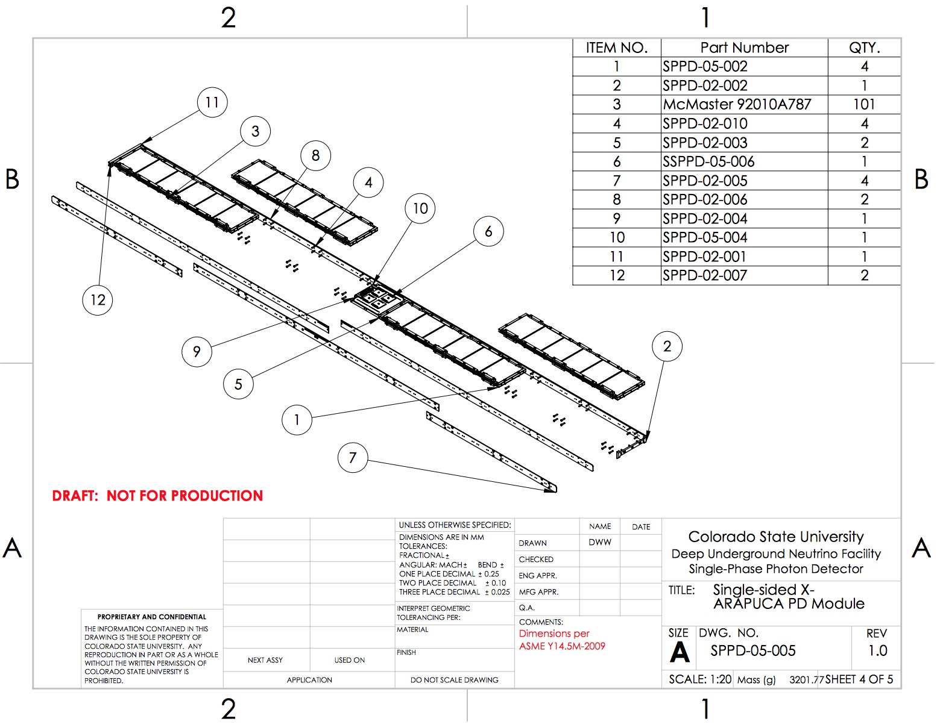
PD Module Design: Module Assembly (iii)
4 supercells
Central readout
4 routing PCBs along sides
Outer strengthening ribs (support flex)

Slide 13
PD Module Design: Module Assembly (iii)
4 Supercells
Central readout
4 routing PCBs along sides
Outer strengthening ribs
Support
Isolation

Slide 14
Rail System (i)
PD modules are supported in APAs in support rails.
There are two types of PD rail assemblies:
Readout Side Rails
Far Side Rails
Rails are supported between APA side and middle tubes.
Rails are designed to accommodate +/- 2mm tolerance of APA tube position.

Slide 15
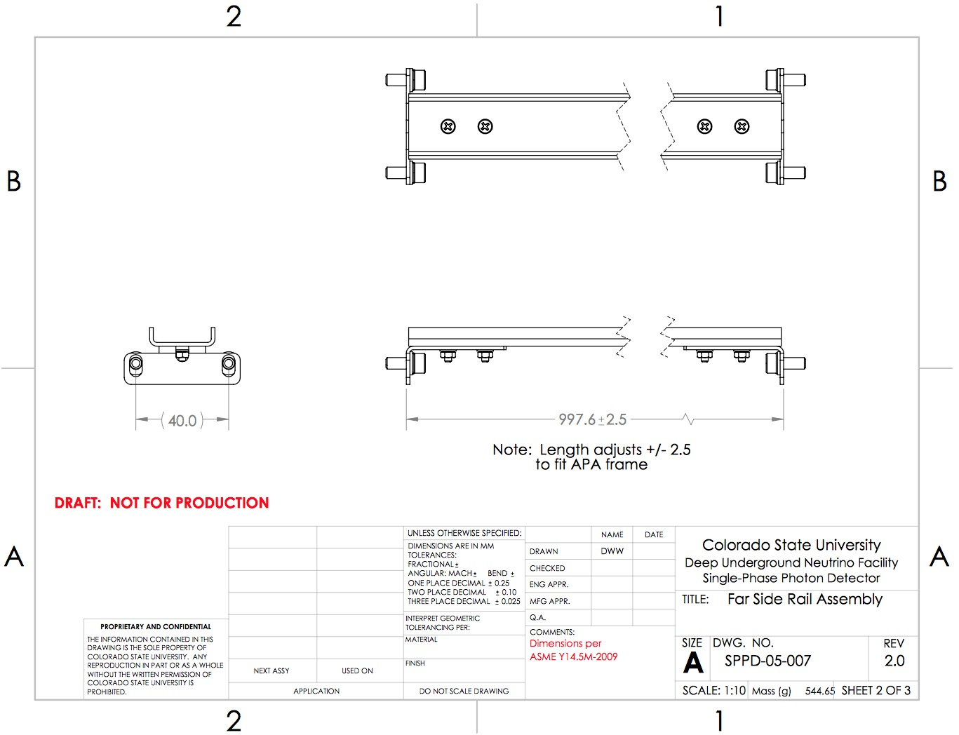
Rail System (ii)
Far side rail assembly
Two assemblies per far side APA bay
Adjustable length to match APA tolerances

Slide 16
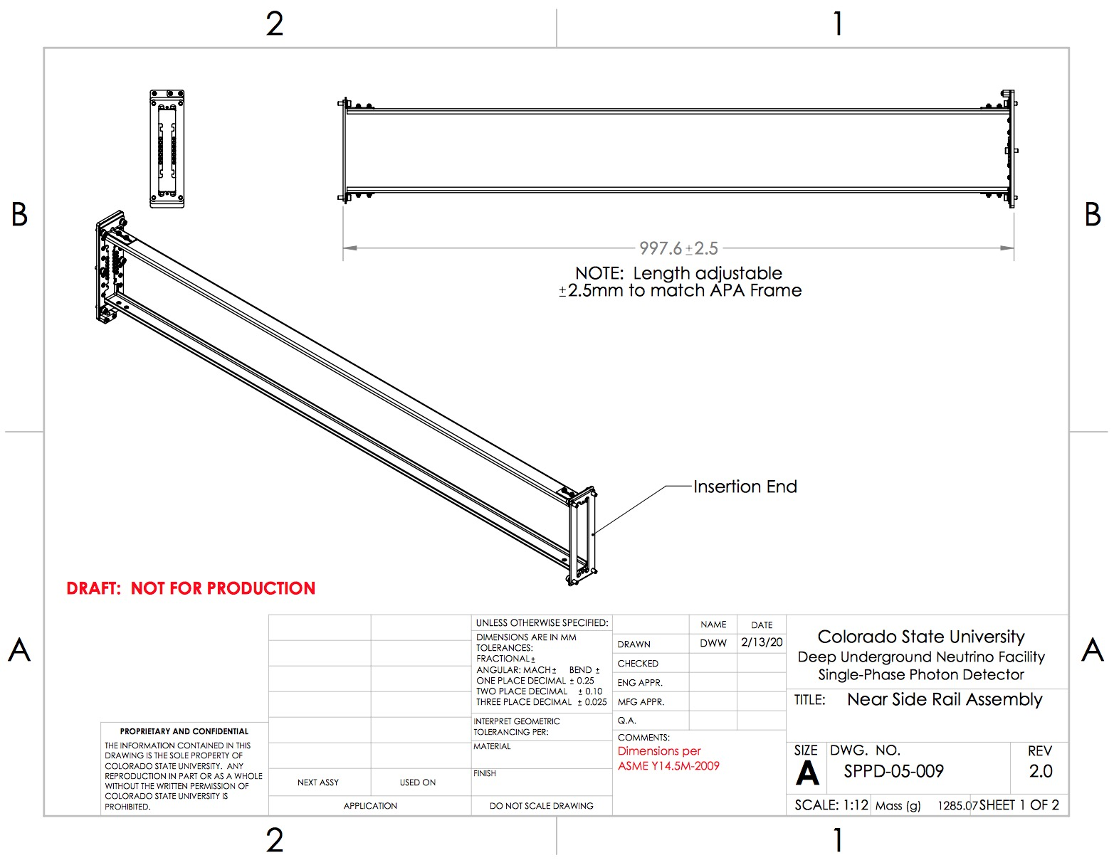
Rail System (iii)
Near side rail assembly.
One assembly per insertion-side APA bay.
Adjustable length to match APA tolerances.
Includes electrical connector assembly.

Slide 17
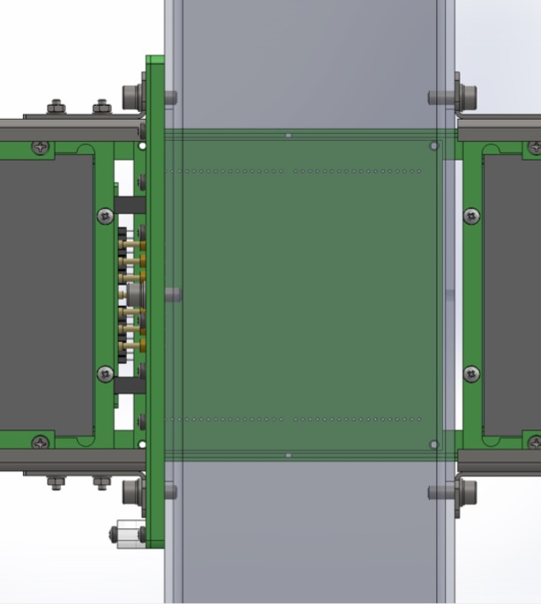
Electrical Connections (i)
Connections made at central tube. Connections occur automatically with module insertion.
Socket board mounted to APA middle tube.
Pin board mounted to module.
Ganging
PCB Here
(Inside middle
APA tube)

Slide 18
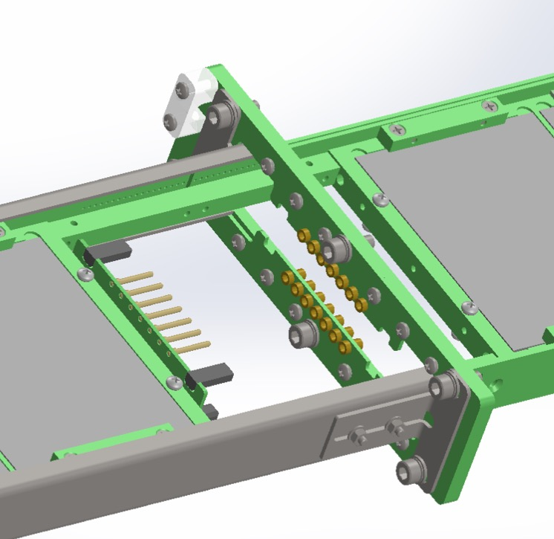
Electrical Connections (ii)
Module being inserted.
Socket board mounted to APA.
Pin board mounted to module.

Slide 19
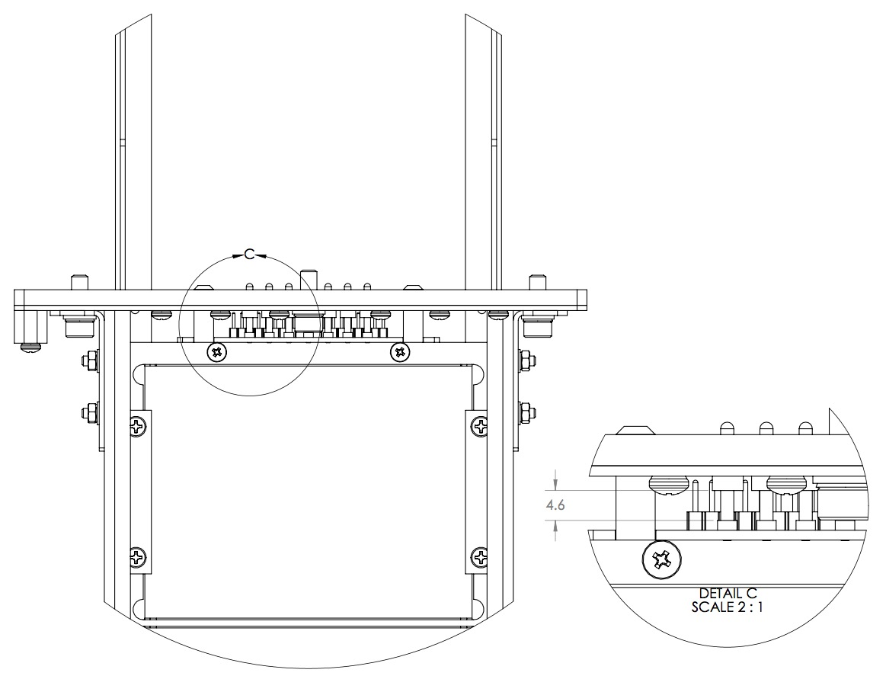
Electrical Connections (iii)
4.6mm nominal gap left between pins and sockets when engaged.
Additional 5mm of engagement length beyond nominal insertion.
Checked to satisfy tolerance stackup and thermal variations .
Pin-socket connections checked during multiple cycles in test dewar.

Slide 20
Electrical Connections (iii)
4.6mm nominal gap left between pins and sockets when engaged
Additional 5mm of engagement length beyond nominal insertion
Checked to satisfy tolerance stack-up and thermal variations
Pin-socket connections checked during multiple thermal cycles in test dewar

Slide 21
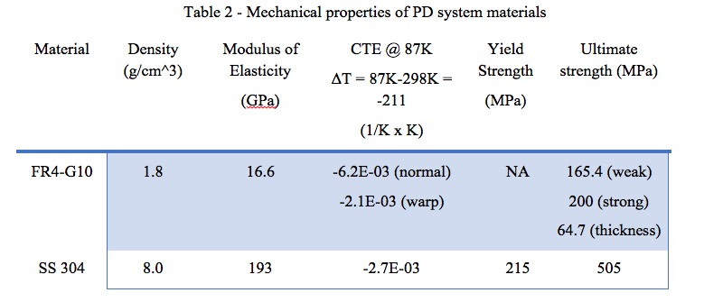
PD System Engineering (i)
PD frame constructed from FR-4 G-10.
Module dimensions in all 3 directions are controlled by in-plane (warp direction) FR-4. Warp direction indicated on component fabrication drawings.
This allows a close match between PD and APA frame thermal expansion.
Validated as part of Compliance Office design evaluation.
Still awaiting final checkout in APA frame assembly at PSL.

Slide 22
PD System Engineering (ii)
PD modules are installed into APA frames in their final orientation, underground at SURF, immediately prior to insertion into the cryostat.
This limits the stresses seen by PD modules due to APA handling.
Evaluations limited to rails in APA frames.
Additional engineering calculations still required prior to FDR:
Dynamic analysis of rails in APA during shipping.
Static analysis of rails in APA worst load cases for APA frame due to known handling/wire wrapping positions.
Calculations ongoing at PSL and Fermilab.

Slide 23
Cable Routing (i): Through APA Frame
Cables
Exit
Here
APA frames joined vertically prior to insertion into cryostat.
Cables from lower APA must route through upper APA.
Requires two varieties of APA: Upper and lower.
PD cable routing shared with CALCI temperature sensor cables. NOT ADDRESSED SPECIFICALLY IN THIS PRESENTATION.
Upper APA
Lower APA

Slide 24
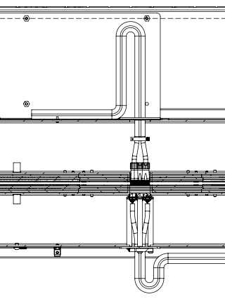
Cable Routing (ii): Through APA Frame
Upper and lower APAs are joined using a custom interface block. Does not limit APA separation. Tested at PSL
Cables mounted in APA frames prior to wire wrapping.
Clearance for 2% relative thermal contraction (cable/APA frame) allowed.
Full cable routing awaiting cryogenic testing at PSL (Covid delay).
Upper APA
Lower APA

Slide 25
Cable Routing (ii3): Shared Cable Tray

Slide 26
Cable Routing (iv): Crossing tube
Photon detectors share cable space in cable trays on top of APA and in crossing tube through cryostat insulation.
PD custom flange shown in figure.
Will be tested at Brookhaven test bed once Covid delays resolved.

Slide 27
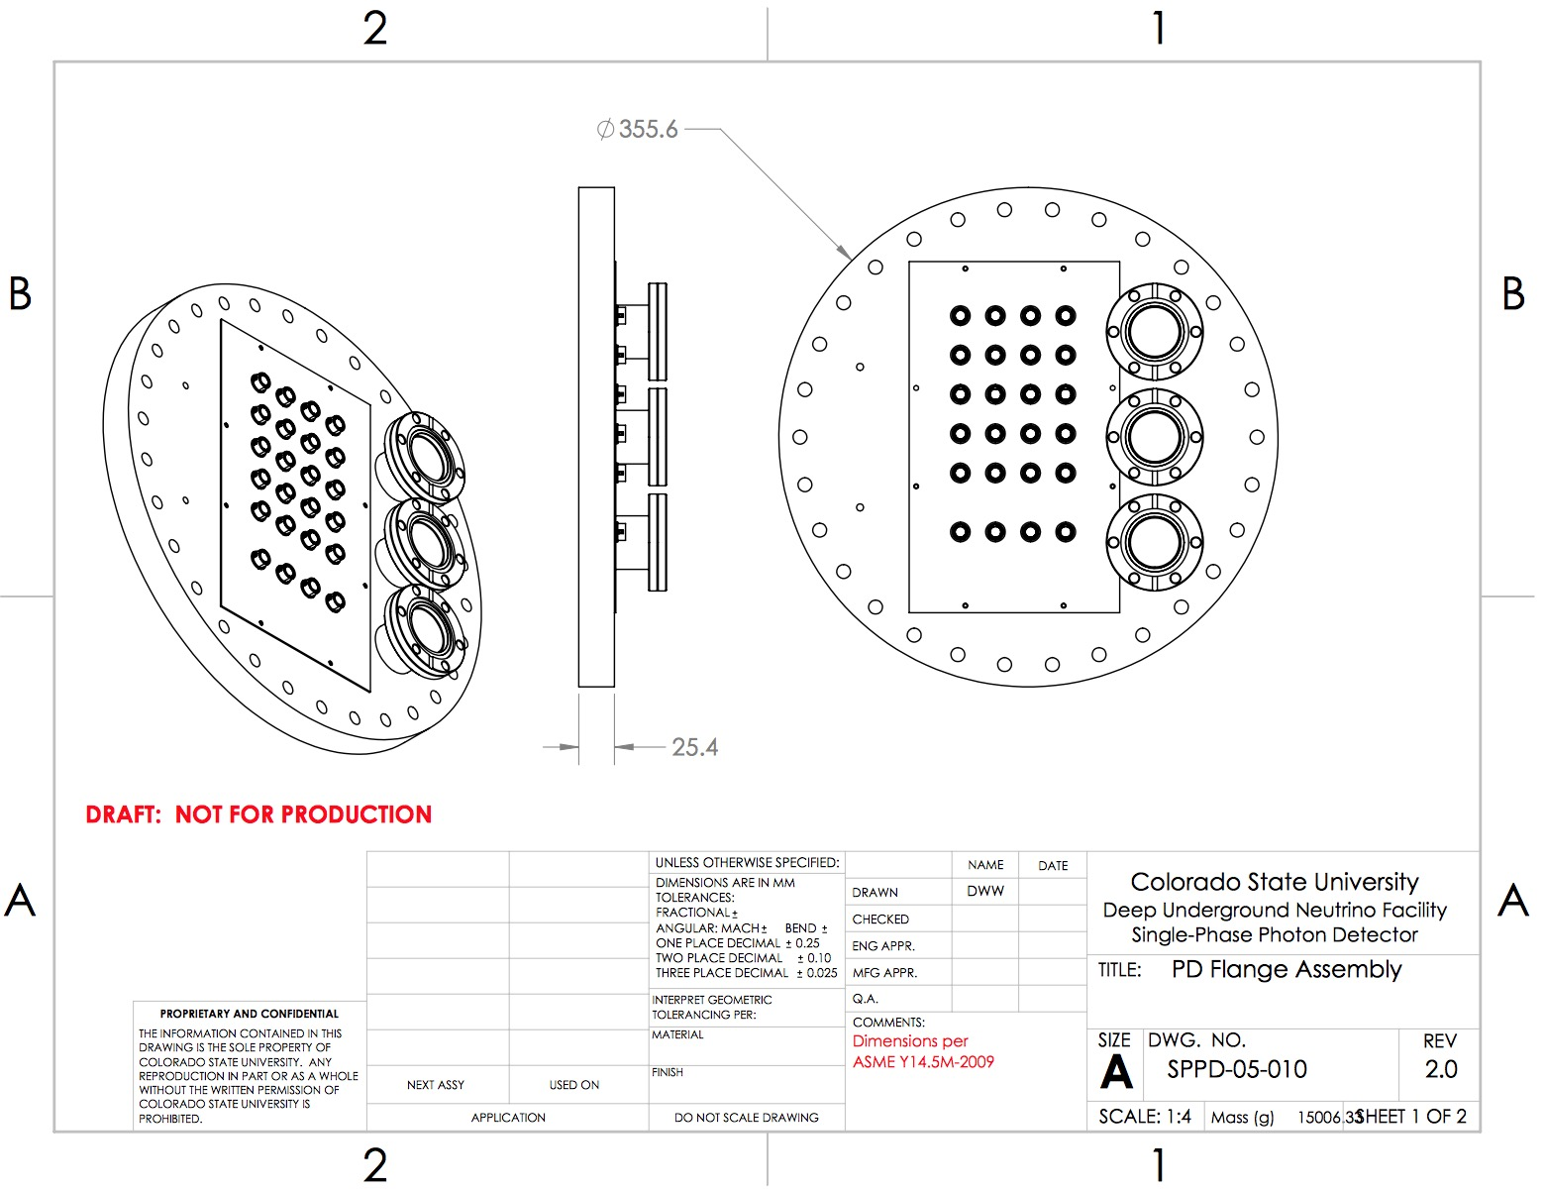
Cable Routing (v): Flange assembly
Based on ProtoDUNE 1 design.
Provided ports for signal cables (Gotti talk) and monitoring system fibers (Martinez talk).
Provides grounding nexus (detector ground reference).
Provides CALCI temperature sensor connectors.

Slide 28
Design Documents: Where to find them!
Modules described in TRD (EDMS 2383194 ) and TDR update document (EDMS 2383195 ).
Full set of mechanical specifications
Component CAD models (.step) and drawings (.pdf)
Assembly CAD models (.step) and drawings (.pdf)
Bill of materials (Workbook and assembly drawing BOMs, including fasteners in most cases)

Slide 29
Mechanical BOM/Drawing/Model Guide (EDMS 2384656)

Slide 30
Engineering Analysis Documents (Compliance Office)
Analysis plan EDMS 2380161
Structural analysis note EDMS 2380229
Independent Review Reports
Additional analysis of PD rail structure in APA frame required
Developing static and dynamic model input with APA
Will be complete prior to FDR
7. Conclusion for the 60 % design review:
The status of the design of the PD is in a status acceptable for the PD 60 % design review. The analysis plan is validated and can be used for the structural analysis required for the Final Design review.

Slide 31
Summary
The baseline Photon Detector system design is complete at the PDR level and documented in EDMS.
The design is significantly unchanged since the TDR
Critical design tolerances have been specified and confirmed with APA and TPC consortia.
Included in Interface Control Documents
While delays due to the COVID 19 crisis have slowed our prototyping plans, validation efforts are re-starting now.
We are prepared to proceed to proceed to validation and analysis for the Final Design Review!

