Slide 1
Photon Detector System Cost and Schedule Status
David Warner
LBNF/DUNE-US Directors Review
18-19 June 2020

Slide 2
Outline
Distribution of Responsibility across Consortium
Cost Summary (M&S)
Cost Summary (Labor)
Brief Basis of Estimate Narrative
Risks
Schedule Summary
Schedule/Milestones
Covid delays
ProtoDUNE Plans
Summary

Slide 3
Distribution of Responsibility Across Consortium
Component | Description | Quantity (per 10 kT) | Primary Responsibility
Detector support | Support rails, electrical connectors, cables | 10 per APA. 1,500 total | DUNE-US
Light collector modules | X-ARAPUCA modules (frames, filters, assembly) | 10 per APA. 1,500 total | Brazil
Photosensors | 6X6mm² SiPMs | 192 per module. 288,000 total | Italy, Spain, Czech Rep.
Cold electronics | Photosensor ganging (6X SiPM passive, 8X active) | 1 per module 1,500 total | Italy, Spain
Warm electronics | DAPHNE system. Based on Mu2e ultrasound ADC | 1 unit per APA 150 total | Colombia, Peru, DUNE-US
Calibration and monitoring | Pulsed UV flasher with CPA mounted diffusers | 204 diffusers, 18 control modules | DUNE-US
Installation and integration | Module insertion, installation in cryostat |  | DUNE-US, Brazil, Europe

Slide 4
Cost Summary (M&S)
P6 cost book data are separated into DOE and non-DOE (international in this case)
Contributions. Also, Detector 2 in included in international numbers.
DOE
International
Total M&S, PDS Detector 1 10.2 M$
Note: International validation/development phase not included

Slide 5
Cost Summary (Labor)
P6 cost book data are separated into DOE and non-DOE (international in this case)
Contributions. Also, Detector 2 in included in international numbers.
DOE
International
Total Labor (Hours), PDS Detector 1 110k hours
Note: International validation/development phase not included

Slide 6
Basis of Estimate Summary
Photosensors and Cold Electronics:
M&S based on vendor estimates,
Labor based on ProtoDUNE 1 and prototype development.
Modules:
M&S based on vendor quotations for all major components.
Labor based on ProtoDUNE module assembly and other time and motion studies.
DAPHNE:
M&S based on vendor quotes for initial prototype components.
Labor based on engineering estimates.
Monitoring System
M&S based on vendor quotations and ProtoDUNE 1 costs.
Labor based on engineering estimates.
Rails/Cables
M&S based on vendor quotations fro all components.
Labor based on time and motion studies assembling prototypes at CSU.

Slide 7
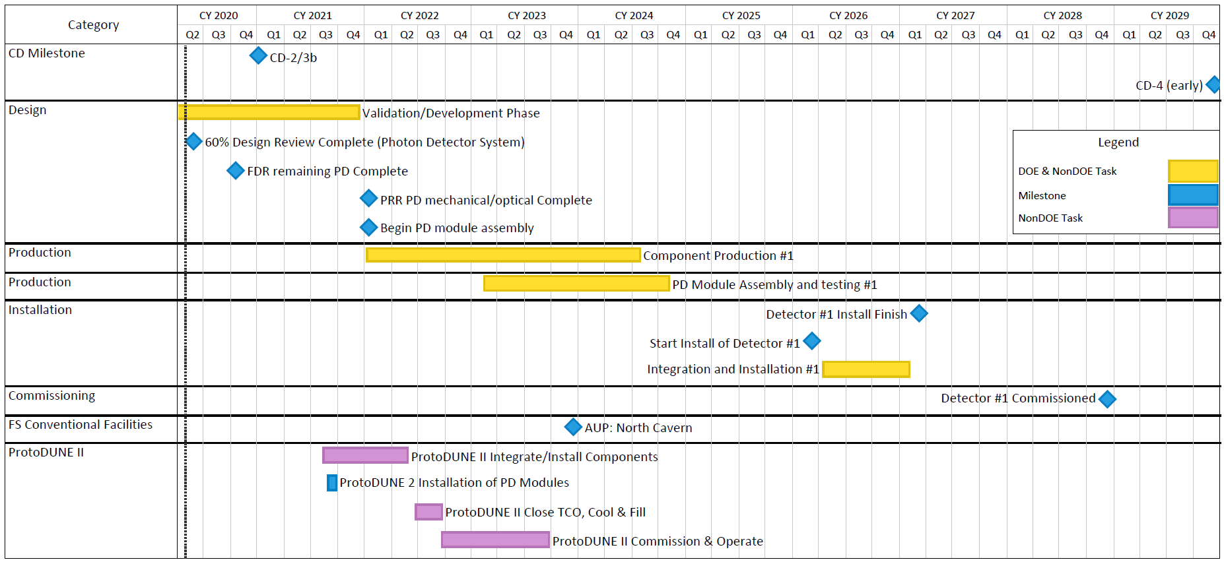
Schedule Summary (Milestones)
Note: 1 year float following PD
module assembly before installation

Slide 8
ProtoDUNE-2 plans
40 “Module 0” PD modules
Single- and double-sided modules
Two candidate SiPMs (down-select following ProtoDUNE 2)
“Module 0” readout chain
Cables/connectors/flanges
Cold amplifiers
DAPHNE warm readout electronics
DAQ interface firmware
“Module 0” Monitoring system
Single LED control unit (modified SSP)
8 diffusers
Final candidate flanges, fibers
Will provide final validation for PRR for entire PD system

Slide 9
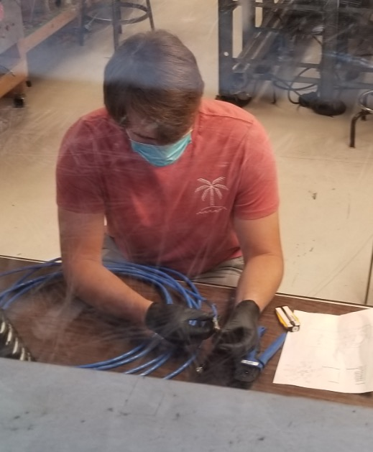
PD Rail/Cable System Fabrication
PD rails and cables are mounted inside the APA frames prior to TPC wire wrapping.
This requires ProtoDUNE-ready (post FDR) rail delivery to Daresbury in Q4 2020.
Special FDR for PD rails/cables Q3 2020.
Greatly increases necessity of re-opening rail fabrication facilities.
Long lead time item (Custom cable) already in hand.
Good News! CSU assembly facility began
re-opening 6/18/20! Impact on schedule
will be evaluated and schedules updated

Slide 10
Impact of COVID-19
Lab work stopped at nearly all national laboratories / universities worldwide in March 2020.
Activities stopped / delayed
PD/APA cold integration testing at PSL halted
Light collector module (X-ARAPUCA) tests at ICEBERG, Milano test beds halted
Warm electronics (DAPHNE) prototypes fabrication delayed
Module mechanical prototyping/production preparation at UNICAMP Brazil delayed.
Impact of these delays on the ProtoDUNE 2 schedule not yet critical, but failure to restart by late June 2020 may begin to impact our schedule
Some progress continuing however
Module/rail installation tests at Ash River satisfactorily completed
Cable bundle installation in APA frames at PSL satisfactorily completed
Sample photosensor fabrication/delivery continuing
Hamamatsu photosensors delivered to Milano late April 2020
FBK photosensors being delivered to Milano now

Slide 11
Plans for Restart
Some European labs/universities reopening on a limited basis
Photosensor testing beginning (Italy, Spain)
X-ARAPUCA module (small prototypes) (Italy)
Photosensor active ganging (cold testing) (Italy)
APA/PD cold interface testing at PSL progressing, albeit at a reduced rate
Delayed by lack of PD rails, cables, test modules
Many US and Latin American institutions beginning to evaluate schedules for re-opening, but the prognosis is unclear.
Priority Validation Items (Critical Path for FDR, ProtoDUNE):
Photosensors: Progressing, but at slowed pace
Warm electronics: Prototype module design fabrication continuing, should proceed through delivery of fabricated modules in Summer 2020. At that point availability of US, Latin American, European testing sites becomes critical
PD/DAQ interface: PD/DAQ interface tests scheduled for Q3 2020 are critical to ProtoDUNE 2 electronics development. Requires re-opening of DAQ testing sites
CERN cold box test: Q1 2020(?)-- Critical “Vertical slice” test of electronics system
NOTE: 10 mechanical models/cables, ~ 10 SIPM-instrumented supercells initially, more supercells in spring.
Light collector module prototype components can be ordered from commercial sites in the US, Brazil, Spain but fabrication delays hindering APA testing.
Summary: Situation not yet critical, but will rapidly deteriorate if reopening of US, Latin American sites delayed past June 2020

Slide 12
Summary
DUNE PD scope, schedule, and costs well understood.
International PD consortium solidly established.
FDR and ProtoDUNE Fabrication beginning Q4 2020.
ProtoDUNE 2 experience will provide critical validation for PRR
Detector 1 PD module fabrication begins Q1 2022, ends Q4 2024
First modules delivered to SURF Q4 2023 , Installation begins Q1 2026
Last modules delivered so SURF Q2 2025, Installation ends Q1 2027
Approximately 1 year float in production schedule
Critical exception: Rails & Cables! Initial deliveries Q4 2020

