Slide 1
Photon Detector System Installation Plans
David Warner
LBNF/DUNE-US Directors Review
18-19 June 2020

Slide 2
Outline
Installation task responsibility
Rail/Cable Installation
Module Installation
Labor Summary
QC testing/data maintenance
Schedule
Summary

Slide 3
PD installation task responsibility (i)
PD consortium personnel
Module Installation
DAPHNE installation & checkout
Monitoring system LED driver installation & checkout
Power supply
Warm fiber/signal connections
Monitoring of cold box checkout
Supervision of other PD related tasks
Bi-weekly dark operation in cryostat
Supervision of all PD-related installation tasks
APA consortium personnel
Installation of rails/cables into APAs (with PD supervision)
Joining of upper/lower APA PD readout cables

Slide 4
PD installation task responsibility (ii)
JT-HV consortium tasks
Mounting of diffusers to CPAs underground
Routing fibers to top of CPAs during installation
TPC consortium personnel
Connection of PD cables in cold box test
Connection of cables in cryostat to from APA to flange
I&I support personnel
Monitoring system fiber routing on DSS
Monitoring system fiber junction during CPA installation
Support for cryostat signal cabling connections
Communication fiber routing
Power supply cable routing

Slide 5
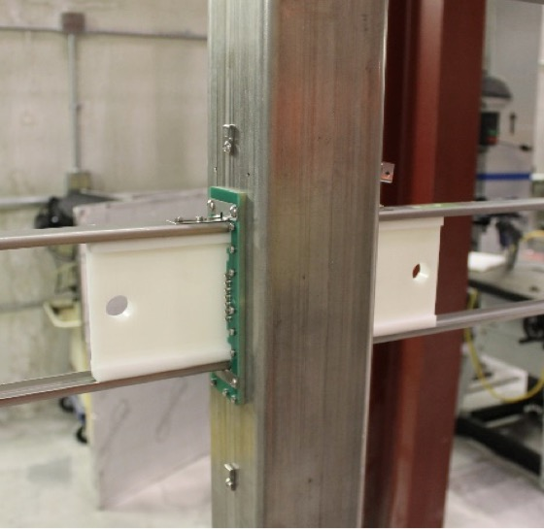
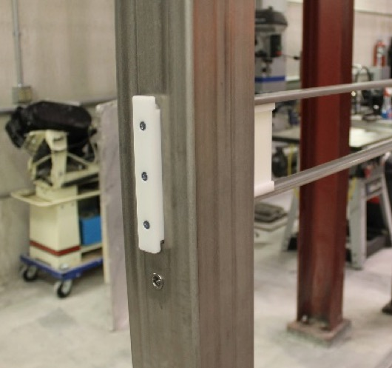
Rail/Cable Installation
Rail Alignment fixturing prototypes
Rails and internal cables will be installed during the APA frame assembly prior to wire wrapping.
Performed by APA personnel
Procedures generated by and progress monitored by PD personnel

Slide 6
Module Installation (i)
Pre-installation inspection of modules includes:
Visual inspection of module, including critical dimension check and photography
LED scanner check-out (as in ProtoDUNE 1)
PD module scanner used in ProtoDUNE 1.
Will increase capacity to 5 modules at a time.

Slide 7
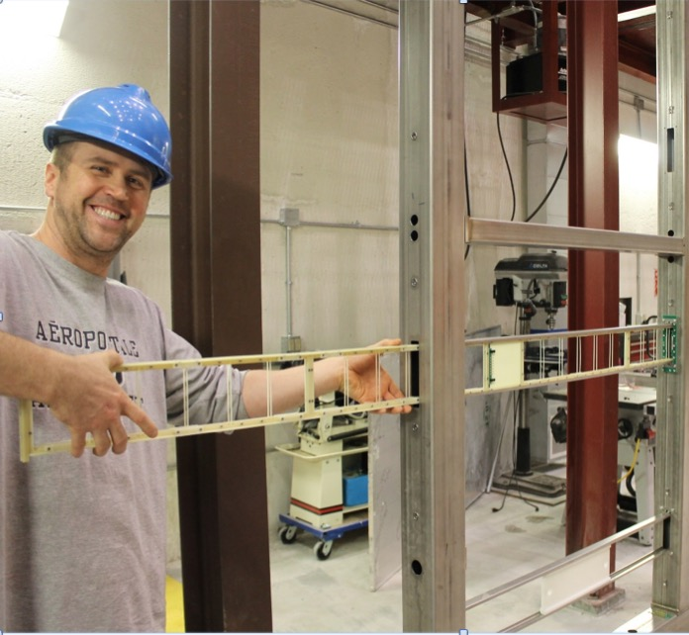
Module Installation (ii)
Modules are self-fixturing. No external tooling is needed to install them
One person can safely handle a module (~3kg), however 2 are optimal for installation

Slide 8
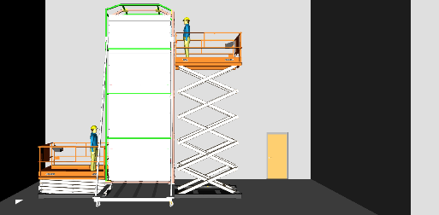
Module Installation (iii)
Module are installed into APA frames before they are removed from the transport frame.
Two two-person lifts are used to lift installation teams to appropriate height. Modules installed by hand.

Slide 9
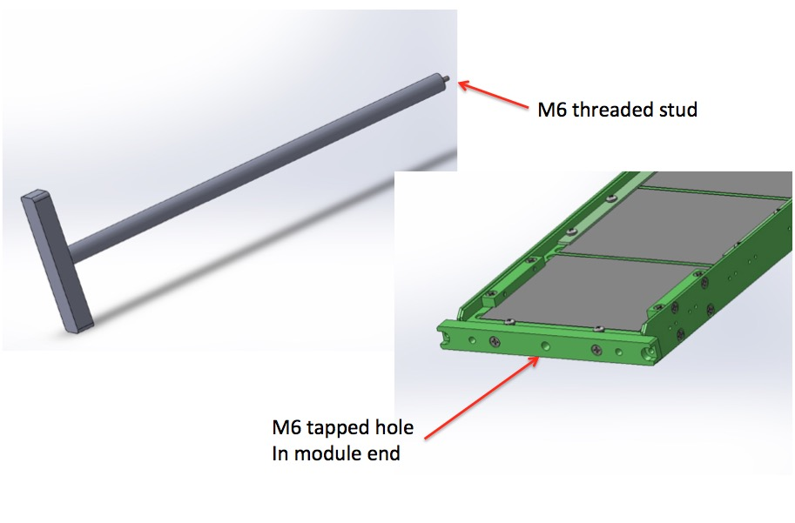
Module Installation Tool
Module fixed into APA frame
With two captive screws
(not shown)
Torque wrench will be used
M4 captive screw here

Slide 10
Post-installation check-out
Automated module connector test box hooked to cables prior to module installation.
Visible during installation from person lift.
Visual indicator (green light) indicates successful connection & correct module orientation.
Same style of apparatus used during upper-lower APA connection, and during APA installation into cryostat.

Slide 11
Installation labor force
Two PD shifts per day (10 hours each), 4 days/week
Each PD installation team consists of:
1 post-doc
1 technician/engineer
2 students
This labor force will be a combination of US, Latin American and European personnel, with a minimum requirement of 2 post docs, 2 technicians, and 4 students at all times.
Expressions of interest from many points
We hope to keep at least one additional post-doc and one additional student to assist with electronics installation, supervise other installation steps, participate in bi-weekly TPC slice checkout, and fill in additional hands where necessary.
A faculty-level responsible person (not necessarily on-site) will provide supervision of installation.
1 year duration

Slide 12
QC checks following module installation
Upper/lower APA connection continuity
Cold box operation
Post cryostat installation cable continuity checkout
Post DAPHNE installation checkout
Bi-weekly checkout with monitoring system

Slide 13
Bi-Weekly PD operation in darkened cryostat
A TPC detector slice (6 APAs, two CPA planes) will be installed every two weeks.
It is planned to darken the cryostat on the weekend shift immediately following the completion of a row to allow an operational test (warm) of the installed PD modules.
This plan is included in the Installation/PDS interface control document.
DAPHNE and monitoring system electronics will be installed prior to installation of a TPC slice, to facilitate this test.
2 PD personnel will be required for this test beyond the standard 4-day workweek (an additional 10 hour shift is allocated).

Slide 14
Summary
Advances in module design and cabling have allowed for significant reductions in the required person power for module installation over ProtoDUNE 1
We understand the steps necessary for installing the PD system and the resources needed
QC steps during installation are planned and based on ProtoDUNE 1 (with improvements!)
The TCP dark-cryostat test represents a significant opportunity to address any problems during installation
Installation plans will advance prior to the FDR.

