Slide 1



sp photon detection SYSTEM – status, charge and answers to previous reviews
Ettore sEGRETO
University of Campinas - UNICAMP - Brazil
SP-PD Preliminary Design Review
18-19 June 2020

Slide 2

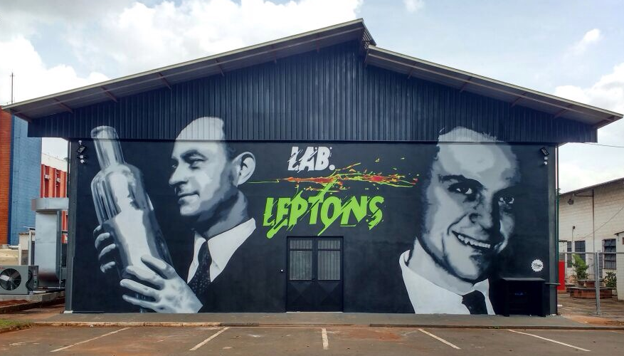
New assembly
Facility

Slide 3
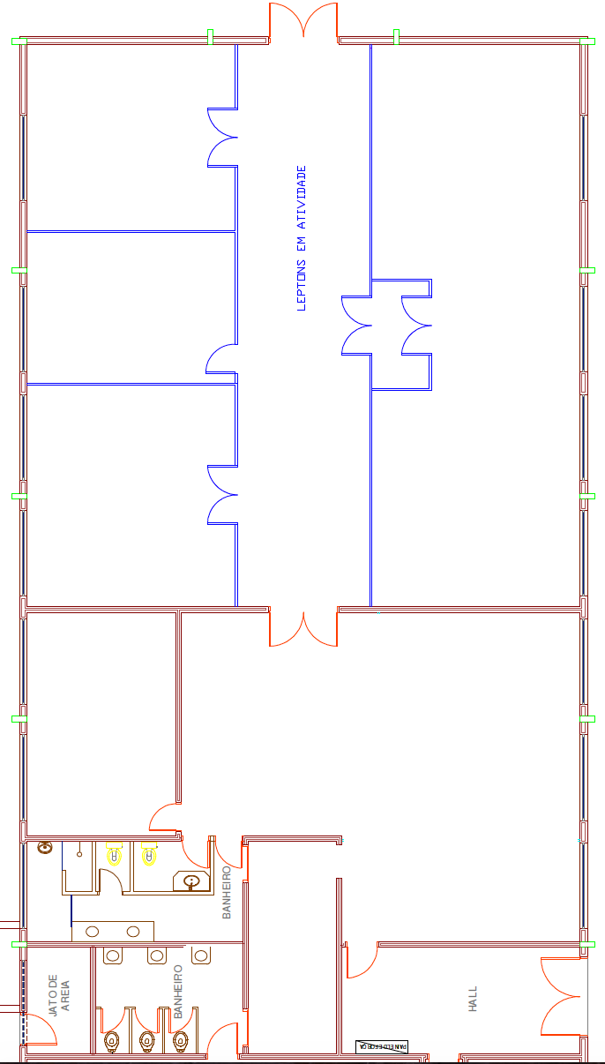
Dark
Room
Clean
Room
Meeting
Room
A new area with 100m² was added to the laboratory which will be dedicated to assembly, testing and storage.
The total area of LabLepton is now around 350m².
Student
Room
ASSEMBLY & TEST AREA
Electronic
Room
STORAGE AREA
A. Machado @ SPPD parallel
15

Slide 4
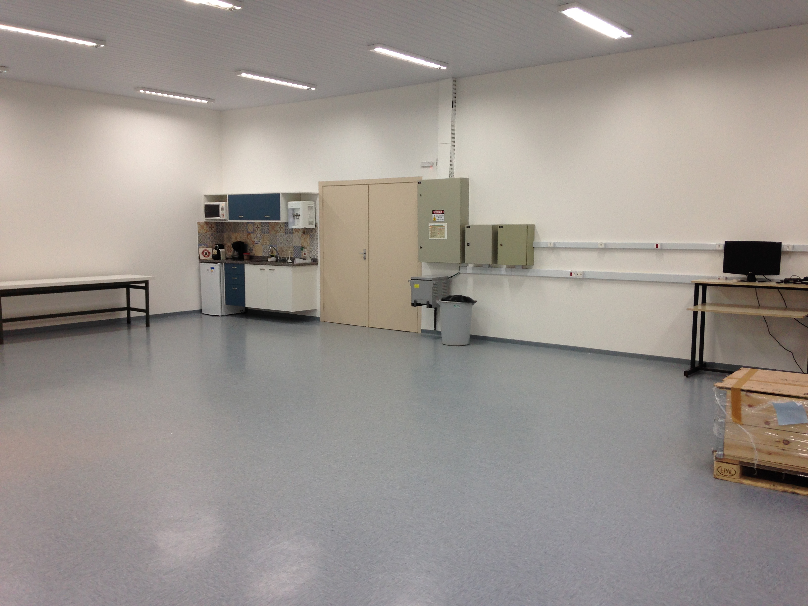
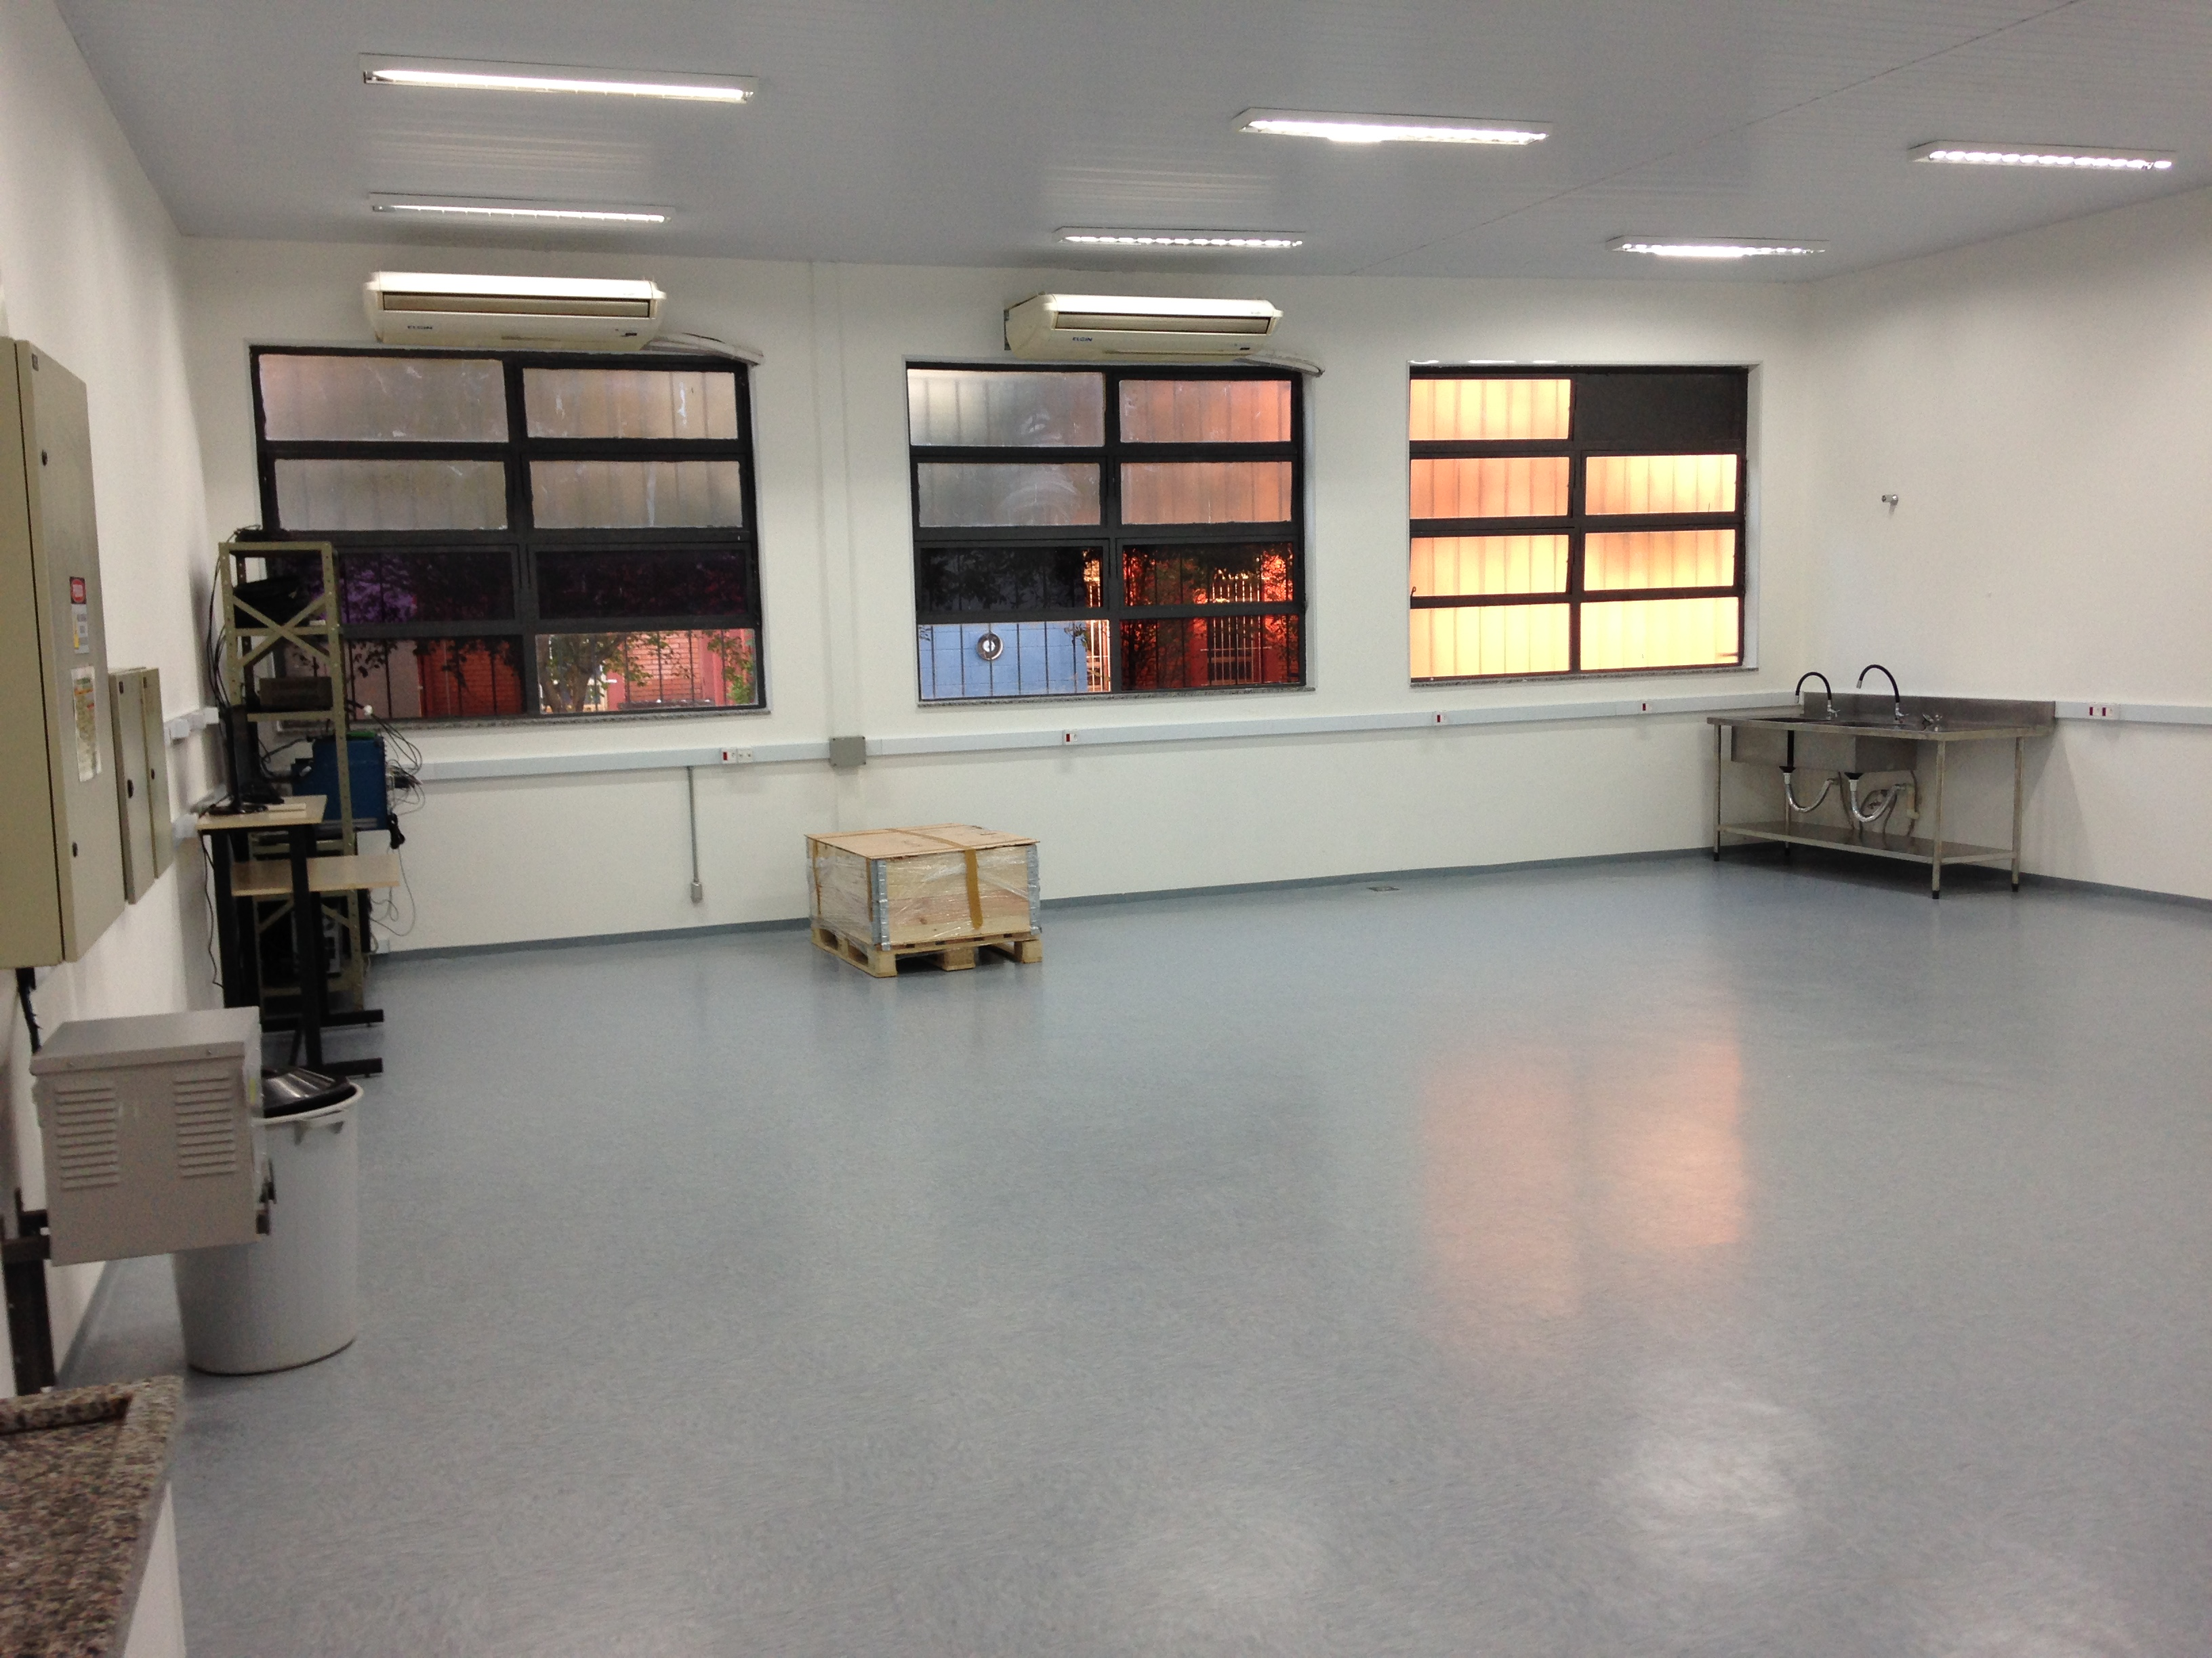
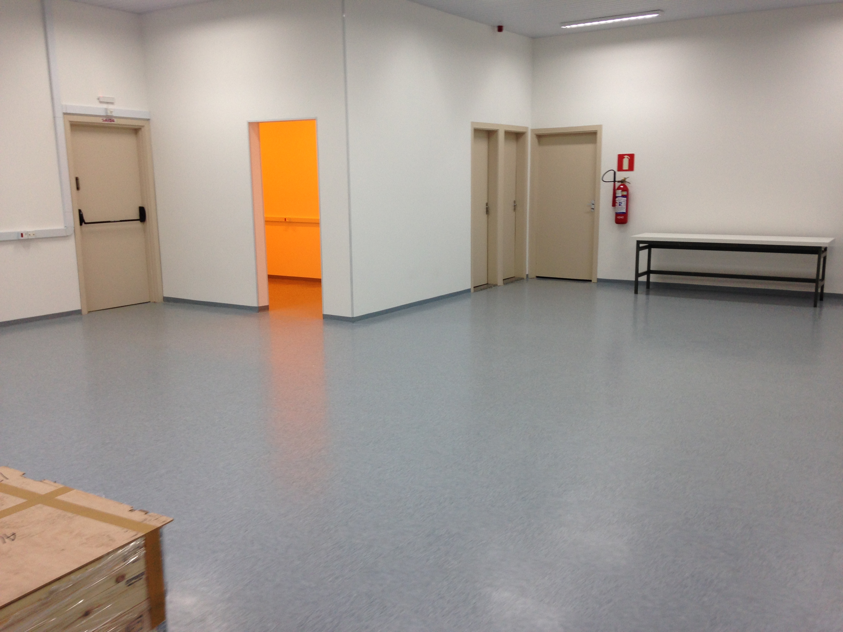
ASSEMBLY & TEST AREA
Electronic
Room
STORAGE AREA
16

Slide 5
X-ARAPUCA -Status
Tests on small scale prototypes showed that X-ARAPUCA design meets requirements. Validation process delayed due to COVID emergency, but restarting right now
There is room for improvements through filter and WLS plates optimization
Production of supercells will start as soon as possible => manufacturer of mechanical components already identified
Vertical slice test of the system (supercell+cold electronics+DAPHNE board): facilities are being set-up in Brazil, Italy and Spain
R&D for Xe X-ARAPUCAs is starting => OPTO Company is developing a dedicate design

Slide 6
Photosensors - Status
About 300,000 sensors needed for the first module of the far detector (10 m² of active surface)
Two vendors engaged by Consortium to develop cryogenic sensors according to DUNE specifications: Hamamatsu and FBK.
Each vendor is producing few different variations (splits) of cryogenic photo-sensors => two of them will be down-selected to be installed in protoDUNE for the Run-II (~400,000 units in total)
First samples of the Hamamatsu and FBK sensors delivered to the Consortium and are being tested (I-V curves, dark count rate, cross-talk, afterpulsing, ...)
29

Slide 7
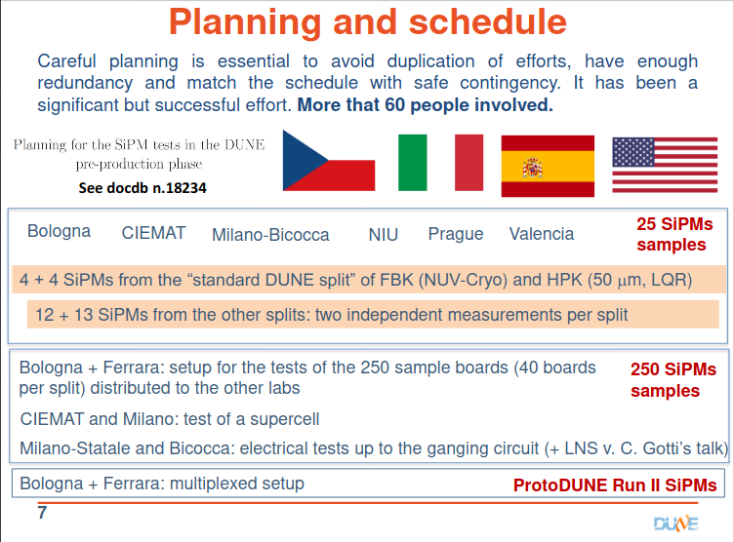
From F. Terranova talk

Slide 8
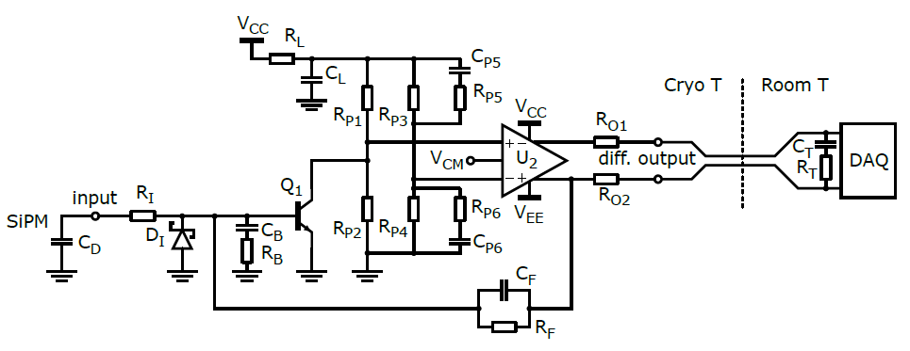
Cold Electronics - Status
Evolution of the TDR design
Now a two-stage amplifier: SiGe bipolar transistor + fully differential opamp (lower noise, lower power consumption, higher flexibility in setting the loop gain, higher dynamic range with respect to previous design)
First tests with SiPM + added capacitance to simulate ganging show promising results for signal to noise ratio
Design of PCBs to fit the PD mechanics is progressing
Further tests of the entire module are planned for next autumn
≈ 30 ns edges
(with 12 m output cables)
30

Slide 9
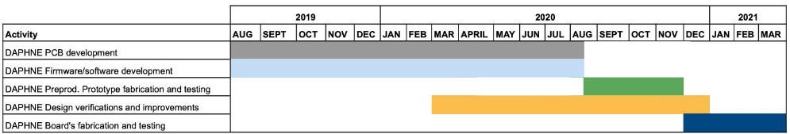
Warm Electronics - Status
The Warm Electronics Board (DAPHNE) made impressive progresses since the CDR
Close Collaboration of Fermilab with Latin American Institutions (Colombia, Peru and Paraguay)
Design of the board competed. Almost ready for Pre-Production Prototyping.
Prototypes will be shared among the Consortium and used to test X-ARAPUCA supercell prototypes

Slide 10
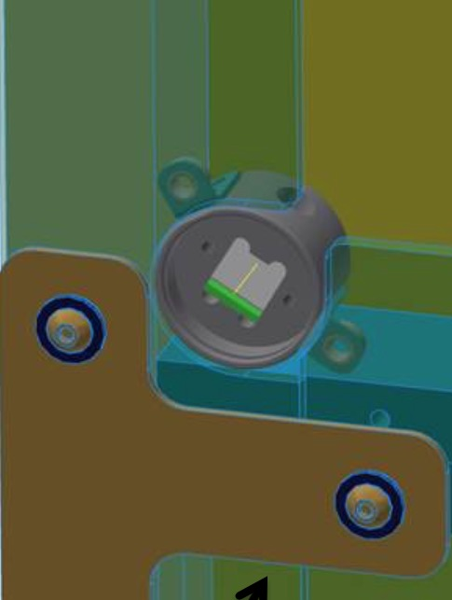
Monitoring System - Status
Modifications with respect to ProtoDUNE-I design (to be tested in ProtoDUNE-II)
Reduced diffuser diameter (from 1” to ¾”)
Calibration Module optimized with 12 light sources/unit, provides UV-LED feedback via SC.
Optical feed-through design optimized, to balance requirements and cost reduction.
Investigate the possibility of using a 355 nm led coupled to plastic fibers
Light diffuser
Optical feedthrough
42

Slide 11
CHARGE

Slide 12
1. Are the specifications for detector performance, particularly detection efficiency and uniformity across the TPC, clearly stated and justified by DUNE physics goals? Are they appropriately documented in EDMS?
The connection between physics goals and detector performance has been addressed on the SPPD TDR Chapter. (EDMS 2383194 and EDMS 2383195)
Addressed in A. Himmel talk in this review.
2. Have design choices been fully identified and do they meet detector requirements for performance, installation, grounding, testing and calibration?
The design choices, based on the X-ARAPUCA design have been illustrated in E. Segreto talk. Performances of the first X-ARAPUCA prototypes and of the APRAUCA arrays in protoDUNE meet the detector requirements and have been illustrated in F. Cavanna talk. The relation between detector performance and physics requirements has been shown in A. Himmel talk. Installation described in D. Warner talk, grounding plan described in C. Gotti talk and in EDMS 2383681. Calibration plan in EDMS 2383195.
3. Does the design have an appropriate validation plan for long term operation in LAr?
Long term validation takes advantages of the protoDUNE Run I F. Cavanna talk. Long term validation of optical components in A. Machado talk.
4. Are the specifications and 3D model/2D drawings for standard and custom components substantially complete and available in EDMS? Are they of sufficient maturity to proceed to final design?
3D and 2D models are essentially complete and available on EDMS.
5. Does the report from the internal Fermilab warm electronics review (EDMS-2385075) indicate sufficient design maturity for preliminary design?
The Internal review ended with a series of recommendations which will be followed in the next steps of DAPHNE development.

Slide 13
6. Is documentation of cryogenic electrical component design (including passive/active photosensor ganging circuitry) presented sufficiently complete and appropriate for preliminary design?
Cryogenic electrical components presented in C. Gotti talk
7. Have schematics and layouts for all PCBs, including cold boards and cryostat feedthroughs, been uploaded to EDMS and are they satisfactory?
A guide to electrical documentation can be found in EDMS2384981
8. Have interfaces with other detector components been addressed and documented in EDMS?
Yes. EDMS 2088720 (TPC), EDMS 2088721 (HV), EDMS 2088726 (DAQ), EDMS 2088735 (APA), EDMS 2145146 (COM), EDMS 2145137 (CALCI)
9. Are engineering analyses sufficient to ensure the design is safe during all phases and have applicable design codes and standards been satisfied? Does the Compliance Office report exist and support a conclusion that the design is safe?
Engineering analyses available in EDMS2380229
The Compliance Office report does exist and states that the status of the design of the PD is in a status acceptable for the PD 60 % design review (EDMS2380230)
10. Are system grounding details documented and in EDMS? Are electrical connections specified and do schematics exists in EDMS? Are all wires, cables and connections documented?
Grounding plan presented in C. Gotti talk and in EDMS 2383681.Wires and connections discussed in D. Warner talk and in EDMS 2145146

Slide 14
11. Does the design enable a reasonable procurement strategy and manufacturing plan and are these plans sufficiently developed to proceed to final design?
Preliminary procurement and manufacturing plan in EDMS 2384693.
12. Does the design enable a reasonable quality control plan and are quality assurance and testing plans sufficiently developed to proceed to final design?
QA/QC plan presented in V. Pimentel talk and EDMS 2384692
13. Does the design enable a reasonable installation plan and are these plans sufficiently developed to proceed to final design?
Installation plan presented in D. Warner talk
14. Have lessons learned from ProtoDUNE been documented and implemented?
ProtoDUNE lesson learned largely implemented: X-ARAPUCA design, SiPM procurement, cold anf warm electronics design. Documented in EDMS 2384687
15. Have recommendations from previous reviews been satisfactorily addressed and documented?
All the recommendations addressed: this presentation and EDMS 2384615
16. Are plans for additional prototyping, including Xe doping, reasonable and sufficient?
Prototyping plan presented in E.Segreto talk. Additional prototyping for Xe doping option illustrated in S. Tufanli talk and in EDMS 2382770.
17. Have appropriate cost estimates and schedule been determined? Are plans for required technical resources consistent with scope of remaining work to reach final design?
Cost and schedule presented in D. Warner talk and EDMS 2382764

Slide 15
COMMENTS AND RECOMMENDATIONS FROM 30% REVIEW

Slide 16
Comments and reccomendations: highlights
Comments and Recommendations focused on three topics:
  Validation of the X-ARAPUCA design with experimental tests and detailed Monte Carlo simulations
  Specs, Packaging, validation procedures, cryogenic optimization of SiPM
  Redesign of the mu2e board, updating the the FPGA
Widely addressed in this review

Slide 17
PHOTON COLLECTOR
Comments
The X-ARAPUCA is an evolutionary version of the ARAPUCA technology which has been developed over the past several years. It was presented that analytical calculations and MC simulations point to an enhancement between 40% and 70% with respect to the standard ARAPUCA. It is proposed that the X-ARAPUCA has a detection efficiency larger than 3% (on the basis on analytical calculations, MC simulations and experimental tests), however, no direct measurements from an X-ARAPUCA were shown.
SEVERAL DIRECT MEASUREMENTS WERE MADE USING AN X-ARAPUCA PROTOTYPE, WHICH IS A SLICE (1/6) OF A FULL SUPERCELL. AN ABSOLUTE DETECTION EFFICIENCY CLOSE TO 3% WAS MEASURED.
It was presented that the X-ARAPUCA design is expected to be >10 times more efficient than the most efficient light-guide bar installed in protoDUNE, however this has not yet been demonstrated.
PROTODUNE ANALYSIS SHOWED THAT THE STANDARD ARAPUCA MODULES ARE >5 FIVE TIMES MORE EFFICIENT THAN THE MOST EFFICIENT LIGHT-GUIDE. CONSIDERING THAT THE ABSOLUTE EFFICIENCY OF THE PROTODUNE ARAPUCA HAS BEEN MEASURED TO BE APPROXIMATELY 2% AND THAT THE DETECTION EFFICIENCY OF THE BASELINE X-ARAPUCA DESIGN HAS BEEN SHOWN TO BE 3%, THE >10 IMPROVEMENT HAS ALREADY BEEN REACHED. FURTHER OPTIMIZATION OF THE X-ARAPUCA (DICHROIC FILTER AND LIGHT GUIDE PLATE) MAY ALLOW FURTHER IMPROVEMENTS THESE FIGURES.
The up-coming tests which will compare the different types of modules is extremely important. Prompt analysis of the data will be necessary to validate the proposed baseline design and aid in validating simulations.
ALL DATA COMING FROM THE TESTS HAVE BEEN ANALYSED AND COMPARED TO MONTE CARLO PREDICTIONS.

Slide 18
Good progress is being made on the simulation effort, which needs to continue to be refined and validated with data.
COMPLETE SIMULATIONS OF THE X-ARAPUCA HAVE BEEN DEVELOPED FOR THE SMALL SCALE MODULES AND FOR THE FULL SUPERCELL. EXPERIMENTAL RESULTS AND MONTE CARLO PREDICTIONS ARE COMPATIBLE.
The schedule for accomplishing all necessary tasks prior to completing the TDR is very tight.
WE SUBMITTED OUR X-ARAPUCA CHAPTER FOR THE TDR ON-TIME (EDMS 2383194)
A second ProtoDUNE run with the final design of the photon detectors is important and should be planned for.
THIS IS THE BASELINE PLAN FOR THE DUNE FD, AND REPRESENTS OUR “MODULE 0” TEST OF ALL COMPONENTS PRIOR TO THE PRR.
Recommendations
Since the performance of X-ARAPUCA and the potential improvement compared with the previous design have not yet been demonstrated, priority should be given to the validation of X-ARAPUCA both through a substantial improvement of the simulation and by direct experimental tests. In particular:
Conduct the proposed hardware tests (Brazil and Fermilab) as soon as possible and put the analysis turnaround at high priority.
WE HAVE FOLOWED THIS RECOMMENDATION, AND MANY TESTS HAVE BEEN CONDUCTED. ADDITIONAL TESTING WILL CONTINUE AS SOON AS THE COVID EMERGENCE EASES.
Continue to develop detailed simulations of the proposed design and compare with measurements.
DETAILED SIMULATIONS HAVE BEEN DEVELOPED AND THE PREDICTIONS COMPARED WITH THE EXPERIMENTAL MEASUREMENT, AND WERE FOUND TO BE COMPATIBLE.

Slide 19
PHOTOSENSORS
Comments
Most of the electrical and mechanical specifications are available and well justified. The optimal sensor dimension, the cell pitch and the dynamic range of the photosensor are still unknown although they do not seem to be critical for the performance of the X-ARAPUCA.
MONTE CARLO SIMULATIONS HAVE BEEN RUN IN ORDER TO FIND THE OPTIMAL SENSOR DIMENSIONS AND OPTIMAL COVERAGE. IT WAS SHOWN THAT THE OPTIMAL INTERNAL COVERAGE WITH SIPMs CORRESPONDS TO 48 SIPMs (WITH 6 mm x 6 mm AREA), WHILE THEIR DIMENSIONS AND ASPECT RATIO IS NOT RELEVANT AS LONG AS THEY EXCEED THE THICKNESS OF THE LIGHTGUIDE BAR. SIPM DYNAMIC RANGE IS NOT RELEVANT FOR THE MAXIMUM AMOUNT OF LIGHT WHICH IS EXPECTED FROM BEAM EVENTS, EVEN IF THESE EVENTS HAPPEN CLOSE TO THE ANODE PLANE.
Packaging is critical for the long term reliability of SiPMs and the best choice has not been identified, yet. Naked SiPMs are the safest solution but increase the complexity of handling, installation and mechanical/thermal constraints
TWO MANUFACTURERS HAVE BEEN IDENTIFIED FOR THE SIPMs: HAMAMATSU AND FBK. BOTH MANUFACTURERS HAVE WIDE EXPERIENCE IN DEVELOPING AND PRODUCING CRYOGENIC SiPMs. THE SOLUTION CHOSEN BY HAMAMATSU FOR THE PACKAGING IS USING A SILICON RESIN, WHILE FBK IS USING AN EPOXY RESIN. BOTH SOLUTIONS HAVE BEEN TESTED AND VALIDATED IN LN2.

Slide 20
Active ganging is compatible with the 1 mus time resolution requirement but the 100 ns goal might require a re-optimization of the ganging board and/or an increase of the number of active components.
A TIMING RESOLUTION BETTER THAN 100 NS HAS BEEN DEMONSTRATED WITH THE PREVIOUS VERSION OF THE GANGING BOARD WITH AN ARRAY OF 48 SIPMs. THE PERFORMANCE OF THE CURRENT VERSION OF THE BOARD, LARGELY BASED ON THE PREVIOUS ONE, IS EXPECTED TO BE SIMILAR. DEDICATED MEASUREMENTS WILL BE REPEATED WITH THE CURRENT VERSION OF THE BOARD AND THE CURRENT VERSION OF THE SIPMs.
The duration of the optimization phase and the delivery time are not fully defined. A delivery time of about one year is a reasonable extrapolation from 10⁴ scale productions performed for other experiments.
HAMAMATSU AND FBK HAVE SPECIFICALLY DEVELOPED SIPMs FOR OUR APPLICATION. TWO DIFFERENT SPLITS HAVE BEEN PRODUCED BY FBK AND FOUR BY HAMAMATSU. 25 SENSORS/SPLIT HAVE BEEN DELIVERED TO THE CONSORTIUM AND ARE BEING TESTED. ONE SENSOR PER VENDOR WILL BE SELECTED FOR THE SECOND RUN OF PROTODUNE. BOTH MANUFACTURERS HAVE THE CAPABILITY OF PRODUCING ALL THE SIPMs REQUIRED FOR THE FIRST FAR DETECTOR MODULE (~ 300,000 SENORS) ACCORDING TO OUR SCHEDULE.
Recommendations
Define as soon as possible the missing specifications for the SiPMs (number of cell per sensor, cell-pitch dimension, dimension of the sensor) in order to start the customization of the photosensors on a firm ground.
SIPM SPECIFICATIONS HAVE BEEN DEFINED. ON THE BASIS OF THESE SPECIFICATIONS HAMAMATSU AND FBK HAVE DEVELOPED THE SENSORS WHICH ARE BEING TESTED.
If ganging up to 48 SiPMs is the optimal configuration, special emphasis should be given to the uniformity of response of the photosensors and, in particular, to the gain at given overvoltage. This may require dedicated customization with the vendors or countermeasures to cope with different operating voltages within the same production batch.
DIFFERENCES IN GAIN IN SENSORS PRODUCED FROM THE SAME WAFER HAVE BEEN SHOWN IN PROTOTYPE BATCHES TO BE NEGLIGIBLE. TESTING WILL CONTINUE THROUGHOUT THE SiPM VALIDATION TESTING. TO MINIMIZE VARIATIONS, ALL SIPMs WILL BE TRACKED AND ONLY SIPMs COMING FORM THE SAME WAFER WILL BE GANGED TOGETHER.

Slide 21
Define a validation procedure to ensure reliability of the packaging over a high number of thermal cycles, determine long term degassing and optical deterioration, and downselect the packaging options.
THE PHOTO-SENSOR WORKING GROUP OF THE CONSORTIUM HAS DEVELOPED A DETAILED VALIDATION PLAN. IN PARTICULAR THE SIPMS NEED TO STAND >20 THERMAL CYCLES FROM ROOM TO LN2 TEMPERATURE. THE I-V CURVE AND SINGLE PHOTON AMPLITUDE AT FIXED OVER-VOLTAGE DOES NOT NEED TO CHANGE ALONG THE CYCLES. PACKAGING OPTIONS HAVE BEEN DEFINED TOGETHER WITH THE MANUFACTURERS.
Since accessibility and reliability is a unique challenge of DUNE, it is important that the vendors are engaged in developing product specifically designed for cryogenic operation.
HAMAMATSU AND FBK HAVE DEVELOPED SIPMs SPECIFICALLY DESIGNED FOR OUR CRYOGENIC APPLICATION.
As soon as the X-ARAPUCA design is validated, define the production centers and the resources needed to produce the boards with the SiPM. Quality assessment procedures during production and installation have not been detailed, yet.
PRODUCTION SITES AND RESOURCES FOR THE BOARDS HAVE BEEN IDENTIFIED INSIDE THE CONSORTIUM. QA/QC PROCEDURES ARE BEING DEVELOPED AND ARE DOCUMENTED.
Utilize the protodune data to assess the performance of the existing sensors, including backgrounds and assess their stability.
PROTODUNE SIPMs HAVE BEEN VERY PRECISELY CHARACTERIZED. IN PARTICULAR, THE HAMAMATSU SENSORS THAT EQUIPPED THE ARAPUCA MODULES AND SOME LIGHT-GUIDE BARS HAVE BEEN EXTENSIVELY STUDIED IN TERMS OF PERFORMANCES AND STABILITY. THE GAIN WAS MEASURED TO BE EXTREMELY STABLE THROUGHOUT THE RUN (AT THE PERCENT LEVEL) AND NO FAILURES WERE OBSERVED. THE QUANTUM EFFICIENCY OF THE SENSORS WAS NOT MEASURED, BUT MONTE CARLO SIMULATIONS SUGGEST THAT, GIVEN THE OVERALL DETECTION EFFICIENCY OF THE ARAPUCA MODULES, IT IS COMPATIBLE WITH THE NOMINAL VALUE.

Slide 22
ELECTRONICS
Comments
About the mu2e FEB: -the Spartan-6 FPGA can go out of production soon; - the Xilinx programming software for this device is towards the end of support; -the channel multiplicity does not match the foreseen ganging scheme of 48 channels; any functionalities of this board are not suited for this application.
THE FRONT-END BOARD HAVE BEEN COMPLETELY RE-DESIGNED AND THE SPARTAN-6 FPGA HAS BEEN REPLACED WITH AN ARTIX-7. THE MULTIPLICITY OF THE BOARD HAS BEEN CORRECTED TO MATCH OUR APPLICATION (40 CHANNELS/BOARD).
In comparing the different schemes of the active ganging of 48 SiPM the total number of used operational amplifiers should be taken into account as well as the power consumption and the final SNR.
THE CURRENT DESIGN OF THE COLD SUMMING BOARD FORESEES A TWO STAGE AMPLIFIER: SiGe BIPOLAR TRANSISTOR + FULLY DIFFERENTIAL OP-AMP. THE S/N TO NOISE RATIO IS GOOD (>4 WITH VERY SIMPLE FILTERING AND CAN REACH 20 WITH OPTIMUM FILTER). THE POWER CONSUMPTION IS AROUND 3 mW.
No plan was presented for how power was going to be brought down for the active electronics in the cold.
THE SUPERIOR-ESSEX CABLE USED DURING PROTODUNE 1 HAS BEEN REPLACED WITH A CUSCOM CABLE (SEE EDMS 238682) WHICH INCLUDES TWO SEPARATE TWISTED PAIR FOR CARRYING THE ACTIVE ELECTRONICS BIAS VOLTAGE.
Noise tests in ICEBERG are essential in testing for any interaction between the Cold Electronics and the active PD cold ganging/amplifier electronics
SPECIFIC ICEBERG TESTS HAVE BEEN PERFORMED WITH A MODIFIED VERSION OF THE MU2E BOARD AND THE FIRST VERSION OF THE COLD SUMMING BOARD, DEVELOPED AT FERMILAB. NEGLECTING SOME INITIAL GROUNDING ISSUES, NO INTERFERENCE OF THE TWO SYSTEMS WAS OBSERVED. A MORE MEANINGFUL TEST WITH A PROTOTYPE OF THE NEW DAPHNE BOARD AND THE LAST VERSION OF THE COLD SUMMING BOARD WILL BE PERFORMED IN THE NEXT FEW MONTHS.

Slide 23
Recommendations
Study the timing performances of the active ganging scheme at LAr temperature and the requirements on the uniformity in breakdown voltage of ganged sensors
THE TIMING PERFORMANCES HAVE BEEN EVALUATED WITH THE PREVIOUS VERSION OF THE ACTIVE GANGING BOARD WITH 48 GANGED SIPMs. AN AVERAGE RISE TIME OF 60 NS HAVE BEEN MEASURED. THE SAME MEASUREMENT WILL BE MADE WITH THE CURRENT VERSION OF THE GANGING BOARD AND AN ARRAY OF THE HAMAMATSU AND FBK DUNE SIPMs.
A Front End board specifically designed for DUNE PDS requirements should be considered, starting from the existing mu2e design.
DONE. THE DAPHNE BOARD HAS BEEN DEVELOPED STARTING FROM THE MU2E DESIGN.
The adopted solution for the front end electronics has to take into account the extended dynamic range of signals expected from SN neutrinos or neutrino beam events.
THE ESTIMATED DYNAMIC RANGE REQUIREMENT PER CHANNEL HAS BEEN ESTIMATED TO BE AROUND 1,000 PHEL/CHANNEL ON THE BASIS OF DETAILED MONTE CARLO SIMULATIONS. THE DAPHNE BOARD HAS BEEN DESIGNED IN ORDER TO HAVE A DYNAMIC RANGE OF 2,000 PE IN ORDER TO MINIMIZE THE FRACTION OF SATURATED EVENTS EVEN FOR INTERACTIONS CLOSE TO THE ANODE PLANE.
The system grounding plans should be documented.
THE GROUNDING PLAN HAS BEEN DEVELOPED AND IS DOCUMENTED (EDMS 2383681)

Slide 24
The cable run between the readout electronics and the DAQ must be fiber optic.
AGREED. THAT IS THE BASELINE PLAN AS DOCUMENTED IN THE ICD.
A plan to qualify all “cold” components should be developed.
PROTOTYPE ACTIVE GANGING BOARDS HAVE BEEN SUCCESSFULLY TESTED IN LN2 AT MILAN BICOCCA. A DETAILED PLAN FOR COLD CYCLING AND OPERATION OF ALL PCBS, CONNECTORS, ELECTRONICS AND CABLES IS BEING DEVELOPED AND WILL BE FOLLOWED THROUGHOUT THE DEVELOPMENT PHASE OF THE PHOTON DETECTOR SYSTEM.
A plan for supplying power for active cold electronic amplifiers should be developed.
THE BIAS VOLTAGE SUPPLIED FOR THE ACTIVE GANGING AMPLIFIERS IS +3V. TO GENERATE THIS VOLTAGE A BUCK CONVERTER (LTC3624) AND A LINEAR REGULATOR (TPS7A701) ARE USED. THE BUCK CONVERTER WILL TAKE +5.5 V COMING FROM THE POWER TRANSFORMER IN DAPHNE AND CONVERT IT INTO +3.3 V. THE LINEAR REGULATOR WILL CONVERT IT TO +3 V. THE TWO COMPONENTS ARE ADJUSTABLE, SO IF A DIFFERENT COLD ELECTRONIC VOLTAGE SHOULD BE USED, IT COULD BE SUPPLIED JUST BY CHANGING THE FEEDBACK RESISTORS.
Evaluate the impact of supernovae burst triggering on the front-end electronics
PDS WILL NOT BE THE PRIMARY TRIGGER SYSTEM FOR SUPERNOVAE BURSTS ALTHOUGH IT WILL CONTRIBUTE TO THE FORMATION OF THE TRIGGER. ALL SIGNALS ABOVE THE THRESHOLD (1.5 PHOTO-ELECTRONS) ARE SENT TO THE DAQ AND IN PRESENCE OF A SUPERNOVAE TRIGGER ALL THE SIGNALS WITHIN A 100 SEC TIME WINDOW ARE RETAINED.

Slide 25
INSTALLATION AND CALIBRATION
Comments
The middle joint between the side strips is potentially a high-stress point. This should be studied.
THE STIFFENING STRIPS MOUNTED TO THE EXTERIOR OF THE MODULE SPAN THE CENTRAL JOINT AND STRENGTHEN IT. PROTOTYPE MODULES BUILT TO THE CURRENT PLAN DEMONSTRATE THAT THIS PROVIDES SUFFICIENT STIFFENING.
There are many small fasteners. A bonding method for some, or all the pieces should be investigated.
THE FASTNERS WERE SELECTED TO PROVIDE MAXIMUM FLEXIBILITY FOR ASSEMBLY OF MODULES ACROSS MULTIPLE ASSEMBLY SITES AND FOR REPAIR OF COMPONENTS FOUND DEFECTIVE DURING FABRICATION QC TESTING. THE DESIGN WAS RE-EVALUATED FOLLOWING THE REVIEW AND THE NUMBER OF FASTENERS REDUCED.
A cross section view of the assembly showing components, dimensions and clearances would be very helpful.
AGREED. ADDITIONAL CROSS SECTION DRAWINGS WILL BE PROVIDED IN THE ENGINEERING ANALYSIS REPORT (EDMS 2380229) AND THE DRAWING PACKAGES.
Cable connection of lower APA to upper APA requires manipulation of cables. This should be tested.
WE AGREE AND HAVE DONE SO. SEE RECOMMENDATIONS BELOW.
Proceed with the analysis of the calibration & monitoring system in ProtoDUNE
TESTS IN PROTODUNE WITH THE MONITORING SYSTEM WERE EXTREMELY SUCCESSFUL, DEMONSTRATING ITS USEFULNESS FOR MONITORING SYSTEM PERFORMANCE AND EVENT TIMING INTEGRATION. SOME WEAKNESSES WERE IDENTIFIED, PARTICULARLY WITH REGARD TO THE UNJACKETED QUARTZ FIBERS, WHICH HAVE BEEN ADDRESSED AND WILL BE TESTED IN PROTODUNE 2.
The Consortium should continue to work with the APA/CE consortium and Technical coordination to finalize integration and installation plans.
WE HAVE DONE SO, AND THE RESULTS ARE INCLUDED IN THE ICD. TESTING AT ASH RIVER AND UPCOMING TESTS AT PSL HAVE/WILL DEMONSTRATE THE SUCCESSFUL INTEGRATION.

Slide 26
INSTALLATION AND CALIBRATION
Comments
• The middle joint between the side strips is potentially a high-stress point. This should be studied.
THE STIFFENING STRIPS MOUNTED TO THE EXTERIOR OF THE MODULE SPAN THE CENTRAL JOINT AND STRENGTHEN IT. PROTOTYPE MODULES BUILT TO THE CURRENT PLAN DEMONSTRATE THAT THIS PROVIDES SUFFICIENT STIFFENING.
• There are many small fasteners. A bonding method for some, or all the pieces should be investigated.
THE FASTNERS WERE SELECTED TO PROVIDE MAXIMUM FLEXIBILITY FOR ASSEMBLY OF MODULES ACROSS MULTIPLE ASSEMBLY SITES AND FOR REPAIR OF COMPONENTS FOUND DEFECTIVE DURING FABRICATION QC TESTING. THE DESIGN WAS RE-EVALUATED FOLLOWING THE REVIEW AND THE NUMBER OF FASTENERS REDUCED.
• A cross section view of the assembly showing components, dimensions and clearances would be very helpful.
AGREED. ADDITIONAL CROSS SECTION DRAWINGS WILL BE PROVIDED IN THE ENGINEERING ANALYSIS REPORT (EDMS 2380229) AND THE DRAWING PACKAGES. • Cable connection of lower APA to upper APA requires manipulation of cables. This should be tested.
WE AGREE AND HAVE DONE SO. SEE RECOMMENDATIONS BELOW.

Slide 27
Proceed with the analysis of the calibration & monitoring system in ProtoDUNE
TESTS IN PROTODUNE WITH THE MONITORING SYSTEM WERE EXTREMELY SUCCESSFUL, DEMONSTRATING ITS USEFULNESS FOR MONITORING SYSTEM PERFORMANCE AND EVENT TIMING INTEGRATION. SOME WEAKNESSES WERE IDENTIFIED, PARTICULARLY WITH REGARD TO THE UNJACKETED QUARTZ FIBERS, WHICH HAVE BEEN ADDRESSED AND WILL BE TESTED IN PROTODUNE 2.
The Consortium should continue to work with the APA/CE consortium and Technical coordination to finalize integration and installation plans.
WE HAVE DONE SO, AND THE RESULTS ARE INCLUDED IN THE ICD. TESTING AT ASH RIVER AND UPCOMING TESTS AT PSL HAVE/WILL DEMONSTRATE THE SUCCESSFUL INTEGRATION.

